Slide 1





AITRIOS’S HACKATHON INDIA FY 24-25
Team Swift
Muthu Nithin V(22ECR114)
Rithanya S(22ECR154)
*AITRIOS and AITRIOS logos are the registered trademarks or trademarks of Sony Group Corporation or its affiliated companies

Slide 2

PROBLEM STATEMENT & RELEVANCE
Supermarket often employs billing staff manually entering the items in billing software. This leads to long queues and ineffective during peak times such as weekends. This is tackled by increasing checkout counters. But it is not effective in business point of view as
each increased counter require an extra employee to operate
it can be used only during peak days(weekends) and stays unused
self checkout is not an ideal solution as this also involves manual
scanning
*AITRIOS and AITRIOS logos are the registered trademarks or trademarks of Sony Group Corporation or its affiliated companies

Slide 3
PROPOSED SOLUTION
Our Team developed an approach to create automated items scan system. This approach uses image classification and object detection to identify the items as it moves through conveyor and then adds it to the billing list. This eliminates the need for manual barcode scanning and price entry, reducing human error and effort .Overall ,a faster billing experience .
*AITRIOS and AITRIOS logos are the registered trademarks or trademarks of Sony Group Corporation or its affiliated companies

Slide 4
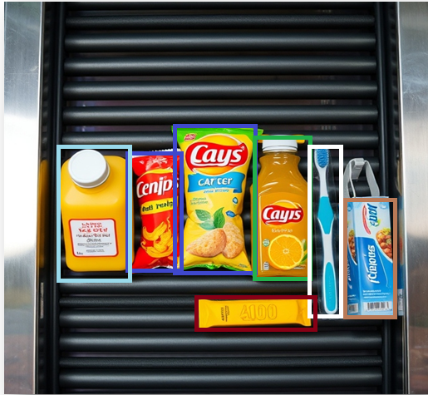
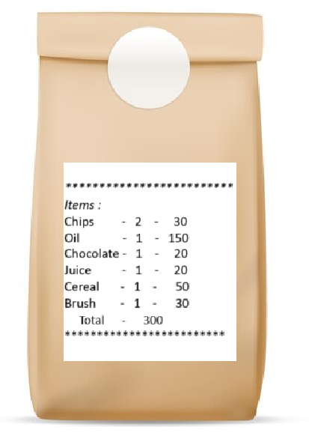
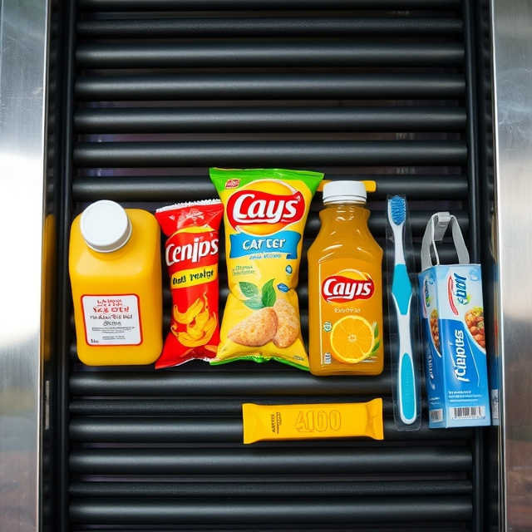
TECHNICAL APPROACH
Customer places the items in cart on conveyor
Items are scanned as they enters scanning area
Scanned items at end of conveyor are packed
chips
juice
oil
chips
brush
cereal
chocolate
*AITRIOS and AITRIOS logos are the registered trademarks or trademarks of Sony Group Corporation or its affiliated companies

Slide 5
TECHNICAL APPROACH
Scan
Process
A YoLo model trained for dataset in the supermarket is deployed in the Raspberry Pi.This detects the items and generates bill .
Print
All the items are sealed in a package and the Generated Bill is sealed on it.
A Scanning point where Raspberry PI Ai camera is mounted takes live video input
*AITRIOS and AITRIOS logos are the registered trademarks or trademarks of Sony Group Corporation or its affiliated companies

Slide 6
OUTCOME & DEMO PLAN
Each items from the cart is place in a tray or a conveyor.
The tray is scanned and once items scanning is over , it can be packed and labelled with list
DEMO PLAN
Grocery items are place in trays
Tray is placed under detection area
Each item getting labelled correctly post processed image *stage-1
Bill generation with correct count of items *stage-2
*AITRIOS and AITRIOS logos are the registered trademarks or trademarks of Sony Group Corporation or its affiliated companies

Slide 7

THANK YOU
muthunithin6@gmail.com
*AITRIOS and AITRIOS logos are the registered trademarks or trademarks of Sony Group Corporation or its affiliated companies

