Slide 1
Should Eniac contract Magist?
Evaluating Magist as Eniac's distribution partner for expansion into Brazil
Group Q
12.08.2026
Notes:
Eniac sells premium, Apple-compatible accessories.
Magist sells everything, cheaply, through the public post office.
Today we're answering one question: does that combination actually work?

Slide 2
Brazilians were already buying online — and growing fast
US$15B
58M
123M
R$434
Brazil e-commerce revenue (2018)
Brazilians shopped online in 2018
online purchases made in 2018
average cart price (2018)
+12% vs. 2017 — first double-digit growth since 2015
27% of the population — up 6 points year over year
+11% vs. 2017
≈US$119, roughly flat vs. 2017
E-commerce was still just ~3% of Brazil’s total retail in 2018 — growing fast, but early. That combination cuts both ways: real demand and headroom for Eniac.
Source: eBit Webshoppers 2019 report (2018 figures), via U.S. Dept. of Commerce Privacy Shield country guide
Notes:
First, some context. In 2018 — Brazil's e-commerce market was booming:
58 million people shopping online, growing double digits for the first time since the 2016 recession.
But it was still only 3% of total retail. That matters: real demand exists, but trust in online shopping was still being built — which means a bad delivery experience does outsized damage.

Slide 3
Eniac’s Two Main Concerns
Are deliveries fast enough?
Is Magist a fit for high-end tech?
Notes:
That brings us to Eniac's two questions:
Is Magist actually a fit for high-end tech?
And are deliveries fast enough to protect the customer experience Eniac is known for?
We'll take these one at a time.

Slide 4
Quick Magist Summary
99,441
25
32,951
Total orders
Months of data
Distinct products
Sep 2016 – Oct 2018
Full order history
Across all categories
3,095
€13.59M
89.2%
Sellers
Total revenue
Orders on time
444 in tech categories (14.3%)
€1.62M from tech (11.9%)
7.9% delayed, 3.0% pending
Tech ➔ Computers Accessories , Telephony, Electronics, Computers
Notes:
Here's what we're working with:
Magist's full order history, filtered specifically to the four tech categories: computer accessories, telephony, electronics, and computers.
This is the data behind everything that follows.

Slide 5
Is Magist a fit for high-end tech?
Notes:
Let’s start with the first question. ’State the question’

Slide 6
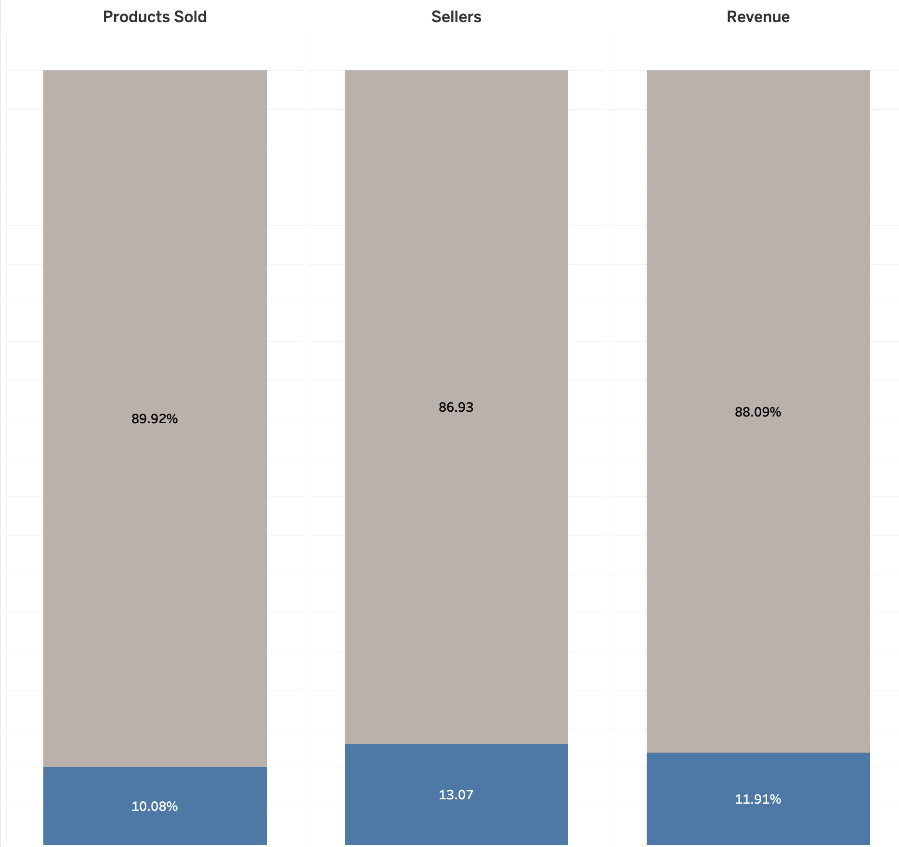
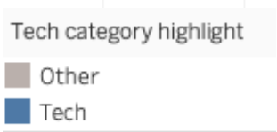
%
%
Tech is established on Magist — but not dominant
Tech products, sellers, and revenue all sit around a tenth of the platform’s total activity
Notes:
Tech is a real category on Magist — but a modest one.
Products, sellers, and revenue all sit around a tenth of the platform's total activity.
So Magist can move tech product. The real question is what kind.

Slide 7
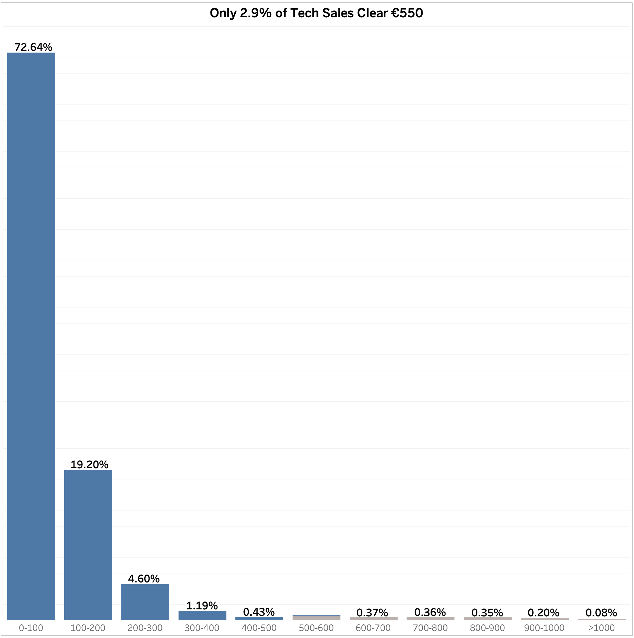
The pricing mismatch
Eniac’s Average Price ➔ €540
Ordered Items
More than 90 % tech ordered items are below
Eniac’s Average Price
Price (€)
Notes:
And here's the mismatch. Eniac's average price point is €540.
On Magist, more than 90% of tech items sold are priced below that.
Magist's tech buyers are trained on budget and mid-tier pricing, Eniac would be entering as a clear outlier, not the norm.

Slide 8
Are deliveries fast enough?
Notes:
Here comes the second part which is about deliveries, are they fast enough?

Slide 9
Avg. Days to Deliver — the hidden cost
~12 Days
~32 Days
On-Time
Delayed
Delayed Orders Take Approx. 3x Longer
Notes:
On delivery: most tech orders arrive on time.
But delayed orders take dramatically longer, turning an acceptable wait into something closer to a month.
That gap is the real risk hiding inside a good-looking average.

Slide 10
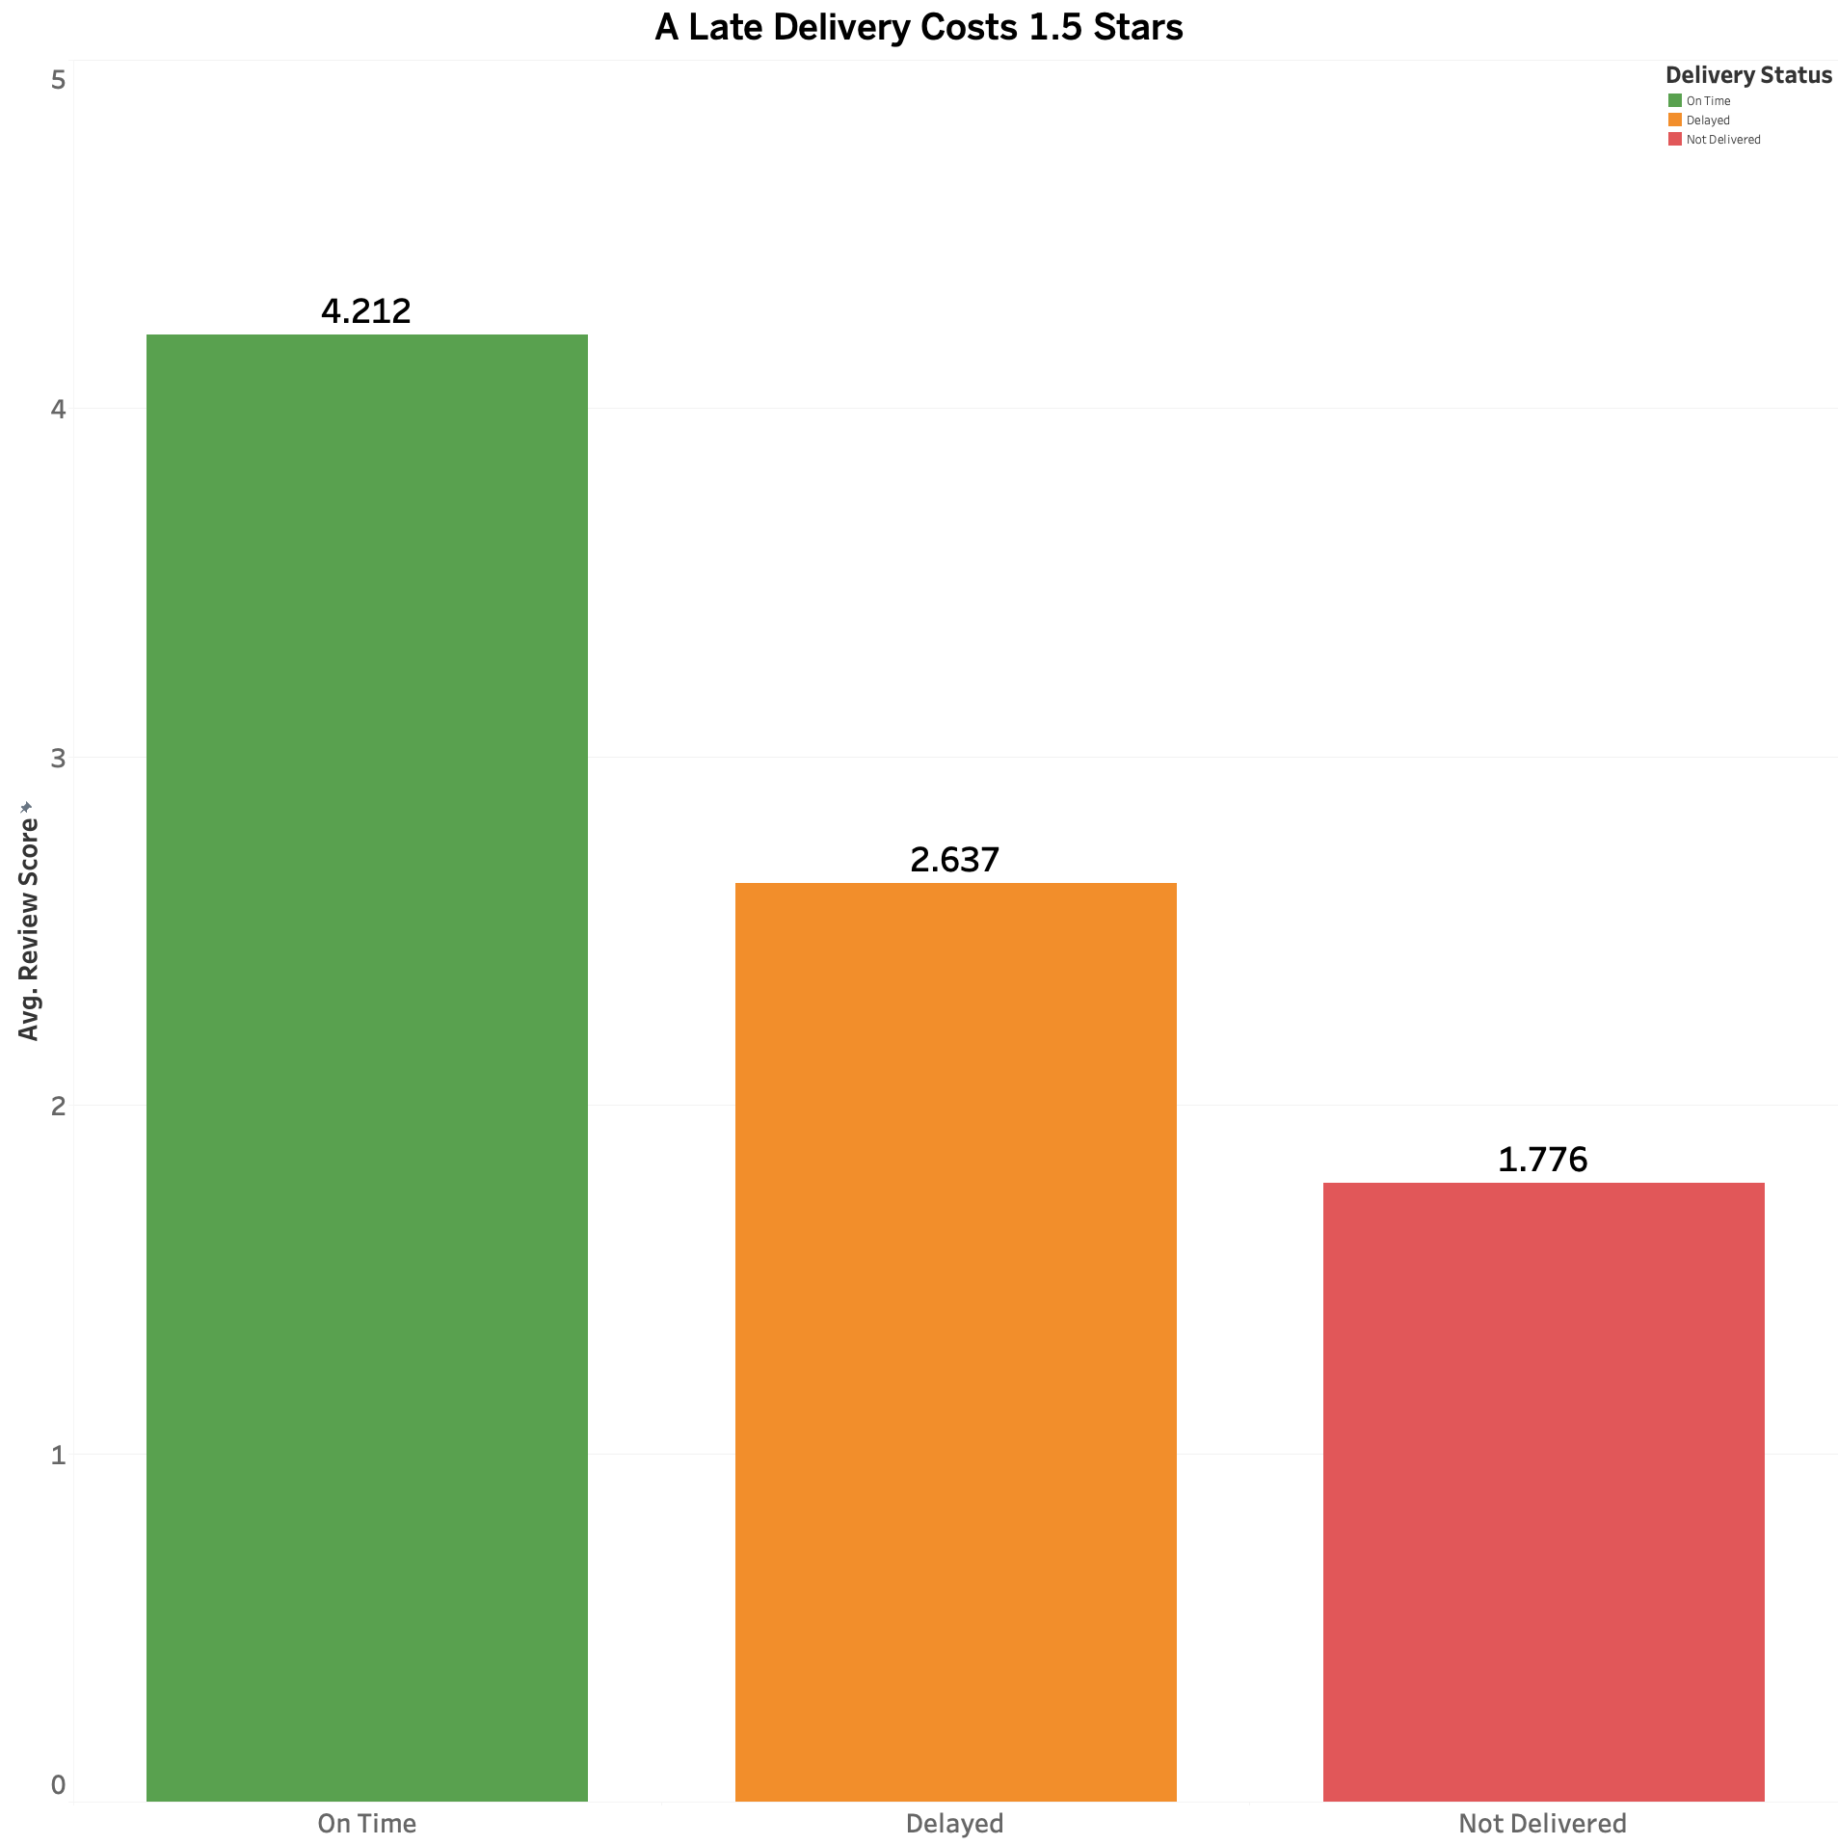
Review Score vs. Delivery status
Delivery delay ➔Customer dissatisfaction
Notes:
And here's why that gap matters: review scores drop sharply the moment an order is late.
This is the clearest finding in our whole analysis:
Delivery delay is the single strongest driver of customer dissatisfaction on this platform.

Slide 11
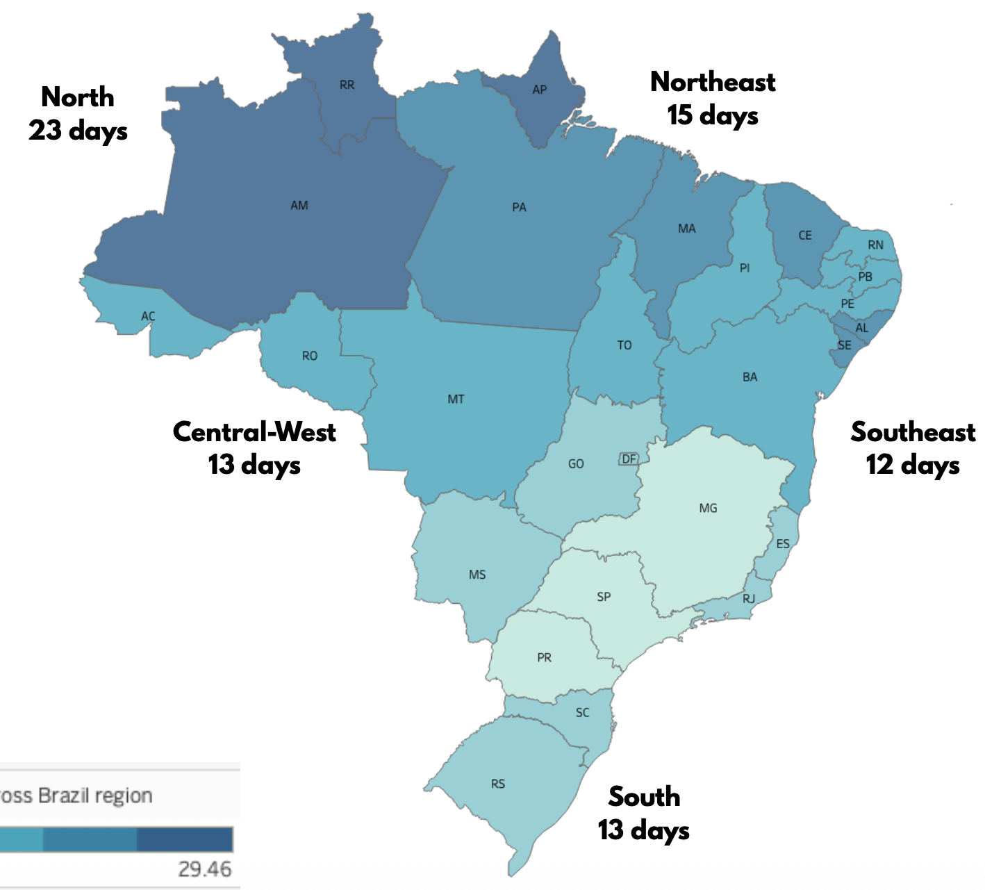
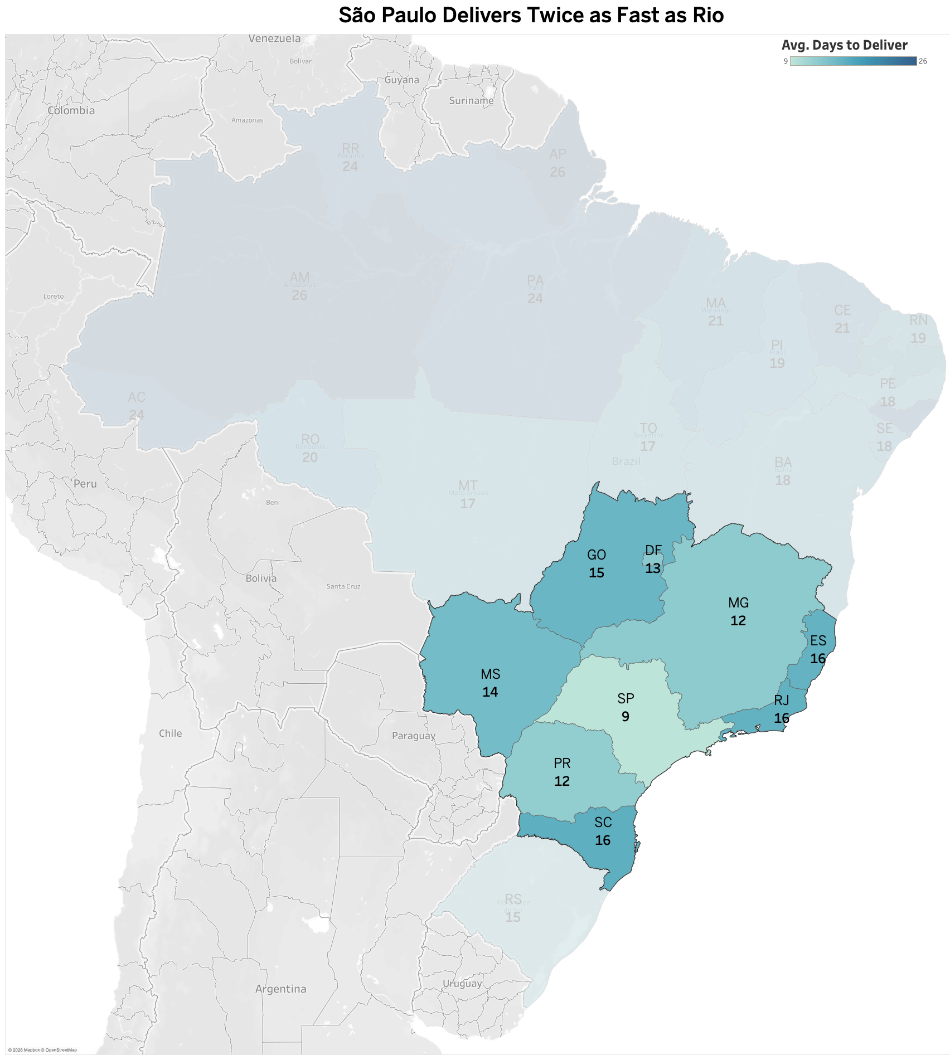
Geography compounds the risk
Apple store ➔ ~1-7 days
Magist ➔ ~13 days
No Express Delivery Services
by Magist
São Paulo Delivers
~Twice as Fast as Rio
60% of the Tech Sellers
are from SP
Notes:
Compare that to the standard:
an Apple Store delivers in one to seven days. Magist averages around 13 — with no express option at all.
And 60% of tech sellers are based in São Paulo, so anywhere outside SP, that gap gets worse.
Technical detail:
Tech sellers are heavily concentrated in São Paulo (268 of 444, ~60%), meaning delivery performance elsewhere depends on longer-distance shipping from a single hub

Slide 12
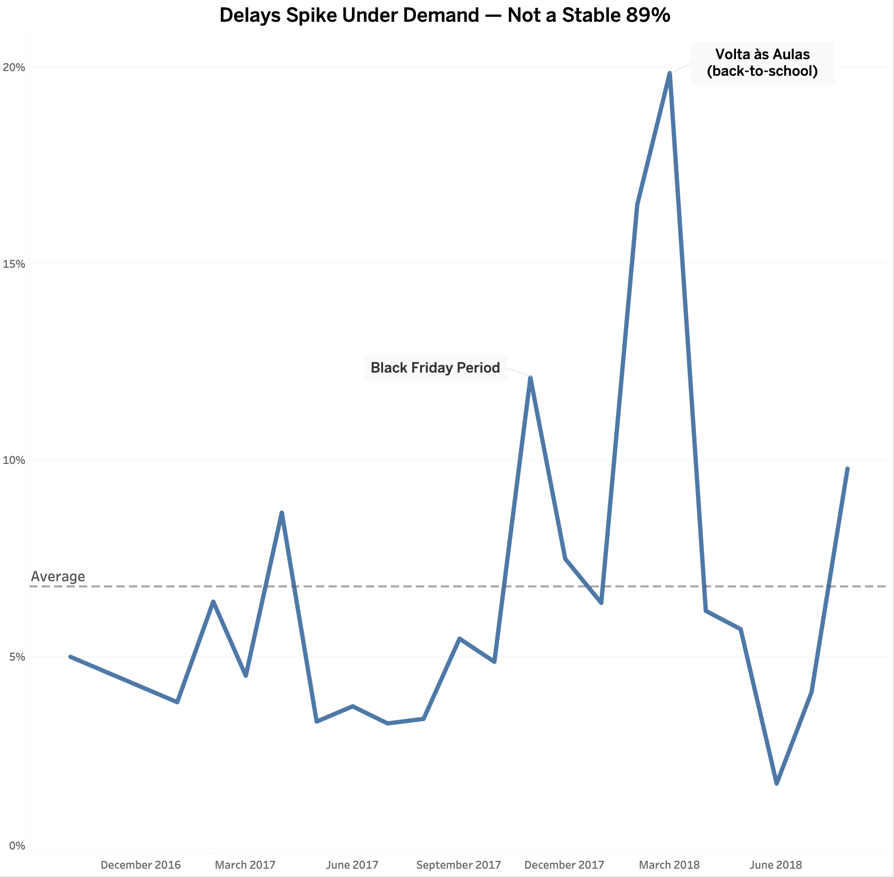
Delivery isn’t stable
Notes:
Delay Rate Over Time — Not Stable
And it's not even a stable 13 days. Delay rates spike under demand:
Both spikes coincide with known Brazilian shopping seasons — Black Friday and back-to-school,
suggesting Magist's delivery network strains specifically under concentrated demand, not steady growth.

Slide 13
Recommendation: Conditional Yes
Enter the Brazilian market through Magist — but only with guardrails
1
2
3
Pilot Program
Delivery Commitments
Phased Rollout
Test a subset of mid-tier accessories before exposing flagship premium lines
Negotiate explicit delivery-time guarantees for tech-category orders specifically
Expand region by region, starting in São Paulo where seller density is highest
Notes:
So, our recommendation:
a conditional yes. Enter through Magist, but with guardrails:
a pilot on mid-tier accessories first,
explicit delivery commitments for tech specifically,
and a phased rollout starting in São Paulo, where the seller network can actually support it.

Slide 14
Thank YOU ☺

Slide 15
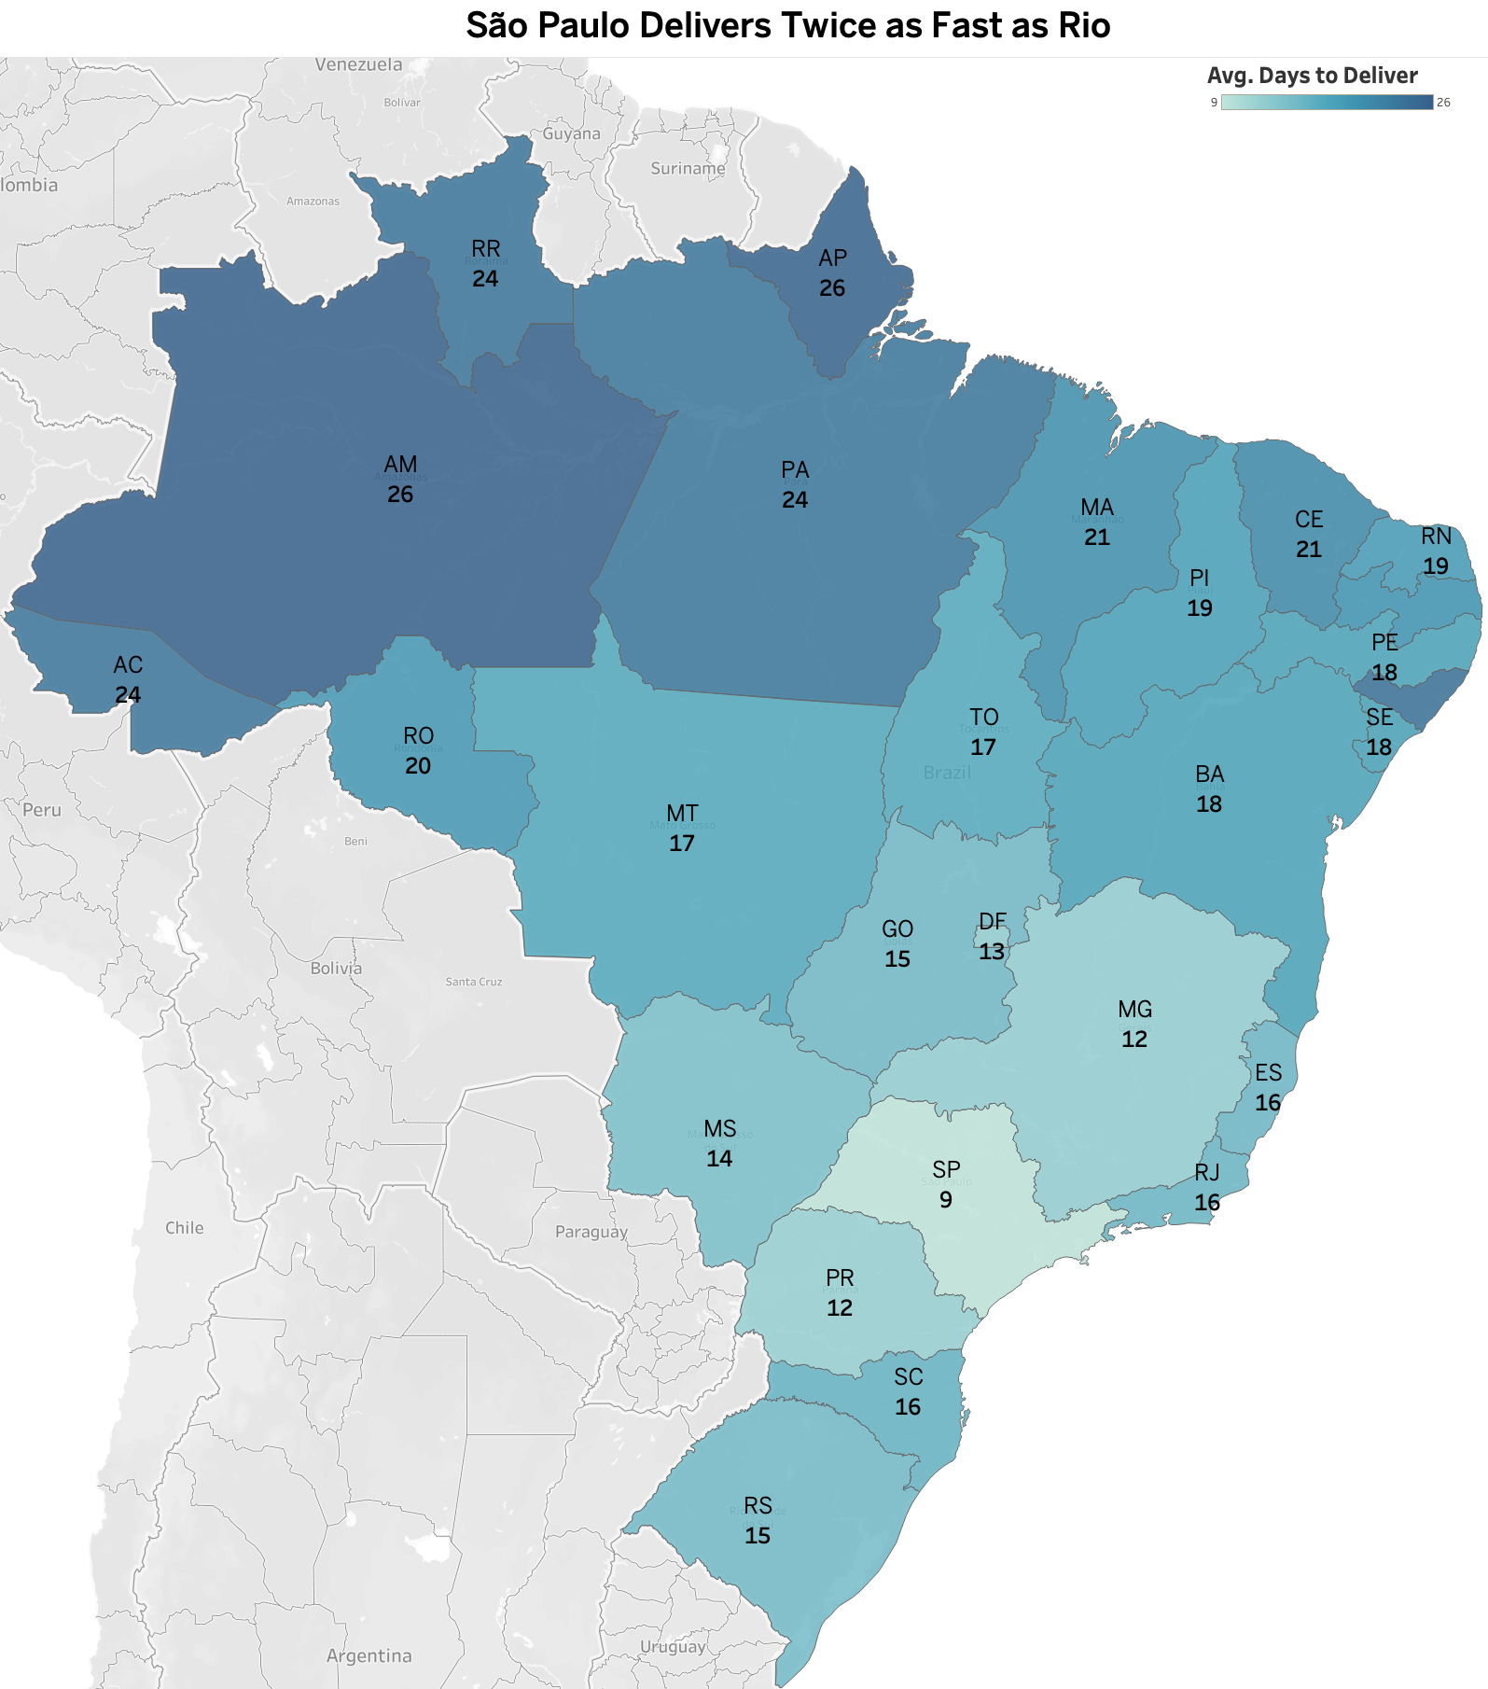
Geography compounds the risk
60% of the Tech Sellers are from SP
No Express Delivery Services
Notes:
Average Delivery days around SP region for the tech products.
Tech sellers are heavily concentrated in São Paulo (268 of 444, ~60%), meaning delivery performance elsewhere depends on longer-distance shipping from a single hub

