Slide 1
Bluetooth RC Car Using Arduino UNO R4

Slide 2
Project Title & Mission
Goal
Design and implement a wireless remote-controlled vehicle.
Primary Features
Bluetooth Low Energy (BLE) control, mobile app integration, and dual-motor propulsion.
Core Platform
Arduino UNO R4 WiFi.

Slide 3
Project Overview
Wireless Control:
Leverages BLE for low-latency communication with mobile devices.
Movement:
Driven by two DC motors via an L298N dual H-bridge motor driver.
Features:
  Adjustable motor speed.
  Active safety using ultrasonic sensors.
  Visual feedback via an integrated LED matrix.

Slide 4
Hardware Components
Microcontroller: Arduino UNO R4 WiFi, featuring an ESP32-S3-Mini-1 co-processor for connectivity.
Motor Driver: L298N Dual H-Bridge for handling high-current DC motors.
Sensing: HC-SR04 Ultrasonic Sensor for obstacle detection.
Power: 6 AA battery pack.

Slide 5
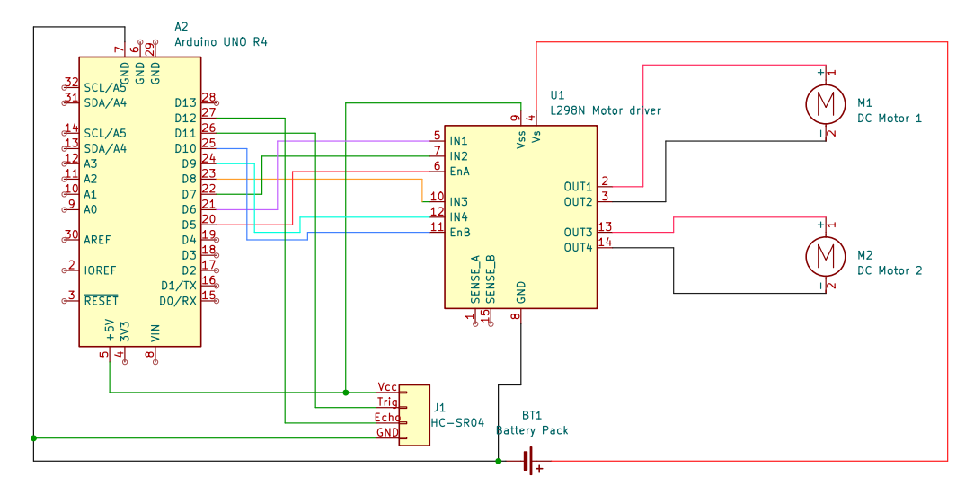
Schematic

Slide 6
Software Architecture
Environment
Developed in C++ using the Arduino IDE.
Key Modules
  Main.ino: Orchestrates the system loop.
  motor_control: Logic for motor movement.
  ble_control: Handles Bluetooth communication.
  sensor_control: Manages ultrasonic data
Modular Design
Software is split into independent files for improved readability and extensibility.

Slide 7
Motor Control & Logic
Abstraction
The system uses high-level "direction" functions rather than direct pin manipulation.
Speed Control
Managed via analogWrite on ENA and ENB pins

Slide 8
Motion truth table
Direction | IN1 | IN2 | IN3 | IN4 | Logic
Forward | HIGH | LOW | HIGH | LOW | Both motors spin forward.
Backward | LOW | HIGH | LOW | HIGH | Polarity is reversed for both motors.
Left Turn | HIGH | LOW | LOW | HIGH | Right motor forward, Left motor backward.
Right Turn | LOW | HIGH | HIGH | LOW | Left motor forward, Right motor backward.
Stop | LOW | LOW | LOW | LOW | All coils de-energized.

Slide 9
BLE Communication
Architecture
Arduino acts as the Peripheral (Server), while the phone acts as the Central (Client).
Service & Characteristic
  Service: "CarControlService".
  Characteristic: "CommandCharacteristic" receives single-character commands (e.g., 'F', 'B', 'S').
  Library: Uses the official ArduinoBLE library.

Slide 10
Mobile App Interface
Application
BLE Controller - Arduino ESP32 by CircuitMagic Inc.
Command Mapping
  'F' / 'B': Forward and Backward.
  'L' / 'R': Left and Right turns.
  '+' / '-': Speed adjustment.
  'T': Toggles between driving modes.
Functionality
Allows the user to create custom buttons and map them to BLE characteristics.

Slide 11
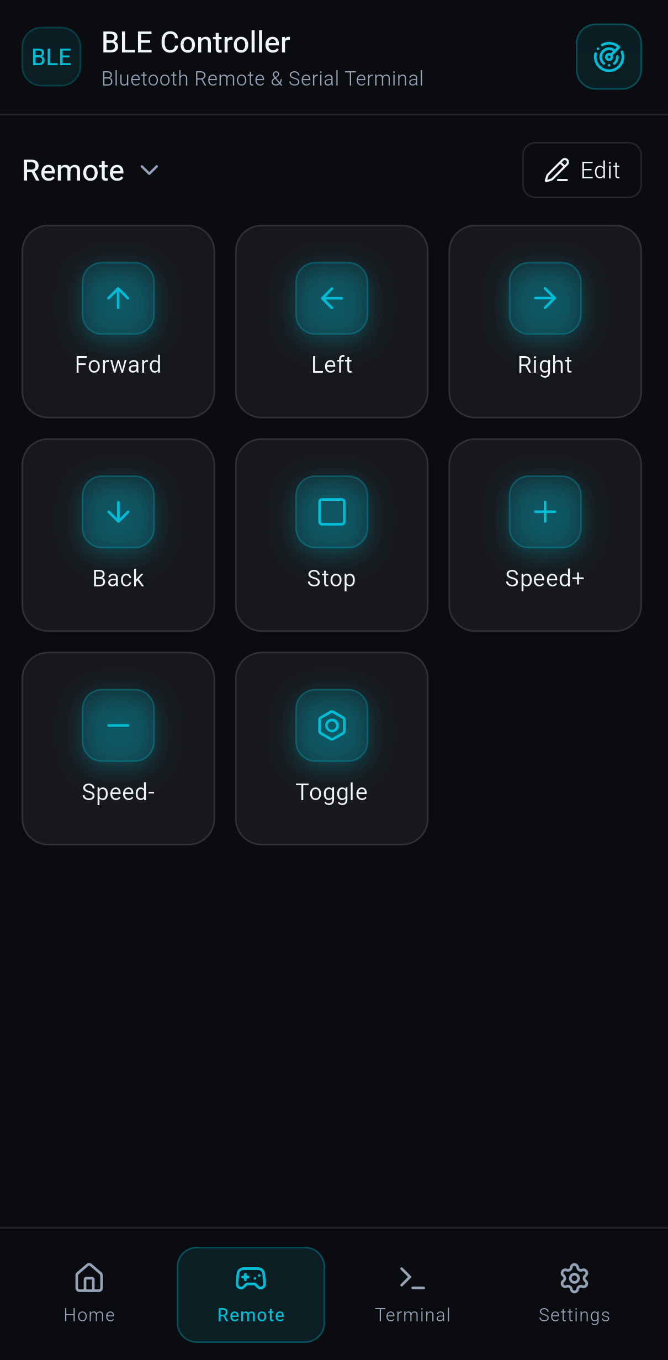
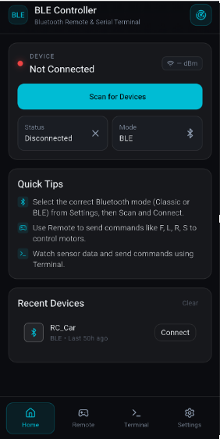

Slide 12
Active Safety & AEB
Collision Prevention:
  Uses "Active Sonar" to monitor surroundings.
Automatic Emergency Braking (AEB):
  If an obstacle is detected within 15 cm, the car stops immediately and overrides user commands.
Automatic Slowdown:
  Speed is automatically capped if an obstacle is detected within 40 cm.

Slide 13
Dual Driving Modes
One-Press Mode (Default)
  A single command triggers persistent movement until a "Stop" command or new direction is received.
Hold-to-Move
  Simulates a "dead-man's switch".
  Requires a constant stream of BLE commands; if no command is received within 300ms, the car stops automatically.
Safety Sync
  Motors stop immediately when switching modes via the 'T' command.

Slide 14
Visual Feedback
Display
Uses the built-in 12x8 LED matrix on the UNO R4.
Technical Implementation
Bitmap data is stored in flash memory and copied to RAM for memory-safe display.
Indications
  Arrows: Show direction of movement.
  Icons: Stop symbols and mode indicators.

