Slide 2
01
Fundamentals of light in machine vision
Electromagnetic Wave and Spectrum
Photon energy in semiconductor and Radiometry
The inverse-square law

Slide 3
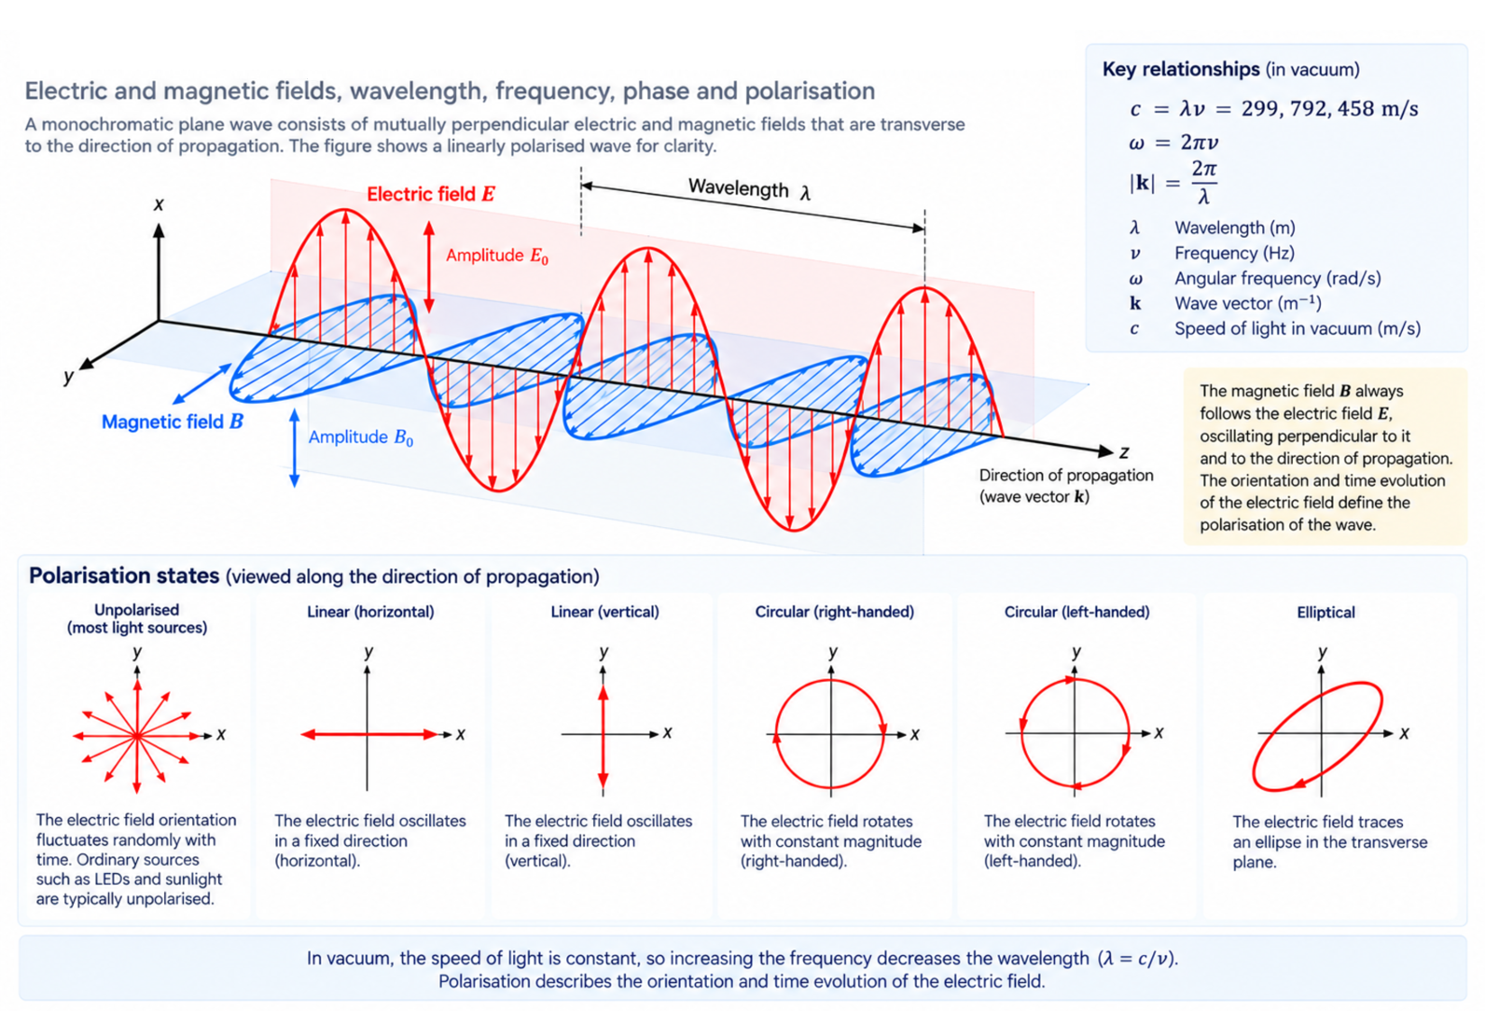
The Electromagnetic Wave

Slide 4
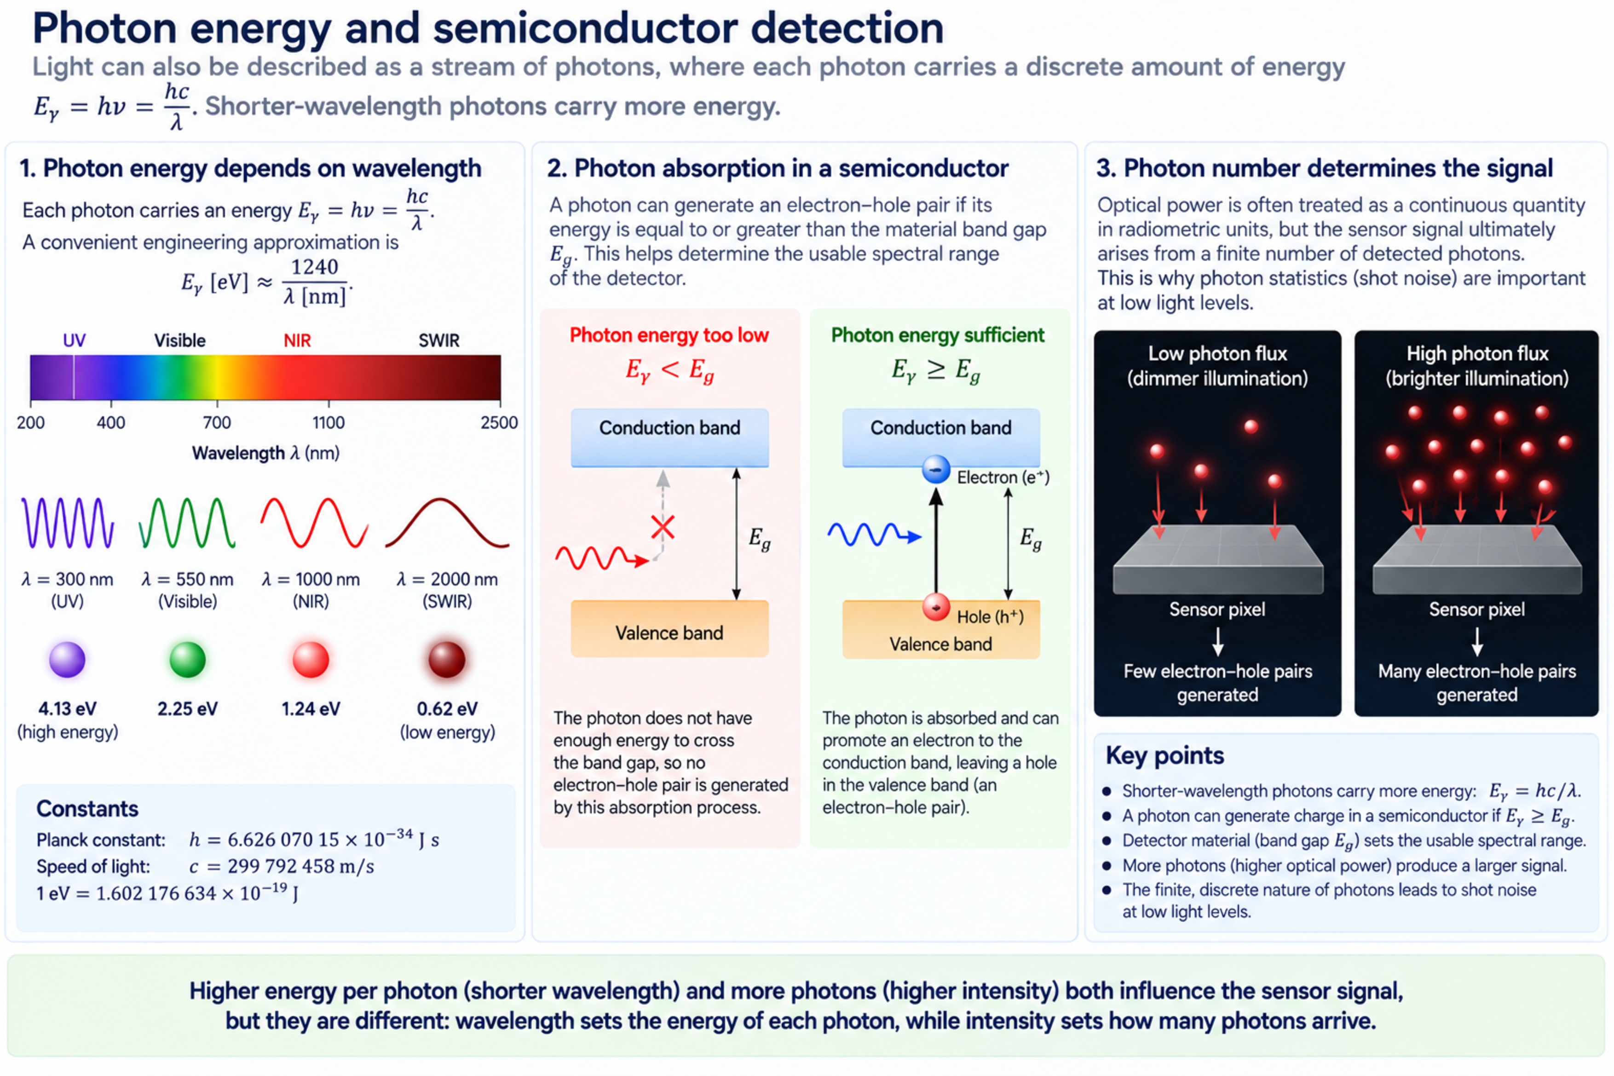
Photon energy and semiconductor detection

Slide 5
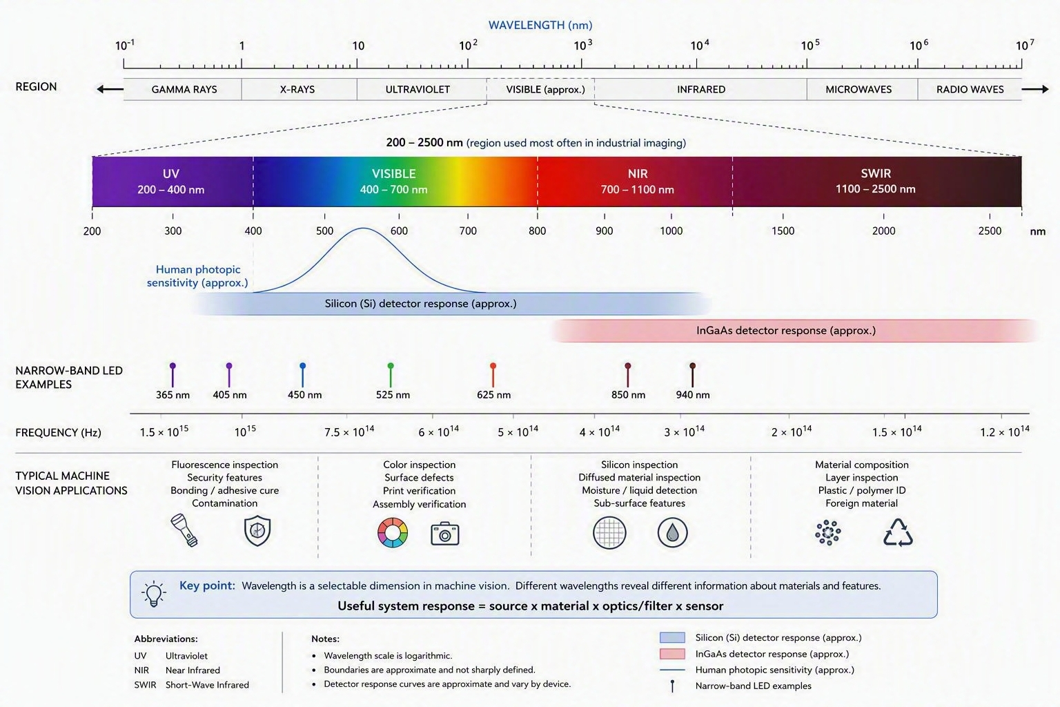
Electromagnetic Spectrum for Machine Vision

Slide 6
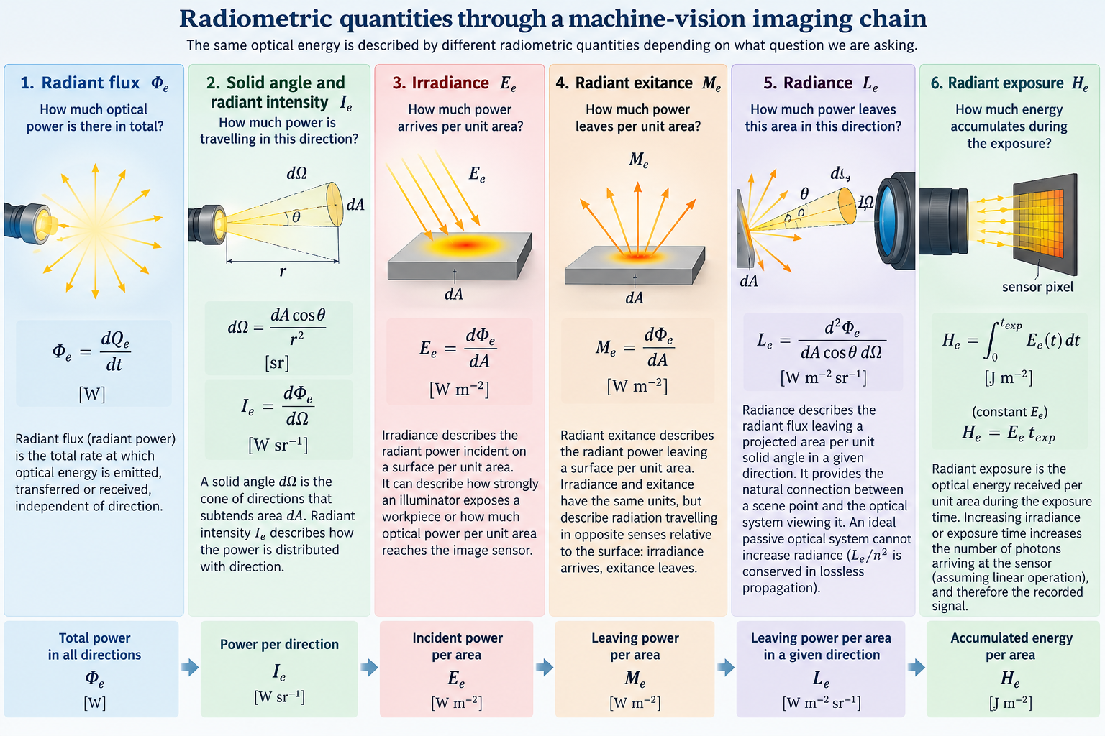
Radiometry quantities through a machine-vision imaging chain

Slide 7
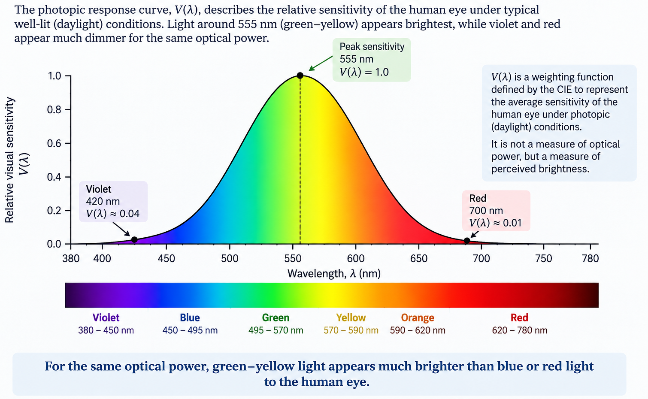
The human eye does not see all wavelengths equally

Slide 8
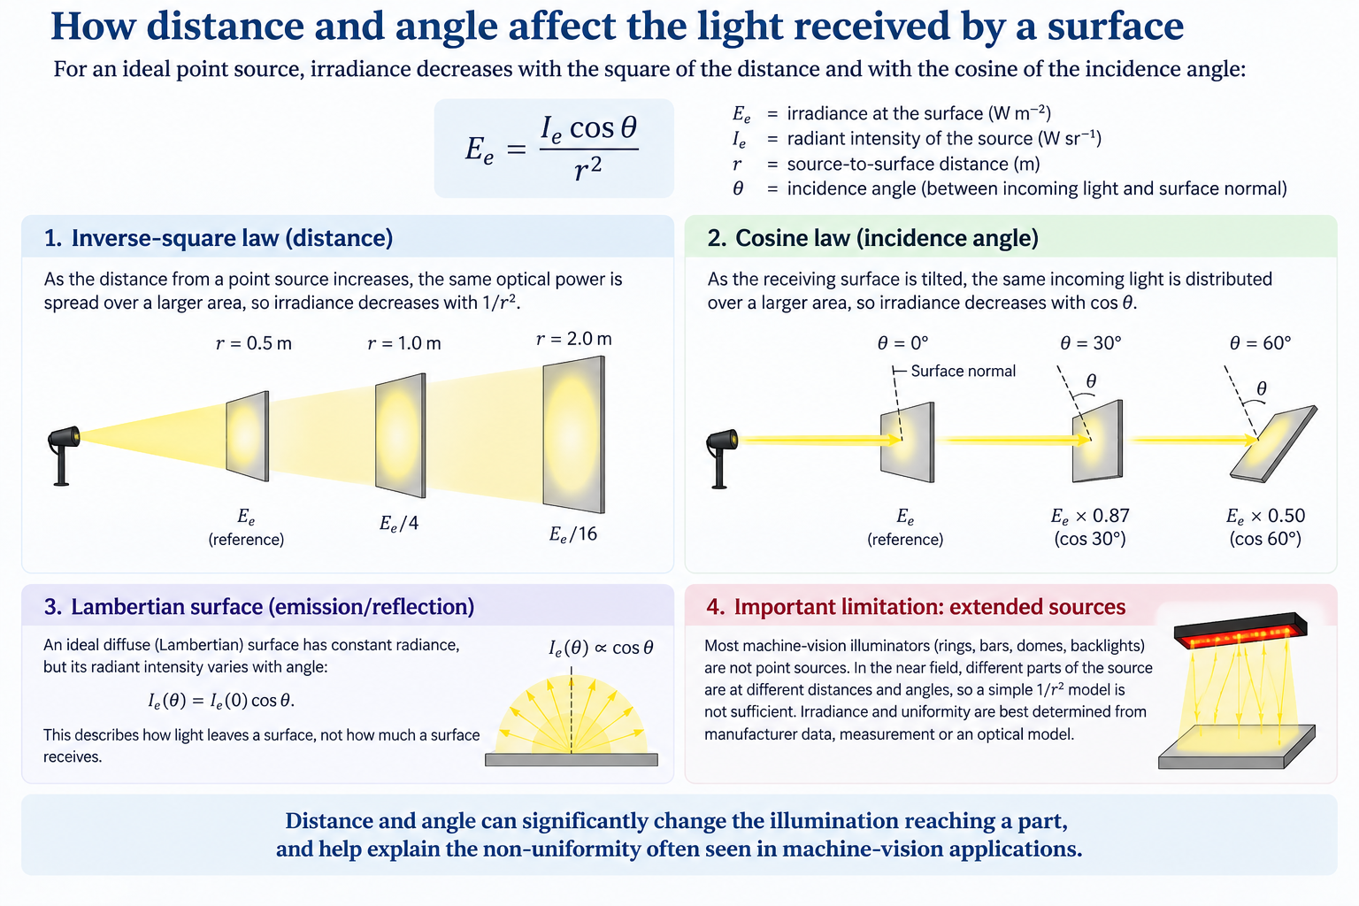
How distance and angle affect the light received by a surface

