Slide 1
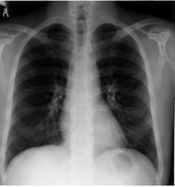
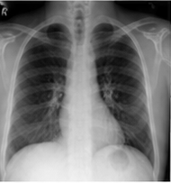
(a) Training
(b) Validation on held-out patients
Future CXR
(target only)
Query / State
Setup
Predicted
latent Ŝₜ₊ₕ
Target future
latent Sₜ₊ₕ
(shared)
Metrics
(lower is better)
Frozen
current latent Sₜ
V-JEPA2
encoder
···
Sₜ
···
L₁
1
Correct
Query
Predictor
···
···
Cosine distance
Current CXR
qₜ
···
Frozen
V-JEPA2
encoder
(same)
2
Copy
Current
State
Sₜ
···
L₁
Trainable
Predictor
···
Cosine distance
Frozen
Trainable
VLA-JEPA
predictor
···
Qwen
vision
Qwen LoRA
+ 24 learned
query tokens
3
Zero
Query
predicted
future latent
Ŝₜ₊ₕ
Sₜ
···
L₁
transition
queries qₜ
Predictor
0
···
Cosine distance
···
L₁
latent-alignment
loss
4
Shuffled
Query
Sₜ
···
L₁
Current
Report
Coarse
Forecast
Horizon
from another
patient
Predictor
···
qₜ⁽ᵒᵗʰᵉʳ⁾
···
Cosine distance
Frozen (not updated)
Trainable (updated)
Target / Metrics / Success

