Slide 1
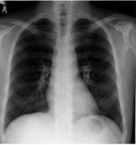
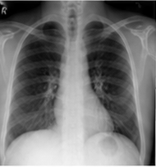
(a) Training
Future CXR
TARGET ONLY
STATE PATH
target future latent Sₜ₊ₕ
current latent Sₜ
FROZEN · SAME
FROZEN
V-JEPA2
encoder
···
V-JEPA2
encoder
···
Current CXR
CLINICAL QUERY PATH
TRAINABLE
transition queries qₜ
TRAINABLE
predicted future latent Ŝₜ₊ₕ
OBJECTIVE
FROZEN
Qwen LoRA
VLA-JEPA
predictor
L₁ loss
latent alignment
Qwen vision
···
···
+ 24 learned query tokens
learned query tokens
···
Match the predicted future state to the frozen target encoding
≡
Current
Report
▦
Coarse Forecast
Horizon

