Slide 1
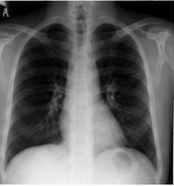
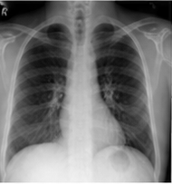
Future CXR
TARGET ONLY
STATE PATH
target future latent Sₜ₊ₕ
current latent Sₜ
FROZEN · SAME
FROZEN
V-JEPA2
encoder
···
V-JEPA2
encoder
···
Current CXR
CLINICAL QUERY PATH
transition queries qₜ
predicted future latent Ŝₜ₊ₕ
TRAINABLE
TRAINABLE
OBJECTIVE
FROZEN
Qwen LoRA
VLA-JEPA
predictor
L₁ loss
latent alignment
Qwen vision
···
···
24 learned query tokens
···
Current
Report
Coarse Forecast
Horizon

