Slide 1
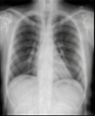
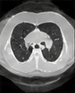

Current / prior studies
(at or before t)
Clinical prediction
Task decoder
Risk: 0.72
(positive)
Patient
state
Transformer
block
…
Transformer
block
Task
head
VLM
Sₜ
Task
query
Segmentation
V-JEPA
encoder
Resampler
+ projector
(LoRA)
Task
loss
Dₜ
Shared
image features
…
…
Dₜ
Shared image features
Visual
tokens
Text
tokens
8 learned
slots
Report / history /
timing / clinical context
(at or before t)
World model
Predicted
future tokens
Future
target tokens
Latent predictor
Tokenizer
+ embedding
Findings: …
History: …
Time: …
Indication: …
Forecast
query
Predictor
block
Predictor
block
Prediction
loss
…
⋮
⋮
Horizon
h
Future loss
Dₜ
Shared image features

