Slide 1
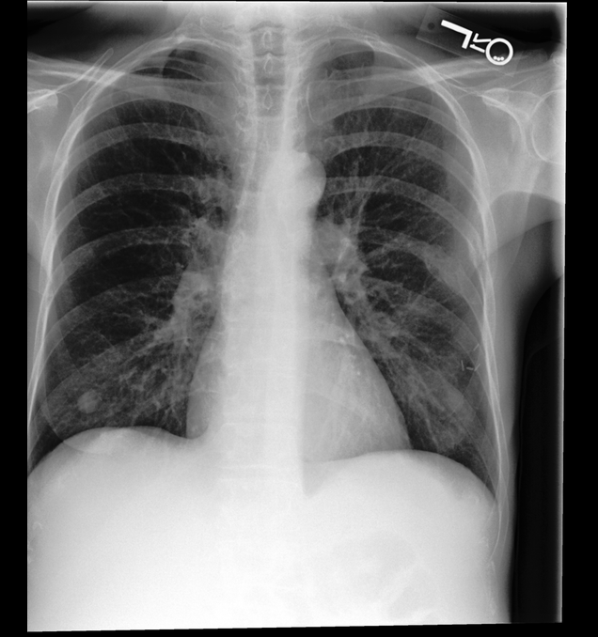
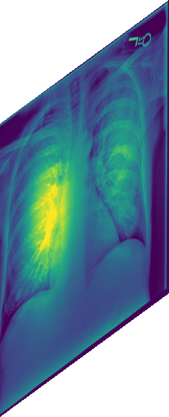
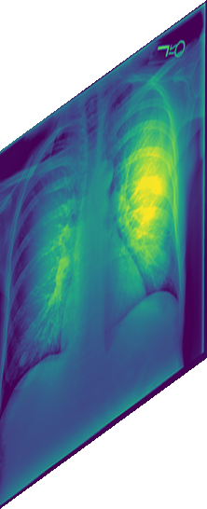
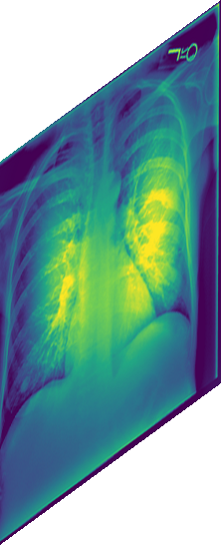
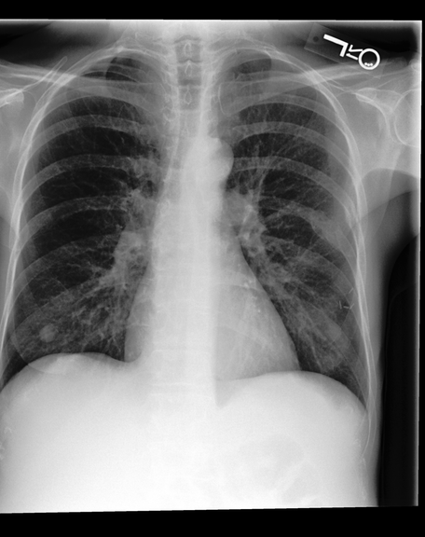
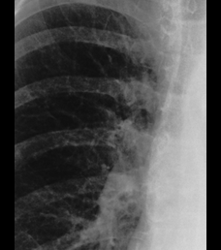
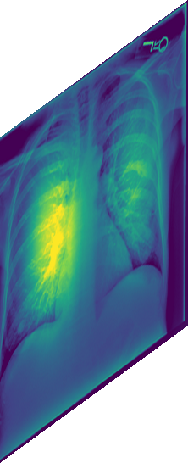
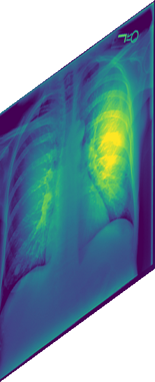
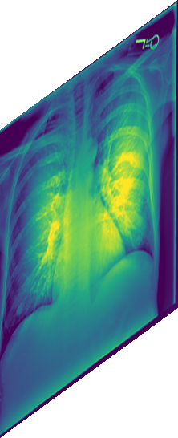
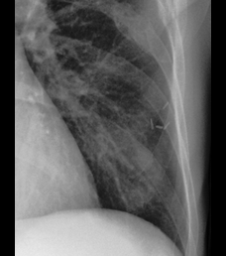
(a) Multi-depth slot construction
(b) Visual slot spatial consistency (training only)
ℓ₁
ℓ₂
ℓ₃
ℓ₄
Coordinate queries
Image
+ Report
…
…
…
State S
(x, y)
VLM
8 × d
Visual slots
S^{v}
Reconstructed
feature field
(after fusion)
Readout
Readout
Readout
Readout
S^{f}
Spatial
reconstruction
k₁
k₂
k₃
k₄
Findings:
No focal
consolidation.
No acute ...
…
…
…
S^{v}
Image + crops
Target features
Align & match
ℒ_{VSSC}
Vision Encoder
(before fusion)
Query
pooling
Query
pooling
Query
pooling
Query
pooling
Frozen
vision
teacher
…
Notes:
Reconstructed from source/fig3_v3.png with MRI replaced by a real PA CXR. The report is abridged from the source CXR report. The six colored feature planes are deterministic Python illustrations based on the CXR texture and analytic spatial functions. They are not learned attention, true teacher embeddings, or measured model results. See scripts/fig3_v3/README.md and assets/provenance.json. Text, shapes, tokens, connectors, braces, and grid are native editable PowerPoint objects; CXR/crops and feature textures are bitmap pictures.

