Slide 1
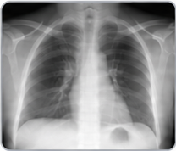
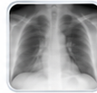
Future findings
(e.g., increased opacity)
h
X-ray
Disease progression
Findings:
Mild cardiomegaly.
No focal consolidation.
…
S_{t}
S_{t+h}
(visual + clinical)
Future report
generation
Clinical report
?
Recognition
VQA
Spatial
understanding
Latent patient space

