Slide 1

MEDICAL
DOCTOR’S
LAST EXAM
Medical Doctor's Last Exam
A living, expert-driven, self-evolution benchmark for rigorous clinical AI agent evaluation.
MDLE Organization Team
A living benchmark for next-generation medical AI
Notes:
MDLE independent project presentation. All titles, rules and wordmark elements remain editable.

Slide 2

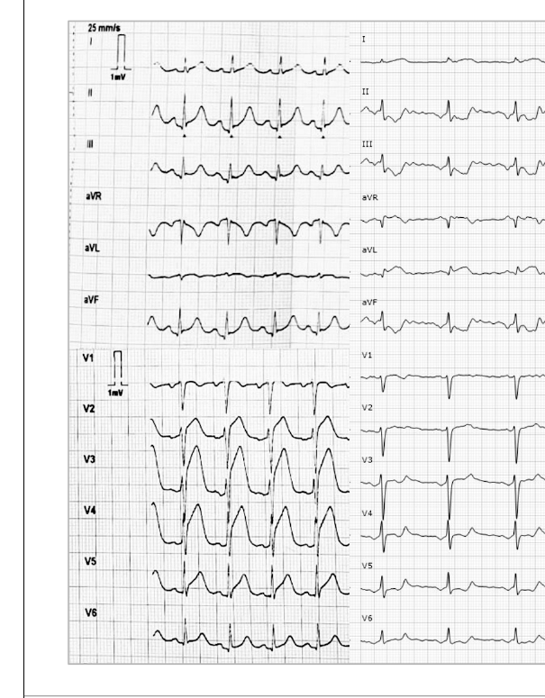
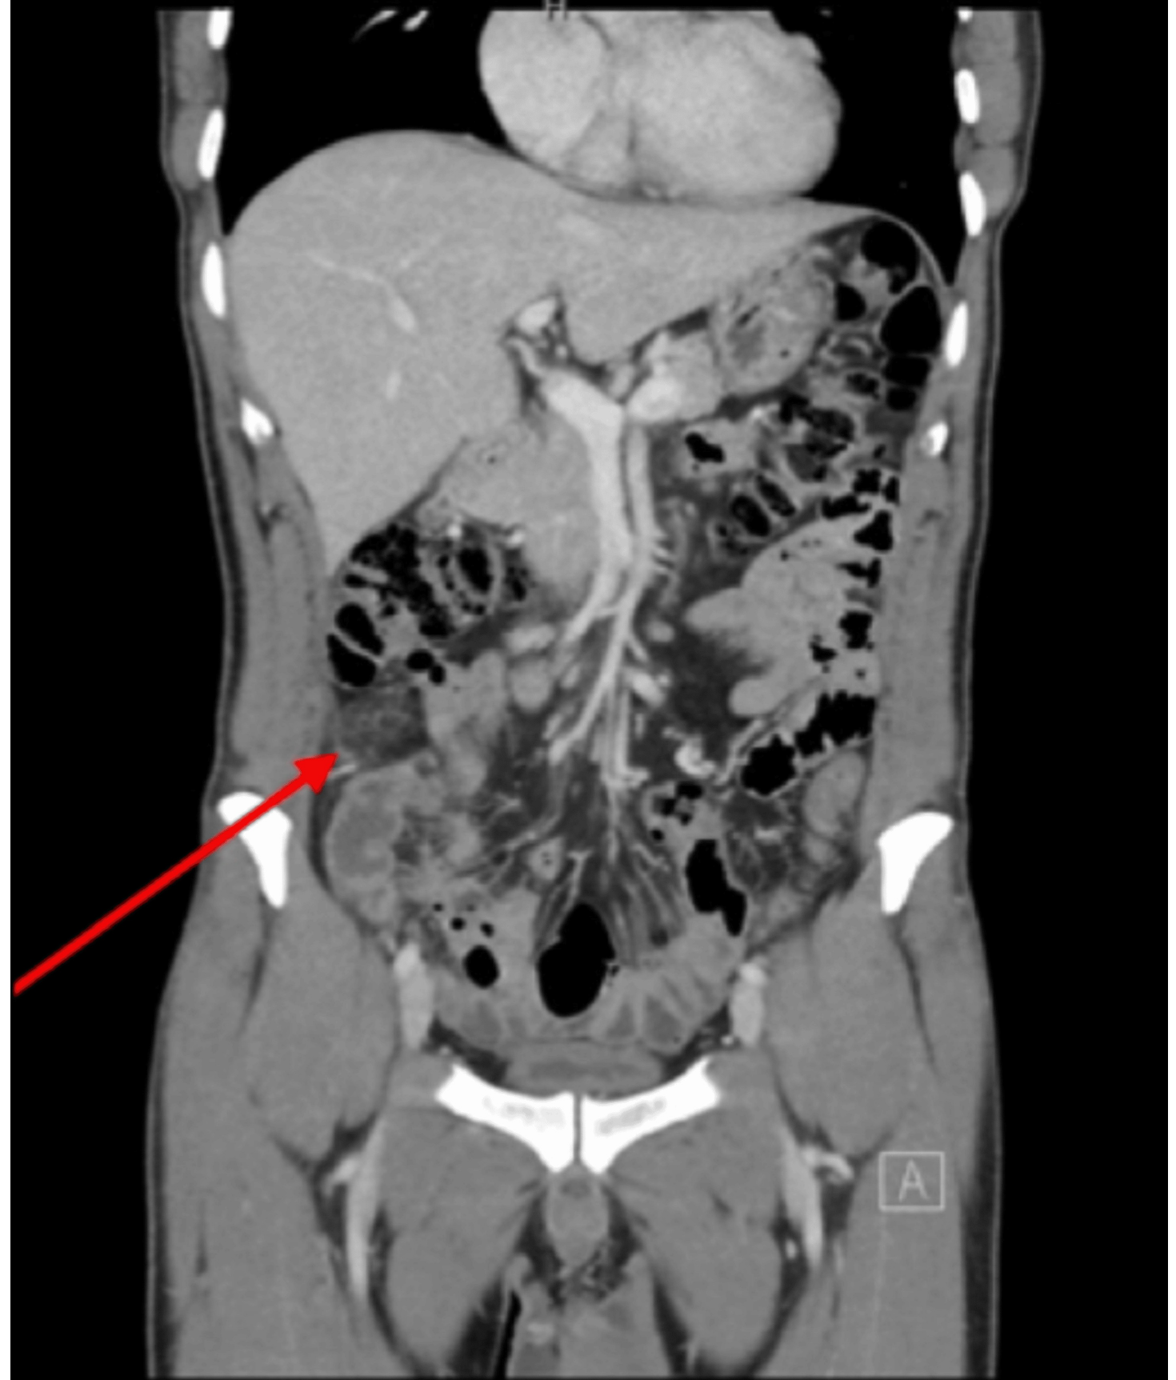
Medical Doctor’s Last Exam
MEDICAL
DOCTOR’S
LAST EXAM
MDLE at a glance: clinical evidence, measurable reasoning gaps
CURRENT BENCHMARK
357
Clinical questions
56
Both models scored 0/10
Published dataset · v1.3.0
15.7% of the benchmark
GROUNDED IN CLINICAL EVIDENCE
WHAT THE QUESTIONS TEST
Question type
Questions · Share
Investigation Interpretation
127 · 35.6%
Mechanism
76 · 21.3%
Diagnosis
57 · 16.0%
Treatment
37 · 10.4%
Complication
25 · 7.0%
Treatment Response
16 · 4.5%
Prognosis
11 · 3.1%
Published
cases
Clinical
questions
Scoring
rubrics
Genetics
7 · 2.0%
Other
1 · 0.3%
Traceable evidence for testing clinical reasoning.
One type per question. Percentages are rounded.
Gemini 3.1 Pro Preview < 6 AND Claude Opus 5 < 6
Scores out of 10 · A score of 6 is excluded · No linked-question exceptions
Dataset v1.3.0 · Question text/rubrics v1.2.1 · Historical model scores v1.1.0.
Source: Hugging Face · Medical-Doctors-Last-Exam/mdle
Selected challenge set; revised questions have not been rerun. Not a general model ranking.
Images: Recio Ibarz et al.; Alabdouli et al. (2026) · CC BY
A living benchmark for next-generation medical AI
Notes:
MDLE dataset v1.3.0: 357 questions, selected only when BOTH Gemini 3.1 Pro Preview and Claude Opus 5 closed-book scores are strictly below 6/10. Exactly 6 is excluded; no linked-question exceptions. 56 questions have both scores equal to zero (15.7%). Nine mutually exclusive question types cover all 357 items; percentages are rounded. All slide typography, type-distribution bars, panels and arrows are native editable objects. Snapshot: assets/data/dataset-v1.3.0-summary.json.
Dataset v1.3.0; question text and rubrics v1.2.1; historical model scores v1.1.0. The revised prompts have not been rerun; this selected challenge set does not establish general model rankings.
Release: https://huggingface.co/datasets/Medical-Doctors-Last-Exam/mdle/tree/v1.3.0
Commit: a96f155e900e6f7cbbc1145fb2e62b4a1ea15616
JSONL SHA256: 3f4dc5090489a59a8f72d18907384e2e21c1dee1e31bd35f448884caf1256838
Preview: https://34.238.150.88/preview/
ECG: retained item q01-8975369c944dd1eb, Recio Ibarz et al., JACC Case Reports (2026), https://doi.org/10.1016/j.jaccas.2026.107618, CC BY. CT: retained item q01-092b434ed74d6936, Alabdouli et al. (2026), https://doi.org/10.7759/cureus.107843, CC BY. Clinical images are unchanged original raster assets from the published release.

Slide 3
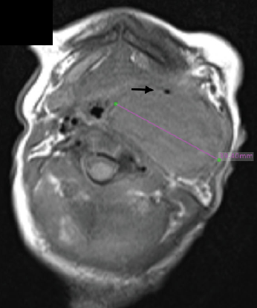
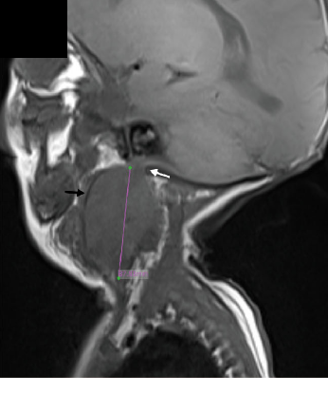
Medical Doctor’s Last Exam
MEDICAL
DOCTOR’S
LAST EXAM
One clinical question: which MRI clue matters?
CASE IN BRIEF
A neonate had a solid left neck mass. MRI suggested a well-defined border and laterally displaced carotid arteries. Surgery revealed no discrete capsule
and encasement of both carotid arteries.
READ THE CLINICAL EVIDENCE
BENCHMARK REFERENCE
The sagittal image shows an indistinct superior boundary between
the tumor and skull-base tissues.
RUBRIC SUMMARY
Identify the sagittal image
6 pts
Describe the indistinct superior boundary and its infiltrative
implication
4 pts
HISTORICAL MODEL RESPONSE
“The axial (left) image is the more reliable clue.”
Axial MRI
Sagittal MRI
Claude Opus 5 · original-prompt response
?
CURRENT BENCHMARK QUESTION
0 / 10
Which image feature best predicted the
non-encapsulated, vessel-encasing surgical finding?
Gemini 3.1 Pro Preview
Claude Opus 5
0 / 10
Clinical reasoning requires selecting the relevant visual evidence.
Dataset v1.3.0 · Question v1.2.1 · Scores v1.1.0; revised question not rerun.
Item: q01-04cfddb40624b468 · MRI: Zhao et al., Front Oncol. 2026 · doi:10.3389/fonc.2026.1776760 · CC BY
A living benchmark for next-generation medical AI
Notes:
Editable reconstruction of the selected MDLE representative-case image. The two clinical images are the original supplied axial and sagittal MRI assets.
Benchmark dataset v1.3.0; item: q01-04cfddb40624b468; question version 1.2.1. The item remains in the strict 357-question release, with both model scores equal to zero. Source endpoint: https://34.238.150.88/preview/api/questions/q01-04cfddb40624b468
The two model scores are historical version 1.1.0 scores against the original prompt. The current revised question was not rerun. The Claude quote is the first sentence of the recorded original-prompt response.
Clinical source: Zhao et al., Neuroblastoma in neonates: a case report and literature review. Frontiers in Oncology (2026), DOI 10.3389/fonc.2026.1776760, CC BY.
Only clinical images are bitmaps. Text boxes, icons, panel outlines, table rules and header/footer fills are native editable PowerPoint objects. Source image is stored separately in assets/references/02-case.png for visual comparison.

Slide 4
Medical Doctor’s Last Exam
MEDICAL
DOCTOR’S
LAST EXAM
A reference-standard item
BENCHMARK · SAMPLE ITEM
01
02
03
THE QUESTION
REFERENCE REASONING
SCORING POINTS
A neonate’s neck mass looked well defined on MRI.
Surgery: no capsule; both carotid arteries encased.
1
Axial view
6 pts
Correct view
Sharp lateral border.
Identifies the right sagittal image.
2
Sagittal view
Indistinct superior tumor–
skull-base interface.
4 pts
Feature + meaning
3
Interpretation
Links the indistinct superior tumor–
skull-base interface to infiltrative growth.
Axial
Sagittal
Suggests infiltrative,
non-encapsulated growth.
Which image feature best predicted the
non-encapsulated, vessel-encasing
surgical finding?
REFERENCE ANSWER
Right sagittal view:
the indistinct superior interface.
Dataset v1.3.0 · q01-04cfddb40624b468 · Rubric highlights
Zhao et al., Front Oncol. 2026 · doi:10.3389/fonc.2026.1776760 · CC BY
A living benchmark for next-generation medical AI
Notes:
Editable reconstruction of the user-selected concise reference-standard demo image (03-rubric.png). Text, numbering, card borders, separators, and arrows are native PowerPoint elements. Only the clinical MRI photographs are raster images.
Case: MDLE dataset v1.3.0, q01-04cfddb40624b468. Question text and scoring rubric are unchanged from prompt version v1.2.1. Scoring highlights: Correct view (6 pts); Feature + meaning (4 pts). This slide intentionally uses only the concise rubric highlights shown in the selected image.
Clinical image source credited by the selected reference: Zhao et al., Frontiers in Oncology (2026), doi:10.3389/fonc.2026.1776760, CC BY. Original axial and sagittal assets are included in assets/clinical/. The photographs retain their aspect ratio and are fitted in black native rectangles to avoid geometric distortion.

Slide 5
Medical Doctor’s Last Exam
MEDICAL
DOCTOR’S
LAST EXAM
Case 02 · ECG localization: what changed after angiography?
SEQUENTIAL 12-LEAD ECGs
CASE IN BRIEF
Before
After
A woman in her 60s presented with acute chest pain at rest, without traditional cardiovascular risk factors.
The RCA, LAD and a small LCx share one ostium in a single aortic sinus.
A dissection flap in the shared sinus extends into the LCx; a separate flap involves the mid-to-distal LAD.
IMAGE TIMING
Left: immediately before angiography.
Right: immediately after angiography.
CURRENT BENCHMARK QUESTION
What new ischemic territory appears after angiography, and does it correspond to the LAD or LCx dissection?
Dataset v1.3.0 · Question/rubric v1.2.1 · Historical scores v1.1.0; revised question not rerun.
Item: q01-8975369c944dd1eb · Recio Ibarz et al., JACC Case Rep. 2026 · doi:10.1016/j.jaccas.2026.107618 · CC BY
A living benchmark for next-generation medical AI
Notes:
MDLE-V3 ECG case, question and original clinical evidence. Item: q01-8975369c944dd1eb.
Source of truth: the frozen published dataset v1.3.0 (357 questions), Hugging Face Medical-Doctors-Last-Exam/mdle, revision a96f155e900e6f7cbbc1145fb2e62b4a1ea15616.
Question and rubric version: v1.2.1. Both displayed model scores are historical closed-book evaluations against v1.1.0. The revised current question has not been rerun. These scores are not a new evaluation.
The clinical figure is the dataset original, with native PowerPoint cropping of blank margins only; all twelve leads and both tracings remain. Left tracing: immediately before invasive coronary angiography. Right tracing: immediately afterward.
The displayed Claude excerpt is verbatim from the recorded candidate answer. Gemini has no raw candidate answer in this record; the slide labels its explanation as a judge summary, not a model quotation.
COMPLETE CURRENT QUESTION
Case: A woman in her 60s with no traditional cardiovascular risk factors presented with acute chest pain at rest. Coronary imaging showed that the RCA, LAD, and a small LCx arose from one ostium in a single aortic sinus. An intimal dissection flap in the shared sinus extended into the LCx. A separate dissection flap involved the mid-to-distal LAD.
Images: The left 12-lead ECG was recorded immediately before invasive coronary angiography. The right ECG was recorded immediately afterward.
Question: What new ischemic territory appears after angiography, and does it correspond to the LAD or LCx dissection?
REFERENCE ANSWER
The right-hand (immediately post-catheterization) tracing shows new/accentuated lateral ischemic changes (ST elevation in aVL with reciprocal/downsloping ST changes toward V5-V6), which were not the dominant feature on the pre-catheterization tracing (which was dominated by anterior/anteroseptal ST elevation in V2-V5). This new lateral pattern corresponds to the left circumflex artery (LCx) territory, distinct from the initial LAD-territory (anteroseptal) presentation.
REFERENCE REASONING
The pre-procedure tracing is dominated by marked ST elevation across V2-V5 (anteroseptal/anterior, LAD territory). On the post-procedure tracing this anterior elevation has diminished while a new pattern of ST elevation appears in aVL with downsloping ST changes extending toward the lateral precordial leads - a lateral-territory pattern. Since the case anatomy places the LCx as the vessel whose flow became compromised (via extension of the intimal flap from the shared sinus) during the catheterization procedure, this newly appearing lateral ECG pattern localizes to the LCx territory, while the initially presenting anteroseptal pattern localizes to the LAD territory.
COMPLETE CURRENT RUBRIC
{
"criteria": [
{
"id": "c1",
"partial_credit": "Award 3/6 if 'lateral' territory is named without referencing which leads changed, or if leads are cited without explicitly stating the territory is lateral",
"points": 6,
"requirement": "Identifies that the new/accentuated abnormality on the post-catheterization tracing is a lateral pattern (aVL, and/or I, V5-V6 changes), distinct from the anteroseptal pattern that dominated the pre-catheterization tracing"
},
{
"id": "c2",
"partial_credit": "Award 2/4 if LCx is named but the distinction from the initial LAD/anteroseptal pattern is not made explicit",
"points": 4,
"requirement": "Correctly attributes the new lateral pattern to the LCx territory (as opposed to the LAD, which corresponds to the initial anteroseptal presentation)"
}
],
"critical_errors": [
{
"error": "States that no new territory is involved, or attributes the new change to an inferior/RCA territory",
"score_cap": 3
}
],
"max_score": 10
}
HISTORICAL EVALUATION RECORD
{
"decision": "closed_book_failed",
"solver_model": "gemini-3.1-pro-preview",
"judge_model": "gemini-3.1-pro-preview",
"closed_book": {
"score": 0.0,
"max_score": 10.0,
"passing_score": 7,
"passed": false,
"criteria": [
{
"id": "c1",
"points_awarded": 0.0,
"met": false,
"reason": "The candidate incorrectly identifies the new pattern as inferior rather than lateral."
},
{
"id": "c2",
"points_awarded": 0.0,
"met": false,
"reason": "Because the candidate incorrectly identified an inferior pattern, they did not attribute a new lateral pattern to the LCx territory."
}
],
"critical_errors_triggered": [
{
"id": "e1",
"reason": "The candidate explicitly attributes the new change to the inferior territory, incorrectly stating there are ST elevations in leads II, III, and aVF."
}
],
"rationale": "The candidate completely misread the second ECG, hallucinating ST elevations in the inferior leads and reciprocal depressions in aVL, when the tracing actually shows ST elevation in aVL and reciprocal depressions in the inferior leads. This triggers the critical error for incorrectly attributing the new changes to the inferior territory."
},
"opus_closed_book_recheck": {
"solver_model": "anthropic.claude-opus-5",
"judge_model": "gemini-3.1-pro-preview",
"graded_at": "2026-08-19T09:45:47.125105+00:00",
"score": 0.0,
"max_score": 10.0,
"passing_score": 7.0,
"passed": false,
"result": "wrong",
"candidate_answer": "**Answer: the inferior (inferolateral) wall — leads II, III and aVF — which corresponds to the dissected left circumflex territory (not the LAD).**\n\nReasoning from the tracings:\n\n- **Left (pre‑angiography) ECG:** the dominant abnormality is anterior/anterolateral — marked ST‑segment elevation with broad hyperacute/coved T waves across V2–V6 (with lesser, secondary change in the inferior leads). This is the LAD‑territory (mid‑to‑distal LAD dissection flap) injury pattern.\n\n- **Right (post‑angiography) ECG:** the precordial ST elevation in V2–V6 has largely resolved/normalized (only residual T‑wave flattening/inversion anteriorly), while the inferior leads II, III and aVF now show the active injury pattern — ST elevation/J‑point shift with terminal T‑wave inversion (with reciprocal change in I/aVL) — i.e. an inferior injury current that was not the dominant feature on the earlier tracing.\n\n- **Territorial attribution:** the inferior–inferolateral wall in this patient is supplied through the circumflex system, in which the dissection flap from the common ostium/shared sinus extended. Thus the newly implicated territory is the **inferior wall = LCx dissection**, indicating propagation/ongoing ischemia in the circumflex flap while the LAD territory reperfused.\n\n(Interpretation is based solely on the reproduced tracings; baseline calibration is standard 25 mm/s, 1 mV.)",
"criterion_scores": [
{
"id": "c1",
"points_awarded": 0,
"met": false,
"reason": "The candidate incorrectly identifies the new change as an inferior pattern (claiming ST elevation in leads II, III, and aVF), rather than correctly identifying the lateral pattern (ST elevation in aVL/I with reciprocal inferior depression)."
},
{
"id": "c2",
"points_awarded": 0,
"met": false,
"reason": "Although the candidate names the LCx, they reach this conclusion through clinically incompatible reasoning by falsely identifying inferior ST elevation instead of recognizing the lateral pattern, earning no credit per grading rules."
}
],
"critical_errors_triggered": [
{
"id": "ce1",
"triggered": true,
"reason": "The candidate incorrectly attributes the new ECG changes to the inferior territory (leads II, III, aVF)."
}
],
"rationale": "The candidate misread the post-catheterization ECG, incorrectly identifying inferior ST elevation when there is actually inferior ST depression and lateral ST elevation. This triggers the critical error for attributing the change to an inferior territory and invalidates the LCx attribution due to clinically incompatible reasoning.",
"raw_answer_available": true,
"judge_rationale_available": true
}
}
ORIGINAL QUESTION (v1.1.0)
A woman in her 60s with no traditional cardiovascular risk factors presented with acute chest pain at rest. Coronary imaging later showed that her right coronary artery, left anterior descending artery (LAD), and a small left circumflex artery (LCx) all arose from a single ostium in one aortic sinus. An intimal dissection flap was present in that shared sinus and extended into the LCx, and a separate dissecting flap was found in the mid-to-distal LAD. The provided image shows two 12-lead ECG tracings recorded from this patient at different times, both displayed with standard limb and precordial lead labels: left, recorded immediately before invasive coronary angiography; right, recorded immediately after the angiography procedure. Comparing the right-hand tracing with the left-hand tracing, which myocardial territory shows a new or previously non-dominant pattern of active ischemic change, and which of the two dissected coronary territories (LAD vs LCx) does this newly implicated territory correspond to?
SOURCE AND EVIDENCE
{
"source": {
"source_id": "source_bfb488c7859c",
"pdf_sha256": "bfb488c7859cbe218c7d0ae1299e414b723f040675f031ac74c9e3390c52e35a",
"original_pdf_filename": "10.1016_j.jaccas.2026.107618-9a4d90d675.pdf",
"doi": "10.1016/j.jaccas.2026.107618",
"doi_url": "https://doi.org/10.1016/j.jaccas.2026.107618",
"title": "Spontaneous Coronary Artery Dissection in Complex Congenital Coronary Anatomy",
"authors": [
{
"given": "Mario José",
"family": "Recio Ibarz"
},
{
"given": "Amanda Leandro",
"family": "Barros"
},
{
"given": "Elena Rodriguez",
"family": "García"
},
{
"given": "Francisco de la Cuerda",
"family": "Llorente"
},
{
"given": "Flavio Augusto",
"family": "Gasparini Noriega"
},
{
"given": "Iván",
"family": "de María Mier"
},
{
"given": "Alberto García",
"family": "Lledó"
}
],
"journal": "JACC Case Reports",
"publisher": "Elsevier BV",
"published_date": "2026-03-26",
"article_type": "journal-article",
"article_url": "https://linkinghub.elsevier.com/retrieve/pii/S2666084926007709",
"pdf_url": "https://www.sciencedirect.com/science/article/pii/S2666084926007709/pdfft?isDTMRedir=true&download=true",
"pdf_url_source": "publisher URL pattern",
"pmcid": null,
"pmc_url": null,
"is_open_access": true,
"oa_status": "gold",
"license": "cc-by",
"metadata_sources": [
"Crossref",
"Unpaywall",
"OpenAlex"
],
"pdf_included": false
},
"evidence": [
{
"page": 3,
"quote": "Immediately post-catheterization qR pattern and 1.5 mm of ST-segment elevation in aVL and downsloping ST straightening in V3 to V5, suggestive of active lateral ischemia."
},
{
"page": 2,
"quote": "progressed into the LCx, obstructing its flow, and involved the RCA ostium due to catheter traction"
}
]
}

Slide 6
Medical Doctor’s Last Exam
MEDICAL
DOCTOR’S
LAST EXAM
Case 02 · ECG localization: the visual finding earns the credit
REFERENCE REASONING
HISTORICAL MODEL RESPONSES
BEFORE ANGIOGRAPHY
AFTER ANGIOGRAPHY
Gemini 3.1 Pro Preview
0 / 10
Dominant anterior / anteroseptal ST elevation in V2–V5.
New lateral pattern: aVL ST elevation with lateral precordial ST changes.
Claude Opus 5
0 / 10
Recorded against the original v1.1.0 prompt
“the inferior (inferolateral) wall —
leads II, III and aVF”
NEW LATERAL ISCHEMIA → LCx DISSECTION
The initial anterior / anteroseptal pattern was LAD territory.
Claude Opus 5 · verbatim excerpt
CURRENT RUBRIC · 10 POINTS
RECORDED JUDGE SUMMARIES
Gemini: inferior-territory interpretation.
Raw answer is not included in this record.
Identify the new lateral pattern and changed leads;
distinguish the initial anteroseptal pattern.
6 pts
Attribute the new pattern to LCx, distinct from
the initial LAD / anteroseptal presentation.
Claude: the same territorial error; LCx was named
with clinically incompatible reasoning.
4 pts
Critical-error cap: 3 / 10
No new territory, or new inferior / RCA territory.
The lead-level interpretation matters.
Dataset v1.3.0 · Question/rubric v1.2.1 · Historical scores v1.1.0; revised question not rerun.
Item: q01-8975369c944dd1eb · Recio Ibarz et al., JACC Case Rep. 2026 · doi:10.1016/j.jaccas.2026.107618 · CC BY
A living benchmark for next-generation medical AI
Notes:
MDLE-V3 ECG case, reference reasoning, rubric and historical evaluation. Item: q01-8975369c944dd1eb.
Source of truth: the frozen published dataset v1.3.0 (357 questions), Hugging Face Medical-Doctors-Last-Exam/mdle, revision a96f155e900e6f7cbbc1145fb2e62b4a1ea15616.
Question and rubric version: v1.2.1. Both displayed model scores are historical closed-book evaluations against v1.1.0. The revised current question has not been rerun. These scores are not a new evaluation.
The clinical figure is the dataset original, with native PowerPoint cropping of blank margins only; all twelve leads and both tracings remain. Left tracing: immediately before invasive coronary angiography. Right tracing: immediately afterward.
The displayed Claude excerpt is verbatim from the recorded candidate answer. Gemini has no raw candidate answer in this record; the slide labels its explanation as a judge summary, not a model quotation.
COMPLETE CURRENT QUESTION
Case: A woman in her 60s with no traditional cardiovascular risk factors presented with acute chest pain at rest. Coronary imaging showed that the RCA, LAD, and a small LCx arose from one ostium in a single aortic sinus. An intimal dissection flap in the shared sinus extended into the LCx. A separate dissection flap involved the mid-to-distal LAD.
Images: The left 12-lead ECG was recorded immediately before invasive coronary angiography. The right ECG was recorded immediately afterward.
Question: What new ischemic territory appears after angiography, and does it correspond to the LAD or LCx dissection?
REFERENCE ANSWER
The right-hand (immediately post-catheterization) tracing shows new/accentuated lateral ischemic changes (ST elevation in aVL with reciprocal/downsloping ST changes toward V5-V6), which were not the dominant feature on the pre-catheterization tracing (which was dominated by anterior/anteroseptal ST elevation in V2-V5). This new lateral pattern corresponds to the left circumflex artery (LCx) territory, distinct from the initial LAD-territory (anteroseptal) presentation.
REFERENCE REASONING
The pre-procedure tracing is dominated by marked ST elevation across V2-V5 (anteroseptal/anterior, LAD territory). On the post-procedure tracing this anterior elevation has diminished while a new pattern of ST elevation appears in aVL with downsloping ST changes extending toward the lateral precordial leads - a lateral-territory pattern. Since the case anatomy places the LCx as the vessel whose flow became compromised (via extension of the intimal flap from the shared sinus) during the catheterization procedure, this newly appearing lateral ECG pattern localizes to the LCx territory, while the initially presenting anteroseptal pattern localizes to the LAD territory.
COMPLETE CURRENT RUBRIC
{
"criteria": [
{
"id": "c1",
"partial_credit": "Award 3/6 if 'lateral' territory is named without referencing which leads changed, or if leads are cited without explicitly stating the territory is lateral",
"points": 6,
"requirement": "Identifies that the new/accentuated abnormality on the post-catheterization tracing is a lateral pattern (aVL, and/or I, V5-V6 changes), distinct from the anteroseptal pattern that dominated the pre-catheterization tracing"
},
{
"id": "c2",
"partial_credit": "Award 2/4 if LCx is named but the distinction from the initial LAD/anteroseptal pattern is not made explicit",
"points": 4,
"requirement": "Correctly attributes the new lateral pattern to the LCx territory (as opposed to the LAD, which corresponds to the initial anteroseptal presentation)"
}
],
"critical_errors": [
{
"error": "States that no new territory is involved, or attributes the new change to an inferior/RCA territory",
"score_cap": 3
}
],
"max_score": 10
}
HISTORICAL EVALUATION RECORD
{
"decision": "closed_book_failed",
"solver_model": "gemini-3.1-pro-preview",
"judge_model": "gemini-3.1-pro-preview",
"closed_book": {
"score": 0.0,
"max_score": 10.0,
"passing_score": 7,
"passed": false,
"criteria": [
{
"id": "c1",
"points_awarded": 0.0,
"met": false,
"reason": "The candidate incorrectly identifies the new pattern as inferior rather than lateral."
},
{
"id": "c2",
"points_awarded": 0.0,
"met": false,
"reason": "Because the candidate incorrectly identified an inferior pattern, they did not attribute a new lateral pattern to the LCx territory."
}
],
"critical_errors_triggered": [
{
"id": "e1",
"reason": "The candidate explicitly attributes the new change to the inferior territory, incorrectly stating there are ST elevations in leads II, III, and aVF."
}
],
"rationale": "The candidate completely misread the second ECG, hallucinating ST elevations in the inferior leads and reciprocal depressions in aVL, when the tracing actually shows ST elevation in aVL and reciprocal depressions in the inferior leads. This triggers the critical error for incorrectly attributing the new changes to the inferior territory."
},
"opus_closed_book_recheck": {
"solver_model": "anthropic.claude-opus-5",
"judge_model": "gemini-3.1-pro-preview",
"graded_at": "2026-08-19T09:45:47.125105+00:00",
"score": 0.0,
"max_score": 10.0,
"passing_score": 7.0,
"passed": false,
"result": "wrong",
"candidate_answer": "**Answer: the inferior (inferolateral) wall — leads II, III and aVF — which corresponds to the dissected left circumflex territory (not the LAD).**\n\nReasoning from the tracings:\n\n- **Left (pre‑angiography) ECG:** the dominant abnormality is anterior/anterolateral — marked ST‑segment elevation with broad hyperacute/coved T waves across V2–V6 (with lesser, secondary change in the inferior leads). This is the LAD‑territory (mid‑to‑distal LAD dissection flap) injury pattern.\n\n- **Right (post‑angiography) ECG:** the precordial ST elevation in V2–V6 has largely resolved/normalized (only residual T‑wave flattening/inversion anteriorly), while the inferior leads II, III and aVF now show the active injury pattern — ST elevation/J‑point shift with terminal T‑wave inversion (with reciprocal change in I/aVL) — i.e. an inferior injury current that was not the dominant feature on the earlier tracing.\n\n- **Territorial attribution:** the inferior–inferolateral wall in this patient is supplied through the circumflex system, in which the dissection flap from the common ostium/shared sinus extended. Thus the newly implicated territory is the **inferior wall = LCx dissection**, indicating propagation/ongoing ischemia in the circumflex flap while the LAD territory reperfused.\n\n(Interpretation is based solely on the reproduced tracings; baseline calibration is standard 25 mm/s, 1 mV.)",
"criterion_scores": [
{
"id": "c1",
"points_awarded": 0,
"met": false,
"reason": "The candidate incorrectly identifies the new change as an inferior pattern (claiming ST elevation in leads II, III, and aVF), rather than correctly identifying the lateral pattern (ST elevation in aVL/I with reciprocal inferior depression)."
},
{
"id": "c2",
"points_awarded": 0,
"met": false,
"reason": "Although the candidate names the LCx, they reach this conclusion through clinically incompatible reasoning by falsely identifying inferior ST elevation instead of recognizing the lateral pattern, earning no credit per grading rules."
}
],
"critical_errors_triggered": [
{
"id": "ce1",
"triggered": true,
"reason": "The candidate incorrectly attributes the new ECG changes to the inferior territory (leads II, III, aVF)."
}
],
"rationale": "The candidate misread the post-catheterization ECG, incorrectly identifying inferior ST elevation when there is actually inferior ST depression and lateral ST elevation. This triggers the critical error for attributing the change to an inferior territory and invalidates the LCx attribution due to clinically incompatible reasoning.",
"raw_answer_available": true,
"judge_rationale_available": true
}
}
ORIGINAL QUESTION (v1.1.0)
A woman in her 60s with no traditional cardiovascular risk factors presented with acute chest pain at rest. Coronary imaging later showed that her right coronary artery, left anterior descending artery (LAD), and a small left circumflex artery (LCx) all arose from a single ostium in one aortic sinus. An intimal dissection flap was present in that shared sinus and extended into the LCx, and a separate dissecting flap was found in the mid-to-distal LAD. The provided image shows two 12-lead ECG tracings recorded from this patient at different times, both displayed with standard limb and precordial lead labels: left, recorded immediately before invasive coronary angiography; right, recorded immediately after the angiography procedure. Comparing the right-hand tracing with the left-hand tracing, which myocardial territory shows a new or previously non-dominant pattern of active ischemic change, and which of the two dissected coronary territories (LAD vs LCx) does this newly implicated territory correspond to?
SOURCE AND EVIDENCE
{
"source": {
"source_id": "source_bfb488c7859c",
"pdf_sha256": "bfb488c7859cbe218c7d0ae1299e414b723f040675f031ac74c9e3390c52e35a",
"original_pdf_filename": "10.1016_j.jaccas.2026.107618-9a4d90d675.pdf",
"doi": "10.1016/j.jaccas.2026.107618",
"doi_url": "https://doi.org/10.1016/j.jaccas.2026.107618",
"title": "Spontaneous Coronary Artery Dissection in Complex Congenital Coronary Anatomy",
"authors": [
{
"given": "Mario José",
"family": "Recio Ibarz"
},
{
"given": "Amanda Leandro",
"family": "Barros"
},
{
"given": "Elena Rodriguez",
"family": "García"
},
{
"given": "Francisco de la Cuerda",
"family": "Llorente"
},
{
"given": "Flavio Augusto",
"family": "Gasparini Noriega"
},
{
"given": "Iván",
"family": "de María Mier"
},
{
"given": "Alberto García",
"family": "Lledó"
}
],
"journal": "JACC Case Reports",
"publisher": "Elsevier BV",
"published_date": "2026-03-26",
"article_type": "journal-article",
"article_url": "https://linkinghub.elsevier.com/retrieve/pii/S2666084926007709",
"pdf_url": "https://www.sciencedirect.com/science/article/pii/S2666084926007709/pdfft?isDTMRedir=true&download=true",
"pdf_url_source": "publisher URL pattern",
"pmcid": null,
"pmc_url": null,
"is_open_access": true,
"oa_status": "gold",
"license": "cc-by",
"metadata_sources": [
"Crossref",
"Unpaywall",
"OpenAlex"
],
"pdf_included": false
},
"evidence": [
{
"page": 3,
"quote": "Immediately post-catheterization qR pattern and 1.5 mm of ST-segment elevation in aVL and downsloping ST straightening in V3 to V5, suggestive of active lateral ischemia."
},
{
"page": 2,
"quote": "progressed into the LCx, obstructing its flow, and involved the RCA ostium due to catheter traction"
}
]
}

Slide 7
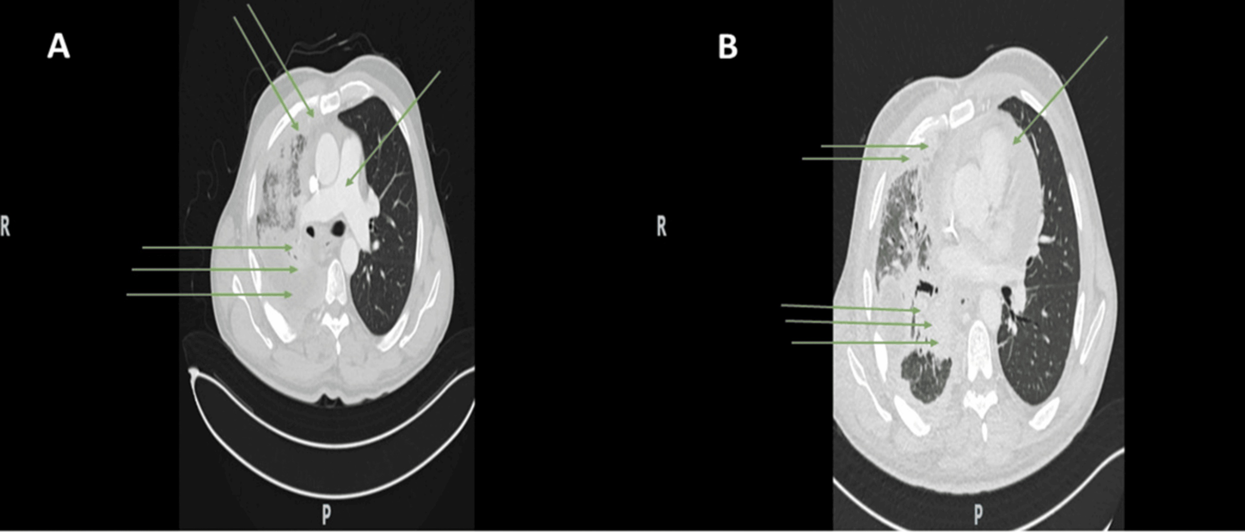
Medical Doctor’s Last Exam
MEDICAL
DOCTOR’S
LAST EXAM
Case 03 · What is restricting the heart?
CLINICAL COURSE
CONTRAST-ENHANCED CHEST CT
01
Competing explanations
Man in his late 50s; prior thoracic
radiotherapy for mediastinal malignancy.
Severe COVID-19 with pericarditis
and tamponade.
02
Later presentation
Anasarca and exertional dyspnea.
Preserved ejection fraction; septal bounce,
ventricular interdependence and reciprocal
respiratory variation in valve inflow.
03
Four-month treatment trial
High-dose corticosteroids plus colchicine
for presumed inflammatory pericarditis.
No symptomatic or hemodynamic
improvement.
A · Great vessels
B · Upper cardiac chambers
Both panels are from the same contrast-enhanced examination.
CURRENT QUESTION
What mechanism explains both the constrictive physiology
and the failure of anti-inflammatory treatment?
Dataset v1.3.0 · Question v1.2.1 · Historical scores v1.1.0; revised question not rerun.
Dawelbeit et al. · Cureus 2026 · CC BY
Item: q01-55ea587e1ed2f1dc · Mechanism
doi:10.7759/cureus.105678
A living benchmark for next-generation medical AI
Notes:
MDLE V3 additional case: q01-55ea587e1ed2f1dc. Question and clinical evidence page.
Dataset v1.3.0; current question and rubric v1.2.1; historical scores v1.1.0. Gemini 3.1 Pro Preview 0/10; Claude Opus 5 3/10. Current question not rerun. Selected because both historical closed-book scores are strictly below 6/10. The current prompt answerability record is preserved.
Question-page clinical course is a concise paraphrase; the final Question sentence is verbatim. Reference explanations are a summary of the dataset reference, not a universal treatment guideline. CT and treatment course must be interpreted together; lack of anti-inflammatory response alone does not prove malignancy. The clinical CT is an unchanged source bitmap. Text, panel borders, arrows and scoring cards are editable PowerPoint elements.
Claude excerpt is copied from its recorded original-prompt response. Gemini raw response is not in this release; its error description is explicitly a judge summary. Claude earned 0 for mechanism and 4 for treatment-response reasoning, then the critical-error cap reduced the final score to 3. A cap is a maximum score, not guaranteed credit.
Release: https://huggingface.co/datasets/Medical-Doctors-Last-Exam/mdle/tree/v1.3.0
Explorer: https://34.238.150.88/preview/api/questions/q01-55ea587e1ed2f1dc
Source: Dawelbeit et al., When Constriction Is Not Just the Pericardium: Extrinsic Cardiac Encasement by Thymic Squamous Cell Carcinoma. Cureus (2026). https://doi.org/10.7759/cureus.105678. CC BY. Evidence excerpts cite source pages 4 and 5.
FULL CURRENT QUESTION
Case: A man in his late 50s had received thoracic radiotherapy for a mediastinal malignancy. He also had severe COVID-19 complicated by pericarditis and pericardial tamponade.
Years later, he presented with anasarca and exertional dyspnea. Echocardiography and right heart catheterization showed marked reciprocal respiratory variation in mitral and tricuspid inflow, a prominent septal bounce, and ventricular interdependence. His ejection fraction was preserved.
He received high-dose corticosteroids and colchicine for 4 months for presumed inflammatory pericarditis. His symptoms and hemodynamics did not improve.
Images: Contrast-enhanced axial chest CT was obtained around this time. Panel A (left) is at the level of the great vessels. Panel B (right) is at the level of the upper cardiac chambers.
Question: What mechanism explains both the constrictive physiology and the failure of anti-inflammatory treatment?
REFERENCE ANSWER
The constrictive physiology is caused by direct malignant tumor infiltration that circumferentially encases the pericardium, mediastinal pleura, and epicardial surface of the heart (malignant extrinsic cardiac encasement / 'pseudo-constriction'), rather than by primary inflammatory or radiation-fibrotic pericardial disease. The CT shows a bulky enhancing soft-tissue mass inseparable from the pericardium/epicardial fat, deforming the right atrium and compressing the inferior vena cava, i.e., a solid mechanical shell rather than isolated pericardial thickening or effusion. Because the restriction is produced by a fixed, non-compliant tumor mass and not by active pericardial inflammation, there is no inflammatory process for corticosteroids/colchicine to suppress, so an adequate 4-month anti-inflammatory trial produced no hemodynamic or symptomatic benefit — the treatment failure itself is evidence that the driver is mechanical/structural rather than inflammatory.
REFERENCE REASONING
Two independent pieces of evidence must be combined: (1) imaging showing a mediastinal mass directly infiltrating/inseparable from the pericardium and epicardial fat with RA deformity and IVC compression — i.e., a mechanical encasing process rather than isolated pericardial disease; and (2) the complete absence of response to a 4-month, guideline-adequate corticosteroid/colchicine trial, which would be expected to improve or resolve inflammatory or post-viral constrictive pericarditis. Neither fact alone is conclusive (imaging alone could reflect coexisting effusion/inflammation on a background of prior radiation and COVID-19 pericarditis; treatment failure alone could reflect an inadequate trial or resistant inflammatory pericarditis), but together they indicate the constrictive physiology is driven by fixed malignant encasement, not reversible pericardial inflammation.
CURRENT RUBRIC
{
"criteria": [
{
"id": "c1",
"partial_credit": "Full credit for any answer identifying tumor infiltration/encasement of the pericardium or heart as the driver, using equivalent terminology (e.g., 'malignant pericardial infiltration', 'extrinsic tumor shell', 'neoplastic encasement'); partial credit (3) if answer says 'malignant pericardial disease' without clearly conveying the mechanical/structural (vs inflammatory) nature; no credit if answer concludes classic inflammatory or radiation-fibrotic constrictive pericarditis is the primary driver",
"points": 6,
"requirement": "States the core mechanism: direct tumor/malignant infiltration and circumferential encasement of the pericardium/heart (extrinsic mechanical restriction), not primary/inflammatory pericardial disease"
},
{
"id": "c2",
"partial_credit": "Full credit if the answer links the absence of an inflammatory target to lack of steroid/colchicine response; partial credit (2) if the link is only implied or partially stated",
"points": 4,
"requirement": "Explains why this mechanism accounts for anti-inflammatory treatment failure (fixed mechanical process, no active inflammatory substrate to treat)"
}
],
"critical_errors": [
{
"error": "Concludes the constriction is primarily due to classic (inflammatory/post-viral/radiation-fibrotic) constrictive pericarditis or isolated pericardial effusion/tamponade, without recognizing tumor encasement as the driver",
"score_cap": 3
}
],
"max_score": 10
}
SOURCE EVIDENCE
[
{
"page": 4,
"quote": "Axial contrast-enhanced CT images at the level of the great vessels (A) and upper cardiac chambers (B) demonstrate significant disease progression and malignant cardiac encasement. The mass directly infiltrates the mediastinal pleura and pericardium, becoming inseparable from the adjacent epicardial fat pads."
},
{
"page": 5,
"quote": "Despite adherence to the anti-inflammatory regimen, the patient's condition failed to improve."
}
]

Slide 8
Medical Doctor’s Last Exam
MEDICAL
DOCTOR’S
LAST EXAM
Case 03 · Connect the CT finding to the treatment failure
BENCHMARK REFERENCE
Malignant cardiac encasement causes fixed mechanical restriction.
LINK THE TWO SOURCES OF EVIDENCE
HISTORICAL MODEL EVIDENCE
1
CT: an encasing mass
Gemini 3.1 Pro Preview
Claude Opus 5
Tumor infiltrates the pericardium and is
inseparable from adjacent epicardial fat.
0 / 10
3 / 10
Claude Opus 5 · original-prompt excerpt
2
Physiology: an external constraint
“burnt‑out, end‑stage fibrotic
(radiation‑induced/post‑inflammatory)
pericardial–mediastinal constriction”
The non-compliant tumor mass restricts
cardiac filling and produces constrictive physiology.
3
Course: anti-inflammatory failure
Recorded Claude grading
Steroids and colchicine do not remove the
fixed mechanical restriction imposed by tumor.
0 for tumor mechanism + 4 for fixed-process reasoning.
Wrong primary cause triggered the 3-point cap → 3/10.
Interpret the CT and the treatment course together.
Gemini judge summary: attributed the restriction to
radiation fibrosis; both criteria received 0.
6 pts
4 pts
Cap: 3/10
Identify malignant encasement
as the mechanical cause.
Explain why anti-inflammatory
treatment cannot remove it.
Miss tumor encasement; attribute
the cause to primary pericardial disease.
Dataset v1.3.0 · Question v1.2.1 · Historical scores v1.1.0; revised question not rerun.
Dawelbeit et al. · Cureus 2026 · CC BY
Item: q01-55ea587e1ed2f1dc · Mechanism
doi:10.7759/cureus.105678
A living benchmark for next-generation medical AI
Notes:
MDLE V3 additional case: q01-55ea587e1ed2f1dc. Reference reasoning, current rubric highlights and recorded historical model evidence.
Dataset v1.3.0; current question and rubric v1.2.1; historical scores v1.1.0. Gemini 3.1 Pro Preview 0/10; Claude Opus 5 3/10. Current question not rerun. Selected because both historical closed-book scores are strictly below 6/10. The current prompt answerability record is preserved.
Question-page clinical course is a concise paraphrase; the final Question sentence is verbatim. Reference explanations are a summary of the dataset reference, not a universal treatment guideline. CT and treatment course must be interpreted together; lack of anti-inflammatory response alone does not prove malignancy. The clinical CT is an unchanged source bitmap. Text, panel borders, arrows and scoring cards are editable PowerPoint elements.
Claude excerpt is copied from its recorded original-prompt response. Gemini raw response is not in this release; its error description is explicitly a judge summary. Claude earned 0 for mechanism and 4 for treatment-response reasoning, then the critical-error cap reduced the final score to 3. A cap is a maximum score, not guaranteed credit.
Release: https://huggingface.co/datasets/Medical-Doctors-Last-Exam/mdle/tree/v1.3.0
Explorer: https://34.238.150.88/preview/api/questions/q01-55ea587e1ed2f1dc
Source: Dawelbeit et al., When Constriction Is Not Just the Pericardium: Extrinsic Cardiac Encasement by Thymic Squamous Cell Carcinoma. Cureus (2026). https://doi.org/10.7759/cureus.105678. CC BY. Evidence excerpts cite source pages 4 and 5.
FULL CURRENT QUESTION
Case: A man in his late 50s had received thoracic radiotherapy for a mediastinal malignancy. He also had severe COVID-19 complicated by pericarditis and pericardial tamponade.
Years later, he presented with anasarca and exertional dyspnea. Echocardiography and right heart catheterization showed marked reciprocal respiratory variation in mitral and tricuspid inflow, a prominent septal bounce, and ventricular interdependence. His ejection fraction was preserved.
He received high-dose corticosteroids and colchicine for 4 months for presumed inflammatory pericarditis. His symptoms and hemodynamics did not improve.
Images: Contrast-enhanced axial chest CT was obtained around this time. Panel A (left) is at the level of the great vessels. Panel B (right) is at the level of the upper cardiac chambers.
Question: What mechanism explains both the constrictive physiology and the failure of anti-inflammatory treatment?
REFERENCE ANSWER
The constrictive physiology is caused by direct malignant tumor infiltration that circumferentially encases the pericardium, mediastinal pleura, and epicardial surface of the heart (malignant extrinsic cardiac encasement / 'pseudo-constriction'), rather than by primary inflammatory or radiation-fibrotic pericardial disease. The CT shows a bulky enhancing soft-tissue mass inseparable from the pericardium/epicardial fat, deforming the right atrium and compressing the inferior vena cava, i.e., a solid mechanical shell rather than isolated pericardial thickening or effusion. Because the restriction is produced by a fixed, non-compliant tumor mass and not by active pericardial inflammation, there is no inflammatory process for corticosteroids/colchicine to suppress, so an adequate 4-month anti-inflammatory trial produced no hemodynamic or symptomatic benefit — the treatment failure itself is evidence that the driver is mechanical/structural rather than inflammatory.
REFERENCE REASONING
Two independent pieces of evidence must be combined: (1) imaging showing a mediastinal mass directly infiltrating/inseparable from the pericardium and epicardial fat with RA deformity and IVC compression — i.e., a mechanical encasing process rather than isolated pericardial disease; and (2) the complete absence of response to a 4-month, guideline-adequate corticosteroid/colchicine trial, which would be expected to improve or resolve inflammatory or post-viral constrictive pericarditis. Neither fact alone is conclusive (imaging alone could reflect coexisting effusion/inflammation on a background of prior radiation and COVID-19 pericarditis; treatment failure alone could reflect an inadequate trial or resistant inflammatory pericarditis), but together they indicate the constrictive physiology is driven by fixed malignant encasement, not reversible pericardial inflammation.
CURRENT RUBRIC
{
"criteria": [
{
"id": "c1",
"partial_credit": "Full credit for any answer identifying tumor infiltration/encasement of the pericardium or heart as the driver, using equivalent terminology (e.g., 'malignant pericardial infiltration', 'extrinsic tumor shell', 'neoplastic encasement'); partial credit (3) if answer says 'malignant pericardial disease' without clearly conveying the mechanical/structural (vs inflammatory) nature; no credit if answer concludes classic inflammatory or radiation-fibrotic constrictive pericarditis is the primary driver",
"points": 6,
"requirement": "States the core mechanism: direct tumor/malignant infiltration and circumferential encasement of the pericardium/heart (extrinsic mechanical restriction), not primary/inflammatory pericardial disease"
},
{
"id": "c2",
"partial_credit": "Full credit if the answer links the absence of an inflammatory target to lack of steroid/colchicine response; partial credit (2) if the link is only implied or partially stated",
"points": 4,
"requirement": "Explains why this mechanism accounts for anti-inflammatory treatment failure (fixed mechanical process, no active inflammatory substrate to treat)"
}
],
"critical_errors": [
{
"error": "Concludes the constriction is primarily due to classic (inflammatory/post-viral/radiation-fibrotic) constrictive pericarditis or isolated pericardial effusion/tamponade, without recognizing tumor encasement as the driver",
"score_cap": 3
}
],
"max_score": 10
}
SOURCE EVIDENCE
[
{
"page": 4,
"quote": "Axial contrast-enhanced CT images at the level of the great vessels (A) and upper cardiac chambers (B) demonstrate significant disease progression and malignant cardiac encasement. The mass directly infiltrates the mediastinal pleura and pericardium, becoming inseparable from the adjacent epicardial fat pads."
},
{
"page": 5,
"quote": "Despite adherence to the anti-inflammatory regimen, the patient's condition failed to improve."
}
]

Slide 9
Medical Doctor’s Last Exam
MEDICAL
DOCTOR’S
LAST EXAM
Case 04 · Surgical judgment: how much tumor should be removed?
TREATMENT
Skull-base surgery · Extent of resection · Nerve preservation
CURRENT CASE
KEY RELATIONSHIPS
A jugular-foramen tumor arises from the accessory nerve. It extends laterally through the extracranial hypoglossal canal to the level of C1. It compresses, but does not invade, the hypoglossal nerve. Adjacent lower cranial nerve territories are also involved. Surgical resection is planned.
Jugular-foramen tumor
CN XI · Accessory nerve
Nerve of origin
CN XII · Hypoglossal nerve
Compressed, but not invaded
Extension to C1
Through the extracranial hypoglossal canal
The nerve of origin is the accessory nerve (CN XI).
Relationship schematic · not an anatomical image
CURRENT BENCHMARK QUESTION
?
What extent-of-resection approach for the intracranial portion best balances tumor removal with preservation of the nerve of origin?
Dataset v1.3.0 · Question v1.2.1 · Scores v1.1.0; revised question not rerun.
Futamura et al., Life (2026) · doi:10.3390/life16040655 · CC BY
A living benchmark for next-generation medical AI
Notes:
MDLE V3 · Case 04 · Current question and case relationships
Item: q03-d89bdb28347ec18a
Dataset v1.3.0 contains 357 questions, each with both model scores strictly less than 6. Current question version: 1.2.1. Historical closed-book model score version: 1.1.0; revised question not rerun.
This is a case-specific benchmark reference strategy, not a general surgical recommendation. The original question supplies no clinical image. The native diagram represents textual relationships only and does not claim anatomical scale or spatial fidelity.
Current full question:
Case: A jugular-foramen tumor arises from the accessory nerve. It extends laterally through the extracranial hypoglossal canal to the level of C1. It compresses, but does not invade, the hypoglossal nerve. Adjacent lower cranial nerve territories are also involved. Surgical resection is planned.
Question: What extent-of-resection approach for the intracranial portion best balances tumor removal with preservation of the nerve of origin?
Complete benchmark reference answer:
An intracapsular resection strategy — removing the bulk of the tumor and its extracranial extension while leaving a thin residual capsule adherent to the accessory nerve (radiographically complete intracapsular resection) — is preferable to an aggressive gross total resection that risks sacrificing or severely damaging the nerve of origin. This balances maximizing decompression of the secondarily affected nerves (relieving hypoglossal, vagus, and glossopharyngeal compression by removing the extracranial/hypoglossal-canal tumor component) against minimizing the risk of new or worsened accessory nerve (CN XI) deficit, at the cost of accepting a small residual/recurrence risk from the retained capsule.
Benchmark reasoning:
In the illustrative case, radiographically complete intracapsular resection (RCIR) rather than gross total resection was performed specifically because the accessory nerve was the nerve of origin, and the discussion explicitly frames CN XI preservation versus resection completeness as a tradeoff distinct from the reversible CN XII compression, noting postoperative CN XI deterioration was reported in a subset of cases when more aggressive resection was pursued.
Complete rubric:
{
"criteria": [
{
"id": "c1",
"partial_credit": "Award 3/6 if response only says 'try to preserve CN XI' without naming an intracapsular/subtotal resection strategy.",
"points": 6,
"requirement": "Recommends intracapsular/subtotal resection preserving the nerve of origin rather than aggressive gross total resection"
},
{
"id": "c2",
"partial_credit": "Award 2/4 for stating a trade-off exists without specifying both sides (decompression benefit vs. CN XI injury/residual risk).",
"points": 4,
"requirement": "Articulates the trade-off between maximal decompression/resection of the tumor (benefiting secondarily compressed nerves) and risk of new accessory nerve injury/residual tumor"
}
],
"critical_errors": [
{
"error": "Recommends deliberate sacrifice of the accessory nerve or states no trade-off exists between resection extent and nerve preservation",
"score_cap": 3
}
],
"max_score": 10
}
Gemini closed-book assessment (judge summary only; no raw response is supplied in this released item):
{
"score": 0.0,
"max_score": 10.0,
"passing_score": 7,
"passed": false,
"criteria": [
{
"id": "c1",
"points_awarded": 0.0,
"met": false,
"reason": "The candidate incorrectly recommends gross total resection rather than an intracapsular or subtotal resection to preserve the nerve."
},
{
"id": "c2",
"points_awarded": 0.0,
"met": false,
"reason": "The candidate does not articulate the trade-off of maximizing decompression versus minimizing accessory nerve injury; instead, they advocate sacrificing the accessory nerve for tumor control."
}
],
"critical_errors_triggered": [
{
"id": "e1",
"reason": "The candidate explicitly recommends deliberate sacrifice of the accessory nerve (CN XI) to achieve complete tumor removal."
}
],
"rationale": "The candidate recommends gross total resection and deliberate sacrifice of the accessory nerve, directly contradicting the reference answer which advises intracapsular resection to preserve the nerve. This triggers a critical error and results in zero points across all criteria."
}
Claude historical assessment: raw response and judge rationale are unavailable; no response content is inferred.
{
"solver_model": "anthropic.claude-opus-5",
"judge_model": "gemini-3.1-pro-preview",
"graded_at": null,
"score": 0.0,
"max_score": 10.0,
"passing_score": 7,
"passed": false,
"result": "wrong",
"candidate_answer": null,
"criterion_scores": [],
"critical_errors_triggered": [],
"rationale": null,
"raw_answer_available": false,
"judge_rationale_available": false
}
Evidence:
[
{
"page": 14,
"quote": "Radiographically complete intracapsular resection of the tumor and its extracranial extension was achieved without complications"
},
{
"page": 18,
"quote": "preservation of accessory nerve function (CN XI) represents a distinct surgical challenge... underscoring the potential tradeoff between achieving adequate tumor resection and avoiding additional CN XI morbidity"
}
]
Source: Futamura et al., Accessory Nerve Schwannomas Presenting with Hypoglossal Nerve Palsy: A Narrative Review with an Illustrative Case. Life (2026). https://doi.org/10.3390/life16040655. CC BY.
Dataset: https://huggingface.co/datasets/Medical-Doctors-Last-Exam/mdle/tree/v1.3.0
Item endpoint: https://34.238.150.88/preview/api/questions/q03-d89bdb28347ec18a

Slide 10
Medical Doctor’s Last Exam
MEDICAL
DOCTOR’S
LAST EXAM
Case 04 · Reference strategy: preserve the nerve of origin
CASE-LEVEL BENCHMARK REFERENCE
Intracapsular resection, retaining a thin capsule adherent to CN XI.
Remove the tumor bulk and extracranial extension while preserving the nerve of origin.
WHAT THE RUBRIC REWARDS
HISTORICAL MODEL SCORES
Recommend intracapsular / subtotal resection to preserve
CN XI, rather than aggressive gross-total resection.
Gemini 3.1 Pro Preview
0 / 10
6 pts
Claude Opus 5
0 / 10
Balance decompression of secondarily affected nerves
against CN XI injury and residual-tumor risk.
RECORDED GEMINI JUDGE SUMMARY
4 pts
The judge recorded a recommendation for gross-total
removal with deliberate CN XI sacrifice.
CRITICAL ERROR · SCORE CAP 3 / 10
Gemini raw response unavailable.
Deliberately sacrifice CN XI, or claim that no trade-off
exists between resection and nerve preservation.
Claude: score only; raw response and judge
rationale unavailable.
The decision weighs decompression against new CN XI injury and residual / recurrence risk.
Dataset v1.3.0 · Question v1.2.1 · Scores v1.1.0; revised question not rerun.
Futamura et al., Life (2026) · doi:10.3390/life16040655 · CC BY
A living benchmark for next-generation medical AI
Notes:
MDLE V3 · Case 04 · Reference answer, rubric and historical score interpretation
Item: q03-d89bdb28347ec18a
Dataset v1.3.0 contains 357 questions, each with both model scores strictly less than 6. Current question version: 1.2.1. Historical closed-book model score version: 1.1.0; revised question not rerun.
This is a case-specific benchmark reference strategy, not a general surgical recommendation. The original question supplies no clinical image. The native diagram represents textual relationships only and does not claim anatomical scale or spatial fidelity.
Current full question:
Case: A jugular-foramen tumor arises from the accessory nerve. It extends laterally through the extracranial hypoglossal canal to the level of C1. It compresses, but does not invade, the hypoglossal nerve. Adjacent lower cranial nerve territories are also involved. Surgical resection is planned.
Question: What extent-of-resection approach for the intracranial portion best balances tumor removal with preservation of the nerve of origin?
Complete benchmark reference answer:
An intracapsular resection strategy — removing the bulk of the tumor and its extracranial extension while leaving a thin residual capsule adherent to the accessory nerve (radiographically complete intracapsular resection) — is preferable to an aggressive gross total resection that risks sacrificing or severely damaging the nerve of origin. This balances maximizing decompression of the secondarily affected nerves (relieving hypoglossal, vagus, and glossopharyngeal compression by removing the extracranial/hypoglossal-canal tumor component) against minimizing the risk of new or worsened accessory nerve (CN XI) deficit, at the cost of accepting a small residual/recurrence risk from the retained capsule.
Benchmark reasoning:
In the illustrative case, radiographically complete intracapsular resection (RCIR) rather than gross total resection was performed specifically because the accessory nerve was the nerve of origin, and the discussion explicitly frames CN XI preservation versus resection completeness as a tradeoff distinct from the reversible CN XII compression, noting postoperative CN XI deterioration was reported in a subset of cases when more aggressive resection was pursued.
Complete rubric:
{
"criteria": [
{
"id": "c1",
"partial_credit": "Award 3/6 if response only says 'try to preserve CN XI' without naming an intracapsular/subtotal resection strategy.",
"points": 6,
"requirement": "Recommends intracapsular/subtotal resection preserving the nerve of origin rather than aggressive gross total resection"
},
{
"id": "c2",
"partial_credit": "Award 2/4 for stating a trade-off exists without specifying both sides (decompression benefit vs. CN XI injury/residual risk).",
"points": 4,
"requirement": "Articulates the trade-off between maximal decompression/resection of the tumor (benefiting secondarily compressed nerves) and risk of new accessory nerve injury/residual tumor"
}
],
"critical_errors": [
{
"error": "Recommends deliberate sacrifice of the accessory nerve or states no trade-off exists between resection extent and nerve preservation",
"score_cap": 3
}
],
"max_score": 10
}
Gemini closed-book assessment (judge summary only; no raw response is supplied in this released item):
{
"score": 0.0,
"max_score": 10.0,
"passing_score": 7,
"passed": false,
"criteria": [
{
"id": "c1",
"points_awarded": 0.0,
"met": false,
"reason": "The candidate incorrectly recommends gross total resection rather than an intracapsular or subtotal resection to preserve the nerve."
},
{
"id": "c2",
"points_awarded": 0.0,
"met": false,
"reason": "The candidate does not articulate the trade-off of maximizing decompression versus minimizing accessory nerve injury; instead, they advocate sacrificing the accessory nerve for tumor control."
}
],
"critical_errors_triggered": [
{
"id": "e1",
"reason": "The candidate explicitly recommends deliberate sacrifice of the accessory nerve (CN XI) to achieve complete tumor removal."
}
],
"rationale": "The candidate recommends gross total resection and deliberate sacrifice of the accessory nerve, directly contradicting the reference answer which advises intracapsular resection to preserve the nerve. This triggers a critical error and results in zero points across all criteria."
}
Claude historical assessment: raw response and judge rationale are unavailable; no response content is inferred.
{
"solver_model": "anthropic.claude-opus-5",
"judge_model": "gemini-3.1-pro-preview",
"graded_at": null,
"score": 0.0,
"max_score": 10.0,
"passing_score": 7,
"passed": false,
"result": "wrong",
"candidate_answer": null,
"criterion_scores": [],
"critical_errors_triggered": [],
"rationale": null,
"raw_answer_available": false,
"judge_rationale_available": false
}
Evidence:
[
{
"page": 14,
"quote": "Radiographically complete intracapsular resection of the tumor and its extracranial extension was achieved without complications"
},
{
"page": 18,
"quote": "preservation of accessory nerve function (CN XI) represents a distinct surgical challenge... underscoring the potential tradeoff between achieving adequate tumor resection and avoiding additional CN XI morbidity"
}
]
Source: Futamura et al., Accessory Nerve Schwannomas Presenting with Hypoglossal Nerve Palsy: A Narrative Review with an Illustrative Case. Life (2026). https://doi.org/10.3390/life16040655. CC BY.
Dataset: https://huggingface.co/datasets/Medical-Doctors-Last-Exam/mdle/tree/v1.3.0
Item endpoint: https://34.238.150.88/preview/api/questions/q03-d89bdb28347ec18a

Slide 11
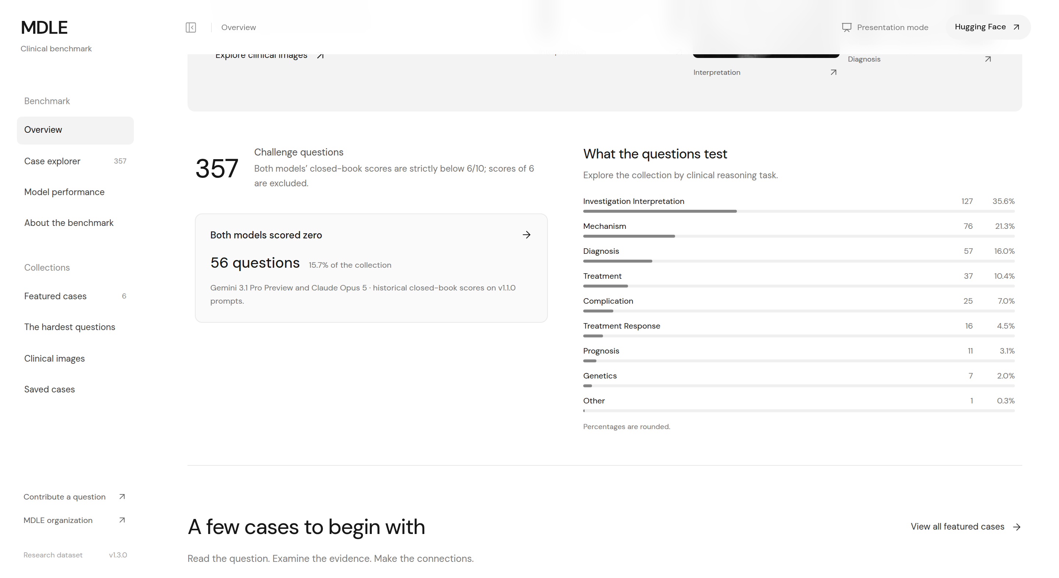

Medical Doctor’s Last Exam
MEDICAL
DOCTOR’S
LAST EXAM
A living benchmark, built through community contributions
EXPLORE THE BENCHMARK
CONTRIBUTE A QUESTION
Questions, evidence, reference answers and rubrics.
Submit a question, answer, reasoning and images.
preview.medlastexam.org
medlastexam.org
Sign-in required
MEDICAL EXPERT
COMMITTEE
20 experts, including 15 chief physicians,
review questions for clinical accuracy and relevance.
HUGGING FACE DATASET
Medical-Doctors-Last-Exam/mdle
Questions · Answers · Reasoning · Rubrics
A living benchmark for next-generation medical AI
Live public pages verified 5 October 2026.
Notes:
Independent MDLE public pages verified 5 October 2026. Explorer: https://preview.medlastexam.org/preview/ . Contribution: https://www.medlastexam.org . Dataset: https://huggingface.co/datasets/Medical-Doctors-Last-Exam/mdle . Fresh screenshots were generated from live public pages by CLI. No dataset questions, clinical images, rubrics or historical scores were changed.

Slide 12
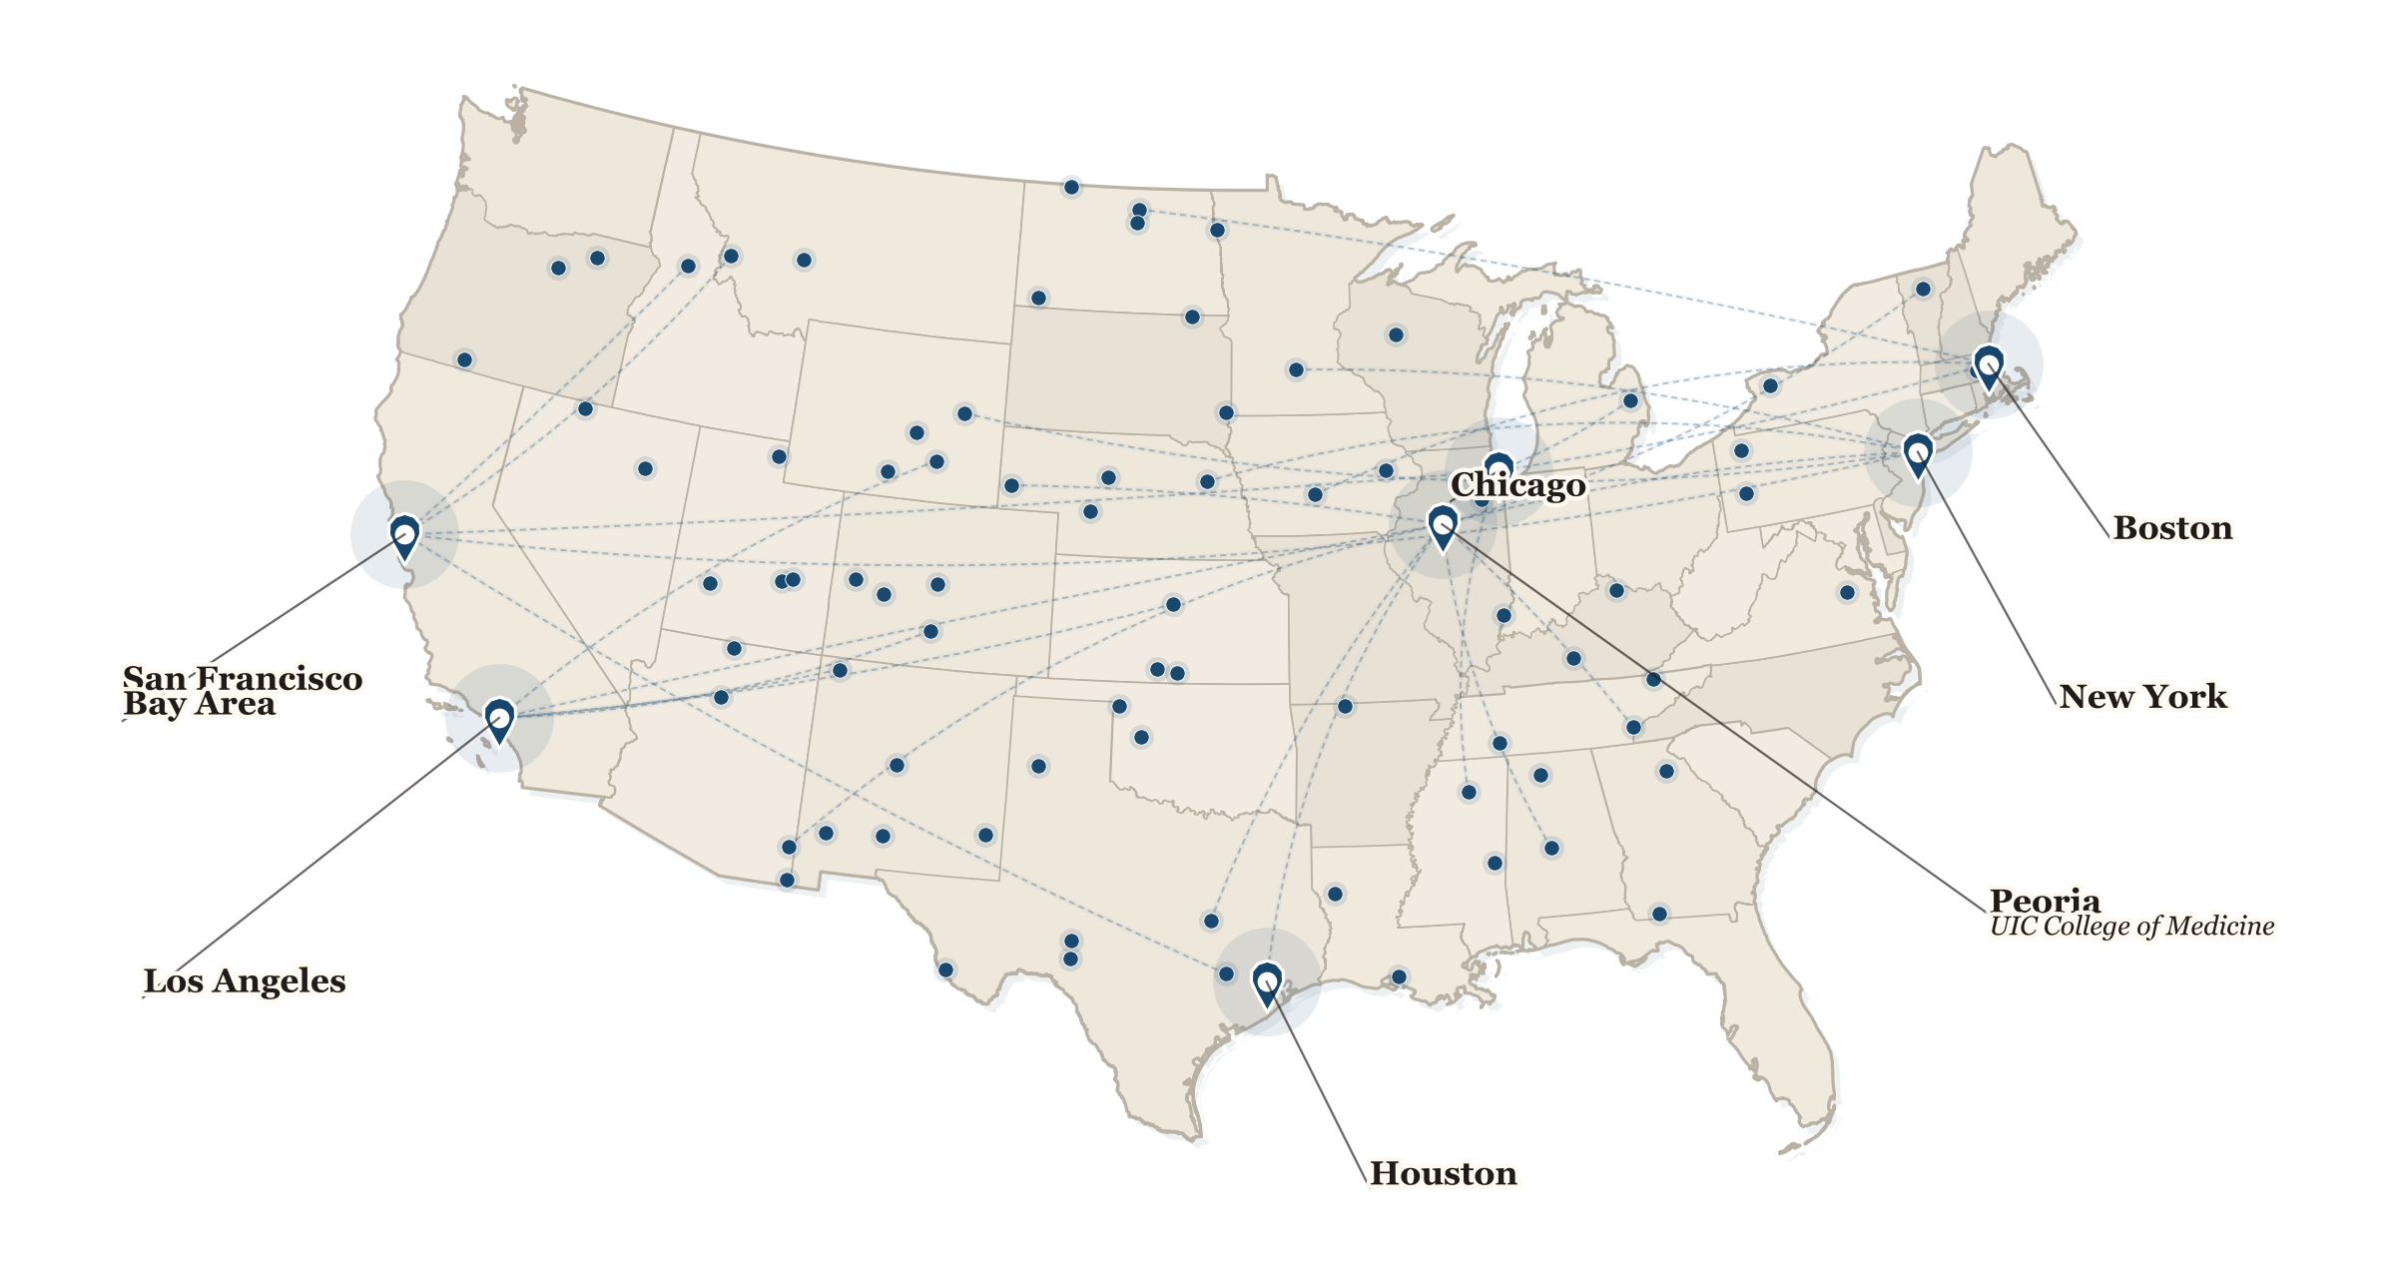









A Broad Medical Expert Network
MEDICAL
DOCTOR’S
LAST EXAM
Deep collaboration across institutions, regions, and expert communities
U.S. collaboration footprint
A Large Expert Community
300+
PhD students
200+
medical experts
Including
200+ medically trained reviewers
who audit benchmark questions.
Experts review, audit, and refine
benchmark questions for quality,
accuracy, and clinical relevance.
Large multidisciplinary participation
across hospitals, universities, and
research groups.
Extensive institutional coverage
Nationwide clinical collaboration
Clinical domain experts
Academic collaboration
Multi-institutional review
Living benchmark community
Real-world medical expertise
Universities and research centers
Rigorous quality assurance
Continuously strengthened
A living benchmark for next-generation medical AI

Slide 13
Medical Doctor’s Last Exam
MEDICAL
DOCTOR’S
LAST EXAM
Independent MDLE stewardship and licensing
Original annotations, software, and third-party clinical sources
Organization and Licensing
Medical Doctor’s Last Exam
https://huggingface.co/Medical-Doctors-Last-Exam
Independent MDLE organization
Original questions and annotations
CC BY 4.0
Questions, answers, reasoning and rubrics, where the necessary rights are held or granted.
Project-owned source code
Apache License 2.0
Software is licensed separately; third-party dependencies keep their licenses.
Article text and clinical images
Original source licenses
Preserve author and publisher terms, attribution, license links and notices of changes.
Repository: Medical-Doctors-Last-Exam/mdle
Release review: verify contributor grants and source/image reuse rights.
A living benchmark for next-generation medical AI
Notes:
Independent MDLE organization: https://huggingface.co/Medical-Doctors-Last-Exam . Administrator: the MDLE organization. English dataset transferred to https://huggingface.co/datasets/Medical-Doctors-Last-Exam/mdle on 5 October 2026, preserving data and existing version tags. Original questions and project-authored annotations: CC BY 4.0 where the necessary rights are held or granted. Project-owned code: Apache License 2.0. Third-party articles and images: original licenses. This policy does not certify completed source-rights review.

Slide 14
Medical Doctor’s Last Exam
MEDICAL
DOCTOR’S
LAST EXAM
Project timeline and research plan
October 2026–March 2027 milestones are planned targets
Timeline
May-Aug, 2026
Hiring Advisory Committee Member
Aug 28, 2026
New Website Beta Version Release
Sep 4, 2026
Inner testing with CS/Health PhD Students in UIUC and Collaborators
Sep 11, 2026
Release the website to public for data collection and outreach
Oct 2026
Validate the benchmark and target an initial arXiv submission.
Nov–Dec 2026
Collect and review questions; improve the live submission website.
Jan–Mar 2027
Expand the collection, rerun the model panel and release updates.
Long term
Build capacity for expert annotation and model evaluation.
A living benchmark for next-generation medical AI
Notes:
Timeline updated 5 October 2026. May–September dates summarize the earlier project schedule. The current frozen challenge set has 357 questions and 235 image crops. AWS website and image submission were verified on 4 October; the English dataset was transferred to Medical-Doctors-Last-Exam/mdle on 5 October. October 2026–March 2027 phases are planned targets, conditional on review capacity and access to the stated model panel. No preprint submission is claimed as completed. The timeline is the last slide.

