Slide 1
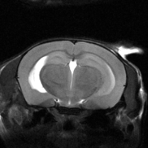
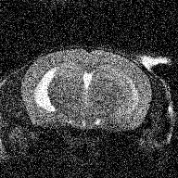
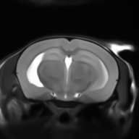

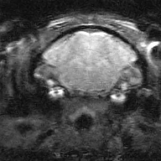


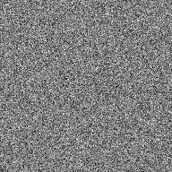


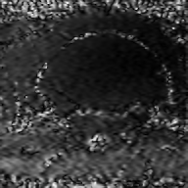
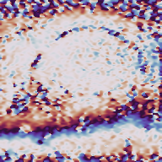
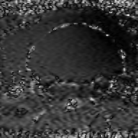
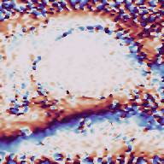
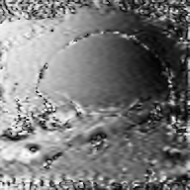
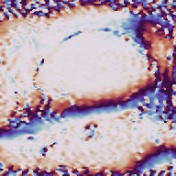

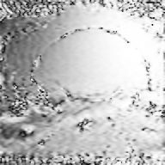
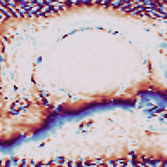









SPEN Diffusion Reconstruction
(a) Training the magnitude prior
Unconditional EDM training
Clean magnitude MRI
Noisy image
D_{θ}(x_{σ}, σ)
Denoised estimate
x₀
x_{σ}
D_{θ}(x_{σ}, σ)
Add Gaussian noise
Loss
(to clean target)
x_{σ} = x₀ + σ ε
ℒ = E[ w(σ) ‖D_{θ}(x_{σ}, σ) − x₀‖² ]
U-Net
Freeze trained weights
(b) Physics-constrained sampling
Measured SPEN data y
(multi-coil, complex)
Calibration from measurements
(not ground-truth maps)
Gaussian
initialization
Frozen denoiser
Clean estimate
Reconstruction
Magnitude
Phase
D_{θ}
x̂₀
x̂
Complex
coil images
|Ŝ_{c}|
∠Ŝ_{c}
Weighted
InvA
z_{c}
z_{c}
π
Data
consistency
Diffusion
update
PE (acquired rows)
Ŝ_{c} =
RSS(z)
…
0
(w†, adjoint)
…
−π
RO (after FFT)
Fixed complex coil fractions: coil + object phase
Repeat as σ decreases
After scanner phase correction
and RO FFT
Interpolate and normalize for finer grids
What the SPEN degradation operator does
Predicted complex
data
Optional
Experimental extension: phase refinement
m =
(x + 1)
× Ŝ_{c}
A_{PE}:
D_{RO}:
M:
+0.3
• Fit residual odd/even phase
from measured data
2
SPEN encoding
RO band limitation
acquired PE rows
Denoiser predicts
normalized real
magnitude x.
Nonnegative
magnitude m = (x + 1)/2.
Apply fixed
complex coil
fractions
(from measurements)
Retained rows
0
• Even rows: exp(iφ); odd rows: 1
Missing rows
Even PE × RO
−0.3
• Update phase during sampling;
prior stays frozen
|A_{PE}|
RO frequency
Residual φ [rad]
48 × 96
Same scanner
trajectory
Retain acquired
bandwidth
Full or undersampled PE
F_{c}(x)
F_{c}(x) = M D_{RO} A_{PE} [Ŝ_{c}
x + 1
]
F_{φ,c}(x) = M{ exp(iEφ) ⊙ D_{RO} A_{PE} [Ŝ_{c} m] }
2
Example: 192 × 192 image grid → 96 × 96 acquisition
E inserts phase on original even scanner rows BEFORE PE masking.
Key:
Blue: learned prior
Teal: fixed physics
Purple: phase / coil estimates
Orange: measurement consistency

