Slide 1
Credit Risk Assessment Hackathon
By
Vignesh

Slide 2
Dataset analysis & Preprocessing
No duplicates found
8 columns has NA values – imputed by Simple Imputer.
earliest_cr_line column contain month year value which we can extract a new feature column out of that by just considering only year and difference from the current year.
Dropped below columns as I thought those columns may not have any impact
'emp_title','addr_state', 'title', 'sub_grade’
Based on the Loan Status column value count in train dataset, 80% of data has Fully Paid loan status and 20 % has Charged Off, so we can try Over/Under sampling on the dataset.

Slide 3
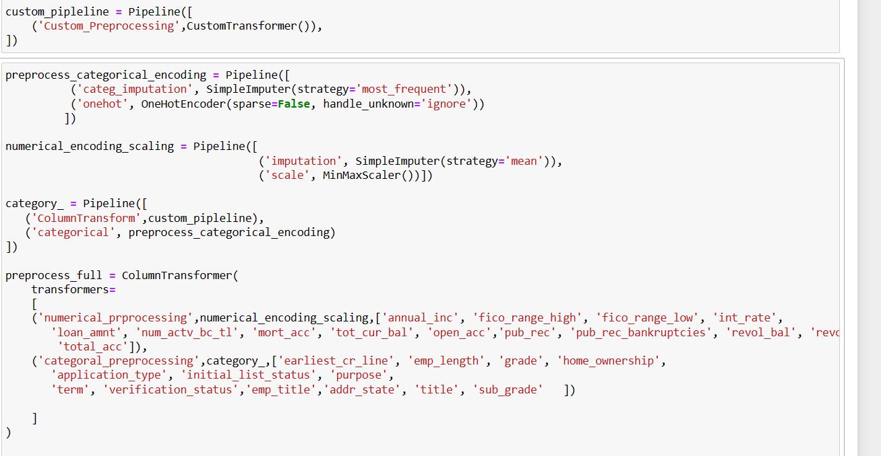
PIPELINE
Constructed below pipeline for accommodating Preprocessing, Modelling.

Slide 4
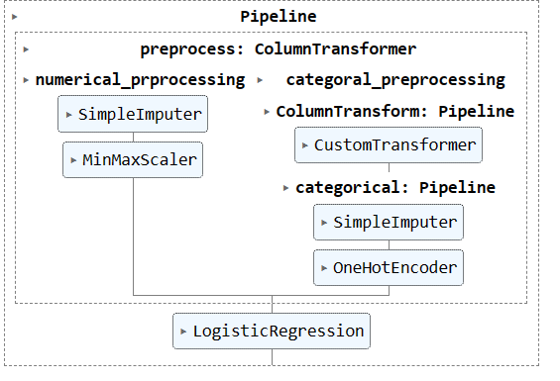
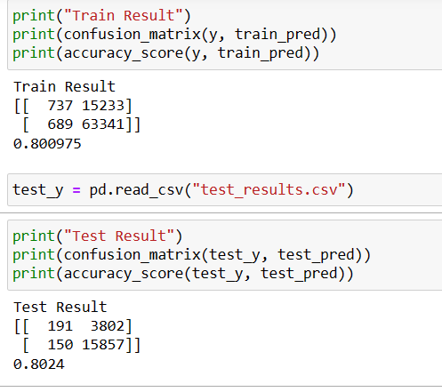
Logistic Regression Model Results

Slide 5
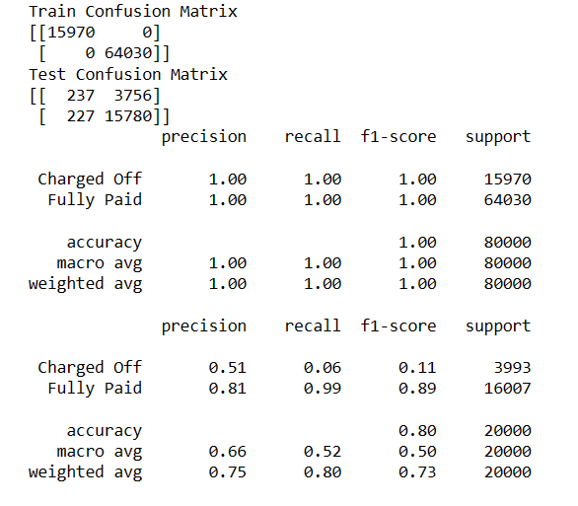
Random Forest model results

Slide 6
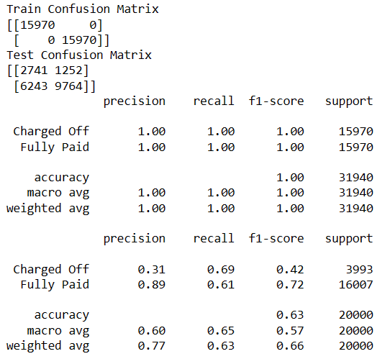
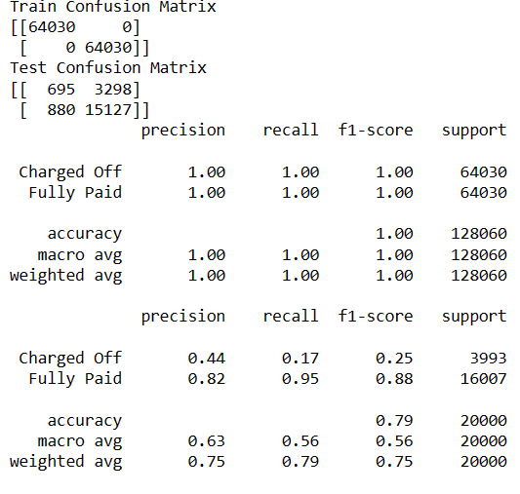
Sampling Results
With Under Sampling With Over Sampling

Slide 7
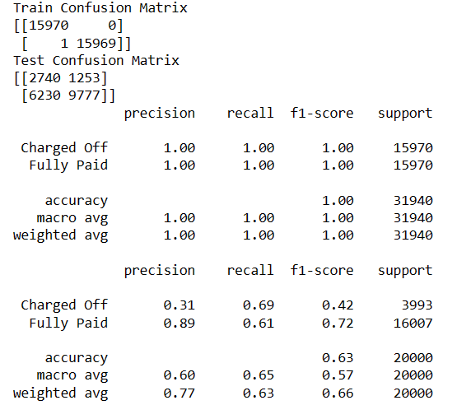
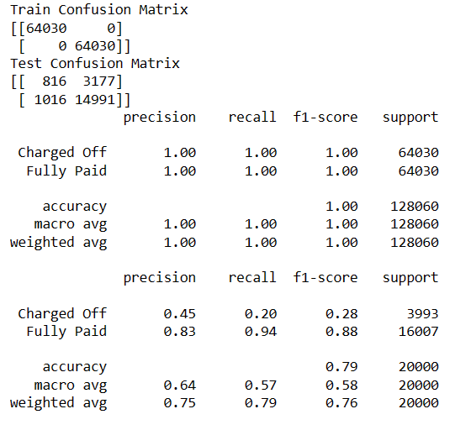
Polynomial with sampling results
With Under Sampling With Over Sampling

Slide 8
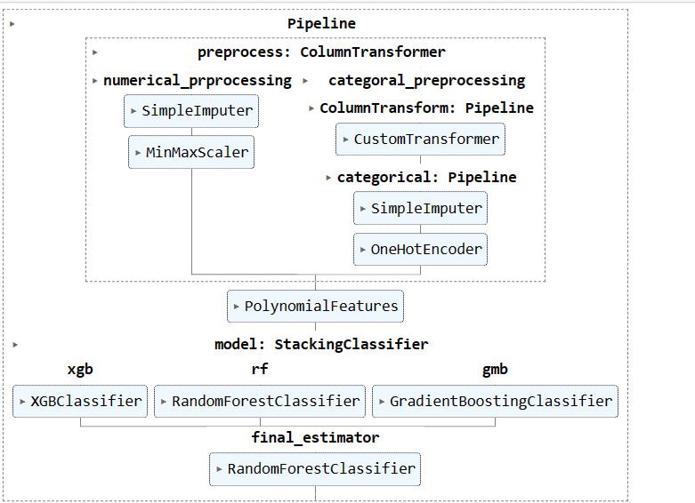
Boosting & Stacking
Used Xgb, Gradient boosting algorithm with Random Forest for Stacking.
Model running for long time..

