Slide 1
Kinematic Motion Diffusion
Towards Semantic-adaptive Motion Synthesis via Kinematic Guidance
Leizhi Li, Jincheng Yang, Yichao Zhong, Junxian Guo
12.25

Slide 2
Background
Diffusion Models
Classifier Guidance

Slide 3
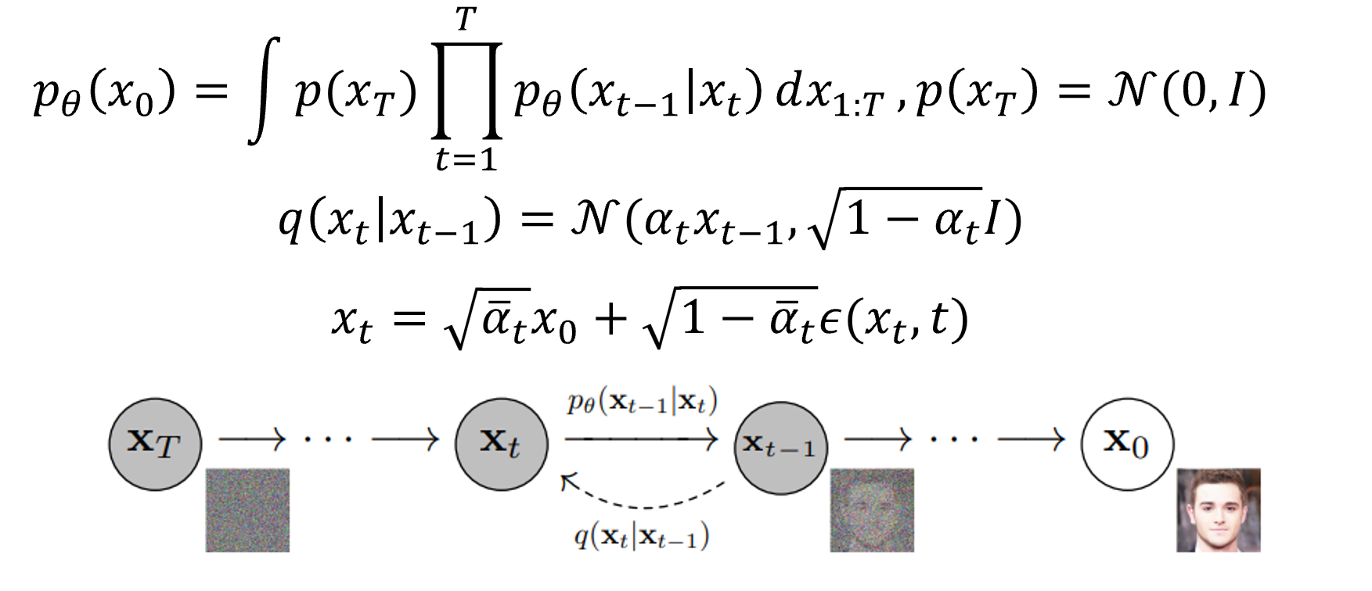
Background: Diffusion Models
DDPM
The most basic diffusion model
x0 to xT: diffusion process q
xT to x0: denoising process p

Slide 4
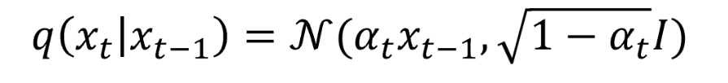
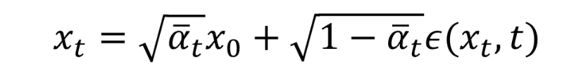
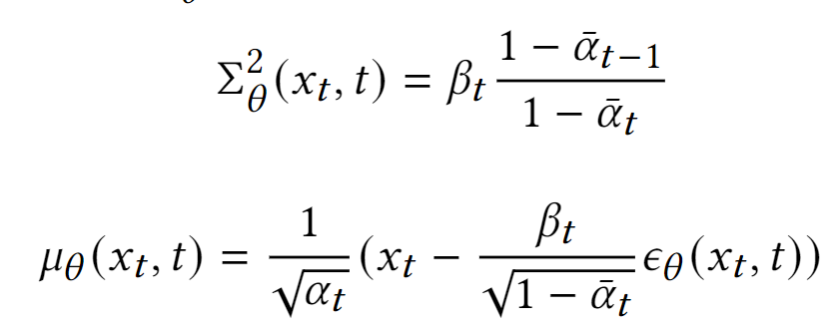
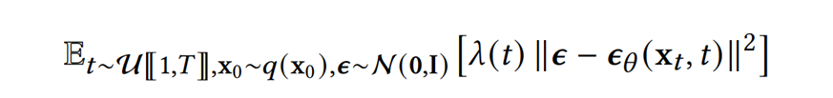
Background: Diffusion Models
DDPM
The most basic diffusion model
x0 to xT: diffusion process q
xT to x0: denoising process p
q:
p_theta:
Learn a noise network to estimate noise at step t with the loss:

Slide 5
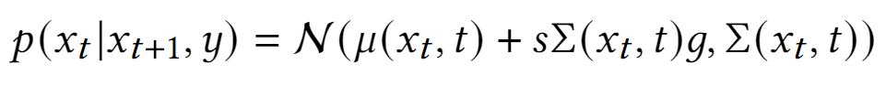

Background: Classifier Guidance
Makes the diffusion model controllable with label condition
An extra classifier (independent with diffusion model) needed
No need for retraining
The only change is the guidance term
where g refers to:
s refers to the gradient scale
Tips: classifier can be a deterministic function, rather than a trained network.

Slide 6
Related Works
Guided Motion Diffusion
Kinematic Phrases

Slide 7
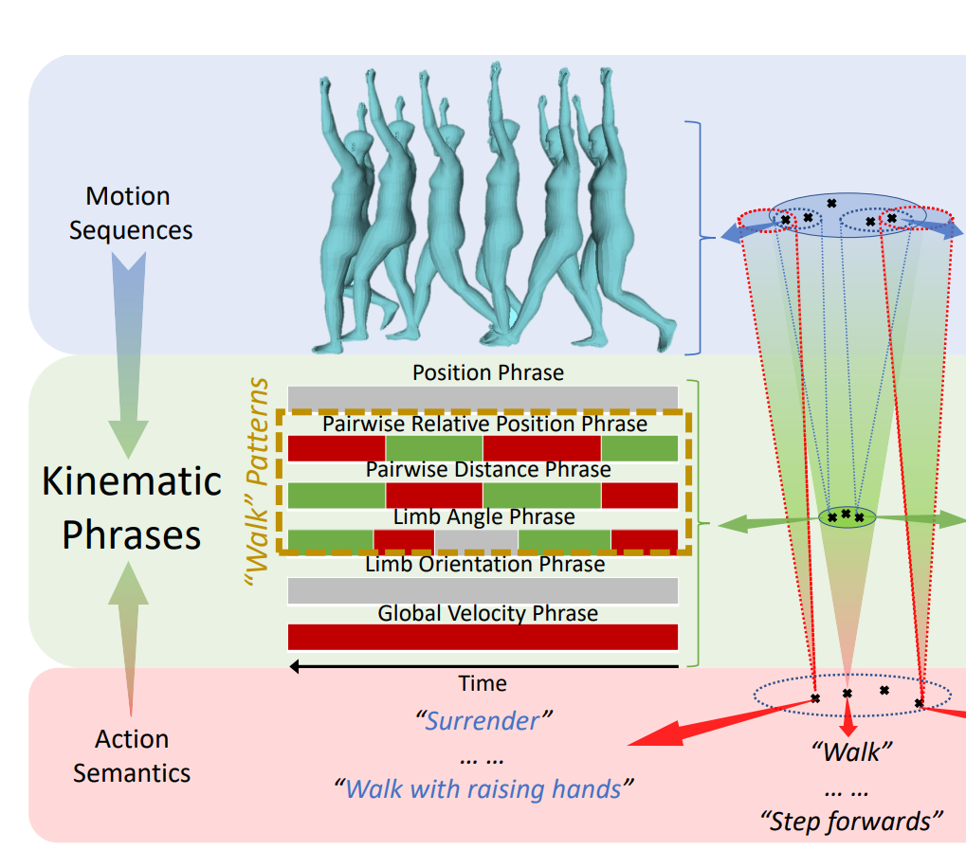
Related Work: Kinematic Phrases (KP)
An intermediate representation
which bridges the gap between
human actions and action semantics.
Input: motion sequences (L,J,3)
Output: N*scores (L,N,1)
Every score has its semantic meanings.
In one of our methods,
we build our classifier based on KPs.

Slide 8
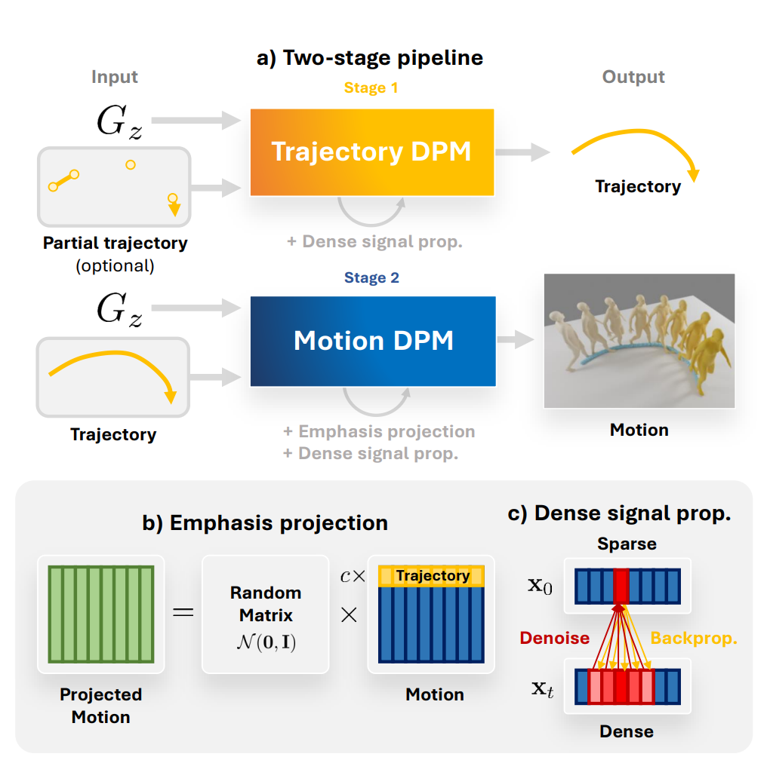
Related Work: Guided Motion Diffusion (GMD)
A Text-to-Motion model with partial trajectory information provided.
Their main contributions:
Emphasis projection
Dense signal propagation

Slide 9
Motivation
Previous motion synthesis lack universal quantitative objectives to evaluate the synthesised motions and mainstream practice relies on real human feedback to support proper assessment.
Traditional multimodal generation paradigm introduced by Latent Diffusion requires directly concating multimodal information. This appoach struggles to cross the domain gap in motion and language.
GMD focus more on industrial applicational pipeline when the main contribution and innovation focus on how to better use trajectory and key frame information but not semantic compatibility

Slide 10
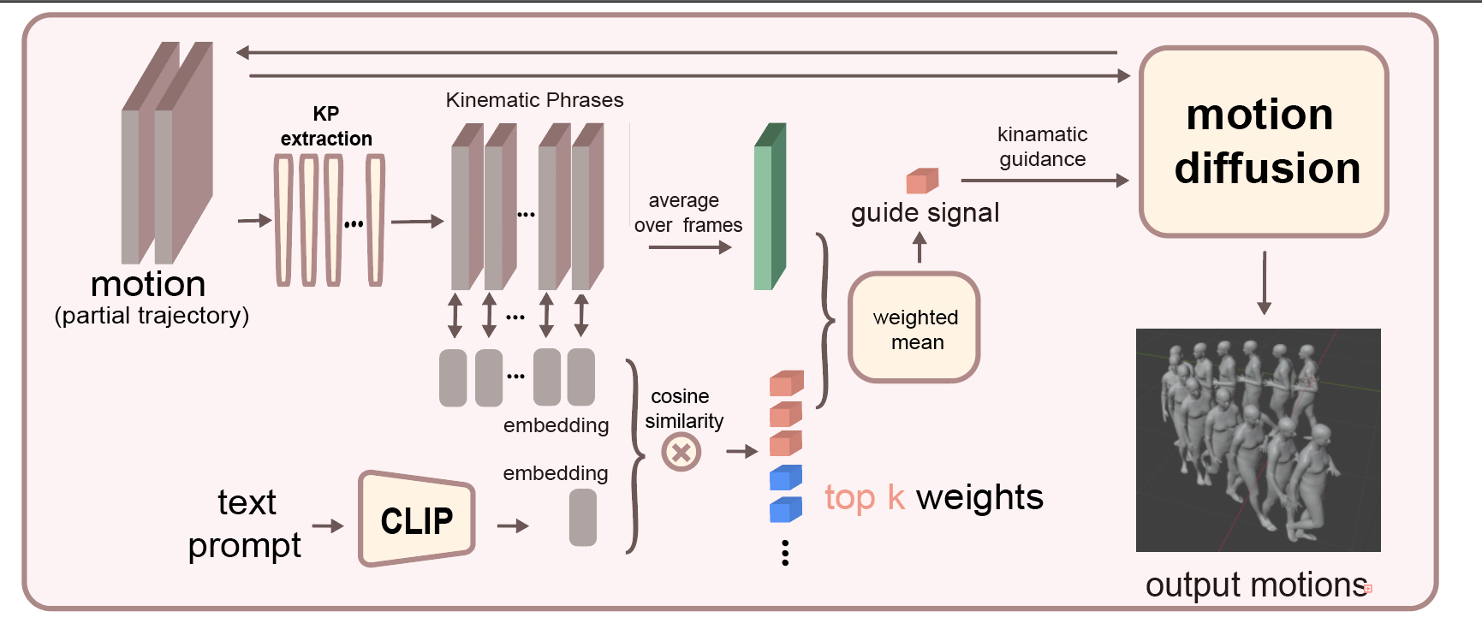
Methods: Overview

Slide 11
Methods: Kinematic Classifier

Slide 12
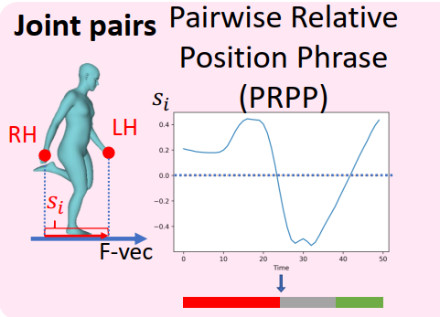
Methods: Kinematic Classifier
A typical Kinematic Phrase:

Slide 13
Methods: Kinematic Classifier
A typical Kinematic Phrase:
a sequence of indicator value of certain portray in skeleton movement

Slide 14
Methods: Kinematic Classifier
A typical Kinematic Phrase:
a sequence of indicator value of certain portray in skeleton movement
average over time
dense kinematic signal

Slide 15
Methods: Kinematic Classifier
A typical Kinematic Phrase:
a sequence of indicator value of certain portray in skeleton movement
average over time
dense kinematic signal
Goal: activate classifier based on scenerio

Slide 16
Methods: Semantic Adaptive Activation

Slide 17
Methods: Semantic Adaptive Activation
trainable embedding
KP item
similarity
rank
selectively
activated classifiers
top-k
CLIP
+MLP
scenerio semantic
text input

Slide 18
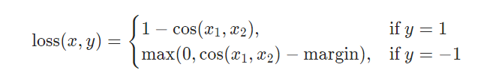
Methods: Semantic Adaptive Activation
trainable embedding
KP item
similarity
rank
selectively
activated classifiers
top-k
CLIP
+MLP
scenerio semantic
text input

Slide 19
Experiment Settings
Dataset
HumanML3D, specially processed to change the representation of the root joint from relative to absolute
Metric
Frechet Inception Distance (FID), measures the distance between the distributions of ground truth and generated motion using a pretrained t2m encoder.
R-Precision, evaluates the relevance of the generated motion and its text prompt.
Diversity, measures the variability within the generated motion.
Trainning Resources
Trainning and evaluating on a single RTX 3080 Ti GPU

Slide 20
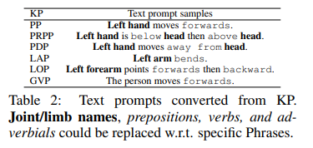
Experiment Settings
Task: single-stage text to motion generation
single-stage: text -> motion conditioned on text
two-stages: text -> trajectory -> motion conditioned on that trajectory
Our experiment majorly explored two approaches
Approach I: non-trainable, directly employ KPG_prompts, CLIP w/o MLP
Approach II: trainable, learned embeddings, CLIP w/ MLP

Slide 21
Approach I: Non-trainable
Examples of KPG_prompts (rich in semantic context)
the person moves forwards
left wrist moves towards right knee
left wrist is below right knee, then above right knee
left arm unbends
Pipeline
CLIP
non-trainable embedding
KPG prompt
similarity
rank
selectively
activated classifiers
top-k
CLIP
scenerio semantic
text input

Slide 22
Observation
Text embedding is concentrated.
e.g. for prompt “a man walks backwards”
KPG prompt | cosine similarity
left hand moves forwards | 0.9189453125
left hand is below head then above head | 0.890380859375
left hand moves away from head | 0.89892578125
left arm bends | 0.9033203125
the person moves forwards | 0.92041015625
the person moves backwards | 0.9306640625

Slide 23
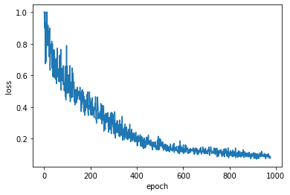
Approach II: trainable
Implementation Details
each embedding is a tensor of size 512
a three layer MLP for CLIP fine-tuning
a Cosine Emsemble Loss is employed
k=10, top 10 is selected

Slide 24
Result
 | FID↓ | R-precision↑ (top3) | Diversity→
Ground Truth | 0.002 | 0.797 | 9.503
T2M (2022) | 1.067 | 0.740 | 9.188
MDM (2022) | 0.556 | 0.608 | 9.446
GMD (2023) | 0.212 | 0.670 | 9.440
Ours | 0.320 | 0.749 | 9.423
Frechet Inception Distance (FID), measures the distance between the distributions of ground truth and generated motion using a pretrained t2m encoder.
R-Precision (top 3), evaluates the relevance of the generated motion and its text prompt.
Diversity, measures the variability within the generated motion.

Slide 25
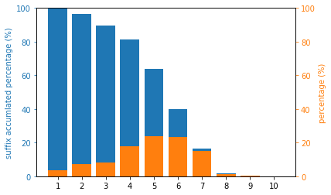
Evaluation: Inspect into text and motion alignment
randomly sample 500 data from GT, count the number part of KP items with top 10 scores in both motion and semantic

Slide 26
Ablation study
top 10 / top 50 / top 100
full set of KP / subset of KP
research into ensemble strategy

Slide 27
Visualization
First, we use guided-motion-diffusion(GMD) generate the .npy file containing the information of all the key points of body
Then, we render SMPL mesh using the SMPLify and generate the .obj files for each frame
Finally, we use blender to help visualize the body movement

Slide 28
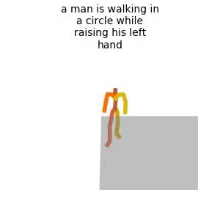
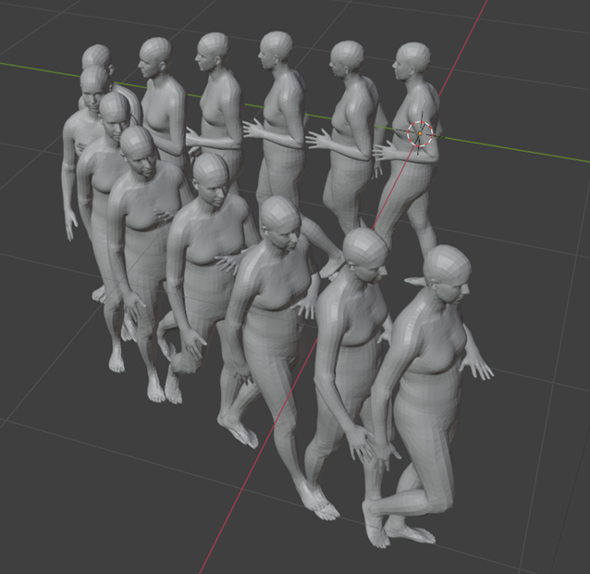
Visualization: demo

Slide 29
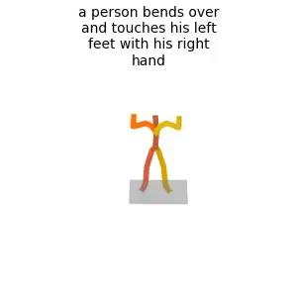
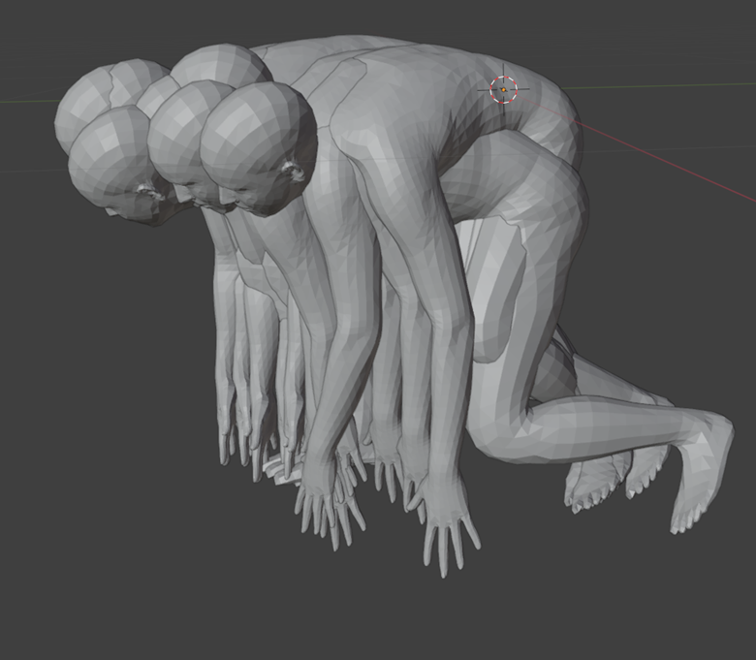
Visualization: demo

Slide 30
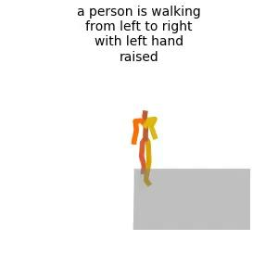
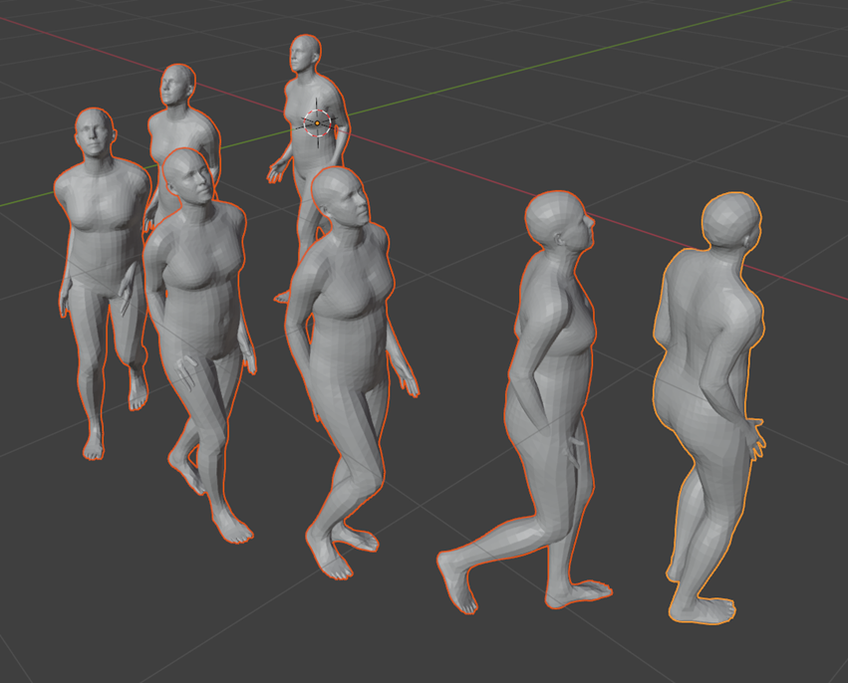
Visualization: demo

Slide 31
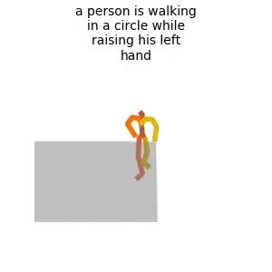
Examples: comparison
Ours
GMD

Slide 32
Conclusion
We introduce kinematic prior into traditional motion diffusion by establishing multiple classifier based on Kinematic Phrases. By utilize its high level of abstraction and characterization on human motions, we manage to establish motion generation on ground of human knowledge and understanding.
We propose semantic adaptive dictionary methods which dynamically adjust our classifier compound to better accommodate diverse motion generation scenarios. This new way of semantic infusion is the first to be used in human motion generation field, bypassing the domain gap between the motion and language.

Slide 33
Thank you for listening!

