Slide 1
VALIUM

Slide 2
Contents
About us
Idea
Technologies
Implementation
Demo

Slide 3
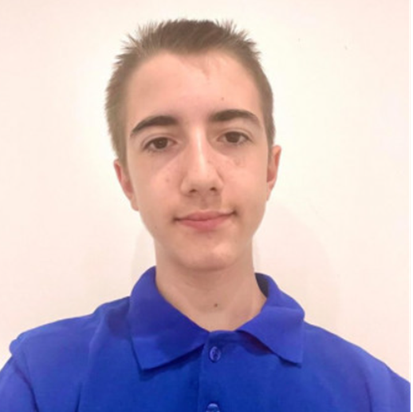
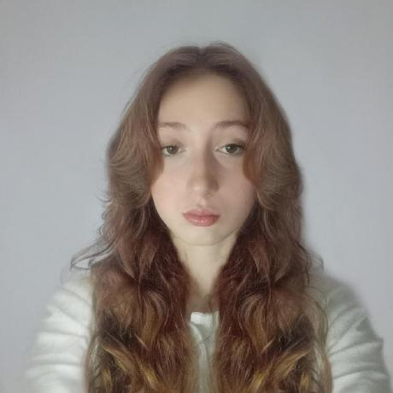
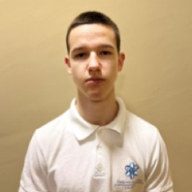
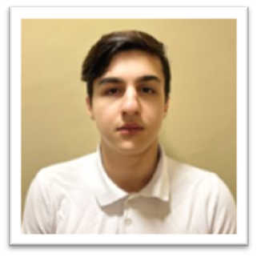
About us
Stelian Mikov
Maria Koleva
Scrum trainer
Frontend developer
Ivelin Bozhilov
Ivan Stoychev
Designer
Backend developer

Slide 4
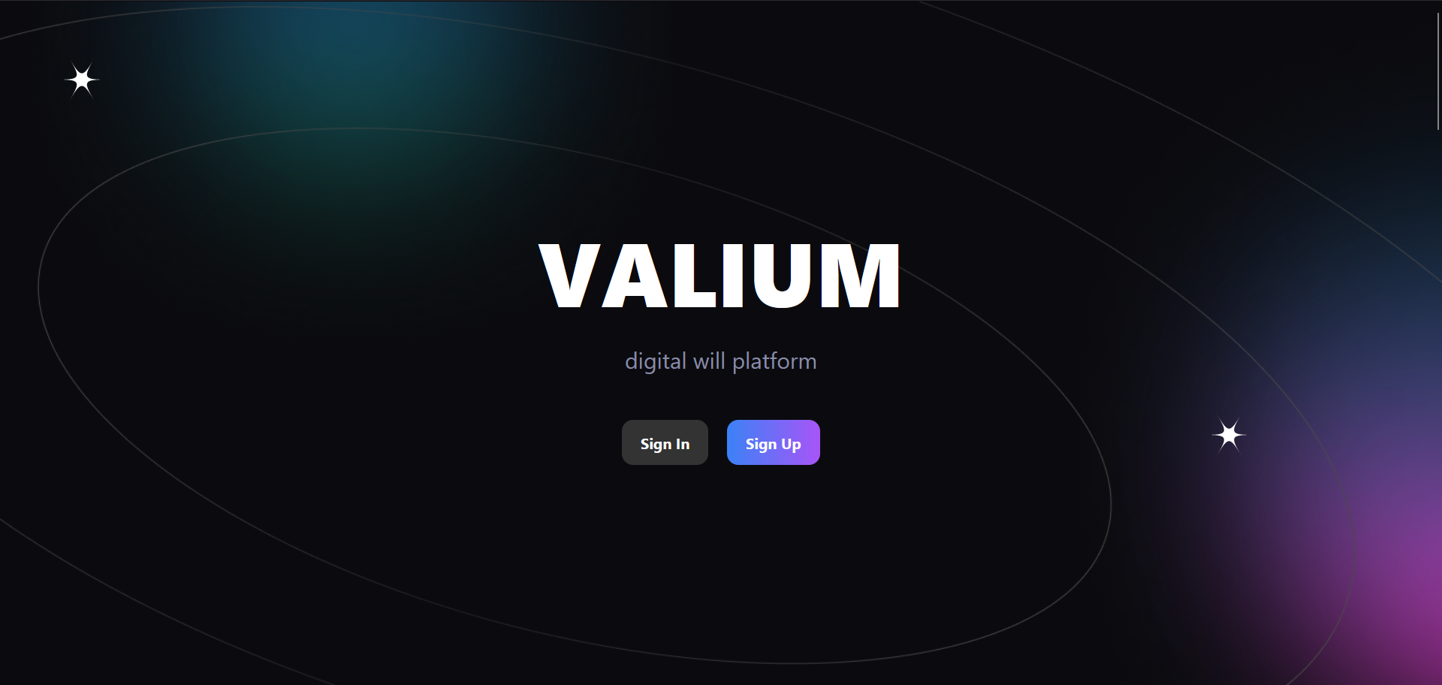
Our idea
It is digital will site where you can bequeath your digital assets to your loved ones and ensure your legacy.

Slide 5











Technologies

Slide 6
Now let’s check out a quick demo

