Slide 1
Statistical Analysis of Time series
Residual analysis.
Moving Average Filtering to Time Series Analysis.
Linear regression analysis of time series;
Review of the features of robust statistics;
Features of adaptive regression models.

Slide 2
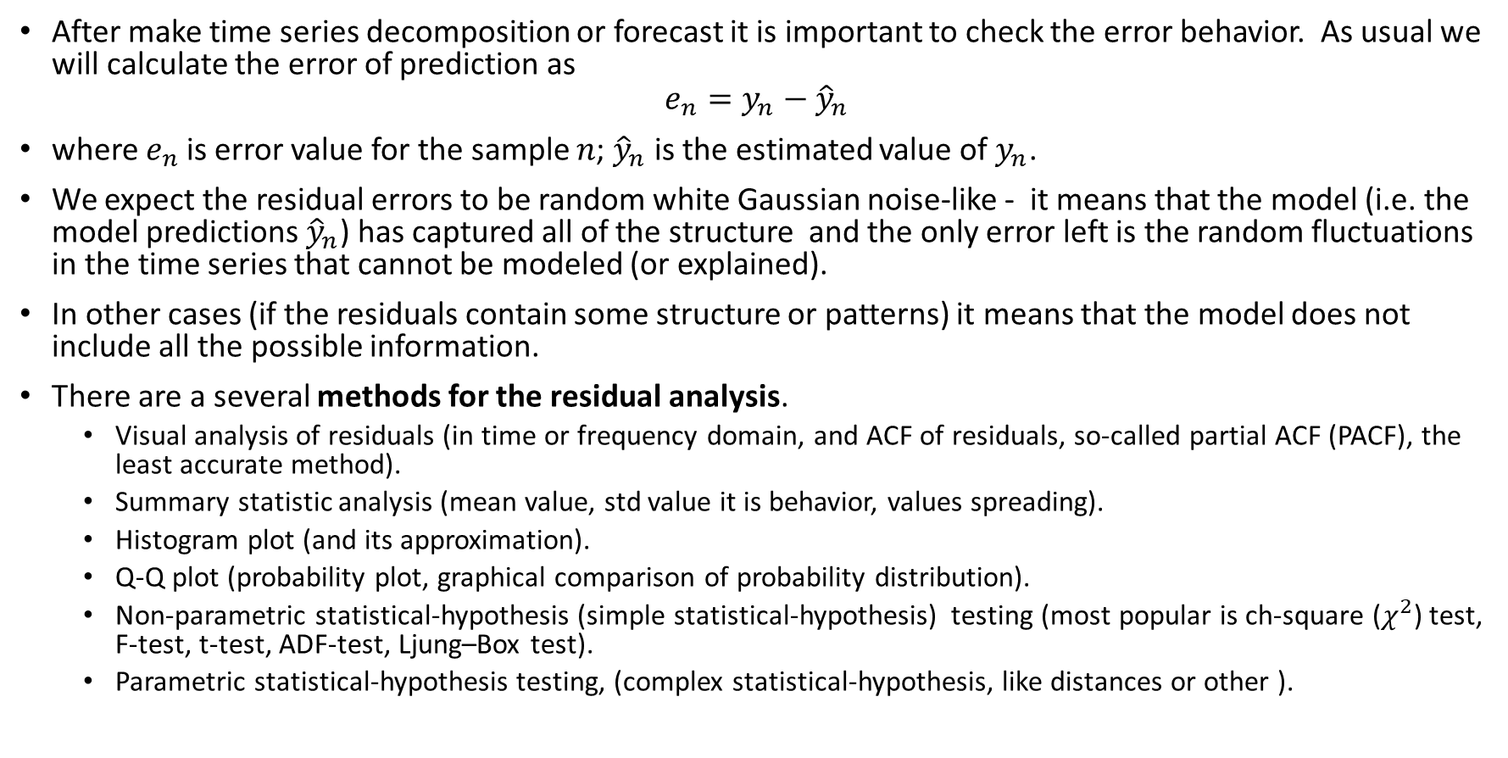
Residual analysis
After make time series decomposition or forecast it is important to check the error behavior. As usual we will calculate the error of prediction as
$$e_{n}=y_{n}−{\hat{y}}_{n}$$
where $e_{n}$ is error value for the sample $n$; ${\hat{y}}_{n}$ is the estimated value of $y_{n}$.
We expect the residual errors to be random white Gaussian noise-like - it means that the model (i.e. the model predictions ${\hat{y}}_{n}$) has captured all of the structure and the only error left is the random fluctuations in the time series that cannot be modeled (or explained).
In other cases (if the residuals contain some structure or patterns) it means that the model does not include all the possible information.
There are a several methods for the residual analysis.
Visual analysis of residuals (in time or frequency domain, and ACF of residuals, so-called partial ACF (PACF), the least accurate method).
Summary statistic analysis (mean value, std value it is behavior, values spreading).
Histogram plot (and its approximation).
Q-Q plot (probability plot, graphical comparison of probability distribution).
Non-parametric statistical-hypothesis (simple statistical-hypothesis) testing (most popular is ch-square ($χ^{2}$) test, F-test, t-test, ADF-test, Ljung–Box test).
Parametric statistical-hypothesis testing, (complex statistical-hypothesis, like distances or other ).

Slide 3
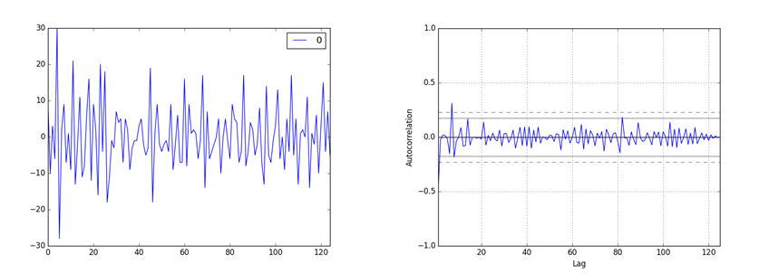
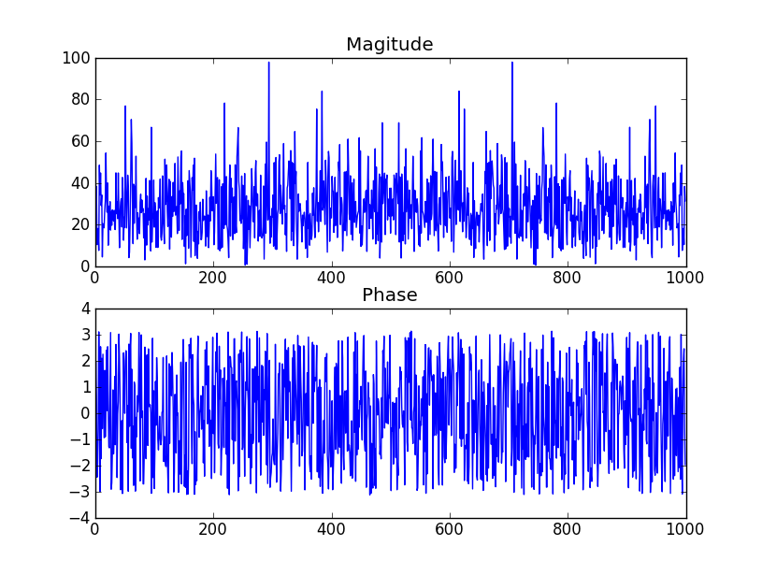
Residual analysis. ACF
The example of the time series forecast residuals.
Here can be checking the presence of the trend, cyclic or seasonal component.
Here is the example of
summary statistic
for the shown graphic
count 125 mean 0.064000 std 9.187776 min -28.000000 25% -6.000000 50% -1.000000 75% 5.000000 max 30.000000
There are the following conclusions are possible.
Mean error value close to zero, but perhaps not close enough (actually we can not say weather it is due to small sample size or by the bias of series or presence of valuable component).
The non-symmetric min and max values also approve some abnormal behavior.
The std in almost 3 times smaller then min value it is normal.

Slide 4
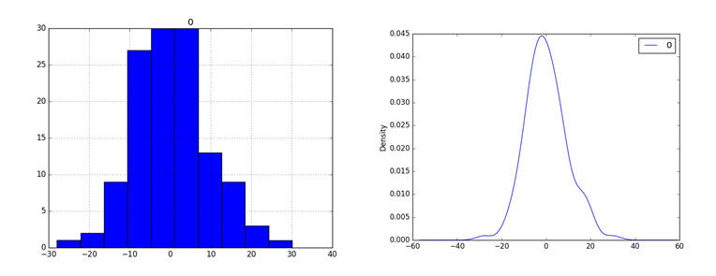
Residual analysis. histogram
Here are the histogram and its normalized approximation are shown. We can see some bias of mean value and presence of skewness (3-rd order statistical moment, some distribution asymmetry).
Orders higher then 3 mean that we can have some non-stationary behavior
The small skewness allow to suppose that some model improvement is required.
The large skewness allow to suppose that the other model is need to be checked or some pre-processing (log, square root of data) is necessary before forecast (or decomposition).

Slide 5
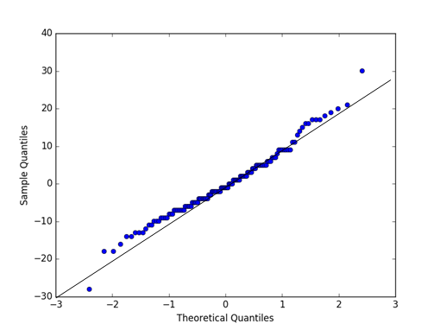
Residual analysis. Q-Q plot
A Q-Q plot, or quantile plot is the method for compares two distributions graphically.
The method can be use for visual estimation how similar or different distribution happen to be. In the residual analysis the obtained distribution values are ordered and compared to an idealized Gaussian distribution. The comparison is shown as a scatter plot (theoretical on the x-axis and observed on the y-axis) where a match between the two distributions is shown as a diagonal line from the bottom left to the top-right of the plot (with angle 45 degree 𝑦=𝑥y=x). The Q-Q plot can help to rapid show the departures from this expectation.

Slide 6
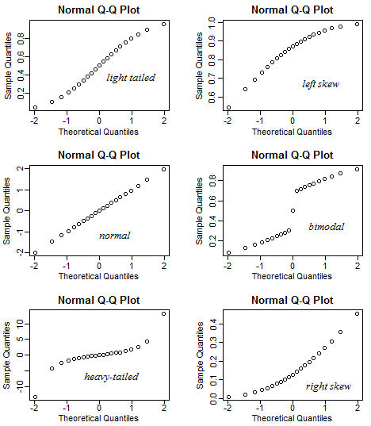
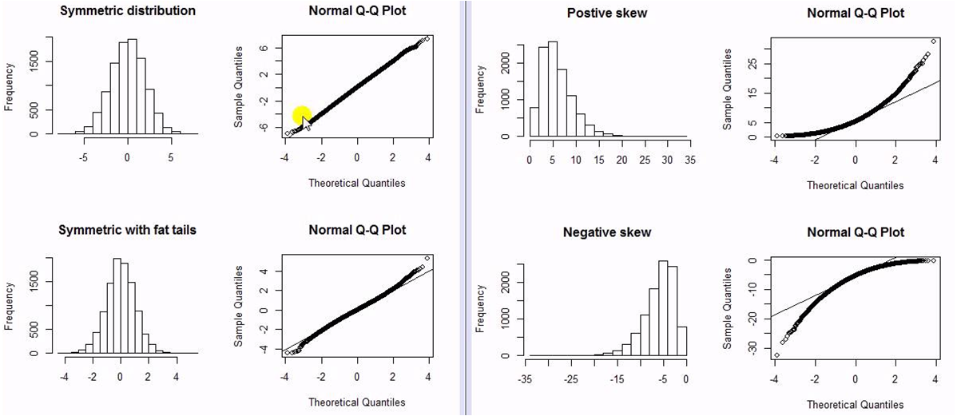
Residual analysis. Q-Q plot deviations

Slide 7
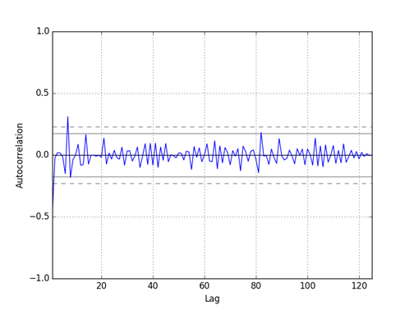
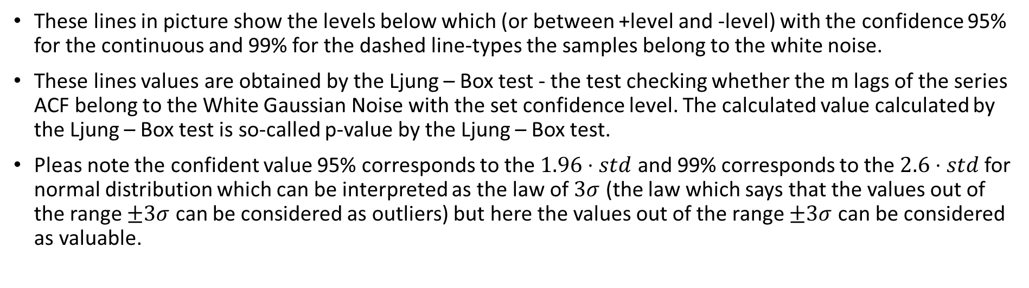
Residual analysis. non-parametric statistic
These lines in picture show the levels below which (or between +level and -level) with the confidence 95% for the continuous and 99% for the dashed line-types the samples belong to the white noise.
These lines values are obtained by the Ljung – Box test - the test checking whether the m lags of the series ACF belong to the White Gaussian Noise with the set confidence level. The calculated value calculated by the Ljung – Box test is so-called p-value by the Ljung – Box test.
Pleas note the confident value 95% corresponds to the $1.96⋅std$ and 99% corresponds to the $2.6⋅std$ for normal distribution which can be interpreted as the law of $3σ$ (the law which says that the values out of the range $±3σ$ can be considered as outliers) but here the values out of the range $±3σ$ can be considered as valuable.

Slide 8
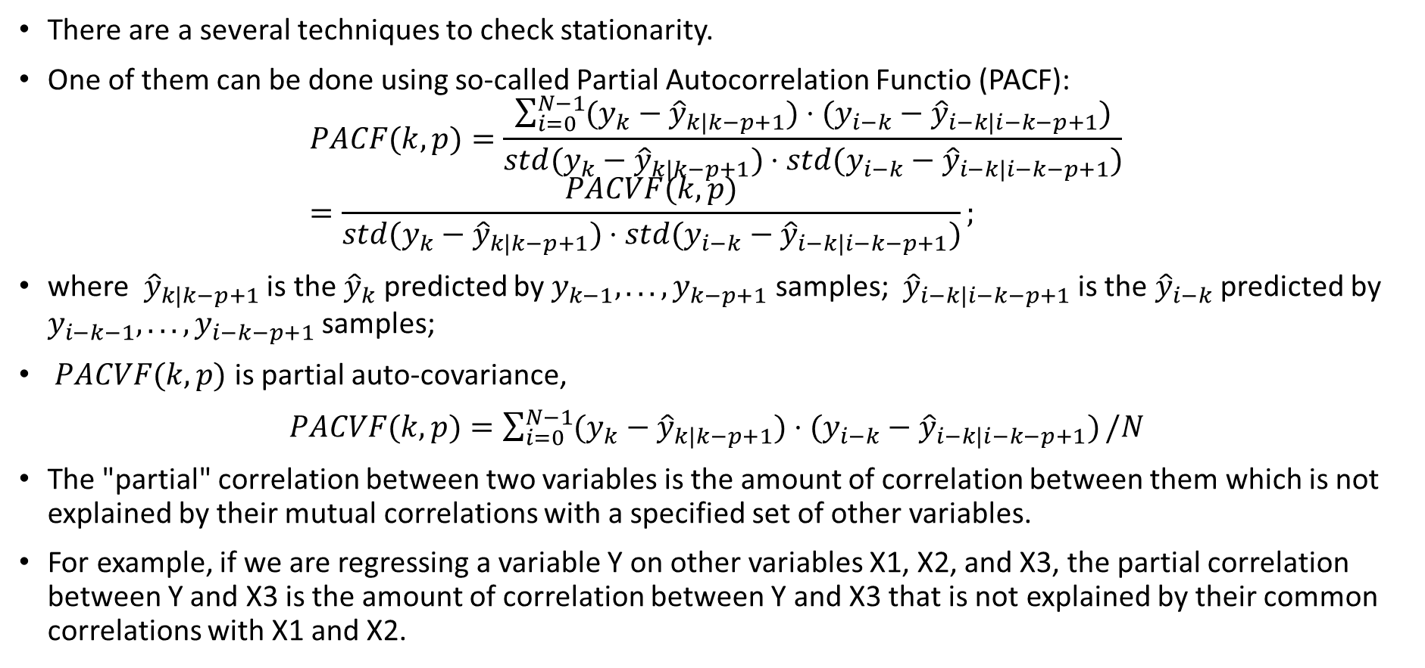
Residual analysis. Stationarity of residuals. PACF
There are a several techniques to check stationarity.
One of them can be done using so-called Partial Autocorrelation Functio (PACF):
$$PACF(k,p)=\frac{\sum_{i=0}^{N−1}{(y_{k}−{\hat{y}}_{k|k−p+1})⋅(y_{i−k}−{\hat{y}}_{i−k|i−k−p+1})}}{std(y_{k}−{\hat{y}}_{k|k−p+1})⋅std(y_{i−k}−{\hat{y}}_{i−k|i−k−p+1})}=\frac{PACVF(k,p)}{std(y_{k}−{\hat{y}}_{k|k−p+1})⋅std(y_{i−k}−{\hat{y}}_{i−k|i−k−p+1})};$$
where ${\hat{y}}_{k|k−p+1}$ is the ${\hat{y}}_{k}$ predicted by $y_{k−1},...,y_{k−p+1}$ samples; ${\hat{y}}_{i−k|i−k−p+1}$ is the ${\hat{y}}_{i−k}$ predicted by $y_{i−k−1},...,y_{i−k−p+1}$ samples;
$PACVF(k,p)$ is partial auto-covariance,
$PACVF(k,p)=\sum_{i=0}^{N−1}{(y_{k}−{\hat{y}}_{k|k−p+1})⋅(y_{i−k}−{\hat{y}}_{i−k|i−k−p+1})}/N$
The "partial" correlation between two variables is the amount of correlation between them which is not explained by their mutual correlations with a specified set of other variables.
For example, if we are regressing a variable Y on other variables X1, X2, and X3, the partial correlation between Y and X3 is the amount of correlation between Y and X3 that is not explained by their common correlations with X1 and X2.

Slide 9
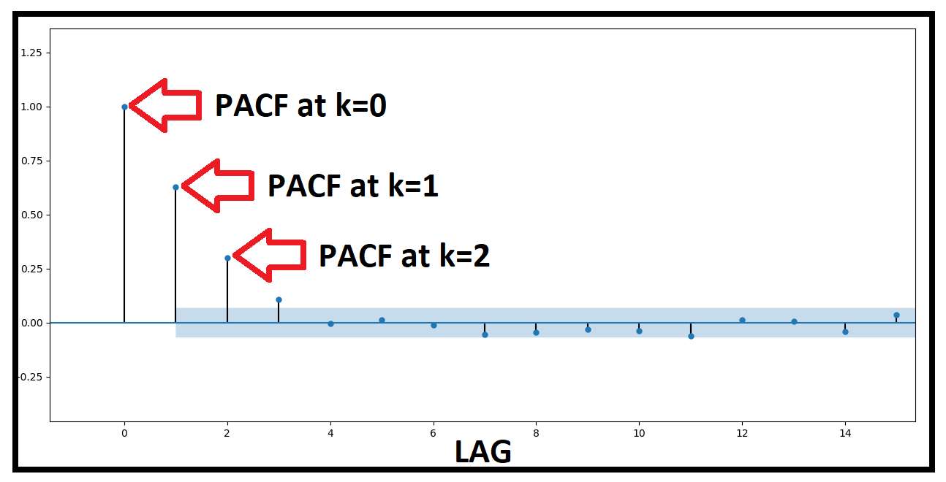
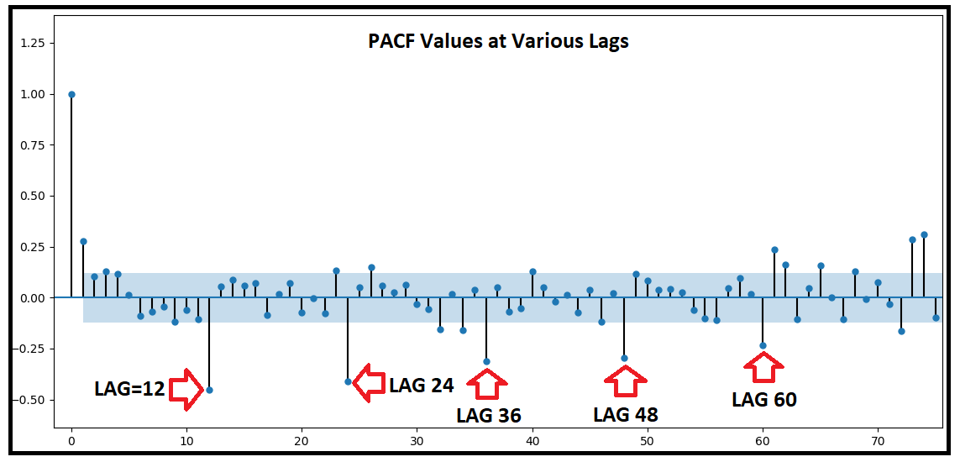

Residual analysis. Stationarity of residuals. PACF
There are a several techniques to check stationarity.
One of them can be done using so-called Partial Autocorrelation Function (PACF):
$$PACF(k,p)=\frac{\sum_{i=0}^{N−1}{(y_{k}−{\hat{y}}_{k|k−p+1})⋅(y_{i−k}−{\hat{y}}_{i−k|i−k−p+1})}}{std(y_{k}−{\hat{y}}_{k|k−p+1})⋅std(y_{i−k}−{\hat{y}}_{i−k|i−k−p+1})}=\frac{PACVF(k,p)}{std(y_{k}−{\hat{y}}_{k|k−p+1})⋅std(y_{i−k}−{\hat{y}}_{i−k|i−k−p+1})};$$
Example of stationary series PACF
Example of non-stationary series PACF

Slide 10
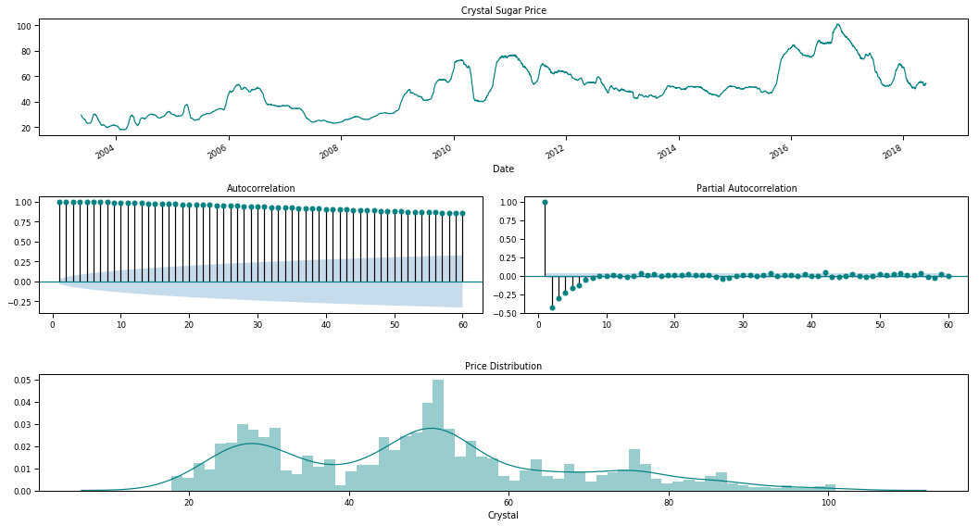
Residual analysis. Stationarity of residuals. Graphical method
The PACF can be used within ACF for stationary analysis and also will be applied further for other aims.
Example of Non-stationary case ACF and PACF

Slide 11
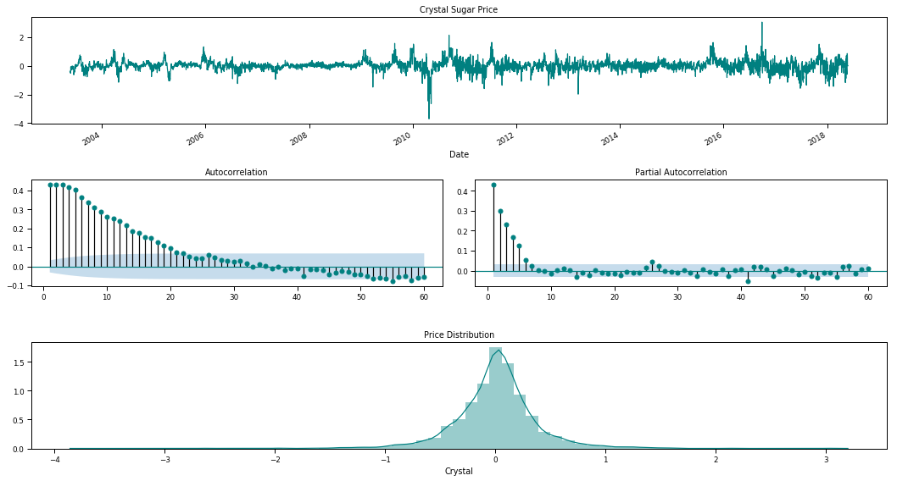
Residual analysis. Stationarity of residuals. Graphical method
The PACF can be used within ACF for stationary analysis and also will be applied further for other aims.
Example of Stationary case ACF and PACF

Slide 12
Smoothing

Slide 13
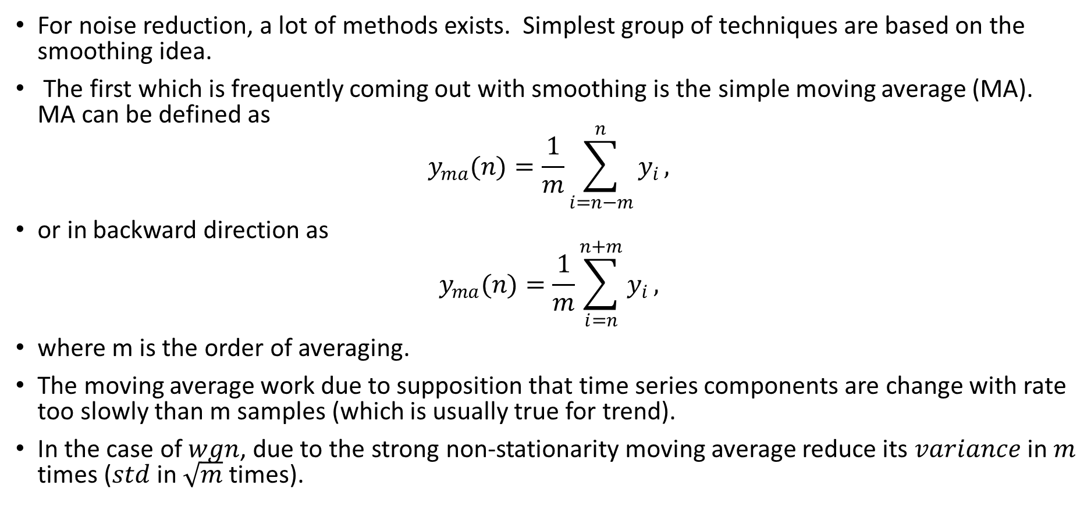
Smoothing. Moving average
For noise reduction, a lot of methods exists. Simplest group of techniques are based on the smoothing idea.
The first which is frequently coming out with smoothing is the simple moving average (MA). MA can be defined as
$$y_{ma}(n)=\frac{1}{m}\sum_{i=n−m}^{n}{y_{i}},$$
or in backward direction as
$$y_{ma}(n)=\frac{1}{m}\sum_{i=n}^{n+m}{y_{i}},$$
where m is the order of averaging.
The moving average work due to supposition that time series components are change with rate too slowly than m samples (which is usually true for trend).
In the case of $wgn$, due to the strong non-stationarity moving average reduce its $variance$ in $m$ times ($std$ in $\sqrt{m}$ times).

Slide 14
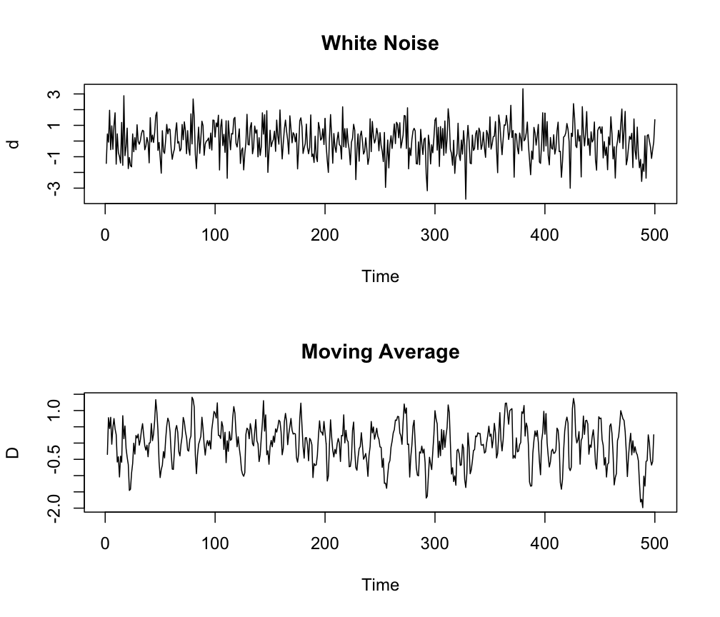

Smoothing. Weighted Moving average
If by some reasons we do not want to take uniformly all the samples in the averaging we may take a so-called weighted moving average (WMA) as:
$$y_{ma}(n)=\frac{1}{m}\sum_{i=n−m}^{n}{w_{i}}y_{i},$$
where $w_{i}$ is the set of weights such that $\sum_{i=0}^{m−1}{w_{i}}=1$.
Note Too big order of average can lead to the error in the trend or cyclic part prediction.

Slide 15
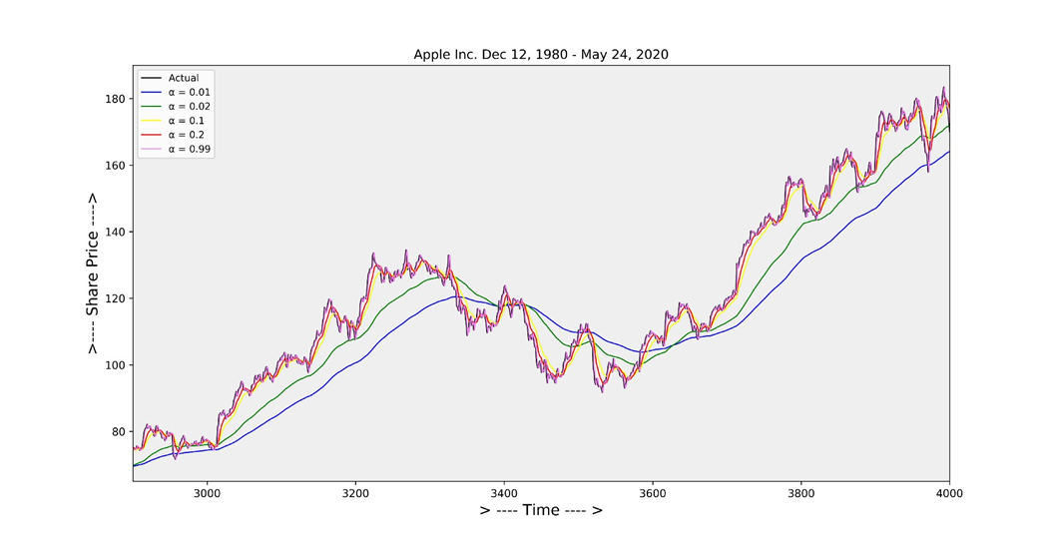

Smoothing. Exponential Smoothing
The next idea, to reduce the ma problem is to using the exponential smoothing. Single Exponential Smoothing, SES (or Single Exponential Moving Average, SEMA):
$${\hat{y}}_{0}=y_{0};$$
$${\hat{y}}_{n}=αy_{n}+(1−α){\hat{y}}_{n−1},$$
where $α$ is the smoothing parameter; $\hat{y}$ is forecast value.
Pleas note, that SEMA work well for data with zero level, however for complex series it is better to choose other methods.

Slide 16
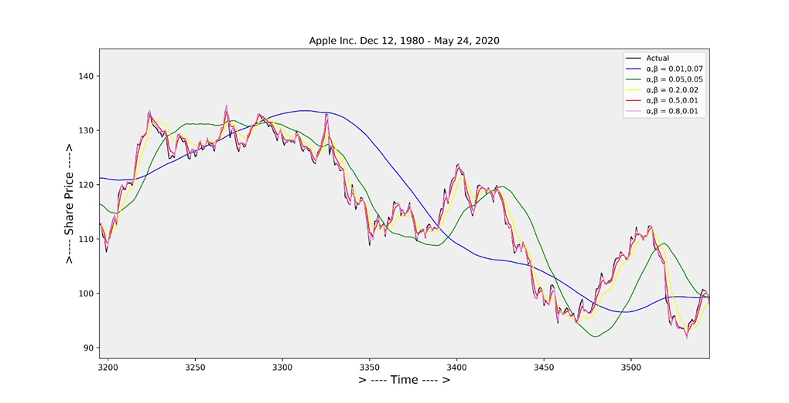

Smoothing. Double Exponential Smoothing
Double Exponential Smoothing, DES (or Double Exponential Moving Average, DEMA, Holt Model):
$$\begin{matrix} & b_{0}=y_{1}−y_{0};→trend \\ & \\ & l_{0}=y_{0};→level \\ & \\ & l_{n}=αy_{n}+(1−α)(l_{n−1}+b_{n−1}); \\ & \\ & b_{n}=β(l_{n}−l_{n−1})+(1−β)b_{n−1}; \\ & \\ & {\hat{y}}_{n+1}=l_{n}+b_{n}\end{matrix}$$
where $α,β$ are the smoothing parameters for level and for trend parts correspondingly.

Slide 17
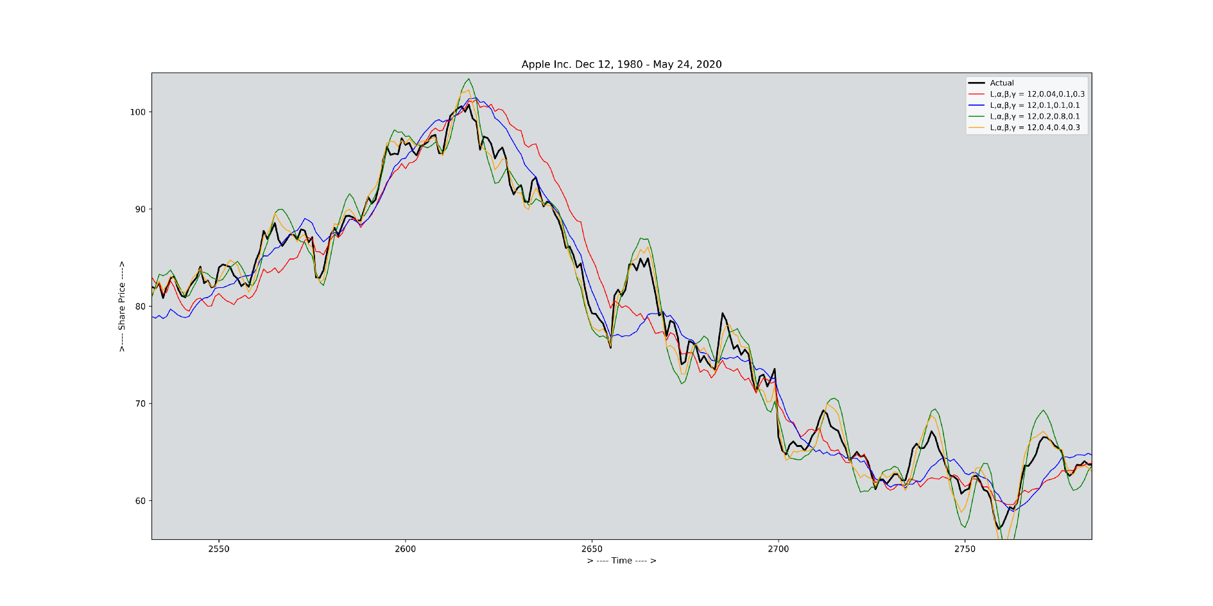

Smoothing. Triple Exponential Smoothing
Triple Exponential Smoothing (or Triple Exponential Moving Average, TEMA, Holt-Winters exponential smoothing, HW):
$$\begin{matrix} & b_{0}=y_{1}−y_{0};→trend \\ & \\ & l_{0}=y_{0};→level \\ & \\ & s_{0}=\sum_{i=0}^{L−1}{(}y_{L+i}−y_{i})/L^{2};→seasonality \\ & \\ & l_{n}=α(y_{n}−s_{n−L}+(1−α)(l_{n−1}+b_{n−1}); \\ & \\ & b_{n}=β(l_{n}−l_{n−1})+(1−β)b_{n−1}; \\ & \\ & s_{n}=γ(y_{n}−l_{n})+(1−γ)s_{n−L}; \\ & \\ & {\hat{y}}_{n+m}=l_{n}+mb_{n}+s_{n−L+1+(m−1)modL}\end{matrix}$$
where $α,β$ are the smoothing parameters
$γ$ is the triple smoothing parameter;
$L$ is the estimation of season length (in samples);
$m$ is where m can be any integer meaning we can forecast any number of points into the future.

Slide 18

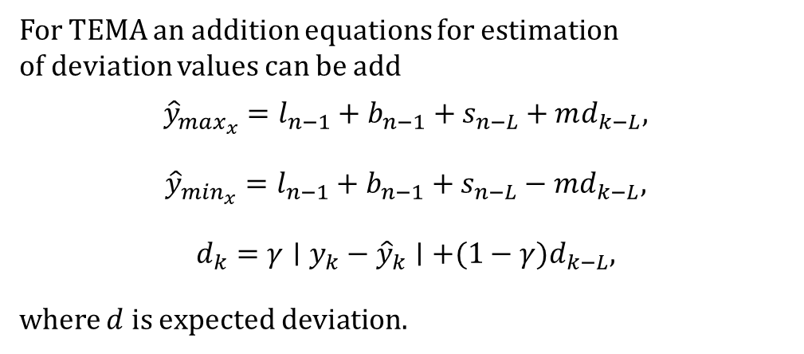
Smoothing. Triple Exponential Smoothing
The index $n−L+1+(m−1)modL$ in the forecast equation for TEMA is the offset into the seasonal components from the last full season from observed data ( i.e. if we are forecasting the 3rd point into the 45 season into the future, we cannot use seasonal components from the 44th season in the future since that season is also forecasted - we can use only the points form the observed data).
For TEMA an addition equations for estimation of deviation values can be add
$$\begin{matrix}{\hat{y}}_{max_{x}}=l_{n−1}+b_{n−1}+s_{n−L}+md_{k−L}, \\ \\ {\hat{y}}_{min_{x}}=l_{n−1}+b_{n−1}+s_{n−L}−md_{k−L}, \\ \\ d_{k}=γ∣y_{k}−{\hat{y}}_{k}∣+(1−γ)d_{k−L},\end{matrix}$$
where $d$ is expected deviation.

Slide 19
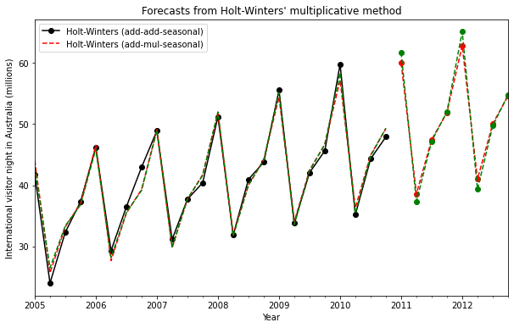
Smoothing. Triple Exponential Smoothing
Beside the shown additive Triple Exponential Smoothing (Holt-Winters exponential smoothing) there are exist a several Holt-Winters models for instance, for the multiplicative series case and for dumped series case.

Slide 20
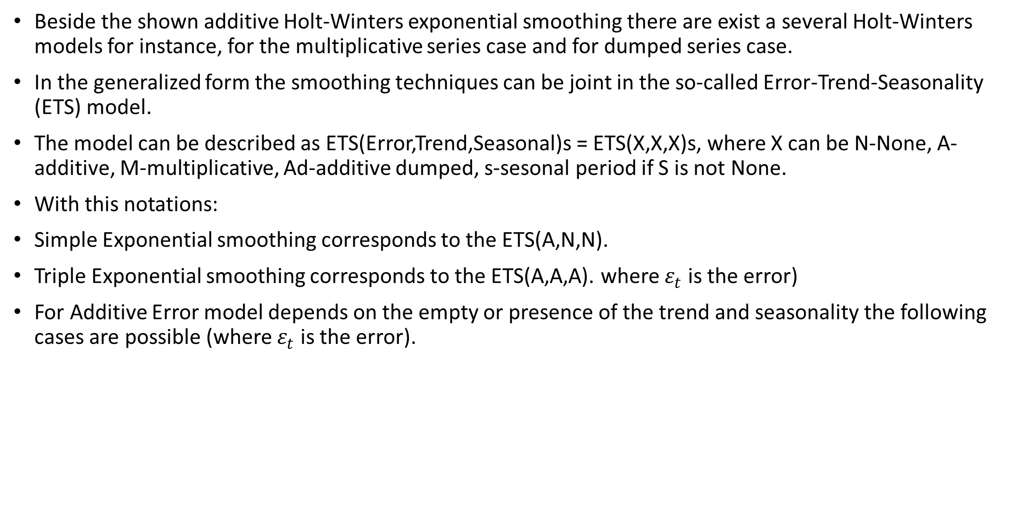
Smoothing. Error-Trend-Seasonality Smoothing
Beside the shown additive Holt-Winters exponential smoothing there are exist a several Holt-Winters models for instance, for the multiplicative series case and for dumped series case.
In the generalized form the smoothing techniques can be joint in the so-called Error-Trend-Seasonality (ETS) model.
The model can be described as ETS(Error,Trend,Seasonal)s = ETS(X,X,X)s, where X can be N-None, A-additive, M-multiplicative, Ad-additive dumped, s-sesonal period if S is not None.
With this notations:
Simple Exponential smoothing corresponds to the ETS(A,N,N).
Triple Exponential smoothing corresponds to the ETS(A,A,A). where $ε_{t}$ is the error)
For Additive Error model depends on the empty or presence of the trend and seasonality the following cases are possible (where $ε_{t}$ is the error).

Slide 21
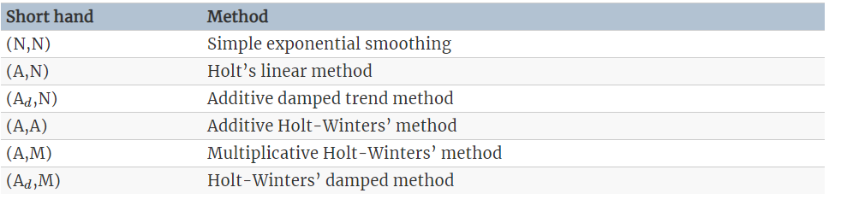
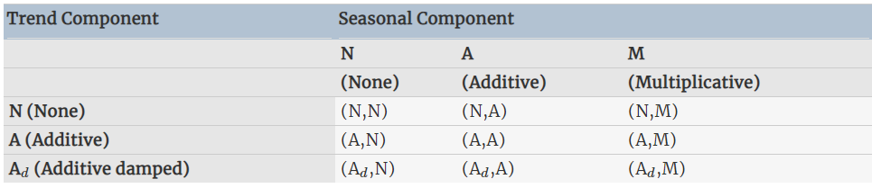
Smoothing. Error-Trend-Seasonality Smoothing
For Additive/Multiplicative Error model depends on the empty or presence of the trend and seasonality the following cases are possible

Slide 22
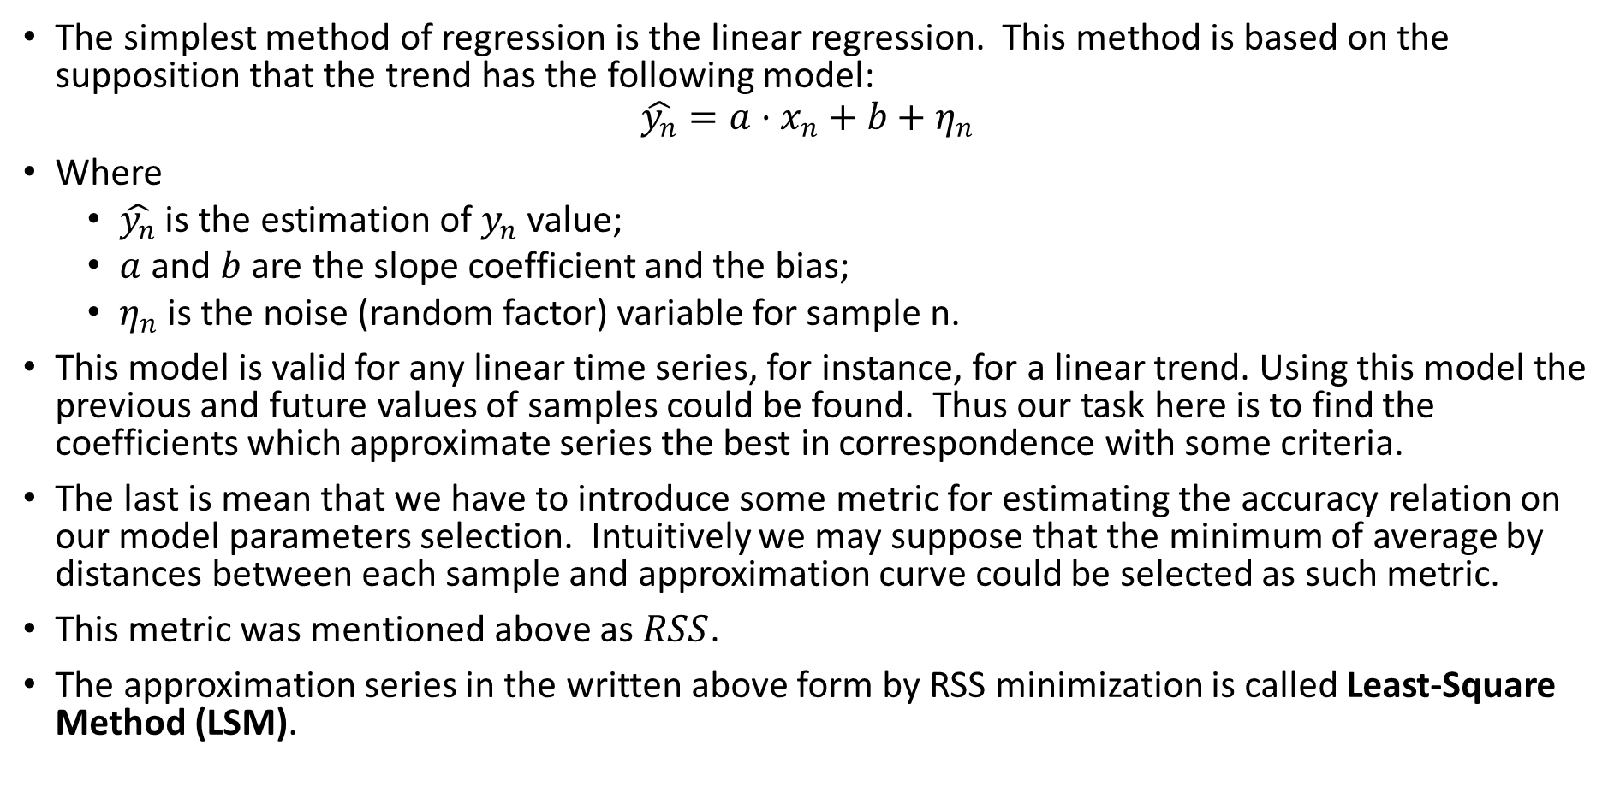
Regression Analysis
The simplest method of regression is the linear regression. This method is based on the supposition that the trend has the following model:
$$\hat{y_{n}}=a⋅x_{n}+b+η_{n}$$
Where
$\hat{y_{n}}$ is the estimation of $y_{n}$ value;
$a$ and $b$ are the slope coefficient and the bias;
$η_{n}$ is the noise (random factor) variable for sample n.
This model is valid for any linear time series, for instance, for a linear trend. Using this model the previous and future values of samples could be found. Thus our task here is to find the coefficients which approximate series the best in correspondence with some criteria.
The last is mean that we have to introduce some metric for estimating the accuracy relation on our model parameters selection. Intuitively we may suppose that the minimum of average by distances between each sample and approximation curve could be selected as such metric.
This metric was mentioned above as $RSS$.
The approximation series in the written above form by RSS minimization is called Least-Square Method (LSM).

Slide 23

Regression Analysis. Ordinary Linear LSM
The simplest casr of LSM is Ordinary LSM (OLS). OLSM task can be given as:
$$\sum_{n=0}^{N−1}{(}y_{n}−\hat{y_{n}})^{2}→0$$
In our case it lead to the following:
$$\sum_{n=0}^{N−1}{(}y_{n}−(a⋅x_{n}+b))^{2}→0$$
This problem can be solved analytically
$$a =\frac{N\sum{xy} −\sum{x} \sum{y} }{N\sum{x^{2}}−{\left( \sum{x}\right)}^{2}}$$
$$b =\frac{∑y − a ∑x}{N}$$

Slide 24
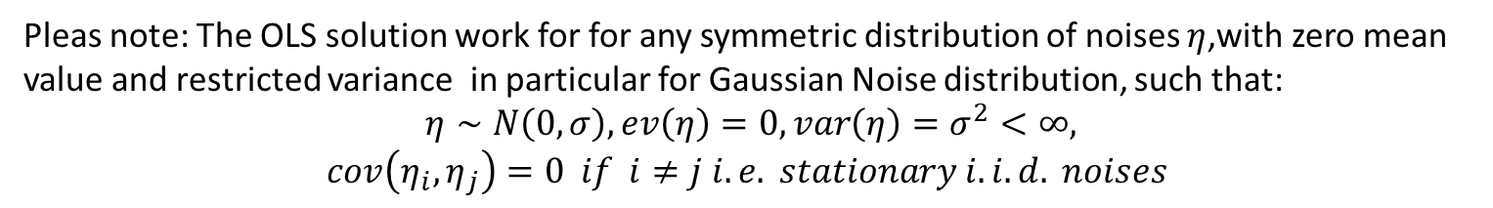
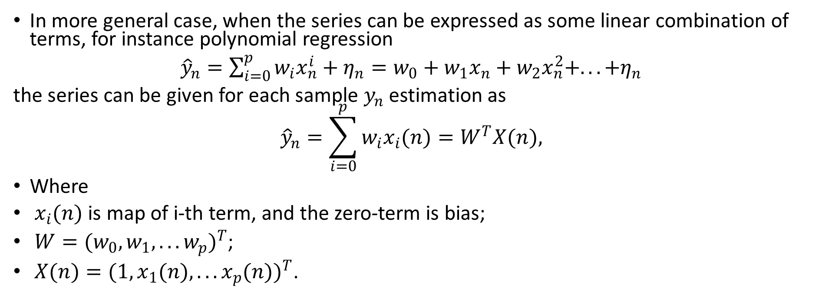
Regression Analysis. Ordinary LSM
In more general case, when the series can be expressed as some linear combination of terms, for instance polynomial regression
${\hat{y}}_{n}=\sum_{i=0}^{p}{w_{i}x_{n}^{i}}+η_{n}=w_{0}+w_{1}x_{n}+w_{2}x_{n}^{2}+...+η_{n}$
the series can be given for each sample $y_{n}$ estimation as
$${\hat{y}}_{n}=\sum_{i=0}^{p}{w_{i}x_{i}(n)}=W^{T}X(n),$$
Where
$x_{i}(n)$ is map of i-th term, and the zero-term is bias;
$W=(w_{0},w_{1},...w_{p})^{T}$;
$X(n)=(1,x_{1}(n),...x_{p}(n))^{T}$.
Pleas note: The OLS solution work for for any symmetric distribution of noises $η$,with zero mean value and restricted variance in particular for Gaussian Noise distribution, such that:
$$η∼N\left(0,σ\right), ev\left(η\right)=0,var\left(η\right)=σ^{2}<∞,$$
$$cov\left(η_{i},η_{j}\right)=0 if i≠j i.e. stationary i.i.d. noises$$

Slide 25
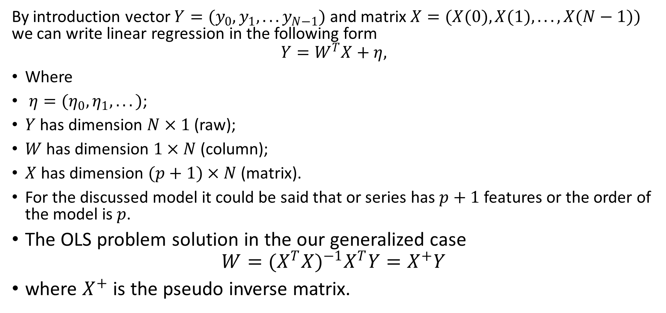
Regression Analysis. Ordinary LSM
By introduction vector $Y=(y_{0},y_{1},...y_{N−1})$ and matrix $X=(X(0),X(1),...,X(N−1))$ we can write linear regression in the following form
$$Y=W^{T}X+η,$$
Where
$η=(η_{0},η_{1},...)$;
$Y$ has dimension $N×1$ (raw);
$W$ has dimension $1×N$ (column);
$X$ has dimension $(p+1)×N$ (matrix).
For the discussed model it could be said that or series has $p+1$ features or the order of the model is $p$.
The OLS problem solution in the our generalized case
$$W=(X^{T}X)^{−1}X^{T}Y=X^{+}Y$$
where $X^{+}$ is the pseudo inverse matrix.

Slide 26
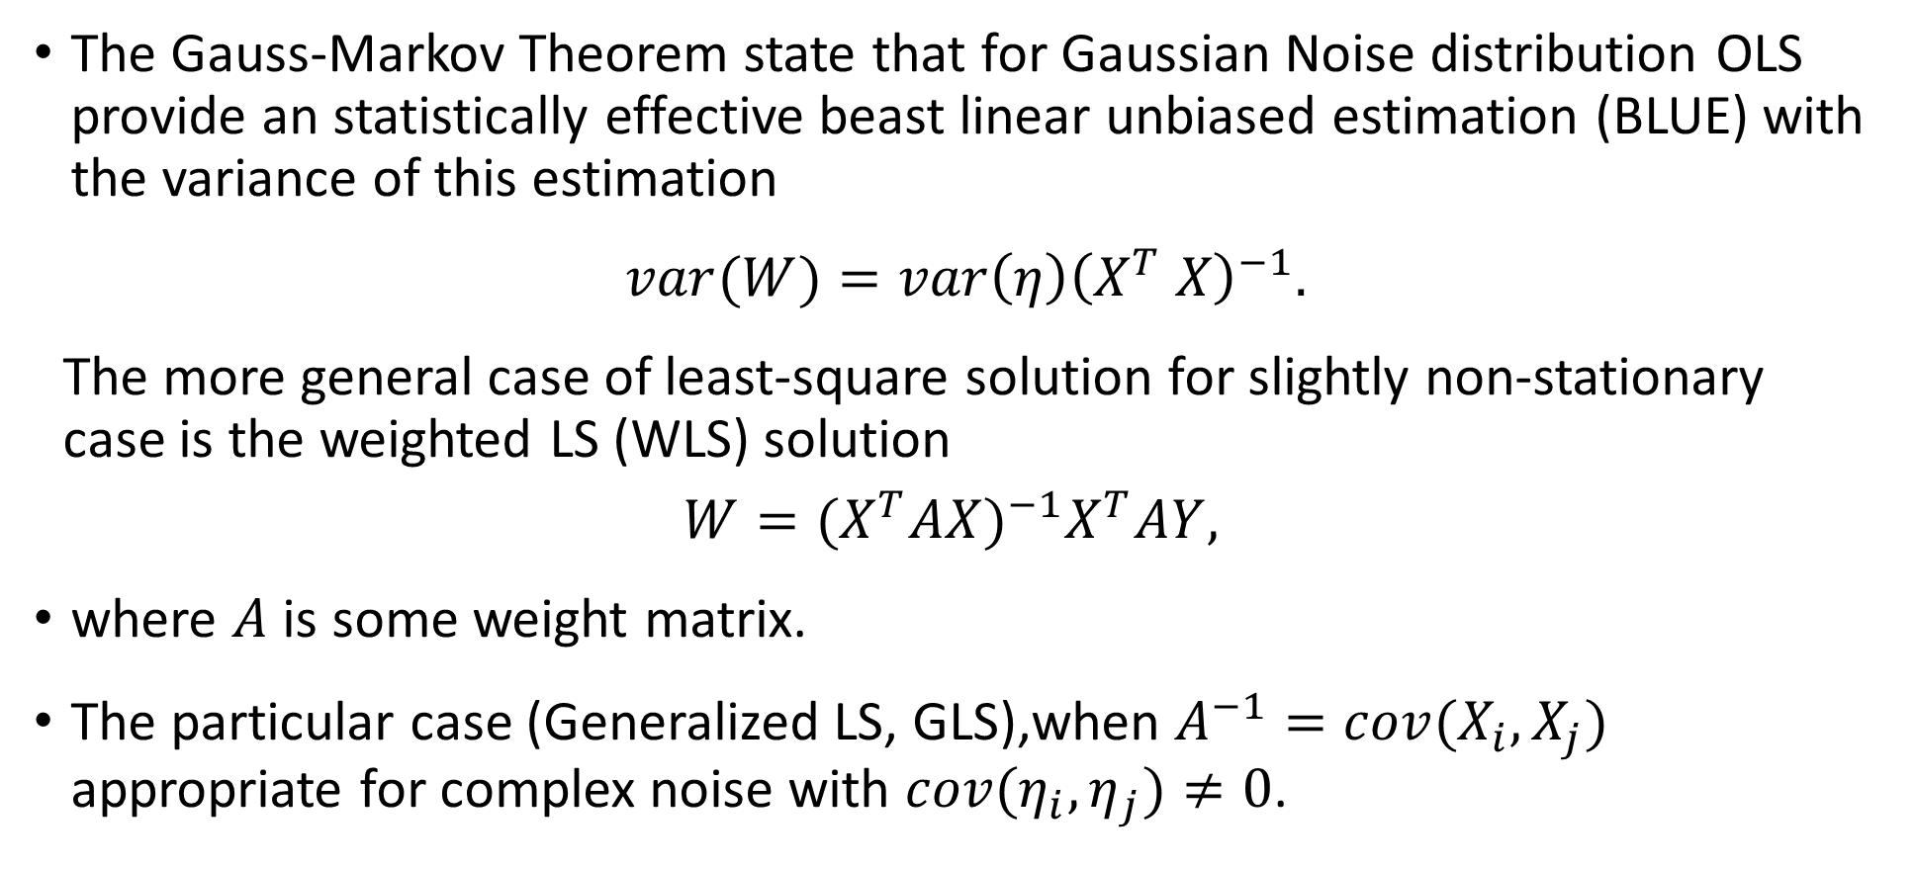
Regression Analysis. The Gauss-Markov Theorem
The Gauss-Markov Theorem state that for Gaussian Noise distribution OLS provide an statistically effective beast linear unbiased estimation (BLUE) with the variance of this estimation
$var(W)=var\left(η\right){\left(X^{T} X\right)}^{−1}.$
The more general case of least-square solution for slightly non-stationary case is the weighted LS (WLS) solution
$$W=(X^{T}AX)^{−1}X^{T}AY,$$
where $A$ is some weight matrix.
The particular case (Generalized LS, GLS),when $A^{−1}=cov(X_{i},X_{j})$ appropriate for complex noise with $cov(η_{i},η_{j})≠0$.

Slide 27
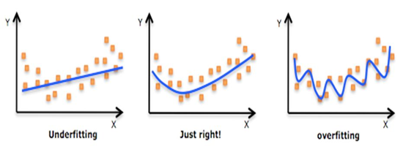
Ill-conditioned problem
One of the main constrain to the using of ordinary regression is the Ill condition number of the processed data.
Ill-conditioned problem – the relatively high changing of the estimation results, caused by the small perturbation (changing) in the data.
Pleas note Ill or well condition are depends on the inverse condition number.
Physically condition number depends on the noise influence on the series.
Thus then more relation of deterministic part to the noise one then better the condition of series (i.e. then smaller the perturbation influence of the data of the estimation result).
The problem of Ill-conditions can implicitly appears in the growing of variance and outliers in the regression prediction.
The problem of Ill-conditions or high noise influence leads to the possibility of overfitting the approximated series.

Slide 28
Ill-conditioned problem
The problem of Ill-conditions or high noise influence leads to the possibility of overfitting the approximated series.
The solutions of ill-condition problem.
Robust regression is the group of heuristically proposed methods for traditional statistical problem solutions. This methods can be based on change the criteria (RSS) on the other which provide statistically ineffective but more robust to noise results (for instance median regression, MAE-regression, or so-called M-estimators).
Features selection (Dimension reduction) - select only restricted (reduced) number of features which contribution number to small (then it smaller - then better).
Feature transformation to the form with better condition (for instance PCA, and other decomposition technique).
Matrix regularization and normalization (L1 lasso, L2 ridge (Tichonov) and e.t.c).

Slide 29
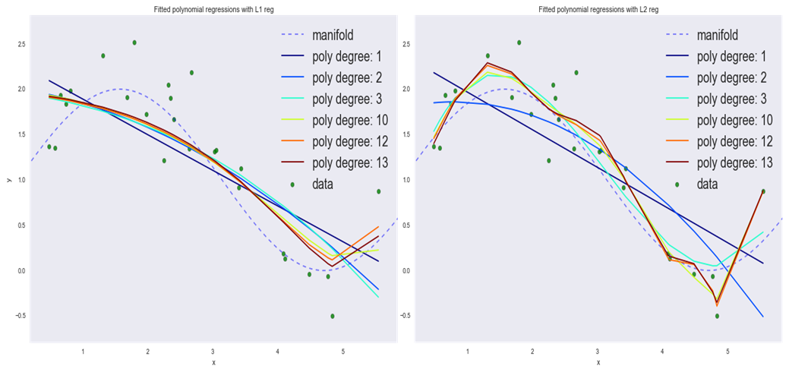
Ill-conditioned problem
Example of previously shown problem solution with using L1 and L2 regularization

Slide 30
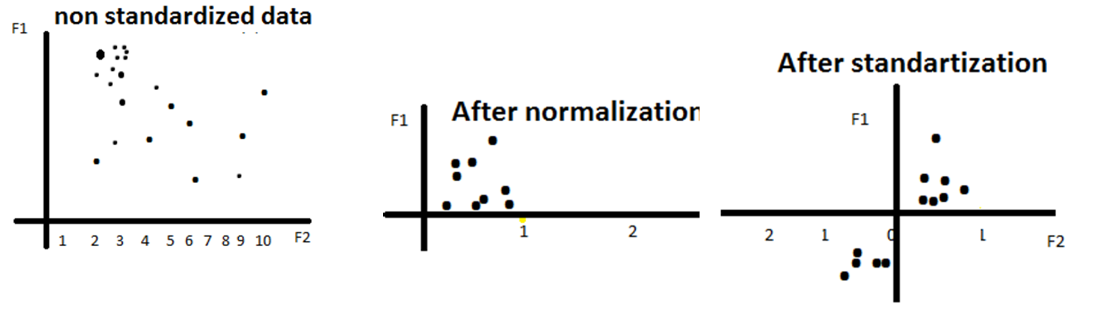
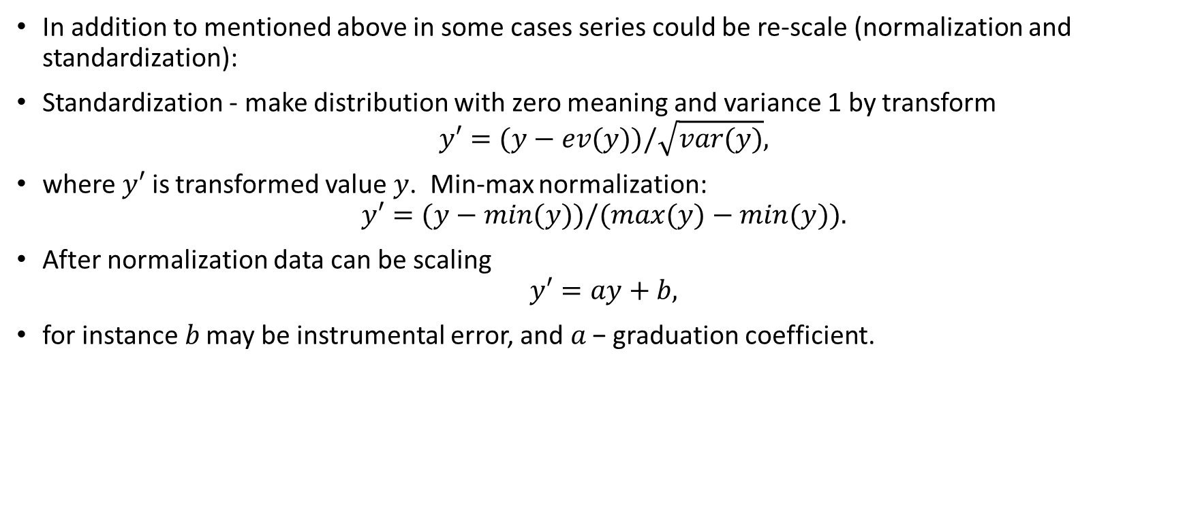
Standardization, normalization, scaling
In addition to mentioned above in some cases series could be re-scale (normalization and standardization):
Standardization - make distribution with zero meaning and variance 1 by transform
$$y′=(y−ev(y))/\sqrt{var(y)},$$
where $y′$ is transformed value $y$. Min-max normalization:
$$y′=(y−min(y))/(max(y)−min(y)).$$
After normalization data can be scaling
$$y′=ay+b,$$
for instance 𝑏 may be instrumental error, and 𝑎 − graduation coefficient.

Slide 31
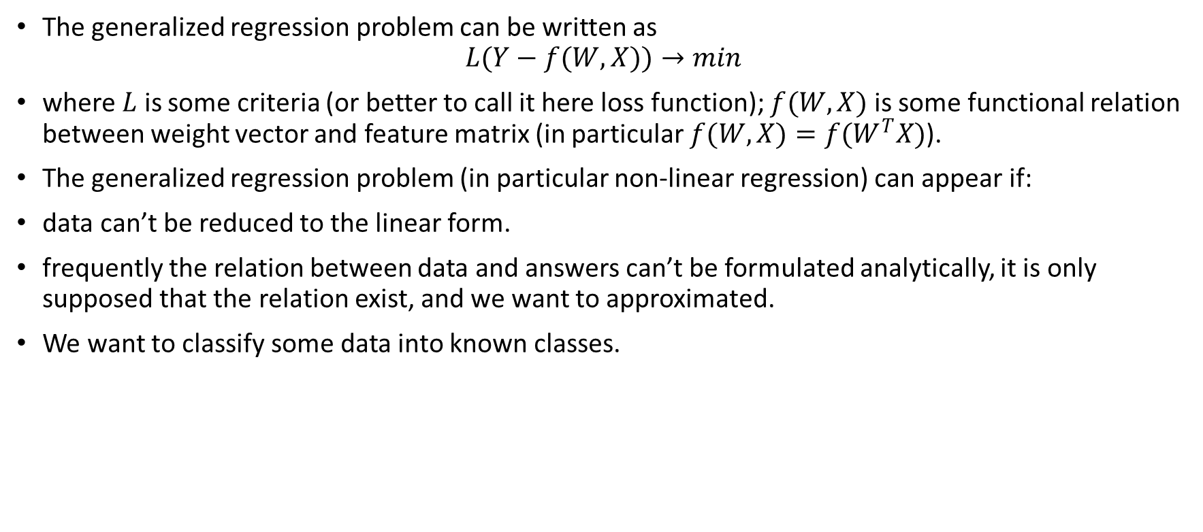
Non-Linear regression
The generalized regression problem can be written as
$$L(Y−f(W,X))→min$$
where $L$ is some criteria (or better to call it here loss function); $f(W,X)$ is some functional relation between weight vector and feature matrix (in particular $f(W,X)=f(W^{T}X)$).
The generalized regression problem (in particular non-linear regression) can appear if:
data can’t be reduced to the linear form.
frequently the relation between data and answers can’t be formulated analytically, it is only supposed that the relation exist, and we want to approximated.
We want to classify some data into known classes.

Slide 32
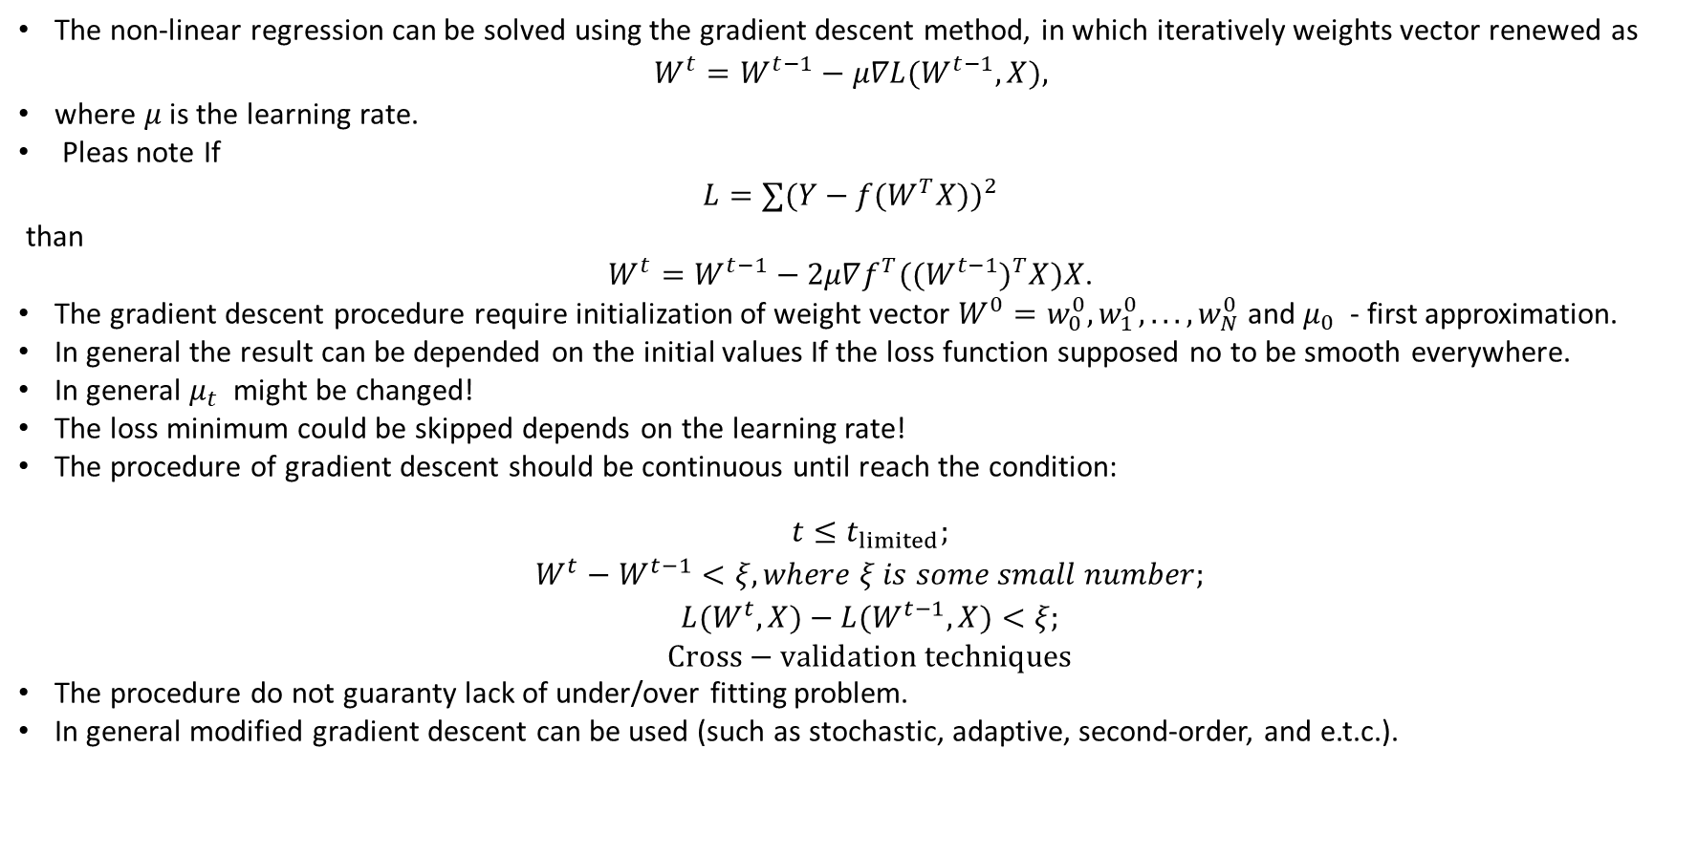
Non-Linear regression
The non-linear regression can be solved using the gradient descent method, in which iteratively weights vector renewed as
$$W^{t}=W^{t−1}−μ∇L(W^{t−1},X),$$
where $μ$ is the learning rate.
Pleas note If
$$L=∑(Y−f(W^{T}X))^{2}$$
than
$W^{t}=W^{t−1}−2μ∇f^{T}((W^{t−1})^{T}X)X$.
The gradient descent procedure require initialization of weight vector $W^{0}=w_{0}^{0},w_{1}^{0},...,w_{N}^{0}$ and $μ_{0}$ - first approximation.
In general the result can be depended on the initial values If the loss function supposed no to be smooth everywhere.
In general $μ_{t}$might be changed!
The loss minimum could be skipped depends on the learning rate!
The procedure of gradient descent should be continuous until reach the condition:
$$\begin{matrix} & t≤t_{limited}; \\ & W^{t}−W^{t−1}<ξ, where ξ is some small number; \\ & L(W^{t},X)−L(W^{t−1},X)<ξ; \\ & Cross−validation techniques\end{matrix}$$
The procedure do not guaranty lack of under/over fitting problem.
In general modified gradient descent can be used (such as stochastic, adaptive, second-order, and e.t.c.).

Slide 33
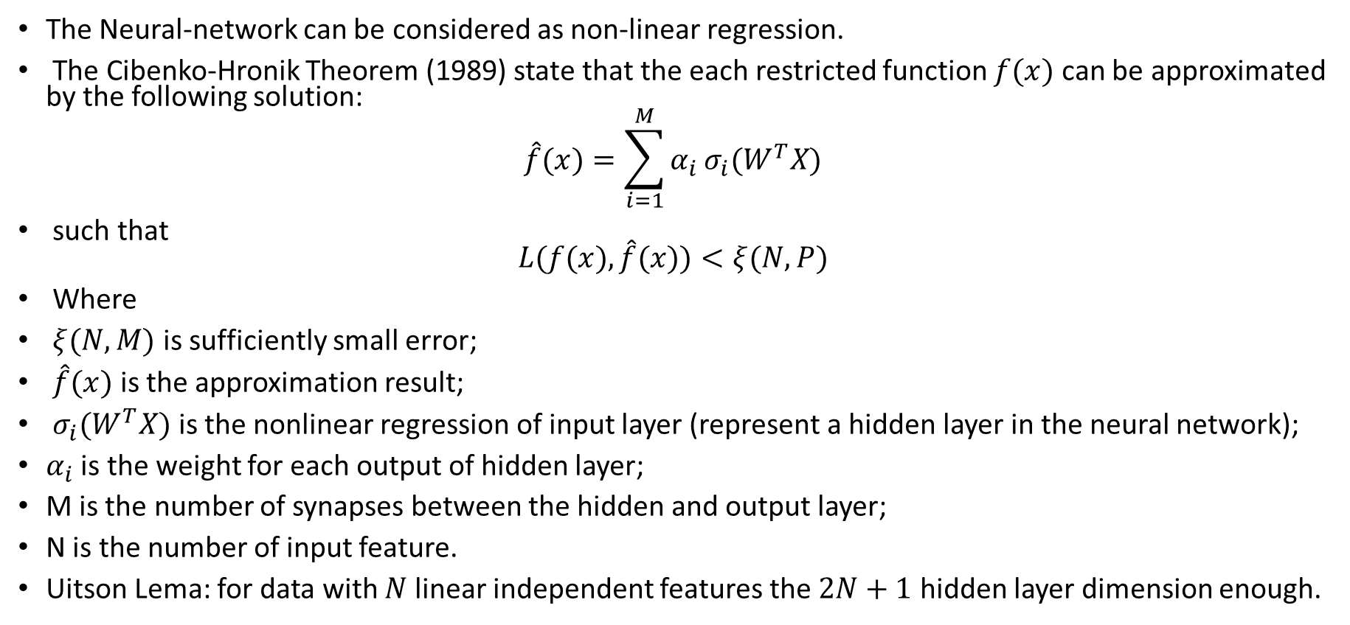
Non-Linear regression
The Neural-network can be considered as non-linear regression.
The Cibenko-Hronik Theorem (1989) state that the each restricted function $f(x)$ can be approximated by the following solution:
$$\hat{f}(x)=\sum_{i=1}^{M}{α_{i}}σ_{i}(W^{T}X)$$
such that $L(f(x),\hat{f}(x))<ξ(N,P)$
Where
$ξ(N,M)$ is sufficiently small error;
$\hat{f}(x)$ is the approximation result;
$σ_{i}(W^{T}X)$ is the nonlinear regression of input layer (represent a hidden layer in the neural network);
$α_{i}$ is the weight for each output of hidden layer;
M is the number of synapses between the hidden and output layer;
N is the number of input feature.
Uitson Lema: for data with $N$ linear independent features the $2N+1$ hidden layer dimension enough.

Slide 34
General Adaptive model (regression). Prophet
Stochastic model Prophet
The facebook business forecast adaptive model
Standard methods like ARIMA or Holt-Winter generate stable forecasts, however they have difficulties forecasting quick changes in time-series, especially when these changes are due to multiple seasonalities or moving rare events (like holydays).
From the other side, if some generalized (parametric) model of process is known the forecast model can be introduce as adaptive parametric one.
For the business forecast like sales, price or demand prediction the model can be described as
deterministic trend one with rare change;
multiple seasonalities (days, weeks, month, years);
and rare events like holydays.

Slide 35
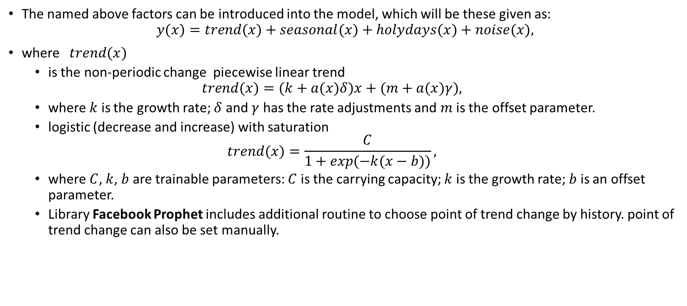
General Adaptive model (regression). Prophet
The named above factors can be introduced into the model, which will be these given as:
$$y(x)=trend(x)+seasonal(x)+holydays(x)+noise(x),$$
where $trend(x)$
is the non-periodic change piecewise linear trend
$$trend(x)=(k+a(x)δ)x+(m+a(x)γ),$$
where $k$ is the growth rate; $δ$ and $γ$ has the rate adjustments and $m$ is the offset parameter.
logistic (decrease and increase) with saturation
$$trend(x)=\frac{C}{1+exp(−k(x−b))},$$
where $C$, $k$, $b$ are trainable parameters: $C$ is the carrying capacity; $k$ is the growth rate; $b$ is an offset parameter.
Library Facebook Prophet includes additional routine to choose point of trend change by history. point of trend change can also be set manually.

Slide 36
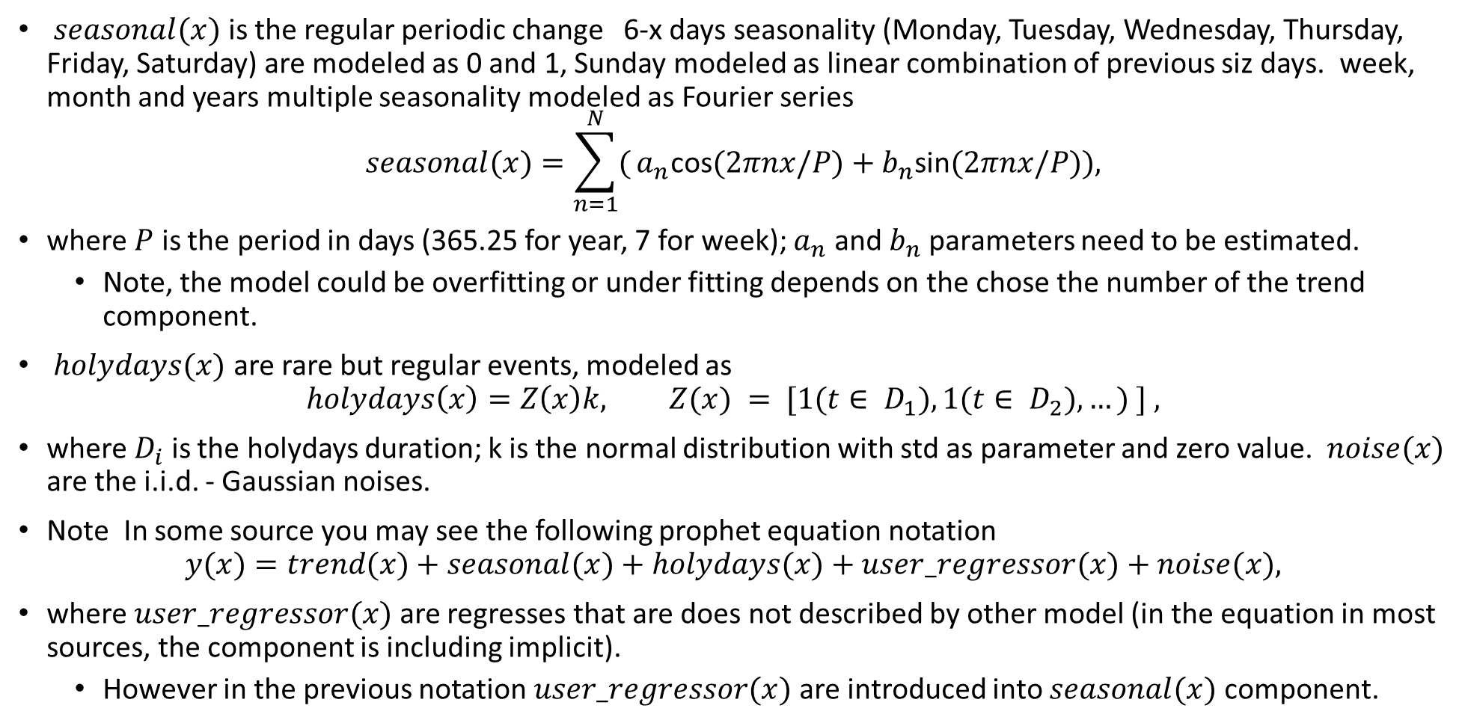
General Adaptive model (regression). Prophet
$seasonal(x)$ is the regular periodic change 6-x days seasonality (Monday, Tuesday, Wednesday, Thursday, Friday, Saturday) are modeled as 0 and 1, Sunday modeled as linear combination of previous siz days. week, month and years multiple seasonality modeled as Fourier series
$$seasonal(x)=\sum_{n=1}^{N}{(}a_{n}\text{cos}(2πnx/P)+b_{n}\text{sin}(2πnx/P)),$$
where $P$ is the period in days (365.25 for year, 7 for week); $a_{n}$ and $b_{n}$ parameters need to be estimated.
Note, the model could be overfitting or under fitting depends on the chose the number of the trend component.
$holydays(x)$ are rare but regular events, modeled as
$$holydays\left(x\right)=Z\left(x\right)k, Z(x) = [1(t∈ D_{1}),1(t∈ D_{2}),…) ] ,$$
where $D_{i}$ is the holydays duration; k is the normal distribution with std as parameter and zero value. $noise(x)$ are the i.i.d. - Gaussian noises.
Note In some source you may see the following prophet equation notation
$$y(x)=trend(x)+seasonal(x)+holydays(x)+user_regressor(x)+noise(x),$$
where $user_regressor(x)$ are regresses that are does not described by other model (in the equation in most sources, the component is including implicit).
However in the previous notation $user_regressor(x)$ are introduced into $seasonal(x)$ component.

Slide 37
General Adaptive model (regression). Prophet
Advantages of prophet
Prophet can fit several linear and non linear features as components.
Ability to easily model any number of seasonalities.
Ability to work with missing dates in time-series.
Easily integrates holidays in the model.
Model transparency.
Allowing flexible step-wise linear or logistic trend modeling with user-specified change points.
Drawbacks of prophet
Prophet does not allow non-Gaussian noise distribution
Prophet does not take autocorrelation on residual into account (thus require only Gaussian noise distribution).
Prophet does not assume stochastic trend behavior (random walk).
Long-horizon forecasting can be volatile with automatic changepoint selection

