Slide 1
Specificity of machine learning methods in time series analysis
Specificity of time series analysis with machine learning methods;
Review of some problems of time series analysis with their solutions using machine learning methods;
Time series metrics;
Review of the tasks of clustering time series;
Review of distances in machine learning.

Slide 2
The tasks of ML in TS
The tasks of ML in TS
1.1.1 Introduction in ML for TS
In the terms of Machine learning the Time Series Analysis can be divided into:
supervised tasks and methods (Point Estimates, Probabilistic Distribution Estimation).
unsupervised tasks and methods.
other (such as semi- or self- supervised and so-on).

Slide 3
The tasks of ML in TS. Supervised tasks
The supervised task assume that we have time series where data are can be called labeled. The typical tasks of the supervised models are:
Regression (continuous target variable):
forecast;
parameters estimation;
supervised data filtration;
supervised feature extraction and selection;
Classification (of some series patterns, or series behavior its self)
(dicreat target variable, probably with multi outputs):
pattern classification;
supervised anomaly of other events classification;
full time series classification
Note. The parameters estimation task can be considered as supervised if its routine is based on the labeled dataset or a priory known parametric model. In the other case (for non-parametric model) parameters estimation task can be considered as unsupervised task.

Slide 4
The tasks of ML in TS. Unsupervised tasks
The unsupervised time series processing task are searching and uncovering undetected patterns in a dataset with no pre-existing labels as, for example, cluster analysis or data-decomposition and data compression algorithms. The the most popular tasks in the unsupervised time series learning are:
anomaly detection (such as outliers, skipped data, abnormal patterns or any other).
feature extraction or unsupervised time series decomposition (trend-seasonality decomposition, PCA, other component decomposition);
time series denoisng (in particular in the case of white Gaussian noises);
data clustering, patterns searching, data segmentation and other.
Pleas note
In some cases it is necessary to eliminate some part of the series that are considered as noise or inferences - this task can be considered as supervised denoisng or supervised time series filtration.
In the case of the series decomposition is performed based on the some a priory known model it should be related to supervised learning tasks (in particular supervised denoisng is the example of such decomposition).
The anomaly detection can be also performed as supervised task if data will be labeled as normal or anomaly or as semi-supervised task if only normal pattern will be labeled

Slide 5
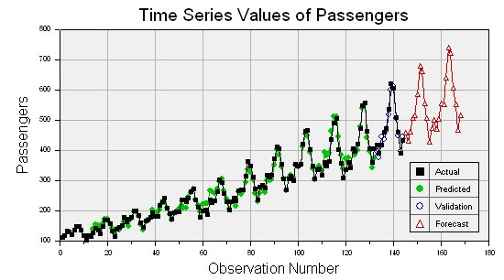
The tasks of ML in TS. Examples of ML in TS
Time series forecast (supervised learning) example

Slide 6
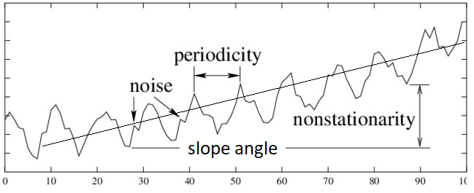
The tasks of ML in TS. Examples of ML in TS
Series parameters estimation example (supervised learning) for parametric a priory known model or if estimation performed based on the labeled data-set (in data-driven manner).

Slide 7
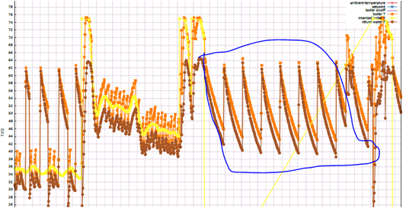
The tasks of ML in TS. Examples of ML in TS
Data or data-pattern (segment of data) classification (supervised learning).

Slide 8
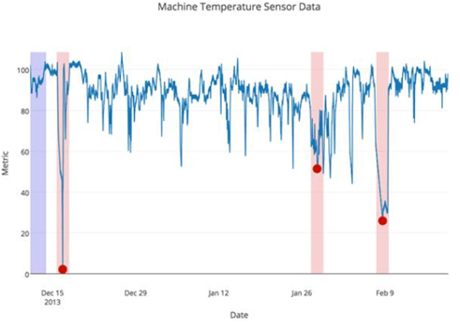
The tasks of ML in TS. Examples of ML in TS
Anomaly detection (outliers, skipped data, abnormal patterns or abnormal behavior, in general unsupervised learning).

Slide 9
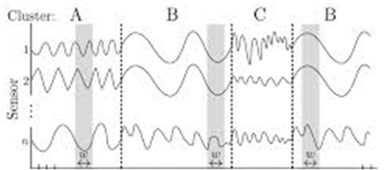
The tasks of ML in TS. Examples of ML in TS
Time series clustering, segmentation, pattern searching (unsupervised learning).

Slide 10
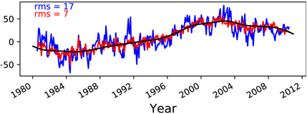
The tasks of ML in TS. Examples of ML in TS
Time series denoising from white Gaussian noises (unsupervised learning case).

Slide 11
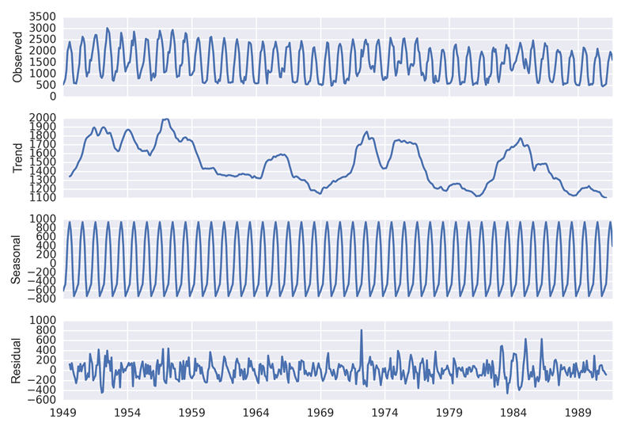
The tasks of ML in TS. Examples of ML in TS
Time series decomposition on obvious trend, seasonal part and residual part (in general unsupervised learning).

Slide 12
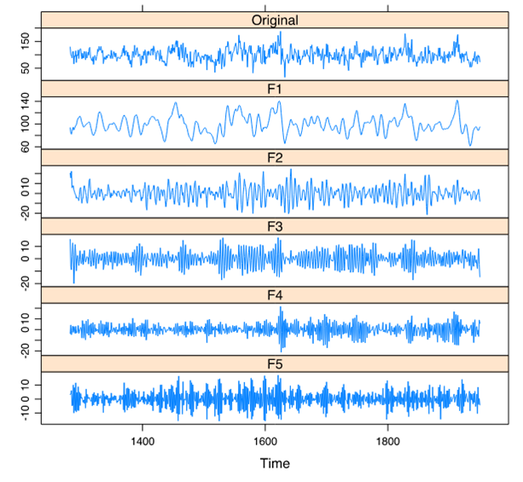
The tasks of ML in TS. Examples of ML in TS
Time series decomposition without any obvious time series patterns (in general unsupervised learning),
If we will rest only slow-changeable components (or for instance, components with the highest variance), than we can resampling data (down sampling) in this case it will be data compression task (unsupervised learning),
if we will know by some model or other source of information which components are valuable we can reconstruct series without inferences and noises (make time series filtration) - in this case it will be supervised learning.

Slide 13
Time Series Clustering. Tasks of clustering
Large amount of data stored in serialized databases make the process of its parsing and screening useful information (visualization) i.e. its clustering actual task.
For instance,
Time series database (TSDB),
sensors measurements results,
speech or music pattern searching.
The process of separating groups according to similarities of data is called clustering.
The goal of clustering is to identify structure in an unlabeled dataset by objectively organizing data into homogeneous groups where the within-group-object similarity is minimized and the between-group-object dissimilarity is maximized.

Slide 14
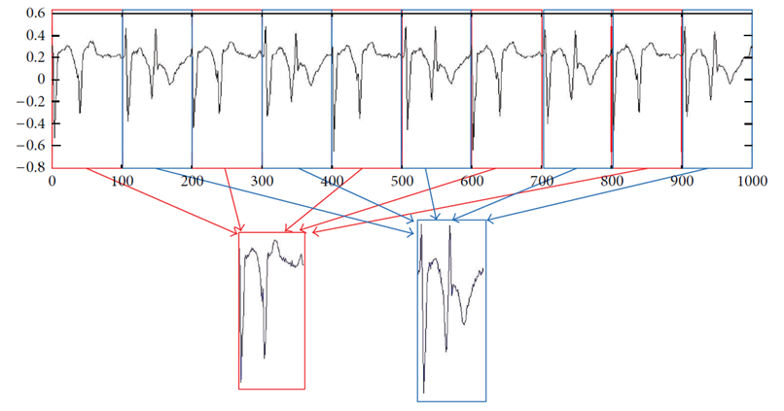
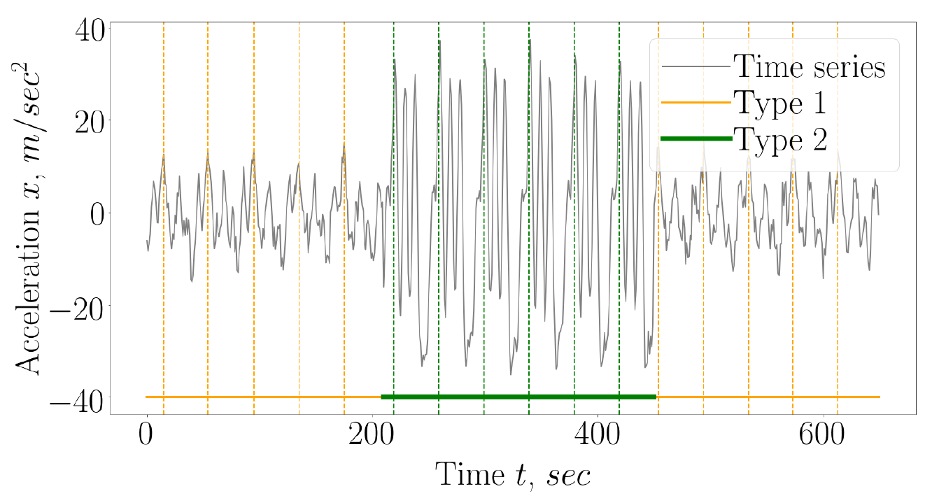
Time Series Clustering. Tasks of clustering
Example of time series segments clustering

Slide 15
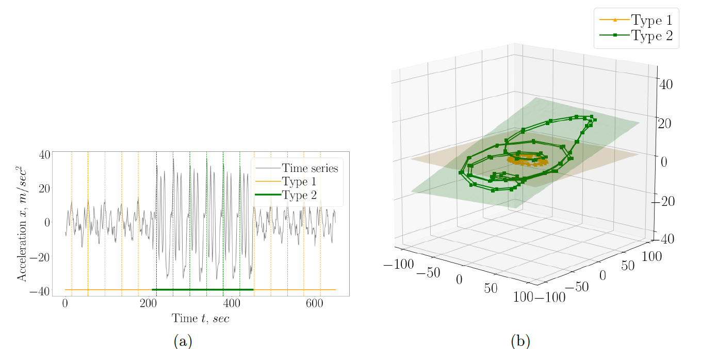
Time Series Clustering. Specificity of clustering
Example of time series segments and its PCA dimension reduction

Slide 16
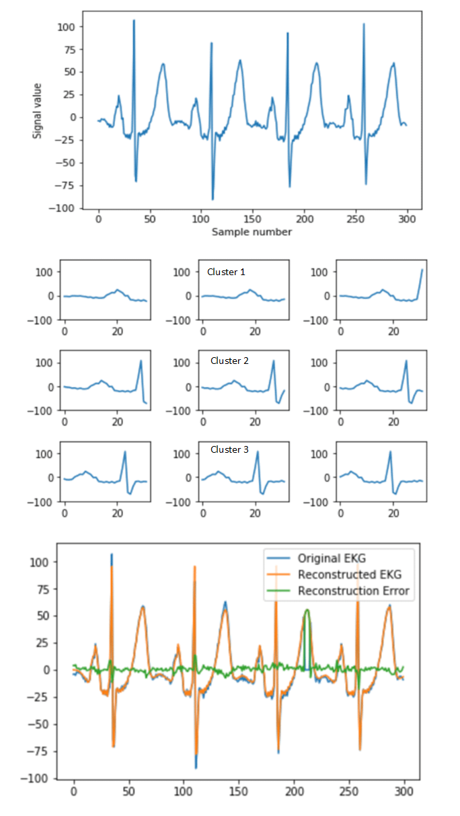
Time Series Clustering. Methods of clustering
Example of clustering

Slide 17
Time Series. Specificity of ML
RAW DATA BASED
Full TS
Segments of TS
Transformation of TS:
Spectrum
Time-frequency representation
Lag-matrix
Contains Full inform of data.
Do not include additional operation, which could be time-consuming.
Complex tasks (use Deep learning for automatic feature extraction and decision making).

Slide 18
Time Series. Specificity of ML
Feature based
Point features
Vector representation (set of Point features)
Reduced-size feature space.
In some case higher interpretability of methods (manual feature extraction and selection).
Models (or models parameters) as features.

Slide 19
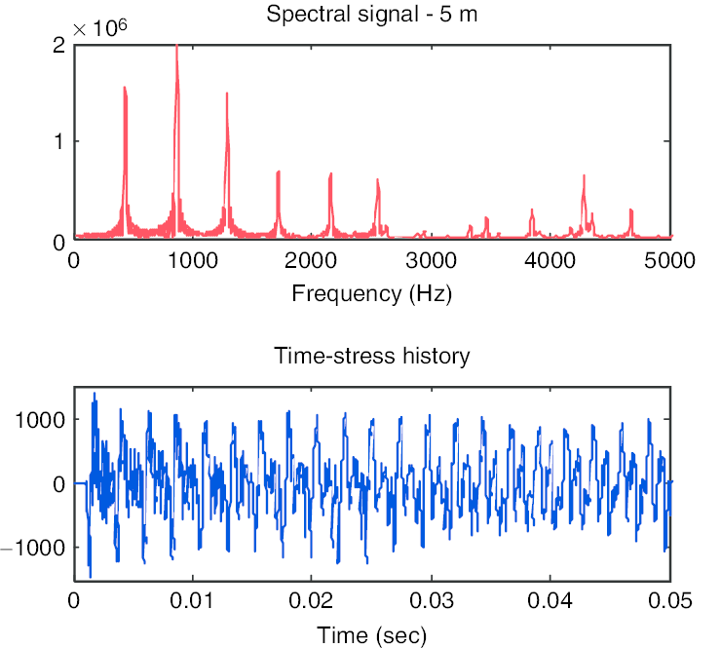
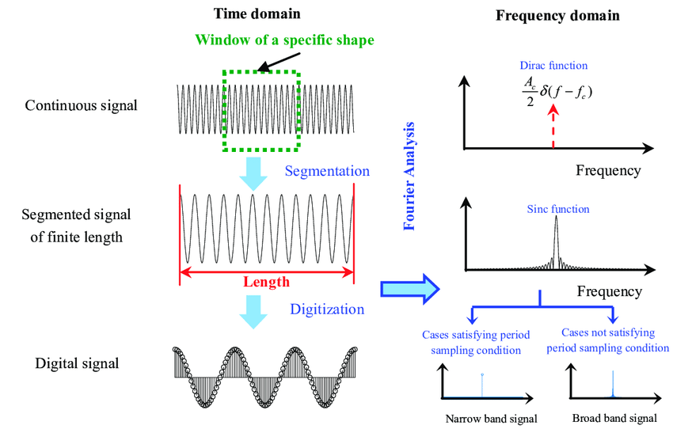

Slide 20
Time Series Segments. Specificity of features
It can be distinguished a several approaches for segments analysis.
Raw series analysis.
Features of the series analysis (feature-based analysis).
Model of the series analysis (model-based analysis).
Feature extraction here mean that we extract such series segments metrics and features as:
Point-value features
Vector-value features

Slide 21
Time Series Segments. Specificity of features
ecdf_percentile
Summary statistic
mean value,
std values,
Kurtosis,
Other characteristic values of distributions (median, mode)
Energy,
Max, min, ecdf percentiles, entropy
Time-based
area under curve,
Slope of the trend
Initial values
Parameters of decomposition
Zero-crossing rate
peak to peak distance.
Autocorrelation lags values
Spectrum-based
maximum frequency,
Barycenter of the spectrum.
spectral entropy
spectral Energy,
fundamental frequencies
AR or ARIMA coefficients
Time- frequency
CWT absolute mean value,
CWT energy of each wavelet scale
CWT variance
Zero-crossing rate
https://tsfel.readthedocs.io/en/latest/descriptions/feature_list.html

Slide 22
Time Series Segments. Specificity of features
Vector-value features
features obtained after PCA or other dimension reduction method,
Main eigen or singular values of the time seris
Perceptually Important Points (PIP)
Piecewise Linear Approximation (PLA) and their parameters.
other non-linear features, for instance,
features vector can be obtained after autoencoder learning or other unsupervised and semi-supervised techniques.
series coding like bag of symbols, SFA symbols, for instance.
feature combinations (bag of features approach).
Model-based feature (ARIMA, ARIMA error, HW error, HW coefficients)

Slide 23
Time Series Segments. Specificity of features
Model-based analysis
Actually it is similar to feature extraction, but here we need to choose some prelimeniar parameters. We can estimate first the parameters of the model for one segment on try to analyze other segments or we can first estimate the model for the full dataset and then analyze each part we divide the data.
Modeling here mean that we extract such series segments parameters as:
AR, MA (ARMA) model parameters,
frequencies filtering, adaptive filtering.
Coefficients of some series approximation curve or analytical (as equation) representation.
Other modeling parameters (for GARH and e.t.c. models).
Beside the modeling parameters clustering, the residuals after subtraction the series model with from the original series can be also taken as feature or as input for feature extraction.
Note
As a rule by the term clustering, we mean clustering of time series segments.
However, in some specific cases the full series or each point values can be clustered.
For instance, in point-wise anomaly detection we will use point values clustering.

Slide 24
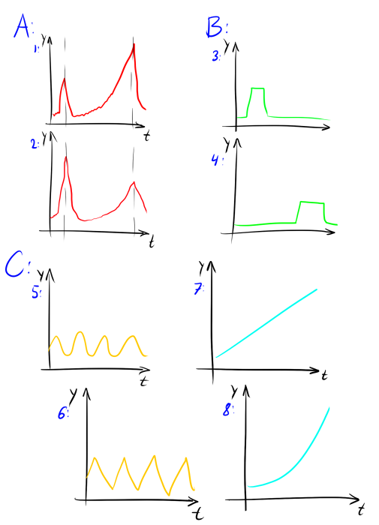
Time Series Segments. Specificity of Segments
Actually there can be several types of Segments analysis for time series.
Similarity in the time behavior
like for 1 and 2 on the picture below, case A.
Similarity in shape without time relation
like for 3 and 4 on the picture below, case B.
Similarity in shape frequency without time relation
like repetition of B.
Similarity in the spectrum of Time-Freq behaviour
Similarity in pattern or structure behavior
like for 5 and 6 by seasonality period, case C.
like 7 and 8 by trend (growing trend without), case D.
Choose of the clustering type depends on the choose of the data representation or algorithm of similarity searching.
Based in the task you will need to select the measure.
e.g. in spectrum domain similarity in shape behavior will be represented in amplitude spectrum similarity. The same for 5 and 6 instances.

Slide 25
Measures for Time Series Segments Comparison
The choose of the correct distance is one of the most complex task in time series as in clustering, as in classification and so on.
The basic distances are:
Similarity in time behavior
Euclidian Distance,
Generalized Euclidian Distance and Mahalanobis Distance,
Median Distance, and other robust distance types,
Mean Absolute Distance and other Minkowski Distances,
Mean Absolute Percentage Distance,
Correlation Distance (or Cosine Distance, Pearson Coefficient),
Similarity in shape
Probability Distribution Based Distances,
Dynamic Time Warping Distance,
Similarity in pattern
more complex techniques, based on the feature extraction and feature transformation.
Note. The main problem with the time series distance is the influence of some segments fluctuations on the resulted value.
Thus, if it is necessary we need to test some complex distances or test some pipelines of feature extraction and feature transformation with distances.

Slide 26
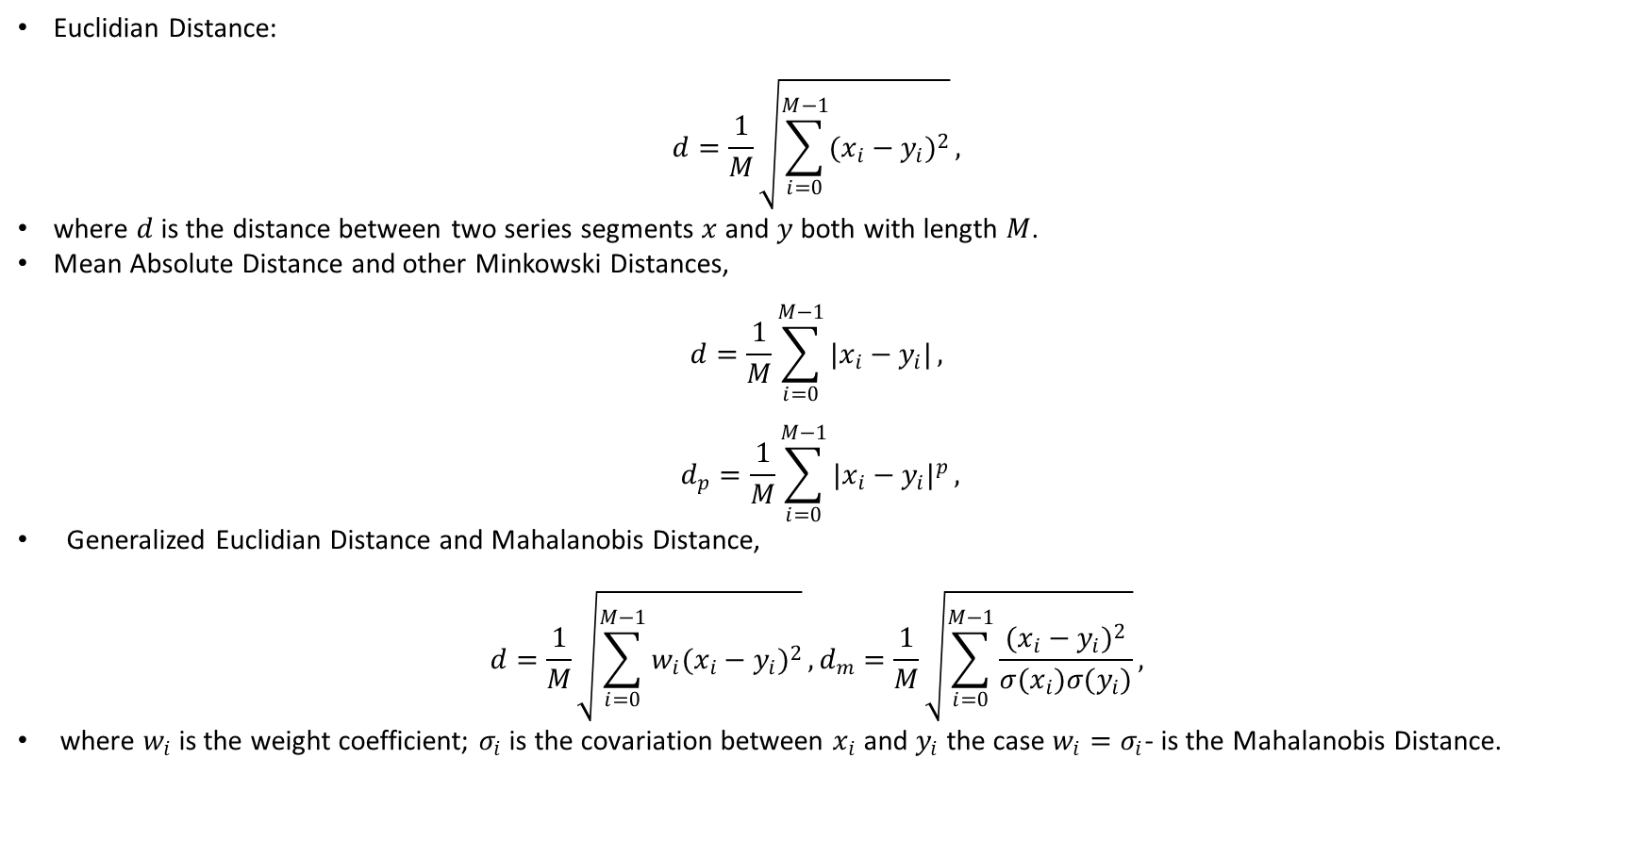
Distances for Time Series Comparison
Euclidian Distance:
$$d=\frac{1}{M}\sqrt{\sum_{i=0}^{M−1}{(x_{i}−y_{i})^{2}}},$$
where $d$ is the distance between two series segments $x$ and $y$ both with length $M$.
Mean Absolute Distance and other Minkowski Distances,
$$d=\frac{1}{M}\sum_{i=0}^{M−1}{|x_{i}−y_{i}|},$$
$$d_{p}=\frac{1}{M}\sum_{i=0}^{M−1}{|x_{i}−y_{i}|^{p}},$$
Generalized Euclidian Distance and Mahalanobis Distance,
$$d=\frac{1}{M}\sqrt{\sum_{i=0}^{M−1}{w_{i}(x_{i}−y_{i})^{2}}},d_{m}=\frac{1}{M}\sqrt{\sum_{i=0}^{M−1}{\frac{(x_{i}−y_{i})^{2}}{σ(x_{i})σ(y_{i})}}},$$
where $w_{i}$ is the weight coefficient; $σ_{i}$ is the covariation between $x_{i}$ and $y_{i}$ the case $w_{i}=σ_{i}$- is the Mahalanobis Distance.

Slide 27
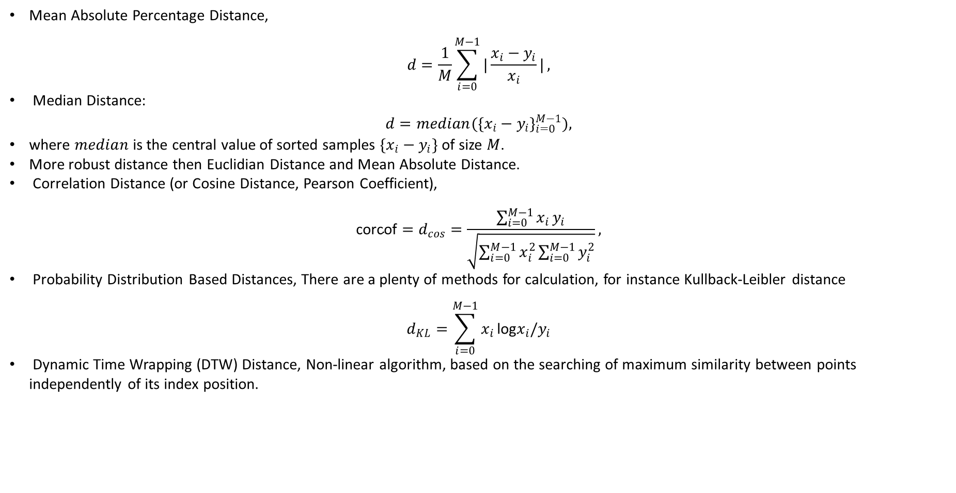
Distances for Time Series Comparison
Mean Absolute Percentage Distance,
$$d=\frac{1}{M}\sum_{i=0}^{M−1}{|\frac{x_{i}−y_{i}}{x_{i}}|},$$
Median Distance:
$$d=median(\{x_{i}−y_{i}\}_{i=0}^{M−1}),$$
where $median$ is the central value of sorted samples $\{x_{i}−y_{i}\}$ of size $M$.
More robust distance then Euclidian Distance and Mean Absolute Distance.
Correlation Distance (or Cosine Distance, Pearson Coefficient),
$$\text{corcof}=d_{cos}=\frac{\sum_{i=0}^{M−1}{x_{i}}y_{i}}{\sqrt{\sum_{i=0}^{M−1}{x_{i}^{2}}\sum_{i=0}^{M−1}{y_{i}^{2}}}},$$
Probability Distribution Based Distances, There are a plenty of methods for calculation, for instance Kullback-Leibler distance
$$d_{KL}=\sum_{i=0}^{M−1}{x_{i}}\text{log}x_{i}/y_{i}$$
Dynamic Time Wrapping (DTW) Distance, Non-linear algorithm, based on the searching of maximum similarity between points independently of its index position.

Slide 28
Dynamic Time Wrapping (DTW) Distance
DTW Non-linear algorithm, based on the searching of maximum similarity between points independently of its index position.
The DTW algorithm has the follows steps:
Calculate the distance between the first point in the first series segment and every point in the second series.
Select the minimum of the calculated values and store it (this is the "time warp" stage).
Move to the second point and repeat stage 1.
Move step by step along points and repeat stage 1 till all points are exhausted.
Calculate and Select the minimum of distances between the first point in the second series segment and every point in the first series.
Move step by step along points in the second segment and repeat stage 3 till all points are exhausted.
Sum all the stored minimum distances.

Slide 29
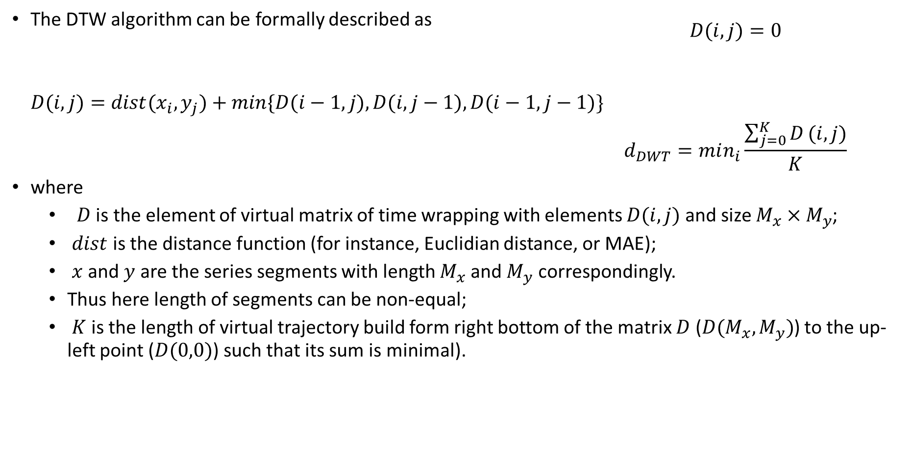
Dynamic Time Wrapping (DTW) Distance
The DTW algorithm can be formally described as $\begin{matrix} & D(i,j)=0 \\ & \\ & \\ D(i,j)=dist(x_{i},y_{j})+min\{D(i−1,j),D(i,j−1),D(i−1,j−1)\} & \\ & d_{DWT}=min_{i}\frac{\sum_{j=0}^{K}{D}(i,j)}{K}\end{matrix}$
where
$D$ is the element of virtual matrix of time wrapping with elements $D(i,j)$ and size $M_{x}×M_{y}$;
$dist$ is the distance function (for instance, Euclidian distance, or MAE);
$x$ and $y$ are the series segments with length $M_{x}$ and $M_{y}$ correspondingly.
Thus here length of segments can be non-equal;
$K$ is the length of virtual trajectory build form right bottom of the matrix $D$ ($D(M_{x},M_{y})$) to the up-left point ($D(0,0)$) such that its sum is minimal).

Slide 30
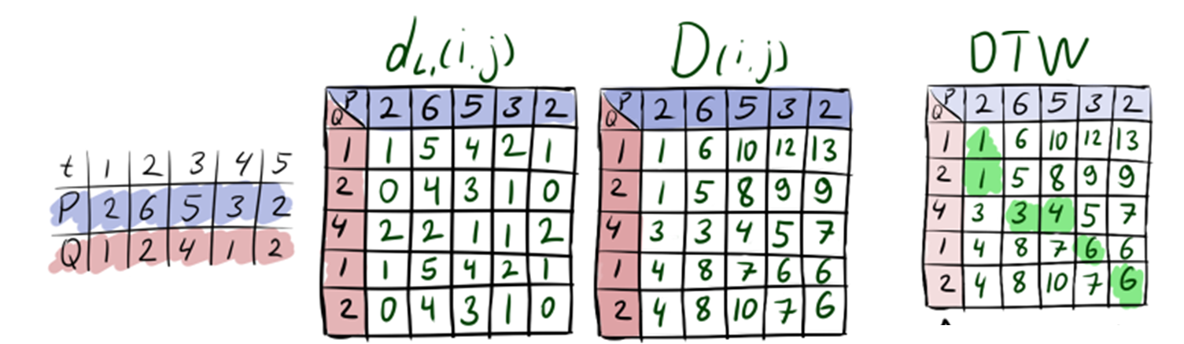
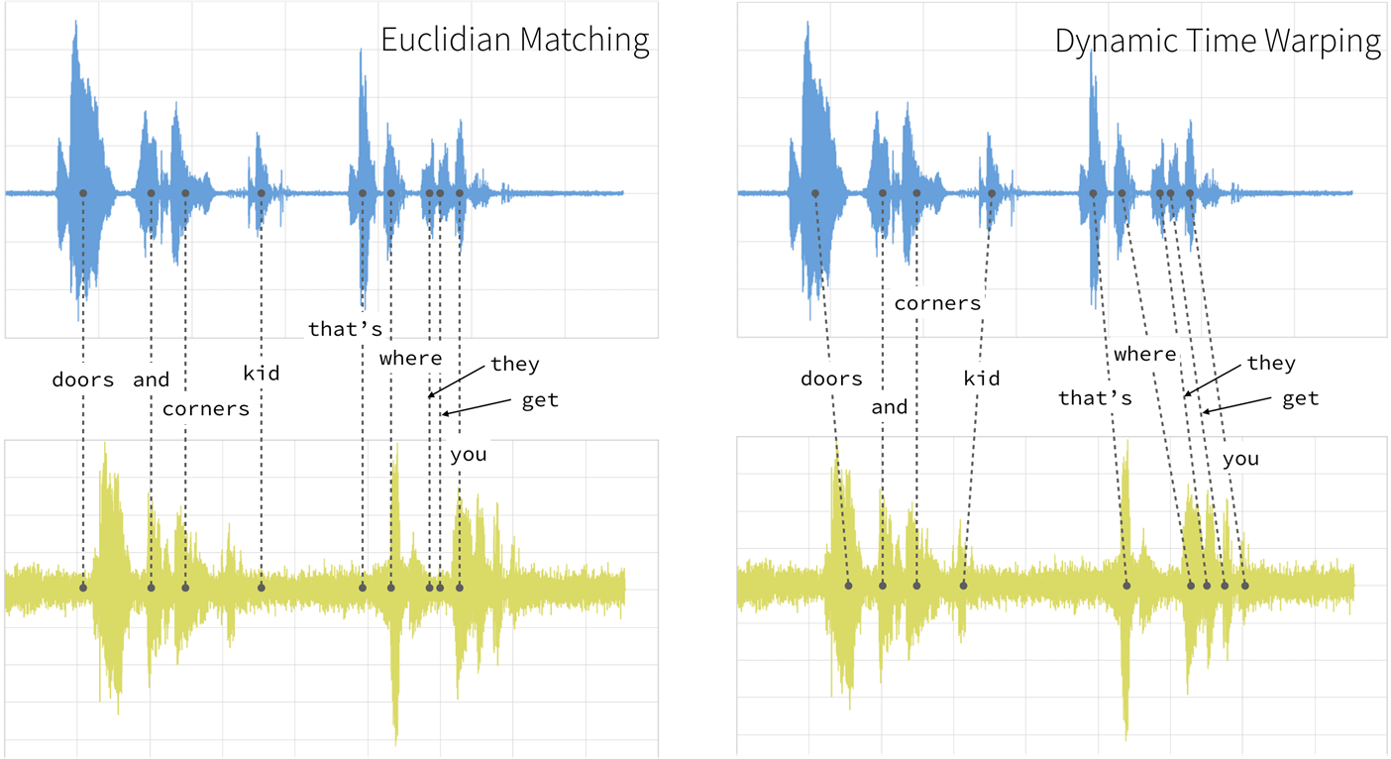
Dynamic Time Wrapping (DTW) Distance
Example of DTW calculation
Example of DTW for speech clustering.

Slide 31
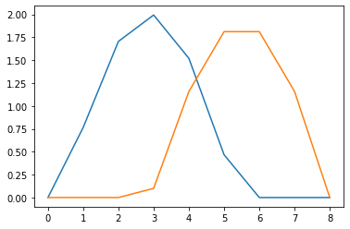
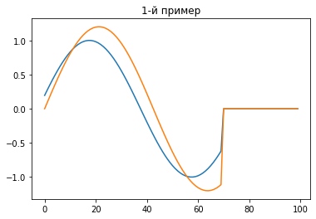
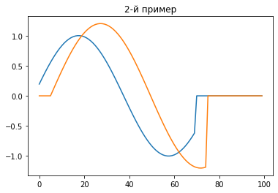
Пример DTW
DTW dist 0.558 Euclud dist 3.694
DTW dist 1.624 Euclud dist 2.379
DTW dist 1.940 Euclud dist 5.481
DTW:
Stable DTW to deformation and shifts.
In combination with 1nn (knn) (1NN-DTW) is the one of the most recommended baseline for classification.
Actually exist several types of DTW, and all of them could be combined with other distance to the so-called elastic ensembles
Better work with same in shape problems

Slide 32
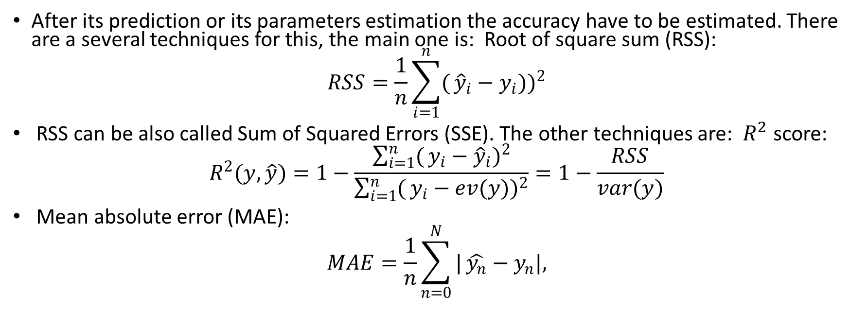
Accuracy metrics
After its prediction or its parameters estimation the accuracy have to be estimated. There are a several techniques for this, the main one is: Root of square sum (RSS):
$$RSS=\frac{1}{n}\sum_{i=1}^{n}{(}{\hat{y}}_{i}−y_{i}))^{2}$$
RSS can be also called Sum of Squared Errors (SSE). The other techniques are: $R^{2}$ score:
$$R^{2}(y,\hat{y})=1−\frac{\sum_{i=1}^{n}{(}y_{i}−{\hat{y}}_{i})^{2}}{\sum_{i=1}^{n}{(}y_{i}−ev(y))^{2}}=1−\frac{RSS}{var(y)}$$
Mean absolute error (MAE):
$$MAE=\frac{1}{n}\sum_{n=0}^{N}{|}\hat{y_{n}}−y_{n}|,$$

Slide 33
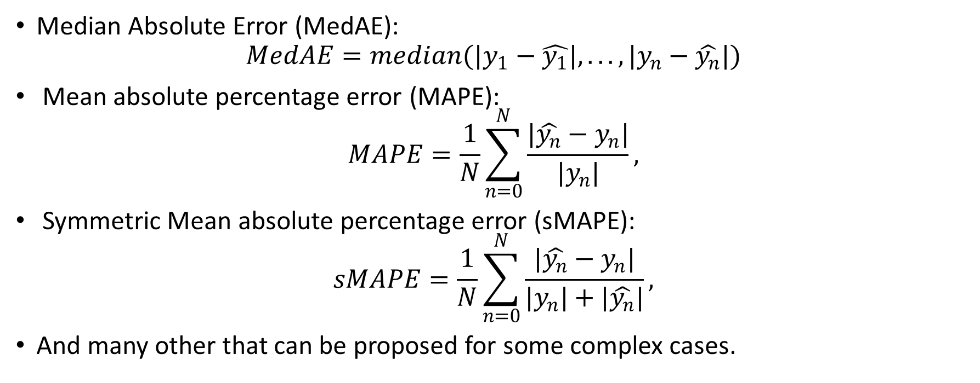
Accuracy metrics
Median Absolute Error (MedAE):
$$MedAE=median(|y_{1}−\hat{y_{1}}|,...,|y_{n}−\hat{y_{n}}|)$$
Mean absolute percentage error (MAPE):
$$MAPE=\frac{1}{N}\sum_{n=0}^{N}{\frac{|\hat{y_{n}}−y_{n}|}{|y_{n}|}},$$
Symmetric Mean absolute percentage error (sMAPE):
$$sMAPE=\frac{1}{N}\sum_{n=0}^{N}{\frac{|\hat{y_{n}}−y_{n}|}{|y_{n}|+|\hat{y_{n}}|}},$$
And many other that can be proposed for some complex cases.

Slide 34
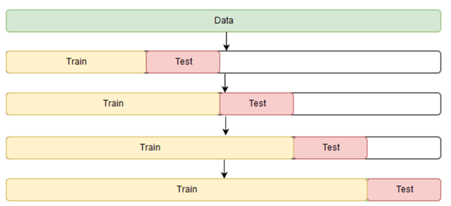
Cross-validation
It is have to be noted that the error value depends on the parameters (i.e. features) of a chosen algorithm.
These parameters as a rule can be optimized using some part of a series as testing (or validation samples) in opposite to other which is taken as training one. This routine is known as cross-validation.
In analogue to k-fold it can be introduced cross-validation on a rolling basis technique.

Slide 35
Time Series Clustering. Methods of clustering K-means
There are exist a plenty methods of clustering, most popular of them are based on the K-means, and similar ideas.
K-means
The method is based on the
calculation distance between each pair of points (or patterns, set of points).
the points (or patterns, set of points) are grouped by searching its centroids (minimization of average distance value in each cluster).
The main drawback of the simple K-means method with Euclidean distance is its instability to various changing in the patterns from one segment to another, e.g. pattern phase delay, shifts, speed of changing or level difference between patterns. Thus other distances need to be used.

Slide 36
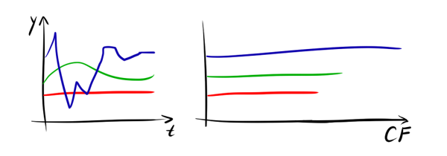
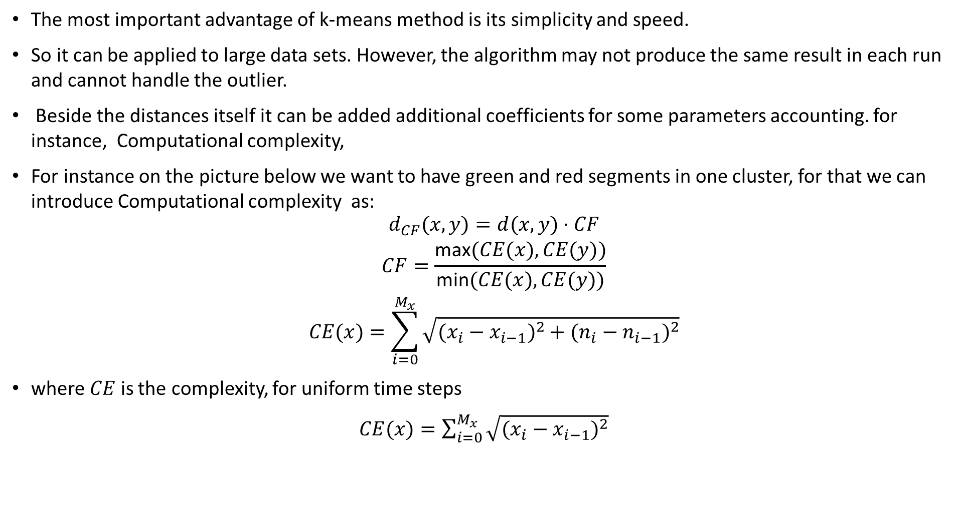
Time Series Clustering. Methods of clustering K-means
The most important advantage of k-means method is its simplicity and speed.
So it can be applied to large data sets. However, the algorithm may not produce the same result in each run and cannot handle the outlier.
Beside the distances itself it can be added additional coefficients for some parameters accounting. for instance, Computational complexity,
For instance on the picture below we want to have green and red segments in one cluster, for that we can introduce Computational complexity as:
$$\begin{matrix} & d_{CF}(x,y)=d(x,y)⋅CF \\ & CF=\frac{\text{max}(CE(x),CE(y))}{\text{min}(CE(x),CE(y))} \\ & CE(x)=\sum_{i=0}^{M_{x}}{\sqrt{(x_{i}−x_{i−1})^{2}+(n_{i}−n_{i−1})^{2}}}\end{matrix}$$
where $CE$ is the complexity, for uniform time steps
$CE(x)=\sum_{i=0}^{M_{x}}{\sqrt{(x_{i}−x_{i−1})^{2}}}$

Slide 37
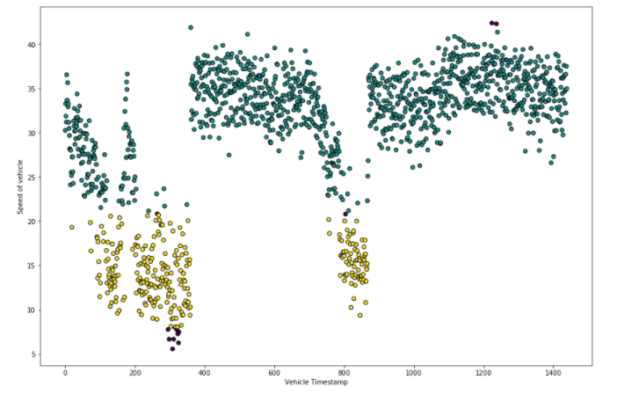
Time Series Clustering. Methods of clustering DBSCAN
Density-based spatial clustering of applications with noise (DBSCAN).
The method is the modified K-means method, but instead of the original ones
in DBSCAN we require a
maximum distance (radius of cluster)
and a minimum number of points in the cluster.
Thus, centroids are the points in which the distance less than maximum, and the number of instances is maximum ( not less than the pre-set minimum number).
Example of time series clustering made by DBSCAN

Slide 38
Time Series Clustering. Methods of clustering
Other methods of time series clustering:
Self-Organized Map (Cohenin network),
Expected Maximization (EM),
Hierarchical,
c-mean (fuzzy-logic clustering),
other more complex.

