Slide 1

How the computer works / Low-level programming
Computing At School

Slide 2
Objectives of the day
To understand the main components of a computer
To understand how a computer executes instructions
To be able to write a simple low-level program
To understand the relationship between high-level and low-level programs
To role play some activities which might be useful in the classroom
To identify further learning needs in this topic area

Slide 3
Agenda for the day
Time | Activity
9:45 | Welcome and introductions
10:00 | What is a computer?
10:15 | What’s inside?
10:45 | Activity: A simple view of how computers work
11:15 | Coffee/tea break
11:30 | How a computer executes instructions
12:15 | Using the Little Man Computer Simulator
12:45 | Lunch
13:45 | Exercises: Practise low-level programming
14:30 | Coffee/tea break
14:45 | High-level and low level programs
16:00 | Evaluation and end of day

Slide 4
What is a computer?
In groups of 3 or 4 come up with a one sentence definition of a computer.
Write your definition clearly on the flip chart paper then attach to the wall.
You have 5 minutes to agree on and write down your definition!

Slide 5
What is a computer? Some answers
An automatic, programmable digital data processor. (BCS Glossary)
A general purpose device that can be programmed to carry out a set of arithmetic or logical operations. Since a sequence of operations can be readily changed, the computer can solve more than one kind of problem.(http://Wikipedia.com)
A device that computes, especially a programmable electronic machine that performs high-speed mathematical or logical operations (http://answers.com)
A computer is a machine that performs computations according to instructions (http://wisegeek.com)

Slide 6
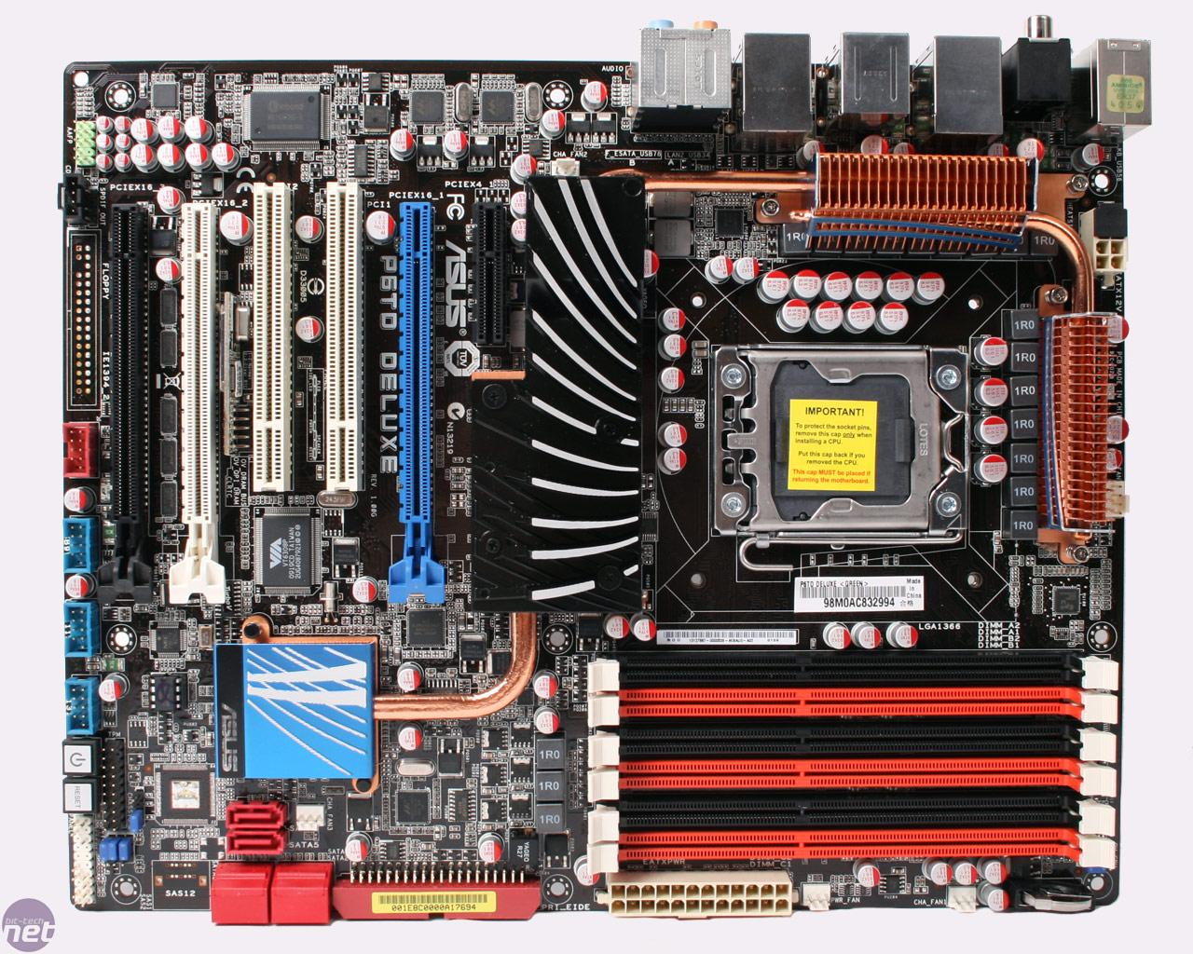
What is inside the box?
In your groups, take apart the computer on your table. Identify
Processor
Memory
Storage
Power
What else?

Slide 7

How a computer works – role play
Work in threes
One person to be:
The Display
The Memory
The Computer
Carry out the instructions given
Exercise taken from: http://cse4k12.org/how_computers_work/

Slide 8
Coffee/tea break

Slide 9
Components of the processor
Control unit
Arithmetic and logic unit
Clock
Registers
The control unit is one of the most important parts of a microprocessor for the reason that it is in charge of the machine cycle. The CPU deals with each instruction it is given in a series of steps. Each step is repeated for each instruction. This series of steps is called the fetch-execute cycle. It involves:
fetching an instruction from memory;
decoding the instruction;
transferring the data;
executing the instruction.

Slide 10
Clock speed
CPU speed is often measured in Hertz [Hz] which is simply cycles per second. One thousand Hertz = 1kHz (kilohertz) One million Hertz = 1MHz (Megahertz One billion Hertz = 1GHz (Gigahertz) One thousand billion Hertz = 1 THz (Terahertz)

Slide 11
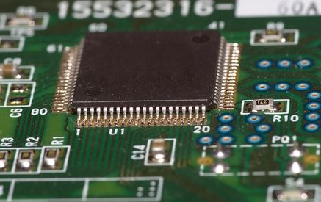
What affects performance?
Clock speed
Cache size
Number of cores

Slide 12
Computers are devices for executing programs
When a program runs on a computer it must be loaded into main memory first. The processor then repeatedly fetches and executes the next instruction from main memory
Fetch
Decode
Execute

Slide 13
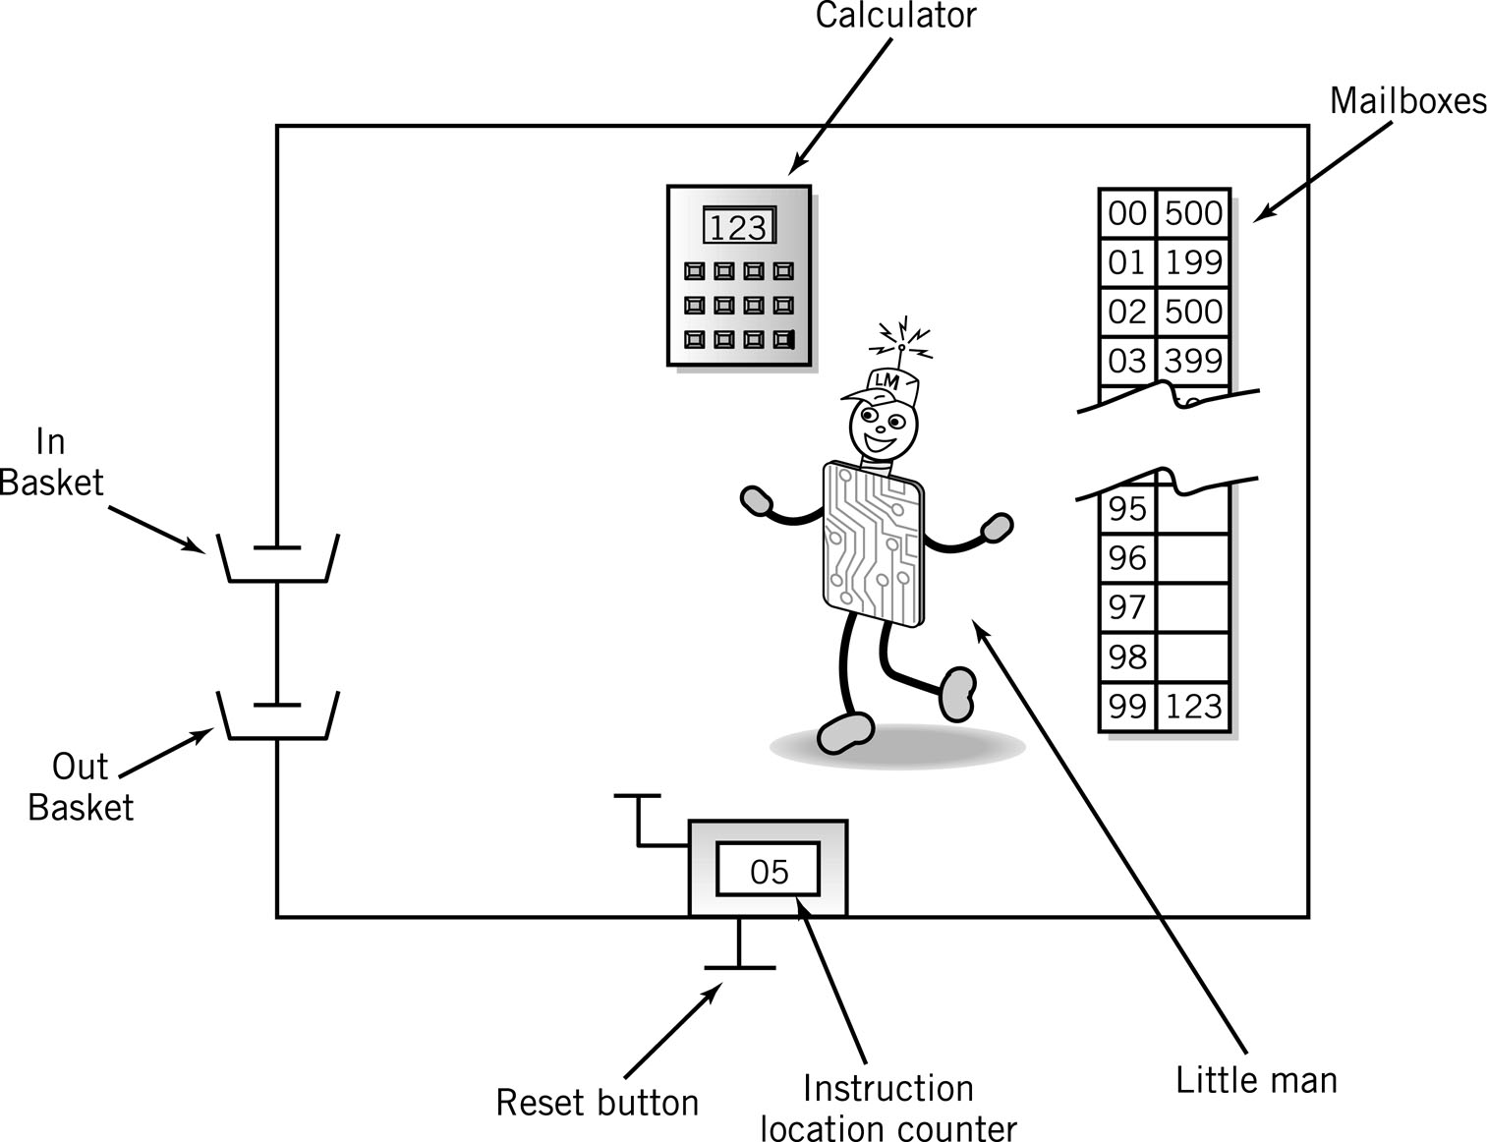
The Little Man Computer

Slide 14
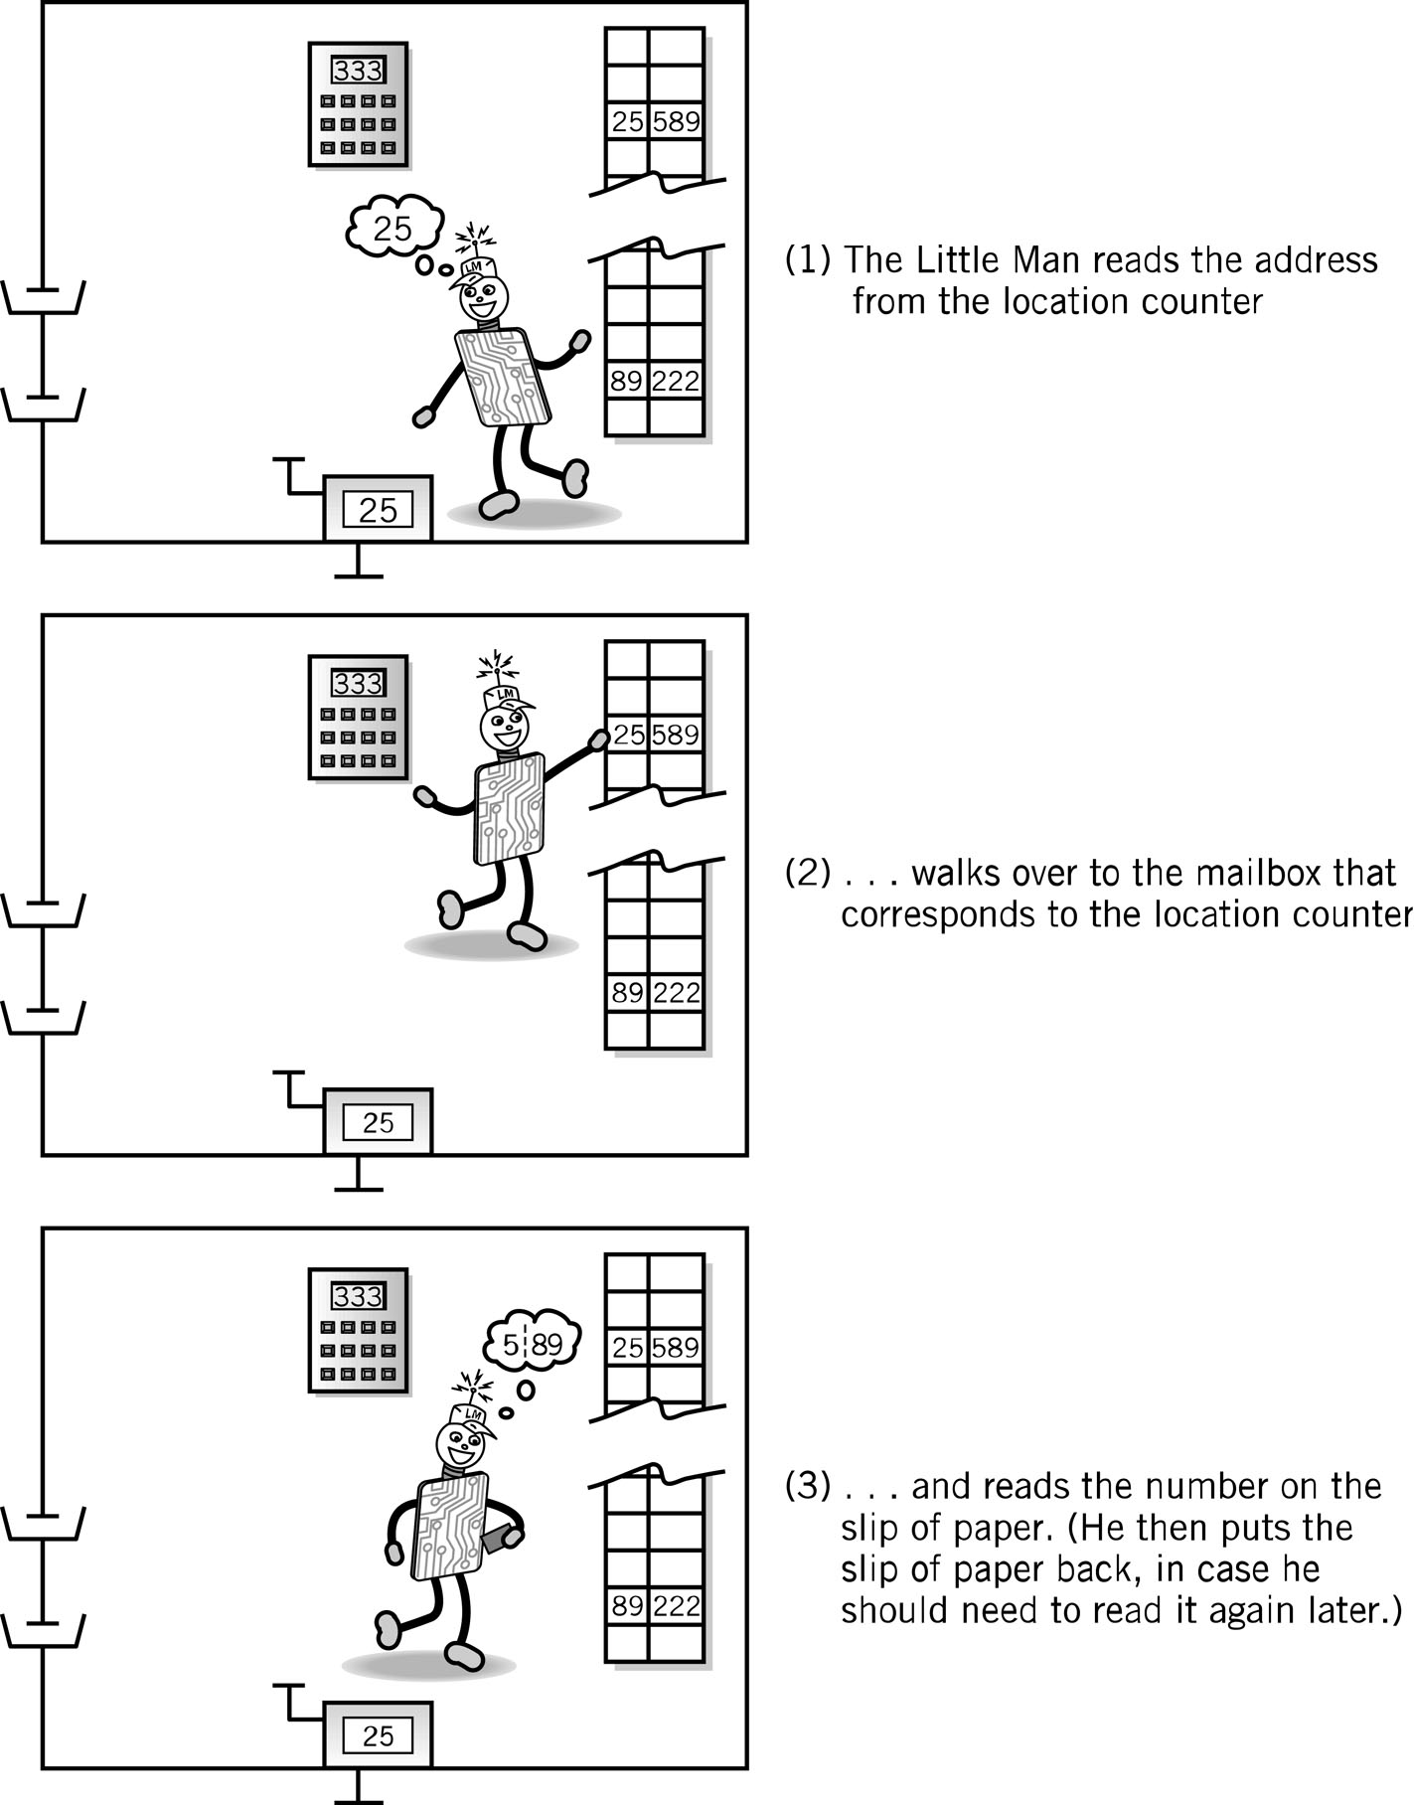
Fetch Portion of Fetch and Execute Cycle
1. Little Man reads the address from the location counter
2. He walks over to the mailbox that corresponds to the location counter

Slide 15
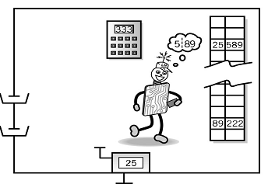
Fetch, cont.
3. And reads the number on the slip of paper (he puts the slip back in case he needs to read it again later)

Slide 16
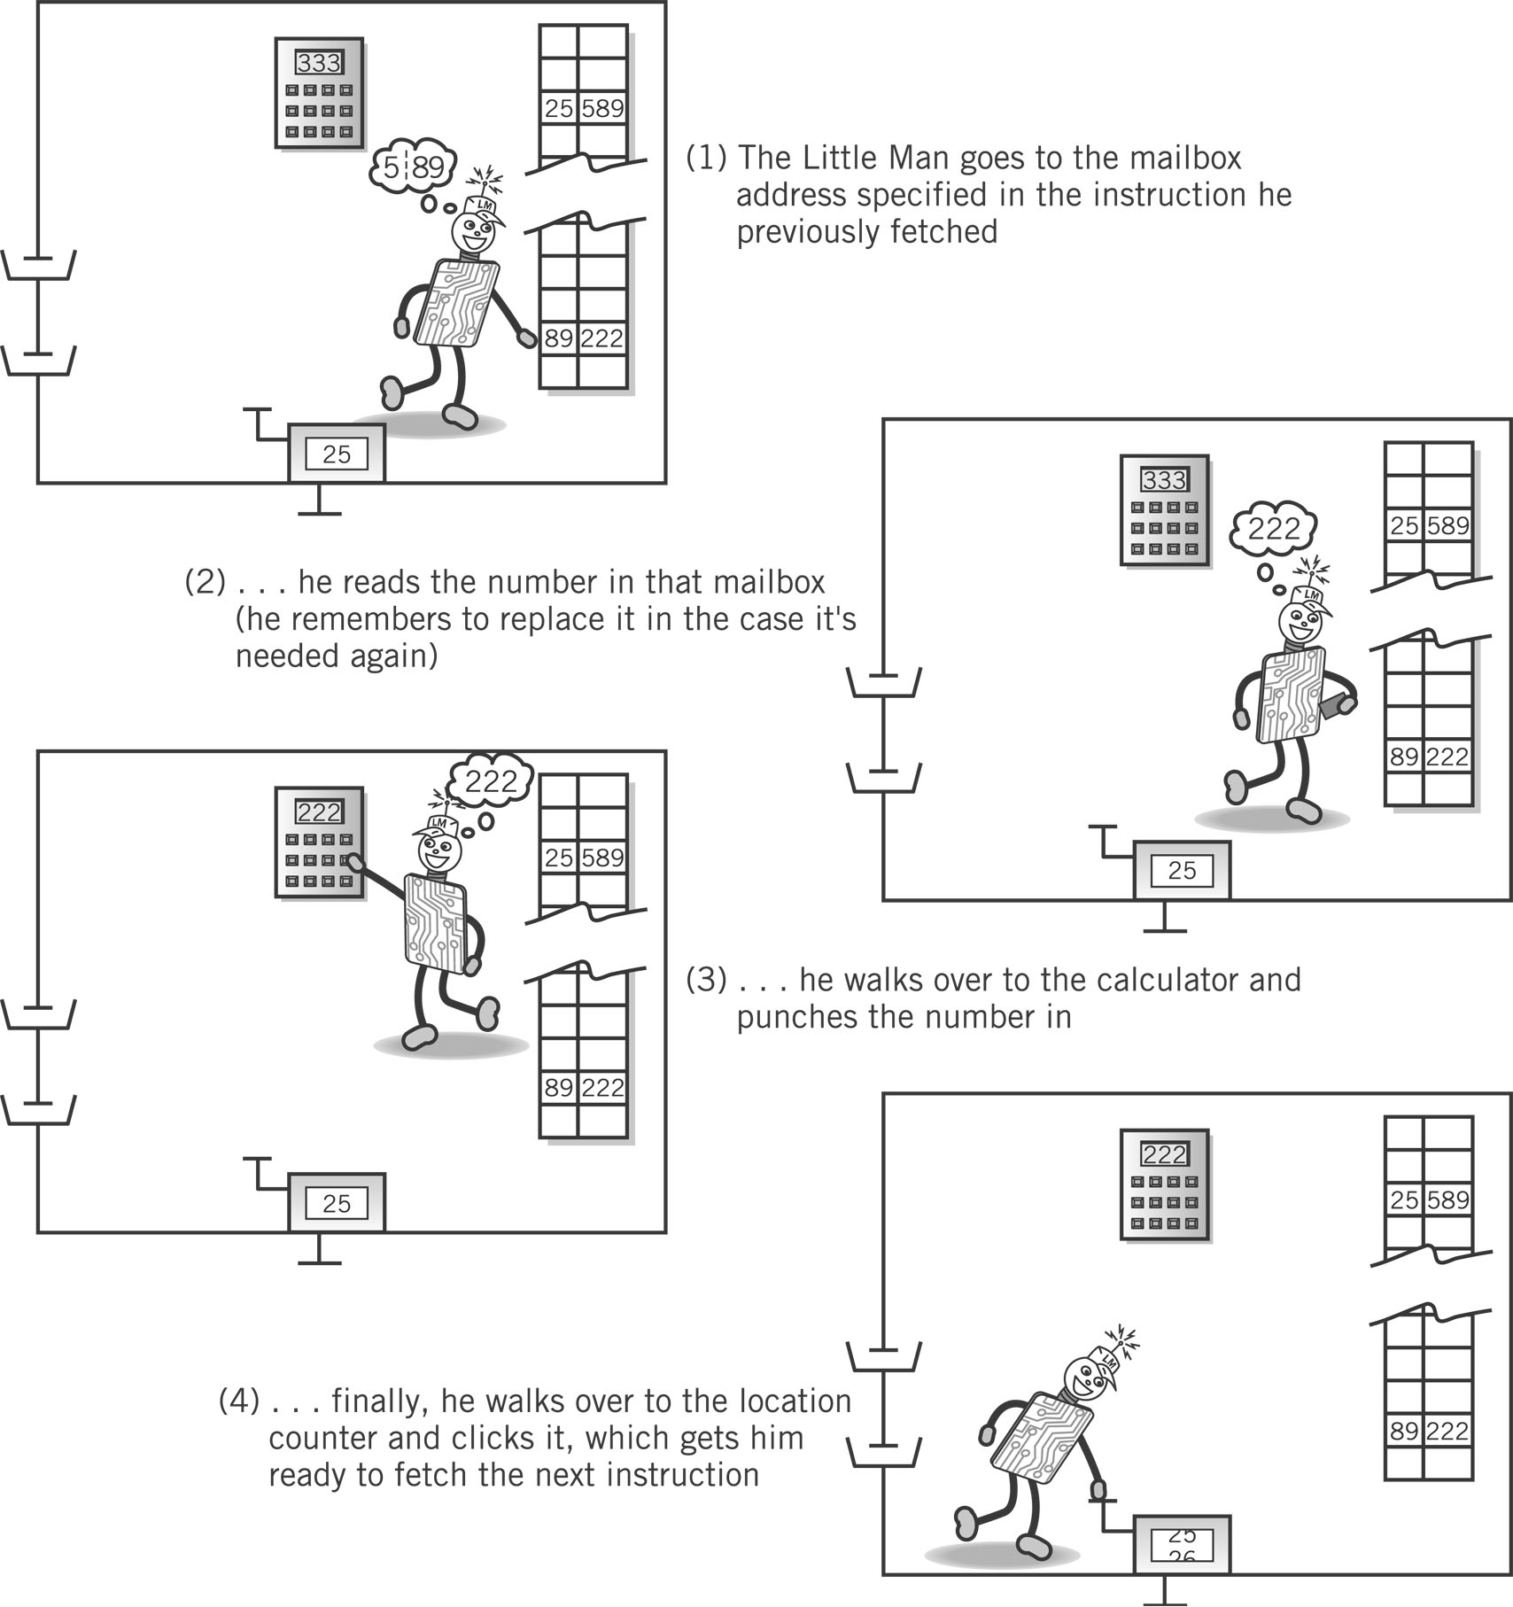
Execute Portion
1. The Little Man goes to the mailbox address specified in the instruction he just fetched.
2. He reads the number in that mailbox (he remembers to replace it in case he needs it later).

Slide 17
Execute, cont.
3. He walks over to the calculator and punches the number in.
4. He walks over to the location counter and clicks it, which gets him ready to fetch the next instruction.

Slide 18
The Little Man Computer
decode the instruction (includes finding the mailbox number for the data it will work on) (say it says get data from box 42)
fetch the instruction from the mailbox with that number
This gives us a fetch-execute cycle as follows:
store the new data in the mailbox from which the old data was retrieved
fetch the data from the mailbox with the number found in the previous step (for example, store the data in the accumulator)
repeat the cycle or halt
execute the instruction
increment the Program Counter (so that it contains the mailbox number of the next instruction)
check the Program Counter for the mailbox number that contains a program instruction (e.g. zero)

Slide 19
The set of instructions LMC works with
Numeric code | Mnemonic code | Instruction
1xx | ADD | ADD
2xx | SUB | SUBTRACT
3xx | STA | STORE
5xx | LDA | LOAD
6xx | BRA | BRANCH (unconditional)
7xx | BRZ | BRANCH IF ZERO (conditional)
8xx | BRP | BRANCH IF POSITIVE (conditional)
901 | INP | INPUT
902 | OUT | OUTPUT
000 | HLT/COB | HALT/COFFEE BREAK
 | DAT | DATA

Slide 20
LMC Input/Output
 | Op Code | Operand (address)
INP (input) | 9 | 01
OUT (output) | 9 | 02
IN
OUT
Slides adapted from here

Slide 21
LMC Internal Data
 | Op Code | Operand (address)
STA (store) | 3 | xx
LDA (load) | 5 | xx
LDA
STO

Slide 22
LMC Arithmetic Instructions
 | Op Code | Operand (address)
ADD | 1 | xx
SUB | 2 | xx
ADD
SUB

Slide 23
Simple Program: Add 2 Numbers
Input a number
Assume data is stored in mailboxes with addresses >90
Write instructions
Store the number
Input a number
Add
Output the
number

Slide 24
Program to Add 2 Numbers: Using Mnemonics
Mailbox | Mnemonic | Instruction Description
00 | INP | Input 1st Number
01 | STA :NUM | store data at position NUM
02 | INP | input 2nd Number
03 | ADD 99 | add 1st # to 2nd #
04 | OUT | output result
05 | HLT | stop
06 | NUM: | data label

Slide 25
Little Man Computer simulator
Two versions (at least):
Riven LMC simulator applet
Atkinson LMC simulator applet
The screenshots and examples here use the River applet but the other version is similar

Slide 26
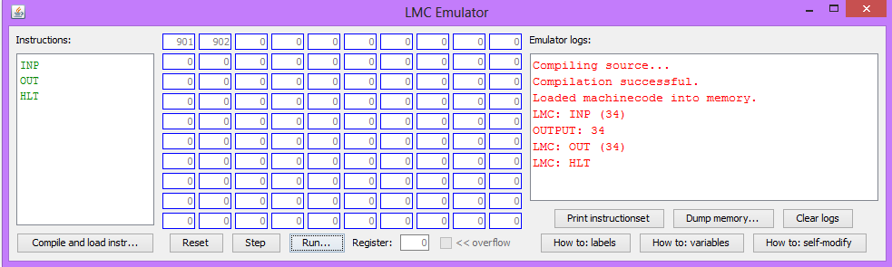
Using the LMC Applet (Riven)
4. Instructions appear in the “mailboxes”
1. Enter program here
2. Compile and load
3. Run program,

Slide 27
Exercise: enter and run this program
Mnemonic | Instruction Description
INP | ; input a number
OUT | ; output result
HLT | ; stop

Slide 28
Lunch

Slide 29
Recap of LMC instruction set
Numeric code | Mnemonic code | Instruction
1xx | ADD | ADD
2xx | SUB | SUBTRACT
3xx | STA | STORE
5xx | LDA | LOAD
6xx | BRA | BRANCH (unconditional)
7xx | BRZ | BRANCH IF ZERO (conditional)
8xx | BRP | BRANCH IF POSITIVE (conditional)
901 | INP | INPUT
902 | OUT | OUTPUT
000 | HLT/COB | HALT/COFFEE BREAK
 | DAT | DATA

Slide 30
Exercises using Little Man Computer
Write a program to input a number, store the number as a data item, output the same number and then stop
Write a program to input two numbers and store each in data areas called FIRST and SECOND. Then your program should output both numbers
Write a program to ask for 2 numbers and add them to give a total. Output the total.
Write a program which inputs 2 numbers and takes the second one away from the first, outputting the answer.
Write a program that will ask for numbers until the number 0 is entered. Then the program should output the total (use a BRA and a BRZ).
EXTENSION: Write a program that will outputs 5, 4, 3, 2, 1 and then stops (use a BRA and a BRZ).

Slide 31
Answers: Exercise 1
INP
STA :NUMBER OUT
HLT
NUMBER:

Slide 32
Answers: Exercise 2
INP STA :FIRST INP STA :SECOND LDA :FIRST OUT LDA :SECOND OUT HLT FIRST: SECOND:

Slide 33
Answers: Exercise 3
Write a program to ask for 2 numbers and add them to give a total. Output the total.
INP STA :FIRST INP ADD :FIRST
OUT HLT
FIRST:

Slide 34
Answers: Exercise 4
Write a program which inputs 2 numbers and takes the second one away from the first, outputting the answer.
INP //value to subtract
STA :FIRST INP // to subtract from
SUB :FIRST
OUT
HLT
FIRST: // data item

Slide 35
Answers: Exercise 5
Write a program that will ask for numbers until the number 0 is entered. Then the program should output the total (use a BRA and a BRZ).
LOOP: INP
BRZ :END
ADD :TOTAL
STA :TOTAL
BRA :LOOP
END: LDA :TOTAL
OUT
HLT
TOTAL: 0

Slide 36
Extension exercise(harder)
Write a program that will outputs 5, 4, 3, 2, 1 and then stops (use a BRA and a BRZ).
LOOP: LDA :COUNT // Count is initialised to 5
BRZ :END // Branch if zero to label END
OUT
SUB :ONE // Subtract value at label ONE
STA :COUNT // Store new value in COUNT
BRA :LOOP // Branch back to LOOP
END:
HLT
COUNT: 5
ONE: 1

Slide 37
Discussion – in groups
What can students learn from the Little Man Computer model?
How might you teach this?
What might be the challenges?

Slide 38
Coffee/tea break

Slide 39
Relationship between high-level and low-level programming

Slide 40
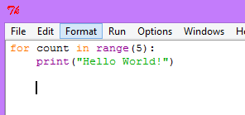
High-level and low-level comparisons
Low level program
Write the code for the program to the right
How many more statements do you need?
High level program

Slide 41
START:
LDA :ZERO
STA :RESULT
STA :COUNT
INP
BRZ :END STA :VALUE
LOOP: LDA :RESULT ADD :
STA :RESULT
LDA :COUNT
ADD :ONE
STA :COUNT
SUB :VALUE
BRZ :ENDLOOP
BRA :LOOP
ENDLOOP: LDA :RESULT
OUT
BRA :START
END: HLT
RESULT:
COUNT:
ONE: 1 /
VALUE:
ZERO:
1. What does this low-level program do?
3. Implement in a high level language
What are the differences?
2. Add comments then get working in LMC

Slide 42
Benefits of high-level languages
Use of sub-routines
Code is easier to follow
Code is easier to debug
Code is shorter

Slide 43
Recap – original objectives of today
To understand the main components of a computer
To understand how a computer executes instructions
To be able to write a simple low-level program
To understand the relationship between high-level and low-level programs
To role play some activities which might be useful in the classroom
To identify further learning needs in this topic area
Have you achieved some or all of these? What are your next steps?

Slide 44
Nearly the end of the day…
Complete the feedback form before you go:
https://www.surveymonkey.com/s/NoEFeedback
Your certificate will be emailed to you once you have filled in the evaluation

Slide 45
Next steps…
Discuss in pairs what you will do after this training…
Good ideas:
Keep in email contact with the trainer and other teachers
Use what you have learned in the classroom and email the trainer/other teachers to let them know how you have got on.
Find one other teacher at your school and pass on what you have learned.
Attend your local CAS Hub meeting

