Slide 1

Introduction to Programmng in Python
Computing At School

Slide 2
Objectives of the day
To introduce some basic programming principles using the Python programming language
To understand how and why variables are used
To be able to understand and write a simple if statement
To be able to understand and write a simple while loop
To reflect on ways of teaching programming in the classroom
To identify further learning needs in this topic area
Assuming you are a beginner programmer, this the beginning of your journey!

Slide 3
Agenda for the day
Time | Activity
9:45 | Welcome and introductions
10:00 | Python programming environment – using IDLE
10:30 | Programs that input and output data
11:00 | Coffee/tea break
11:15 | Conditions and changing the flow of control
12:15 | Practice: the Maze Game
13:00 | Lunch
13:45 | Using the while loop: repeating statements
14:15 | Practice: Guessing Game
14:45 | Coffee/tea break
15:00 | Practice: Creating a quiz
16:00 | Evaluation and end of day

Slide 4
Why program? … and what is computational thinking?
Computational thinking is recognised as a key skill set for all 21st-century learners – whether they intend to continue with computing science or not. It involves viewing the world through the thinking practices that software developers use to write programs.
5 main areas:
seeing a problem and its solution at many levels of detail (abstraction)
thinking about tasks as a series of steps (algorithms)
understanding that solving a large problem will involve breaking it down into a set of smaller problems (decomposition)
appreciating that a new problem is likely to be related to other problems the learner has already solved (pattern recognition)
realising that a solution to a problem may be made to solve a whole range of related problems (generalisation).
Learning to program is a way of developing these skills

Slide 5
Key features of computers
Computers are deterministic: they do what you tell them to do. This is news to many, who think of them as pure magic.
Computers are precise: they do exactly what you tell them to do.
Computers can therefore be understood; they are just machines with logical working.

Slide 6
Why Python?
Once you learn one programming language you will find it easy to pick up others – it does not really matter which one you start with
Python has become popular because it has a simple syntax, is free, and works on any platform. It is thought to be a good language for beginners.
Most students will be moving from a visual programming environment (Scratch, Kodu, Alice) to a text-based programming language at some stage – whatever language they learn there will be a jump for them.
The concepts underlying every programming language are the same. Only practice makes you a better programmer!

Slide 7
Python demonstration
Using the interpreter window (the “Shell”)
Using the editor and saving and running programs
Introducing variables
Input and output
Two data types: string and integer

Slide 8
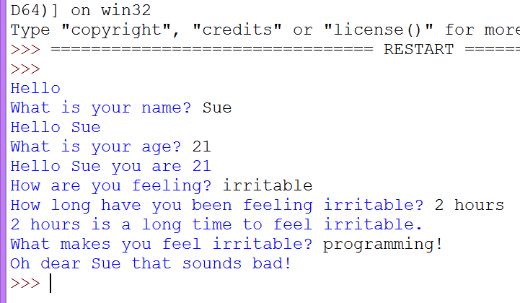
Exercise: Therapy program
Write a program to have a dialogue with the user asking how they are and giving some suitable feedback – be sympathetic and ask more questions!
Extension:
Carry on with more exercises found here:
Stuck? To repeat the demonstrations you have seen go to:
http://pythonschool.net

Slide 9
Coffee/tea break

Slide 10
Python demonstration
Using def to define a function
Selection (if… then .. else)

Slide 11
Exercises
Write a function that asks the user to input a number between 1 and 20. Give a response which indicates if the number is either within the range, too high or too low. Solution
Write a function which inputs the names of two football teams, and the score of one team followed by the score of the other team. Your function should calculate how many points each team gets (3 for a win,1 for a draw, 0 if they lose). Solution

Slide 12
Maze Game
In this task we have given you a starter program.
It is a very simple game where you win if you find a pot of gold in the middle of a maze. Your task is to extend this program to include more challenge and more twists and turns! Perhaps you could add three directions to choose from, or more choices to make.
Download the task starter program here.

Slide 13
Lunch

Slide 14
Demonstration in Python
While loops

Slide 15
Exercise: The Guessing Game
In pairs, write a program that:
Randomly generates a number between 1 and 100
Asks the user to guess it
Tells the user if the number they guessed is too high or too low
Repeats until the user guesses correctly
EXTENSION: Tell the user how many guesses they had

Slide 16
Coffee/tea break

Slide 17
Developng a quiz (consolidation)
This task uses all the programming skills you have learned today:
Variables
Assignment
If statements
While loops
In pairs, write a quiz with two questions in it. Ask the question, input the user’s answer, then give feedback as to whether it is right or wrong. Then go on to the next question. Keep count of the score.
Finish this task off at home as a take-home task if you don’t finish it today
Extension: Give three goes to get the answer right.
Stuck? Go to http://www.pythonschool.net/basics_task2/

Slide 18
Recap: Objectives of the day
To introduce some basic programming principles using the Python programming language
To understand how and why variables are used
To be able to understand and write a simple if statement
To be able to understand and write a simple while loop
To reflect on ways of teaching programming in the classroom
To identify further learning needs in this topic area
Have you achieved some or all of these? What are your next steps?

Slide 19
Nearly the end of the day…
Complete the feedback form before you go:
https://www.surveymonkey.com/s/NoEFeedback
Your certificate will be emailed to you once you have filled in the evaluation

Slide 20
Next steps…
Discuss in pairs what you will do after this training…
Good ideas:
Keep in email contact with the trainer and other teachers
Use what you have learned in the classroom and write to the trainer/other teachers to let them know how you have got on.
Continue working through the materials on http://pythonschool.net
Attend your local CAS Hub meeting

