Slide 1


Projectile Modelling in Scratch

Slide 2
Outline
Explain how we model projectiles in 2D
Explain vertical movement (up/down)
Begin creating projectiles in Scratch
Make our game 2-player!
Explain horizontal movement & add to game
Introduce Power and Angle of trajectory
Involves a bit of trigonometry, but don’t worry!

Slide 3
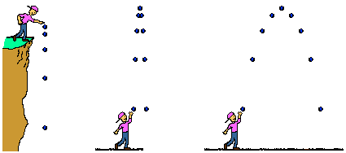
What is a projectile?
GRAVITY

Slide 4
Projectiles in 2D
Scratch exists in 2D
Two axes of movement
X direction (left/right)
Y direction (up/down)
Two velocities to deal with:
vx
vy
y
x

Slide 5
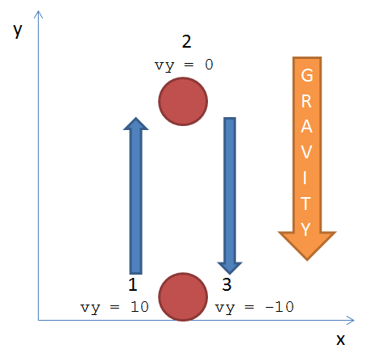
vy Movement
For now, let vx = 0
vy is given an initial value (e.g. 10)
A constant force of gravity acts on the projectile, causing vy to decrease over time

Slide 6
Let’s Scratch!

Slide 7
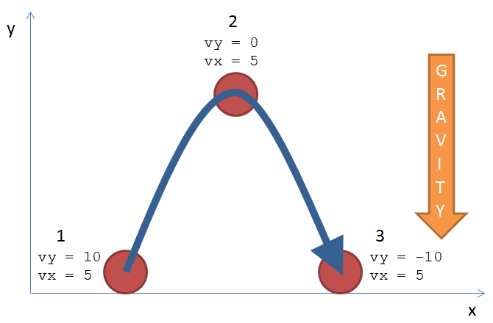
vx Movement
Is vx affected by gravity?
Nope!
Let’s add this to our game!

Slide 8
Power / Force (V) and Angle (of Trajectory)
cos(Angle) = vx / V
vx = V * cos(Angle)
Power (V)
vy
sin(Angle) = vy / V
vy = V * sin(Angle)
Projectile
Angle
vx
Ground
hyp
cos(A) = adj / hyp
sin(A) = opp / hyp
tan(A) = opp / adj
opp
SOH CAH TOA
A°
adj

