Slide 1

Project Milestone 2 Presentation
Course: ENGR 413 | AI in Engineering | Fall 2025
Team Members:
Mathias Vesterled 925032391
Lasse Schou 925033756
Shivangi Narayan 920002990
Date:
10/27/2025

Slide 2
SOCCER PREDICTOR
Goals / Milestones
  Predict outcomes of games and data
  Make it into a chatbot
Recap
  Premier league data
  Only KNN – 62% and 37%

Slide 3
Adjustments
Vision
  Add vision to extract game information from pictures
Models
  Test different models
  Tune models

Slide 4
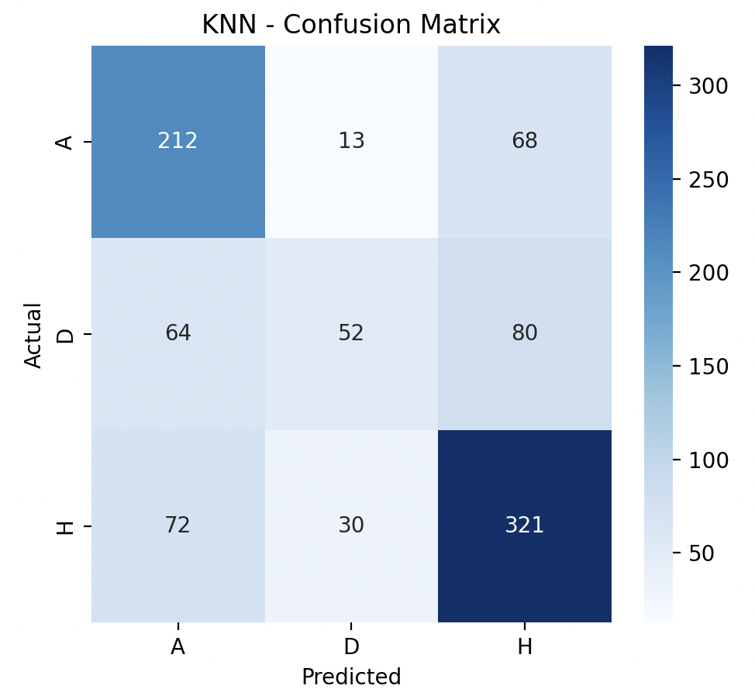
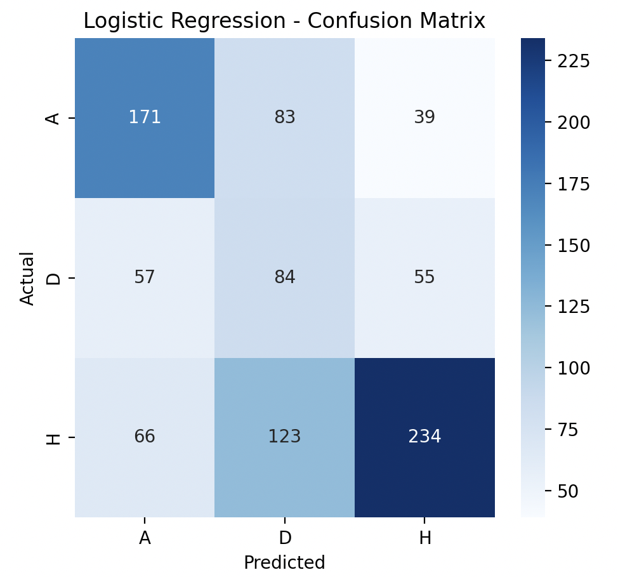
Model details
KNN
K=9
Logistic Regression
Multinomial
Class_weight = balanced
Notes:
Class_weight = balanced – because theres a lot more wins than draws. Draws underperform in dataset, dataset is unbalanced

Slide 5
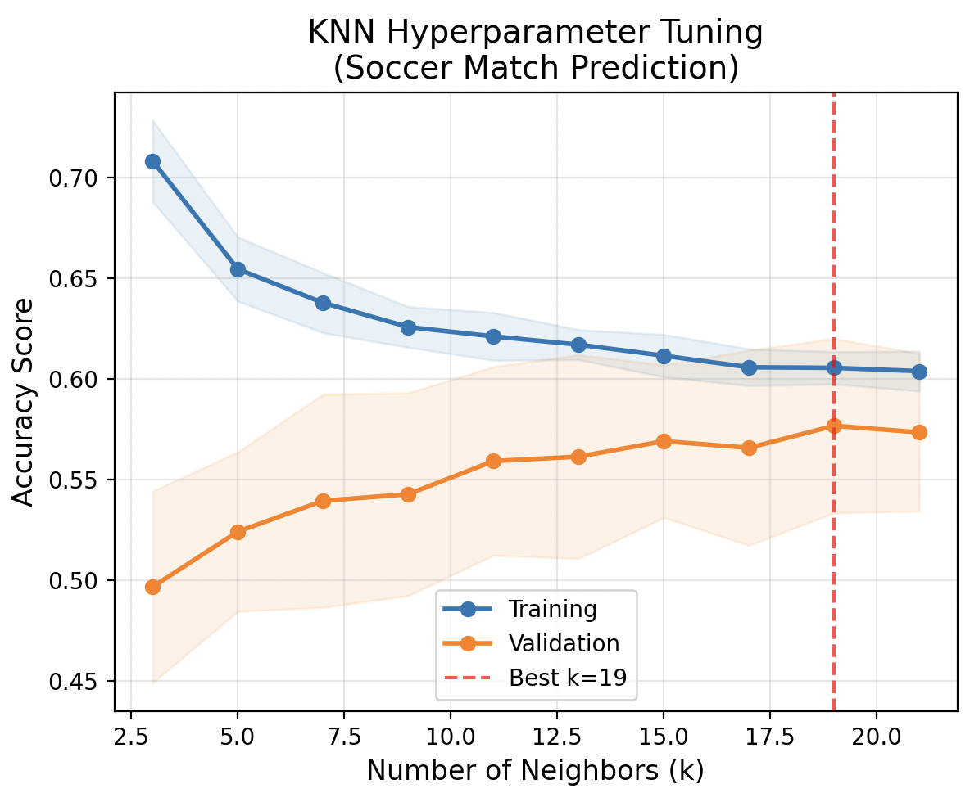
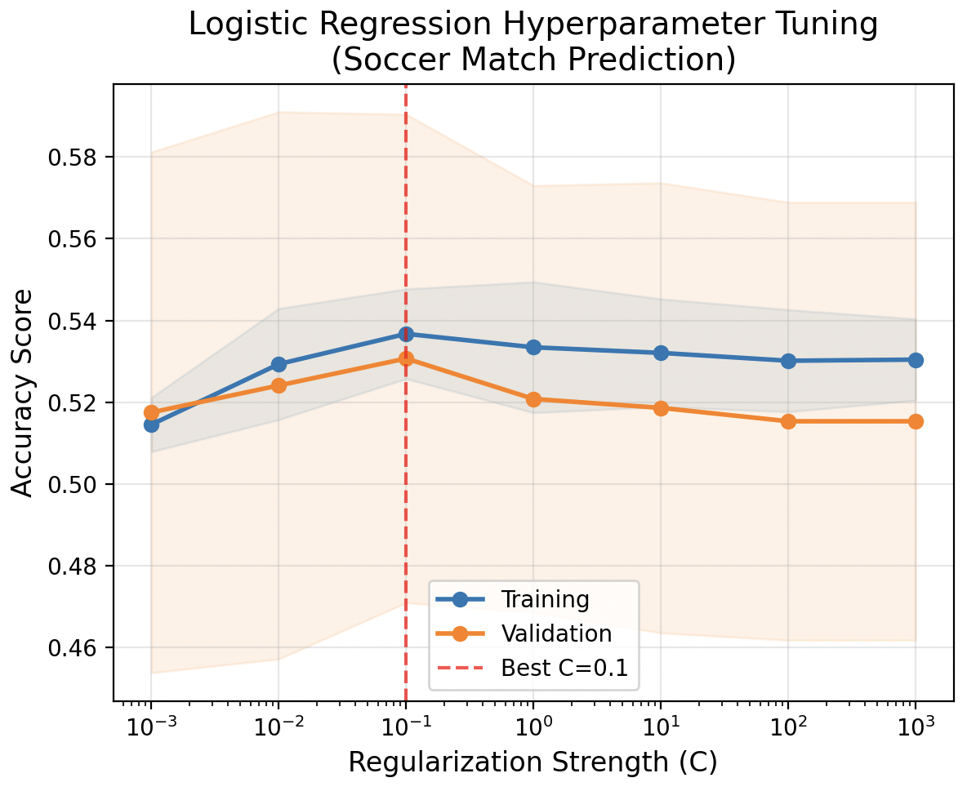
Model details
Hyperparameter tuning
Cross validation
5 folds

Slide 6
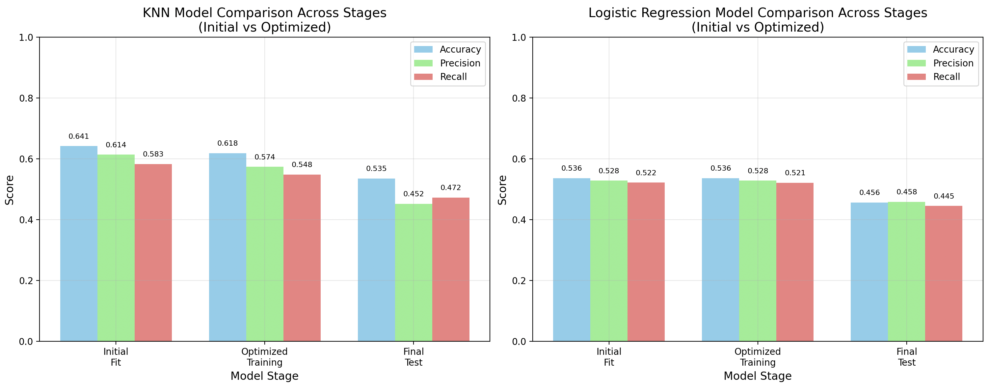
Training/Validation results
Notes:
Both models does worse in test data
KNN = overfitting
LR = underfitting

Slide 7
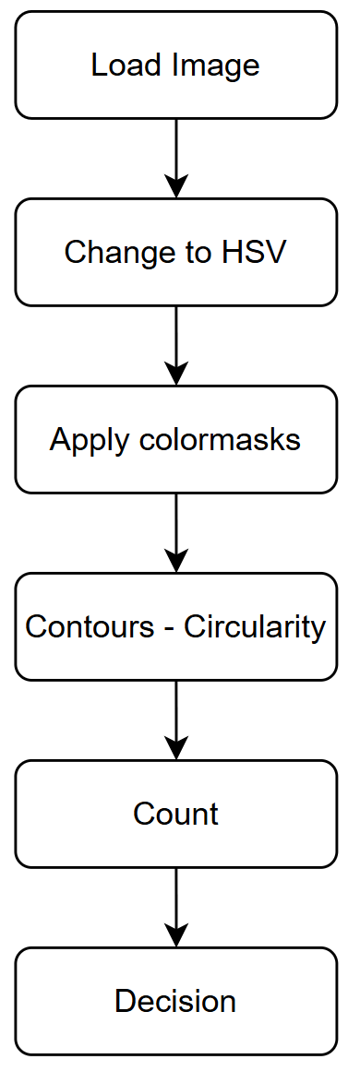
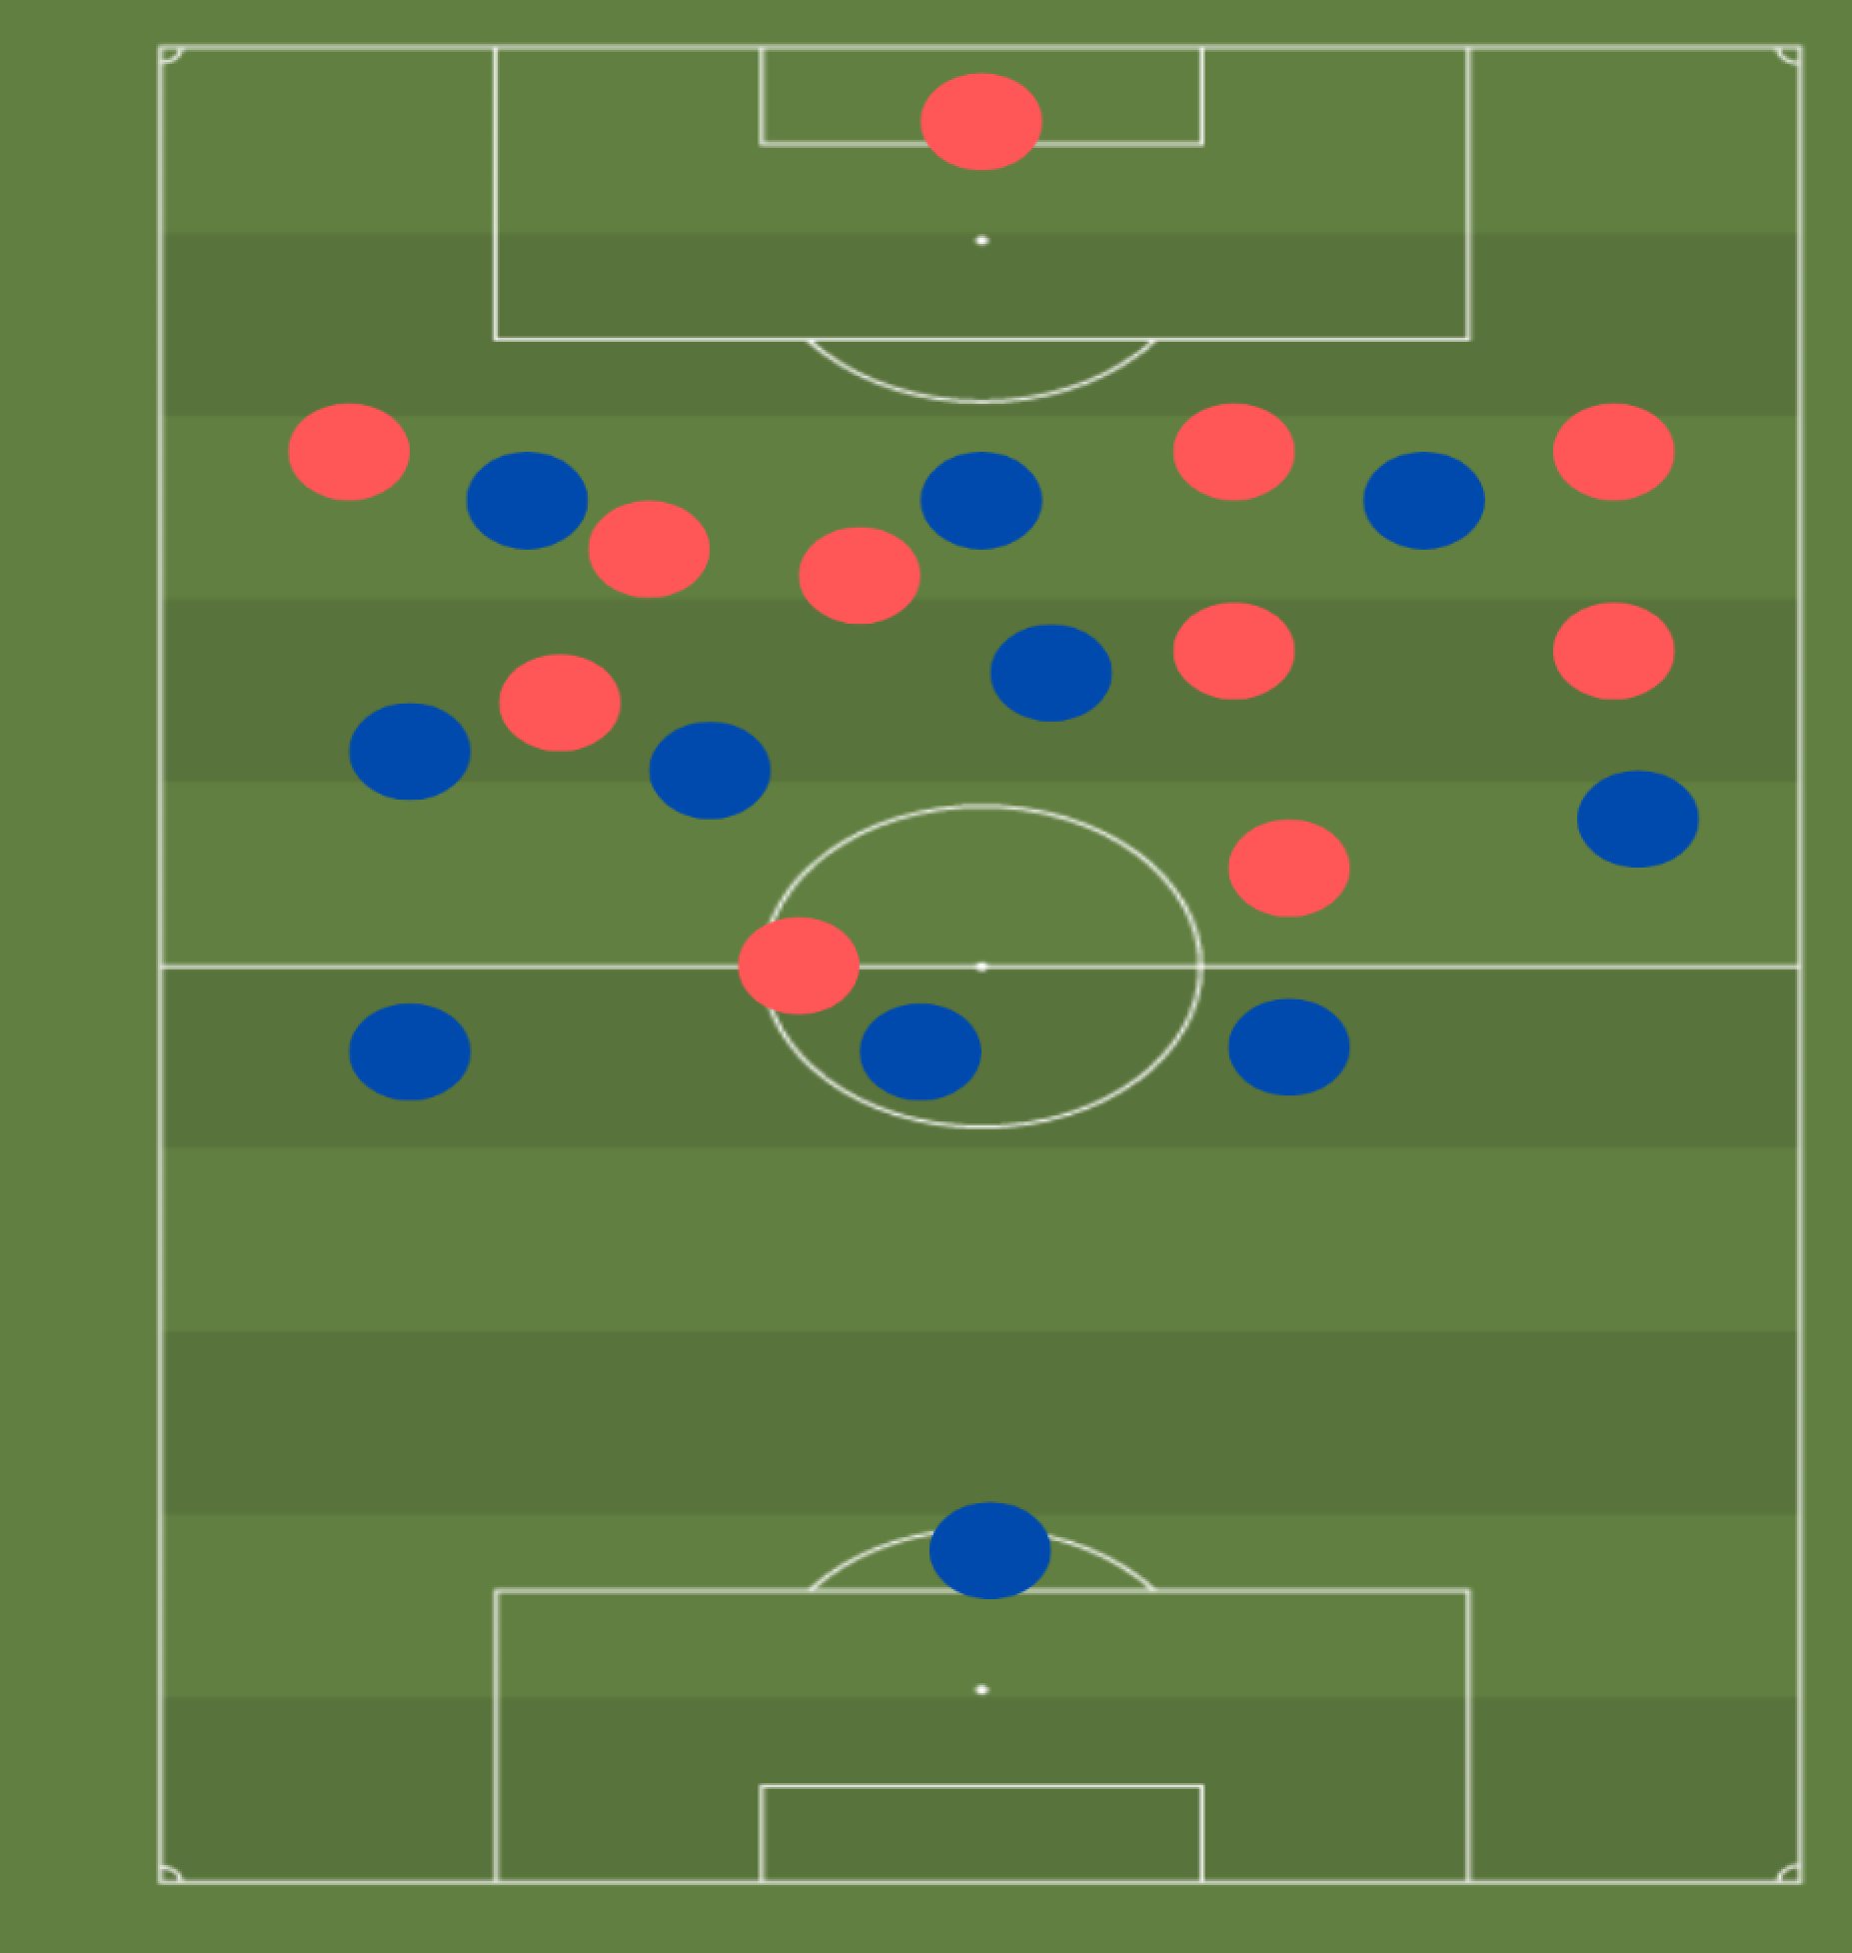
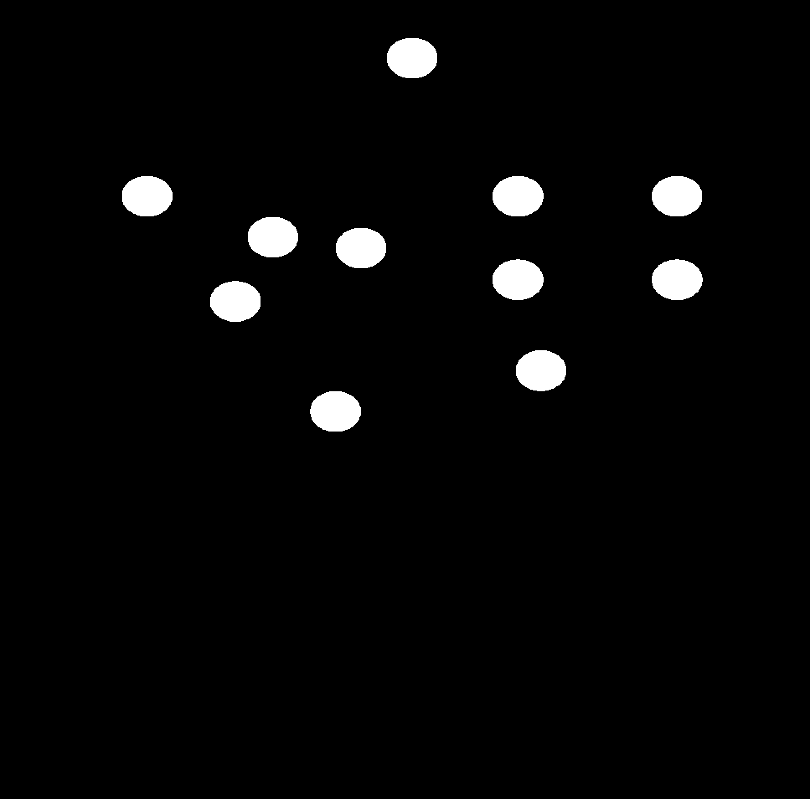
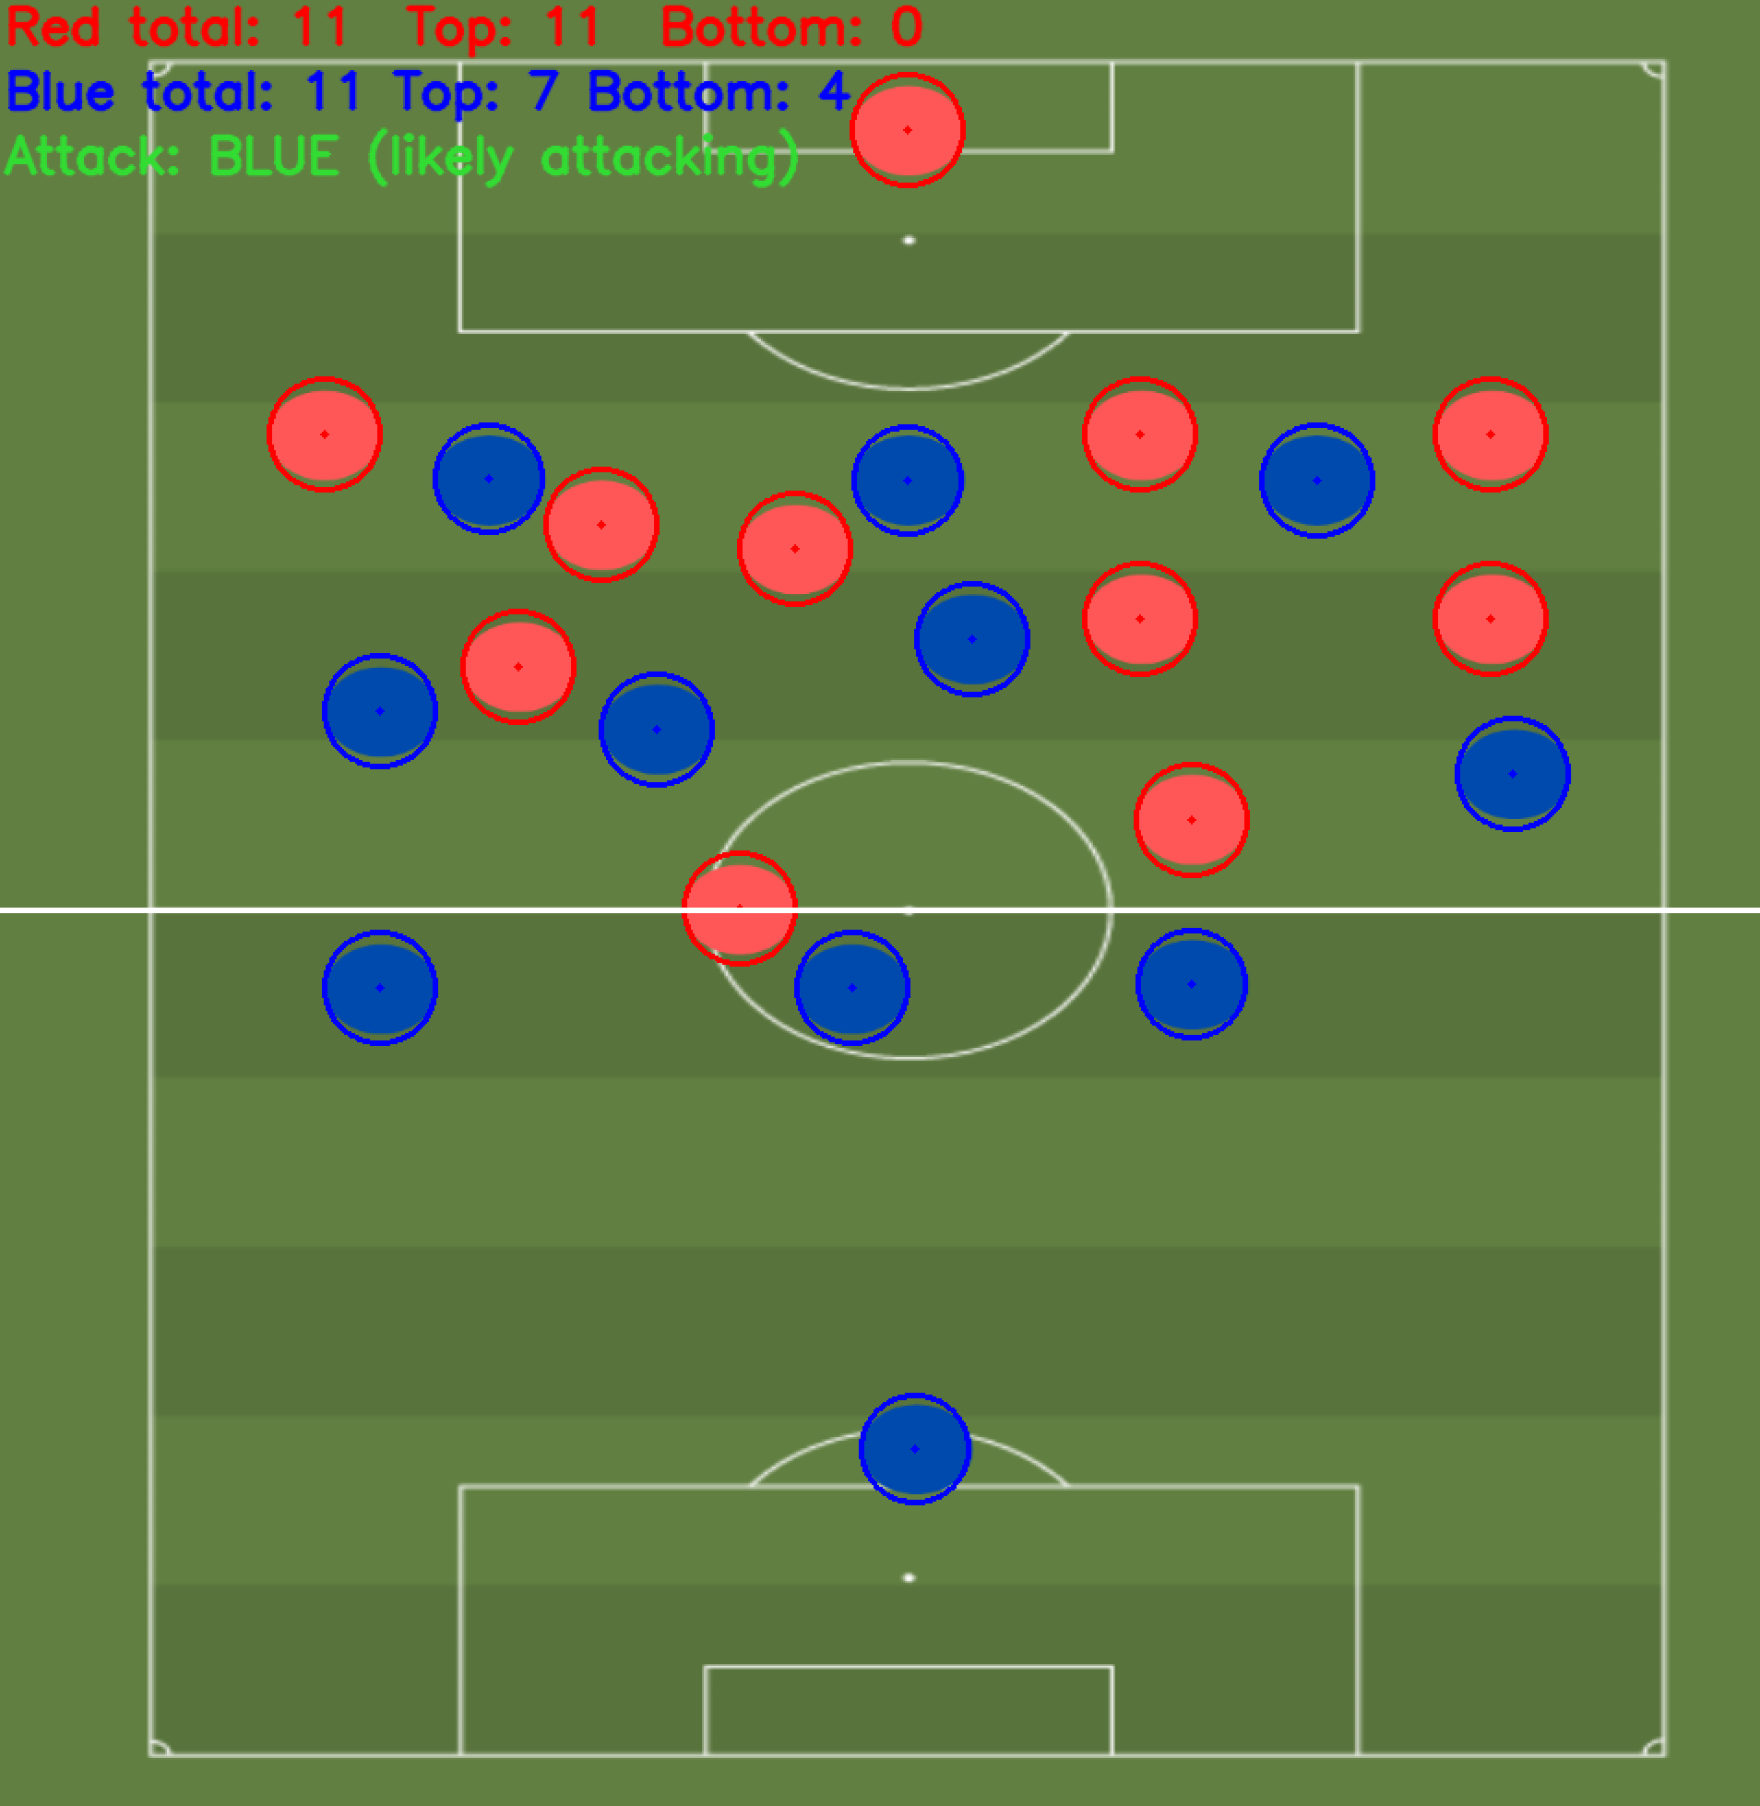

Vision
Goal
Program flow
$$Circularity=\frac{4∗π·A}{Perimeter^{2}}$$

Slide 8
Offline chatbot with ML and CV integration
Supported doc types: txt, pdf, csv
LLM model used: Tinylama
Used Ollama – runs models locally
Read doc and split text to chunks of 900 chars
Convert text chunk to vectors
Store these to ChromaDB
Use this to answer questions from the documents
Integrated it with the ML model so it can make predictions from inside that chat app.
Integrated it with Computer Vision so it can also run from inside the chat app.

Slide 9
Next steps
Build a UI so user can upload docs and images real time and ease of use.
Open to suggestions

