Slide 1

Project Milestone 1 Presentation
Course: ENGR 413 | AI in Engineering | Fall 2025
Team Members: Mathias Vesterled 925032391 Lasse Schou 925033756 Shivangi Narayan 920002990 Date: 09/29/2025

Slide 2
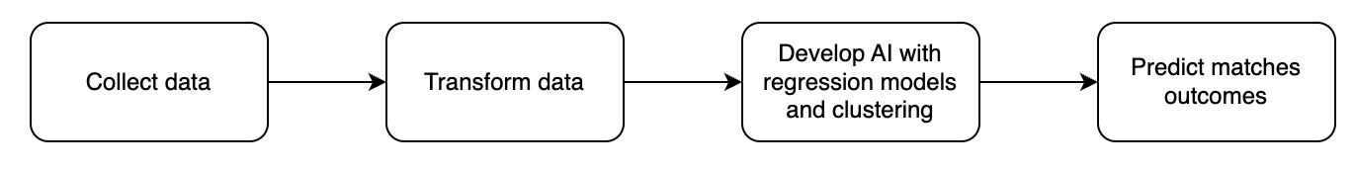

Soccer Predictor
Soccer generates massive amount of data
Challenge: transforming data into accurate predictions and insights
Develop AI to address this challenge
Predict match outcomes, key events (numbers of goals, corners etc.)
Regression models, clustering

Slide 3

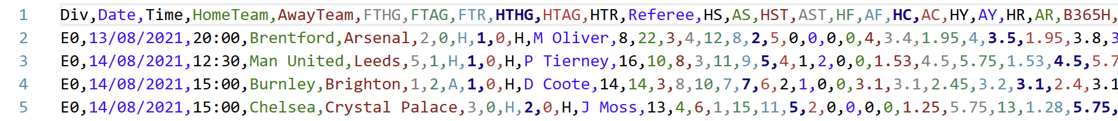
Preliminary Research & Data
Soccer analytics is based on every aspect of the game
Football-Data.co.uk
30 seasons
Bookmarker, cornerkicks, shots on target, yellow cards, referee, etc.

Slide 4
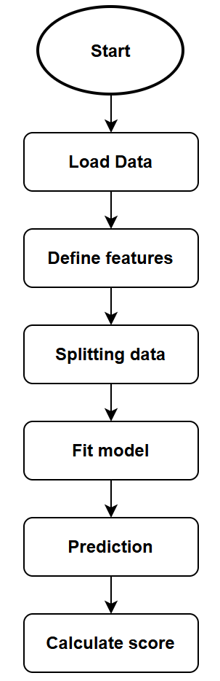
Initial Model/Approach
Features: Result
Goals
Shots on target
Corners
Fouls
Betting data
…
K – Nearest Neighbor
Features
Not tuned

Slide 5
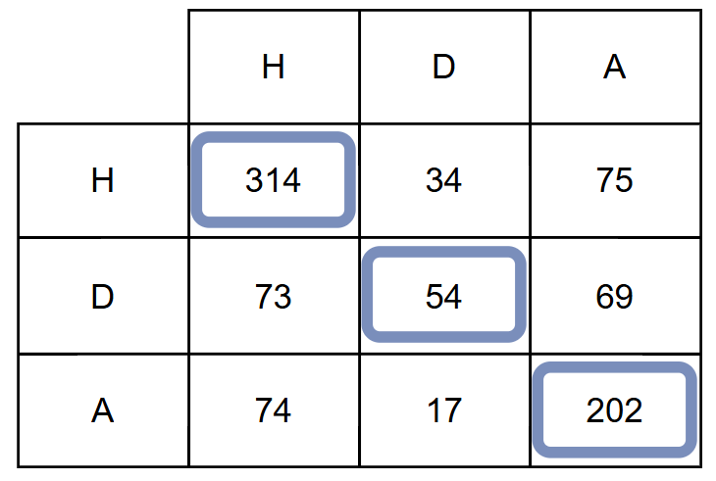

Current Status
Predicted
Do we have a prediction?
Score / Confusion matrix
Actual
$$Accuracy_{training}=\frac{TP}{Total games}=\frac{314+54+202}{912}=0.625=62.5\%$$
$$Accuracy_{test}=0.377=37.7\%$$

Slide 6
Expected Outcomes & Goals
Establish baseline models (e.g., K-NN) to predict match outcomes and key events using historical match data.
Train and evaluate advanced models (e.g., Decision Trees, Random Forests) and identify the most influential features using SHAP.
Retrain models using only the most relevant features to assess potential improvements in prediction accuracy.
Begin building a locally hosted chatbot that can answer questions based on the database.

