Slide 1
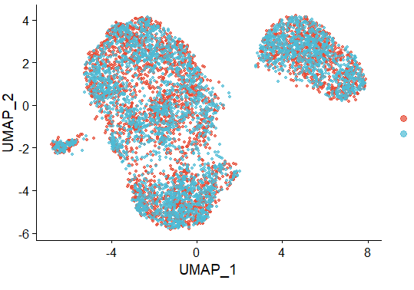
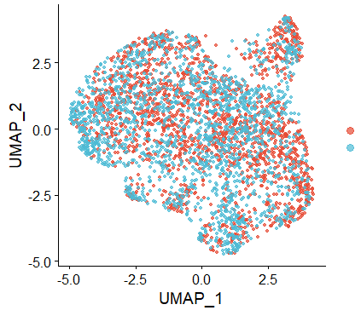
Biological replicates run on separate runs demonstrate negligible technical variation as cells overlay perfectly without application of batch-effect correction
OS17 cells in cell culture and in orthotopic lung with replicates
I: Merge Seurat Objects
OS17 – cell culture
(different passage)
OS17 – orthotopic lung
(different passage, different mouse)
Replicate - 1
Replicate - 1
Replicate - 2
Replicate - 2

Slide 2
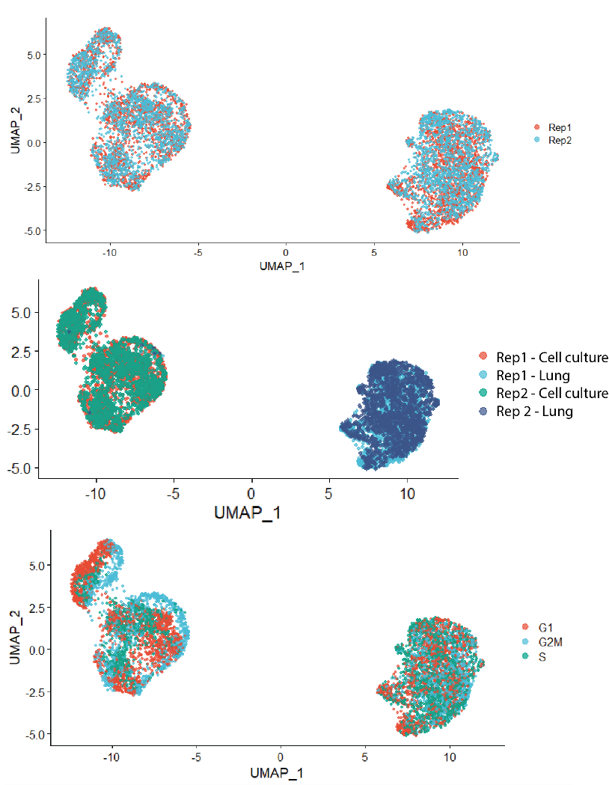
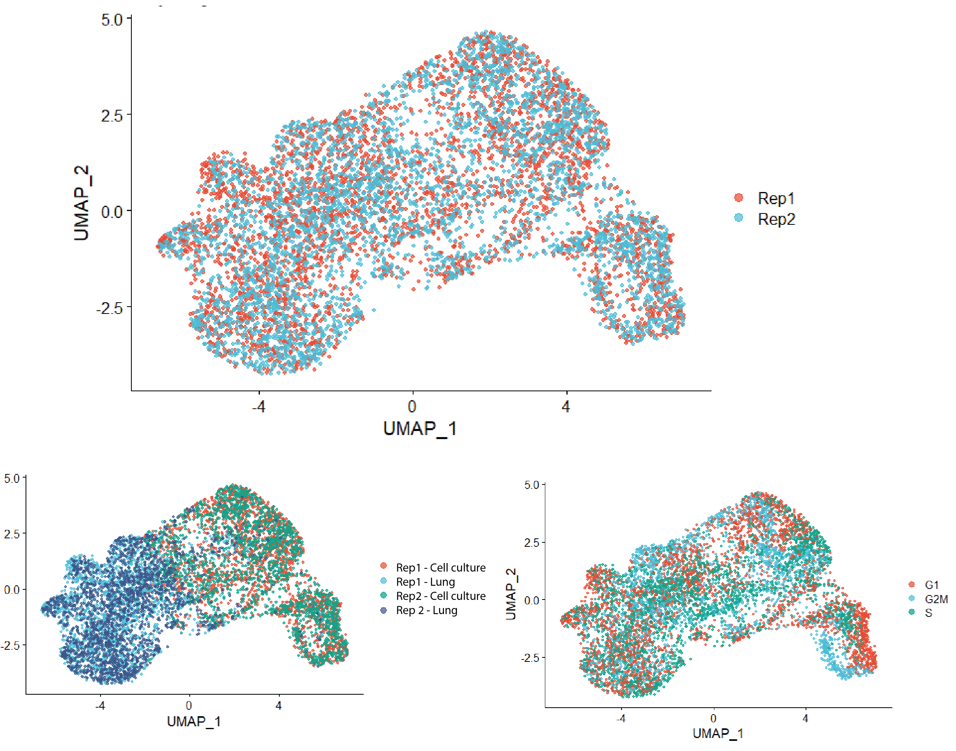
Merging Seurat objects or application of Harmony within a model generates similar trend in data and cells in merged data do not cluster based on cell cycle state
OS17 cells in cell culture and in orthotopic lung with replicates
I: Merge Seurat Objects
II: Harmony

Slide 3
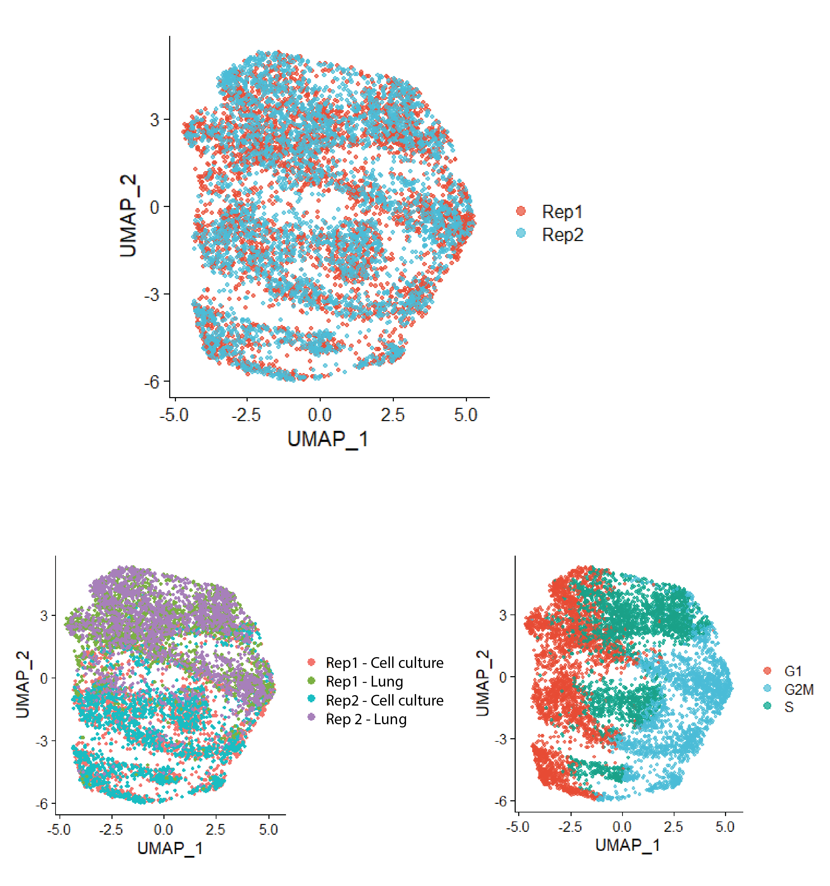
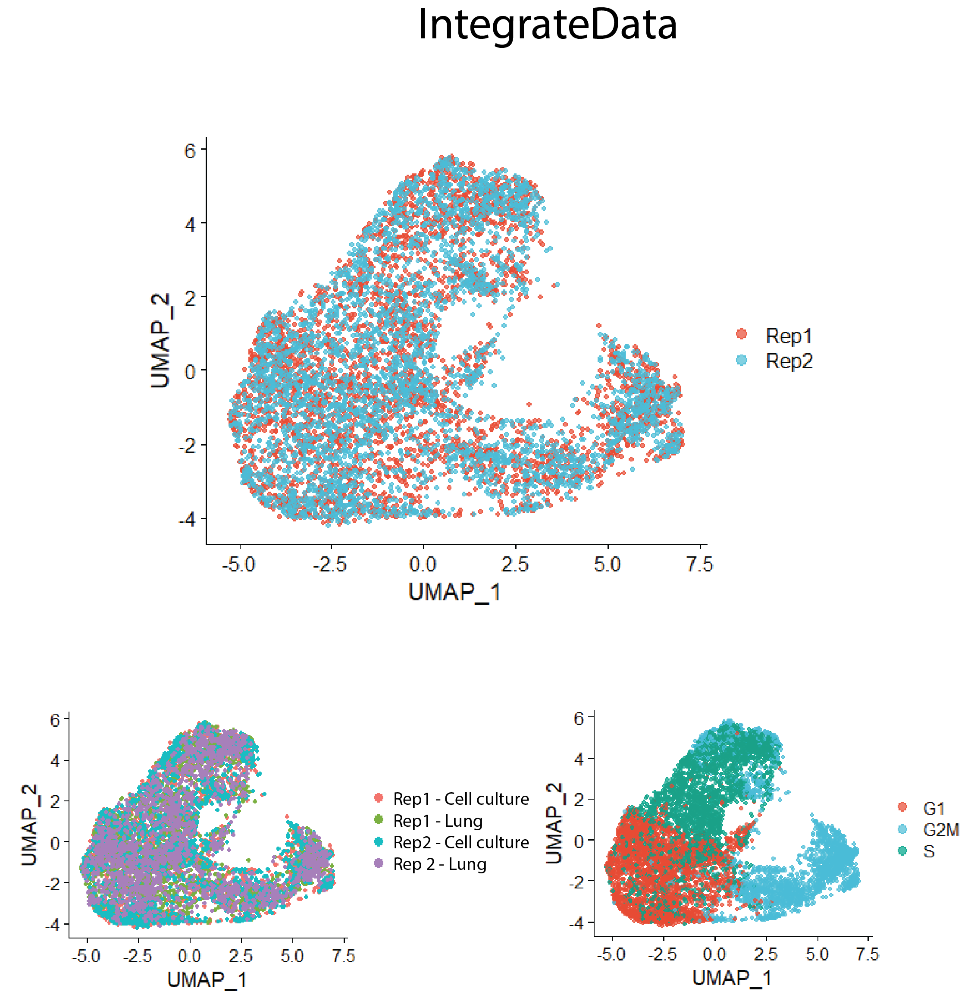
Cells cluster based on state of cell cycle despite ‘scaling out’ cell cycle genes prior to integration (methods: FastMNN, Seurat’s Integratedata: SCTransform)
OS17 cells in cell culture and in orthotopic lung with replicates
III: FastMNN
IV: SCTransform

Slide 4
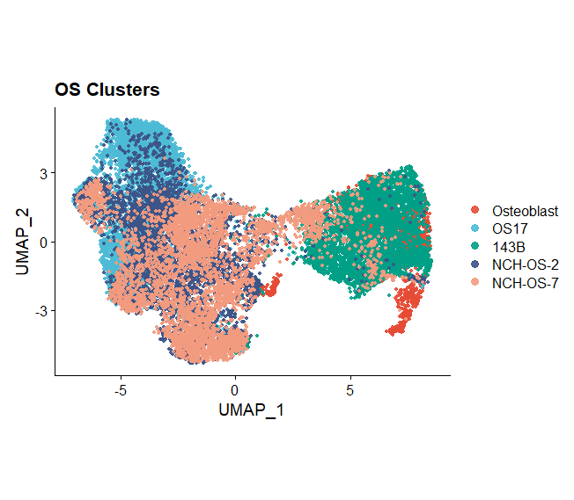
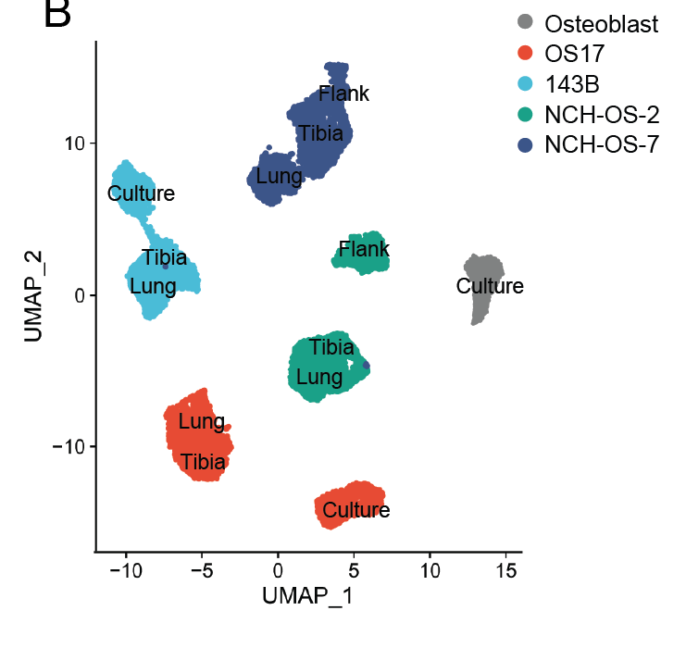
Osteosarcoma tumors have a high degree of Inter-tumor heterogeneity and application of Harmony forces similarity in these datasets
Conditions (culture/flank, tibia, lung) merged across all models
Osteoblast (control: presumed precursor cells of osteosarcoma)
I: Merge Seurat Objects
II: Harmony

Slide 5
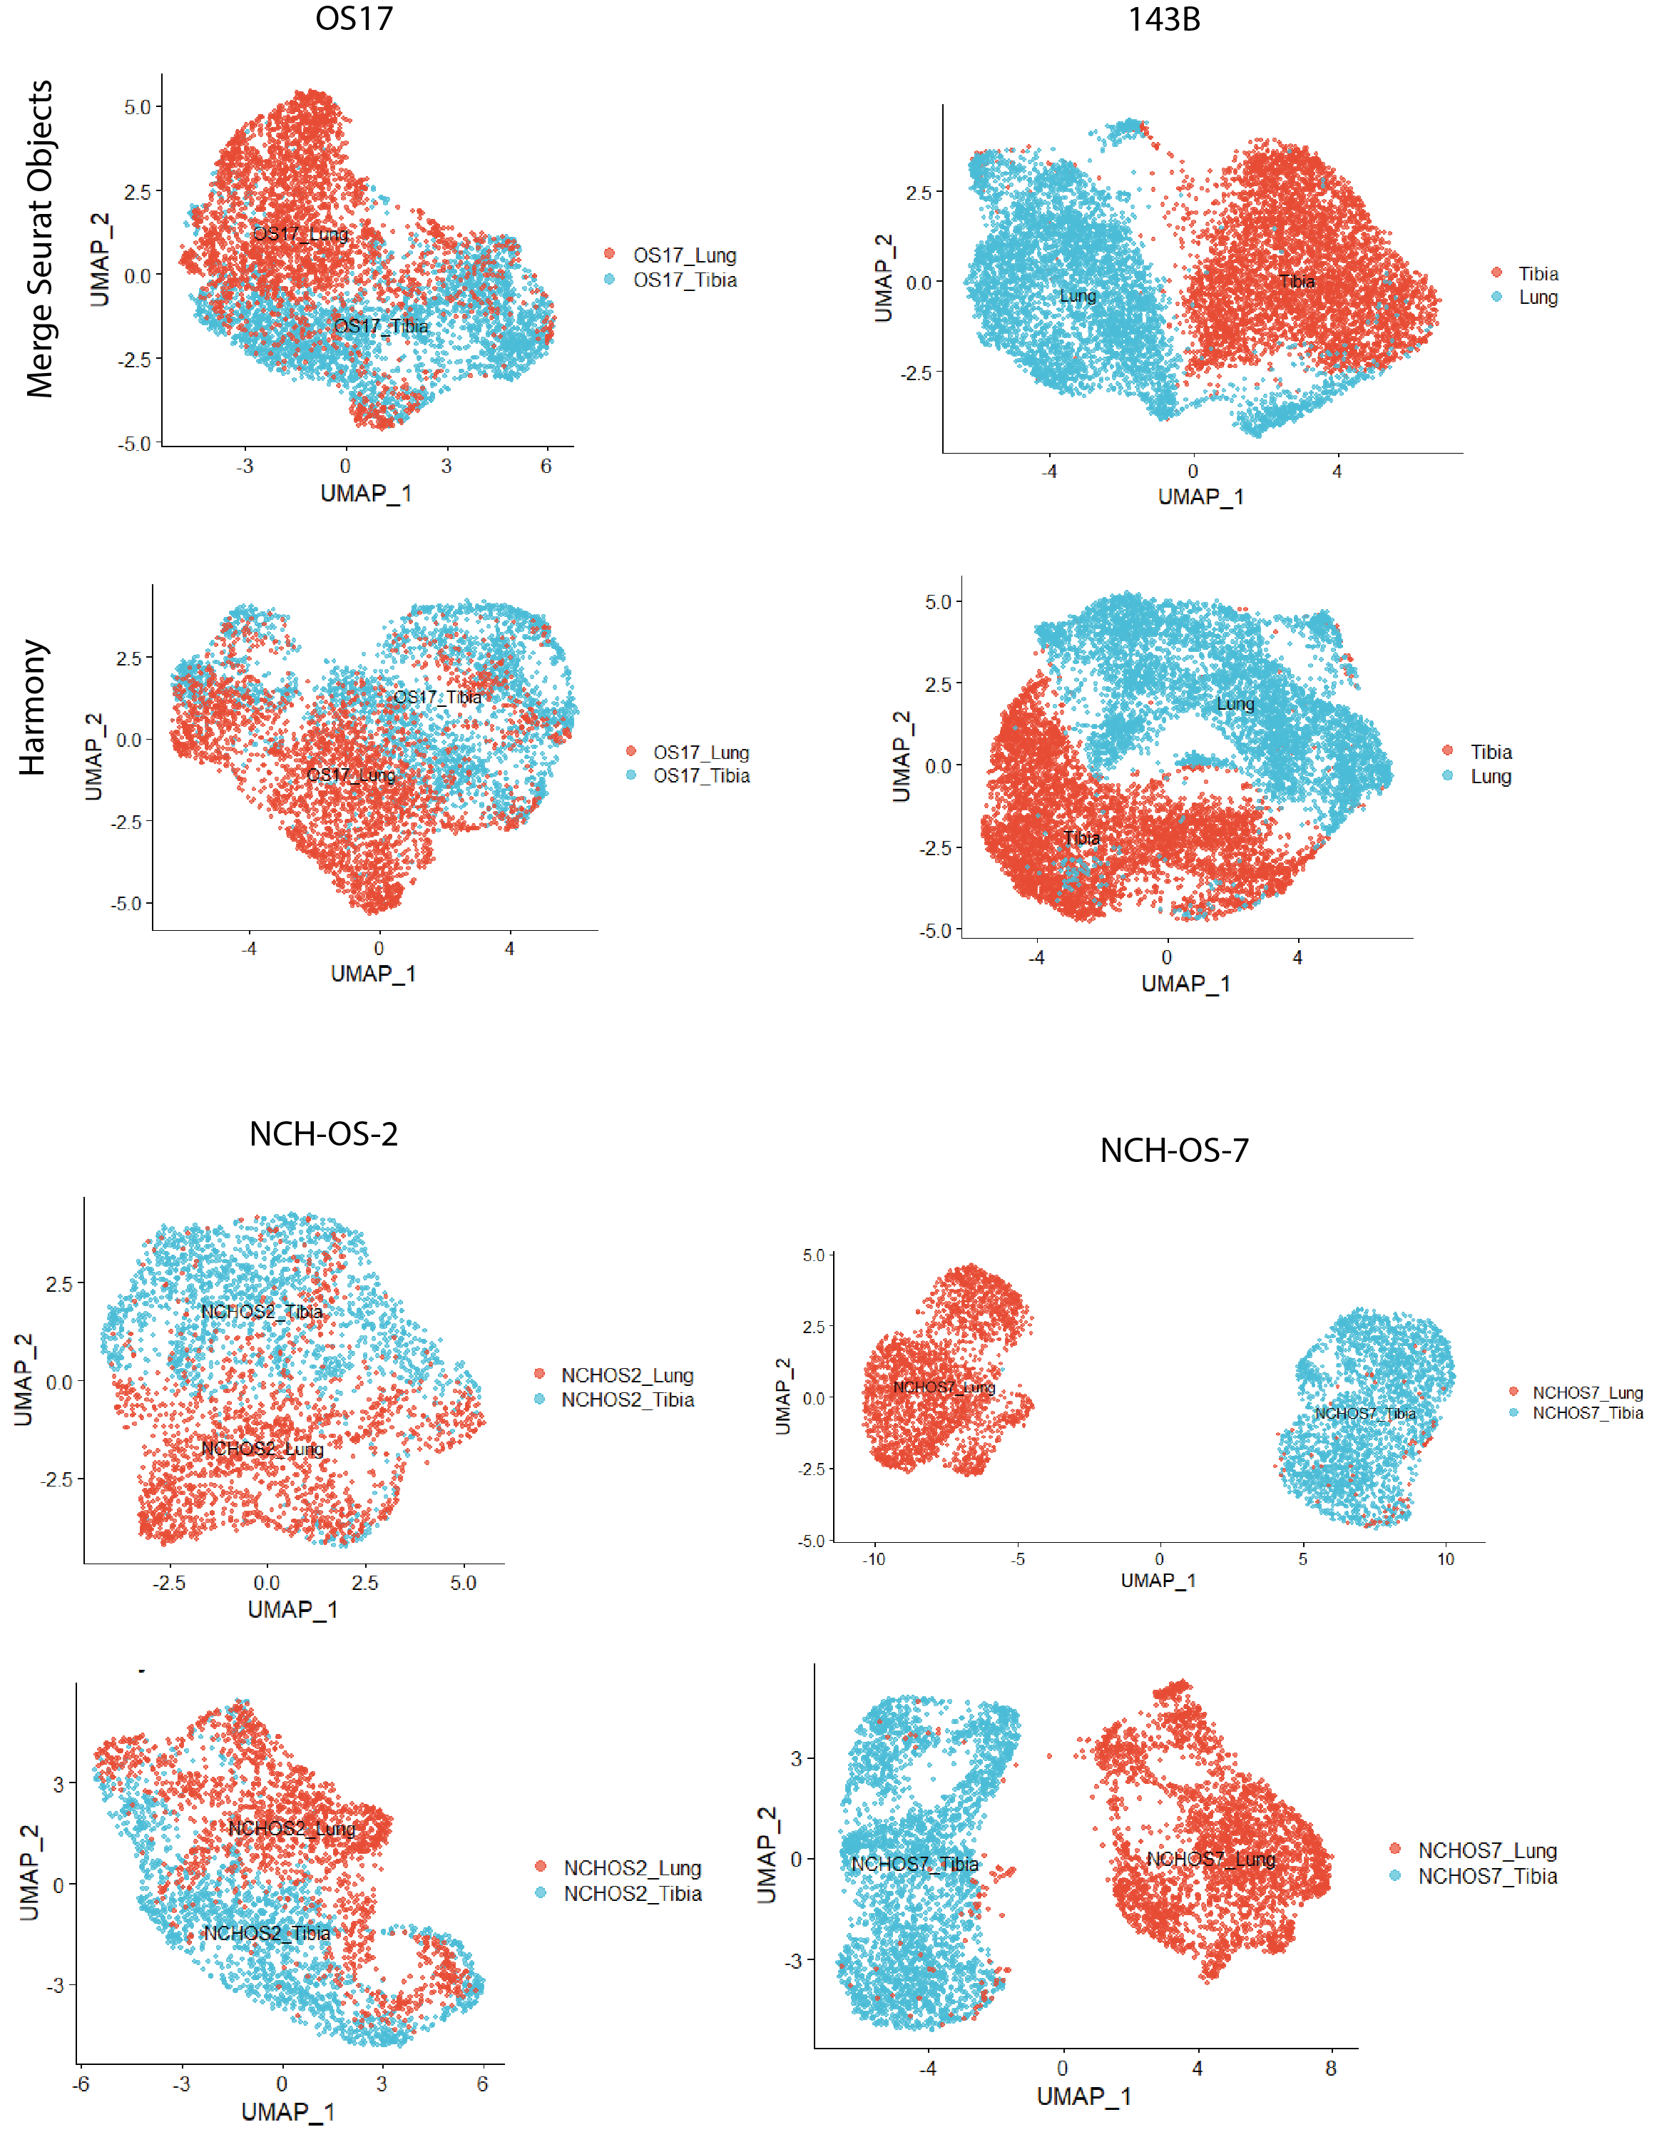
Merging Seurat objects or application of harmony across orthotopic tibia, and lung tumor datasets give similar trends in data
OS17
143B
NCH-OS-2
NCH-OS-7
Merge Seurat Objects
Harmony

