Slide 1
RNAseq

Slide 2
Topics
RNAseq technology
RNAseq data
RNAseq data analysis
Data visualization
Experimental design
Data interpretation

Slide 3
RNAseq Technology
Next-gen sequencing technology
Massively parallel
Millions of sequences generated
Screen all* RNAs at once
*microRNAs, lncRNAs, etc

Slide 4
Benefits
No prior information required
Get gene expression on any RNAs present
Microarrays only evaluate designed transcripts
Identification of splice variants
No saturation of signal
Both a benefit and drawback
Very sensitive

Slide 5
Difficulties
Bioinformatics required
Big data sets
Library preparation can introduce bias
Highly expressed genes in one sample but not the other can skew data significantly

Slide 6
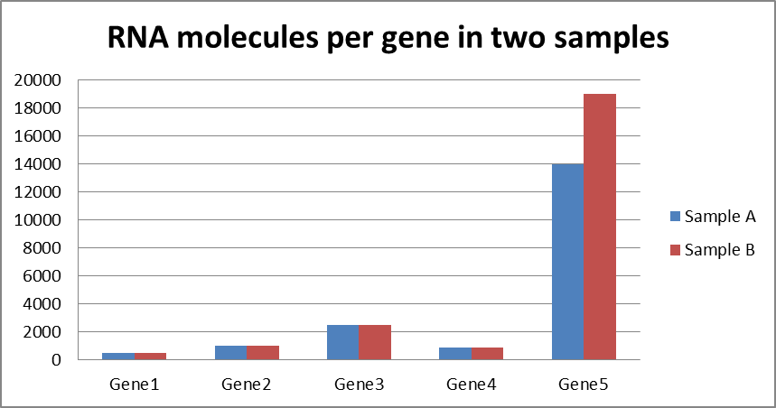
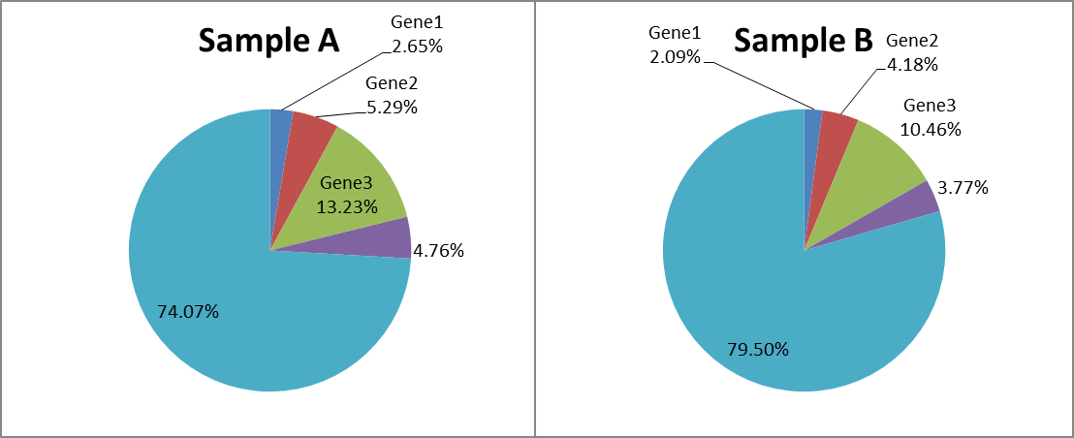
Sequence 30 million reads per sample
Need to normalize data!

Slide 7
RNAseq Technology
Long read technologies (PacBio)
Fewer reads (~4M)
Full length isoform sequence
High error rate compared to Illumina (~10%)
Single read-through - improved by CCS sequencing

Slide 8
RNAseq Technology
Long read technologies (PacBio)
Why?
Isoform detection
Non-model organisms (uncharacterized genes)
Gene fusion events
Why not?
Quantification

Slide 9
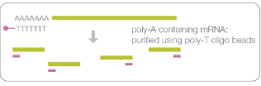
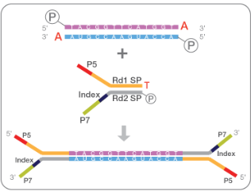
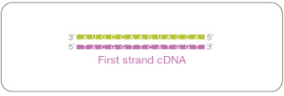
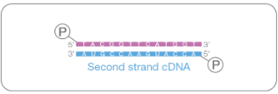
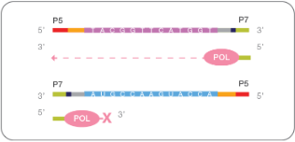
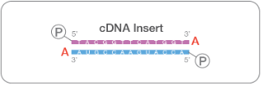
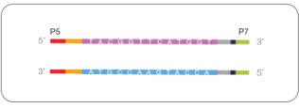
Illumina RNAseq Technology
https://support.illumina.com/content/dam/illumina-support/documents/documentation/chemistry_documentation/samplepreps_truseq/truseq-stranded-mrna-workflow/truseq-stranded-mrna-workflow-reference-1000000040498-00.pdf

Slide 10
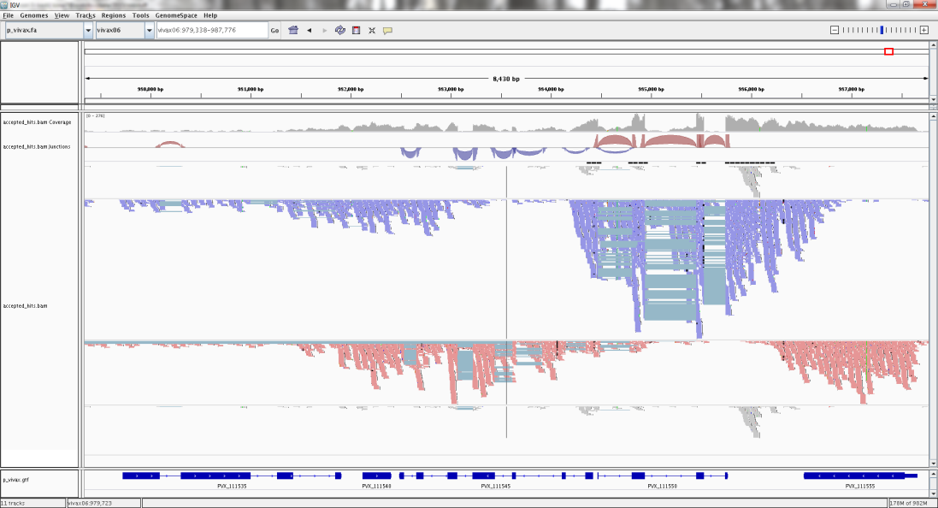
Stranded vs Non-stranded Libraries
Stranded libraries provide strand info
Useful for overlapping genes on opposite strands

Slide 11
Polyadenylated RNA Selection
Gets rid of rRNAs (80%+ of total RNA)
More reads for what you’re interested in
Ignores all non-polyadenylated RNAs
lncRNAs, enhancer RNAs, etc..
Depends on which organism you’re looking at:
Sequencing bacterial RNA?

Slide 12
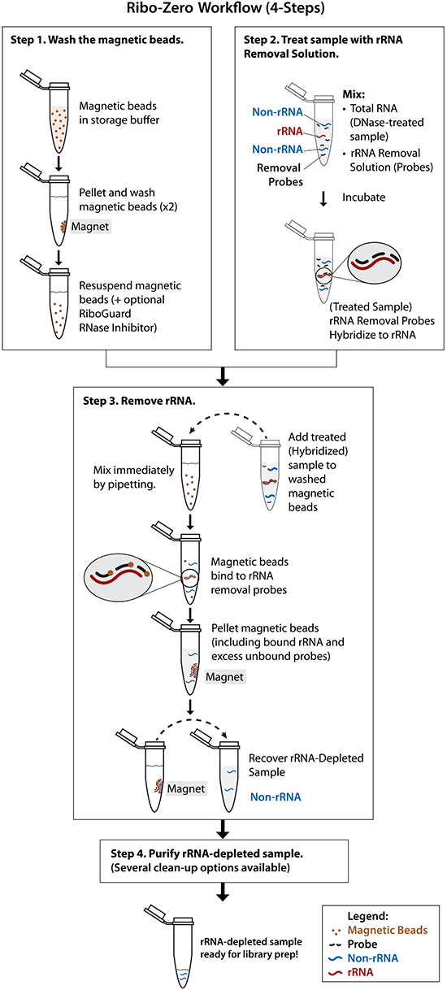
Alternatives to Poly-A Selection
rRNA depletion beads
Keep everything but rRNAs
http://www.illumina.com/products/ribo-zero-rrna-removal-human-mouse-rat.html

Slide 13
Alternatives to Poly-A Selection
rRNA depletion beads
Higher cost
Library prep kits:
Illumina stranded ~$50/rxn
Illumina ribozero ~$95/rxn
Keep everything but rRNAs
http://www.illumina.com/products/ribo-zero-rrna-removal-human-mouse-rat.html

Slide 14
Alternatives to Poly-A Selection
Blood as an input?
rRNA and globin reduction kits
Gets rid of globin RNA (~25% of all poly-A RNA)
Also expensive

Slide 15
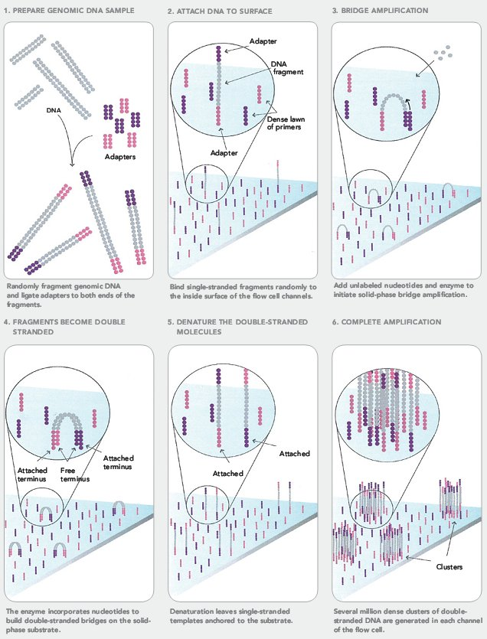
Cluster generation
http://seqanswers.com/forums/images/content/ilmn-step1-6.jpg

Slide 16
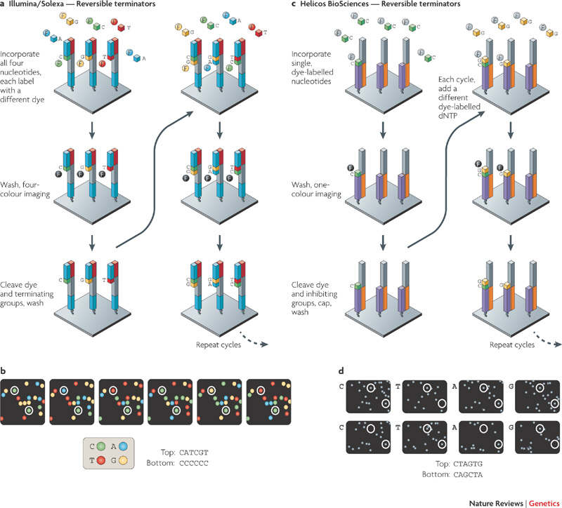
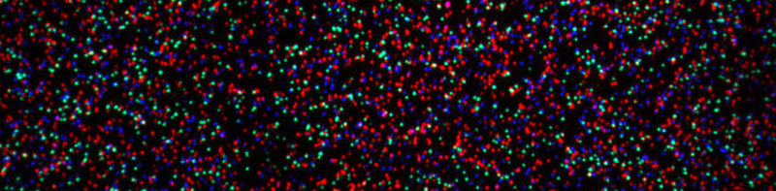
RNAseq Technology
http://www.massey.ac.nz/massey/fms/Genome%20Services/Images/GA_tile_banner11.jpg?3CAB6D498DEB00DBC1CAA91A01EAF71E
http://www.nature.com/nrg/journal/v11/n1/images/nrg2626-f2.jpg

Slide 17
RNAseq Technology
Paired end sequencing
http://www.nature.com/nrg/journal/v11/n1/images/nrg2626-f2.jpg

Slide 18
RNAseq Technology
Paired end sequencing
http://www.nature.com/nrg/journal/v11/n1/images/nrg2626-f2.jpg

Slide 19
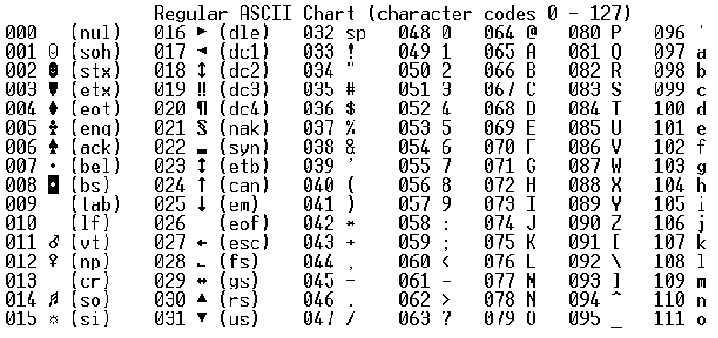
RNAseq Data
Sequencer interprets pictures and returns text
Two files (for paired end) format:
@Read name
sequence
+
Sequence quality (ASCII value -33)
Includes:
@M01057:82:000000000-A6ANP:1:1101:16707:1429 1:N:0:11
GGACAGAAAGACCCTATGAAGCTTTACTGTAGCTTGGTATTGTGCCCGGGCTCGCAATGCGCAGGATAGGTG
+
BBBBBBFFFFFFGGGGGGGGGGHHHHHHHHHHGHHHGHHHHHHHFHHGEGGGHGGGGGHHGGGGGGHBGHGG
Q = -10log₁₀(e)
e= estimated probability of wrong call
Quality score: 38
Quality Score | Probability of Incorrect Base Call | Inferred Base Call Accuracy
10 | 1 in 10 | 90%
20 | 1 in 100 | 99%
30 | 1 in 1000 | 99.9%

Slide 20
RNAseq Data
Rule of thumb:
Higher is better
Anything below 20 => greater than 1% chance of being wrong – meh data
Quality only matters for RNAseq for mapping
Incorrect base calls can lead to mismapped or unmapped reads
Matters more if you’re calling SNPs for genome sequencing

Slide 21
RNAseq Data Analysis
What to do with data?
Check quality of your data
Make sure there are no major issues
Read quality issues, machine errors leading to read issues, adequate read counts, library quality ok, etc…
FastQC/MultiQC
Look at select regions for “sanity check”
IGV, SeqMonk, etc…

Slide 22
RNAseq Data Analysis
Aligning your reads
Most will use a reference sequence (ie: human)
Need to determine where each read aligns
Far apart
Exon 1
Exon 2
Exon 3

Slide 23
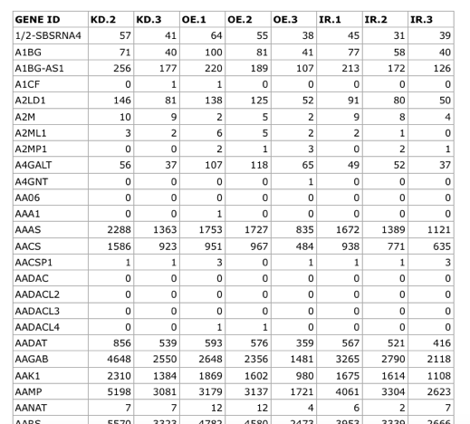
RNAseq Data Analysis
Count reads per gene
FeatureCounts, HTSeq-count, etc.
Generates a table of genes x sample
https://hbctraining.github.io/Intro-to-rnaseq-hpc-O2/lessons/05_counting_reads.html

Slide 24
Splice Variant Detection
Exon 1
Exon 2
Exon 3

Slide 25
Splice Variant Detection
Exon 1
Exon 2
Exon 3
Sample 1
Exon 1
Exon 2
Exon 3
Sample 2

Slide 26
RNAseq Data Analysis
Other approaches
De novo assembly (Trinity)
Only need if no (or incomplete) reference exists
ie: non-model organisms or extensive chromosomal rearrangements
Exon 1
Exon 2
Exon 3
Exon 1
Exon 2
Exon 3

Slide 27
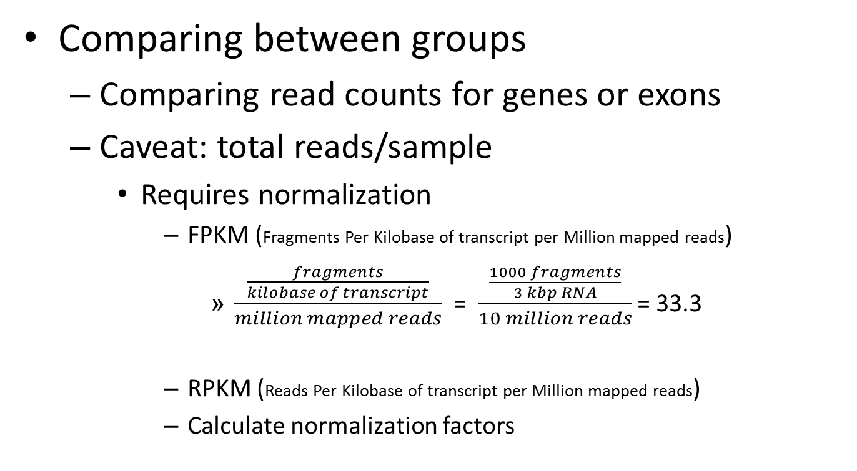
RNAseq Data Analysis

Slide 28
RNAseq Data Analysis
Need to calculate:
Fold change between groups
Straightforward, using either corrected counts or FPKM
Usually given as log2
p-values between groups
Several approaches
p-value correction for multiple testing
Bonferroni – big penalty (especially if comparing exons)
False discovery rate – lower penalty, requires interpretation

Slide 29
Looking at the Data
Factors to consider when assessing RNAseq data
Percent aligned (~80% +)
Non-genic aligning reads
Reads in exons only
Reads per sample (outliers/failed libraries?)

Slide 30
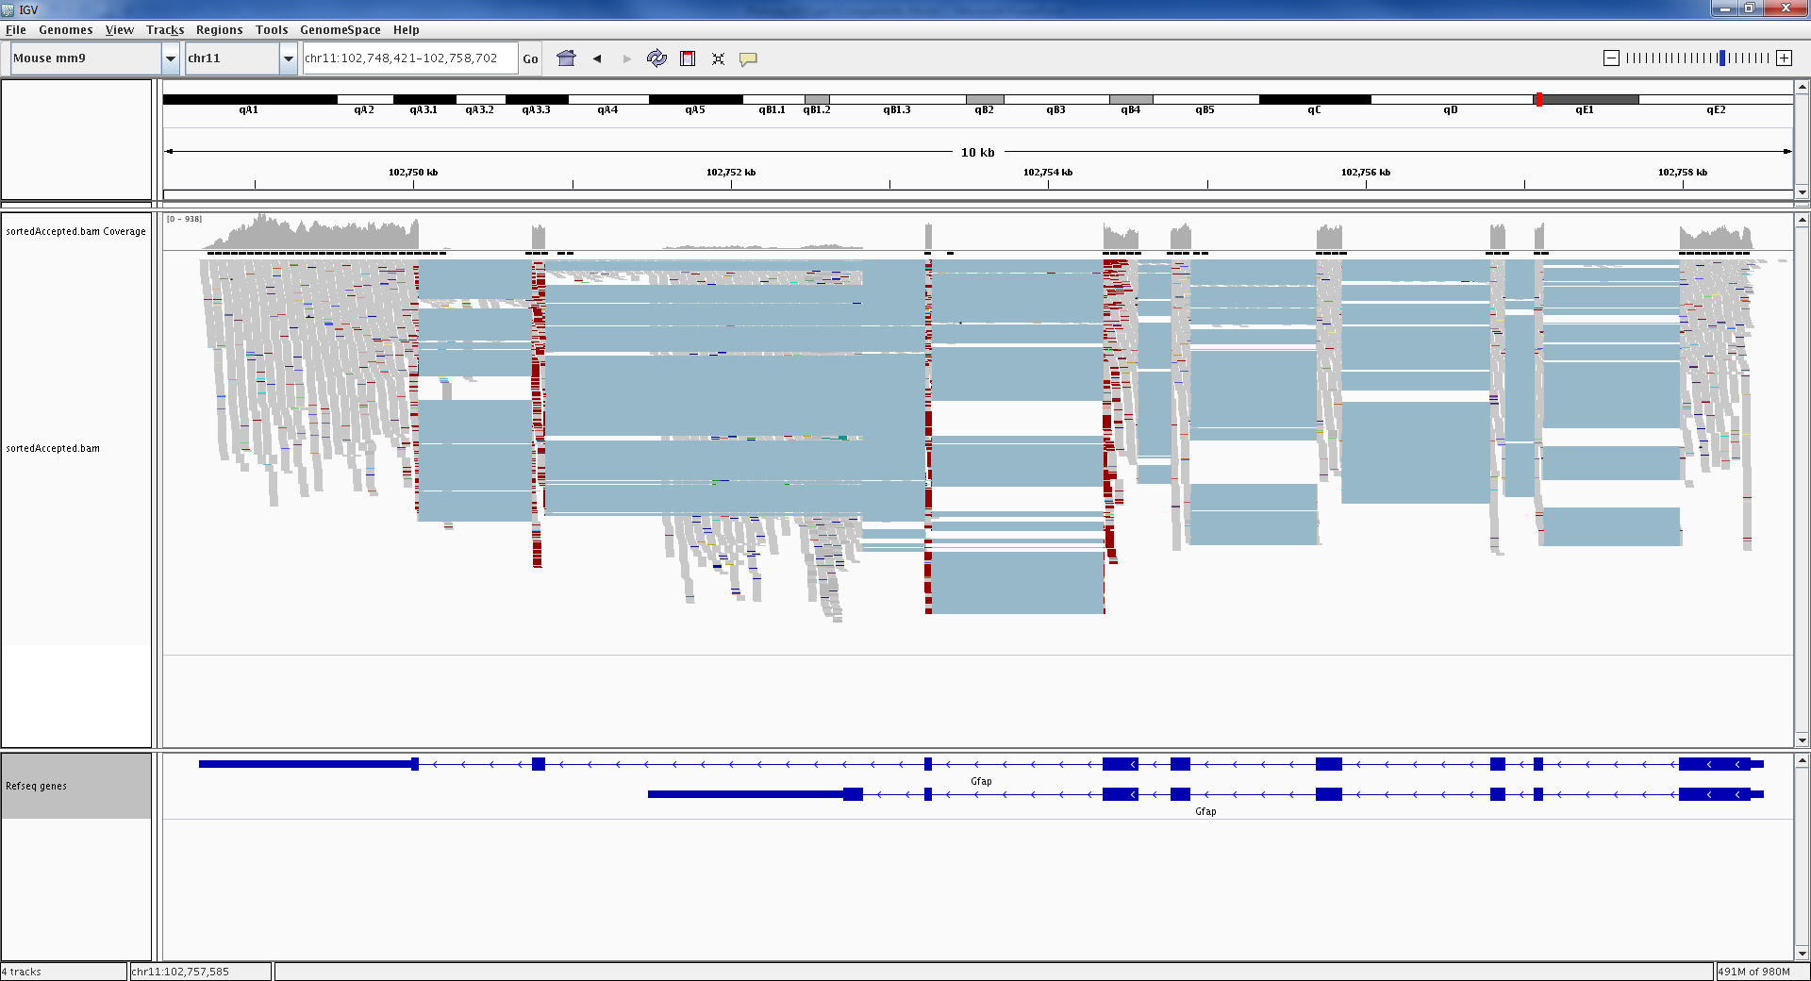
Looking at the Data

Slide 31
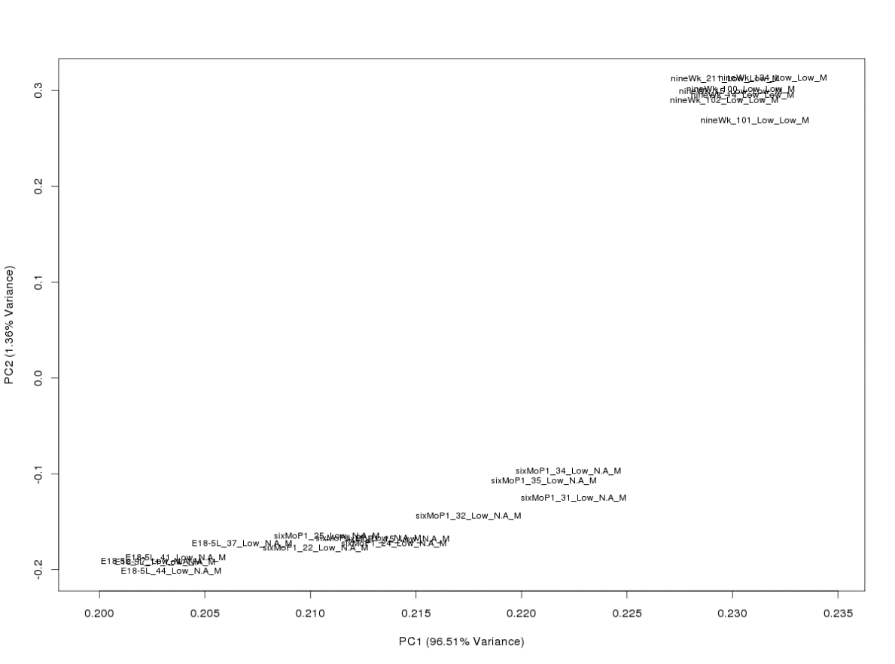
Looking at the Data
Principle Component Analysis
Can identify outliers, technical mistakes

Slide 32
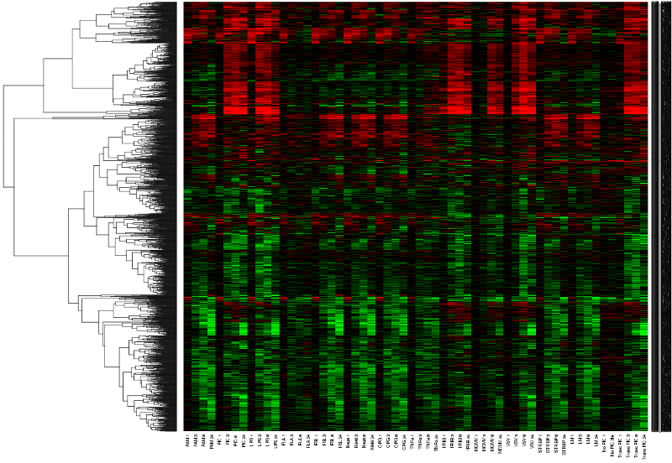
Heatmaps
Display gene expression patterns using unsupervised clustering

Slide 33
Heatmaps
Genes
Samples

Slide 34
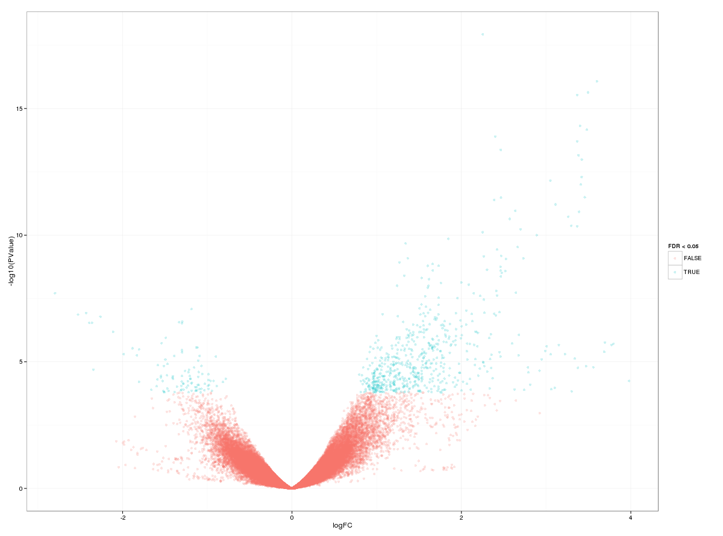
Volcano Plots
Display overall results, highlighting DE genes/exons

Slide 35
Designing RNAseq Experiments
Basic experimental design still applies
Proper controls
Adequate biological replicates
Good laboratory protocols
Preparation of quality RNA
Prepare libraries at the same time
Randomize

Slide 36
Designing RNAseq Experiments
Encode has good guidelines:
“Standards, Guidelines and Best Practices for RNA-Seq“
http://genome.ucsc.edu/ENCODE/protocols/dataStandards/ENCODE_RNAseq_Standards_V1.0.pdf
Conesa et al., 2016, Genome Biology
“A survey of best practices for RNA-seq data analysis”

Slide 37
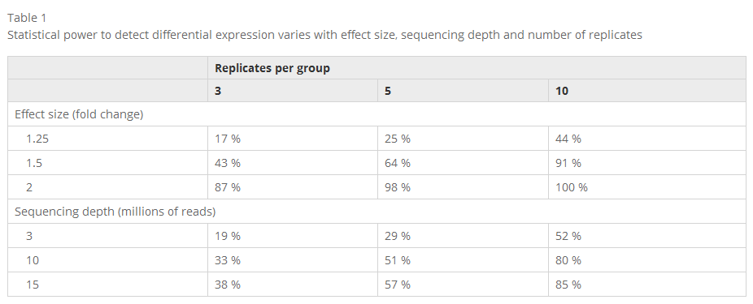
Designing RNAseq Experiments
Choosing how many samples per group
Generally speaking, 5+ is good
Higher sample count leads to the ability to detect smaller differences between groups
Power analysis
Conesa et al., 2016, Genome Biology

Slide 38
Designing RNAseq Experiments
Read depth per sample?
Which organism?
Doing expression only?
Encode suggests 30M+ per sample for human
Looking for splice variants?
Encode suggests 100-200M+ paired end read pairs
Tissues with high expression of a few genes?
Whole blood (globin), liver(albumin, mup gene family)
Need more reads to compensate

Slide 39
Designing RNAseq Experiments
Cost:
~ $500 - $750 per sample for 60-80M reads
Bump that up if you want more/longer reads
N = 5 for two groups -> $5000+

Slide 40
What to do with the Data?
Make sure it makes sense
Is your knockout knocked out?
Tissue specific genes?
Confirm genes of interest with other methods
Look at differentially expressed genes and evaluate based on biological function
Pathway analysis, gene ontology

