Slide 1
Concepts of Neural Networks
Matt Cannon

Slide 2
Key Terms will be highlighted
Lets play a game!
Is it reddish?™

Slide 3
What is a Neural Network?
A model to produce a prediction given an input
Picture data -> neural network -> is cat
Real estate info -> neural network -> suggested selling price
Single cell data -> neural network -> cell type annotations
Very generalizable
Very good with high dimensional data

Slide 4
Key Terms will be highlighted
Lets play a game!
Is it reddish?™

Slide 5
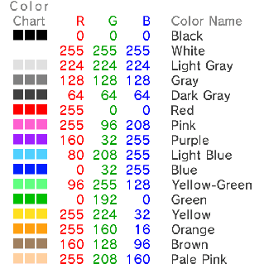
Is it reddish?
R
255
1
1
G
1
B
R
http://smilebasic.com/en/e-manual/manual28/
1
1
255
G
-1
B

Slide 6
Is it reddish?
# / 255
Weights
R
255
1
1
1
0.004
0.004
1
G
-1
B
-1
(1 * 1) + (0.004 * -1) + (0.004 * -1) = 0.992
http://smilebasic.com/en/e-manual/manual28/

Slide 7
Is it reddish?
# / 255
Weights
R
255
1
1
1
0.004
0.004
1
G
-1
1 - 0.004 - 0.004 = 0.992
B
-1
R
http://smilebasic.com/en/e-manual/manual28/
1
1
255
0.004
0.004
1
1
G
-1
0.004 - 0.004 - 1 = -1
B
-1

Slide 8
Is it reddish?
# / 255
R
255
96
208
1
0.376
0.815
1
G
-1
1 – 0.376 - 0.815 = -0.191
B
-1
Seems like it should be closer to 1?
http://smilebasic.com/en/e-manual/manual28/
Adjust the weights!

Slide 9

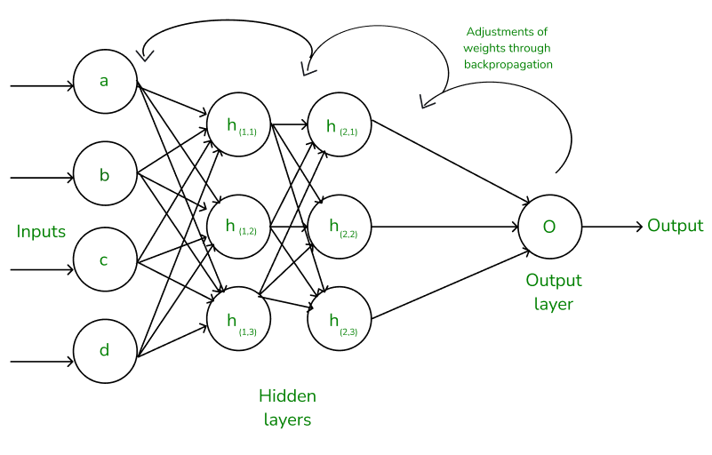
Optimizing Weights
Randomize?
Super slow
Use math to figure out which weights to change and in what direction
Backpropagation/gradient descent
https://www.geeksforgeeks.org/backpropagation-in-neural-network/#

Slide 10
Is it reddish?
# / 255
R
255
96
208
1
0.376
0.815
10
G
-1
10 – 0.376 - 0.407 = 9.217
B
-0.5
Better? But it’s really big
http://smilebasic.com/en/e-manual/manual28/

Slide 11
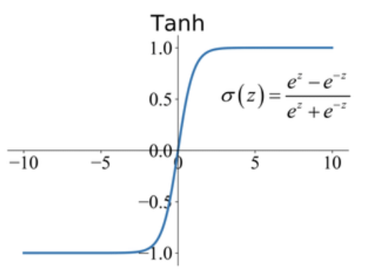
Squish our Numbers to [-1, 1]
Activation function
https://paperswithcode.com/method/tanh-activation

Slide 12
Is it reddish?
# / 255
R
255
96
208
1
0.376
0.815
10
G
-1
10 – 0.376 - 0.407 = 9.217
B
-0.5
http://smilebasic.com/en/e-manual/manual28/
1

Slide 13
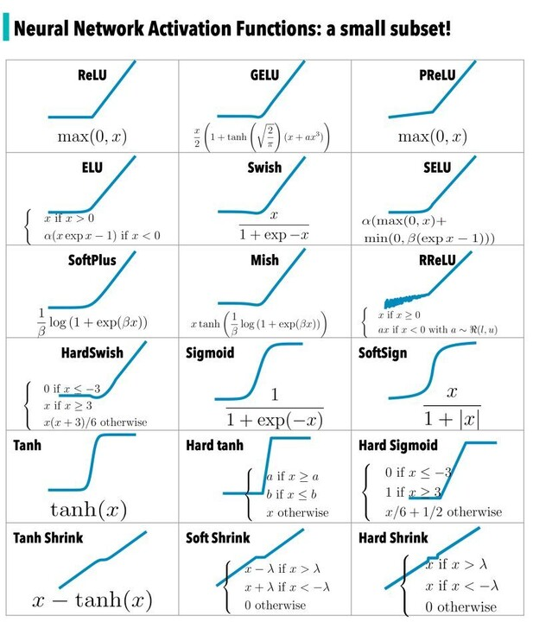
Activation Functions
https://www.linkedin.com/pulse/activation-functions-heba-al-haddad/

Slide 14
Couldn’t Think of a Way to Work Bias in
# / 255
Bias
R
255
96
208
1
0.376
0.815
10
G
-1
-4
(10 - 0.376 - 0.407) + -4 = 5.217
B
-0.5
1

Slide 15
Basic Neural Network Anatomy
Input layer
Input and output are both numeric values
Want to work with other data?
-> Convert it to numbers
Hidden layer
Output layer
0.4
3
1
0.1
0.4
-0.1
0.1
-5
0.5
1
-1
Biases
Weights

Slide 16
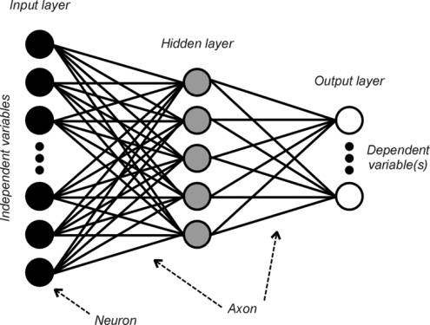
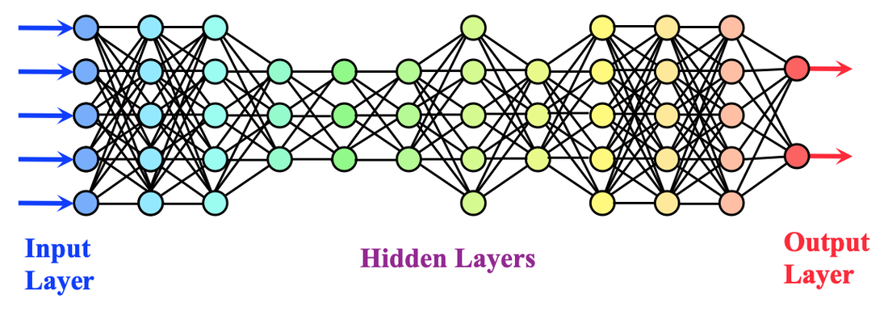
Basic Neural Network Anatomy
*Fully connected
https://mriquestions.com/what-is-a-neural-network.html
https://www.researchgate.net/figure/The-General-Anatomy-of-an-Artificial-Neural-Network_fig3_5246556

Slide 17
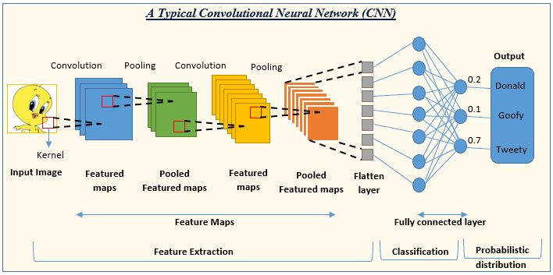
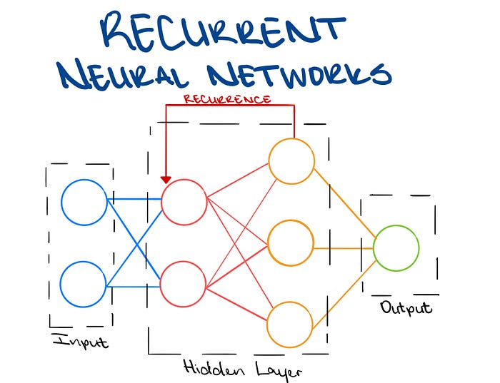
Basic Neural Network Anatomy
https://www.analyticsvidhya.com/blog/2022/01/convolutional-neural-network-an-overview/
https://towardsdatascience.com/introducing-recurrent-neural-networks-f359653d7020

Slide 18
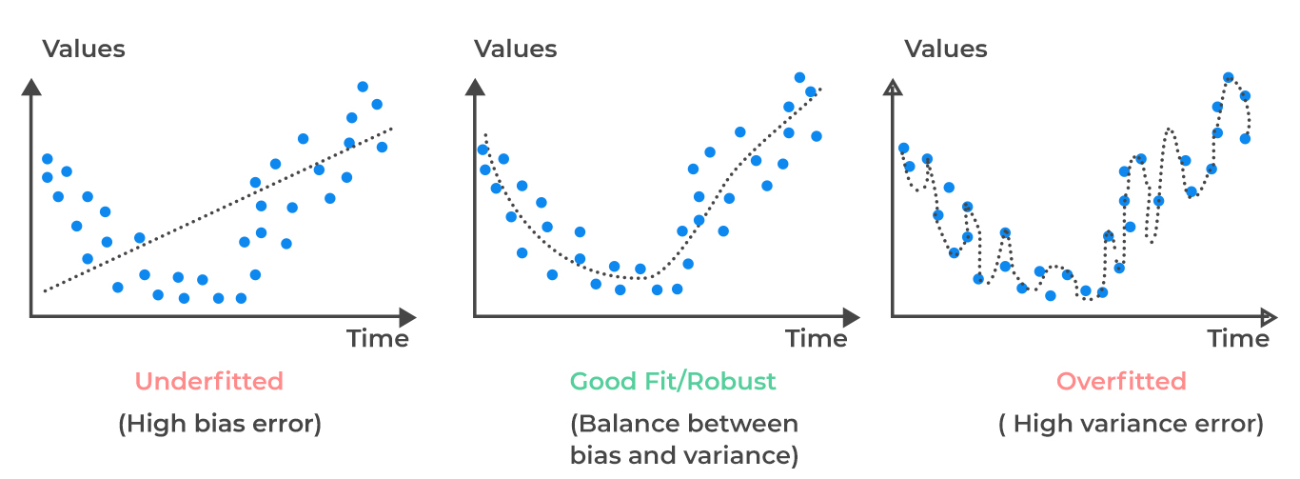
Training a Neural Network
Supervised learning
Need training data
Input data with expected outputs
Randomly split into training and validation datasets
Train to optimize weights/biases
Test on validation data to make sure you’re not overfitting
Use it to predict
https://analystprep.com/study-notes/cfa-level-2/quantitative-method/overfitting-methods-addressing/

Slide 19
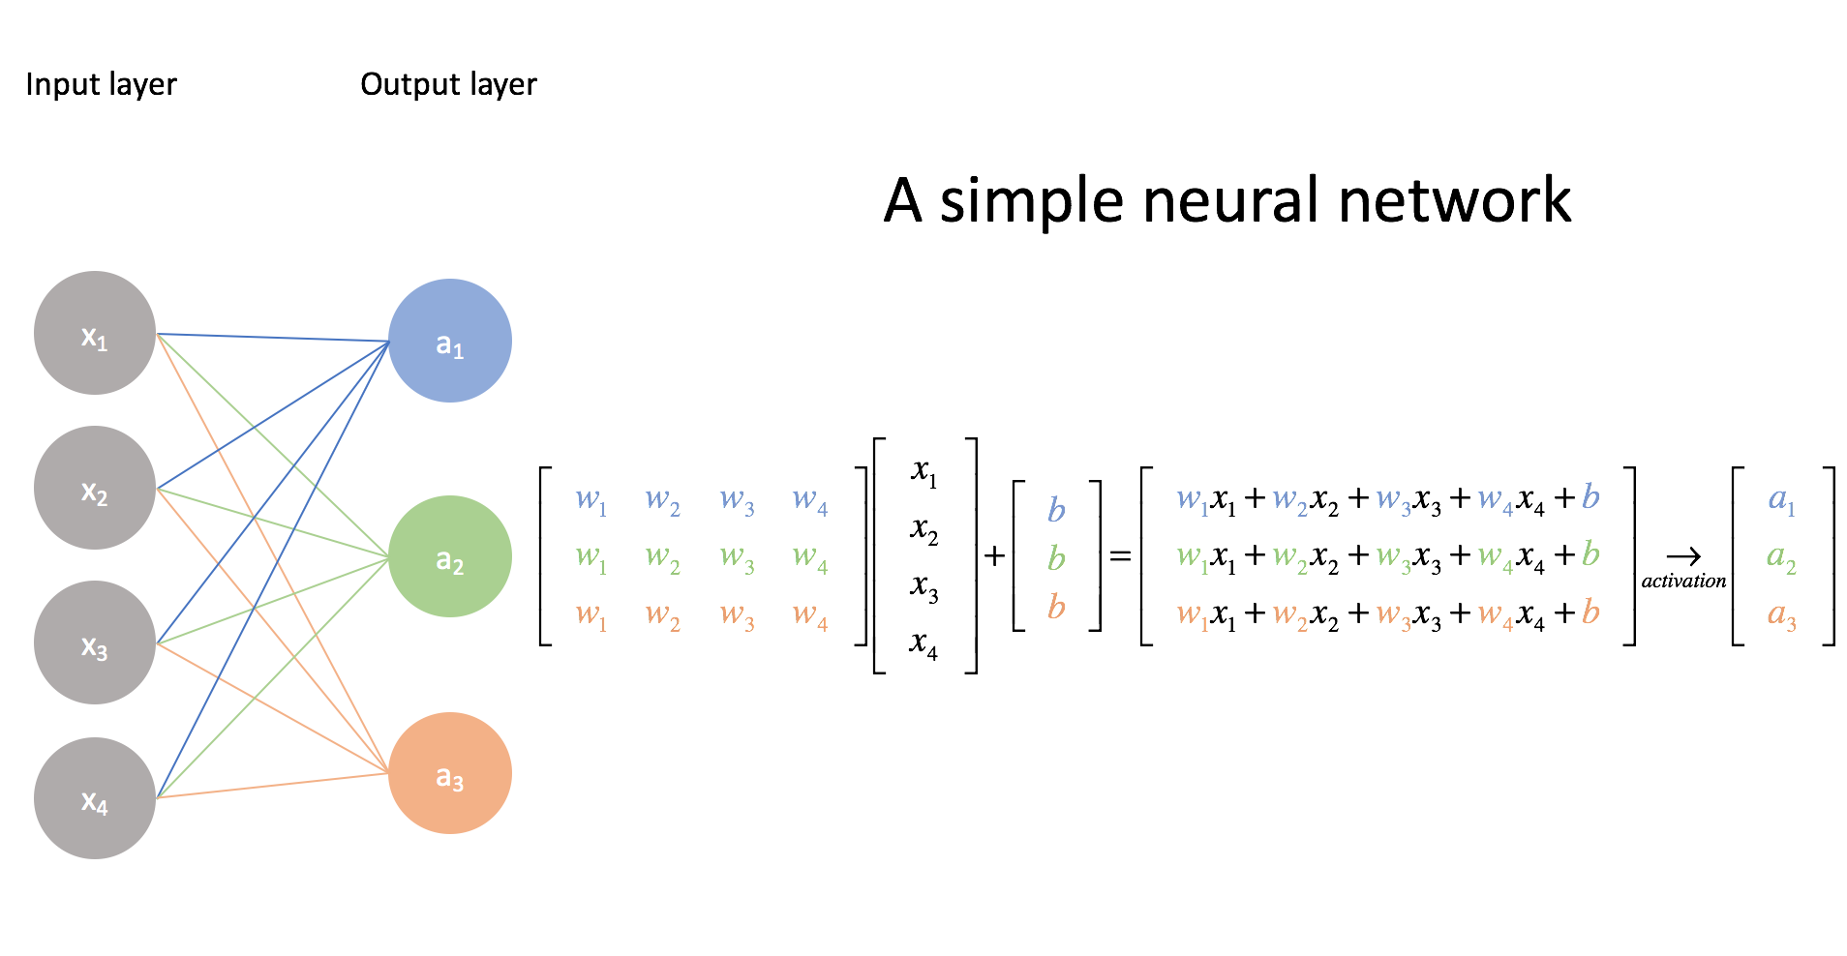
Mathematical View
w₁
w₂
w₃
w₄
https://www.jeremyjordan.me/intro-to-neural-networks/

Slide 20
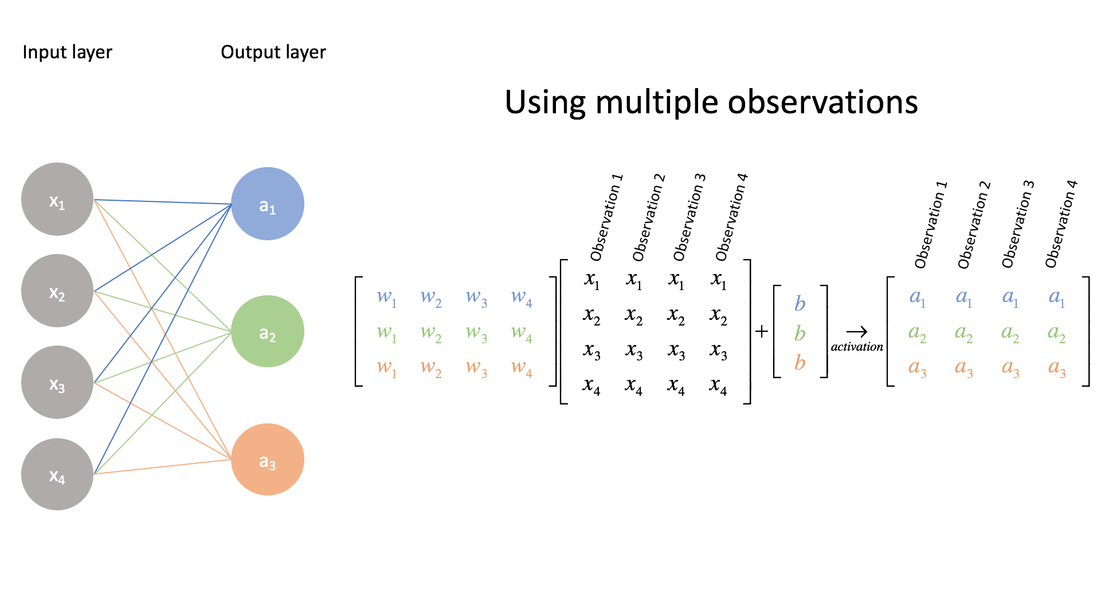
Mathematical View
https://www.jeremyjordan.me/intro-to-neural-networks/

Slide 21
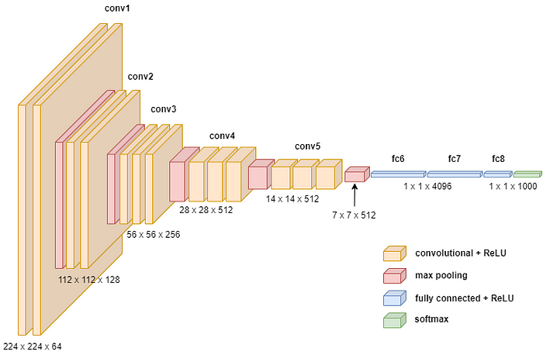
Deep Learning/Deep Neural Networks
https://towardsdatascience.com/how-to-easily-draw-neural-network-architecture-diagrams-a6b6138ed875

Slide 22
Common Libraries/Modules
Tensorflow (python and R)
PyTorch (python)
Keras (python and R)

Slide 23
Resources
https://www.youtube.com/watch?v=aircAruvnKk
3Blue1Brown
https://www.youtube.com/watch?v=tPYj3fFJGjk
Python tensorflow – 7 hours
https://victorzhou.com/blog/intro-to-neural-networks/

