Slide 1
Warehouse Fulfillment Summary Capstone Project
Melissa Viar
Dataset provided by Coursera “Analyzing Data to Answer Questions”
Notes:
This was a project learning tool used when during education of SQL syntax for subqueries.

Slide 2
Introduction
In my capstone project, I focused on the optimization and analysis of warehouse fulfillment processes using SQL. The goal was to streamline operations, improve efficiency, and enhance decision-making capabilities through data-driven insights.

Slide 3
Objectives
Data Collection and Integration: Gather and integrate data from various sources, including inventory management systems, order processing platforms, and shipping logs.
Data Cleaning and Preparation: Ensure data accuracy and consistency by performing necessary cleaning and transformation tasks.
Database Design: Develop a robust database schema tailored to the needs of warehouse fulfillment operations.
Query Development: Create SQL queries to extract, manipulate, and analyze data to support operational and strategic decisions.
Performance Optimization: Implement techniques to optimize query performance and ensure efficient data retrieval.

Slide 4
Constructed Complex SQL Queries
Constructed complex SQL queries to analyze order fulfillment times, inventory turnover rates, and shipping accuracy.
Used JOIN operations to combine data from multiple tables and derive meaningful insights.
Employed aggregate functions to summarize data and generate reports on key performance indicators (KPIs).
Indexed key columns to speed up query execution.
Analyzed query execution plans to identify and resolve performance bottlenecks.
Optimized database schema and queries to handle large datasets efficiently.
Generated reports and dashboards using SQL queries to provide stakeholders with clear and actionable insights.
Connected SQL outputs to visualization tools to create dynamic and interactive reports.

Slide 5
Example of SQL Query
SELECT
Warehouse.warehouse_id,
CONCAT(Warehouse.state, ': ', Warehouse.warehouse_alias) AS warehouse_name,
COUNT(Orders.order_id) AS number_of_orders,
(Select COUNT(*) From melissa-viar.warehouse_orders.orders AS Orders) AS total_orders,
CASE
WHEN COUNT(Orders.order_id)/(SELECT COUNT(*) FROM melissa-viar.warehouse_orders.orders AS Orders) <= 0.20
THEN 'Fulfilled 0-20% of Orders'
When COUNT(Orders.order_id)/(SELECT COUNT(*) From melissa-viar.warehouse_orders.orders AS Orders) > 20
And COUNT(Orders.order_id)/(SELECT COUNT(*) FROM melissa-viar.warehouse_orders.orders AS Orders) <= 0.60
Then 'Fulfilled 21-60% of Orders'
Else 'Fulfilled more than 60% of Orders'
END AS fulfillment_summary
FROM melissa-viar.warehouse_orders.warehouse AS Warehouse
LEFT JOIN melissa-viar.warehouse_orders.orders AS Orders
On Orders.warehouse_id = Warehouse.warehouse_id
GROUP BY
Warehouse.warehouse_id,
warehouse_name
HAVING
COUNT(Orders.order_id) > 0

Slide 6
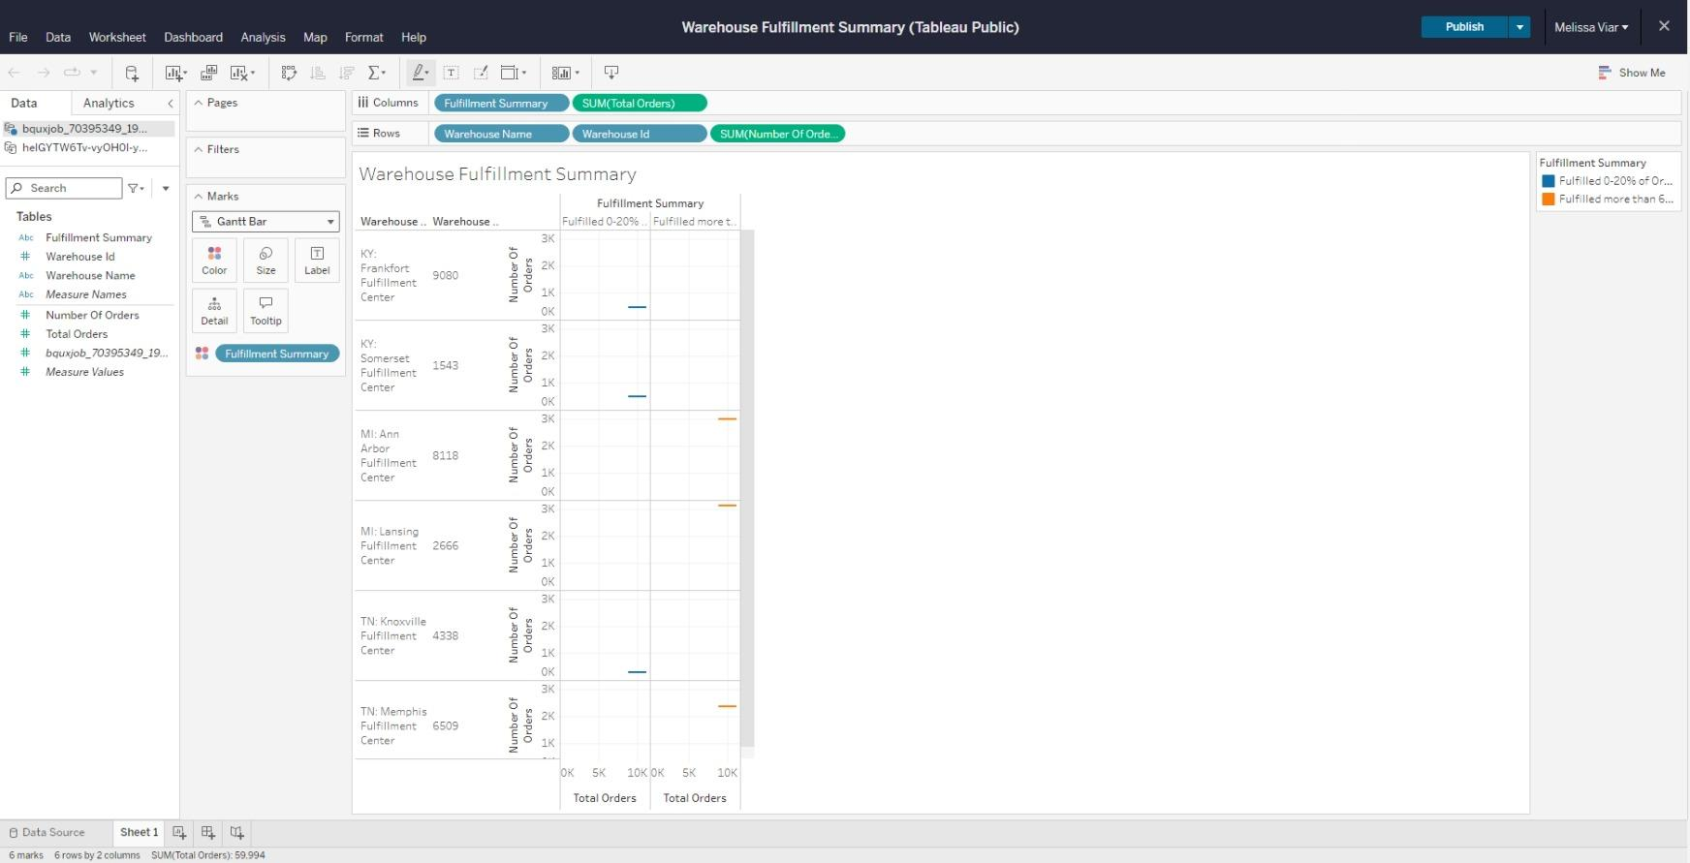
Example of Visualization using Tableau

Slide 7
Achievements
Generated reports and dashboards using SQL queries to provide stakeholders with clear and actionable insights.
Successfully integrated data from disparate sources into a cohesive and well-structured database.
Improved query performance, reducing data retrieval times by up to 50%.
Provided actionable insights that led to a 20% improvement in order fulfillment efficiency.
Developed a comprehensive set of SQL scripts and queries that can be reused and adapted for future warehouse optimization projects.
Connected SQL outputs to visualization tools to create dynamic and interactive reports.

Slide 8
In Conclusion
Relearning the warehouse fulfillment summary SQL dataset and syntax writing as part of my capstone project demonstrated the critical role of database management and data analysis in optimizing warehouse operations. Using SQL, I was able to provide valuable insights and possibly drive significant improvements in the efficiency and effectiveness of warehouse fulfillment processes. Also, by using Tableau as a data visualization tool I was able to effectively show how I could come to an analysis conclusion. Tableau helped me to be able to show which warehouses were performing their best and which ones need improvement to reach higher levels of order fulfillment.

