Slide 1
MindBricks
Group: Luca Beltrami, Luca di Bello, Marta Safarova

Slide 2
Our Goal
"MindBricks turns invisible environmental factors into actionable insight to boost your productivity"
We combine a Pomodoro timer with device sensing (light, noise, and phone usage) to understand the conditions that help you focus best. ​
​
Data-driven personal study timeline
City-building game
Insightful visualizations

Slide 3
How does it work?
Pomodoro timer app => (25m study + short breaks) x4 times + longer break
Background sensor sampling (foreground service)
  Noise (background)
  Light level
  Number of phone pick-ups
Mood + Perceived productivity questionnaire = "focus score" (0-100)
City building game: shop + big world
Visualizations:
  Generated Daily schedule
  Average weekly focus
  Study Streak Calendar
  Focus score heatmap
  Focus time distribution
  …..

Slide 4
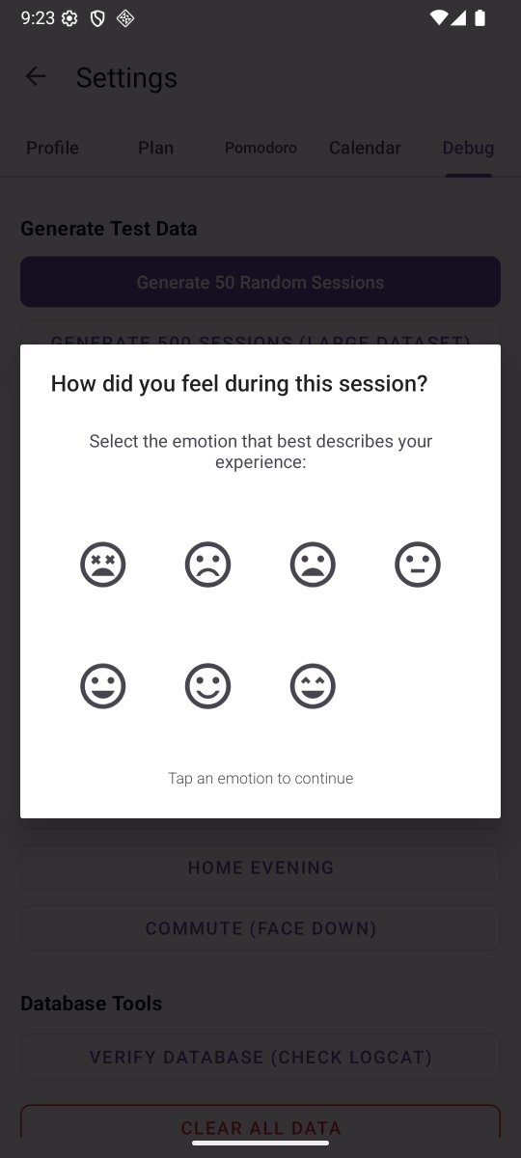
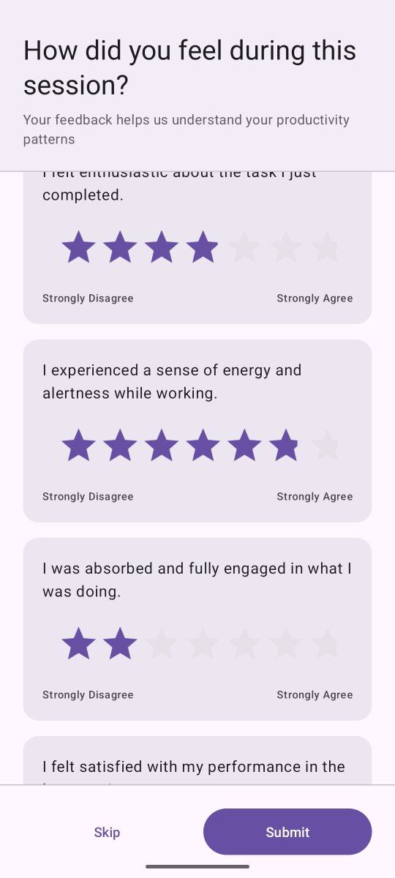
Questionnaires
After EVERY session...
Engagement
Alertness and Vitality
Satisfaction
Motivation
Anticipation
  "I want to study more!"

Slide 5
Live demo

Slide 6
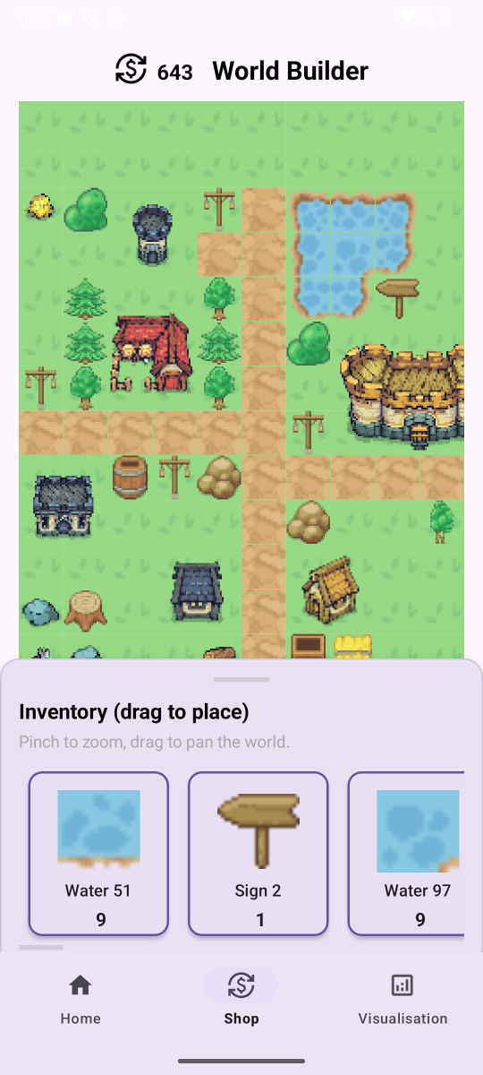
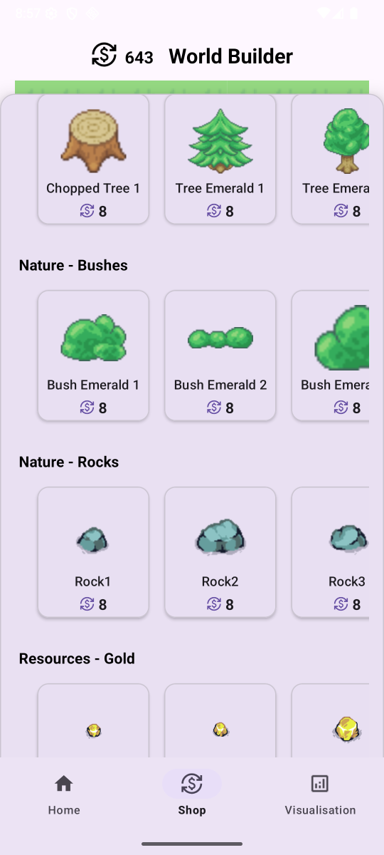
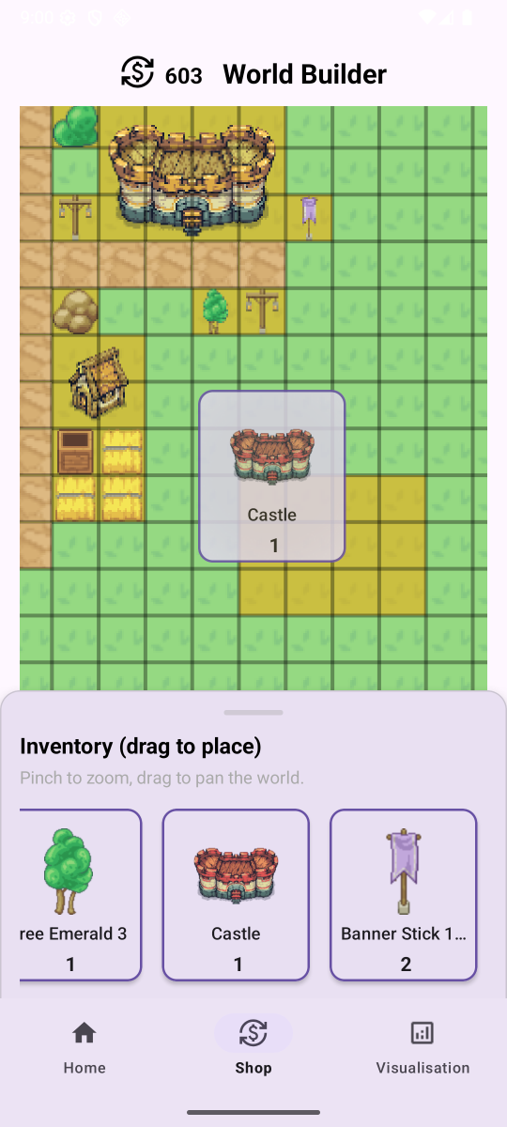

Slide 7
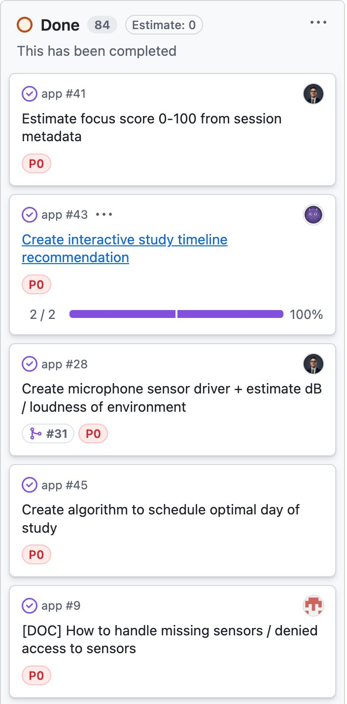
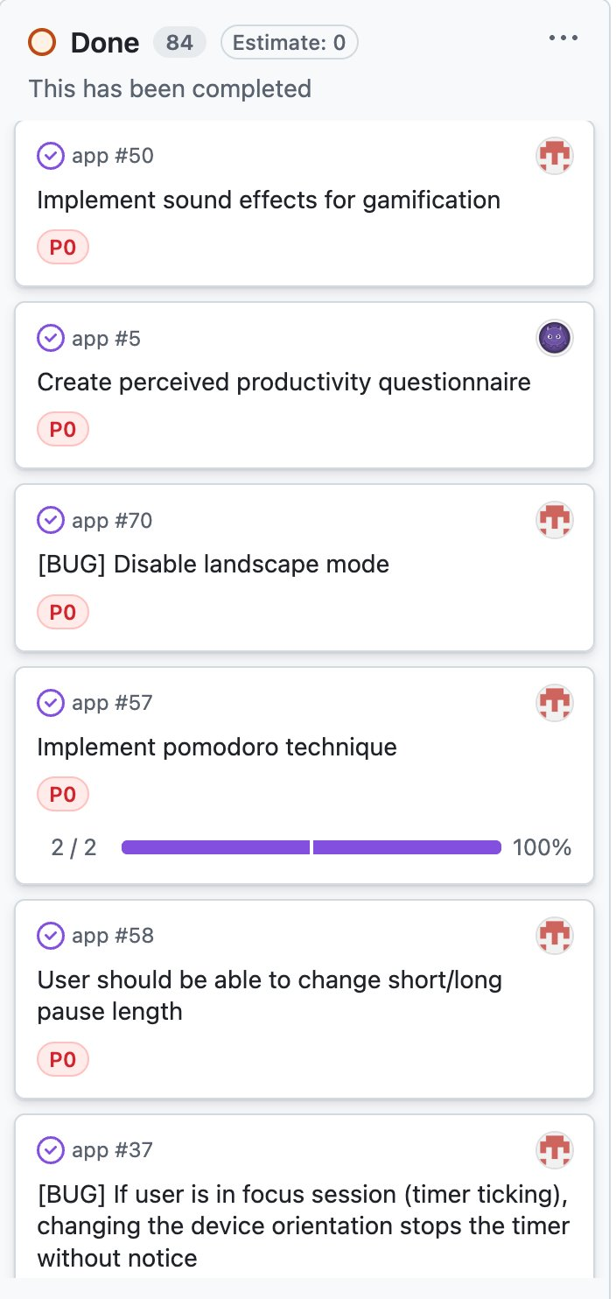
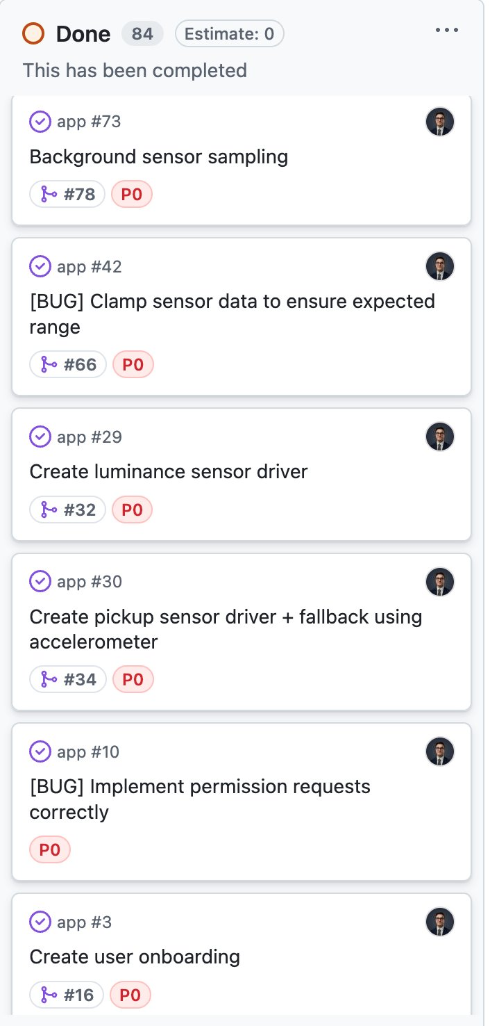
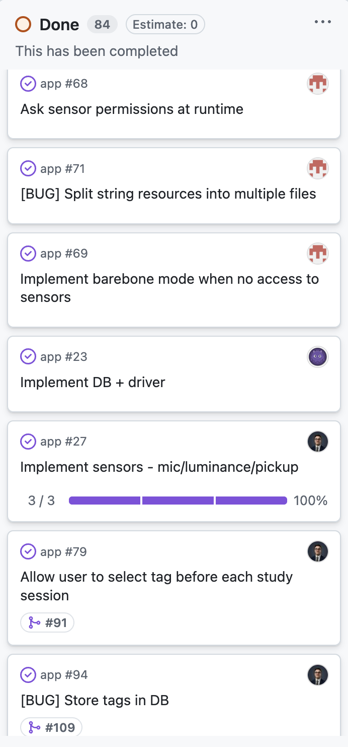
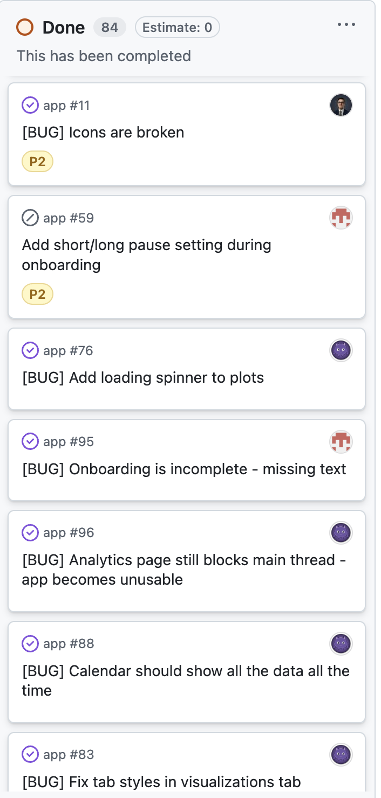
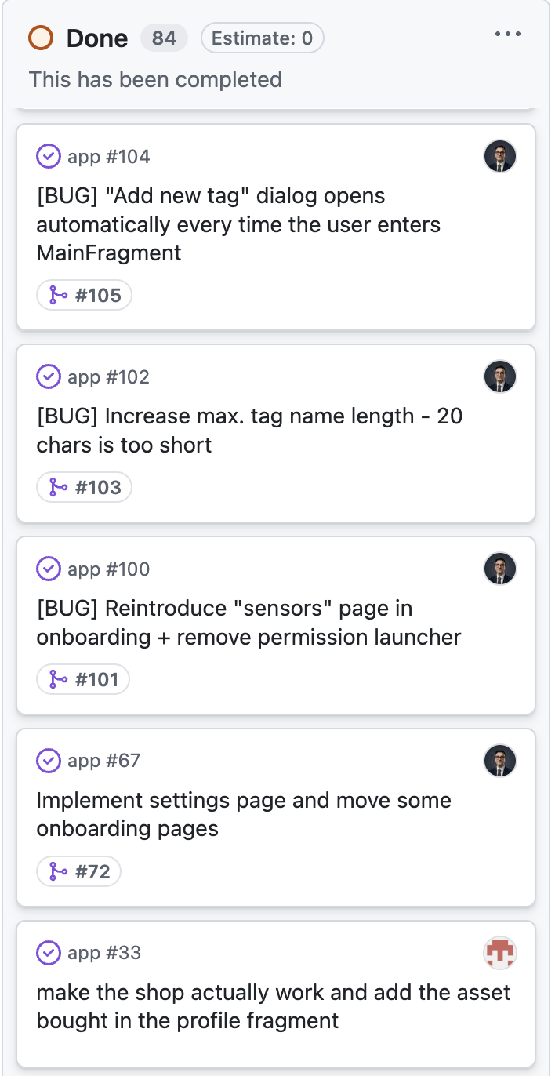
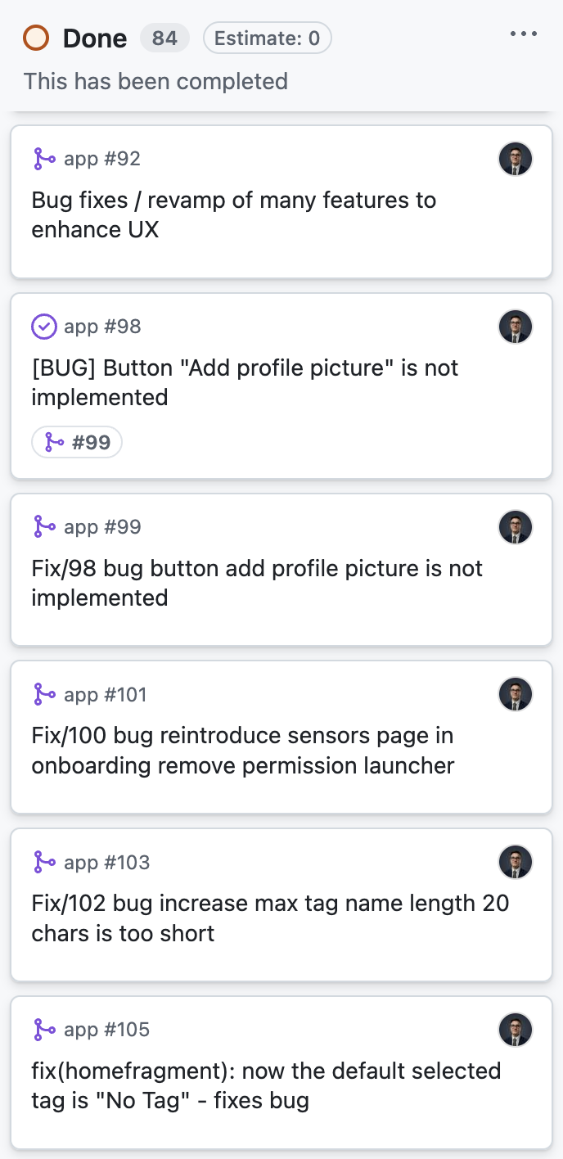
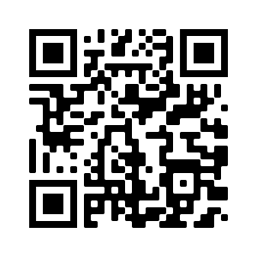
Project management:
GitHub Projects
(project is public!)

Slide 8
Thanks!

