Slide 1
Project Overview_ Per Module
NPI/ Relocation
SCM_ Plan
SCM_ Source
SCM_ Make
112
ET 200SP Base Unit Ramp Up in SEWC
6
SPS05# - LEAN transformation-VSM
10
AE-DUR @SEWC
13
Robot and automation in SEWC
2
S7-1200 CPU global value add project
7
SPS09# - Visual Management
11
JONAS @Distributors
14
Technology roadmap @SEWC
3
S7-1500C global value add project
8
SPS11# - Continuous improvement
12
Plastic parts localization
4
HMI comfort panel 7’-12' global value add project
9
Storage Optimization
5
ET 200SP I/O Ramp Up in SEWC
Remark:
SCM_ Deliver
SCM_ Digital Plat form
Not start
On schedule
Warning
Project Delay
15
Tecnomatix @SEWC
16
Competence development @SEWC
Closed
Notes:
Description:
Project overview which could present project status per different “selection fields” as below:
Request:
Selection field option:
Original due day( per key milestone which identify by project leader): Year/ Month ( Per key milestone)
Menu level:
E. G like pivot table which could also show sub-item, SCM PLAN-> 1. Intelegent plan 2. simulation 3. sysmatical inv Mgt
Extension Module is possible: e.g could added other name

Slide 2
Project Overview_ Per Leader/ Member
NPI/ Relocation
SCM_ Plan
SCM_ Source
SCM_ Make
112
ET 200SP Base Unit Ramp Up in SEWC
6
SPS05# - LEAN transformation-VSM
10
AE-DUR @SEWC
13
Robot and automation in SEWC
2
S7-1200 CPU global value add project
7
SPS09# - Visual Management
11
JONAS @Distributors
14
Technology roadmap @SEWC
3
S7-1500C global value add project
8
SPS11# - Continuous improvement
12
Plastic parts localization
4
HMI comfort panel 7’-12' global value add project
9
Storage Optimization
5
ET 200SP I/O Ramp Up in SEWC
Remark:
SCM_ Deliver
SCM_ Digital Plat form
Not start
On schedule
Warning
Project Delay
15
Tecnomatix @SEWC
16
Competence development @SEWC
Closed
Notes:
Description:
Project overview which could present project status per different “selection fields” as below:
Request:
Selection field option:
Person
Original task due day: Year/ Month
Content:
Project level, major milestone/ task status

Slide 3
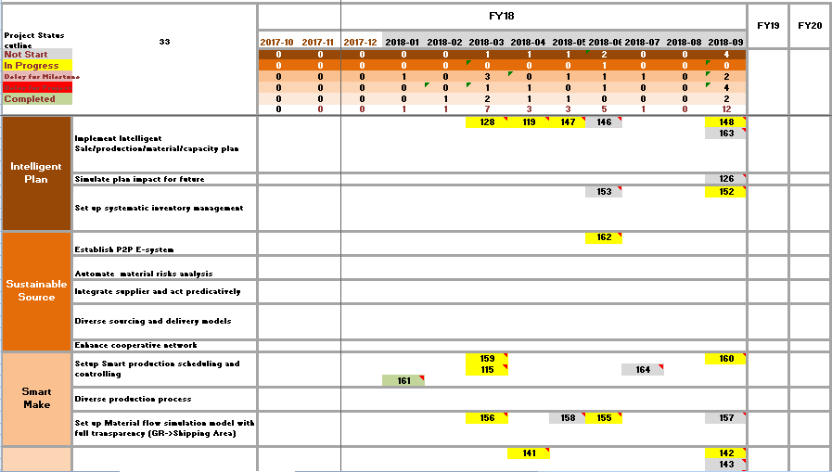
Project Overview_ Per Calendar option
Notes:
Description:
Project overview which could present project status per different “selection fields” as below:
Request:
Selection field option:
Project level, major milestone
Project Leader & Milestone owner
Time scope: Year/ Month

Slide 4
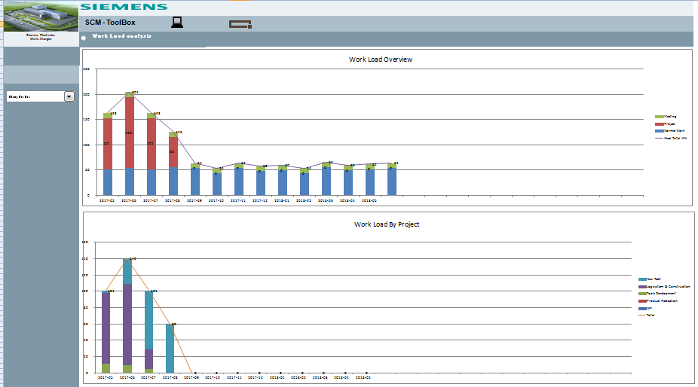
Resource status _ Person
TBD
Notes:
How to do work loading linkage with current project?

Slide 5
Project _ One Page
Goals
Scope
KPIs
Set up transparency of storage performance( Hardware performance, utilization, bin occupied rate etc.)
Optimize storage utilization
Build up simulation / FCST Tools for optimization / further decision
Pallet WH, MIT
Inventory parameter optimize ( inc. SP, slow moving parts)
Diverse supply mode change ( New way, Handsome, Tontect)
Storage management (Bin utilization optimize, packing utilization)
Simulation Tools for MVS & MIT Capacity & Bottleneck
Transparency reports / FCST
Reduction of unreasonable boxes ( 5K???)
PUMA/ Benefits/ Investment | Due date
Project kick off _ Phase 2 | 2017-10
Data study and Mitigation Plan finalized | 2017-10
Storage Bin Mgt Optimization | 2018-06
Divers Supply Mode for pilot vender ( New Way, Handsome, Tontec) | 2018-06
Transparency reports build up | 2018-09
Simulation tools build up | 2018-09
Team
Sponsor: | Li Yan | Coach: | Li Yan
Leader: | Ye Li Na
Member: | SCM :Zhang Xiao Hua, Wang Qian Ying, Li Yang, Duan Mei Kun, Chen Xin, Nie Fu Ping IT: Pan Rong Sheng, Guan Tu Jiang QM: Xiu Wei Lin
TBD
Notes:
Necessarily for red wording or not
Added field into excel for Data prepare

Slide 6
Project_ Milestone Status
Problem: xxxxxxxxx
Impact: xxxxxxxxx
Action Request: xxxxxxxxx
Due: xxxxxxx
8.Production Line ready for NS
2.Raw-M Procurement Strategy
Equipment Material Ready ( Old)
Equipment Material Ready ( New)
Equipment Transportation
Im & Exp process
Production line On site
Incorterm communication
MOQ judgment
Procurement mode
4.PO released
6.Raw-M Ready
PR release
PO release
Missing Parts Tracking
Risk Material Unblock
10.SOP
2017.10.10 ( Original )
2017.09.01
3.SAP Done
5.Material Flow Ready_ Raw-M
7.Material Flow Ready_ FG
9.NS
11.Handover to Log 2
1.Project Strategy
BOM
SOP
MRP
Raw-M ( SAP)
Raw-M ( No-SAP)
FG ( SAP)
FG ( Non-SAP)
Repacking solution
MIT
Pallets WH
MVS
Tour
External
Material Flow design
PAMA
Package Instruction
External Transportation
1st shipment out
Last time buy from EWA
Transition Plan( FG)
Raw-M
Support Doc / Pic
Risk Highlights:
Show it if project have content/ Hide it in opposite status
inputs in Excel Sheet
Based on “Due day” to get the previous Date achievements with select field of “weekly, bi-weekly, monthly, bi-monthly”
Notes:
Description:
Details milestone status & problem & doc show up
Request:
Project creation Option:
Template module for NPI/ Product transfer
Customized for others
Project /Milestone & time change:
Project first official release is the base for project timeline & milestone, date show below line
All latest time line show up above line
Achievements & focus have selection fields, and the result will show in timeline traffic lights
Based on “Due day” to get the previous Date achievements with select time field of “ DMY-DMY”
All change show in timeline traffic lights w/o any wording

