Slide 1
GCP AutoML Churn Application

Slide 2
About
The Churn Probability Estimator on GCP is an application that a user can provide inputs to and receive the probability of a customer churn (cancelling service).
The idea behind the project is to demonstrate the ability to use GCP's AutoML tool and provide an application for a company (such as Telco) to be able to quickly estimate the risk of losing a customer.

Slide 3



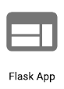


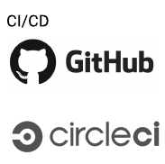

Architecture
Pipeline
Pipeline: The data is stored in Cloud Storage and using the BigQuery Data Transfer Service it is moved to BigQuery for processing and analysis. DataPrep preprocesses and transforms the data within BigQuery. This is entirely automated using the GCP tools stated above.
Deployment: The source files are stored in Github, pushed to Cloud Source Repositories, and automatically deployed to the cloud utilizing a trigger upon a modification to the source code.
Interface: Python (w/Flask) and HTML comprise the front end. The model is stored in AutoML Tables. When a user inputs data into the required fields to yield a prediction, the data is sent to the model and the model returns a probability of churn.
Cloud Storage
BigQuery
DataPrep
Application
Cloud Source Repositories
App Engine
AutoML Tables

Slide 4
The Data
Over 7040 observations, with both categorical and numeric data.
A few examples of the attributes include: senior citizen (boolean), tenure (how long they have been a customer, monthly charges (the monthly bill), and there are multiple columns for types of billing (monthly, one-year, two-year).
The dependent variable is churn, or whether the customer cancelled their service with the company.

Slide 5
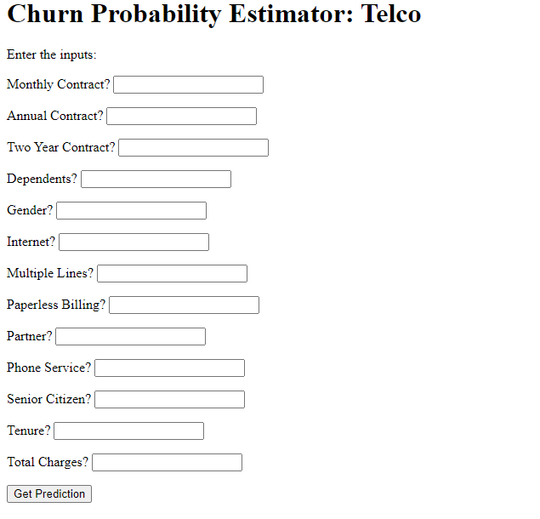
User-Interface
The user enters a 1 (true) or 0 (false) for each field.

Slide 6
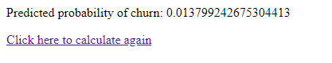
Results
User receives probability of a churn occurring, as shown below.

