Slide 1
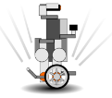

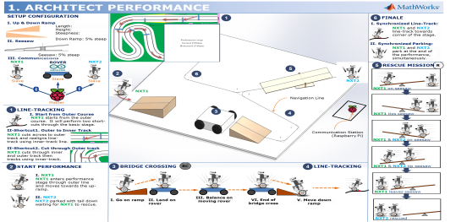

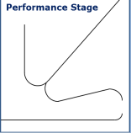
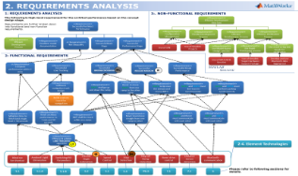

東京
地域：
地区：
東京都港区
チームＩＤ：374
チーム名： Wirewolf
所属：
MathWorks
☆チーム紹介
☆企画思想
WireWolf
ET ROBOCON team
[Performance Concept]
Basic concept is NXT1 rescuing NXT2 from Mario saving the princess a castle through obstacles.
NXT 1: is Mario
NXT 2: is Princess
Arduino Rover: is Yoshi
We, “Wirewolf”, are a team of engineers at the MathWorks from Japan and the United States.
USA
Japan
The MathWorks is the leading developer of
mathematical computing software for engineers
and scientists. We are working towards
accelerating the pace of engineering and science.
☆製品開発の未来に一言
[Design Concept]
1. Basic Stage
Performs two short cuts to reduce time spent at basic stage area.
Goal: Complete within 30 seconds.
Model-based design (MBD) is a highly attractive development approach of the future. The MBD approaches such as real-time simulation, hardware-in-the-loop and rapid prototyping methods allow engineers to effectively design and develop highly complex, large scale, and safety critical systems.
We believe MATLAB and Simulink can be the foundation to Model-based design.
2. Performance Stage
Designed custom performance stage for line-tracking.
Goal: Complete within 1:30 minutes.
2.1 Bridge Crossing
Goal: Go up the ramp then cross by getting on a rover then balancing on it while rover is moving.
2.2 Rescue Mission
- Goal: Rescue NXT2 by using NXT1 to tip over the seesaw.
2.3 Finale
- Synchronous line-tracking and parking performance.
☆コンテストにかける意気込み、アピール
We are adopting the Model-Based design approach using MATLAB, Simulink, and the Simulink Target Hardware support packages. These tools give us an advantage in implementing algorithms, validating them using simulation and quickly verifying them through rapid-prototyping.
Our motivation is to design, develop and test the architect performance using only Model-based design tools.
☆企画書の概要
PAGE 1: Architect Performance
Designed overall architect performance to have most attractive and challenging obstacles for the competition. A custom navigation track was designed.
☆パフォーマンスのここに注目！
Point 1: Communications architecture via use of Bluetooth
Designed a communication network that allows multiple NXT robots and external embedded device to communicate using Bluetooth.
Network architecture is scalable (easy to include additional devices)
Point 2: Use of other Embedded devices
Use of additional embedded devices such as:
  Arduino : Used to control the rover at the Bridge Cross.
  Raspberry Pi : Used as host for communication network of Bluetooth devices.
Point 3: Balancing two robots on a seesaw
Two robots balancing on a seesaw using balancing algorithm
Two robots communicating via Bluetooth network to work together on the seesaw.
PAGE 2: Requirements Analysis
Compiled requirements based on architect performance design.
- Functional & Non-Functional Requirements
PAGE 3: Development Process and Tools
Design model components in parallel across the team using Simulink Projects integrated with configuration management tool (SVN).
PAGE 4: NXT Model Architecture
Designed nxt model architecture based on components.
PAGE 5: Control Algorithms
Design component via Model-Based Design approach using products.
☆企画書の掲示指定
PAGE 6: Communications
Designed communication architecture using Bluetooth to synchronize multiple embedded devices (Raspberry Pi, Arduino and NXT) .
Page 1. Architect Performance
Page 3. Development Process and Tools
Page 4. NXT Model Architecture
Page 6. Communications
Page 7. Performance Algorithms
PAGE 7: Performance Algorithms
Designed component models using the elementary technologies.

