Slide 1
ET Robocon 2013: Competition for Architects Rules
By Pravallika

Slide 2

Introduction
New category in 2013
Judged on the idea, design, implementation and presentation
Minimal rules so as to encourage creativity
If there is anything questionable that is not covered in the document, the judges will decide on the day of the competition

Slide 3
Judgment
Judged on two categories
Planning (Design document for the model)
The plan document is to be submitted prior to the competition
Evaluated (100 pts) before the day of the competition by the Executive Committee judge
Competition
Reproducibility between model and performance: Evaluated by the Executive Committee judge (100 pts)
Attractiveness of the performance: Judged by Special/ Ordinary judges (200 pts)
Both evaluations are necessary

Slide 4
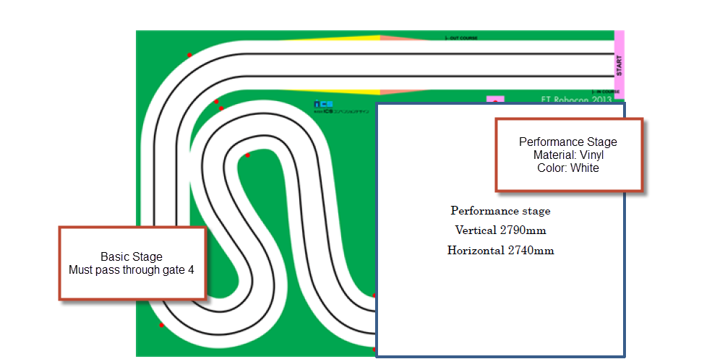
Competition field

Slide 5
What the competitor can bring in
Robot
NXTway-ET robot used for Development competition
Gadget(s)
Can be used on the performance stage as well as operation space
Gadgets could be anything including projector, speaker, amplifier, auxiliary power, mobile router etc.

Slide 6
Equipment provided by the committee
Table for operation
Table provided in the ‘operation space’
AC power supply available here
Can place up to 2 laptops here
AC Power supply
100V, 200W AC power
Microphone
Can be used during the performance to present the robot

Slide 7
Other facilities
Presentation Video
While the calibrator is calibrating, this video (Max: 2 min) can be played instead of the competitor presenting.
If used, should be submitted prior to the competition
Measurement System
Shows progress of the competition
Video Projector
Shows the presentation and the measurement system
Teams are not allowed to connect any other items to this projector

Slide 8
Competition Sequence
Order of the competition to be informed the day before
Rehearsal
On the day of the competition
Not exclusive
Inspection
Only the LEGO NXT will undergo inspection
No re-trial
Competitors will be called when it’s their turn

Slide 9
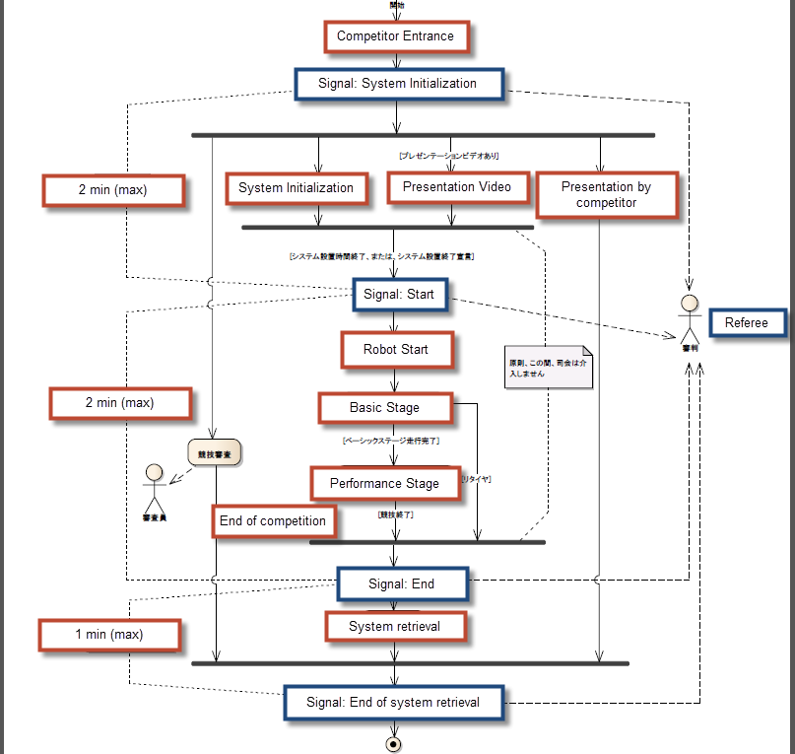

Slide 10
Prohibitions
Use of fire/ liquid
Causing damage to the track
Hurt people/ equipment
Interference in the operation of the competition
Violation of laws (Copyright infringement, licenses etc.)
Inadequate expression in performance

