Slide 1
Rover

Slide 2
Rover Hardware Overview
DC Motors
Left Motors
PWM
Motor Controller
IR Distance Sensors
Microcontroller
Servo Protocol Command
Upper
Analog Voltages
Right Motors
Lower
Sharp Analog Distance Sensor
10-80cm
Arduino Mega 2560
Sabertooth 12A RC Motor Controller
Lynx 12 VDC Motors
Notes:
Sharp GP2Y0A21YK0F Analog Distance Sensor 10-80cm
http://www.pololu.com/catalog/product/136
Arduino Mega 2560
http://arduino.cc/en/Main/arduinoBoardMega2560
Sabertooth 12A RC Motor Controller (sabertooth2x12rc)
http://www.dimensionengineering.com/products/sabertooth2x12rc
Motor Controller Assembly Guide
http://www.lynxmotion.com/images/html/build122.htm
Lynx DC Gear Head Motor - 12vdc 30:1 200rpm (6mm shaft)
http://www.lynxmotion.com/p-93-gear-head-motor-12vdc-301-200rpm-6mm-shaft.aspx

Slide 3
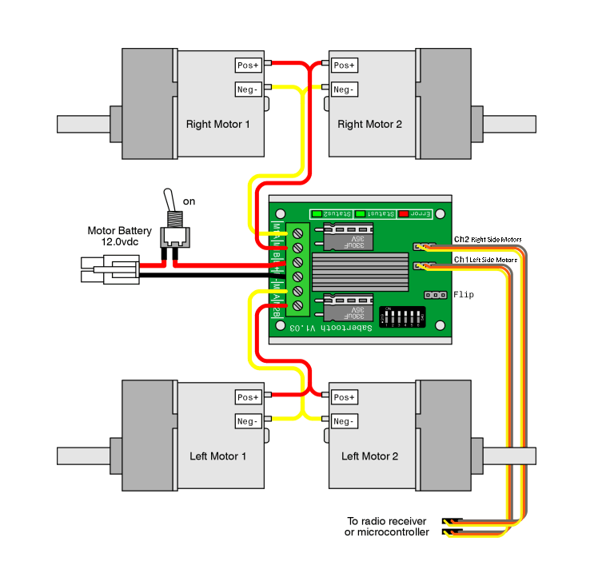
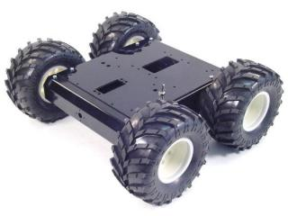
Media

Slide 4
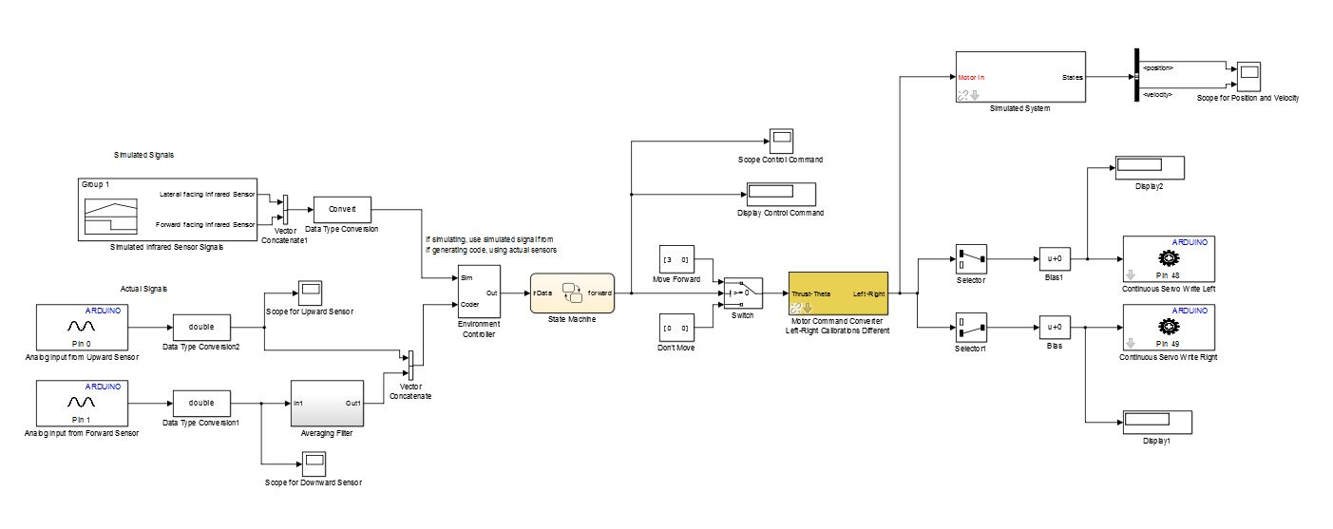

Slide 5
LED Cube

Slide 6
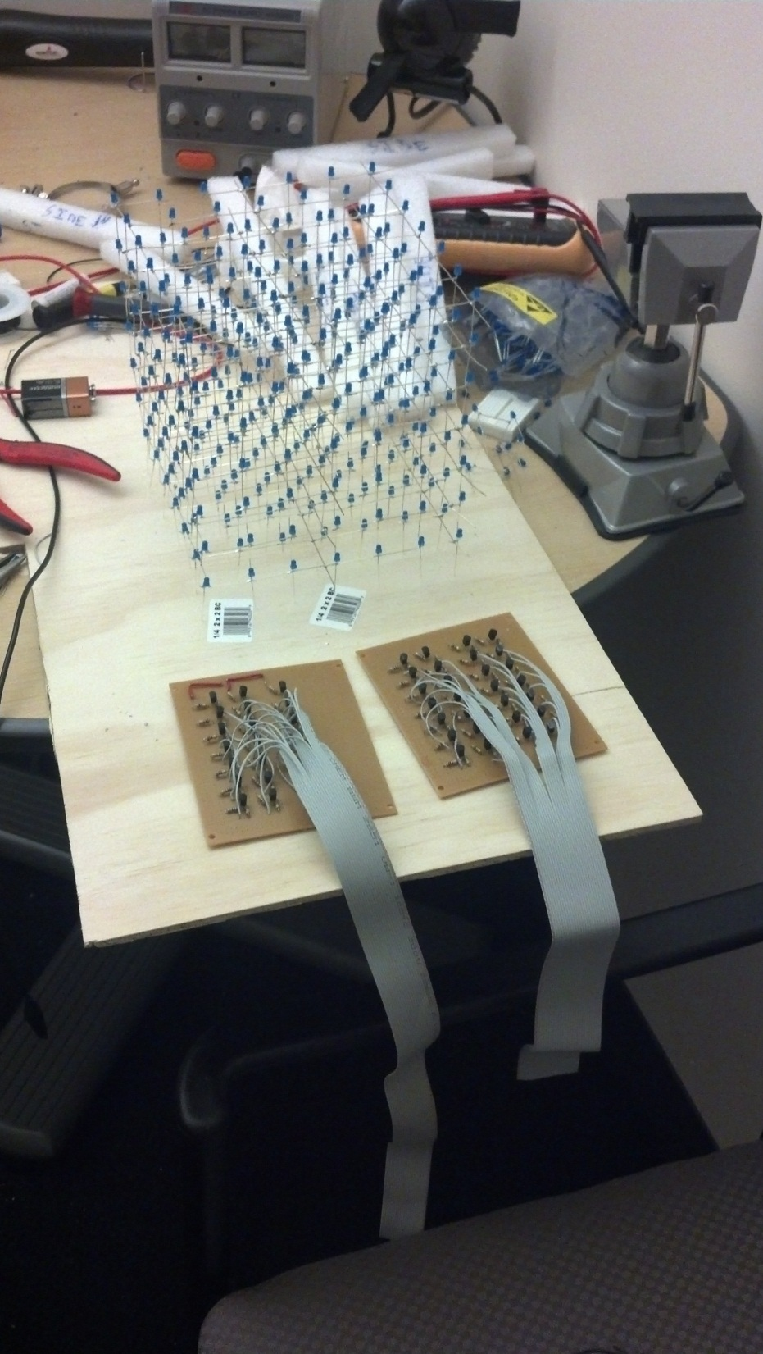
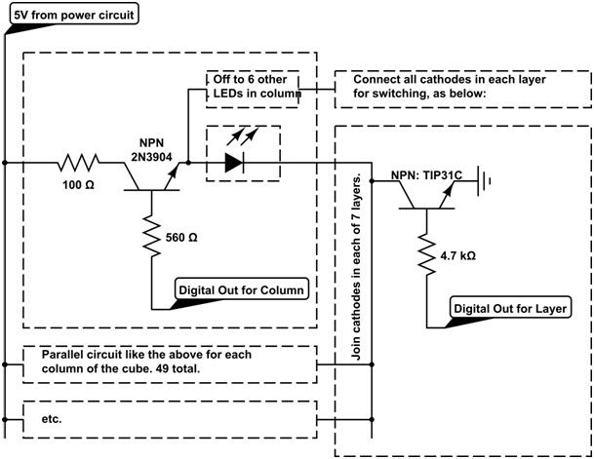

Slide 7
