Slide 1
DUBAI OFF-PLAN · INVESTMENT COMPARISON · JULY 2026
Three projects.
One decision.
Floareá Skies · JVC · 2028
Arancia · City of Arabia · 2029
Celesto Tower 4 · DLRC · 2028
Marwan Wareth
01

Slide 2
THE BRIEF
What we're solving for
Requirement | Client brief
Budget | ≈ AED 2,000,000
Unit type | 1–2 Bedroom
Purchase stage | Off-plan
Priority 1 | Net rental yield
Priority 2 | Time to first rent
Priority 3 | Capital before handover
Priority 4 | Resale liquidity
One buyer, roughly AED 1.5–2M of capital, looking for an off-plan one- or two-bedroom that earns. Three shortlisted projects that answer it in three completely different ways.
3
3
18 months
PROJECTS
COMMUNITIES
HANDOVER SPREAD
Marwan Wareth
02

Slide 3
HEAD TO HEAD
The three, side by side
Metric | Floareá Skies | Arancia | Celesto 4
Community | JVC | City of Arabia | DLRC
Developer | Mashriq Elite | BEYOND · OMNIYAT | Al Tarrad
Handover | Q1 2028 | Q1 2029 | Q4 2028
Units in building | 192 | 272 | 414
1 BR size | 837 sqft | 750–762 sqft | 590–650 sqft
1 BR all-in cost | AED 1,204,160 | AED 1,513,250 | AED 899,650 est
Capital in before keys | 30% | 40% | 50%
4% DLD fee | Payable | Payable | Payable
Furnished on handover | Yes | No | Yes
Metro | Purple Line, future | Yellow Line, future | Blue Line, 1 min, future
To DXB airport | 35 min | 23 min | 18 min
Green marks the strongest of the three on that row. The full cost stack is on the next slide. Floareá's numbers come from a live sales offer (unit FS 611, 18 July 2026); Arancia and Celesto are still to be confirmed. Not financial advice.
Marwan Wareth
03

Slide 4
THE FULL COST, LINE BY LINE
From price to net return
Every cost a buyer actually pays, and what is left at the end of a year. One bedroom, entry unit, same method for all three.
One bedroom · AED | Floareá Skies | Arancia | Celesto 4
Starting unit price | 1,154,000 (discount possible) | 1,450,000 | 860,000 est
DLD registration fee 4% | 46,160 | 58,000 | 34,400
Admin fee | 4,000 | 5,250 | 5,250
Total cost to buy | 1,204,160 | 1,513,250 | 899,650
in EUR | €280,690 | €352,739 | €209,708
Unit size | 837.54 sqft | 750 sqft | 590 sqft
Price per sqft | 1,378 | 1,933 | 1,458
Annual rent | 80,000 | 90,000 | 68,000
Service charge | 11,726 (14/sqft) | 11,250 (15/sqft) | 7,080 (12/sqft)
Net return, annual | 68,274 | 78,750 | 60,920
in EUR | €15,915 | €18,357 | €14,200
Net rental yield | 5.7% | 5.2% | 6.8%
Marwan Wareth
Net return = rent − service charge. Yield = net return ÷ total cost including DLD and admin. FX 1 EUR = 4.29 AED. Floareá confirmed; Arancia and Celesto prices to be verified on a price list. Not financial advice.
04

Slide 5
IF THE BRIEF MOVES UP A SIZE
The two-bedroom picture
All three quote a two-bedroom, and the spread is wide — AED 780,000 between the cheapest and the dearest before a single fee is added.
2 Bedroom | Floareá Skies | Arancia | Celesto 4
Price from | AED 1,900,000 | AED 2,100,000 | AED 1,320,000
Size | 1,105–1,170 sqft · 3 types | 1,100–1,179 sqft | 852–1,070 sqft
Price per sqft | AED 1,623 | AED 1,909 | AED 1,550
DLD 4% | 76,000 | 84,000 | 52,800
Admin fee | 4,000 | 5,250 | 5,250
All-in cost | AED 1,980,000 | AED 2,189,250 | AED 1,378,050
Units of this type | 16 of 192 | To confirm | 72 of 414
Payment plan | 30 / 70 | 40 / 60 | 50 / 50, 1% monthly
Handover | Q1 2028 | Q1 2029 | Q4 2028
Marwan Wareth
05

Slide 6
WHERE YOUR MONEY SITS, AND WHEN
Capital exposure before you hold keys
Each bar is 100% of the purchase price. The question that matters isn't the headline split — it's how much is out of your pocket before the asset can earn anything.
Project | Before keys | On handover | Shape
Floareá Skies | 30% | 70% | Milestone
Arancia | 40% | 60% | Milestone
Celesto 4 | 50% | 50% | 1% monthly
Two different kinds of easy. Floareá asks the least before keys — 30%, of which 20% is the booking. It also carries the largest payment at the end: 70% on completion, usually the point a mortgage is drawn. Celesto's 1% a month is the opposite trade.
Marwan Wareth
06

Slide 7
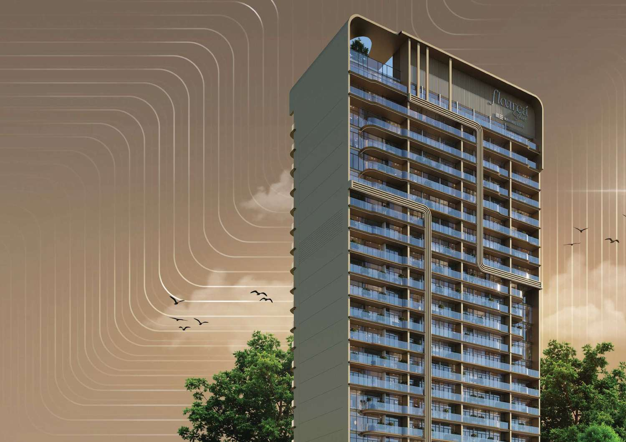
HIGH END APARTMENTS · JUMEIRAH VILLAGE CIRCLE
Floareá Skies
A LIFE PAINTED IN PASTEL HORIZONS
Developer · Mashriq Elite Developments Handover · Q3–Q4 2027 From · AED 1,050,000
Marwan Wareth
07

Slide 8
Floareá Skies · Mashriq Elite
Floareá Skies · Mashriq Elite
THE DEVELOPER
Mashriq Elite
Developments
The property arm of Al Mashriq Group — a diversified house with over two decades across real estate, project development and telecommunications, with a network spanning the UAE, United States, Europe, Singapore and Saudi Arabia. Design, architecture and delivery sit under one roof in their own design centre.
Floareá Skies is their fourth venture, positioned as the project that sets their benchmark. The record is short but real: a project launched September 2023 was handed over in August 2025, with further launches in June 2024 and February 2025, and announced chapters in Dubai Islands and Dubailand.
20 + yrs
4th
GROUP HISTORY
VENTURE
Marwan Wareth
Marwan Wareth
08
08

Slide 9
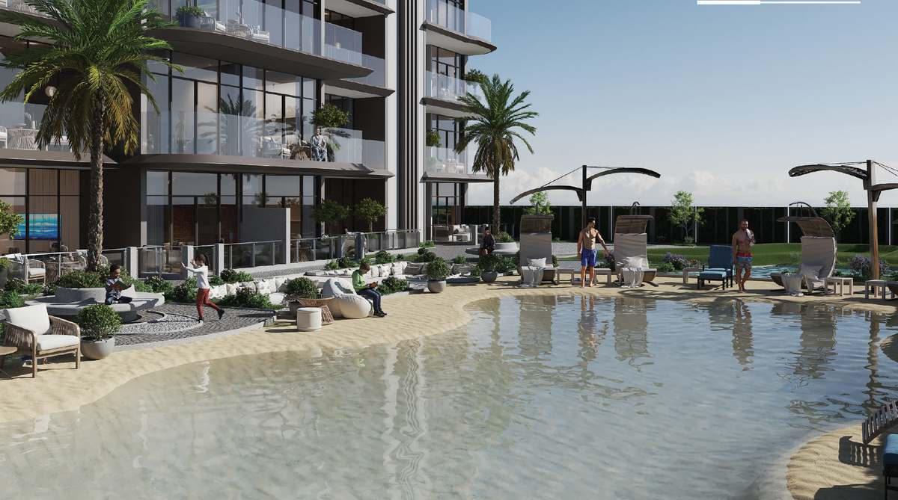
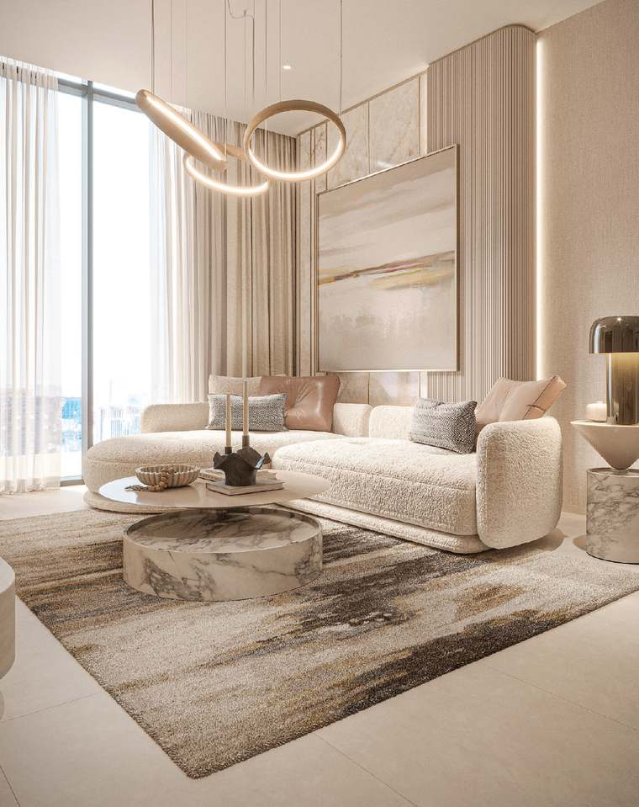
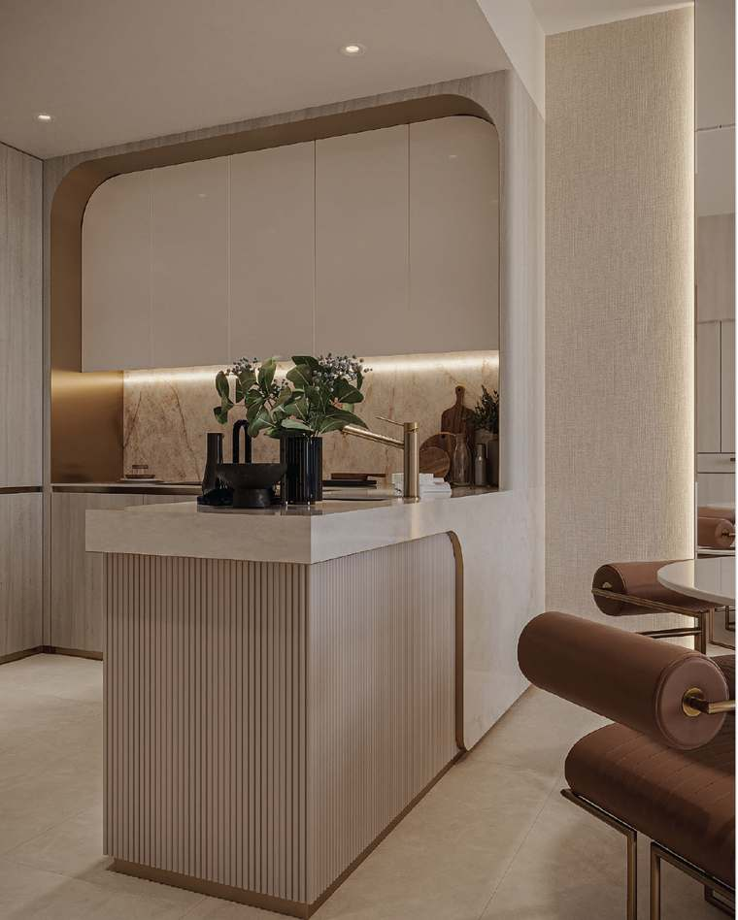
Floareá Skies · JVC
THE PROJECT
Adjacent to JVC's entry and exit, with a Purple Line metro station coming
Attribute | Detail
Location | Jumeirah Village Circle
Types | Studio · 1 BR · 2 BR
Configuration | G + 4P + 19 floors
Total units | 192
Handover | Q1 2028
Payment plan | 30 / 70 · 20% on booking
Service charge | AED 14 / sqft
Amenities. Rooftop infinity pool · organic pool · sunken lounge · floating meditation deck · gym · mini golf · ground-floor retail
Drive times. Internet City & Media City 10 · Miracle Garden 5 · Marina, Burj Al Arab, Mall of the Emirates 15 · Downtown & Dubai Mall 25 · DXB Airport 35
Marwan Wareth
09

Slide 10
Floareá Skies · What's included
DELIVERABLES
It arrives fitted — that's the whole argument
Included
Smart home
Not included
Decorative wall cladding — tile and wood-textured panels
Dresser console wall with mirror
Glass wardrobes; glass and wooden in the bedroom
Living room wall console with bookshelf
Bathroom fittings, vanity, LED-lit mirror
Alexa-integrated home system
Smart switch panels
AC thermostats
Curtains — provision only. Conduit and electrical point supplied; the smart curtains themselves are not
Living room mirror
Bedroom decor mirror piece
Study room furniture
Chandeliers
Wallpaper
Marwan Wareth
10

Slide 11
Floareá Skies · Unit FS 611 · 1 BR, 837.54 sqft
PRICE TO BE PAID
RENTAL RETURN SCENARIO
1 Bedroom · Type D · 837.54 sqft | AED | EURO
Unit price | 1,154,000 | €269,001
DLD registration fee 4% | 46,160 | €10,760
Admin fee | 4,000 | €932
Average price / sqft | 1,378 | €321
Total | 1,204,160 | €280,690
Annual | AED | EURO
Average gross rental | 80,000 | €18,648
Unit size | 837.54 sqft | —
Service charge · AED 14/sqft | 11,726 | €2,733
Net return, annual | 68,274 | €15,915
Net rental yield | 5.7%
Q1 2028
837 sqft
30%
Fitted
HANDOVER · EARLIEST
LARGEST 1 BR
CAPITAL BEFORE KEYS · LEAST
ON HANDOVER
Marwan Wareth
FX 1 EUR = 4.29 AED. Net yield is net rental divided by total cost including fees. Figures subject to change — verify on the price list and SPA. Not financial advice.
11

Slide 12
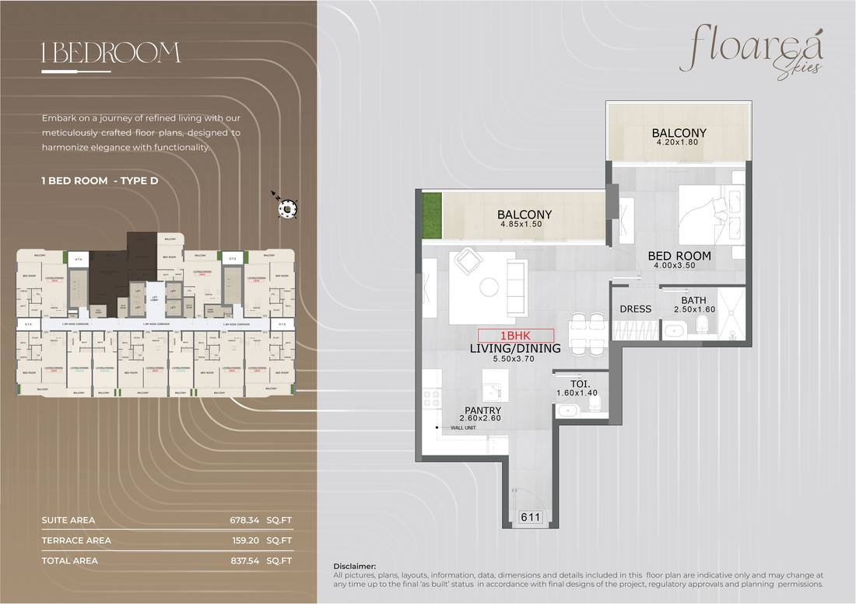
Floareá Skies · Sales offer S 611 · 18 July 2026
THE ACTUAL SCHEDULE
UNIT FS 611 · 1 BEDROOM TYPE D
Description | % | Due | AED
Down payment | 20% | On booking | 230,800
1st instalment | 5% | 1 Dec 2026 | 57,700
2nd instalment | 5% | 1 Jun 2027 | 57,700
On completion | 70% | Q1 2028 | 807,800
Total | 100% |  | 1,154,000
Government & admin fees | % | Due | AED
DLD fee | 4% | Booking date | 46,160
Admin fee | — | Booking date | 4,000
Due at booking, all in |  |  | 280,960
Unit detail | Value
Total area | 678.34 suite + 159.20 balcony = 837.54 sqft
Marwan Wareth
12

Slide 13
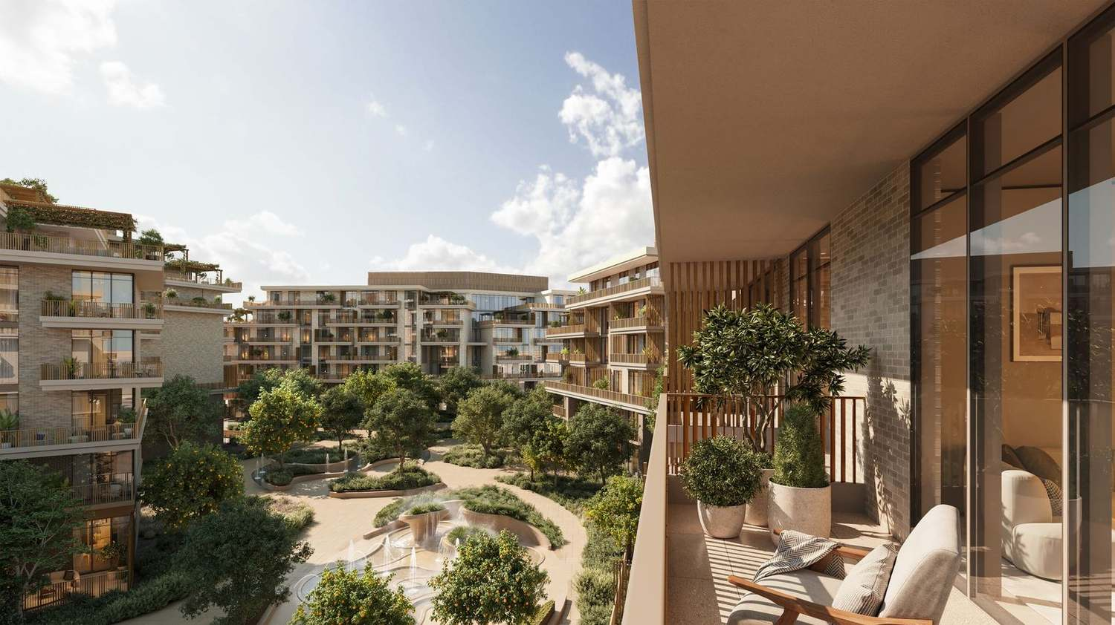
GARDEN RESIDENCES · CITY OF ARABIA
Arancia
CITRUS COURTYARDS, ONE KILOMETRE OF GREEN
Developer · BEYOND · OMNIYAT Group Handover · Q1 2029 From · AED 1,450,000
Marwan Wareth
13

Slide 14
Arancia · BEYOND · OMNIYAT
THE DEVELOPER
BEYOND
The Yards is BEYOND's master-planned destination in City of Arabia: 2.3 million sqft of gross floor area, 1,560 residences, organised along a one-kilometre green spine, with 70% of the total area given to open landscape. Mediterranean-inspired, with its own school, clinic, mosque, farm, gardens and retail — a complete community rather than an apartment block with a pool.
The premium residential brand of OMNIYAT Group, founded in Dubai in 2005 — the group behind the city's ultra-prime waterfront portfolio.
Arancia is the first cluster to launch inside it: 272 residences across three low-rise buildings, G+6 and G+7, arranged around a central green valley.
AED 4 bn
70%
MASTERPLAN VALUE
OPEN LANDSCAPE
Marwan Wareth
14

Slide 15
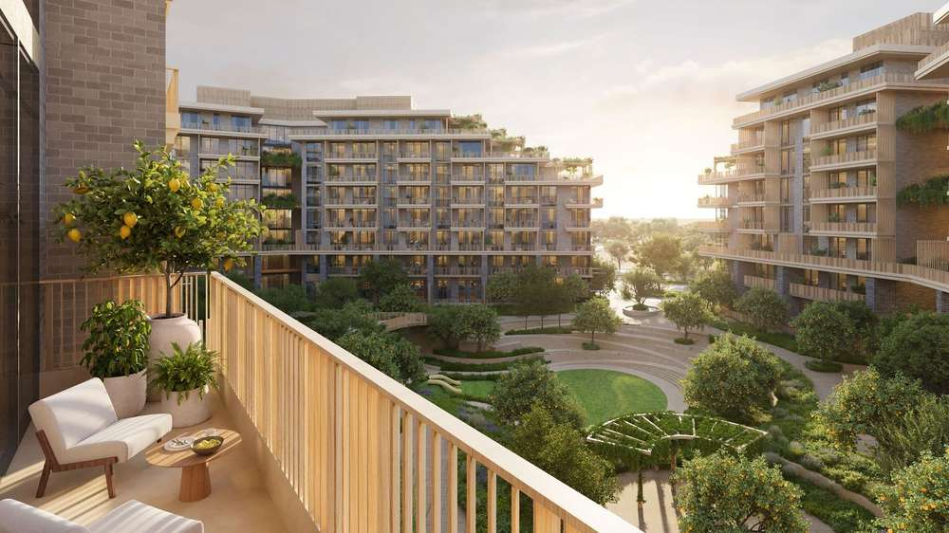
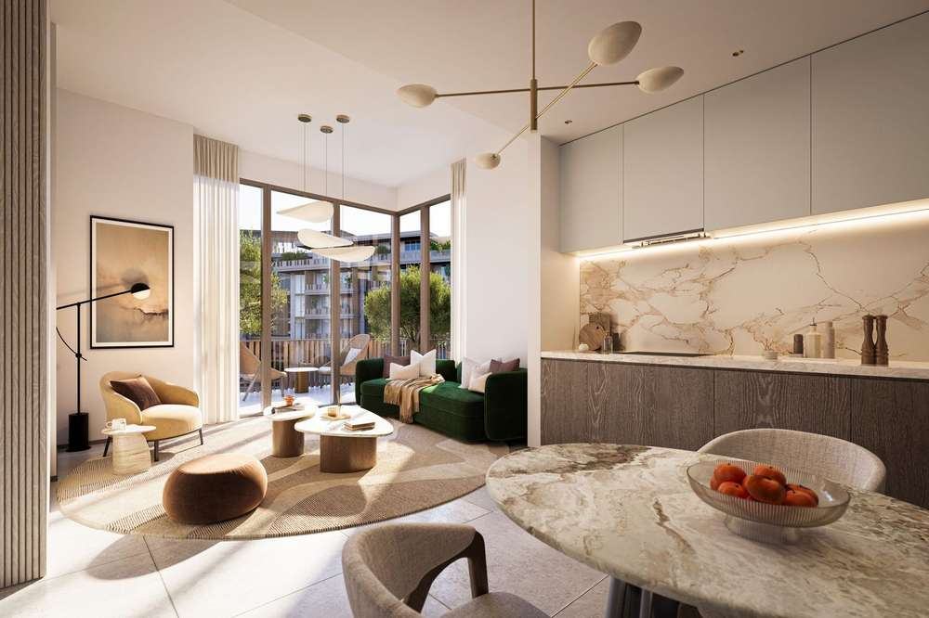
Arancia · City of Arabia
THE PROJECT
PRICE LADDER
Three low-rise buildings around a central green valley, inside a AED 4bn masterplan
Type | Size | From
1 Bed | 750–762 sqft | AED 1,450,000
2 Beds | 1,100–1,179 sqft | AED 2,100,000
3 Beds | 1,700–1,751 sqft | AED 3,370,000
Attribute | Detail
Location | City of Arabia, Dubailand
Types | 1 · 2 · 3 Bedrooms
Buildings | 3 low-rise, G+6 / G+7
Total units | 272 in phase · 1,560 masterplan
Handover | Q1 2029
Ceiling height | 3.1 m
Payment plan | 40 / 60
Service charge | To confirm
In-unit. Private terraces to every residence · 3.1 m ceilings · floor-to-ceiling thermally insulated glazing · courtyard views
Amenities. Lagoon pool · lounge pool with lap pool · gyms · spa · cinema room · kids' club · yoga areas · sports court · amphitheatre · orchard gardens · farm
Marwan Wareth
15

Slide 16
Arancia · 1 BR, 750 sqft
PRICE TO BE PAID
RENTAL RETURN SCENARIO
1 Bedroom · 750 sqft | AED | EURO
Unit price | 1,450,000 | €337,995
DLD registration fee 4% | 58,000 | €13,520
Admin fee | 5,250 | €1,224
Average price / sqft | 1,933 | €451
Total | 1,513,250 | €352,739
Annual | AED | EURO
Annual rent | 90,000 | €20,979
Unit size | 750 sqft | —
Service charge · AED 15/sqft | 11,250 | €2,622
Net return, annual | 78,750 | €18,357
Net rental yield | 5.2%
90,000
1,933
272
2029
AED RENT · HIGHEST
AED / SQFT · PREMIUM
UNITS IN PHASE
HANDOVER · LONGEST WAIT
Marwan Wareth
FX 1 EUR = 4.29 AED. Net yield is net rental divided by total cost including fees. Figures subject to change — verify on the price list and SPA. Not financial advice.
16

Slide 17
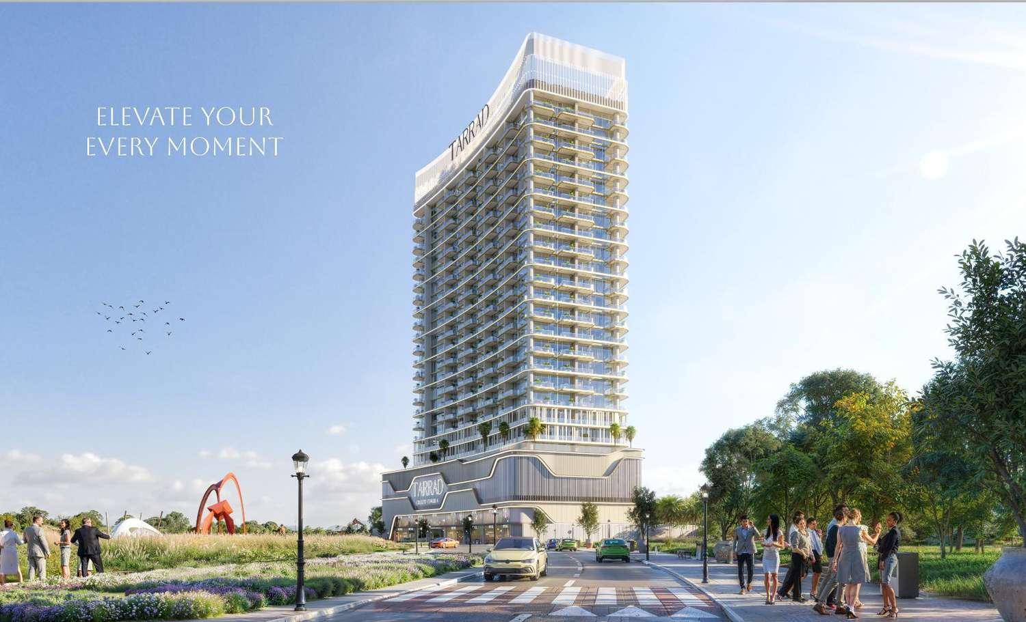
HIGH END APARTMENTS · DUBAILAND RESIDENCE COMPLEX
Celesto Tower 4
Developer · Al Tarrad Development Handover · Q4 2028 From · AED 540,000
Marwan Wareth
17

Slide 18
Celesto Tower 4 · Al Tarrad
THE DEVELOPER
Al Tarrad
Development
Al Tarrad runs a focused, repeatable formula: mid-rise residential towers in Dubailand aimed at the investor and entry end-user market — fully furnished, smart-home fitted, priced below the mid-market. Celesto 4 is the fourth in a numbered series, which tells you the model works well enough to keep running.
The submitted design package is itself a confidence signal: a full climate and solar study, site accessibility and land-use analysis, verified area calculations against permitted GFA, a reconciled unit matrix and complete floor plans. Residential GFA comes in at 22,309.05 sqm against an allowed 22,311.00.
Marwan Wareth
18

Slide 19
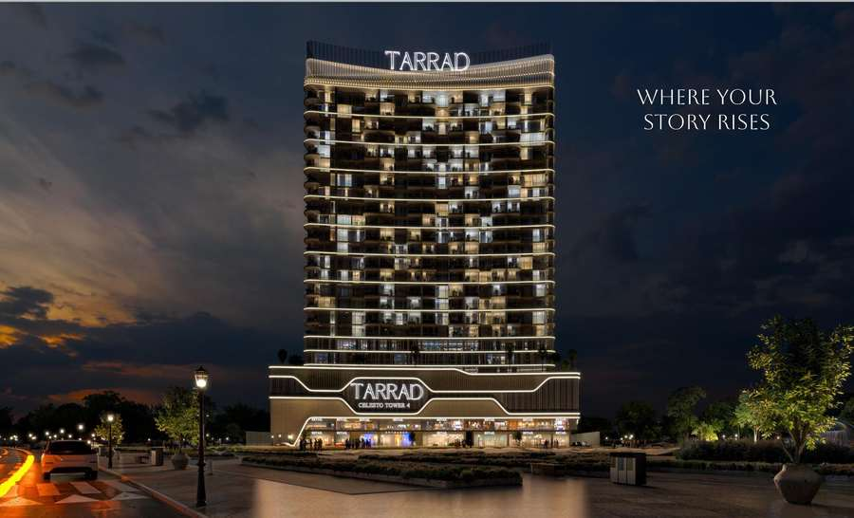
Celesto Tower 4 · DLRC
THE PROJECT
UNIT MIX
One minute from a Blue Line metro station, eighteen from Downtown, DIFC and the airport
Type | Size incl. balcony | Units
Studio · A–D | 326–363 sqft | 162
1 BHK · A–C | 550–598 sqft | 180
2 BHK · A–D | 852–1,070 sqft | 72
Total |  | 414
Attribute | Detail
Location | DLRC, Wadi Al Safa 5
Types | Studio · 1 BHK · 2 BHK
Configuration | 3B + G + M + 3P + 21 floors
Total units | 414
Handover | Q4 2028
Parking | 1 space per apartment
Furnishing | Fully furnished, smart home
Service charge | AED 12 / sqft (confirm)
Amenities. Indoor and outdoor gym · indoor and outdoor kids play areas · adults and kids pools · sauna and jacuzzi · BBQ area · yoga area · outdoor cinema · zen garden · ground-floor retail
Marwan Wareth
19

Slide 20
Celesto Tower 4 · Studio & 1 BR
STUDIO · 326 SQFT · CONFIRMED ENTRY PRICE
1 BEDROOM · 590 SQFT · PRICE ESTIMATED
Studio | AED | EURO
Unit price | 540,000 | €125,874
DLD registration fee 4% | 21,600 | €5,035
Admin fee | 5,250 | €1,224
Average price / sqft | 1,657 | €386
Total | 566,850 | €132,133
Rent 42,000 − service charge 3,910 | 38,090 | €8,879
Net rental yield | 6.7%
1 Bedroom | AED | EURO
Unit price (estimate) | ≈860,000 | €200,466
DLD registration fee 4% | 34,400 | €8,019
Admin fee | 5,250 | €1,224
Average price / sqft | 1,458 | €340
Total | 899,650 | €209,708
Rent 68,000 − service charge 7,080 | 60,920 | €14,200
Net rental yield | 6.8%
2028
414
1% /month
1 min
HANDOVER
UNITS · MOST
FOR 30 MONTHS
TO BLUE LINE METRO
Marwan Wareth
FX 1 EUR = 4.29 AED. Service charge AED 12/sqft, published for Celesto Tower — confirm for Celesto 4. Net return = rent − service charge; yield = net return ÷ total cost including DLD and admin. Not financial advice.
20

Slide 21
WHAT EACH ONE COSTS YOU
No project here is perfect
Every option has a real weakness. These are the ones worth knowing before signing, not after.
Floareá Skies
Arancia
Celesto Tower 4
THE CATCH
THE CATCH
THE CATCH
Boutique developer with a thin delivery record — the real risk on this deal
JVC is Dubai's most crowded pipeline: 16,800–22,000 units to 2028, so rents may soften 5–10% at handover
70% falls due on completion — the largest single payment of the three, usually the point a mortgage is drawn
AED 1.2M all-in for the mid yield of the three at 5.7% — a size-and-timing buy more than an income buy
Service charge of AED 14/sqft is above Celesto's 12 — the rooftop pool and meditation deck cost something to run
At the confirmed AED 1.45M price it is the dearest per foot (1,933) and the lowest yield of the three at 5.2%
Q1 2029 handover — the longest wait. Four years before a dirham of rent
1,560 units across the masterplan: resale competes with the developer's own later phases
Inland City of Arabia — resale depends on the community delivering as drawn
Not furnished, unlike the other two
The only one with no published service charge, and the heaviest amenity and landscape load
414 units in one building — at handover the 1BR competes with 179 identical neighbours
39% of the building is studios — investor-heavy, higher churn, weaker resale base
The 1BR is the smallest of the three at 590 sqft
One parking space per apartment, no resident surplus
Least established developer; record on Celesto 1–3 unverified
Marwan Wareth
21

Slide 22
THE DECISION
Three different propositions, not a ranking
The numbers land close enough that they don't decide this. What decides it is which of these three sentences sounds most like you.
“I want the biggest apartment, the earliest keys, and the least tied up until then.”
Floareá Skies
Q1 2028, 837 sqft, only 30% before handover — and the developer will talk about the price.
“I want the best address and the strongest rent, and I can wait until 2029.”
Arancia
AED 90,000 a year — the highest rent of the three — OMNIYAT's brand and the only true community. Priced for it at 1,933/sqft.
“I want the smallest cheque, paid monthly, and the best yield.”
Celesto Tower 4
6.8% on the least capital, 1% a month for 30 months, metro at one minute.
My recommendation: Floareá Skies. It is the only project where every figure is confirmed by the developer in writing — and the most complete buy of the three: the largest one-bedroom at 837 sqft, delivered fully fitted, the earliest keys at Q1 2028, and just 30% before handover. Your rent starts in JVC’s proven market a year ahead of the others, and the developer is open on price. Celesto is the smart smaller cheque at 6.8%; Arancia the five-year address play — both strong second choices.
Marwan Wareth
22

Slide 23
NEXT STEPS
Where we go from here
Shortlist one, and I'll pull live availability and the current price list the same day.
YOUR BROKER
Marwan Wareth
I'll get the service charge in writing on your pick — it moves net yield up to a full point.
Bridges & Allies Real Estate · Dubai off-plan residential
Escrow account and RERA registration verified before any deposit moves.
📞 +971 56 164 5645
✉ marwan.w@bridgesandalliesre.com
Site visit or sales-centre walkthrough arranged for the two you like most.
📍 502 Al Fattan Office Tower · JBR · Dubai
Marwan Wareth
All figures developer- and broker-published and subject to change. For information only — not financial advice. Verify on the current price list and SPA.
23

