Slide 1
Partitioning effects on the intra-annual variability of GPP of a boreal forest ecosystem
Marieke Wesselkamp

Slide 2
Background
Masterthesis: Fusion of a Neural Network (MLP) and a process-model for the prediction of GPP of boreal forests (PRELES)
Method: Transfer Learning with domain adaptation

Slide 3
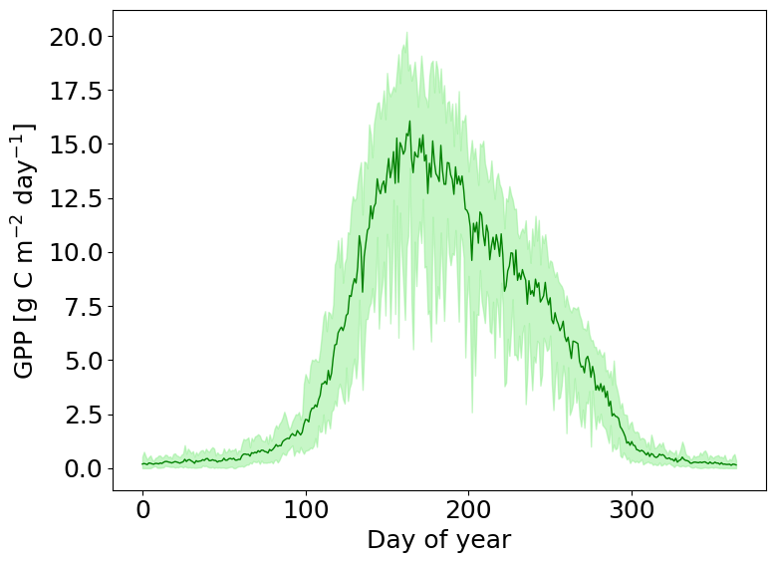
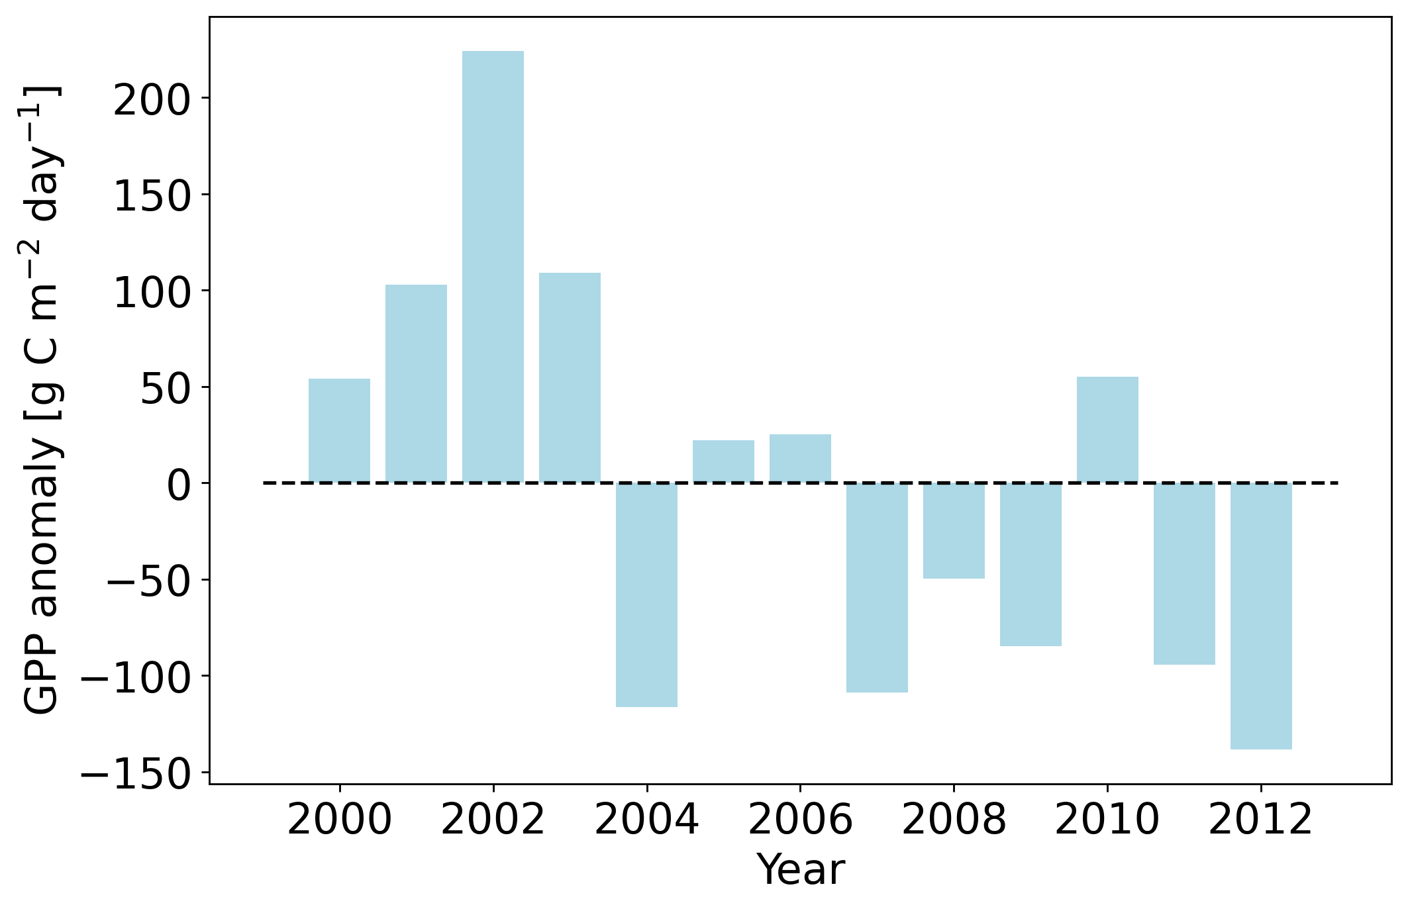
Gross primary productivity (GPP) at Soro (DK)
13 years (2000-2012) of daily GPP measurements [2]
Mean sum of yearly GPP: ﻿1850.27

Slide 4
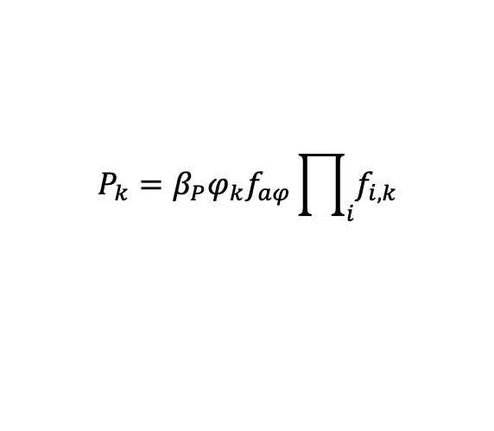
Modeling GPP 1) Semi-empirical: PRELES
Light-use efficiency (P)
Evapotranspiration (ET)
$$P_{k}=β_{P}φ_{k}f_{aφ}\prod_{i}{f_{i,k}}$$
Soil water content (SW)
30 Parameters and 5 climatic input variables: Tair, Precip, PAR, fAPAR, VPD
(CO2)
[3]
2) Empirical: Neural Network (MLP)
Clim
GPP
1857 trainable Parameters and 5 climatic input variables: Tair, Precip, PAR, fAPAR, VPD
32 32 16

Slide 5
Modeling GPP 1) Semi-empirical: PRELES
Potential light-use efficiency
Light-use efficiency (P)
Evapotranspiration (ET)
$$P_{k}=β_{P}φ_{k}f_{aφ}\prod_{i}{f_{i,k}}$$
Soil water content (SW)
30 Parameters and 5 climatic input variables: Tair, Precip, PAR, fAPAR, VPD
(CO2)
[3]
2) Empirical: Neural Network (MLP)
Clim
GPP
1857 trainable Parameters and 5 climatic input variables: Tair, Precip, PAR, fAPAR, VPD
32 32 16

Slide 6
Modeling GPP 1) Semi-empirical: PRELES
Photosynthetic photon flux density
Light-use efficiency (P)
Evapotranspiration (ET)
$$P_{k}=β_{P}φ_{k}f_{aφ}\prod_{i}{f_{i,k}}$$
Soil water content (SW)
30 Parameters and 5 climatic input variables: Tair, Precip, PAR, fAPAR, VPD
(CO2)
[3]
2) Empirical: Neural Network (MLP)
Clim
GPP
1857 trainable Parameters and 5 climatic input variables: Tair, Precip, PAR, fAPAR, VPD
32 32 16

Slide 7
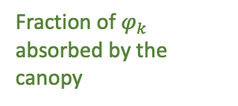
Modeling GPP 1) Semi-empirical: PRELES
Fraction of $φ_{k}$ absorbed by the canopy
Light-use efficiency (P)
Evapotranspiration (ET)
$$P_{k}=β_{P}φ_{k}f_{aφ}\prod_{i}{f_{i,k}}$$
Soil water content (SW)
30 Parameters and 5 climatic input variables: Tair, Precip, PAR, fAPAR, VPD
(CO2)
[3]
2) Empirical: Neural Network (MLP)
Clim
GPP
1857 trainable Parameters and 5 climatic input variables: Tair, Precip, PAR, fAPAR, VPD
32 32 16

Slide 8
Modeling GPP 1) Semi-empirical: PRELES
Light-use efficiency (P)
Evapotranspiration (ET)
$$P_{k}=β_{P}φ_{k}f_{aφ}\prod_{i}{f_{i,k}}$$
Soil water content (SW)
30 Parameters and 5 climatic input variables: Tair, Precip, PAR, fAPAR, VPD
(CO2)
[3]
2) Empirical: Neural Network (MLP)
Clim
GPP
1857 trainable Parameters and 5 climatic input variables: Tair, Precip, PAR, fAPAR, VPD
32 32 16

Slide 9
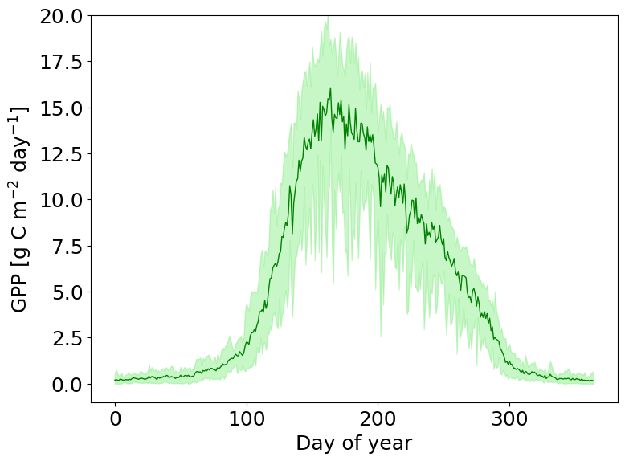
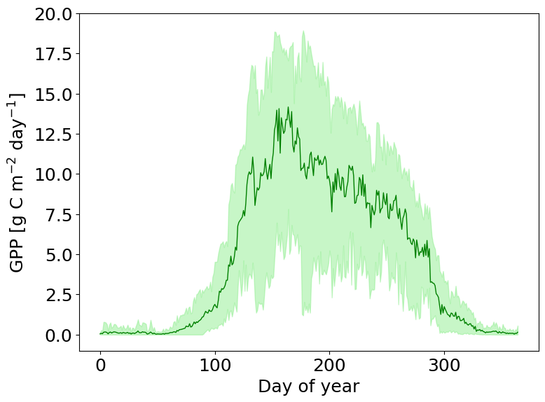
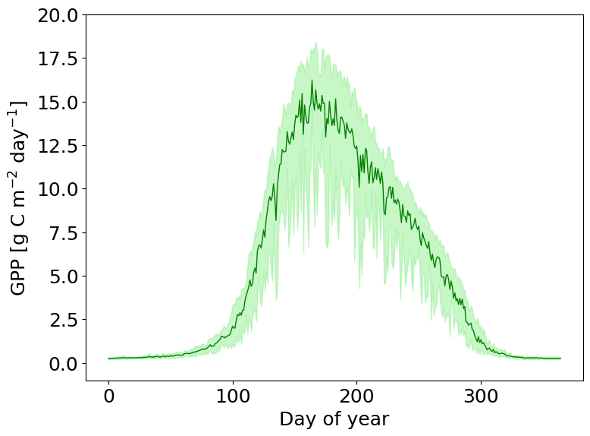
Calibrating PRELES and the MLP for 13 years of Soro stand data
Mean of 13 years (2000-2012) of daily GPP measurements [2]
Mean PRELES predictions for 13 years (2000-2012)
Mean neural network predictions for 13 years (2000-2012)

Slide 10
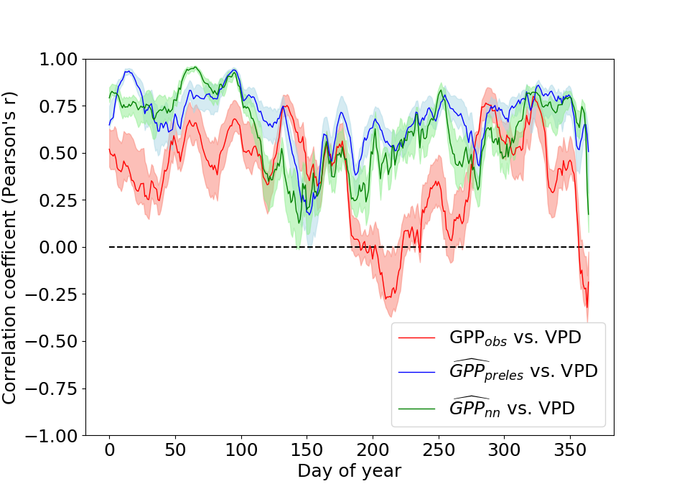
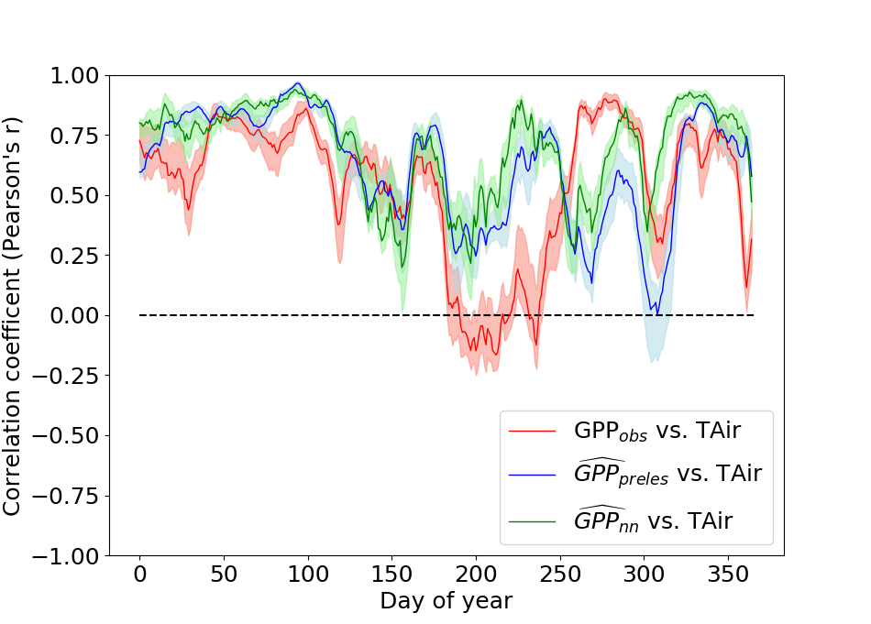
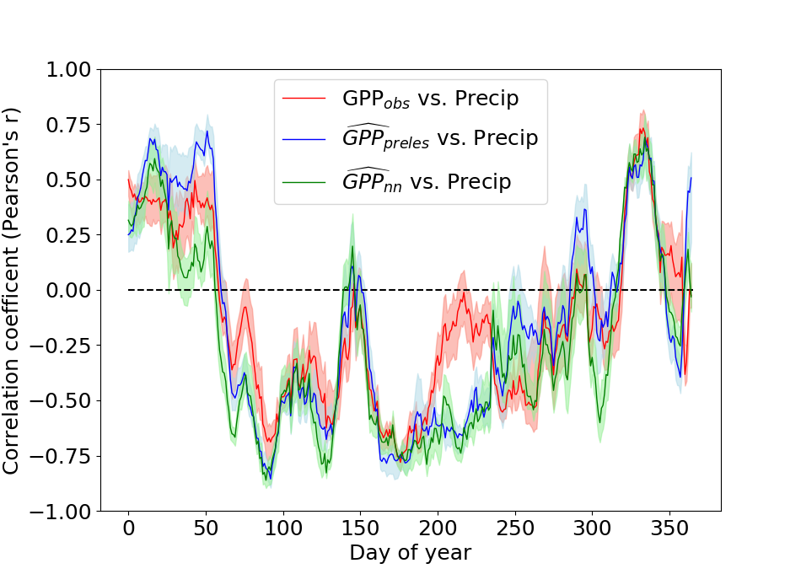
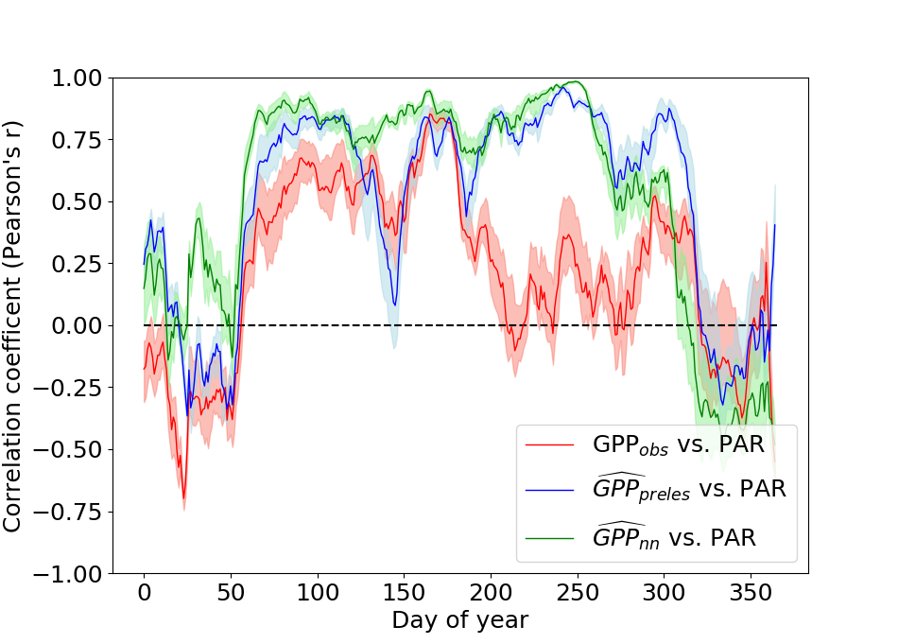
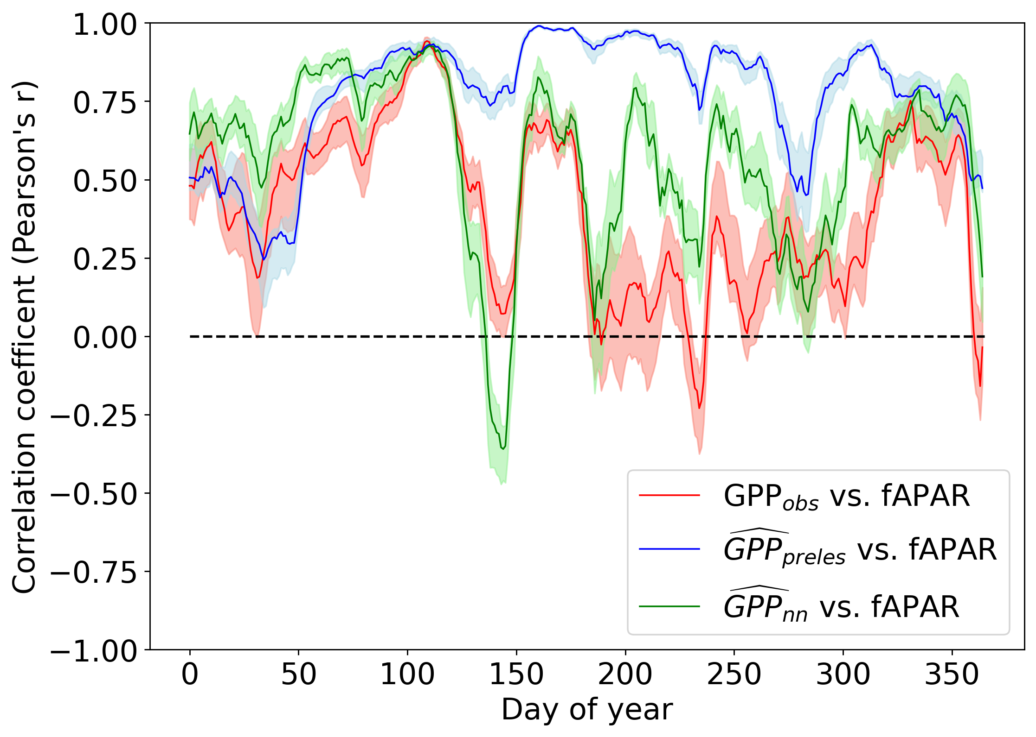
Represented relations in modeled GPP: Time-series of correlation coefficients
Bivariate correlation of the total sum of GPP with the mean climate state of each climate dimension in a 30-day moving window

Slide 11
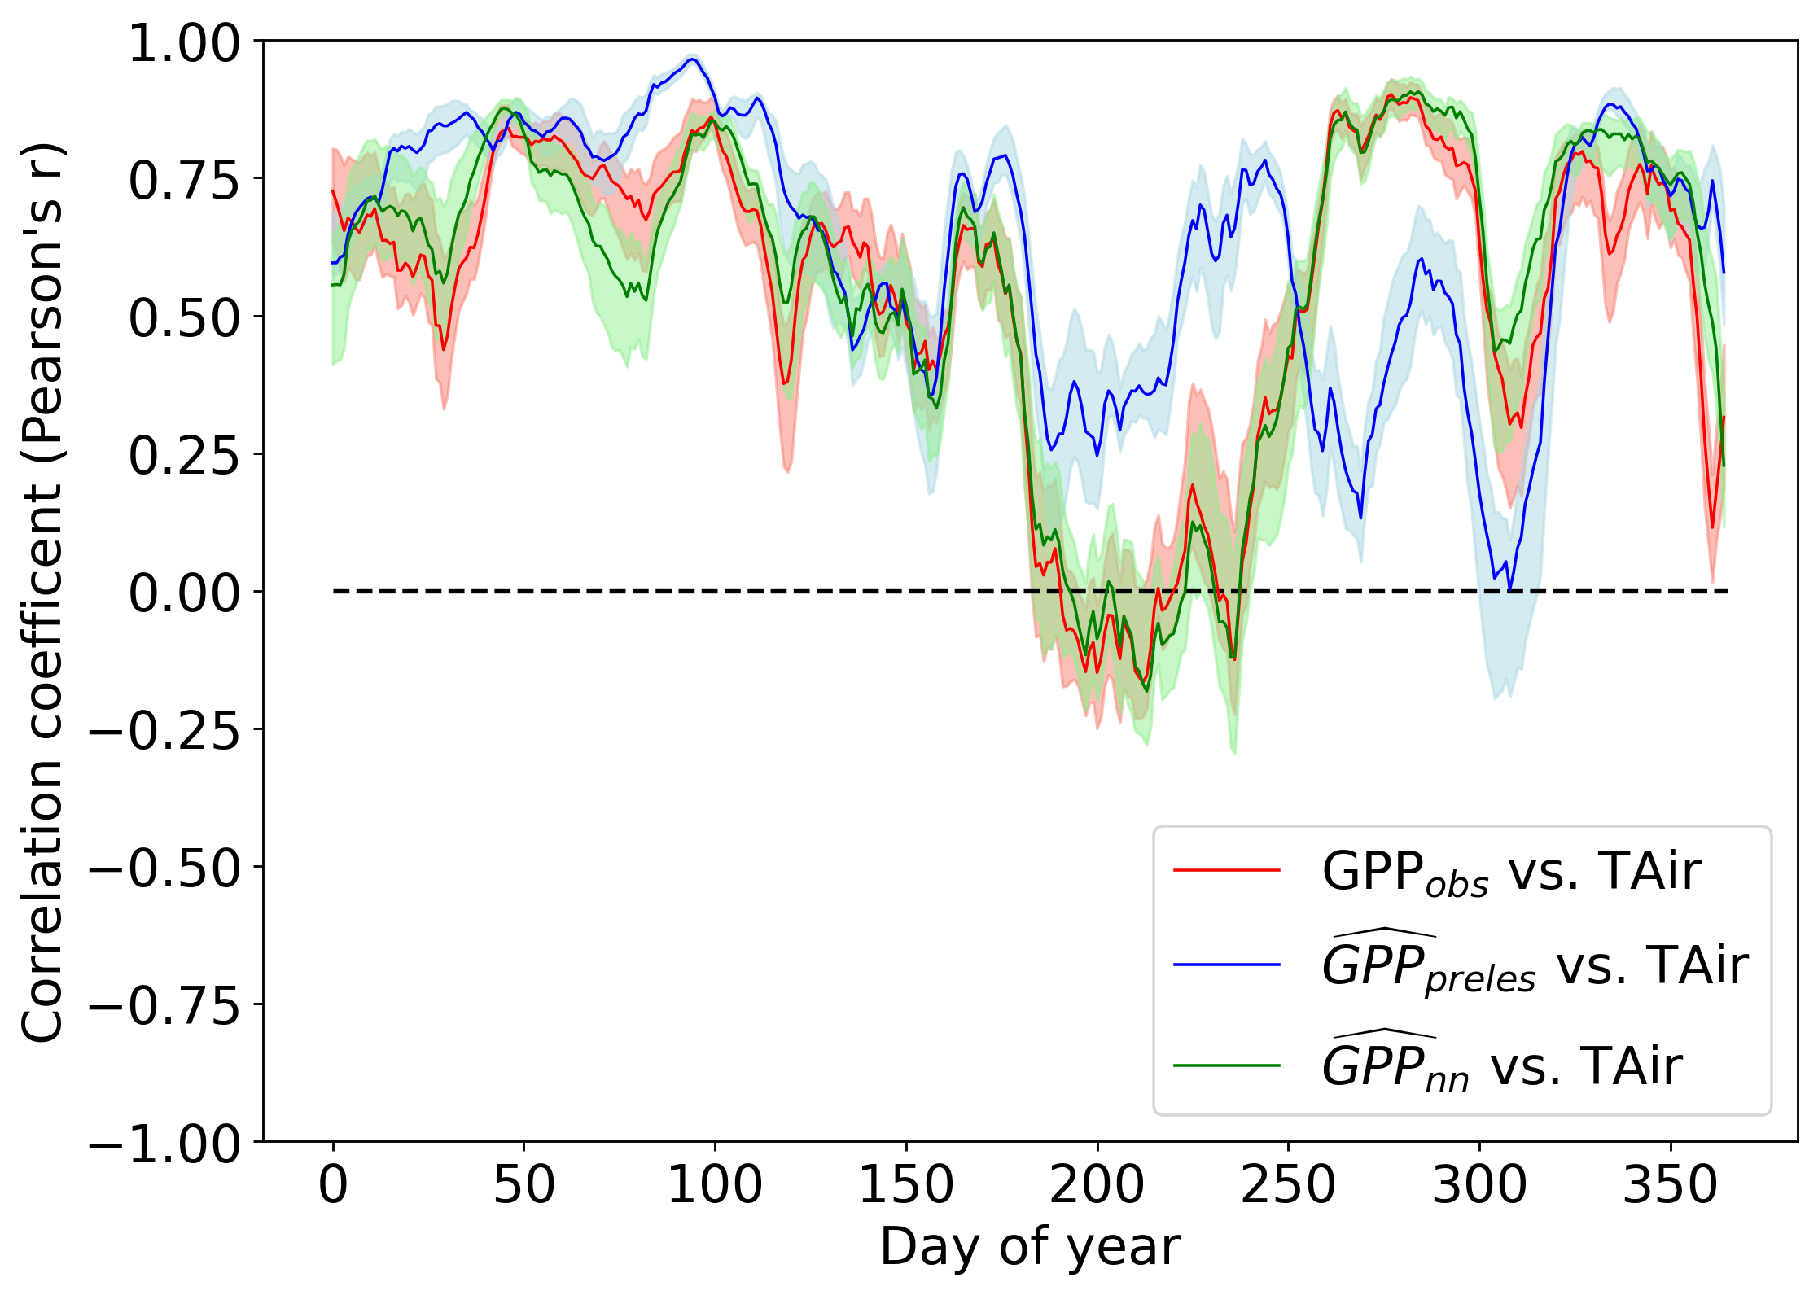
Represented relations in modeled GPP: Time-series of correlation coefficients
Neural network training:
One set of parameters for 13 years
Neural network training:
One set of parameters for each year

Slide 12
Partitioning effects on intra-annual variability in GPP
IDEA: If we know the effect of varying climate on the intra-annual GPP variability, we know the leftover effect can be attributed to ecosystem functional changes.
Notes:
This only holds under the assumption, that the models and choice of explaining variables are perfect!
Ecosystem functional changes that we can also understand as biotic effects.
These are captured by model parameters, which are in PRELES the 30 specified stand properties and in the neural network unspecified through its trainable parameters.
We will use the neural network to distinguish the effects.

Slide 13
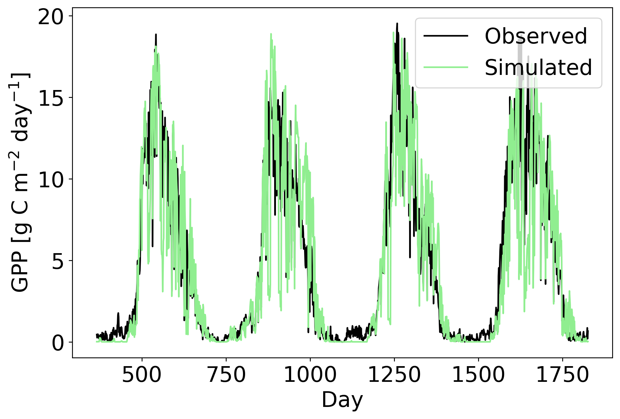
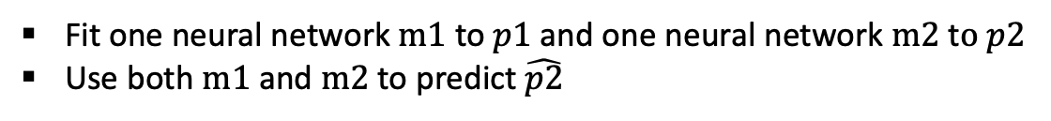
Partitioning effects on intra-annual variability in GPP
IDEA: If we know the effect of varying climate on the intra-annual GPP variability, we know the leftover effect can be attributed to ecosystem functional changes.
Approach
Fit one neural network $m1$to $p1$and one neural network $m2$ t$o p2$
Use both $m1$and $m2$to predict $\hat{p2}$
p1
p2
Notes:
The Approach is as follows:
We fit one neural network $m1$to $p1$and one neural network $m2$ t$o p2$.
Doing so we assume, the climate-GPP relations are perfectly represented in the network.
I decided to use two years instead of one, which means we will look at changes in GPP over four years.
I did this, because the precision of the network predictions were much better and we wanted perfect models.

Slide 14
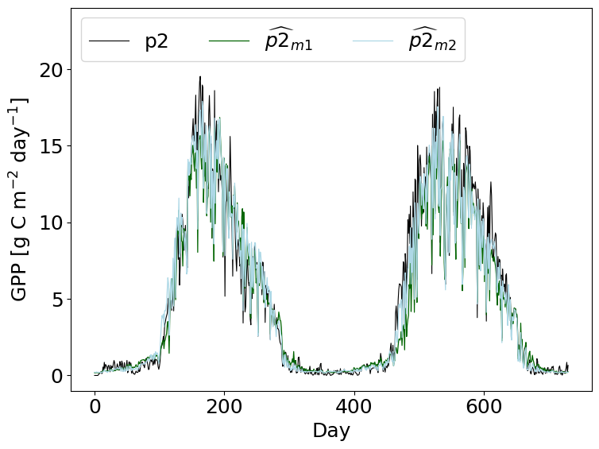
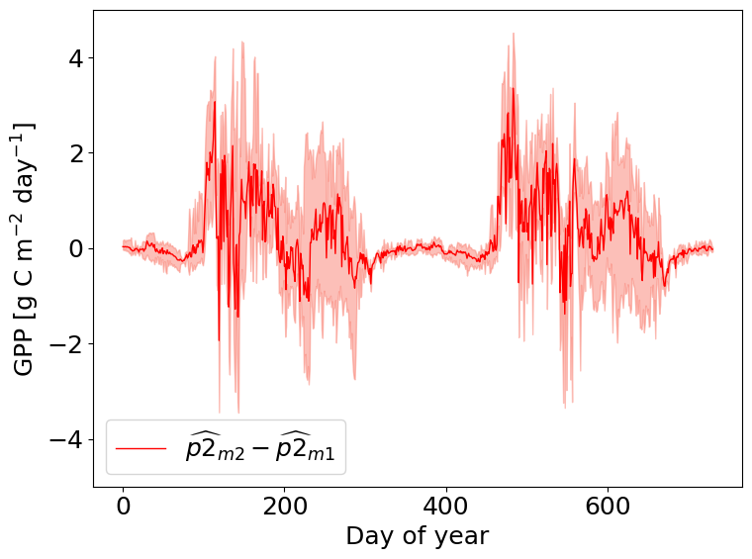
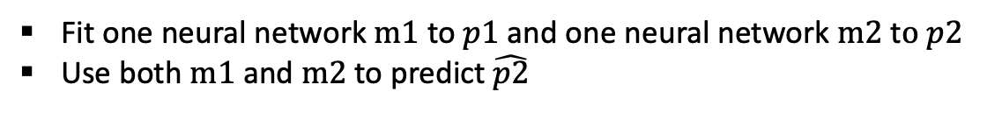
Partitioning effects on intra-annual variability in GPP
IDEA: If we know the effect of varying climate on the intra-annual GPP variability, we know the leftover effect can be attributed to ecosystem functional changes.
p2
Approach
Fit one neural network $m1$to $p1$and one neural network $m2$ t$o p2$
Use both $m1$and $m2$to predict $\hat{p2}$
Notes:
The Approach is as follows:
We fit one neural network $m1$to $p1$and one neural network $m2$ t$o p2$.
Doing so we assume, the climate-GPP relations are perfectly represented in the network.
I decided to use two years instead of one, which means we will look at changes in GPP over four years.
I did this, because the precision of the network predictions were much better and we wanted perfect models.

Slide 15
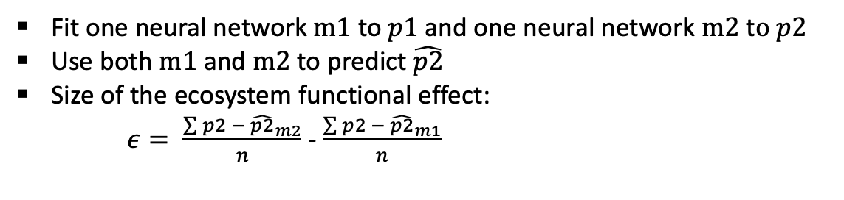
Partitioning effects on intra-annual variability in GPP
IDEA: If we know the effect of varying climate on the intra-annual GPP variability, we know the leftover effect can be attributed to ecosystem functional changes.
p2
Approach
Fit one neural network $m1$to $p1$and one neural network $m2$ t$o p2$
Use both $m1$and $m2$to predict $\hat{p2}$
Size of the ecosystem functional effect:
$ε= \frac{\sum{p2 − {\hat{p2}}_{m2}}}{n}$ - $\frac{\sum{p2 − {\hat{p2}}_{m1}}}{n}$
Mean absolute errors
Notes:
The Approach is as follows:
We fit one neural network $m1$to $p1$and one neural network $m2$ t$o p2$.
Doing so we assume, the climate-GPP relations are perfectly represented in the network.
I decided to use two years instead of one, which means we will look at changes in GPP over four years.
I did this, because the precision of the network predictions were much better and we wanted perfect models.

Slide 16
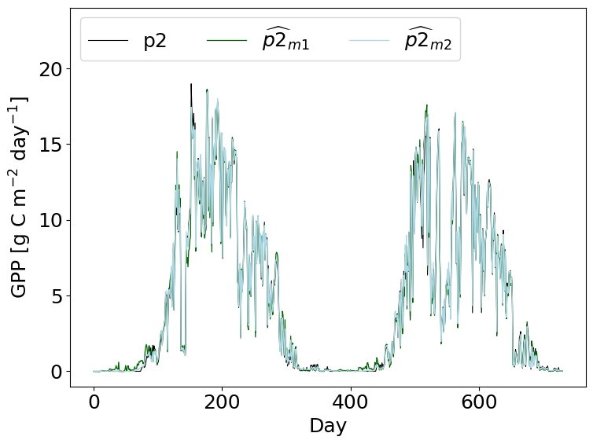
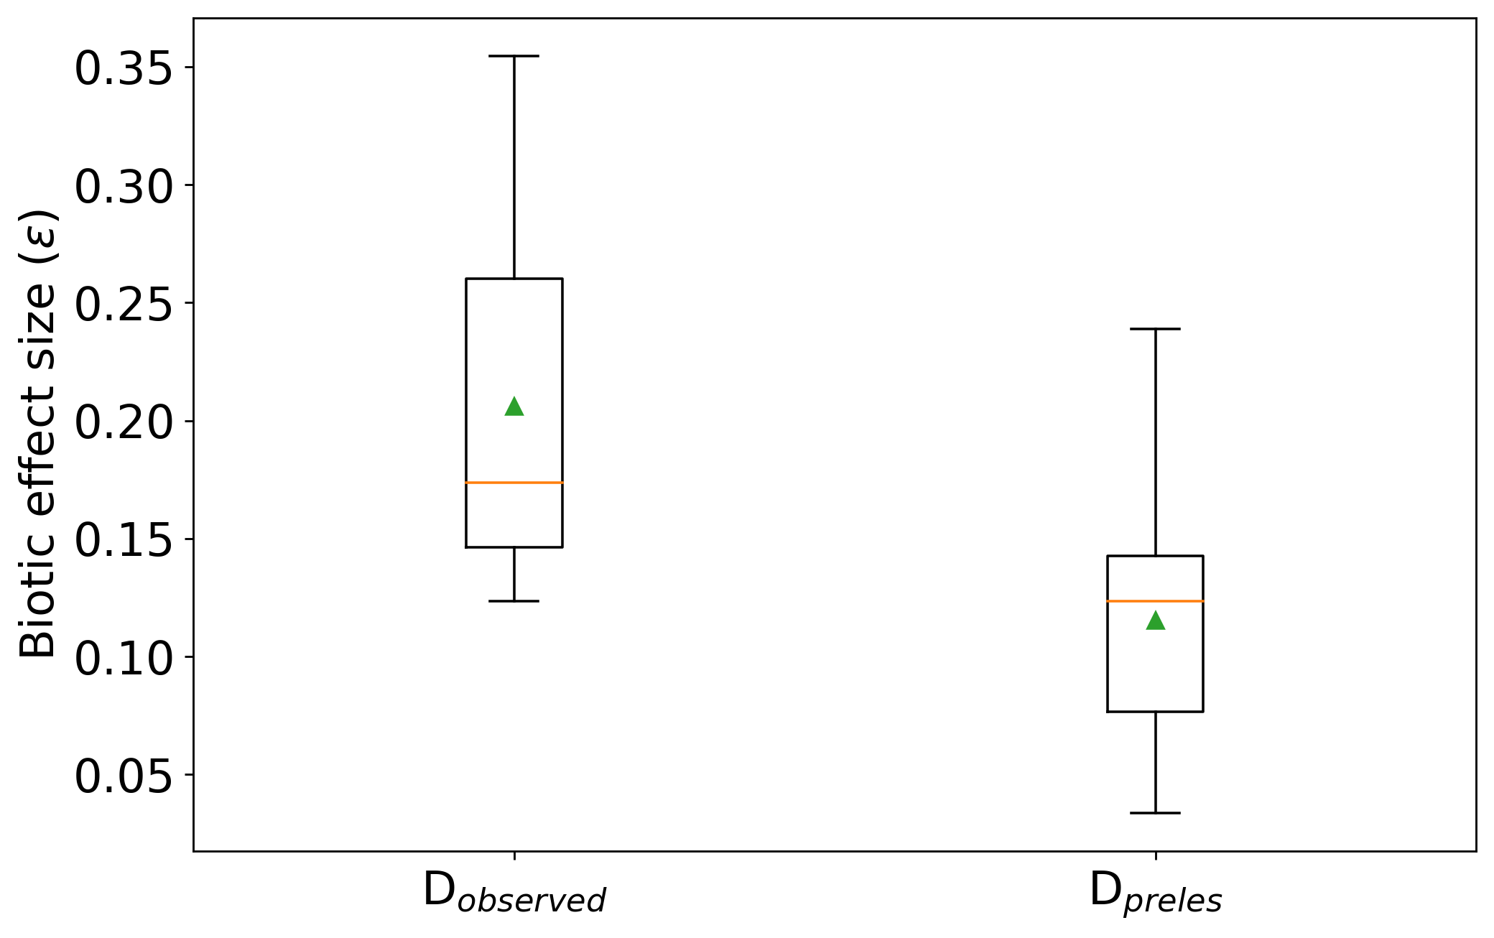
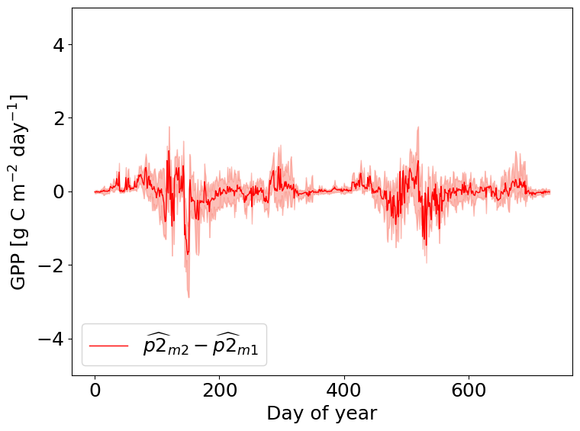
Partitioning effects on intra-annual variability in GPP
Measured GPP
GPP simulated from PRELES
Doing this year-wise over all 13 years

Slide 17
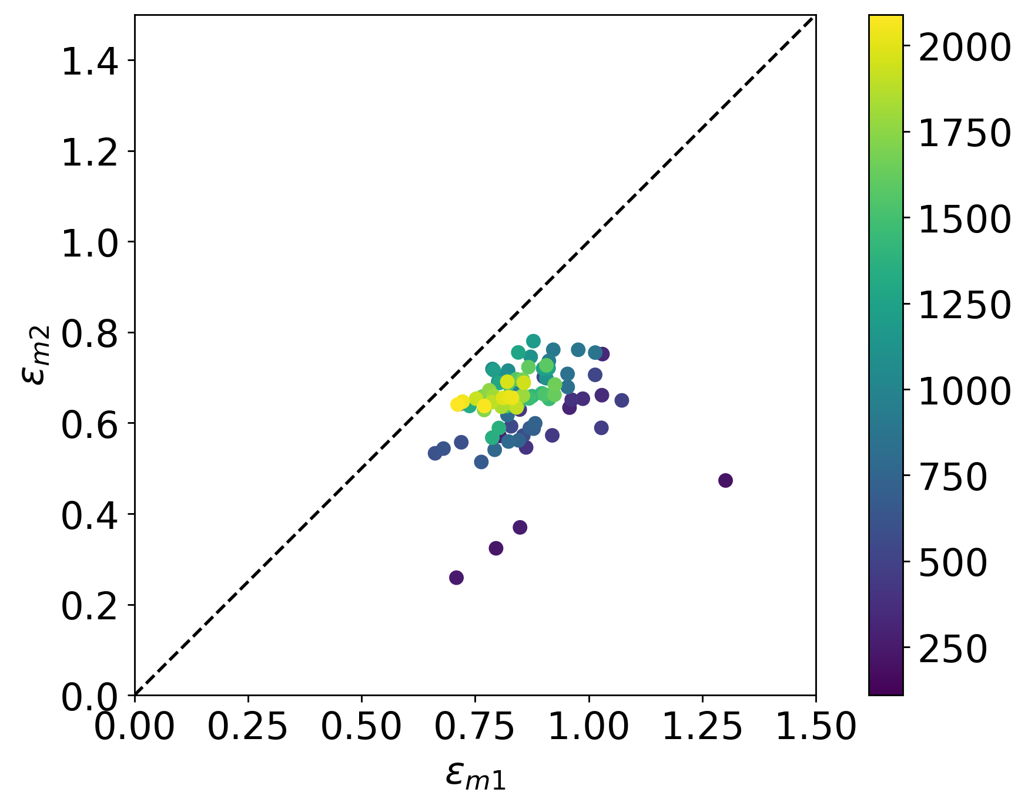
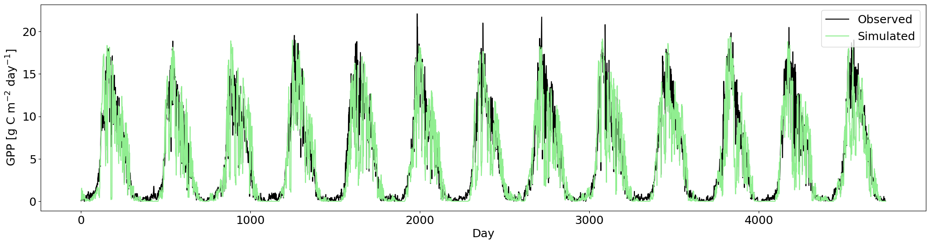
Increasing the length of time-series p1 and p2
Stepwise increase of p1 and subsequent p2 by ten days.
Notes:
Another experiment, inspired by the presentation of Lazaro a couple of week ago.

Slide 18
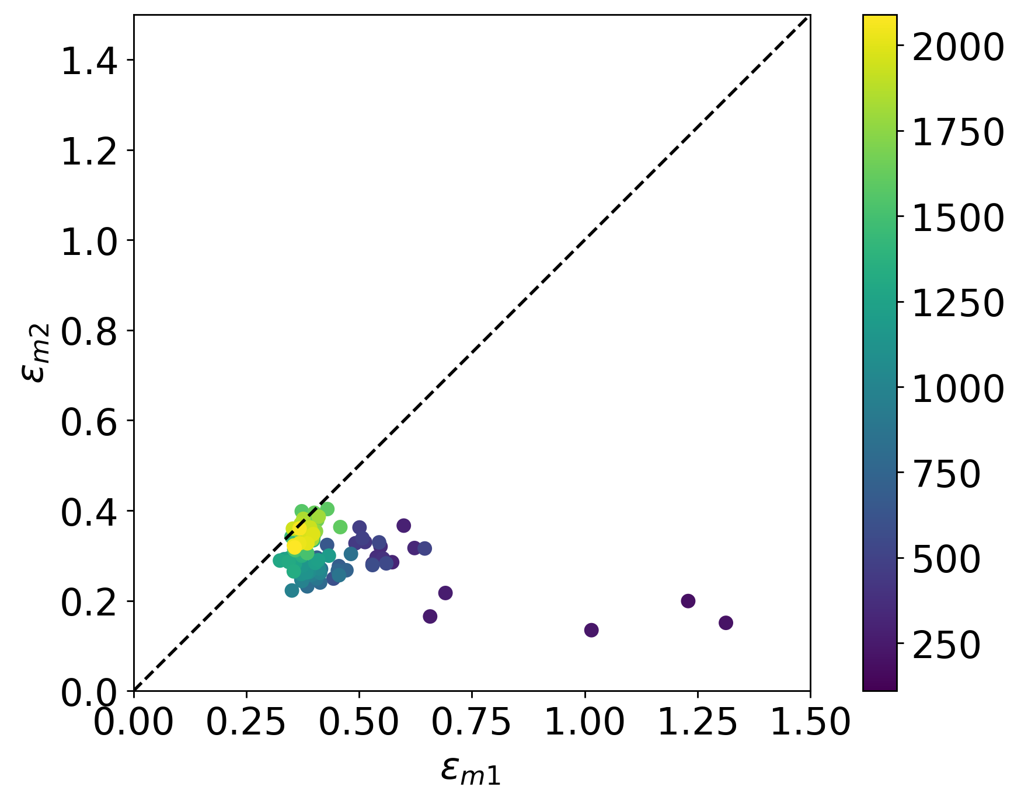
Increasing the length of time-series p1 and p2
Stepwise increase of p1 and subsequent p2 by ten days.
observed
simulated

Slide 19
References
[1] Christopher PO Reyer, Ramiro Silveyra Gonzalez, Klara Dolos, Florian Hartig, Ylva Hauf, MatthiasNoack, Petra Lasch-Born, Thomas R ̈otzer, Hans Pretzsch, Henning Meesenburg, et al. Theprofound database for evaluating vegetation models and simulating climate impacts on europeanforests.Earth system science data, 12(2):1295–1320, 2020.
[2] J. Wu, L. van der Linden, G. Lasslop, N. Carvalhais, K. Pilegaard, C. Beier, and A. Ibrom. Effectsof climate variability and functional changes on the interannual variation of the carbon balancein a temperate deciduous forest.Biogeosciences, 9(1):13–28, 2012. doi: 10.5194/bg-9-13-2012.URLhttps://bg.copernicus.org/articles/9/13/2012/
[3] Mikko Peltoniemi, Minna Pulkkinen, Mika Aurela, Jukka Pumpanen, Pasi Kolari, and AnnikkiM ̈akel ̈a. A semi-empirical model of boreal-forest gross primary production, evapotranspiration,and soil water-calibration and sensitivity analysis. 2015

