Slide 1
Partitioning effects on the intra-annual variability of GPP of a boreal forest ecosystem
Marieke Wesselkamp

Slide 2
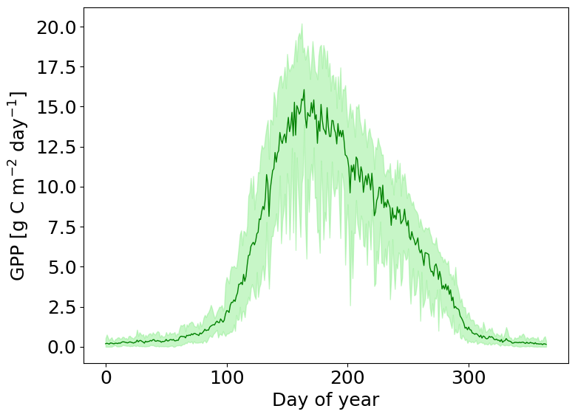
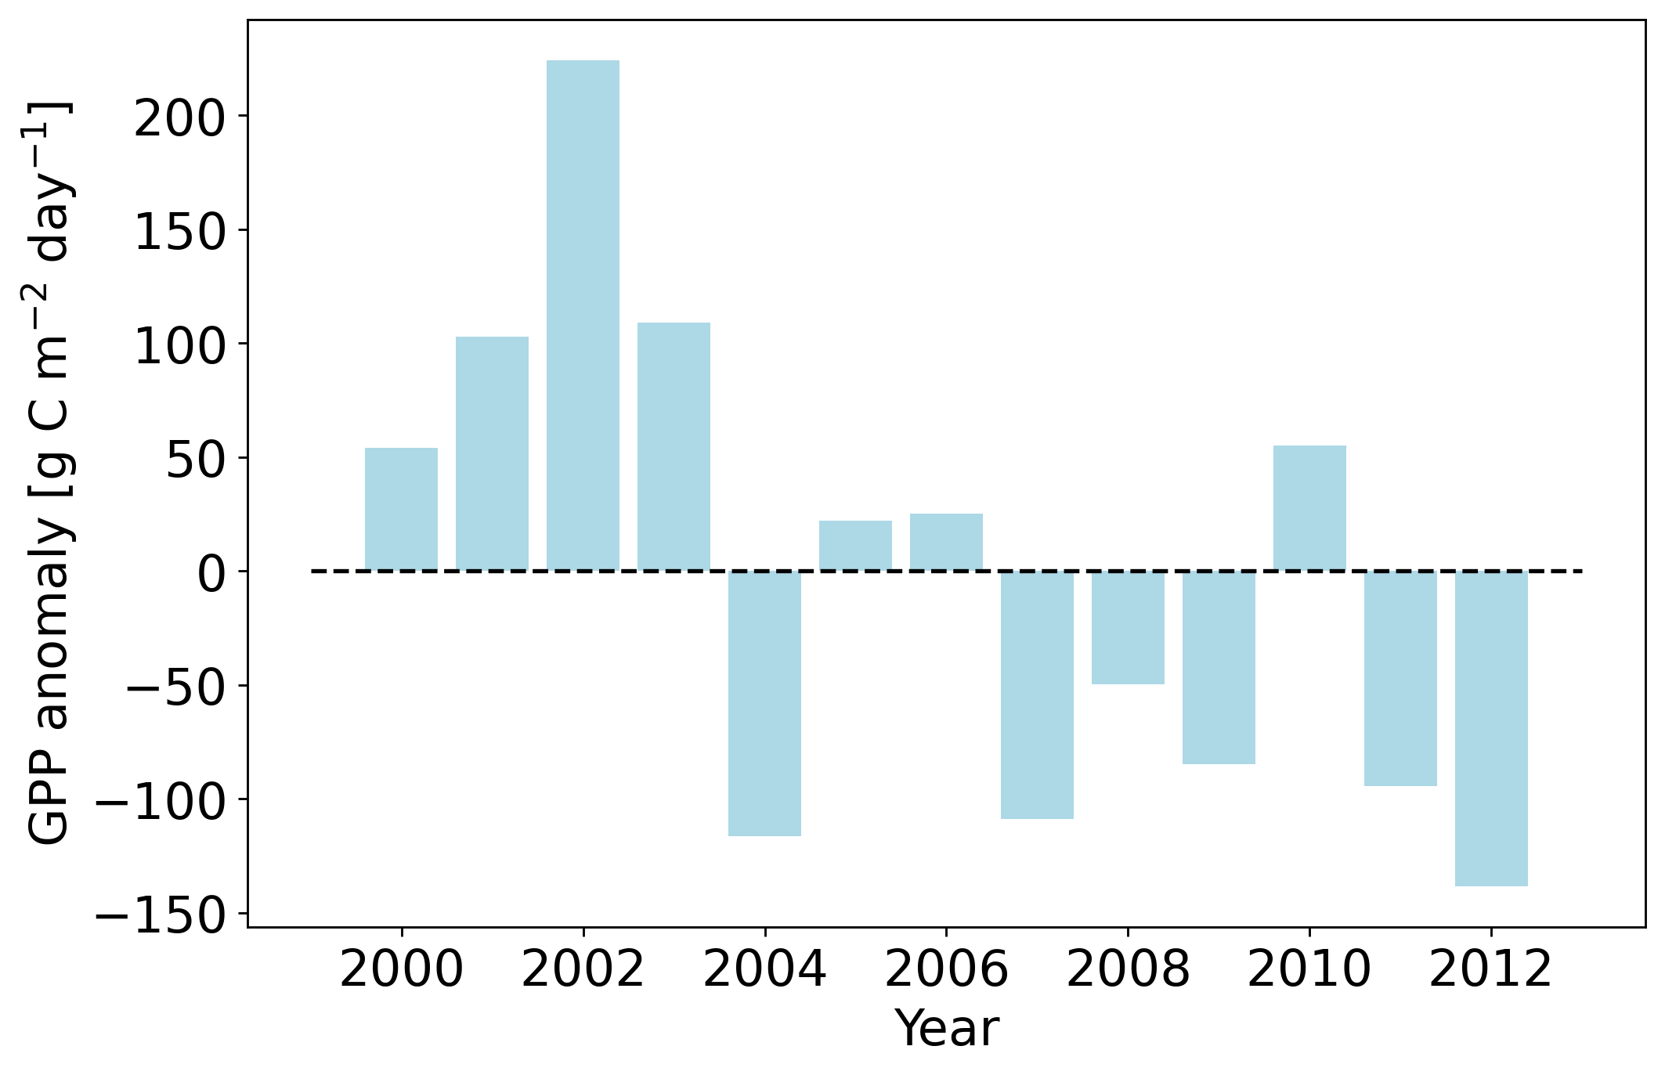
Gross primary productivity at Soro (DK)
Mean daily GPP over 13 years (2000-2012)
Mean sum of yearly GPP: ﻿1850.27

Slide 3
Process-based modeling of the gross primary productivity

Slide 4
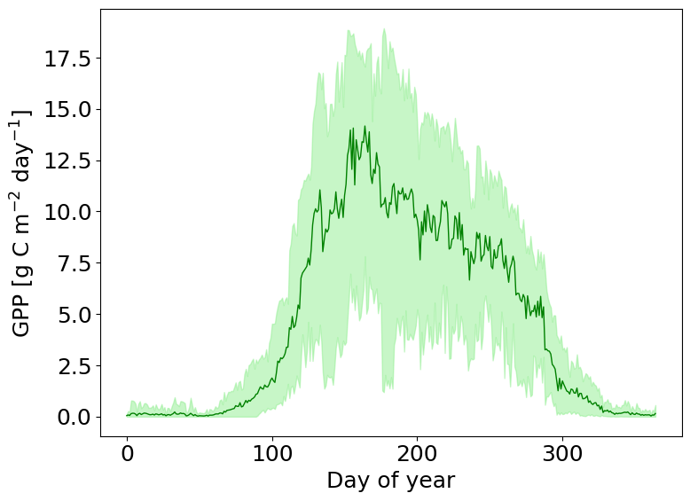
Observed and modeled GPP
Observations
PRELES predictions

Slide 5
Physical consistency in the modelled processes

Slide 6
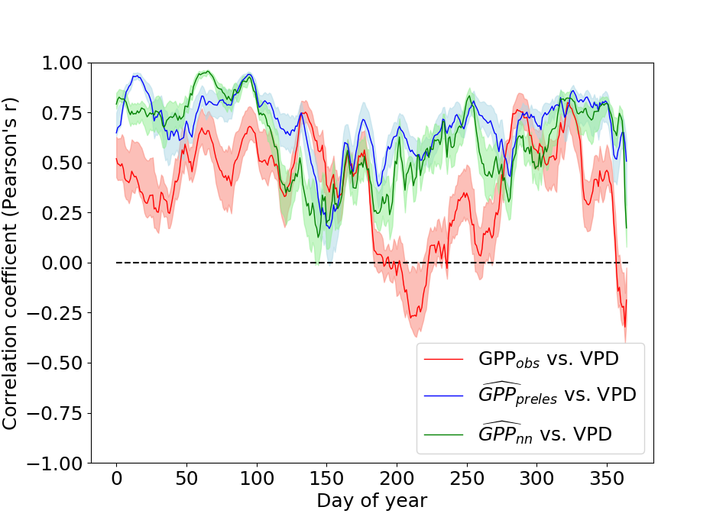
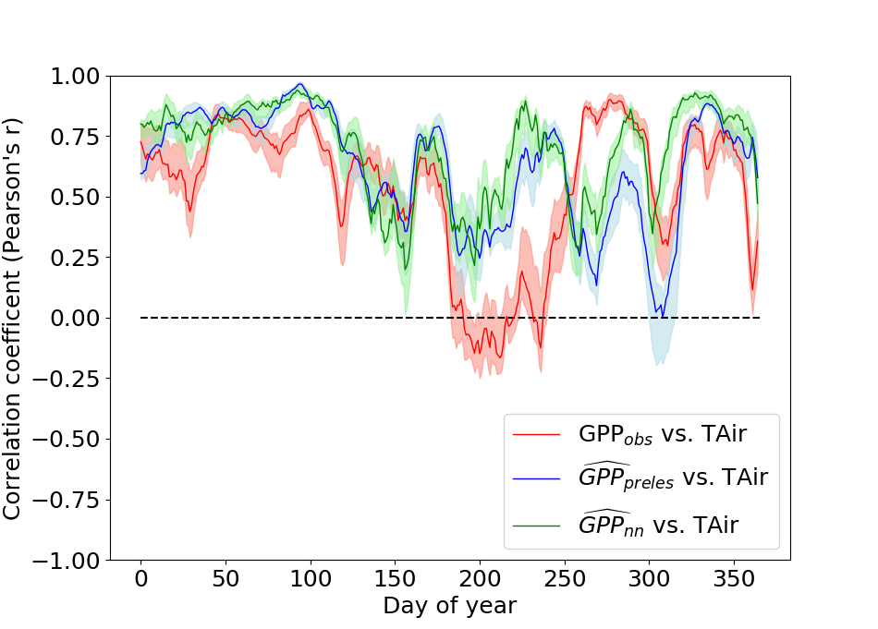
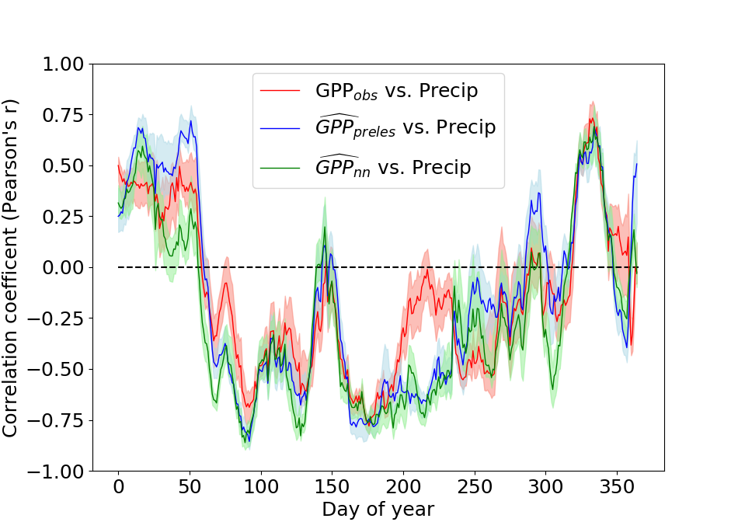
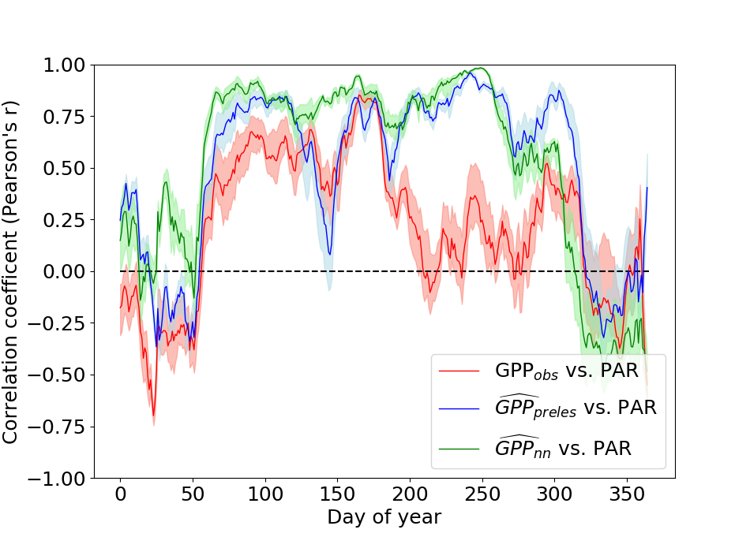
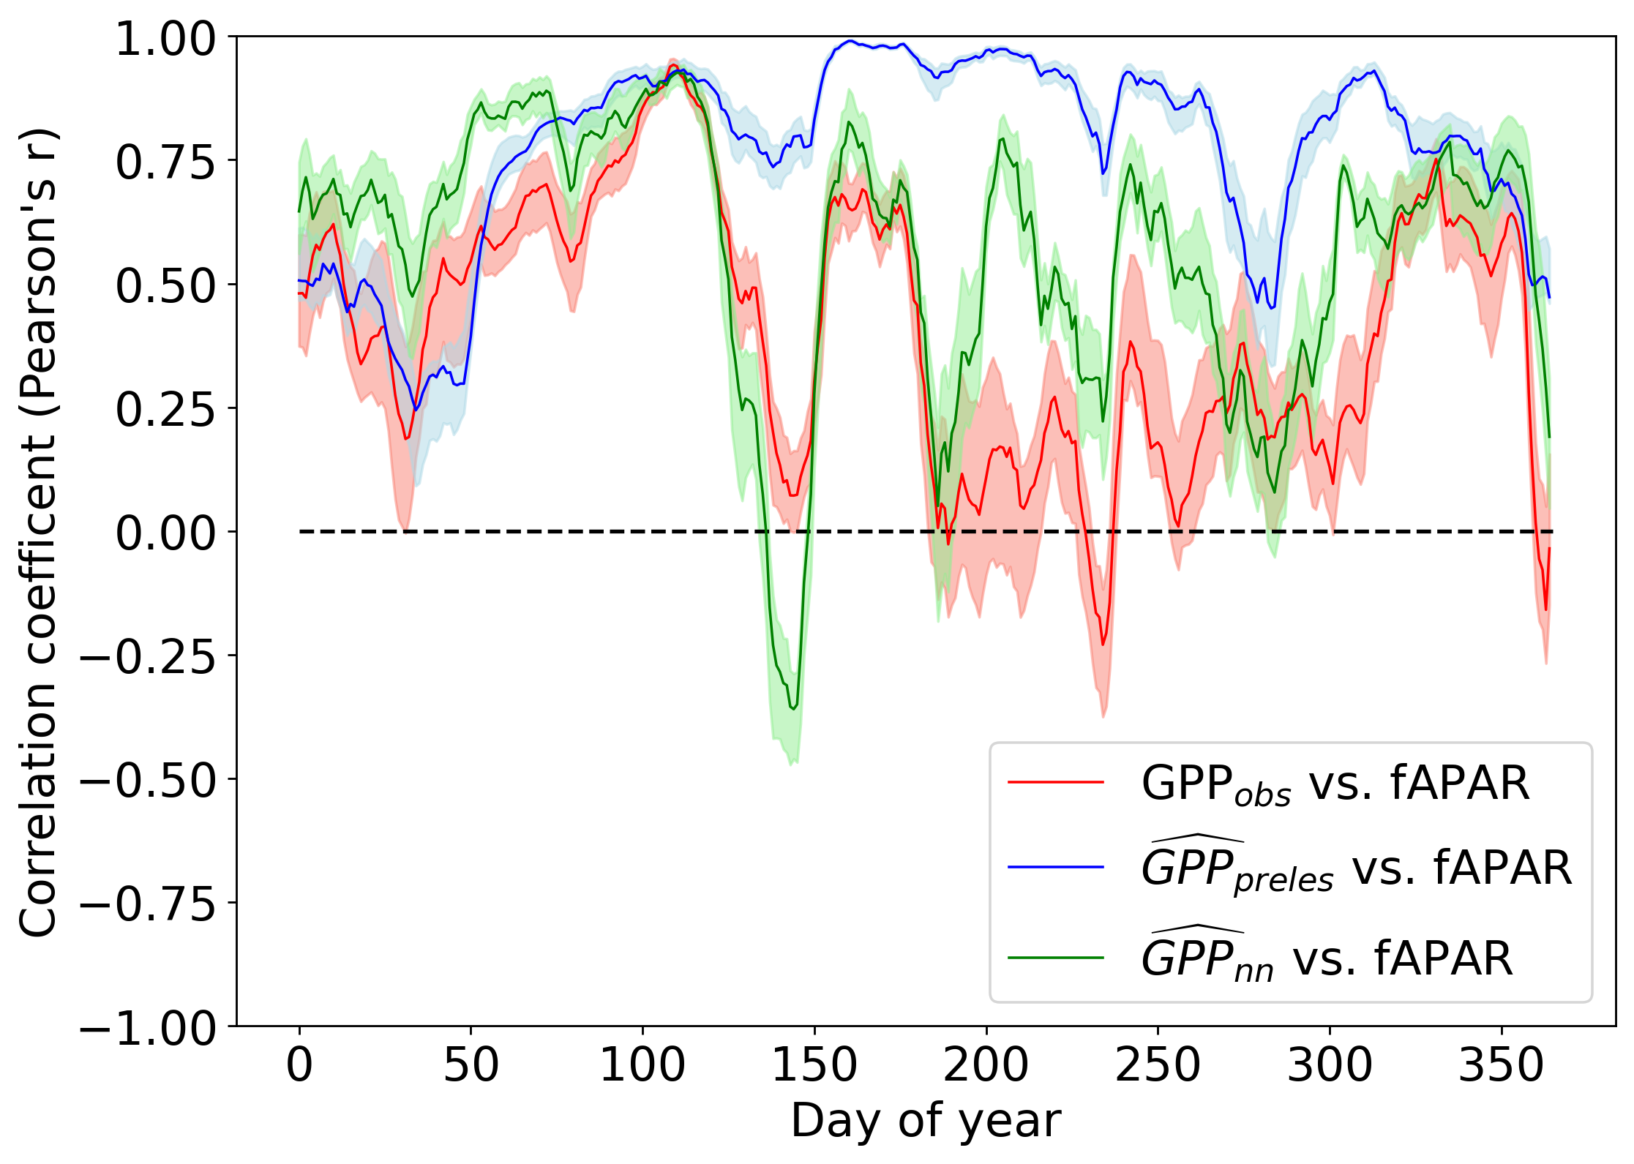

Slide 7
Partitioning climatic and biotic effects on GPP

Slide 8
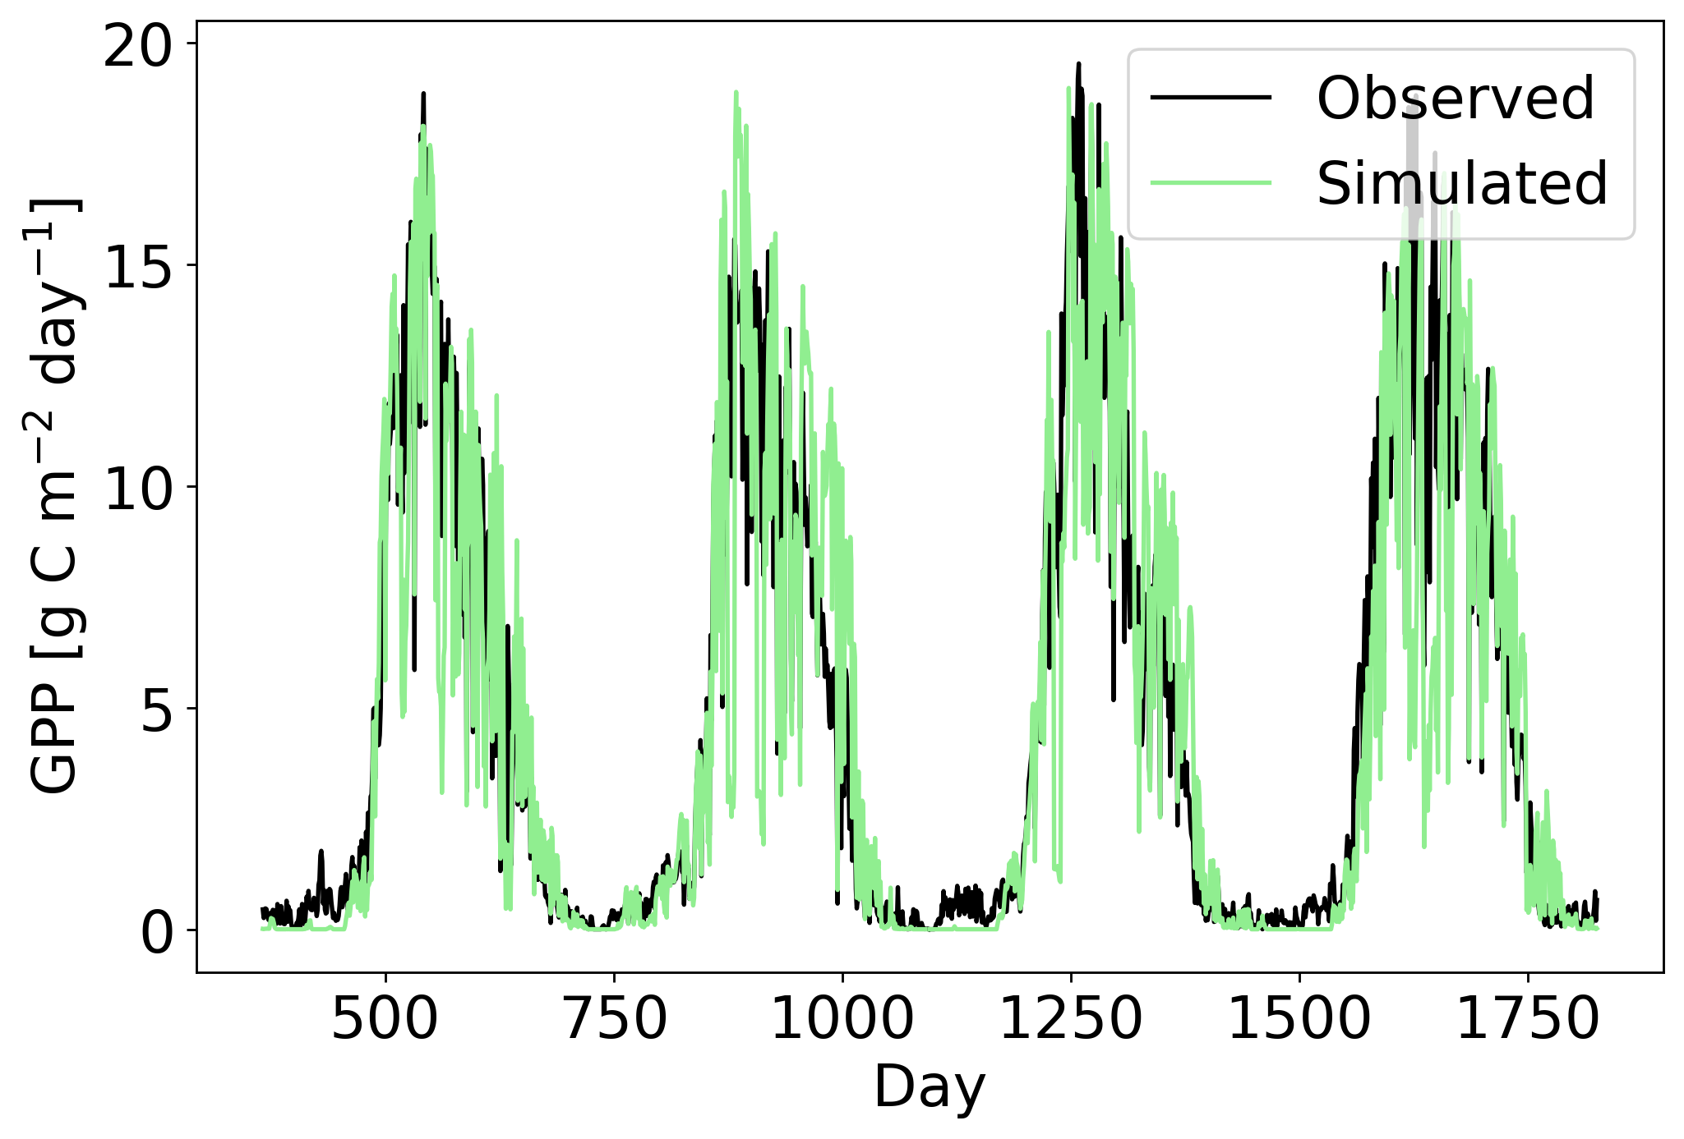
Partitioning climatic and biotic effects on GPP
P1
P2

Slide 9
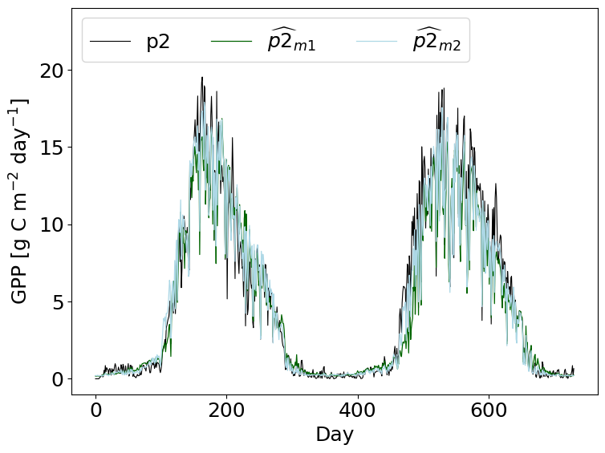
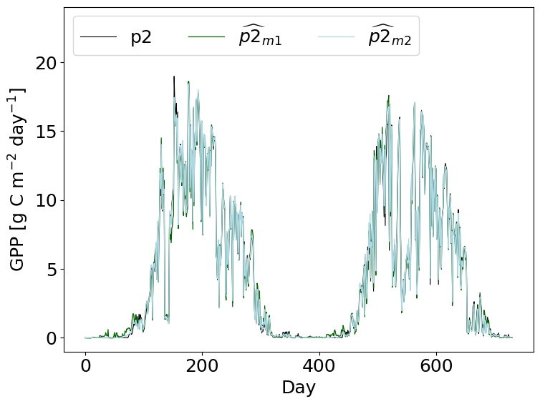
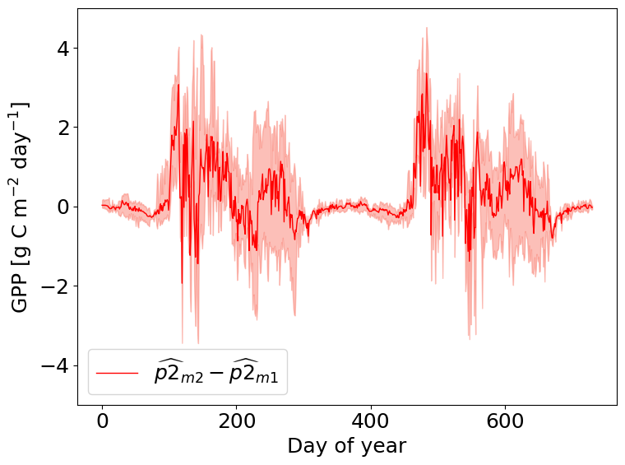
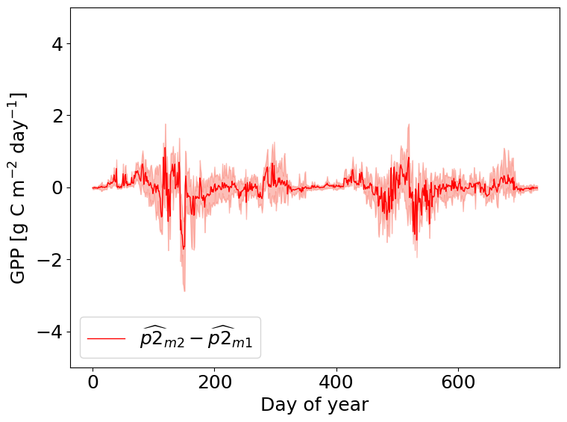
Partitioning climatic and biotic effects on GPP

Slide 10
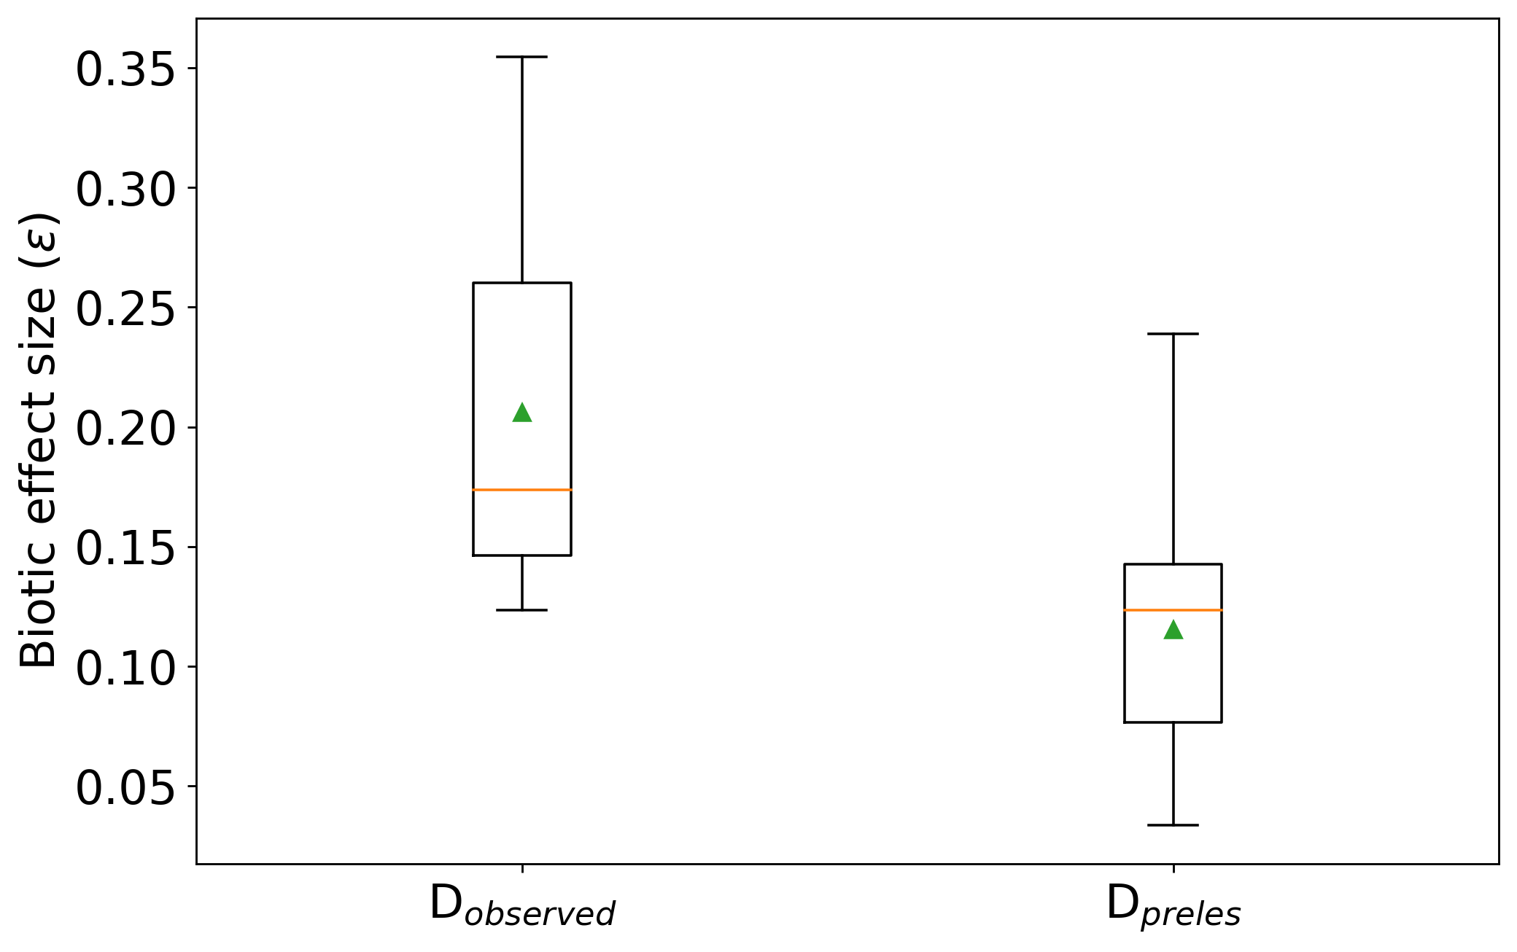
Partitioning climatic and biotic effects on GPP

Slide 11
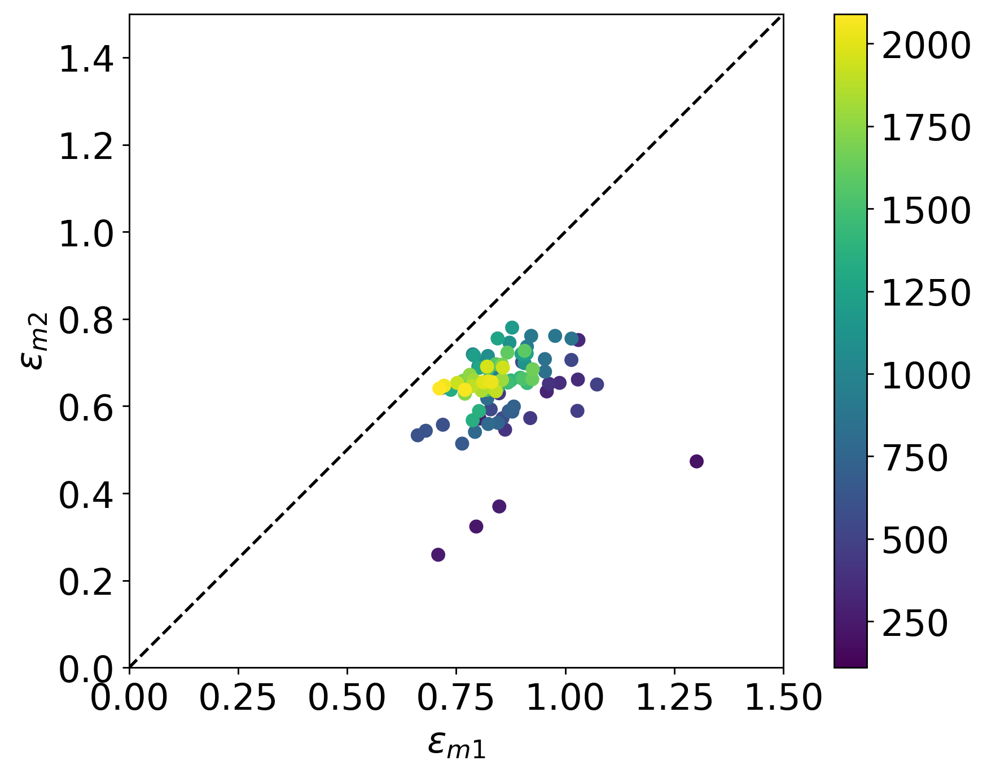
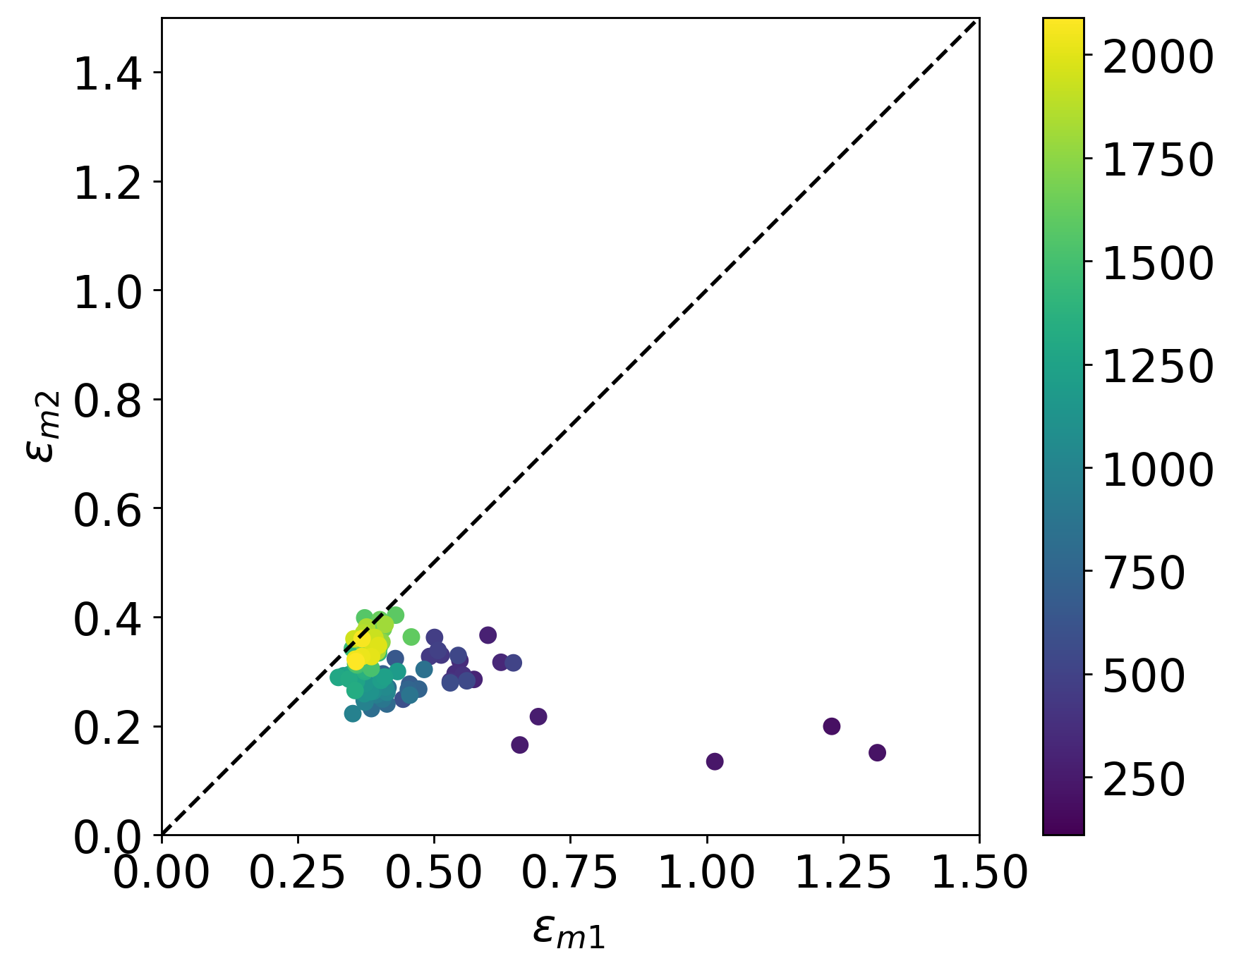
Partitioning climatic and biotic effects on GPP

