Slide 1
Partitioning effects on the intra-annual variability of GPP of a boreal forest ecosystem
Marieke Wesselkamp

Slide 2
Background
Based on the paper of Wu et al. [1]

Slide 3
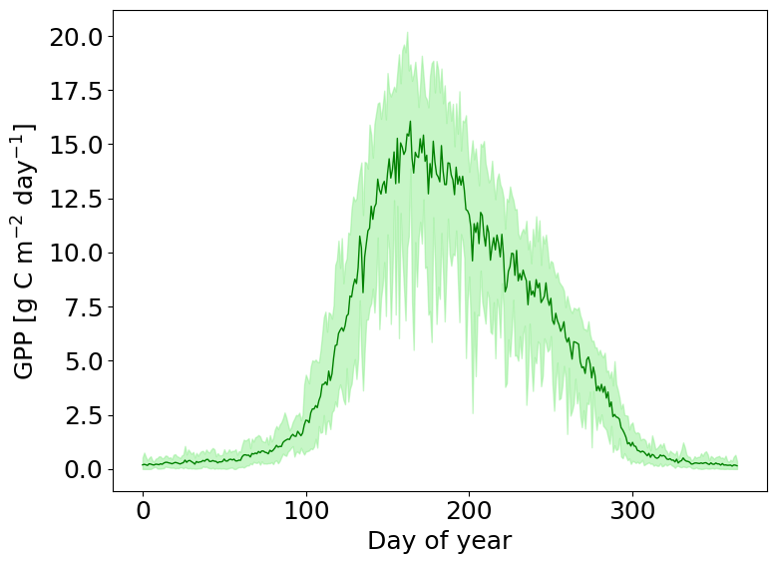
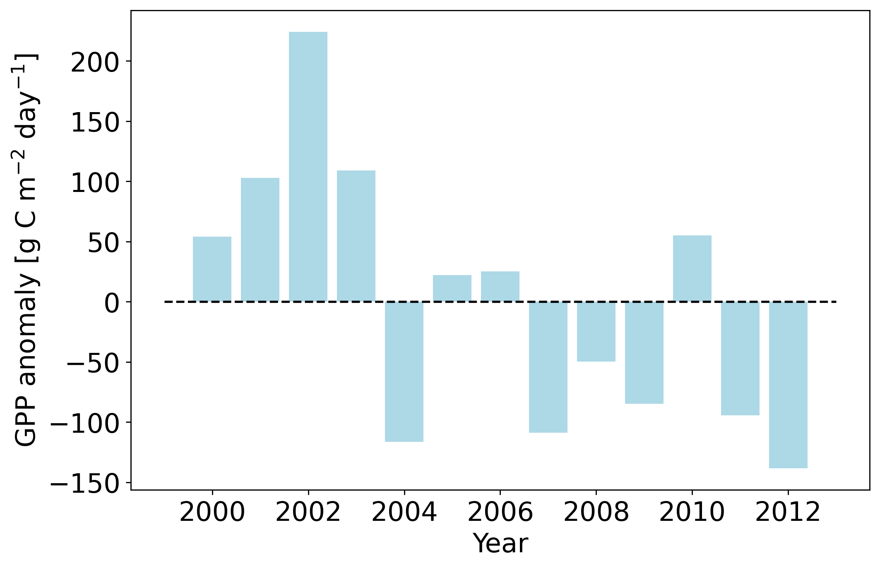
Gross primary productivity at Soro (DK)
13 years (2000-2012) of daily GPP measurements [2]
Mean sum of yearly GPP: ﻿1850.27

Slide 4
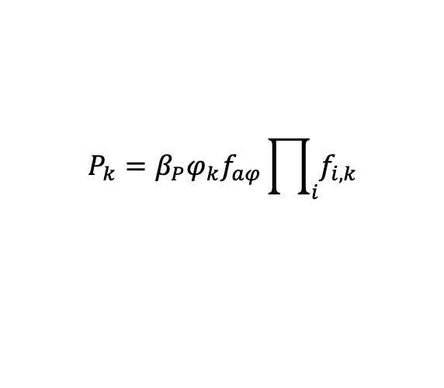
Process-based modeling of the gross primary productivity: PRELES
Light-use efficiency (P)
Evapotranspiration (ET)
$$P_{k}=β_{P}φ_{k}f_{aφ}\prod_{i}{f_{i,k}}$$
Soil water content (SW)

Slide 5
Process-based modeling of the gross primary productivity: PRELES
Light-use efficiency (P)
Evapotranspiration (ET)
$$P_{k}=β_{P}φ_{k}f_{aφ}\prod_{i}{f_{i,k}}$$
Potential light-use efficiency
Soil water content (SW)

Slide 6
Process-based modeling of the gross primary productivity: PRELES
Light-use efficiency (P)
Evapotranspiration (ET)
$$P_{k}=β_{P}φ_{k}f_{aφ}\prod_{i}{f_{i,k}}$$
Photosynthetic photon flux density
Soil water content (SW)

Slide 7
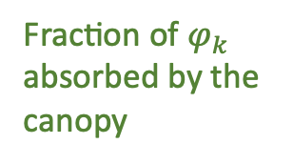
Process-based modeling of the gross primary productivity: PRELES
Light-use efficiency (P)
Evapotranspiration (ET)
$$P_{k}=β_{P}φ_{k}f_{aφ}\prod_{i}{f_{i,k}}$$
Fraction of $φ_{k}$ absorbed by the canopy
Soil water content (SW)

Slide 8

Process-based modeling of the gross primary productivity: PRELES
Light-use efficiency (P)
Evapotranspiration (ET)
$$P_{k}=β_{P}φ_{k}f_{aφ}\prod_{i}{f_{i,k}}$$
Modifiers for $β_{P}$
Soil water content (SW)

Slide 9
Process-based modeling of the gross primary productivity: PRELES
Light-use efficiency (P)
Evapotranspiration (ET)
$$P_{k}=β_{P}φ_{k}f_{aφ}\prod_{i}{f_{i,k}}$$
30 Parameters and 5 climatic input variables:
Tair
Precip
PAR
fAPAR
VPD
(CO2)
Soil water content (SW)

Slide 10
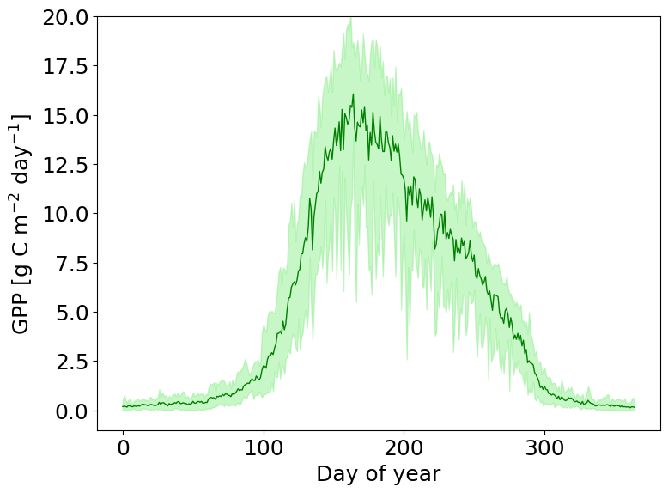
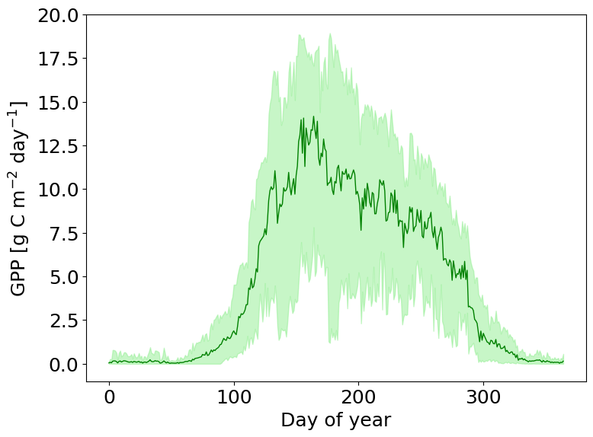
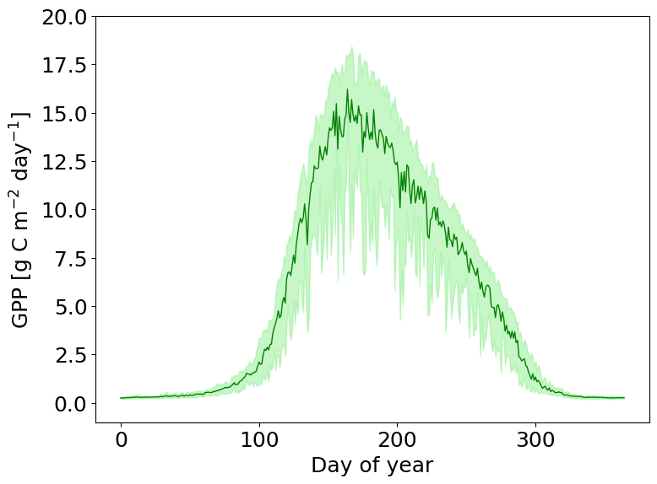
Observed and modeled GPP
13 years (2000-2012) of daily GPP measurements [2]
PRELES predictions for 13 years (2000-2012) of associated climatic states
Neural network predictions for 13 years (2000-2012) of associated climatic states

Slide 11
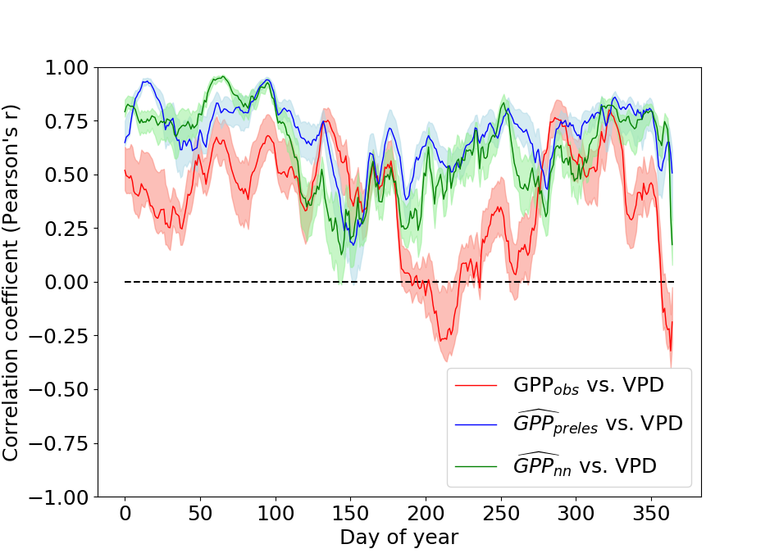
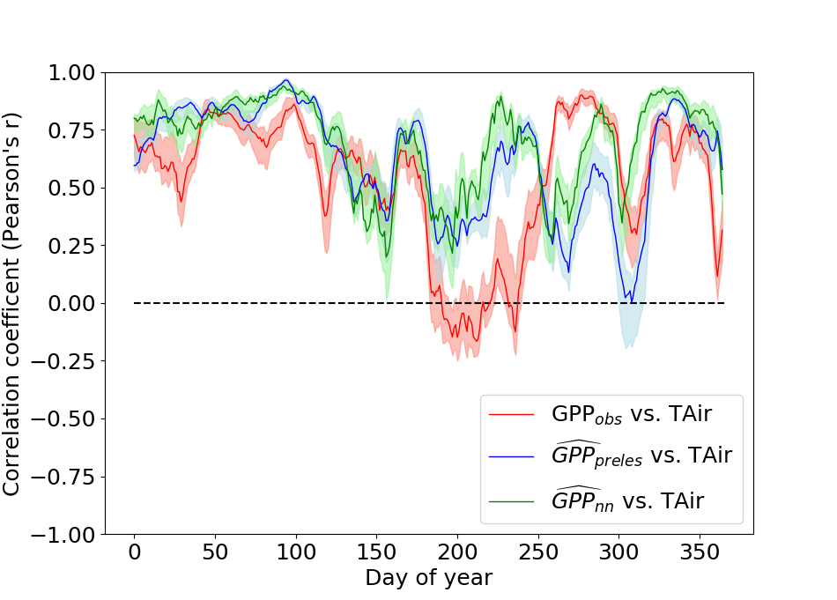
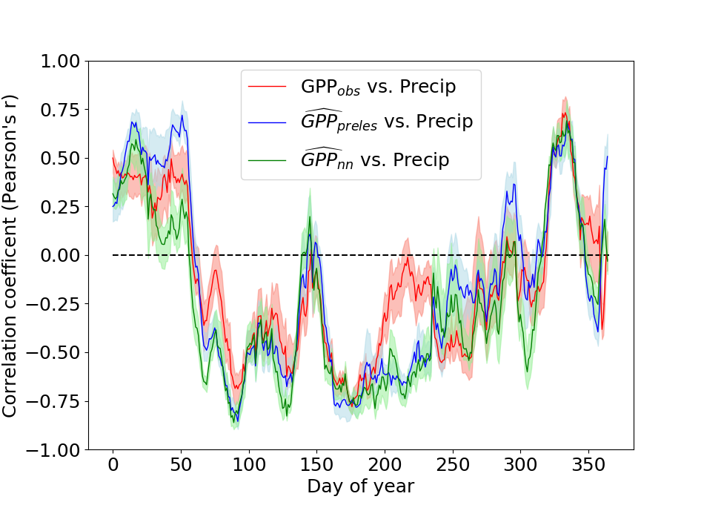
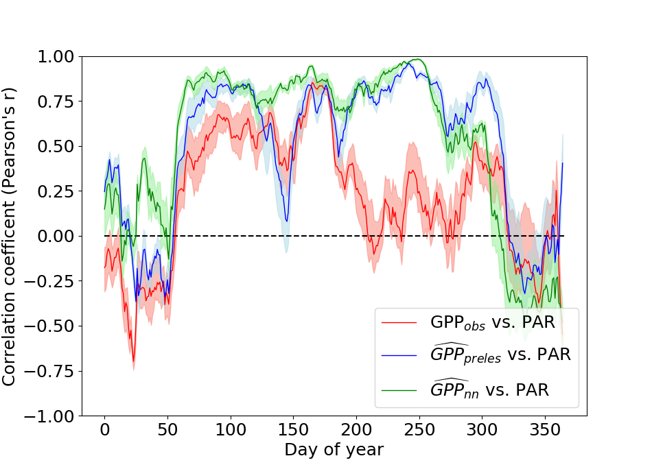
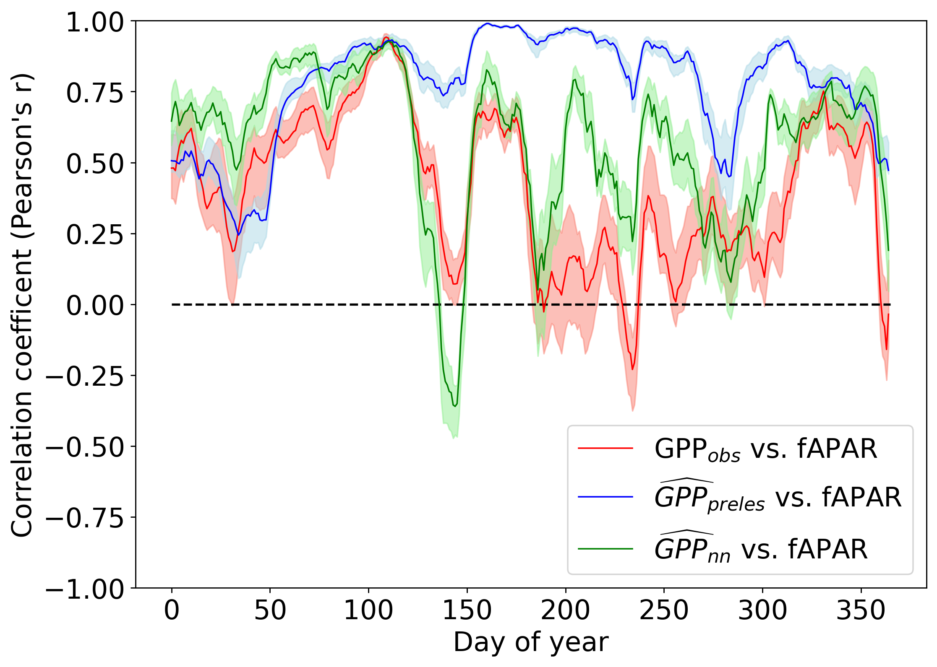
Represented relations in modeled GPP: Time-series of correlation coefficients
Bivariate correlation of the total sum of GPP with the mean climate state of each climate dimension in a 30-day moving window

Slide 12
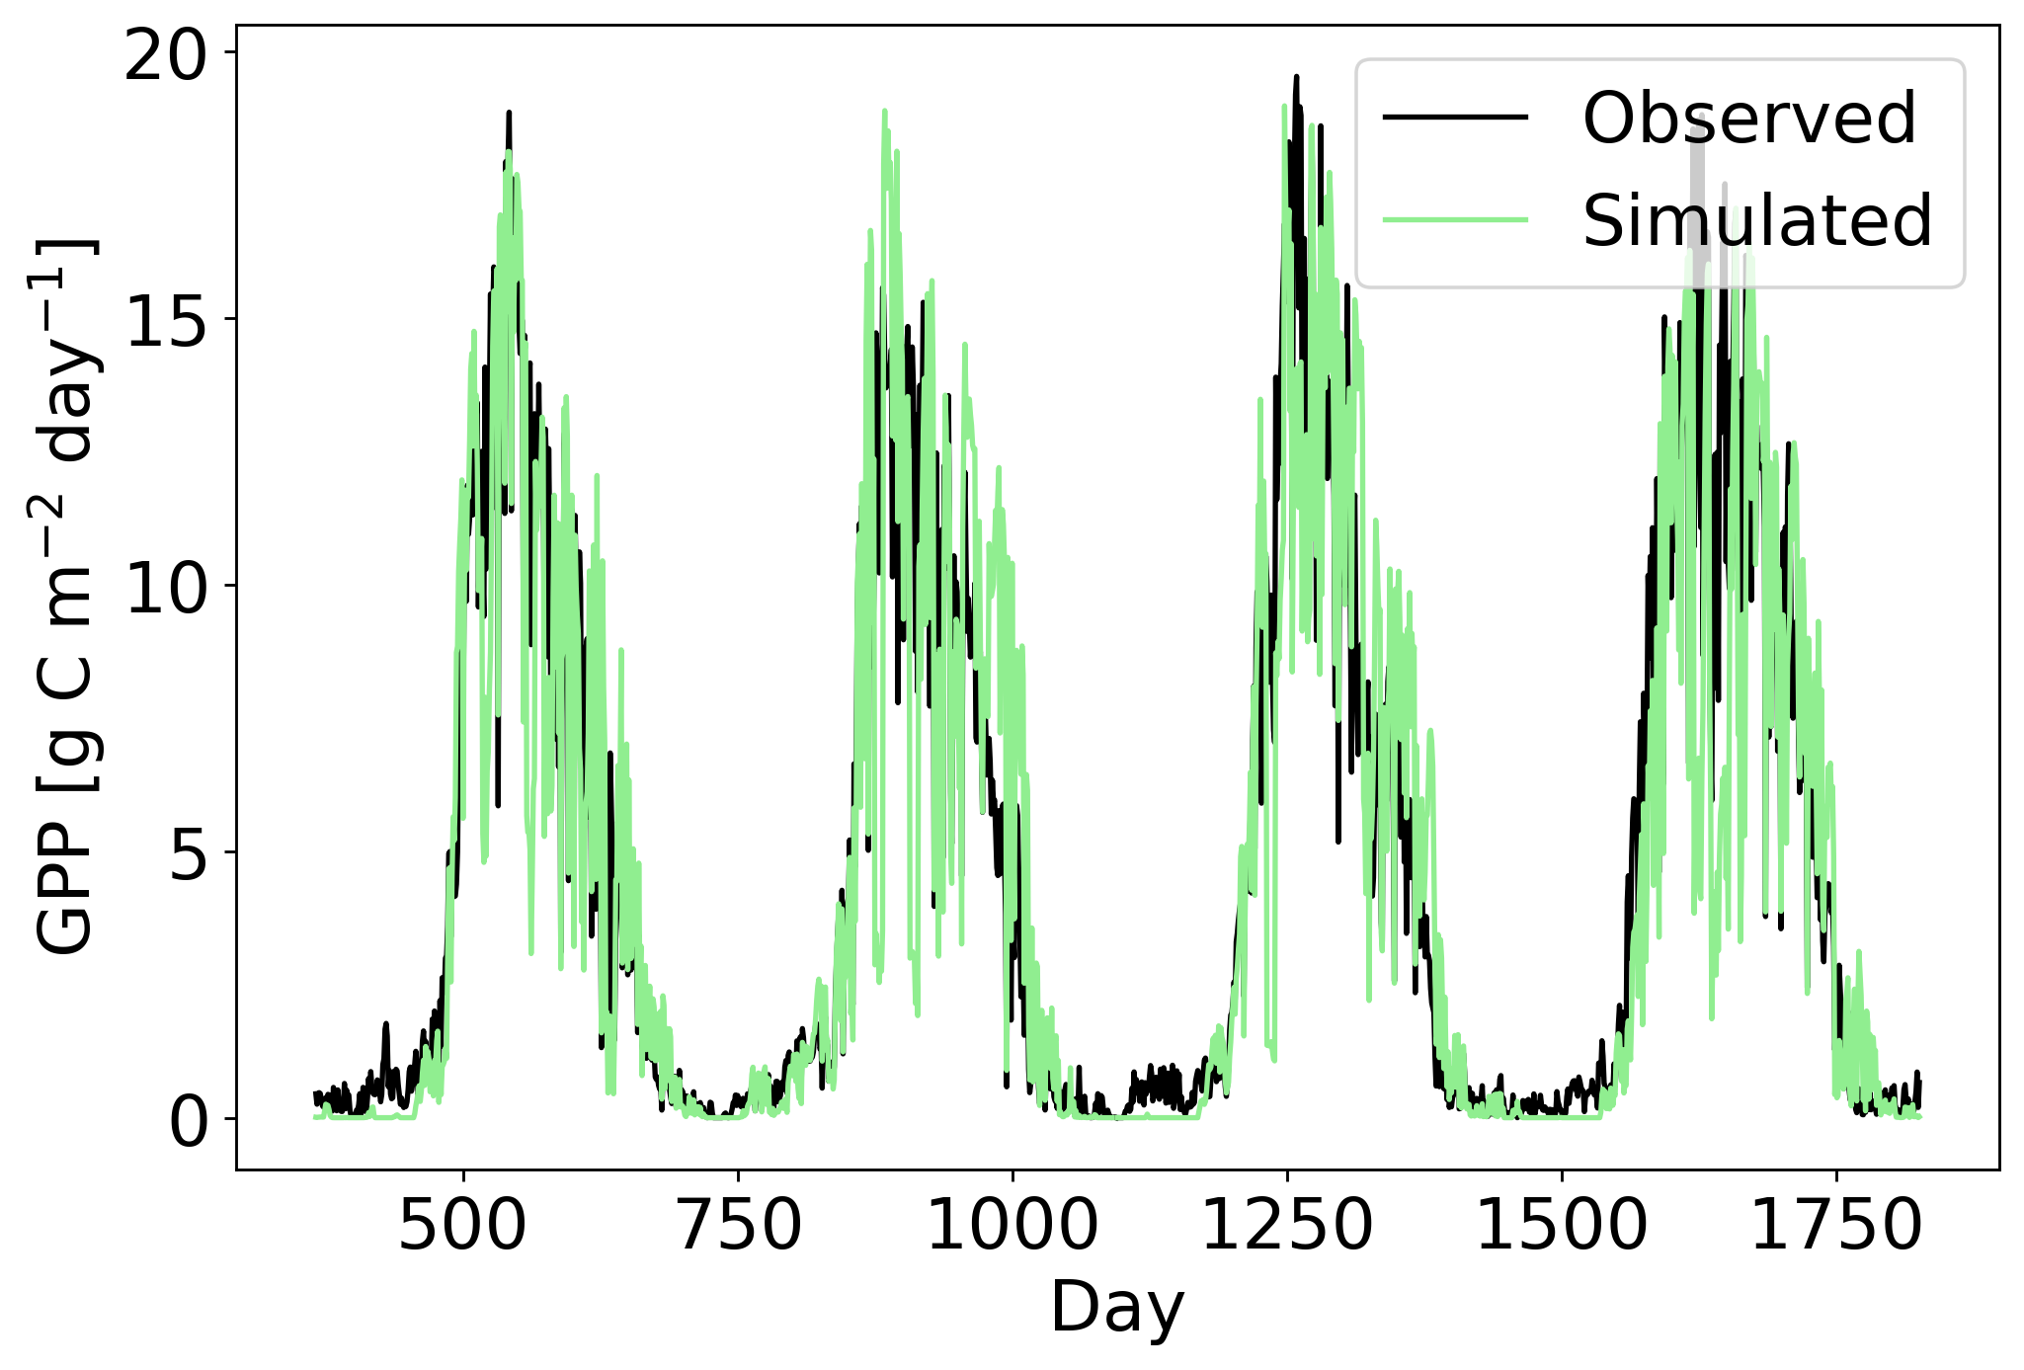
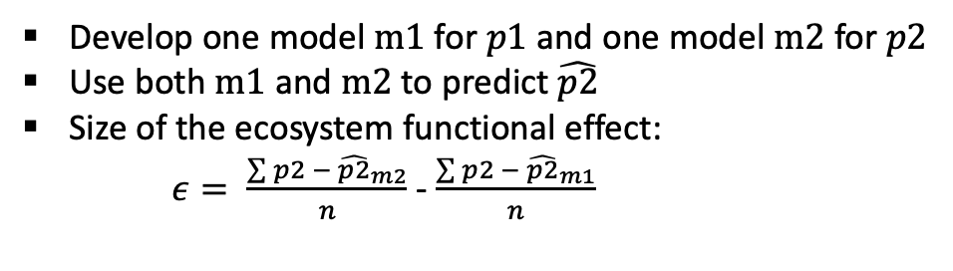
Partitioning effects on intra-annual variability in GPP
How much of the intra-annual variation can be attributed to ecosystem functional changes?
Approach
Develop one model $m1$for $p1$and one model $m2$ for$p2$
Use both $m1$and $m2$to predict $\hat{p2}$
Size of the ecosystem functional effect:
$ε= \frac{\sum{p2 − {\hat{p2}}_{m2}}}{n}$ - $\frac{\sum{p2 − {\hat{p2}}_{m1}}}{n}$
p1
p2

Slide 13
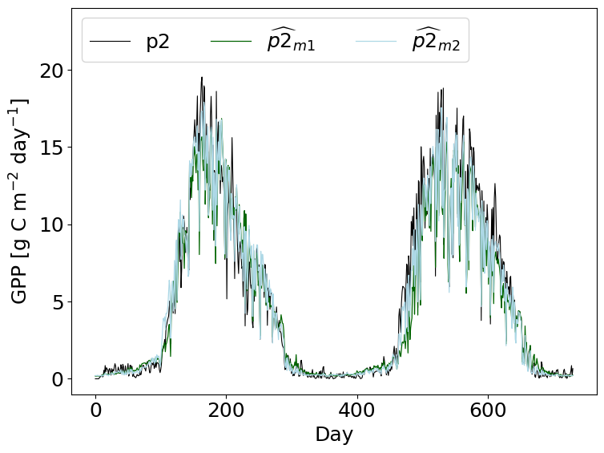
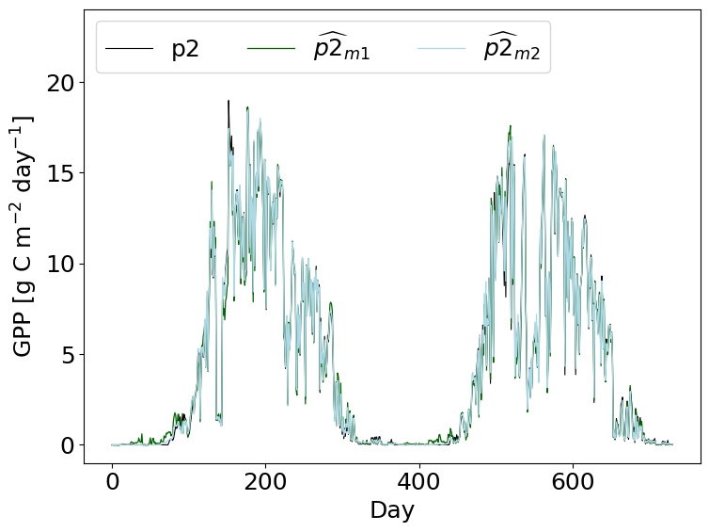
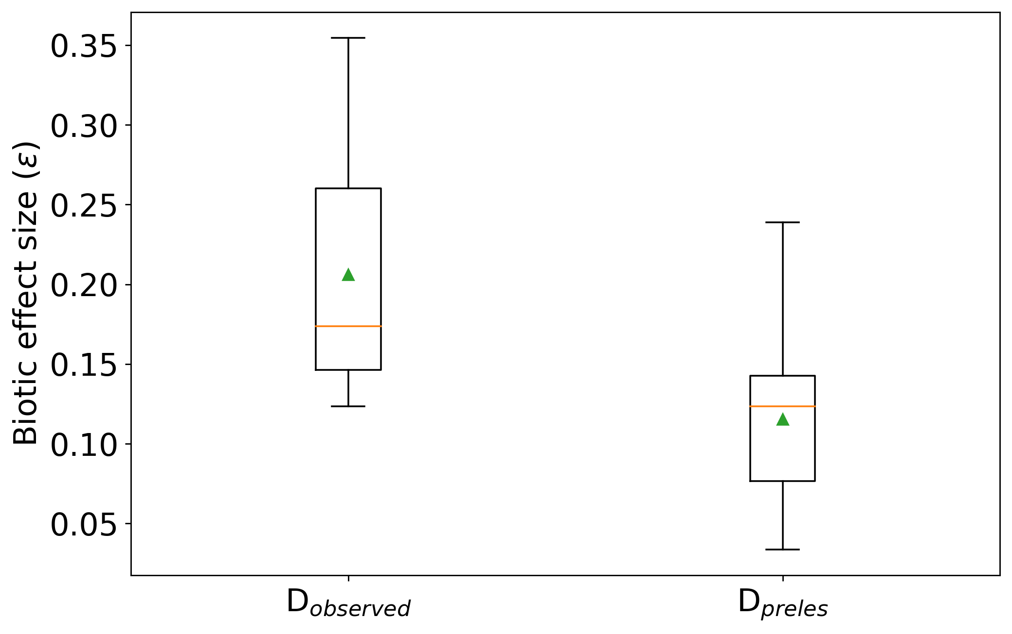
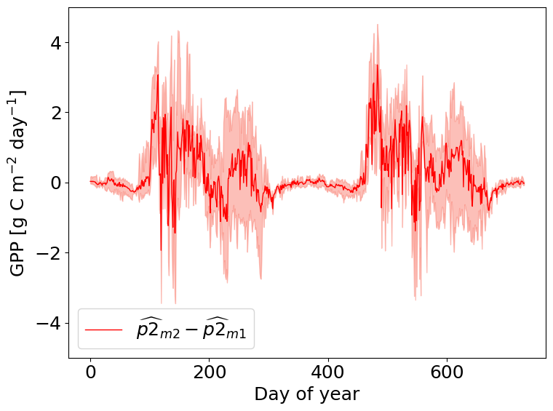
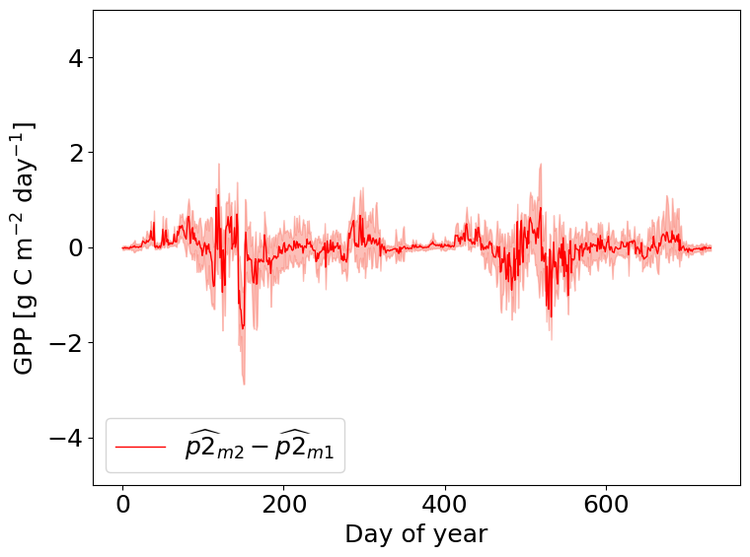
Partitioning effects on intra-annual variability in GPP
GPP measurements
PRELES simulations

Slide 14
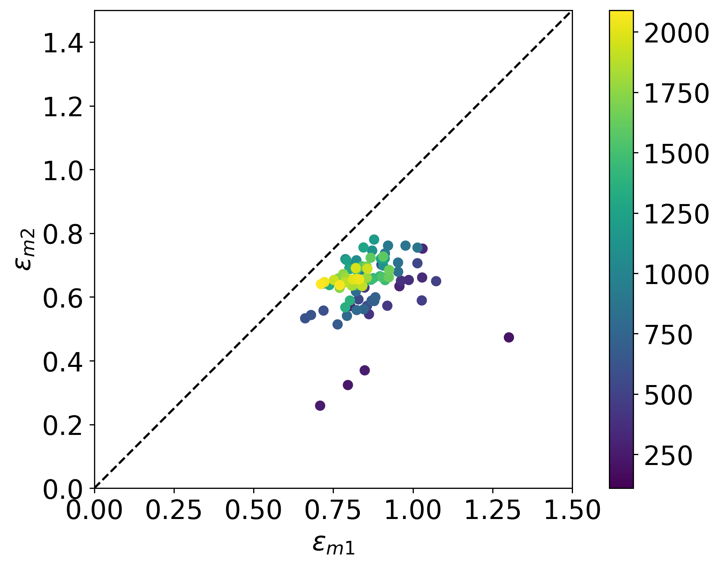
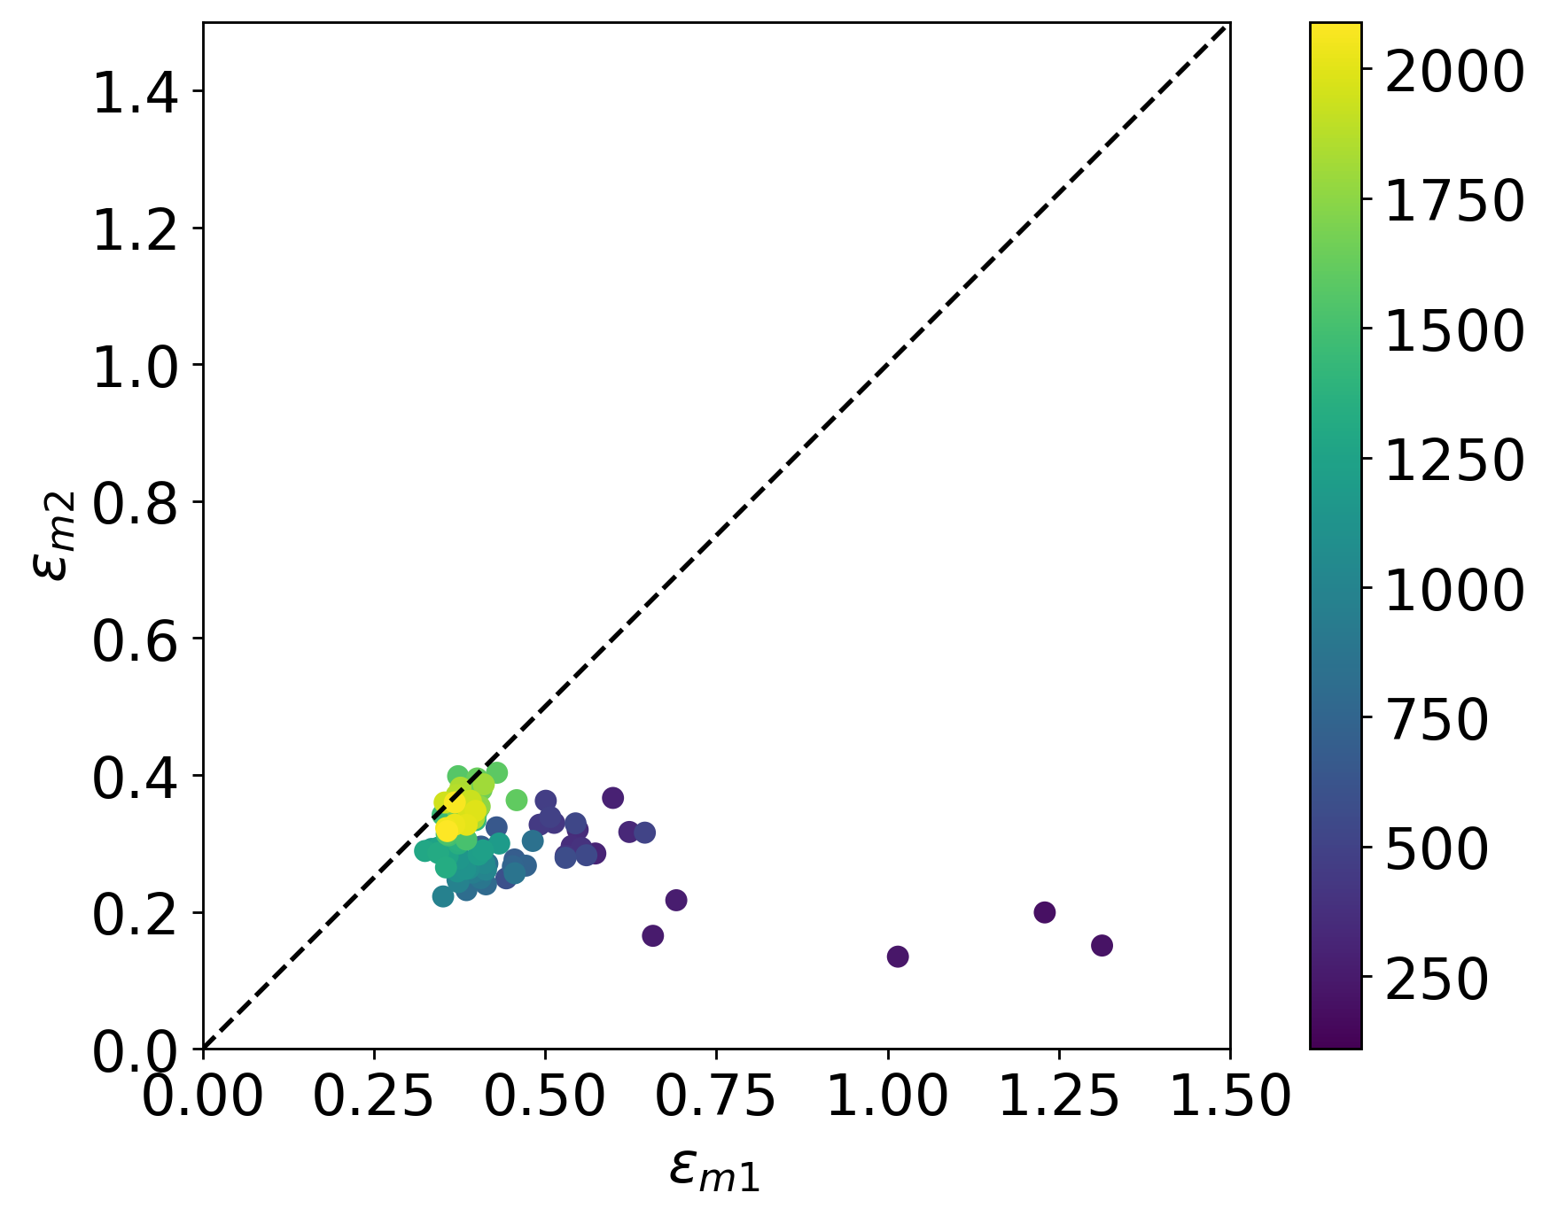
Partitioning climatic and biotic effects on GPP

Slide 15
References
[1] Christopher PO Reyer, Ramiro Silveyra Gonzalez, Klara Dolos, Florian Hartig, Ylva Hauf, MatthiasNoack, Petra Lasch-Born, Thomas R ̈otzer, Hans Pretzsch, Henning Meesenburg, et al. Theprofound database for evaluating vegetation models and simulating climate impacts on europeanforests.Earth system science data, 12(2):1295–1320, 2020.
[2] J. Wu, L. van der Linden, G. Lasslop, N. Carvalhais, K. Pilegaard, C. Beier, and A. Ibrom. Effectsof climate variability and functional changes on the interannual variation of the carbon balancein a temperate deciduous forest.Biogeosciences, 9(1):13–28, 2012. doi: 10.5194/bg-9-13-2012.URLhttps://bg.copernicus.org/articles/9/13/2012/
[3]

