Slide 1

Barriers to Implementing a Just Culture
Mark White
CSD380
Assignment#9.2

Slide 2
What is a Just Culture?
A just culture promotes accountability and learning from mistakes, not punishment.
Key traits include:
Balancing accountability with system design flaws
Encouraging open communication
Promoting trust, transparency, and shared responsibility

Slide 3
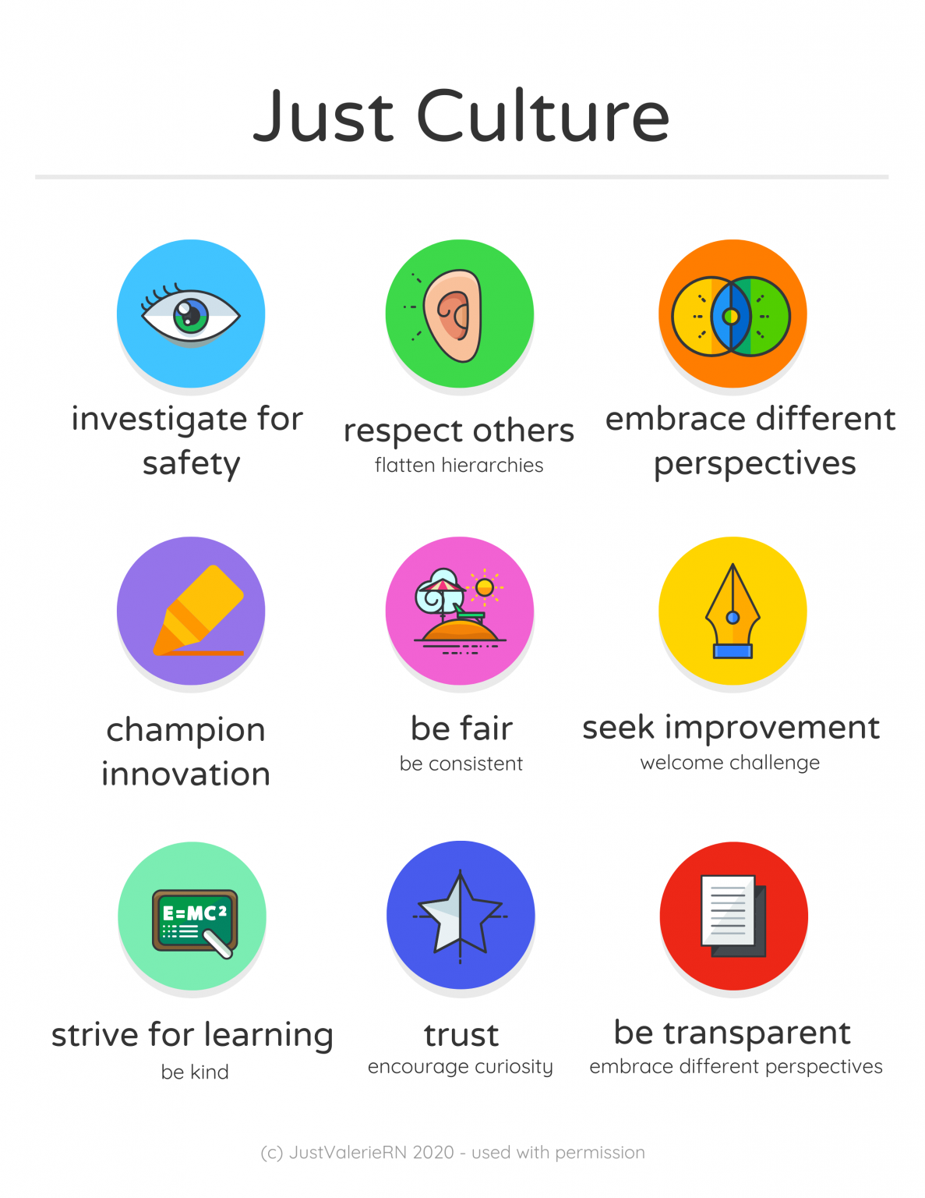

Slide 4
Barrier 1: Fear of Punishment
Employees may avoid reporting mistakes
Concerns about retaliation or career impact
Inhibits learning from incidents
Encourages cover-ups rather than transparency

Slide 5

Barrier 2: Lack of Leadership Buy-in
Leaders may be reluctant to shift from a blame culture.
Resistance to sharing responsibility for systemic issues.
Without leadership modeling just culture, adoption falters.

Slide 6
Barrier 3: Poor Communication Systems
No consistent way to report or analyze incidents
Delays or misunderstandings when sharing findings
Staff unclear on what to report or how it will be used

Slide 7
Barrier 4: Trust, Psychological Safety & Inconsistency
Inconsistency reduces psychological safety.
Lack of transparency deters reporting and creates distrust.
Culture must evolve from shared beliefs, not be imposed.

Slide 8
Culture Change Process
Change process for Just Culture:
1. Educate staff and leadership on just culture principles
2. Replace punitive policies with restorative ones
3. Implement anonymous reporting tools
4. Highlight improvements and share lessons learned
5. Ensure transparent and consistent assessment.

Slide 9
Strategies to Overcome Barriers
Train leadership and staff on just culture principles
Use anonymous reporting systems
Encourage psychological safety in teams
Share positive examples of learning from mistakes

Slide 10
References
Just Culture. (2025). Overcoming Barriers to a Just Culture – Health Quality Alberta Justculture.hqa.ca. https://justculture.hqa.ca/overcoming-barriers-to-a-just-culture/
LinkedIn. (n.d.) Breaking Down Barriers: Realising a Just Culture in Healthcare Organisations. (n.d.). Www.linkedin.com. https://www.linkedin.com/pulse/breaking-down-barriers-realising-just-culture-chris-ingram/
Shorrock, S. (2023). Why Is It Just So Difficult? Barriers to “Just Culture” in the Real World. Humanistic Systems. https://humanisticsystems.com/2023/10/18/why-is-it-just-so-difficult-barriers-to-just-culture-in-the-real-world/

