Slide 1


BATTLEZONE
F15-18545 (Team MX-Butterfly)
Ashish Shrestha
Hui Jun Tay
Peter Pearson

Slide 2

PRESENTATION OVERVIEW
Battlezone (What, Why, Where)
System Architecture Overview
6502 Core
Memory Infrastructure
Analog Vector Generator
MathBox
POKEY
What we’ve learned
Things to watch out for
Conclusion

Slide 3
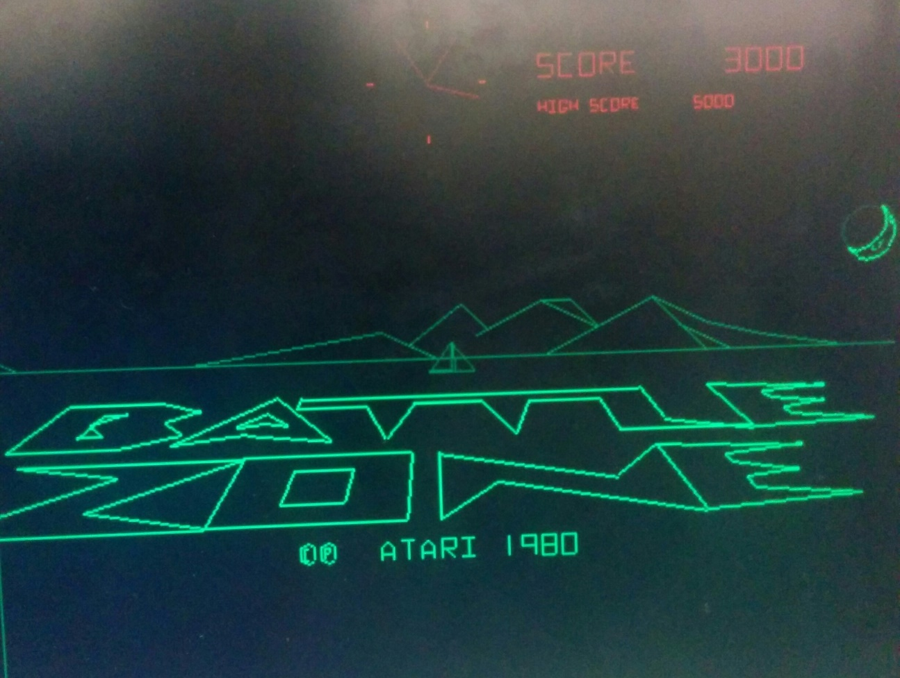
BATTLEZONE
Originally called “Moon Tank”
Drive a tank, shoot at other tanks
Two joysticks with buttons
Vector graphics
3-D game world

Slide 4
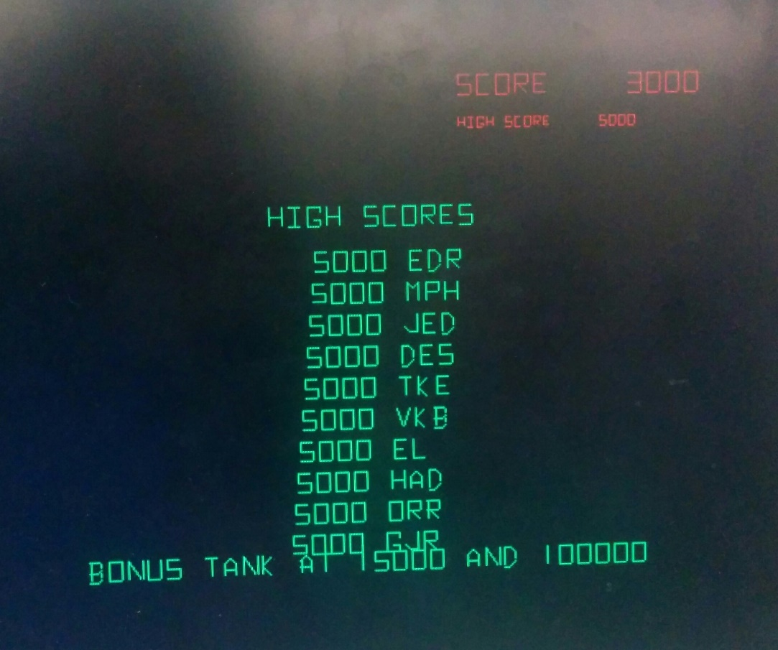
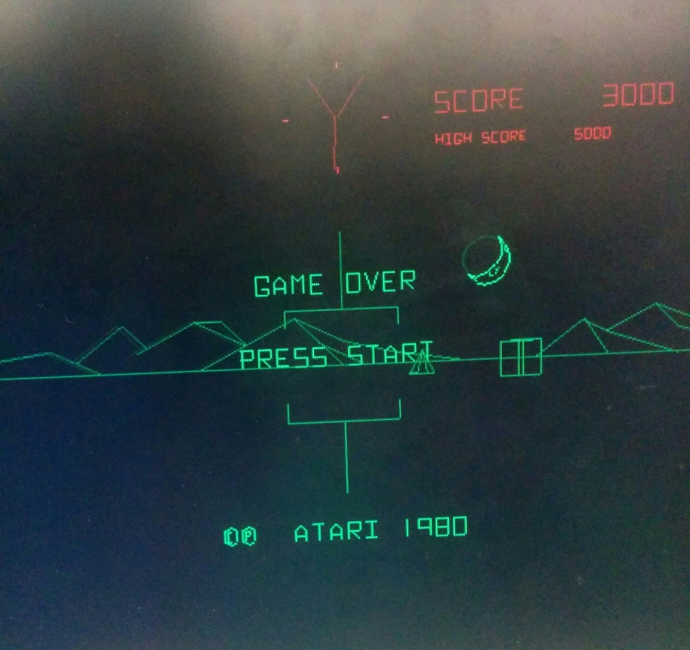
FINAL STATUS
Working copy of the game
Some sounds missing
Make option switches accessible
Cabinet

Slide 5
SYSTEM ARCHITECTURE OVERVIEW
6502 CORE
ADDRESS DECODER
POKEY
AUDIO
CONTROLS
PROGRAM RAM
PROGRAM ROM
AVG
LINE REGISTER QUEUE
MATHBOX
RASTERIZER
VGA
VECTOR
RAM/ROM
NMI
FRAME BUFFER

Slide 6
6502 PROCESSOR
Using OpenCores 6502 processor
Fixed a small bug involving decimal mode
Handles game flow and most calculations
6502 CORE

Slide 7
6502 processor - interfacing
Graphics
Writes into graphics memory
MathBox
Writes calculation requests, reads results
POKEY
Sound, controls, RNG
NMI Counter
6502 CORE
ADDRESS DECODER
POKEY
AVG
MATHBOX
VECTOR
RAM/ROM
NMI

Slide 8
MEMORY INFRASTRUCTURE
Address Decoder
Program RAM
Program ROM
Vector RAM/ROM
Memory Mapped I/O (Pokey/MathBox)
Settings and miscellaneous signals
6502 CORE
ADDRESS DECODER
POKEY
PROGRAM RAM
PROGRAM ROM
MATHBOX
VECTOR
RAM/ROM

Slide 9
ANALOG VECTOR GENERATOR (AVG)
Reads instructions from Vector RAM/ROM
Communication with 6502 processor
Draws lines for game
9 Instruction ISA
Runs at 6 MHz
6502 CORE
ADDRESS DECODER
VECTOR
RAM/ROM
AVG

Slide 10
AVG - INTERFACING
Connects to line register hardware queue
Queues up endpoints of lines for rasterizer
Reads instructions from memory
Uses two ports of different sizes to get 8/16-bit instructions
VECTOR
RAM/ROM
AVG
16-bit
LINE REGISTER QUEUE
8-bit

Slide 11
AVG - RASTERIZER
Bresseham’s line algorithm
One pixel of output per clock cycle
Uses linear geometry to calculate dependent offsets of line coordinates
LINE REGISTER QUEUE
RASTERIZER
FRAME BUFFER

Slide 12
AVG - FRAME BUFFER
640x480 VGA output
Switch between two BRAMs
Rasterizer draws (writes) to one, VGA reads from other
4-Bit intensity value
Addressed by row/col counter
LINE REGISTER QUEUE
RASTERIZER
VGA
FRAME BUFFER
A
B

Slide 13
MATHBOX
Math co-processor
Used for 3-D calculations (rotations, translations)
Primarily does fixed-point multiplication/division
Treated as memory mapped I/O
6502 CORE
ADDRESS DECODER
MATHBOX

Slide 14
MATHBOX
Proprietary, nearly no documentation
MAME has software implementation
Abstracted own implementation based on source
Abusing faster hardware for design
6502 CORE
ADDRESS DECODER
MATHBOX

Slide 15
POKEY I/O - CONTROLS
Analog-digital converters to read controls
Core polls POKEY for controls
6 (functional) buttons attached by GPIO pins
Two forward/backward (one for each joystick)
Two firing buttons (functionally one)
Start button
6502 CORE
ADDRESS DECODER
POKEY
CONTROLS

Slide 16
POKEY I/O - RNG
Hardware RNG
Linear feedback shift register
Used in sound and in-game
6502 CORE
ADDRESS DECODER
POKEY
RNG

Slide 17
POKEY I/O - Sound
Four audio channels
Core writes to determine frequency/volume (per channel)
Uses frequency divider to get final sound
6502 CORE
ADDRESS DECODER
POKEY
AUDIO

Slide 18
POKEY I/O - Sound
Some sound is external to POKEY
Capacitive discharge
Used to create fading sounds
Bullets, explosions, engine
Triggered by 6502 writes
6502 CORE
ADDRESS DECODER
POKEY
BREAKOUT BOARD
AUDIO

Slide 19
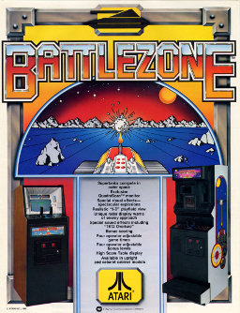
FINAL HARDWARE SETUP
Nexys4 board running game
Sony VGA Monitor with “arcade overlay”
POKEY
Dual external speakers
Push-button joysticks + arcade buttons
Wood arcade cabinet mount
Coin-door stretch goal

Slide 20




LESSONS LEARNED
Watch out for proprietary hardware
MAME is a godsend
Overshoot on expected FPGA specs
Vivado...

Slide 21
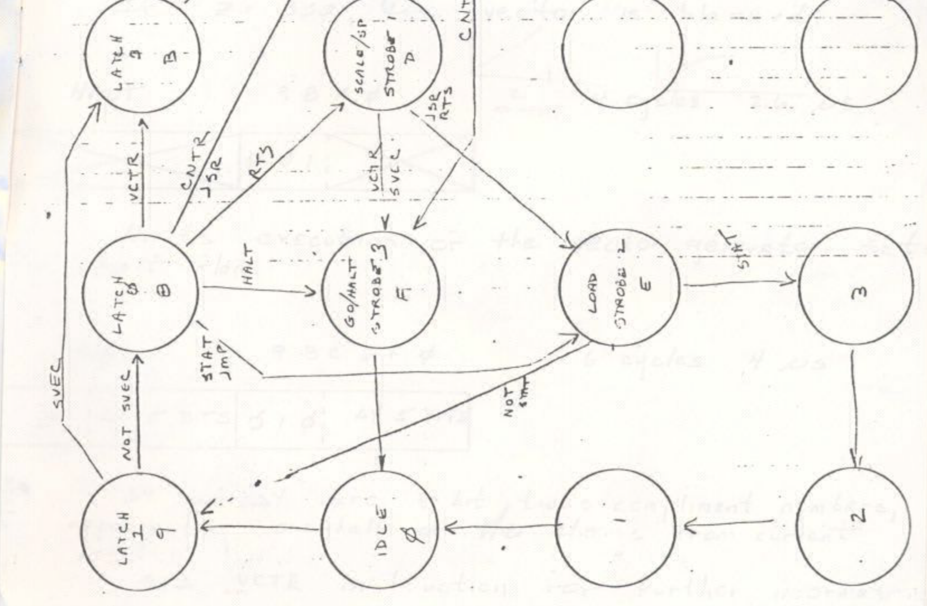
WHAT TO WATCH OUT FOR
Don’t trust Ryan with your core
Be willing to ignore the schematics
Don’t assume that old devs cared about protocol
Vivado...

Slide 22

CONCLUSIONS
Vector graphics surprisingly complex
Reverse engineering specifications
Frustrating & Fun
Long hours of debugging small issues
Vivado…

Slide 23
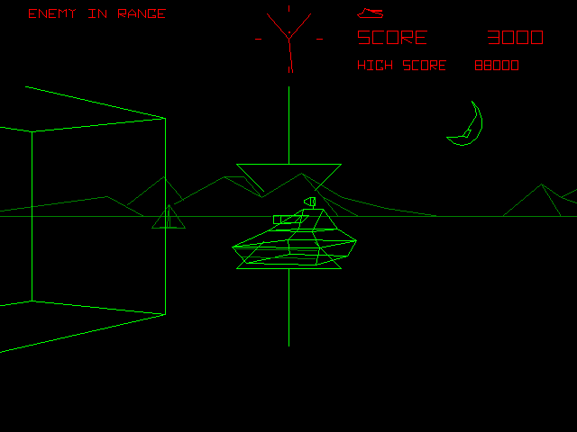

Tank you
Q&A

