Slide 1

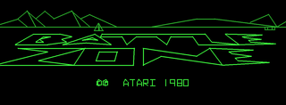


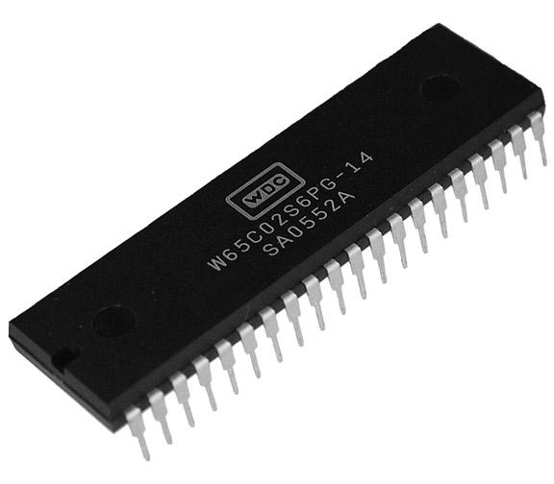
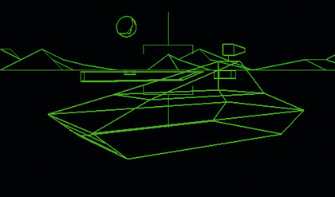






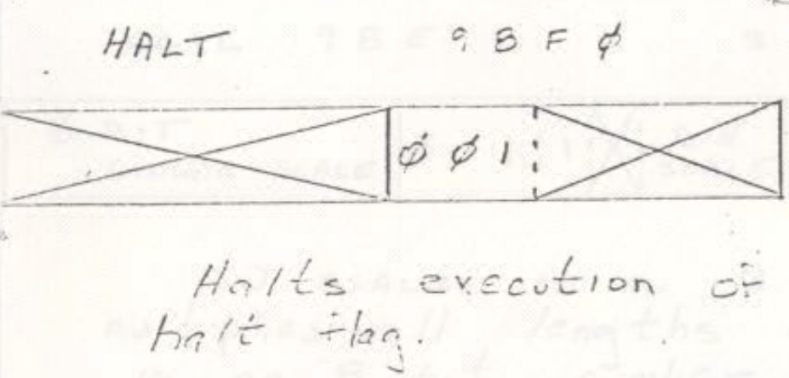
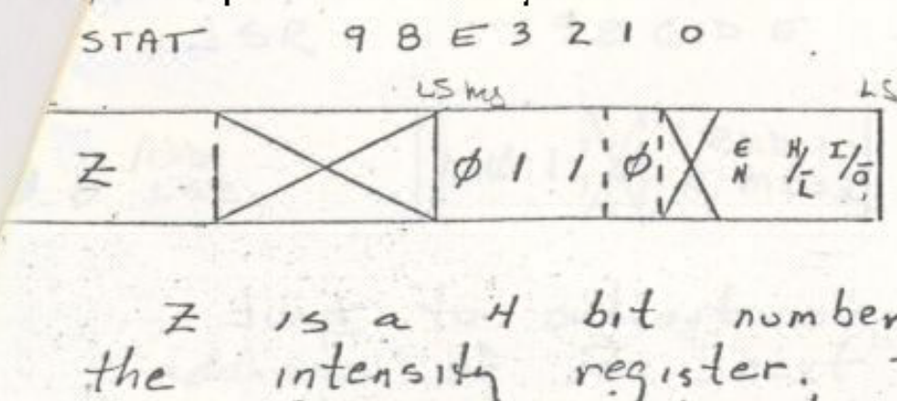
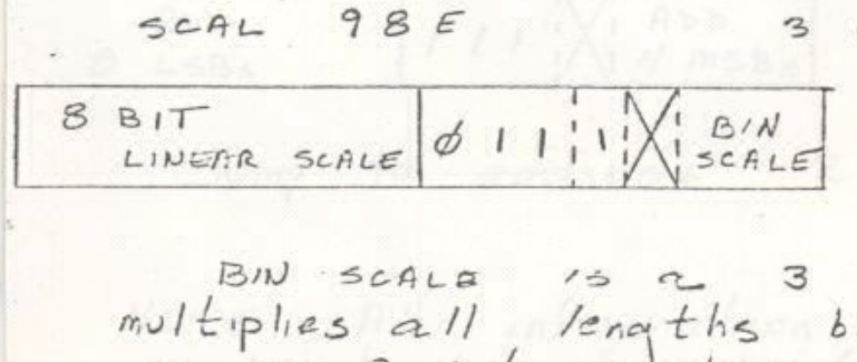
F15 18545 Digital Design Project
TEAM M-X BUTTERFLY
Ashish Shrestha
Hui Jun Tay
Peter Pearson
POKEY I/O
6 buttons attached by GPIO pins
Joysticks correspond to tank treads
Analog-digital converters read controls
6502 polls POKEY for controls
Four audio channels
6502 writes frequency/volume to POKEY
Uses frequency divider for final sound
Capacitive discharge (fading sounds)
Hardware RNG
Linear feedback shift register
6502 Core
6502 CORE
ADDRESS DECODER
POKEY
AUDIO
Standard 6502 Core
15-Bit address bus
8-Bit data bus
Used in many old consoles/games
Open source Verilog description
Made by Arlet Ottens
Fixed bug in decimal mode
Passed verification
Runs at 3 MHz
Periodic non-maskable interrupts
One-cycle read latency
CONTROLS
Graphics
PROGRAM RAM
Rasterizer
Bresseham’s line algorithm
Line Register Queue
Buffers output from AVG to Rasterizer
Frame Buffer
Double-buffer (Read/Write)
Outputs to 640x480 VGA
Stores 4-bit intensity
Hard-coded red/green pixels
AVG
LINE REGISTER QUEUE
PROGRAM ROM
RASTERIZER
MATHBOX
FRAME BUFFER
VECTOR
RAM/ROM
RASTERIZER
FRAME BUFFER
VGA
NMI
VGA
WRITE
READ
Addressing and Memory
Math Box
Analog Vector Generator
Memory System
Used Vivado Block RAM for all memory
Divided memory into blocks by function
Memory Mapped I/O
POKEY and Math Box
Address decoding
Takes addresses from 6502, sends to different memory partitions
Reads and writes to memory mapped I/O
Proprietary hardware piece
Hard to find specifications
Handles rotations
Fixed point multiplication & division
Built using MAME as reference
Originally an analog component
Electron gun moved around screen and drew lines
9 instruction ISA for a mini-processor
Re-designed for this project in a digital manner
Built a 9-instruction processor
Reads from vector RAM/ROM
16-Bit reads from memory
Sends line information to Rasterizer
Debugged with custom-built tool chain
Software simulator
Assembler/Disassembler
“The math box was passed a 2x2 rotation matrix and -- I believe -- a list of points to rotate. If I remember correctly translation was handled in the 6502, although this may have been done in the math box as well. It's been a long time.”
-Ed Rotberg, Programmer for Battlezone

