Slide 1
MPI- Message Passing Interface

Slide 2
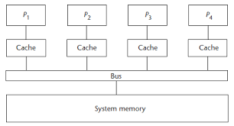
Shared Memory System

Slide 3
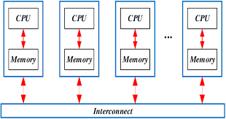
Distributed Memory System

Slide 4
Distributed memory computers can execute in parallel
Main differences between the shared memory and distributed memory computer architectures.
price of communication:
number of processors that can cooperate efficiently, is in favor of distributed memory computers.
Primary choice when computing complex tasks will be to engage a large number of fastest available processors
communication among them poses additional limitations.
Cooperation among processors implies communication or data exchange among them.
When the number of processors must be high to reduce the execution time, the speed of communication becomes a crucial performance factor

Slide 5
Distributed memory computers can execute in parallel
Difference in the speed of data movement between two computing cores within a single multicore computer,
Depending on the location of data to be communicated.
Data can be stored in registers, cache memory, or system memory
Differences in the communication speed get even more pronounced in the interconnected computers
By orders of magnitude
Depends on the technology and topology of the interconnection networks and on the geographical distance of the cooperating computers.

Slide 6
Distributed memory computers can execute in parallel
Complex tasks can be executed efficiently either
on a small number of extremely fast computers
on a large number of potentially slower interconnected computers.
Message Passing Interface (MPI), which enables system-independent parallel programming.
MPI standard1 includes
process creation and management
language bindings for C and Fortran,
point-to-point and collective communications
group and communicator concepts.
Newer MPI standards are trying to better support the scalability in future extreme-scale computing systems,
Advanced topics, as one-sided communications, extended collective operations, process topologies, external interfaces, etc., are also covered by these standards

Slide 7
Programmer’s view
Programmers have to be aware that the cooperation among processes implies the data exchange.
Total execution time is consequently a sum of computation and communication time.
Algorithms with only local communication between neighboring processors are faster and more scalable than the algorithms with the global communication among all processors.
Programmer’s view of a problem that will be parallelized has to incorporate a wide number of aspects
Data independency,
Communication type and frequency,
Balancing the load among processors,
Balancing between communication and computation,
Overlapping communication and computation,
Synchronous or asynchronous program flow,
Stopping criteria,
Etc
Most of the above issues that are related to communication are efficiently solved by the MPI specification.

Slide 8
Message passing interface
Standardization effort of a message passing interface (MPI) library began in nineties
Most successful project of the software standardization.
Cooperation between academia and industry that has been created with the MPI standardization forum.
MPI library interface is a specification, not an implementation.
MPI is not a language
MPI operations are expressed as functions, subroutines, or methods, according to the appropriate language bindings for C and Fortran
MPI standard defines the syntax and semantics of library operations that support the message-passing model, independently of program language or compiler specification.

Slide 9
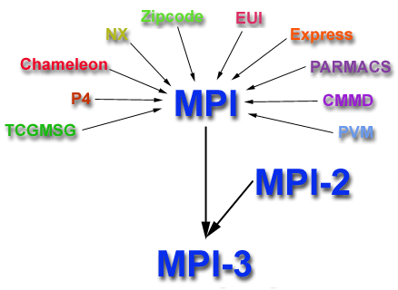
History and Evolution
MPI-4.0 was approved by the MPI Forum on June 9, 2021..

Slide 10
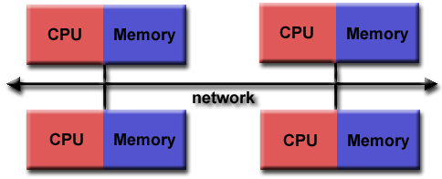
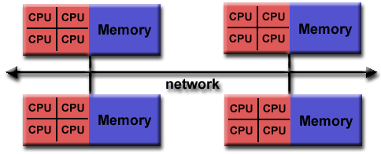
Programming Model:

Slide 11
Message passing interface
MPI program consists of autonomous processes that are able to execute their own code in the sense of multiple instruction multiple data (MIMD) paradigm.
MPI process can be interpreted in this sense as a program counter that addresses their program instructions in the system memory
which implies that the program codes executed by each process have not to be the same.
Processes communicate via calls to MPI communication operations, independently of operating system.

Slide 12
Message passing interface
MPI can be used in a wide range of programs written in C or Fortran.
Several efficient MPI library implementations have been developed, either in open-source in the public domain.
Success of the project is evidenced by a coherent development of the parallel software projects that are portable between different computing environments,
e.g. parallel computers, clusters, and heterogeneous networks,
Scalable along wide numbers of cooperating processors, from one to millions.
MPI interface is designed for end users, parallel library writers and developers of parallel software tools.

Slide 13
Message passing interface
MPI program should have operations to initialize execution environment and to control starting and terminating procedures of all generated processes.
MPI processes can be collected into groups of specific size that can communicate in its own environment
message sent in a context must be received only in the same context.
Process group and context together form an MPI communicator.
Process is identified by its rank in the group associated with a communicator.
Default communicator MPI_COMM_WORLD whose group encompass all initial processes, and whose context is default.
Two essential questions arise
”How many processes are participating in computation?”
”Which are their identities?”

Slide 14
Message passing interface
Basic MPI communication is characterized by two fundamental MPI operations
MPI_SEND and MPI_RECV
sends and receives of process data represented by numerous data types.
Two operations synchronize the cooperating processes in time instants where communication has to be established
e.g. a process cannot proceed if the expected data has not arrived.
Single program may use several communicators
Enables to use different MPI based parallel libraries that can communicate independently, with in a single parallel program.

Slide 15
Message passing interface
Parallel algorithms can be implemented by just a few MPI operations,
MPI-1 standard offers a set of more than 120 operations for elegant
Efficient programming, including operations for collective and asynchronous communication in numerous topologies of interconnected computers.
MPI library is well documented from its beginning and constantly developing.
MPI-2 provides standardized process startup, dynamic process creation and management, improved data types, one-sided communication and versatile input/output operations.
The MPI-3 standard introduces non blocking collective communication that enable communication-computation overlapping and the MPI Shared Memory (SHM) model that enables efficient programming of hybrid architectures,
e.g. a network of multicore computing nodes.
The MPI 4.0 standardization efforts aim at adding new techniques, approaches, or concepts to the MPI standard that will help MPI address the need of current and next generation applications and architectures.

Slide 16

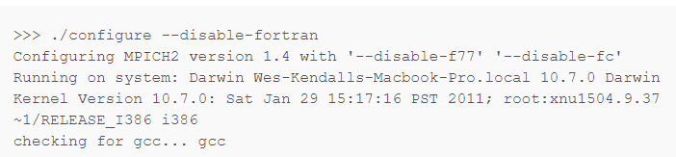
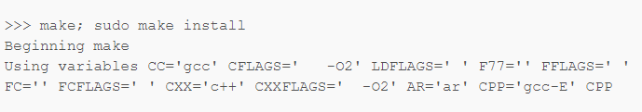
Make your computer ready for using MPI-Installing MPICH
./configure --prefix=/installation/directory/path

Slide 17
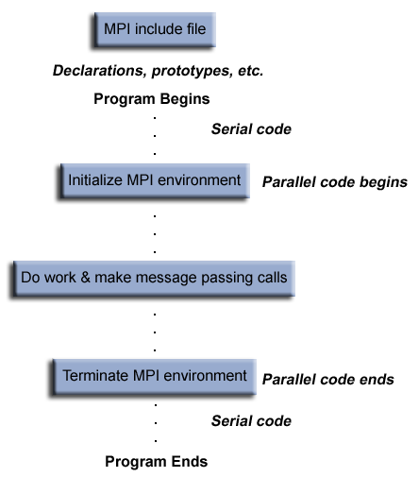
General MPI Program Structure

Slide 18
#include <stdio.h>
#include "mpi.h"
int main( argc, argv )
int argc;
char **argv;
{
int rank, size;
MPI_Init( &argc, &argv );
MPI_Comm_size( MPI_COMM_WORLD, &size );
MPI_Comm_rank( MPI_COMM_WORLD, &rank );
printf( "Hello world from process %d of %d\n", rank, size );
MPI_Finalize();
return 0;
}

Slide 19
MPI_Init initializes the MPI execution environment
MPI_Finalize exits the MPI,
MPI_Comm_size(MPI_COMM_WORLD, &size) returns size, which is the number of started processes
MPI_Comm_rank(MPI_COMM_WORLD, &rank) that returns rank, i.e. an ID of each process.
MPI operations return a status of the execution success;

Slide 20
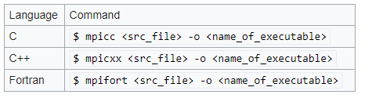

Compiling & Running

Slide 21
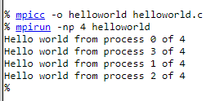

Slide 22
MPI operation syntax
MPI standard is independent of specific programming languages.
Capitalized MPI operation names will be used in the definition of MPI operations.
MPI operation arguments, in a language-independent notation, are marked as:
IN - for input values that may be used by the operation
OUT - for output values that may be updated by the operation
INOUT - for arguments that may be used and/or updated by the MPI operation.
IN arguments are in normal text, e.g. buf, sendbuf, MPI_COMM_WORLD, etc.
OUT arguments are in underlined text, e.g. rank, recbuf, etc.
INOUT arguments are in underlined italic text, e.g inbuf, request, etc.

Slide 23
MPI operation syntax
some terms and conventions that are implemented with C program language binding:
Function names are equal to the MPI definitions but with the MPI_ prefix and the first letter of the function name in upper case, e.g. MPI_Finalize().
Status of execution success of MPI operations is returned as integer return codes
e.g. ierr = MPI_Finalize().
Return code can be an error code or MPI_SUCCESS for successful competition
defined in the file mpi.h,
All predefined constants and types are fully capitalized.
All OUT and INOUT arguments are passed by reference (as pointers)
e.g. MPI_Comm_size (MPI_COMM_WORLD, &size).

Slide 24
MPI data types
MPI communication operations specify the message data length in terms of number of data elements, not in terms of number of bytes.
message data elements is machine independent
In order to retain machine independent code
MPI standard defines its own basic data types
Can be used for the specification of message data values
Correspond to the basic data types of the host language.
MPI does not require that communicating processes use the same representation of data, i.e. data types,
It needs to keep track of possible data types through the build-in basic MPI data types.

Slide 25
MPI data types
MPI offers operations to construct custom data types
e.g. array of (int, float) pairs, and many other options.
Type casting between a particular language and the MPI library may represent a significant overhead,

Slide 26
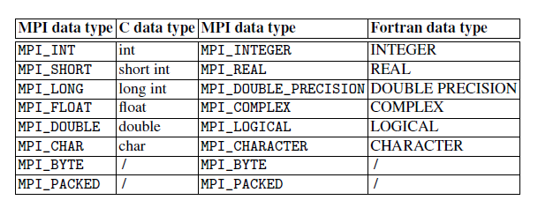
MPI data types

Slide 27
MPI data types
Data types MPI_BYTE and MPI_PACKED do not correspond to a C or a Fortran data type.
Value of type MPI_BYTE consists of a byte, i.e. 8 binary digits.
byte is uninterpreted and is different from a character.
Different machines may have different representations for characters, or may use more than one byte to represent characters.
byte has the same binary value on all machines.
If the size and representation of data is known, the fastest way is the transmission of raw data,
for example, by using an elementary MPI data type MPI_BYTE

Slide 28
MPI data types
MPI communication operations have involved only buffers containing a continuous sequence of identical basic data types.
To pass messages that contain values with different data types,
e.g. Number of integers followed by a sequence of real numbers;
To send non-contiguous data
e.g. Sub-block of a matrix.
MPI_PACKED is maintained by MPI_PACK or MPI_UNPACK operations
Enable to pack different types of data into a contiguous send buffer and to unpack it from a contiguous receive buffer.

Slide 29
MPI data types
More efficient alternative is a usage of derived data types for construction of custom message data.
Derived data types allow to avoid explicit packing and unpacking
requires less memory and time.
User specifies in advance the layout of data types to be sent or received
communication library can directly accesses a non-continuous data.
Simplest non-contiguous datatype is the vector type, constructed with MPI_Type_vector.
For example
sender process has to communicate the main diagonal of an NXN array of integers,
int matrix[N][N];
Stored in a row-major layout.

Slide 30
MPI data types
Continuous derived datatype diagonal can be constructed:
MPI_Datatype MPI_diagonal;
specifies the main diagonal as a set of integers:
MPI_Type_vector (N, 1, N+1, MPI_INT, &diagonal);
where their count is N, block length is 1, and stride is N+1.
Receiver process receives the data as a contiguous block.

Slide 31
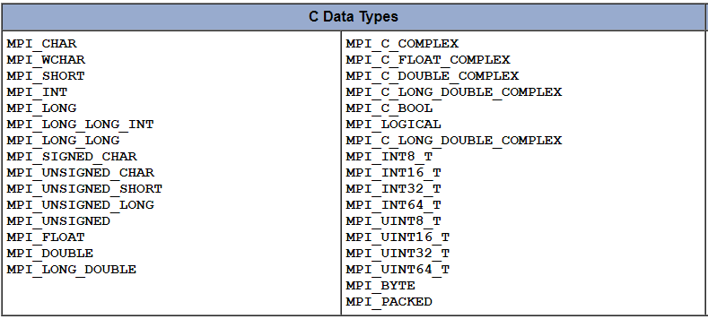

Slide 32
MPI data types
MPI also provides facilities for you to define your own data structures based upon sequences of the MPI primitive data types.
Such user defined structures are called derived data types.
Primitive data types are contiguous.
Derived data types allow you to specify non-contiguous data in a convenient manner and to treat it as though it was contiguous.
MPI provides several methods for constructing derived data types:
Contiguous
Vector
Indexed
Struct

Slide 33
MPI error handling
MPI standard assumes a reliable and error free underlying communication platform
It does not provide mechanisms for dealing with failures in the communication system.
For example, a message sent is always received correctly, and the user need not check for transmission errors, time-outs, or similar.
Similarly, MPI does not provide mechanisms for handling processor failures.
Program error can follow an MPI operation call with incorrect arguments
e.g. non-existing destination in a send operation, exceeding available system resources, or similar

Slide 34
MPI error handling
Most of MPI operation calls return an error code that indicates the completion status of the operation.
Before the error value is returned, MPI_error handler is called
by default, aborts all MPI processes.
MPI provides mechanisms for users to change this default and to handle recoverable errors.
One can specify that no MPI_error is fatal, and handle the returned error codes by custom error-handling routines.

Slide 35
Running and configuring MPI processes
mpiexec (or mpirun) program that can launch one or more MPI applications on a single computer or on a set of interconnected computers (hosts).
mpiexec –help
Common options are
-n <num_processes>
-host
-machinefile.

Slide 36
Running and configuring MPI processes
$ mpiexec -n 3 MyMPIprogram
MPI will automatically distribute processes among the available core,
option -cores <num_cores_per_host>
Program can be launched on two interconnected computers, on each with four processes,
$ mpiexec -host 2 host1 4 host2 4 MyMPIprogram
$ mpiexec -machinefile myhostsfile -n 3 MyMPIprogram

Slide 37

Running and configuring MPI processes
Configuration file can be used for a specification of processes on a single computer or on a set of interconnected computers.
Single Computer
For each host, the number of processes to be used on that host can be defined by a number that follows a computer name.
For example
localhost 4

Slide 38
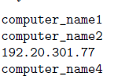
Running and configuring MPI processes
Interconnected computers
Configuration file must be edited in a way that all cooperating computers are listed.
Example :
four computers will cooperate, each with two computing cores.
Configuration file: myhostsfile should contain names or IP addresses of these computers

Slide 39
Running and configuring MPI processes
To execute MPI program MyMPIprogram on a set of computers in a network, e.g. connected with an Ethernet.
Editing, compiling and linking process is the same as in the case of a single computer.
MPI executable should available to all computers,
e.g. manual copying of the MPI executable on the same path on all computers, or more systematically, through a shared disk.
Cooperating computers should have the same version of the MPI library installed,
Compiled MPI executable should be compatible with the computing platforms (32 or 64 bits) on all computers.
Command from the master host:
$mpiexec -machinefile myhostsfile \\MasterHost\share\MyMPIprog

Slide 40
Running and configuring MPI processes
One will need a basic user account and an access to the MPI executable that must be located on the same path on all computers.
In Linux, this can be accomplished automatically by placing the executable in /home/username/ directory.
Finally, a method that allow automatic login, is needed, to enable automatic login between cooperating computers.
e.g. in Linux, SSH login without password,

Slide 41
Basic MPI operations
MPI_INIT (int *argc, char ***argv)
Operation initiates an MPI library and environment.
Arguments argc and argv are required in C language binding only, where they are parameters of the main C program.
MPI_FINALIZE ()
Operation shuts down the MPI environment.
No MPI routine can be called before MPI_INIT or after MPI_FINALIZE, with one exception MPI_INITIALIZED(flag), which queries if MPI_INIT has been called.

Slide 42
Basic MPI operations
MPI_COMM_SIZE (comm, size)
Operation determines the number of processes in the current communicator.
Input argument comm is the handle of communicator
output argument size returned by the operation MPI_COMM_SIZE is the number of processes in the group of comm.
If comm is MPI_COMM_WORLD then it represents the number of all active MPI processes.
MPI_COMM_RANK (comm, rank)
Operation determines the identifier of the current process within a communicator.
Input argument comm is the handle of the communicator
Output argument rank is an ID of the process from comm, which is in the range from 0 to size-1.

Slide 43
Process-to-process communication
Processes may have multiple program threads, associated with separate program counters, which share a single process’s address space.
Message passing model formalizes the communication between processes that have separate address spaces.
Process-to-process communication has to implement two essential tasks:
Data movement
Synchronization of processes,
Therefore it requires cooperation of sender and receiver processes.
Every send operation expects a pairing/matching receive operation.

Slide 44
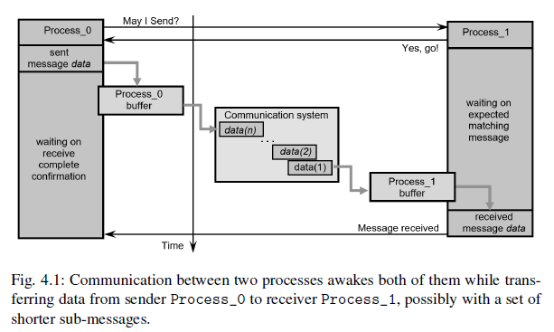
Process-to-process communication

Slide 45
Process-to-process communication
Optional intermediate message buffers are used in order to enable sender Process_0 to continue immediately after it initiates the send operation.
Process_0 will have to wait on the return from the previous call, before it can send a new message.
Process_1 can do some useful work instead of idling while waiting on the matching message reception.
Communication system must ensure that the message will be reliably transferred between both processes.
If the processes have been created on a single computer, the actual communication will be probably implemented through a shared memory.
If the processes reside on two distant computers, then the actual communication might be performed through an existing interconnection network using, e.g. TCP/IP communication protocol.

Slide 46
Process-to-process communication
Blocking send/receive operations enable a simple way for synchronization of processes, they could introduce unnecessary delays in cases where sender and receiver do not reach communication point at the same real time.
For example,
if Process_0 issues a send call significantly before the matching receive call in Process_1,
Process_0 will start waiting to the actual message data transfer.
In the same way, processes’ idling can happen if a process that produces many messages is much faster than the consumer process.
Message buffering may alleviates the idling to some extent, but if the amount of data exceeds the capacity of the message buffer, which can always happen, Process_0 will be blocked again.

Slide 47
Process-to-process communication
Concern of the blocking communication are deadlocks.
For example, if Process_0 and Process_1 initiate their send calls in the same time,
they will be blocked forever by waiting a matching receive calls.
Fortunately, there are several ways for alleviating such situations
Before an actual process-to-process transfer of data happens, several issues have to be specified,
How will message data be described
How processes will be identified
How the receiver recognizes/screens messages
when the operations will complete.

Slide 48
MPI_Send
int MPI_Send(const void *buf, int count, MPI_Datatype datatype, int dest, int tag, MPI_Comm comm)
buf -initial address of send buffer (choice)
count -number of elements in send buffer (nonnegative integer)
datatype -datatype of each send buffer element (handle)
dest- rank of destination (integer)
tag-message tag (integer)
comm -communicator (handle)

Slide 49
MPI_Send
Operation, invoked by a blocking call MPI_SEND in the sender process source, will not complete until there is a matching MPI_RECV in receiver process dest, identified by a corresponding rank.
MPI_RECV will empty the input send buffer buf of matching MPI_SEND.
MPI_SEND will return when the message data has been delivered to the communication system and the send buffer buf of the sender process source can be reused.
Send buffer is specified by the following arguments:
buf - pointer to the send buffer
count - number of data items
Datatype - type of data items.
Receiver process is addressed by an envelope that consists of arguments dest, which is the rank of receiver process within all processes in the communicator comm, and of a message tag.

Slide 50
MPI_Send
Message tags provide a mechanism for distinguishing between different messages for the same receiver process identified by destination rank.
Tag is an integer in the range [0, UB] where UB, defined in mpi.h, can be found by querying the predefined constant MPI_TAG_UB.
When a sender process has to send more separate messages to a receiver process, the sender process will distinguish them by using tags
For example, if a receiver process has to distinguish between messages from a single source process, a message tag will serve an additional means for messages differentiation.
MPI_ANY_TAG is a constant pre-defined in mpi.h, which can be considered as a "wild-card", where all tags will be accepted.

Slide 51
MPI_Recv
int MPI_Recv(void *buf, int count, MPI_Datatype datatype, int source, int tag, MPI_Comm comm, MPI_Status * status)
buf -initial address of receive buffer (choice)
status-status object (Status)
count -maximum number of elements in receive buffer (integer)
datatype-datatype of each receive buffer element (handle)
Source-rank of source (integer)
tag -message tag (integer)
comm- communicator (handle)

Slide 52
MPI_Recv
Operation waits until the communication system delivers a message with matching datatype, source, tag, and comm.
Messages are screened at the receiving part based on specific source, which is a rank of the sender process within communicator comm, or not screened at all on source by equating it with MPI_ANY_SOURCE.
Screening is performed with tag, or if screening on tag is not necessary, by using MPI_ANY_TAG, instead.
return from MPI_RECV the output buffer buf is emptied and can be reused.

Slide 53
MPI_Recv
Number of received data items of datatype must be equal of fewer as specified by count, which must be positive or zero.
Receiving more data items results an error.
output argument status contains further information about the error.
Entire set of arguments: count, datatype, source, tag and comm, must match between the sender process and the receiver process to initiate actual message passing.

Slide 54
#include "mpi.h"
#include <stdio.h>
int main(argc,argv)
int argc;
char *argv[]; {
int numtasks, rank, dest, source, rc, count, tag1=1, tag2=2;
char inmsg, outmsg='x';
MPI_Status Stat;
MPI_Init(&argc,&argv);
MPI_Comm_size(MPI_COMM_WORLD, &numtasks);
MPI_Comm_rank(MPI_COMM_WORLD, &rank);

Slide 55
if (rank == 0) {
dest = 1;
source = 1;
rc = MPI_Send(&outmsg, 1, MPI_CHAR, dest, tag1, MPI_COMM_WORLD);
rc = MPI_Recv(&inmsg, 1, MPI_CHAR, source, tag2, MPI_COMM_WORLD, &Stat);
}
else if (rank == 1) {
dest = 0;
source = 0;
rc = MPI_Send(&outmsg, 1, MPI_CHAR, dest, tag2, MPI_COMM_WORLD);
rc = MPI_Recv(&inmsg, 1, MPI_CHAR, source, tag1, MPI_COMM_WORLD, &Stat);
}
rc = MPI_Get_count(&Stat, MPI_CHAR, &count);
printf("Task %d: Received %d char(s) from task %d with tag %d \n",
rank, count, Stat.MPI_SOURCE, Stat.MPI_TAG);
MPI_Finalize();
}

Slide 56
# include <stdio .h>
# include <stdlib .h>
# include "mpi.h"
int main ( int argc , char * argv [])
{
int numprocs , rank , tag = 100 , msg_size =64;
char * buf ;
MPI_Status status ;
MPI_Init (& argc , & argv );
MPI_Comm_size ( MPI_COMM_WORLD , & numprocs );
if ( numprocs != 2) {
printf (" The number of processes must be two !\n");
MPI_Finalize ();
return (0);
}
MPI_Comm_rank ( MPI_COMM_WORLD , & rank );
printf (" MPI process %d started ...\ n", rank );
fflush ( stdout );

Slide 57
while ( msg_size < 10000000) {
msg_size = msg_size *2;
buf = ( char *) malloc ( msg_size * sizeof ( char ));
if ( rank == 0) {
MPI_Send (buf , msg_size , MPI_BYTE , rank +1, tag , MPI_COMM_WORLD );
printf (" Message of length %d to process %d\n",msg_size , rank +1);
fflush ( stdout );
MPI_Recv (buf , msg_size , MPI_BYTE , rank +1, tag , MPI_COMM_WORLD , & status );
}
if ( rank == 1) {
// MPI_Recv (buf , msg_size , MPI_BYTE , rank -1 , tag , MPI_COMM_WORLD , & status );
MPI_Send (buf , msg_size , MPI_BYTE , rank -1, tag , MPI_COMM_WORLD );
printf (" Message of length %d to process %d\n",msg_size ,rank -1);
fflush ( stdout );
MPI_Recv (buf , msg_size , MPI_BYTE , rank -1, tag , MPI_COMM_WORLD , & status );
}
free (buf);
}
MPI_Finalize ();
}

Slide 58
Send & Recv Example
int world_rank;
MPI_Comm_rank(MPI_COMM_WORLD, &world_rank);
int world_size;
MPI_Comm_size(MPI_COMM_WORLD, &world_size);
int number;
if (world_rank == 0) {
number = -1;
MPI_Send(&number, 1, MPI_INT, 1, 0, MPI_COMM_WORLD);
} else if (world_rank == 1) {
MPI_Recv(&number, 1, MPI_INT, 0, 0, MPI_COMM_WORLD,
MPI_STATUS_IGNORE);
printf("Process 1 received number %d from process 0\n",
number);
}

Slide 59
Non-blocking communication
Non-blocking sends and receives
MPI_Isend & MPI_Irecv
returns immediately and sends/receives in background
Enables some computing concurrently with communication
Avoids many common dead-lock situations
Also non-blocking collective operations in MPI 3.0

Slide 60
Non-blocking send
MPI_Isend(buf, count, datatype, dest, tag, comm, request)
Parameters Similar to MPI_Send but has an additional request parameter
buf -send buffer that must not be written to until one has checked that the operation is over
request - handle that is used when checking if the operation has finished (integer in Fortran, MPI_Request in C)

Slide 61
Non-blocking receive
MPI_Irecv(buf, count, datatype, source, tag, comm, request)
Parameters similar to MPI_Recv but has no status parameter
buf - receive buffer guaranteed to contain the data only after one has checked that the operation is over
request - handle that is used when checking if the operation has finished

Slide 62
#include <stdio.h>
#include <stdlib.h>
#include <mpi.h>
/**
* @brief Illustrates how to send a message in a non-blocking fashion.
* @details This program is meant to be run with 2 processes: a sender and a
* receiver.
**/
int main(int argc, char* argv[])
{
MPI_Init(&argc, &argv);
// Get the number of processes and check only 2 processes are used
int size;
MPI_Comm_size(MPI_COMM_WORLD, &size);
if(size != 2)
{
printf("This application is meant to be run with 2 processes.\n");
MPI_Abort(MPI_COMM_WORLD, EXIT_FAILURE);
}

Slide 63
// Get my rank and do the corresponding job
enum role_ranks { SENDER, RECEIVER };
int my_rank;
MPI_Comm_rank(MPI_COMM_WORLD, &my_rank);
switch(my_rank)
{
case SENDER:
{
int buffer_sent = 12345;
MPI_Request request;
printf("MPI process %d sends value %d.\n", my_rank, buffer_sent);
MPI_Isend(&buffer_sent, 1, MPI_INT, 1, 0, MPI_COMM_WORLD, &request);
// Do other things while the MPI_Isend completes
// <...>
// Let's wait for the MPI_Isend to complete before progressing further.
MPI_Wait(&request, MPI_STATUS_IGNORE);
break;
}

Slide 64
case RECEIVER:
{
int received;
MPI_Recv(&received, 1, MPI_INT, 0, 0, MPI_COMM_WORLD, MPI_STATUS_IGNORE);
printf("MPI process %d received value: %d.\n", my_rank, received);
break;
}
}
MPI_Finalize();
return EXIT_SUCCESS;
}

Slide 65
MPI_SENDRECV
MPI standard specifies several additional operations for message transfer that are a combination of basic MPI operations.
They are useful for writing more compact programs.
operation MPI_SENDRECV combines a sending of message to destination process dest and a receiving of another message from process source
However, with two distinct message buffers: sendbuf, which acts as an input, and recvbuf, which is an output.
Note, that buffers’ sizes and types of data can be different.

Slide 66
MPI_SENDRECV
int MPI_Sendrecv(const void *sendbuf, int sendcount, MPI_Datatype sendtype, int dest, int sendtag, void *recvbuf, int recvcount, MPI_Datatype recvtype, int source, int recvtag, MPI_Comm comm, MPI_Status *status)
sendbuf : initial address of send buffer (choice)
sendcount: number of elements in send buffer (integer)
sendtype :type of elements in send buffer (handle)
dest :rank of destination (integer)
sendtag : send tag (integer)
recvcount: number of elements in receive buffer (integer)
recvtype: type of elements in receive buffer (handle)
source : rank of source (integer)
recvtag : receive tag (integer)
comm : communicator (handle)
recvbuf :initial address of receive buffer (choice)
status : status object (Status). This refers to the receive operation.

Slide 67
MPI_SENDRECV
The send-receive operation is particularly effective for executing a shift operation across a chain of processes.
If blocking MPI_SEND and MPI_RECV are used, then one needs to order them correctly
for example - even processes send, then receive, odd processes receive first, then send
so as to prevent cyclic dependencies that may lead to deadlocks.
By using MPI_SENDRECV the communication subsystem will manage these issues

Slide 68
MPI_SENDRECV
There are further advanced communication operations
For example
MPI_SENDRECV_REPLACE (buf, count, datatype, dest, sendtag, source, recvtag, comm, status)
Operation implements the functionality the MPI_SENDRECV, but uses only a single message buffer.
Operation is therefore useful in cases with send and receive messages of the same length and of the same data type

Slide 69
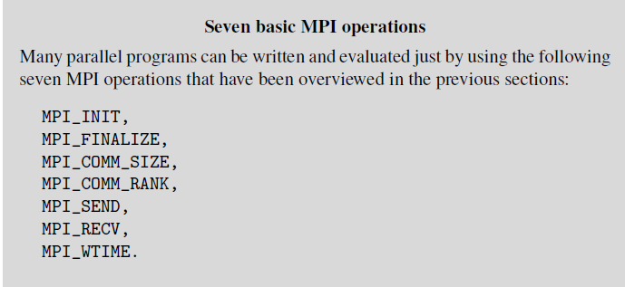

Slide 70
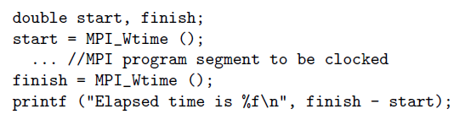
Measuring performances
The elapsed time (wall-clock) between two points in an MPI program can be measured by using operation MPI_WTIME ()

Slide 71
Measuring communication bandwidth
Design a simple MPI program, which will measure the communication channel bandwidth,
i.e. the amount of data transferred in a specified time interval,
using MPI communication operations MPI_SEND and MPI_RECV.
Generate two processes, either on a single computer or on two interconnected computers.
In the first case, the communication channel will be a data-bus that ”connects” the processes through their shared memory,
second case the communication channel will be an Ethernet link between computers.

Slide 72
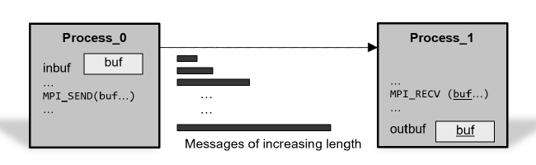
Measuring communication bandwidth

Slide 73
Measuring communication bandwidth
Process with rank = 0 will send a message, with a specified number of doubles, to the process with rank = 1.
The communication time is a sum of the communication start-up time ts and the message transfer time,
i.e. the transfer time per word tw times message length.
With shorter messages the bandwidth will be lower because a significant part of communication time will be spent on setting-up the software and hardware of the message communication channel,
i.e. on the start-up time ts.
With long messages, the data transfer time will dominate
we could expect that the communication bandwidth will approach to a theoretical value of the communication channel.

Slide 74
# include <stdio .h>
# include <stdlib .h>
# include "mpi.h"
# define NUMBER_OF_TESTS 10 // for more reliable average results
int main ( int argc , char * argv [])
{
double *buf ;
int rank , numprocs ;
int n;
double t1 , t2;
int j, k, nloop ;
MPI_Status status ;
MPI_Init (& argc , & argv );
MPI_Comm_size ( MPI_COMM_WORLD , & numprocs );
if ( numprocs != 2) {
printf (" The number of processes must be two !\n");
return (0);
}

Slide 75
MPI_Comm_rank ( MPI_COMM_WORLD , & rank );
if ( rank == 0) {
printf ("\tn\ ttime [sec ]\ tRate [Mb/sec ]\n");
}
for (n = 1; n < 100000000; n *= 2) { // message length doubles
nloop = 1000000 / n;
if ( nloop < 1) nloop = 1; // just a single loop for long messages .
buf = ( double *) malloc (n * sizeof ( double ));
if (! buf ) {
printf (" Could not allocate message buffer of size %d\n", n);
MPI_Abort ( MPI_COMM_WORLD , 1);
}
for (k = 0; k < NUMBER_OF_TESTS ; k++) {
if ( rank == 0) {
t1 = MPI_Wtime ();
for (j = 0; j < nloop ; j ++) {// send message nloop times
MPI_Send (buf , n, MPI_DOUBLE , 1, k, MPI_COMM_WORLD );
}

Slide 76
t2 = ( MPI_Wtime () - t1) / nloop ;
}
else if ( rank == 1) {
for (j = 0; j < nloop ; j ++) {// receive message nloop times
MPI_Recv (buf , n, MPI_DOUBLE , 0, k, MPI_COMM_WORLD , & status );
}
}
}
if ( rank == 0) { // calculate bandwidth
double bandwidth ;
bandwidth = n * sizeof ( double ) *1.0e -6 * 8 / t2; // in Mb/ sec
printf ("\t %10 d\t %10.8 f\t %8.2 f\n", n, t2 , bandwidth );
}
free (buf);
}
MPI_Finalize ();
return 0;
}

Slide 77
Collective MPI communication
MPI collective operations are called by all processes in a communicator.
Typical tasks that can be elegantly implemented in this way are:
global synchronization
reception of a local data item from all cooperating processes in the communicator
etc

Slide 78
MPI_BARRIER (comm)
This operation is used to synchronize the execution of a group of processes specified within the communicator comm.
When a process reach this operation it has to wait until all other processes have reached the MPI_BARRIER.
No process returns from MPI_BARRIER until all processes have called it.
Programmer is responsible that all processes from communicator comm will really call to MPI_BARRIER.

Slide 79
MPI_BARRIER (comm)
Barrier is a simple way of separating two phases of a computation to ensure that messages generated in different phases do not interfere.
MPI_BARRIER is a global operation that invokes all processes therefore it could be time-consuming.
In many cases the call to MPI_BARRIER should be avoided by an appropriate use of explicit addressing options, e.g. tag, source, or comm.

Slide 80
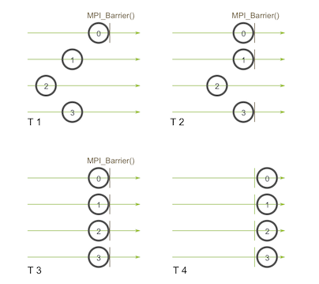
MPI_Barrier(MPI_Comm communicator)

Slide 81
#include "mpi.h"
#include <stdio.h>
int main(int argc, char *argv[])
{
int rank, nprocs;
MPI_Init(&argc,&argv);
MPI_Comm_size(MPI_COMM_WORLD,&nprocs);
MPI_Comm_rank(MPI_COMM_WORLD,&rank);
MPI_Barrier(MPI_COMM_WORLD);
printf("Hello, world. I am %d of %d\n", rank, nprocs);
fflush(stdout);
MPI_Finalize();
return 0;
}

Slide 82
MPI_BCAST (inbuf, incnt, intype, root, comm)
Operation implements a one-to-all broadcast operation
single named process root sends its data to all other processes in the communicator, including to itself.
Each process receives this data from the root process, which can be of any rank.
At the time of call, the input data are located in inbuf of process root and consists of incnt data items of a specified intype.
This implies that the number of data items must be exactly the same at input and output side.
After the call, the data are replicated in inbuf as output data of all remaining processes.
inbuf is used as an input argument at the root process, output argument in all remaining processes, it is of the INOUT type.

Slide 83
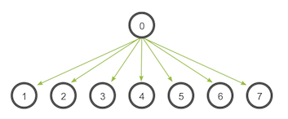
MPI_Bcast( void* data, int count, MPI_Datatype datatype, int root, MPI_Comm communicator)

Slide 84
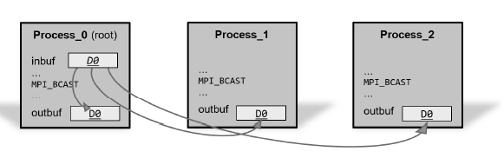
MPI_BCAST (inbuf, incnt, intype, root, comm)

Slide 85
MPI_BCAST (inbuf, incnt, intype, root, comm)
Functionality of MPI_BCAST could be implemented, in the above example,
by three calls to MPI_SEND in the root process
by a single corresponding MPI_RECV call in any process.
Usually, such an implementation will be less efficient than the original MPI_BCAST.
All collective communications could be time consuming.
Their efficiency is strongly related with the topology and performance of interconnection network.

Slide 86
#include <mpi.h>
#include <stdio.h>
int main(int argc, char** argv) {
int rank;
int buf;
const int root=0;
MPI_Init(&argc, &argv);
MPI_Comm_rank(MPI_COMM_WORLD, &rank);
if(rank == root) {
buf = 777;
}
printf("[%d]: Before Bcast, buf is %d\n", rank, buf);
/* everyone calls bcast, data is taken from root and ends up in everyone's buf */
MPI_Bcast(&buf, 1, MPI_INT, root, MPI_COMM_WORLD);
printf("[%d]: After Bcast, buf is %d\n", rank, buf);
MPI_Finalize();
return 0;
}

Slide 87
MPI_GATHER (inbuf, incnt, intype, outbuf, outcnt, outtype, root, comm)
All-to-one collective communication is implemented by MPI_GATHER.
This operation is also called by all processes in the communicator.
Each process, including root process, sends its input data located in inbuf that consists of incnt data items of a specified intype, to the root process, which can be of any rank.
Note, that the communication data can be different in count and type for each process.
However, the root process has to allocate enough space, through its output buffer, that suffices for all expected data.
After the return from MPI_GATHER in all processes, the data are collected in outbuf of the root processes

Slide 88
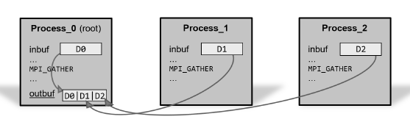
MPI_Gather( void* send_data, int send_count, MPI_Datatype send_datatype, void* recv_data, int recv_count, MPI_Datatype recv_datatype, int root, MPI_Comm communicator)

Slide 89
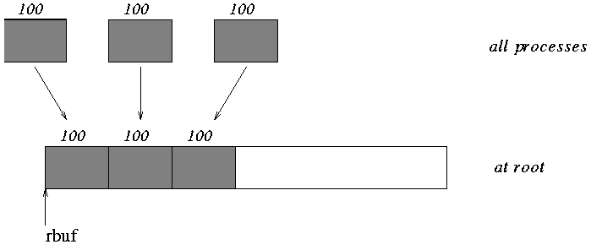
MPI_Comm comm;
int gsize,sendarray[100];
int root, myrank, *rbuf;
...
MPI_Comm_rank( comm, myrank);
if ( myrank == root) {
MPI_Comm_size( comm, &gsize);
rbuf = (int *)malloc(gsize*100*sizeof(int));
}
MPI_Gather( sendarray, 100, MPI_INT, rbuf, 100, MPI_INT, root, comm);

Slide 90
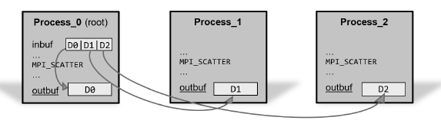
MPI_SCATTER (inbuf, incnt, intype, outbuf, outcnt, outtype, root, comm)
This operation works inverse to MPI_GATHER
i.e. it scatters data from inbuf of process root to outbuf of all remaining processes, including itself.
count outcnt and type outtype of the data in each of the receiver processes are the same, so, data is scattered into equal segments.

Slide 91
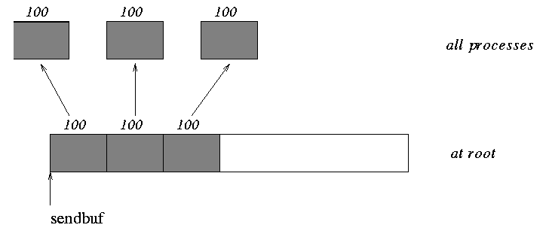
MPI_Comm comm;
int gsize,*sendbuf;
int root, rbuf[100];
...
MPI_Comm_size( comm, &gsize);
sendbuf = (int *)malloc(gsize*100*sizeof(int));
...
MPI_Scatter( sendbuf, 100, MPI_INT, rbuf, 100, MPI_INT, root, comm);

Slide 92
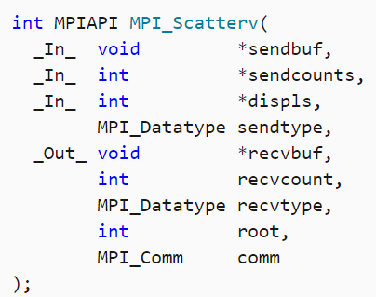
MPI_Scatterv
The MPI_Scatterv function extends the functionality of the MPI_Scatter function by allowing a varying count of data, as specified in the sendcounts array, to be sent to each process.
The specification of counts, types, and displacements should not cause any location on the root to be read more than one time.

Slide 93
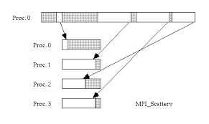
MPI_Scatterv

Slide 94
MPI_Gatherv
MPI_Gatherv extends the functionality of MPI_Gather to permit a varying count of data from each process, and to allow some flexibility in where the gathered data is placed on the root process.
int MPI_Gatherv(const void *sendbuf, int sendcount, MPI_Datatype sendtype, void *recvbuf, const int *recvcounts, const int *displs, MPI_Datatype recvtype, int root, MPI_Comm comm)
Displs - integer array (of length group size).
Entry i specifies the displacement relative to recvbuf at which to place the incoming data from process i (significant only at root)

Slide 95
Collective MPI data manipulations
Instead of just relocating data between processes, MPI provides a set of operations that perform several simple manipulations on the transferred data.
Operations represent a combination of collective communication and computational manipulation in a single call and therefore simplify MPI programs.
Collective MPI operations for data manipulation are based on data reduction paradigm that involves reducing a set of numbers into a smaller set of numbers via a data manipulation.
For example
three pairs of numbers: {5, 1}, {3, 2}, {7, 6}, each representing the local data of a process,
can be reduced in a pair of maximum numbers, i.e. {7, 6}, or in a sum of all pair numbers, i.e. {15, 9}, and in the same way for other reduction operations defined by MPI:

Slide 96
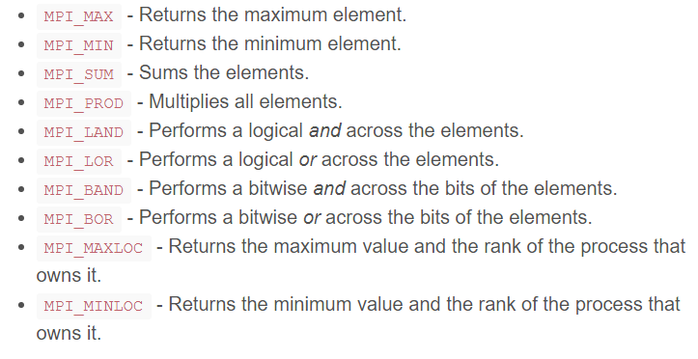
Collective MPI data manipulations

Slide 97
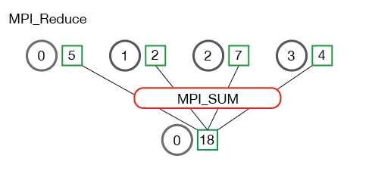

Slide 98
MPI_REDUCE
int MPI_Reduce(const void *sendbuf, void *recvbuf, int count, MPI_Datatype datatype, MPI_Op op, int root, MPI_Comm comm)
sendbuf - address of send buffer
count -number of elements in send buffer
datatype - data type of elements of send buffer
op - reduce operation
root - rank of root process
comm –communicator
recvbuf - address of receive buffer

Slide 99
MPI_REDUCE
MPI_REDUCE operation implements manipulation op on matching data items in input buffer sendbuf from all processes in the communicator comm.
Results of the manipulation are stored in the output buffer recvbuf of process root.
Functionality of MPI_REDUCE is in fact an MPI_GATHER followed by manipulation op in process root.
Reduce operations are implemented on a per-element basis, i.e. i-th elements from each process’ sendbuf are combined into the i-th element in recvbuf of process root.

Slide 100
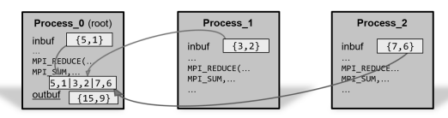
MPI_REDUCE
MPI_REDUCE (inbuf, outbuf, 2, MPI_INT, MPI_SUM, 0, MPI_COMM_WORLD)

Slide 101
MPI_ALLREDUCE
In many parallel calculations, a global problem domain is divided into subdomains that are assigned to corresponding processes.
Often, an algorithm requires that all processes take a decision based on the global data.
For example
iterative calculation can stop when the maximal solution error reaches a specified value.
calculation of maximal subdomain errors
collection of them in a root process, which will evaluate a stopping criteria
broadcast the final result/decision to all processes

Slide 102
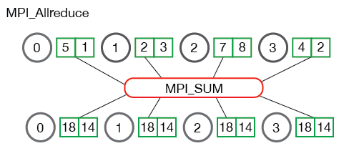
MPI_ALLREDUCE
MPI_Allreduce( void* send_data, void* recv_data, int count, MPI_Datatype datatype, MPI_Op op, MPI_Comm communicator)

Slide 103
Program 4 Scatter & Gather
#include<stdio.h>
#include<stdlib.h>
#include<mpi.h>
int numnodes,myid,mpi_err;
#define mpi_root 0
int main(int argc, char *argv[])
{
int *myray, *send_ray, *recv_ray;
int count;
int size, mysize, i, k,j, total;
mpi_err = MPI_Init(argc,argv);
mpi_err = MPI_Comm_size(MPI_COMM_WORLD, &numnodes);
mpi_err = MPI_Comm_rank(MPI_COMM_WORLD, &myid);
count = 4;

Slide 104
myray = (int*)malloc(count * sizeof(int));
if(myid == mpi_root)
{
size = count * numnodes;
send_ray = (int*)malloc(size * sizeof(int));
recv_ray = (int*)malloc(numnodes * sizeof(int));
for(i = 0 ; i < size ; i++)
{
send_ray[i] = i;
printf("send_ray = %d\n",send_ray[i]);
}
}
mpi_err = MPI_Scatter(send_ray,count,MPI_INT,myray,count,MPI_INT,mpi_root,MPI_COMM_WORLD);
total = 0;
for(i = 0 ; i < count ; i++)
{
total = total + myray[i];
printf("myray = %d\n",myray[i]);
}

Slide 105
printf("myid = %d total = %d\n",myid,total);
mpi_err = MPI_Gather(&total,1,MPI_INT,recv_ray,1,MPI_INT,mpi_root,MPI_COMM_WORLD);
if(myid == mpi_root)
{
total = 0;
for(i = 0; i < numnodes ; i++)
total = total + recv_ray[i];
printf("results from all processors = %d\n",total);
}
mpi_err = MPI_Finalize();
}

Slide 106
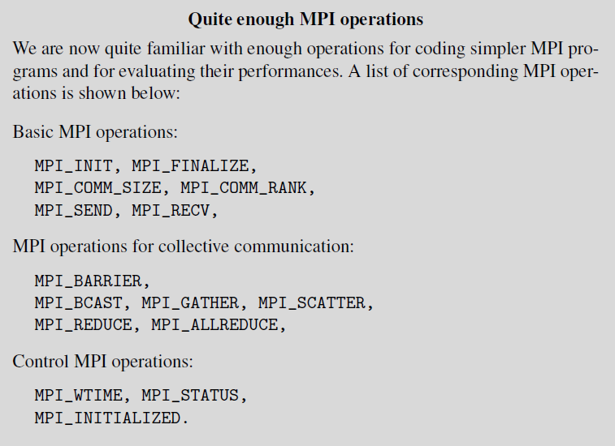

Slide 107
Communication and computation overlap
Contemporary computers have separate communication and calculation resources
Therefore they are able to execute both tasks in parallel
For example, instead of just waiting for a data transmission to be completed, a certain part of calculation could be done that could be eventually required in the next computing step.
If a process can perform useful work while some long communication is in progress, overall execution time might be reduced.
This approach is often termed as a hiding latency.
Various communication modes are available in MPI that enable hiding latency
but they require correct usage to avoid communication deadlock or program shutdown.

Slide 108
Communication modes
MPI processes can communicate in four different communication modes:
standard, buffered, synchronous and ready.
Each of these modes can be performed in blocking or in non-blocking type,
first being less eager to the amount of required memory for message buffering,
second being often more efficient, because of an ability to overlap the communication and computation tasks.

Slide 109
Blocking communication
Standard mode send call, with operation MPI_SEND, should be assumed as a blocking send,
which will not return until the message data and envelope have been safely stored away.
Sender process can access and overwrite the send buffer with a new message.
However, depending on the MPI implementation, short messages might still be buffered while longer messages might be split and sent in shorter fragments, or they might be copied into a temporary communication buffer

Slide 110
Blocking communication
Message buffering requires extra memory space and memory-to-memory copying,
Implementations of MPI libraries do not guarantee the amount of buffering therefore one has always to count on the possibility that send call will not complete until a matching receive has been posted, and the data has been moved to the receiver.
In other words, the standard send call is non-local, i.e. may require execution of an MPI operation in another process.

Slide 111
Blocking communication
According to the MPI standard, a program is correct and portable if it does not rely on system buffering in the standard mode.
Buffering may improve the performance of a correct program, but does not affect the result of the program.
There are three blocking send call modes, indicated by a single-letter prefix:
MPI_BSEND,
MPI_SSEND
MPI_RSEND,
B for buffered, S for synchronous, and R for ready,
The send operation syntax is the same as in the standard send, e.g.
MPI_BSEND (buf, count, datatype, dest, tag, comm).

Slide 112
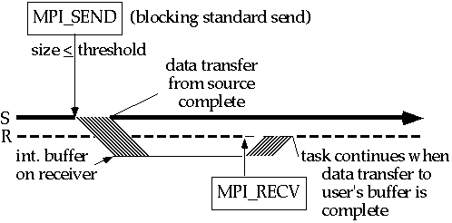

Slide 113
Buffered mode
Buffered mode send is a standard send with a user-supplied message buffering.
It will start independent of a matching receive and can complete before a matching receive is posted.
However, unlike the standard send, this operation is local, i.e. its completion is independent on the matching receive.
Thus, if a buffered send is executed and no matching receive is posted, then the MPI will buffer the outgoing message, to allow the send call to complete.
It is a responsibility of programmer to allocate enough buffer space for all subsequent MPI_BSEND by calling MPI_BUFFER_ATTACH (bbuf, bsize).
Buffer space bbuf cannot be reused by subsequent MPI_BSENDs if they have not been completed by matching MPI_RECVs, therefore it must be large enough to store all subsequent messages.

Slide 114
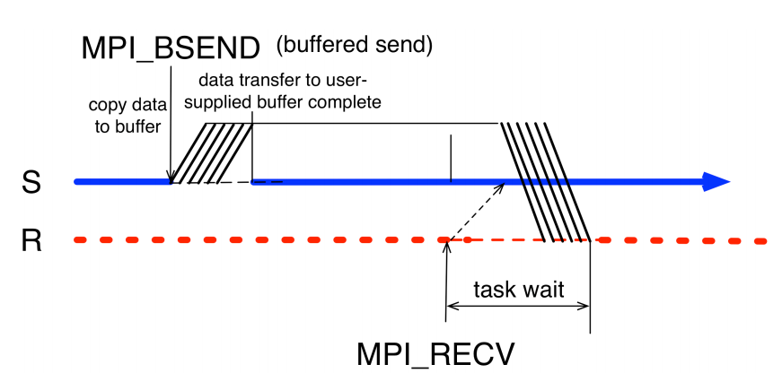

Slide 115
MPI_Bsend
int MPI_Bsend(const void *buf, int count, MPI_Datatype datatype, int dest, int tag, MPI_Comm comm)
buf -initial address of send buffer (choice)
count -number of elements in send buffer (nonnegative integer)
datatype -datatype of each send buffer element (handle)
dest -rank of destination (integer)
tag -message tag (integer)
Comm -communicator (handle)

Slide 116
Synchronous mode
Synchronous mode send can start independently of a matching receive.
However, the send will complete successfully only if a matching receive operation has started to receive the message sent by the synchronous send.
Completion of a synchronous send not only indicates that the send buffer can be reused
but also indicates that the receiver has reached a certain point in its execution, i.e. it has started executing the matching receive.
If both sends and receives are blocking operations then the use of the synchronous mode provides synchronous communication semantics:
Communication does not complete at either end before both processes rendezvous at the communication.
Send executed in this mode is non-local, because its competition requires a cooperation of sender and receiver processes.

Slide 117
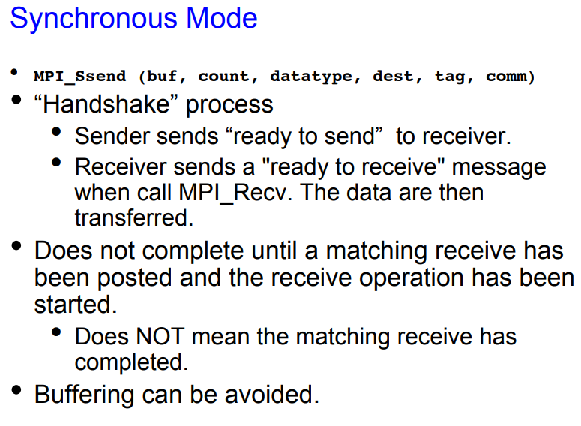

Slide 118
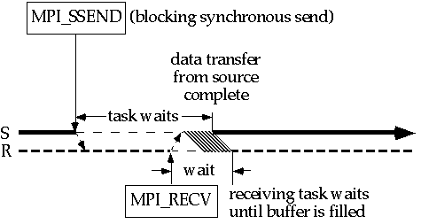

Slide 119
Synchronous mode
System overhead
Transferring the message data from the sender onto the network, and from transferring the message data from the network into the receiver.
Synchronization overhead
The time spent waiting for an event to occur on another task.
The sender must wait for the receive to be executed and for the handshake to arrive before the message can be transferred.

Slide 120
Ready mode
Ready mode send may be started only if the matching receive has been already called.
Otherwise, the operation is erroneous and its outcome is undefined.
On some systems, this allows the removal of a hand-shake operation that is otherwise required, which could result in improved performance.
In a correct program, a ready send can be replaced by a standard send with no effect on the program results, but with eventual improved performances.
The receive call MPI_RECV is always blocking, because it returns only after the receive buffer contains the expected received message.

Slide 121
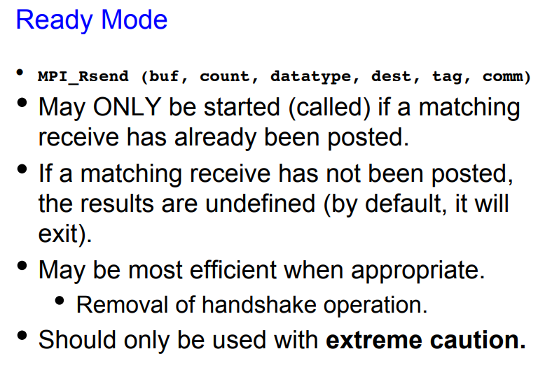

Slide 122
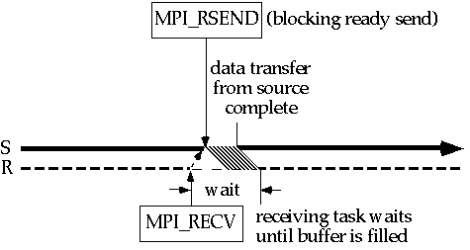

Slide 123
Ready mode
Aims to minimize system overhead and synchronization overhead incurred by the sending task.
In the blocking case, the only wait on the sending node is until all data have been transferred out of the sending task's message buffer.
The receive can still incur substantial synchronization overhead, depending on how much earlier it is executed than the corresponding send.

Slide 124
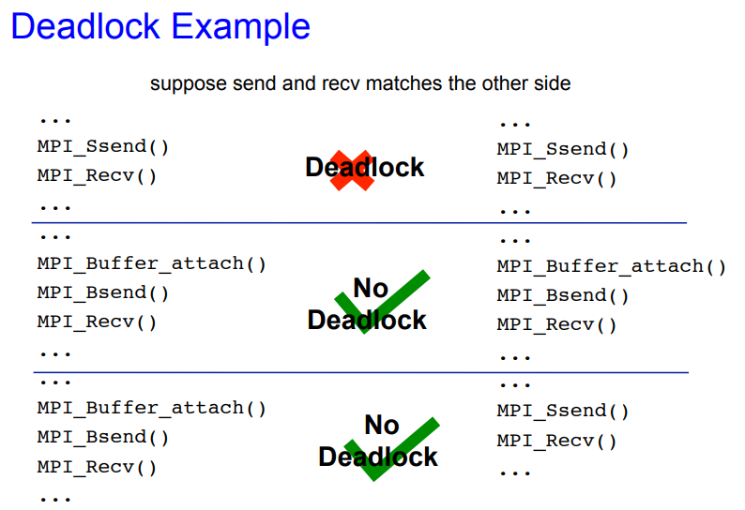

Slide 125
Non-blocking communication
Non-blocking send start calls are denoted by a leading letter I in the name of MPI operation.
They can use the same four modes as blocking sends: standard, buffered, synchronous and ready, i.e. MPI_ISEND, MPI_IBSEND, MPI_ISSEND, MPI_IRSEND.
Sends of all modes, except ready, can be started whether a matching receive has been posted or not;
Non-blocking ready send can be started only if a matching receive is posted.
In all cases, the non-blocking send start call is local, i.e. it returns immediately, irrespective of the status of other processes.
Non-blocking communications return immediately request handles that can be waited on, or queried, by specialized MPI operations that enables to wait or to test for their completion.

Slide 126
Non-blocking communication
The syntax of the non-blocking MPI operations are the same as in the standard communication mode
MPI_ISEND (buf, count, datatype, dest, tag, comm, request)
MPI_IRECV (buf, count, datatype, dest, tag, comm, request),
Additional request handle that is used for later querying by send complete calls
MPI_WAIT (request, status)
MPI_TEST (request, flag, status)

Slide 127
Non-blocking communication
Non-blocking standard send call MPI_ISEND initiates the send operation, but does not complete it, in a sense that it will return before the message is copied out of the send buffer.
later separate call is needed to complete the communication, i.e. to verify that the data has been copied out of the send buffer.
In the meantime, a computation can run concurrently.
In the same way, a non-blocking receive call MPI_IRECV initiates the receive operation, but does not complete it.
The call will return before a message is stored into the receive buffer.
A later separate call is needed to verify that the data has been received into the receive buffer.
While querying about the reception of the complete message, a computation can run concurrently.

Slide 128
Program 3 Non-Blocking Send Receive
#include "mpi.h"
#include <stdio.h>
#include <stdlib.h>
int main (int argc, char *argv[])
{
int numtasks, rank, next, prev, buf[2], tag1=1, tag2=2;
MPI_Request reqs[4];
MPI_Status stats[2];
MPI_Init(&argc,&argv);
MPI_Comm_size(MPI_COMM_WORLD, &numtasks);
MPI_Comm_rank(MPI_COMM_WORLD, &rank);

Slide 129
prev = rank-1;
next = rank+1;
if (rank == 0) prev = numtasks - 1;
if (rank == (numtasks - 1)) next = 0;
MPI_Irecv(&buf[0], 1, MPI_INT, prev, tag1, MPI_COMM_WORLD, &reqs[0]);
MPI_Irecv(&buf[1], 1, MPI_INT, next, tag2, MPI_COMM_WORLD, &reqs[1]);
MPI_Isend(&rank, 1, MPI_INT, prev, tag2, MPI_COMM_WORLD, &reqs[2]);
MPI_Isend(&rank, 1, MPI_INT, next, tag1, MPI_COMM_WORLD, &reqs[3]);
MPI_Waitall(4, reqs, stats);
printf("Task %d communicated with tasks %d & %d\n",rank,prev,next);
MPI_Finalize();
}

Slide 130
Non-blocking communication
Non-blocking send MPI_ISEND immediately followed by send-complete call MPI_WAIT is functionally equivalent to a blocking send MPI_SEND.
One can wait on multiple requests,
e.g. in a master/slave MPI program, where the master waits either for all or for some slaves’ messages, using MPI operations:
MPI_WAITALL (count, array_of_requests, array_of_statuses)
MPI_WAITSOME (incount, array_of_requests, outcount, array_of_indices, array_of_statuses).

Slide 131
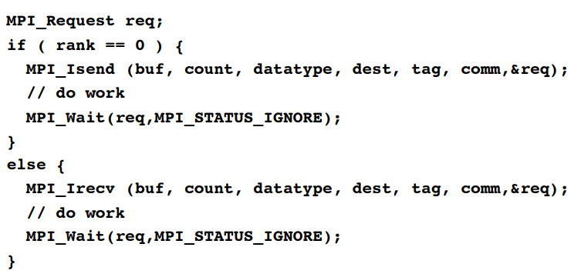
Non-blocking communication
Call returns immediately, which allows for work to be overlapped.
User must ensure that:
Data to be sent is out of the send buffer.
Data to be received has finished arriving.

Slide 132
Non-blocking communication
send-complete call returns when data has been copied out of the send buffer.
if the send mode is synchronous, then the send can complete only if a matching receive has started, i.e. a receive has been posted, and has been matched with the send.
send-complete call is non-local.
Note that a synchronous, non-blocking send may complete, if matched by a non-blocking receive, before the receive complete call occurs.
It can complete as soon as the sender ”knows” that the transfer will complete, but before the receiver ”knows” that the transfer will complete.

Slide 133
Non-blocking communication
If the non-blocking send is in buffered mode then the message must be buffered if there is no pending receive.
In this case, the send-complete call is local, and must succeed irrespective of the status of a matching receive.
If the send mode is standard then the send-complete call may return before a matching receive occurred, if the message is buffered.
On the other hand, the send-complete may not complete until a matching receive occurred, and the message was copied into the receive buffer.
Non-blocking sends can be matched with blocking receives, and vice versa.
Completion of a send operation may be delayed, for a standard mode, and must be delayed, for synchronous mode, until a matching receive is posted.
Use of non-blocking sends in these two cases allows the sender to proceed ahead of the receiver, so that the computation is more tolerant of fluctuations in the speeds of the two processes.

Slide 134
Non-blocking communication
Non-blocking sends in the buffered and ready modes have a more limited impact.
Non-blocking send will return as soon as possible, whereas a blocking send will return after the data has been copied out of the sender memory.
Use of nonblocking sends is advantageous in these cases only if data copying can be concurrent with computation.

Slide 135
Non-blocking communication
Message-passing model implies that a communication is initiated by the sender.
Communication will generally have lower overhead if a receive is already posted when the sender initiates the communication,
e.g. message data can be moved directly into the receive buffer, and there is no need to queue a pending send request.
Receive operation can complete only after the matching send has occurred.
Use of non-blocking receives allows one to achieve lower communication overheads without blocking the receiver while it waits for the send.

Slide 136
Sources of deadlocks
if (rank == 0) {
MPI_Recv (rec_buf, count, MPI_BYTE, 1, tag, comm, &status);
MPI_Send (send_buf, count, MPI_BYTE, 1, tag, comm);
}
if (rank == 1) {
MPI_Recv (rec_buf, count, MPI_BYTE, 0, tag, comm, &status);
MPI_Send (send_buf, count, MPI_BYTE, 0, tag, comm);
}

Slide 137
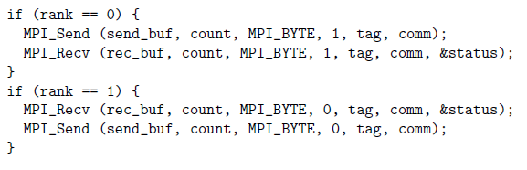
Sources of deadlocks

Slide 138
Sources of deadlocks
An alternative approach is to supply receive buffer in the same time as the send buffer, which can be done by operation MPI_SENDRECV.
If we replace the MPI_RECV and MPI_SEND pair by MPI_SENDRECV
in both processes, the deadlock is not possible, because four buffers will prevent eventual mutual waiting.
Next possibility is to use a pair of non-blocking operations MPI_IRECV, MPI_ISEND in each process, with subsequent waiting in both processes to both requests by MPI_WAITALL:
Finally, non-blocking buffered send can be used MPI_BSEND with explicit allocation of separate send buffers by MPI_BUFFER_ATTACH

Slide 139
Sources of deadlocks
...
MPI_Request requests[2]
...
if (rank == 0) {
MPI_Irecv (rec_buf,count,MPI_BYTE,1,tag,comm,&requests[0]);
MPI_Isend(send_buf,count,MPI_BYTE,1,tag,comm,&requests[1]);
}
else if (rank == 1) {
MPI_Irecv (rec_buf,count,MPI_BYTE,0,tag,comm,&requests[0]);
MPI_Isend(send_buf,count,MPI_BYTE,0,tag,comm,&requests[1]);
}
MPI_Waitall (2, request, MPI_STATUSES_IGNORE);

Slide 140
Hiding latency
In situations where a significant calculation work follows a send of a large message, and it does not interfere with the send buffer
it might be more efficient to use non-blocking send.
Calculation work following the send operation can start almost immediately after the send process is initiated, and can continue to run while the send operation is pending.
Similarly, a non-blocking receive could be more efficient than its blocking counter-part if work following the receive operation does not depend on the received message.

Slide 141
Hiding latency
In some MPI programs, communication and calculation tasks can run concurrently, and consequently, can speed-up the program execution.
Suppose that a master process have to receive large messages from all slaves.
Then, all processes have to do an extensive calculation that is independent of data in the messages.
If blocking communication is used, the execution time will be a sum of communication and calculation time.
If asynchronous, non-blocking communication is used, a part of communication and calculation tasks could overlap, which could result in a shorter execution time.

Slide 142
Hiding latency
One way to implement the above task is to start a master process that will receiving messages from all slave processes, and then proceed with its calculation work.
The slave processes will send their messages and then start to calculate.
The program runs until all communication and calculation is done.

Slide 143
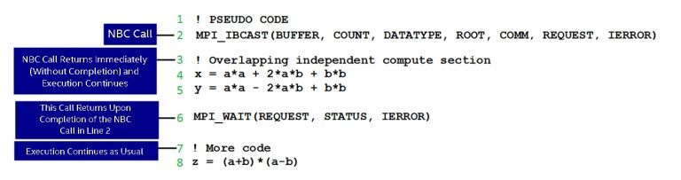

Slide 144
Some subsidiary features of message-passing
MPI communication model is by default non-deterministic.
Arrival order of messages sent from two processes, A and B, to a third process, C, is not known in advance.
MPI communication is unfair.
No matter how long a send process has been pending, it can always be overtaken by a message sent from another sender process.
For example, if process A sends a message to process C, which executes a matching receive operation, and process B sends a competing message that also matches the receive operation in process C, only one of the sends will complete.
It is the programmer’s responsibility to prevent "starvation" by ensuring that a computation is deterministic, e.g. by forcing a reception of specific number of messages from all competing processes.

Slide 145
Some subsidiary features of message-passing
MPI communication is non-overtaking.
If a sender process posts successive messages to a receiver process, and a receive operation matches all messages, the messages will be managed in the order as they were sent, i.e. the first sent message will be received first, etc.
Similarly, if a receiver process posts successive receives, and all match the same message, then the messages will be received in the same order as they have been sent.

Slide 146
Some subsidiary features of message-passing
If an MPI process is multi-threaded, then the semantics of thread execution may not define a relative order between send operations from distinct program threads.
In the case of multi-threaded MPI processes, the messages sent from different threads can be received in an arbitrary order.
Same is valid also for multi-threaded receive operations, i.e. successively sent messages will be received in an arbitrary order.

Slide 147
Fairness and overtaking of MPI communication
Master process is ready to receive 10*(size-1) messages
Slave processes want to send 10 messages to the master process, each with a larger tag.
Master process lists all received messages with their source process ranks and their tags.

Slide 148
# include "mpi.h"
# include <stdio .h>
int main ( int argc , char ** argv )
{
int rank , size , i, buf [1];
MPI_Status status ;
MPI_Init (& argc , & argv );
MPI_Comm_rank ( MPI_COMM_WORLD , & rank );
MPI_Comm_size ( MPI_COMM_WORLD , & size );
if ( rank == 0) {
for (i = 0; i < 10*( size -1) ; i++) {
MPI_Recv (buf , 1, MPI_INT , MPI_ANY_SOURCE ,
MPI_ANY_TAG , MPI_COMM_WORLD , & status );
printf (" Msg from %d with tag %d\n",
status . MPI_SOURCE , status . MPI_TAG );
}
}
else { // rank > 0
for (i = 0; i < 10; i++)
MPI_Send (buf , 1, MPI_INT , 0, i, MPI_COMM_WORLD );
}
MPI_Finalize ();
return 0;
}

Slide 149
MPI communicators
Default communicator MPI_COMM_WORLD
which incorporates all processes involved and defines a default context.
More complex parallel programs usually need more process groups and contexts to implement various forms of sequential or parallel decomposition of a program.
MPI library supports modular programming via its communicator mechanism that provides the ”information hiding” and ”local name space”, which are both needed in modular programs.

Slide 150
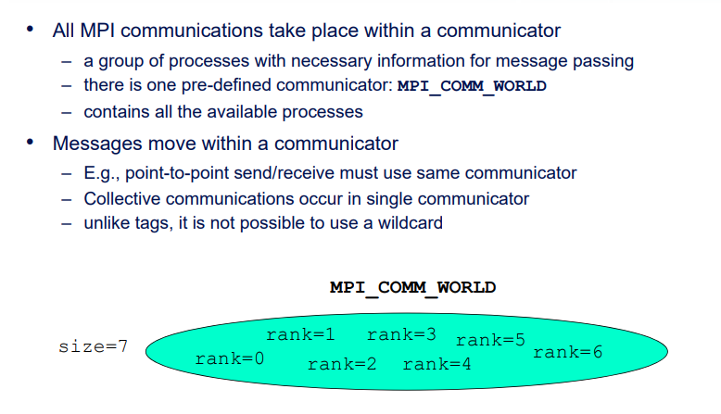
MPI communicators

Slide 151
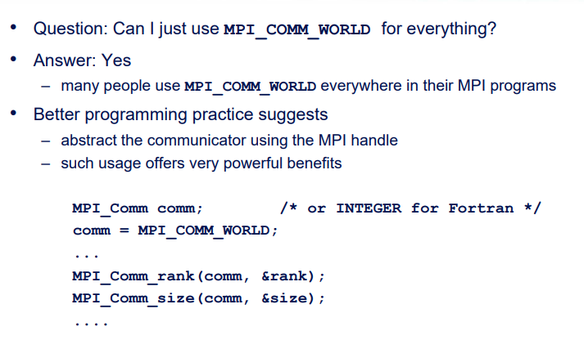
MPI communicators

Slide 152
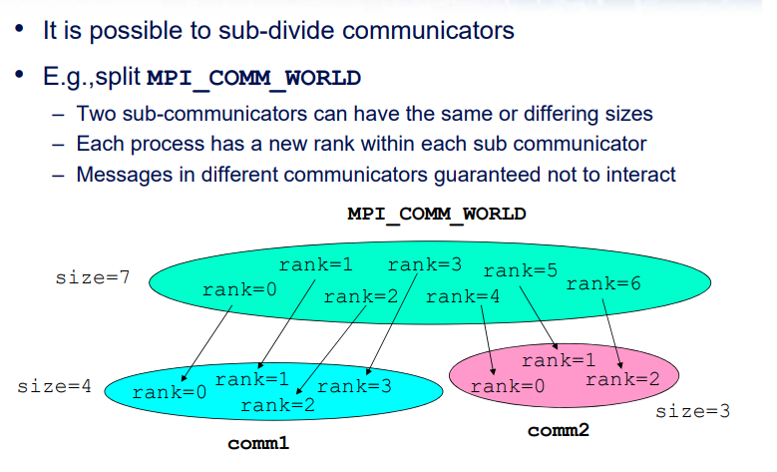
MPI communicators

Slide 153
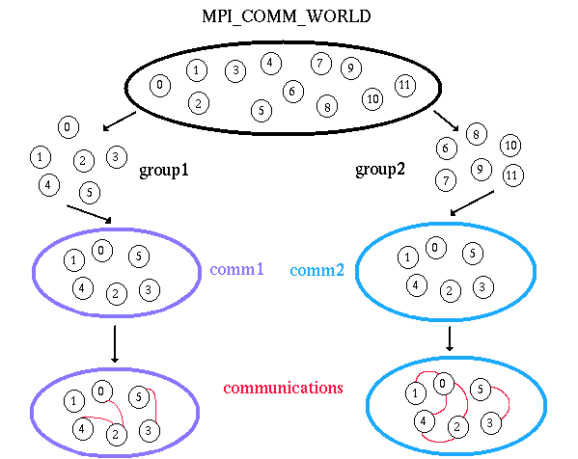

Slide 154
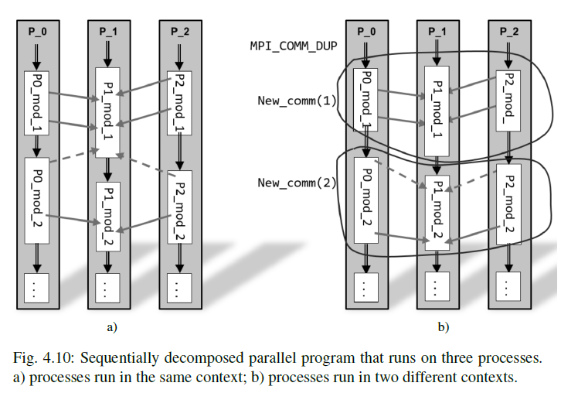

Slide 155
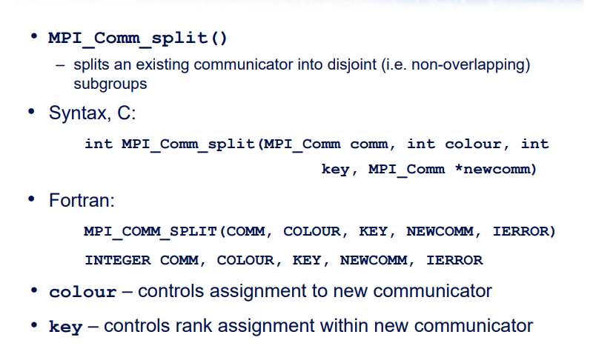
MPI_Comm_Split

Slide 156
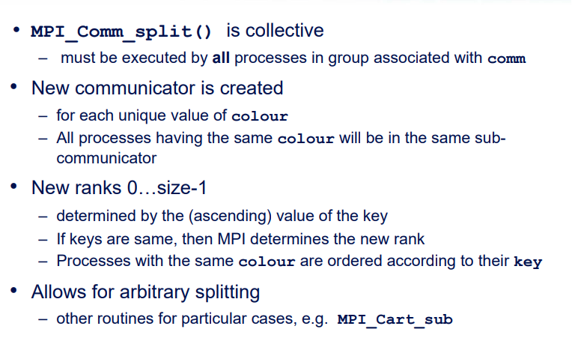
MPI_Comm_Split

Slide 157
Example
MPI_Comm comm, newcomm;
int colour, rank, size;
comm = MPI_COMM_WORLD;
MPI_Comm_rank(comm, &rank);
/* Set colour depending on rank: Even numbered ranks have
colour = 0, odd have colour = 1 */
colour = rank%2;
MPI_Comm_split(comm, colour, rank, &newcomm);
MPI_Comm_size (newcomm, &size);
MPI_Comm_rank (newcomm, &rank);

Slide 158
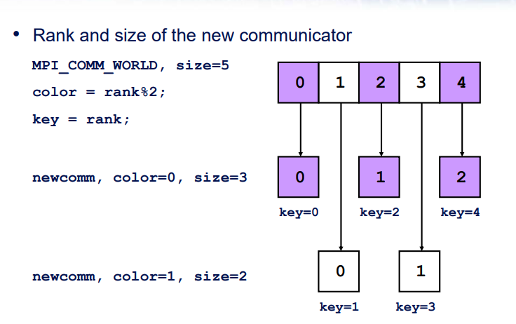
Example

Slide 159
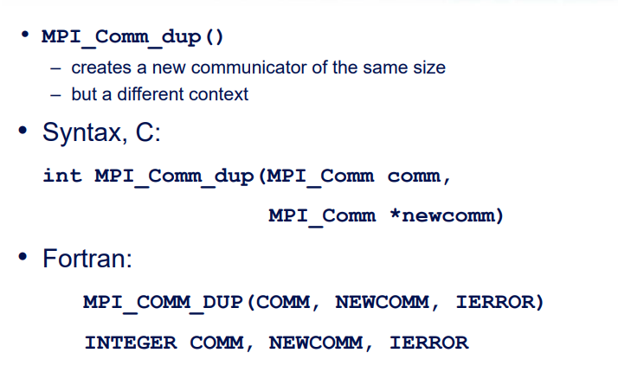
Duplicating Communicator

Slide 160
Duplicating Communicator
MPI_Comm_dup(): duplicate communicator
Same group of processes, but different communication context
Communications sent using duplicated comm cannot be received with original comm.
Used for writing parallel libraries; will not interfere with user’s communications
Collective routine; All processes must call same function

Slide 161
Communicators
Every call to MPI_COMM_DUP or MPI_COMM_SPLIT should be followed by a call to MPI_COMM_FREE, which deallocates a communicator that can be reused later
Dedicated MPI operations can
create groups in a communicator by MPI_COMM_GROUP
obtain a group size of a calling process by MPI_GROUP_SIZE,
perform set operations between groups, e.g. union by MPI_GROUP_UNION, etc
create a new communicator from the existing group by MPI_COMM_CREATE_GROUP.

Slide 162
How effective are your MPI programs?
First two stages the sequential problem is decomposed into, as small as possible
tasks and the required communication among the tasks is identified.
The available parallel execution platform is ignored for these two phases, because the aim is a maximal decomposition,
Third and fourth stages respect the ability of targeted parallel computer.
The identified fine-grained tasks have to be agglomerated to improve performance and to reduce development costs.
Last stage is devoted to the mapping of tasks on real computers, taking into account locality of communication and balancing of calculation load.

Slide 163
How effective are your MPI programs?
Developed parallel program speed-up, and consequently, its efficiency, and scalability, depend mainly on the following three issues:
balancing of computing and communication loads among processes,
ratio between computing and communication, and
computer architecture.
Further improvements in the parallelization efficiency could be obtained by an overlapping of calculation with communication,

Slide 164
Write a MPI program to find factorial of a number using Broadcast and Reduce operation.
Write a MPI program to find word count of a file using Scatter and
gather approach.

Slide 165
Thankyou

