Slide 1
Stream and Complex Event Processing in the Big Data Era - Project
Lorenzo Pratissoli

Slide 2
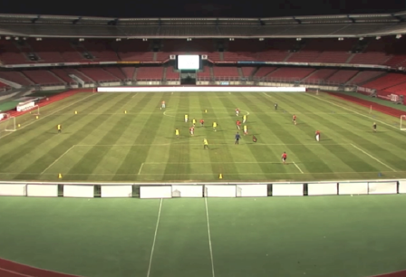


System Architecture
Game Simulator
Pub/sub
message queue
Stream processing
framework
Queries
Results

Slide 3
Outline
Game simulation / Data preprocessing & analysis
Stream processing in Flink
Checking queries results
Performance

Slide 4
Game simulator
Kafka producer script
Produces sensor events from Debs2013 Grand Challenge data
Can operate either in “fast” or “real-time” mode

Slide 5
Game data
Data is split in first and second half
Each half is enriched with game interruption events
Game simulation happens on either the first or the second half

Slide 6
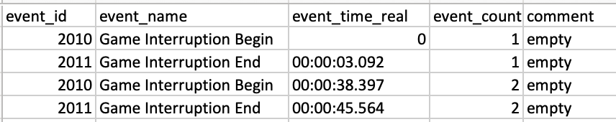
Data preprocessing and analysis
How to add game interruptions(example for first half)
First half starts at timestamp 10753295594424116
table
First interruption is added at 38.397 - 3.092 after the start of the game
Actually by looking at the data(and the video) 10753295594424116 does not correspond to the start of the game
At 10753295594424116 game is already started
Estimated the delay to be around 0.9885 seconds
Notes:
same for second half

Slide 7
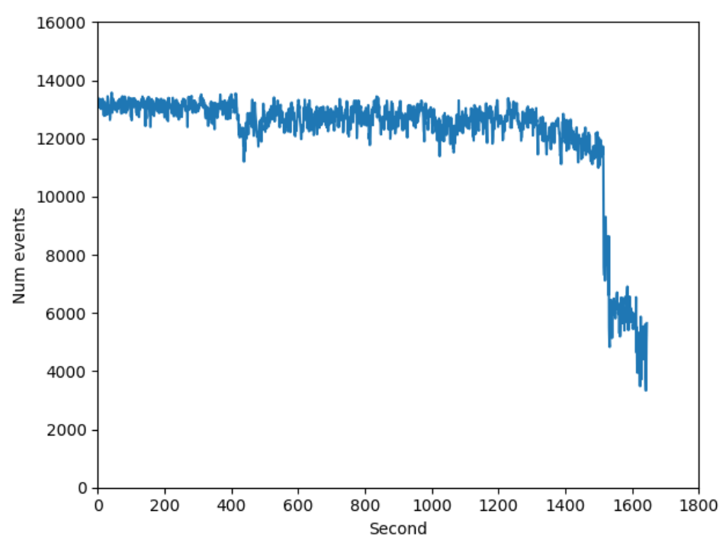
Data preprocessing and analysis
First half
13k/s → ~1.04 Mb/s
Given 80 byte per event

Slide 8
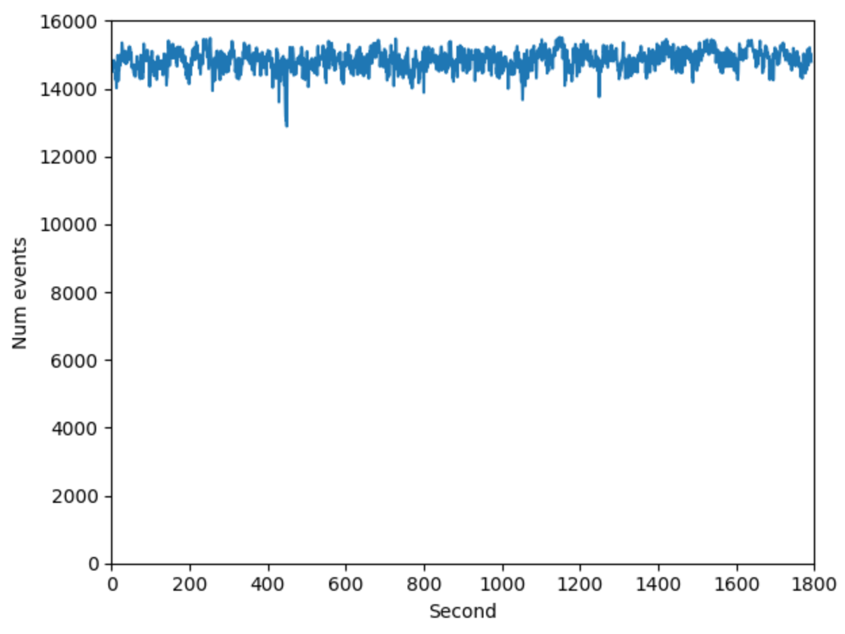
Data preprocessing and analysis
Second half
15k/s → ~1.2 Mb/s
Given 80 byte per event

Slide 9
Game data simulation
For “real-time” simulation a kafka producer able to produce at-least 16k events(of 80 byte each) per second is needed

Slide 10
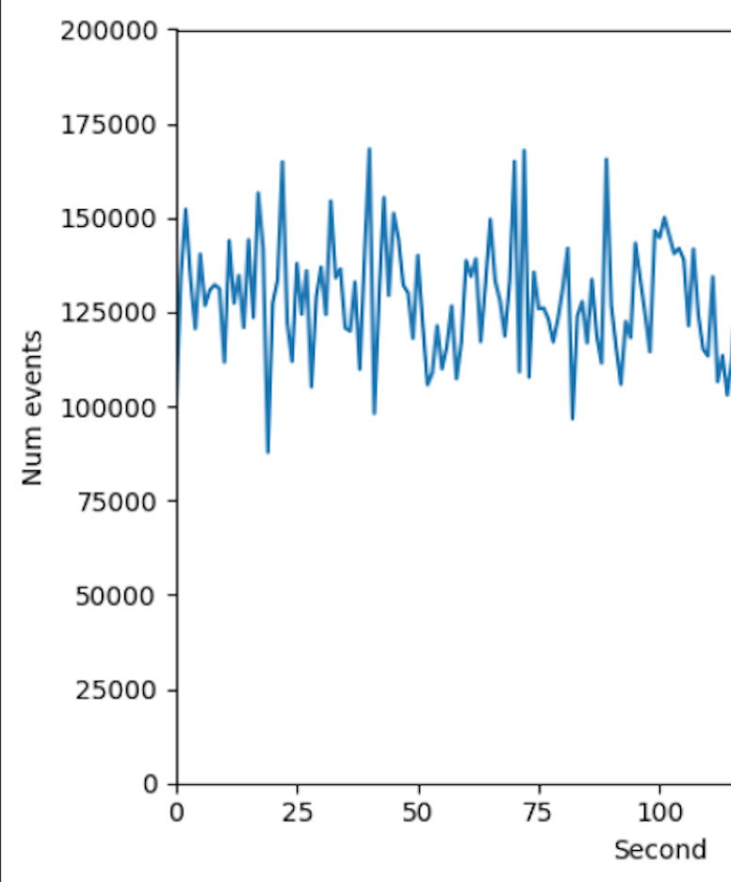
Game data simulation
Macbook Pro mid 2014
2,6 GHz Intel Core i5, dual core
Kafka 2.12-2.2.0
Single broker, one partition
Using confluent-kafka-python
Event size is 80 byte

Slide 11
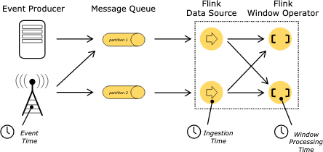
Stream processing in Flink
Event time
the time that each individual event occurred on its producing device(game sensors)
Embedded in the sensor data(sensor event timestamp)
Data dictates the progress in time through watermarks
Notes:
late events

Slide 12
Flink Job Execution Graph
Ball Possession
Checker
Sink
Kafka Source
Raw Event
Map
Unused Data
Filter
Enriched Event
FlatMap
Shot on Goal Checker
Sink

Slide 13
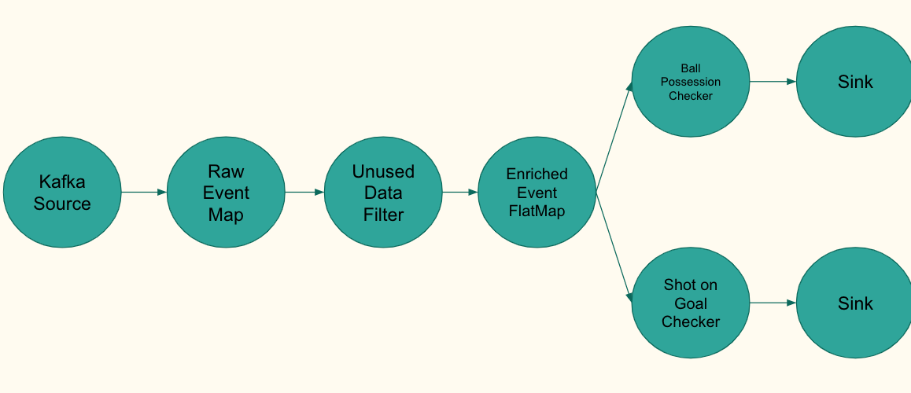
KafkaSource
Using built-in FlinkKafka consumer

Slide 14
RawEventMap
Map function
Simply takes sensor data and preprocesses it
For example millimeter to meter conversion

Slide 15
UnusedData
Filter
Filter function
Filters unused data like referee sensor events
Could be put before the RawEventMap

Slide 16
EnrichedEvent
FlatMap
FlatMap function
Stateful operator
Keeps as state the last ball event and the game status(interrupted or not)
Sends downstream at player sensor frequency an EnrichedEvent
EnrichedEvent → PlayerSensorEvent + BallState + GameState

Slide 17
BallPossession
Checker
FlatMap function
Stateful operator
Implements Query 1: Ball Possession
Logic is similar to the one presented in the Debs2013 finite state machine
Constant time complexity
Can produce results in either Standard mode(with timestamps in picoseconds) or in OracleLike mode(time with respect to the video of the game)

Slide 18
ShotOnGoal
Checker
FlatMap function
Stateful operator
Implements Query 2: Shot on Goal
Can produce results in either Standard mode or in OracleLike mode

Slide 19
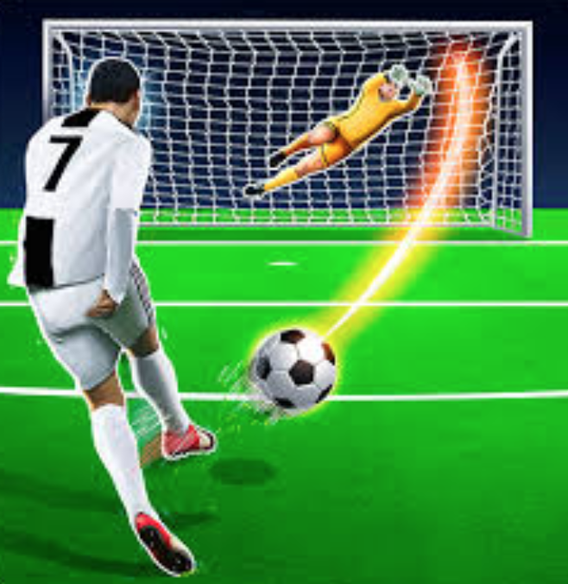
ShotOnGoalChecker
Each soccer goal is a rectangular parallelepiped
Shot on goal is detected if the ball following its estimated trajectory will be in a point inside the parallelepiped within IntervalTime seconds
Ball positions along the trajectory are sampled every SamplingTime seconds
Time complexity: O(IntervalTime / SamplingTime)
IntervalTime = 1.6s
SamplingTime = 0.01s

Slide 20
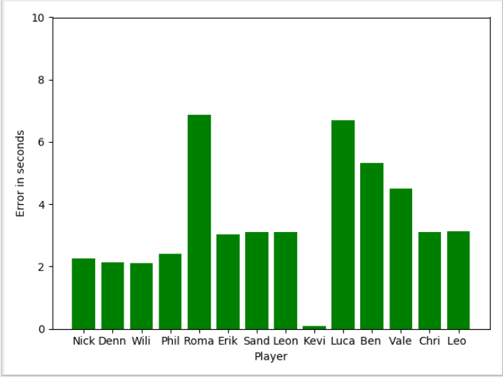
Checking Queries Results - Ball Possession
First half example plot of possession time “““error”””
Gives an initial idea

Slide 21
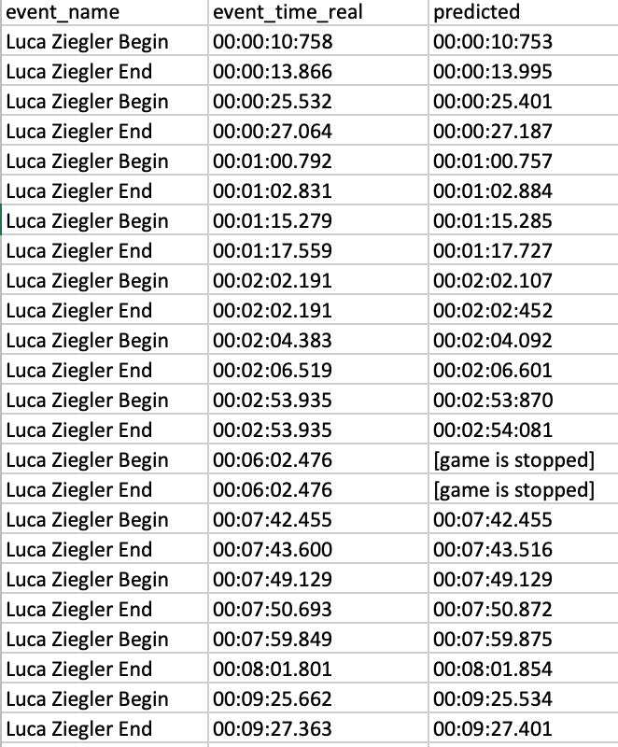
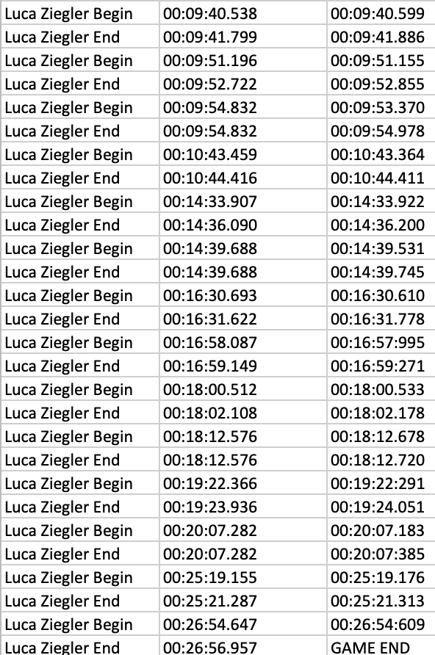
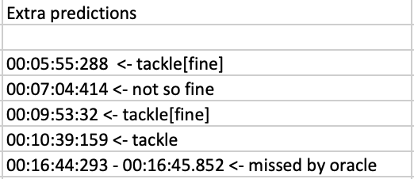
Checking Queries Results - Ball Possession
A closer look on Luca Ziegler (predictions in OracleLike time)
Notes:
same results for second half

Slide 22
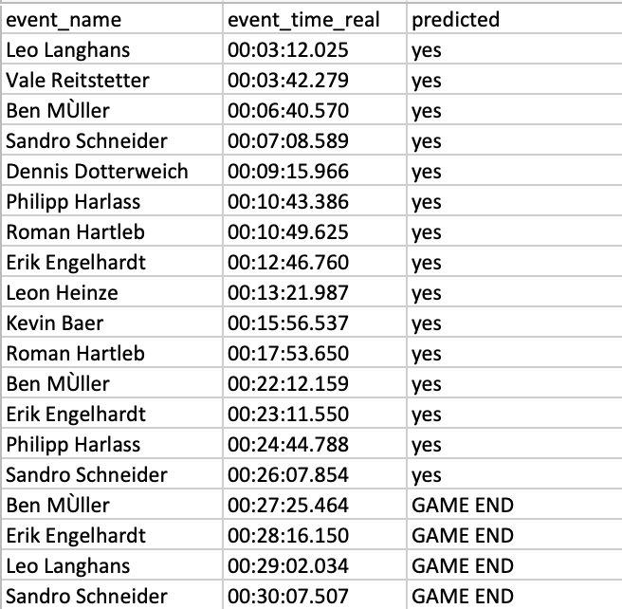
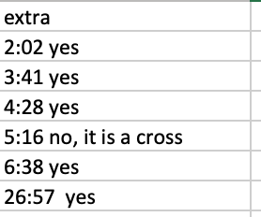
Checking Queries Results - Shot on Goal
First half example
Notes:
same results for second half

Slide 23
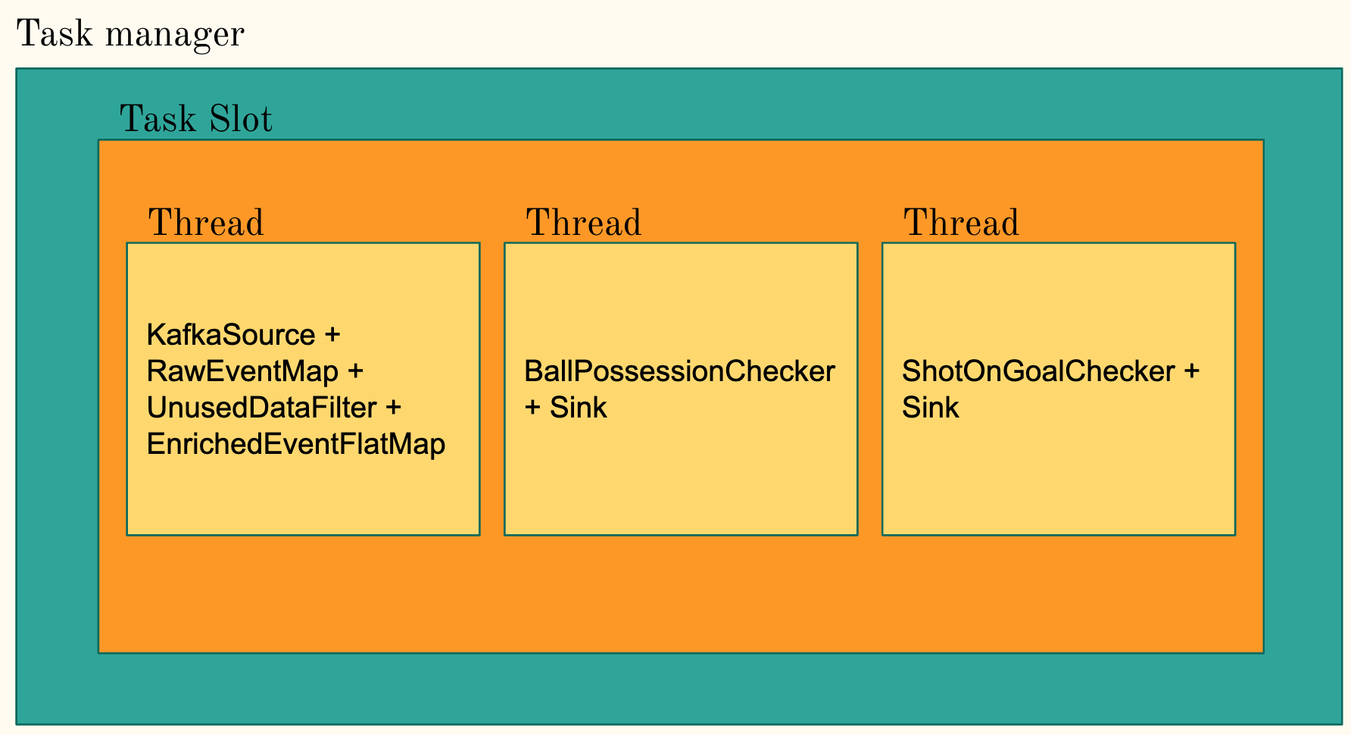
Execution model
Operator chaining to mainly reduce communication costs
Parallelism is one
With hyper-threading, each slot takes 2 or more hardware thread contexts

Slide 24
Measuring Performance
Macbook Pro mid 2014
2,6 GHz Intel Core i5, dual core
Game simulator
Python 3.6.8
confluent-kafka-python 1.0.1
Kafka
Kafka 2.12-2.2.0
Single broker, one partition
Flink
Apache Flink 1.8
Scala 2.11.12
Checkpointing disabled

Slide 25
Measuring Performance
Throughput
Built-in numRecordsPerSecond metrics
Meter
Latency
Built-in latency tracking
When measuring throughput latency tracking is off as it significantly impacts the performance

Slide 26
Measuring Performance - First Half “Real Time”
~6k/s
Ball Possession
Checker
Sink
End-to-end latency ~43 ms
~6k/s
Kafka Source
Raw Event
Map
Unused Data
Filter
Enriched Event
FlatMap
~13k/s
~1.04 Mb/s (80 byte per event)
~12k/s
~6k/s
~6k/s
Shot on Goal Checker
Sink
Notes:
throughput in num events != throughput in mb !
input = output is misleading
ok we can process in real-time

Slide 27
Measuring Performance - Second Half “Real Time”
~6k/s
Ball Possession
Checker
Sink
End-to-end latency ~38 ms
~6k/s
Kafka Source
Raw Event
Map
Unused Data
Filter
Enriched Event
FlatMap
~15k/s
~1.2 Mb/s (80 byte per event)
~14k/s
~6k/s
~6k/s
Shot on Goal Checker
Sink
Notes:
throughput in num events != throughput in mb !
input = output is misleading

Slide 28
Measuring Performance - First/Second Half “Fast”
~83k/s
Ball Possession
Checker
Sink
End-to-end latency ~10 ms
~112k/s
Kafka Source
Raw Event
Map
Unused Data
Filter
Enriched Event
FlatMap
~240k/s
~19.2Mb/s (80 byte per event)
~225k/s
~83k/s
~112k/s
Shot on Goal Checker
Sink
Notes:
throughput in num events != throughput in mb !

Slide 29
Measuring Performance - Difference in Latency
Instead of sending each record one-by-one, Flink buffers a bunch of records into its network buffers and sends them altogether
This reduces the costs per record and leads to higher throughput
By reducing the timeout of sending an incompletely filled buffer, you may sacrifice throughput for latency
env.setBufferTimeout(...)
[Source: https://flink.apache.org/2019/06/05/flink-network-stack.html]

Slide 30
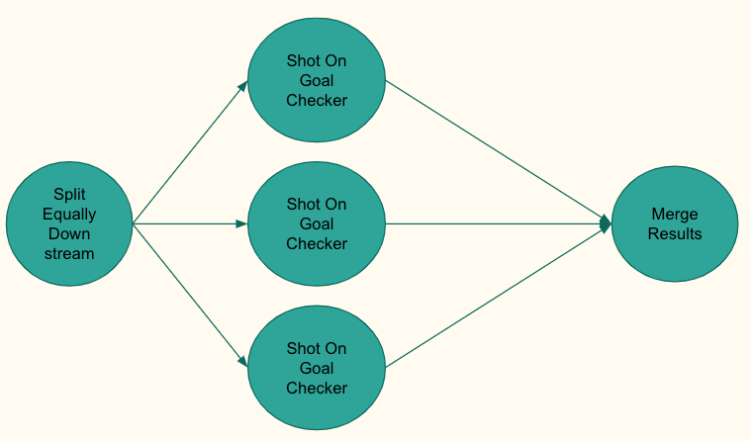
Scale Up - Exploiting Parallelism
Example - Trajectory computation for Shot on Goal (parallelism=3)
Event ordering is lost on merge
Time window is needed to aggregate events and sort them before processing
Worse performance

Slide 31
Scale Up - Exploiting Parallelism
Let’s say the split-merge above improves performance
Sooner or later the bottleneck will be the single kafka consumer
Events read per second(assuming 80 byte per event) is capped at around ~300k on my machine
Assume to have a sensor system producing 300k+ events per second
It is necessary to produce in parallel on multiple kafka partition with different kafka producers
It is necessary to read in parallel multiple kafka partitions with different kafka consumers
Notes:
easy with flink-kafka consumer
not so easy to organize the processing graph in a performant way, given the task which is not inherently parallel, while maintaining a real-time analysis

Slide 32
Scale Up - Other Improvements
Work in place
Mutable data structures

Slide 33
Demo
wifi off

Slide 34
Thank you for your attention!

