Slide 1



Capstone Project – Level 2
Cloud native Personal Blog using WordPress on AWS
Infrastructure as Code with Terraform
13 February 2026
Notes:
1.7.2013
1
‹#›

Slide 2

Project Introduction & Goals
Develop a personal portfolio and blog site using WordPress with a MySQL backend
Automate deployment on AWS using Terraform to ensure reproducibility and scalability
Design a secure, modular and scalable architecture across network, compute and database layers
Enable self‑directed learning and ownership of DevOps processes
Deliver a fully functional site with custom blog posts and author page
[1][2][3]
Notes:
1.7.2013
2
‹#›

Slide 3
Project Levels
Level | Key Components
Level 1 | EC2 Web server, VPC with public & private subnets, local MySQL
Level 2 | Adds RDS in a private subnet and adjusts scripts for remote DB
[4][5][6]
Notes:
1.7.2013
3
‹#›

Slide 4
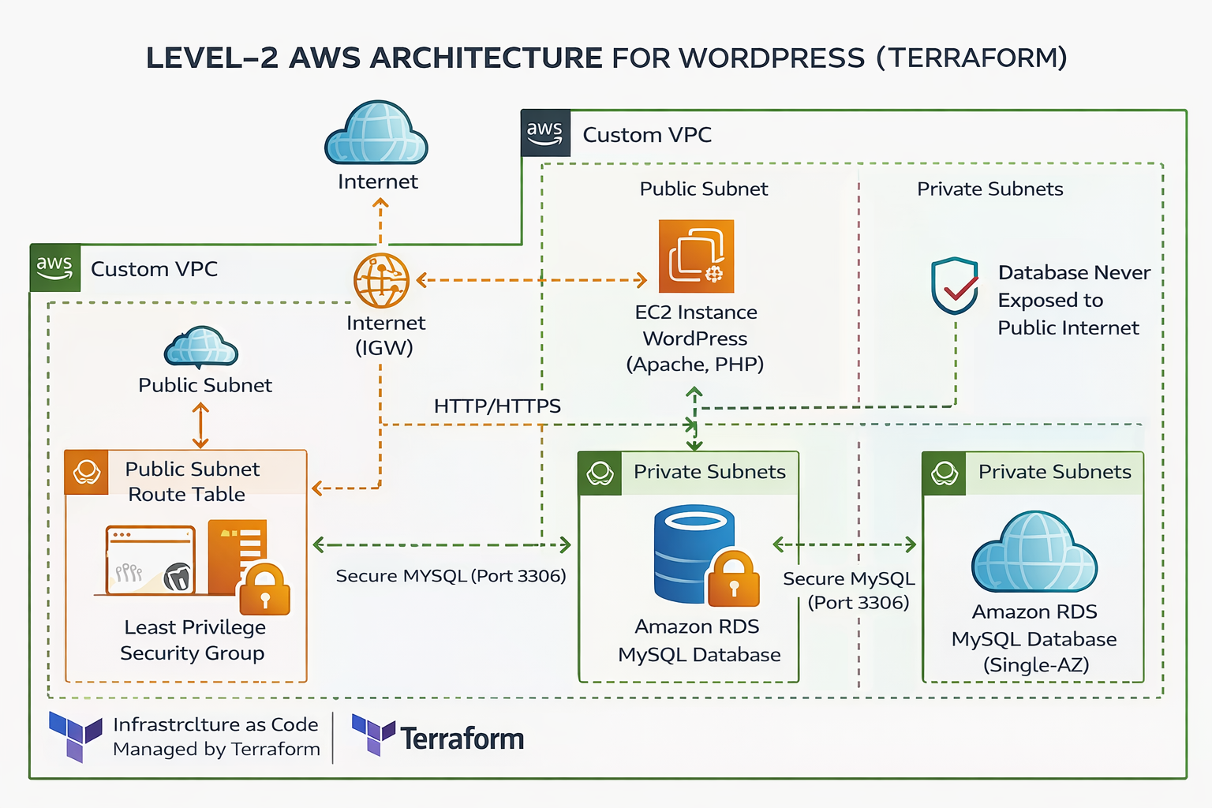
Level-2 Enterprise Architecture Overview
Notes:
1.7.2013
7
‹#›

Slide 5
Key Architectural Highlights – Level 2
Two-tier architecture separating application and database layers
EC2 (WordPress) deployed in Public Subnet with controlled HTTP/HTTPS access
Amazon RDS (MySQL) deployed in Private Subnets – no public exposure
Security Groups enforce least-privilege network rules (Port 3306 only from EC2)
Custom VPC with route tables and Internet Gateway for controlled traffic flow
Infrastructure fully provisioned and version-controlled using Terraform
Security Group Configuration (Project Specific)
Web-SG: Allows HTTP (80) and HTTPS (443) from 0.0.0.0/0
SSH access restricted (admin-controlled access only)
DB-SG: Allows MySQL (3306) traffic ONLY from Web-SG
No public inbound rules configured on RDS
Implements principle of least privilege network security
Notes:
1.7.2013
9
‹#›

Slide 6
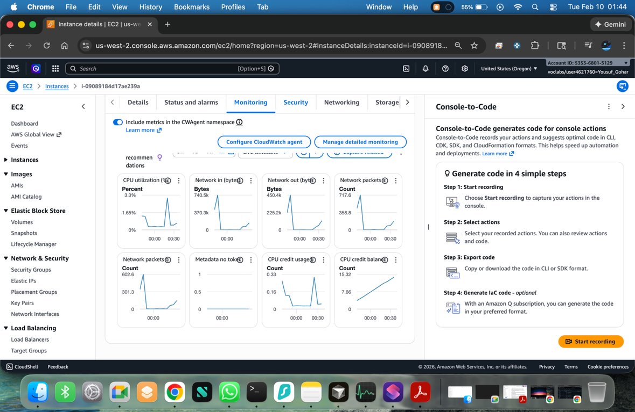
Instance Load & Monitoring
CPU utilization remains low (< 3%) indicating efficient use of compute resources.
Network In/Out metrics show traffic spikes corresponding to user activity.
Network packets per second reflect moderate load on the instance.
CloudWatch graphs confirm health of the WordPress application in real time.

Slide 7
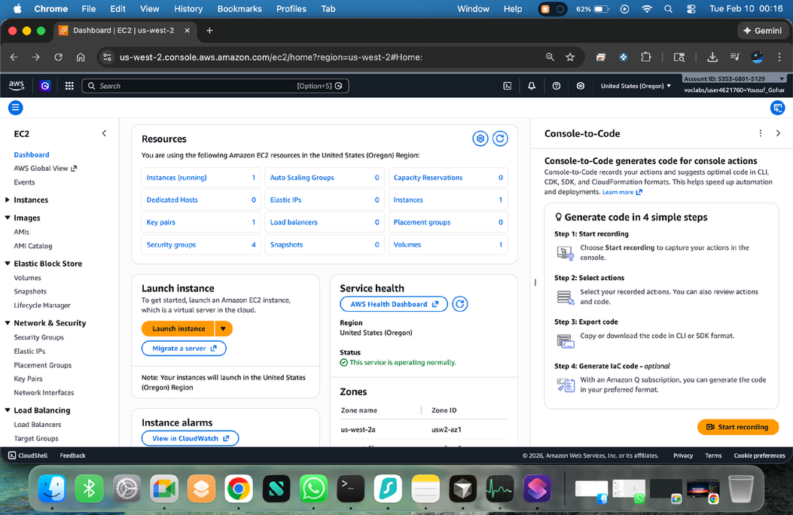
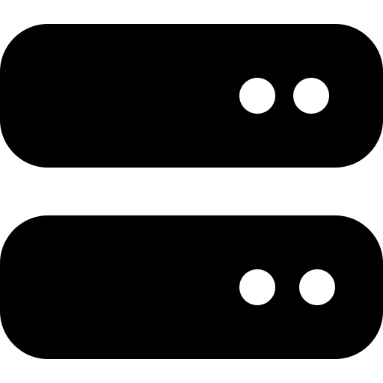

Compute & Application
Amazon Linux 2 EC2
Instances host the WordPress application and PHP stack.
Bootstrapped via user data to install Apache, PHP and WordPress.
Connects securely to RDS using private endpoints.
Compute
User Data
[9]
Notes:
1.7.2013
5
‹#›

Slide 8





Infrastructure as Code
Modular Project Structure
• network, security, compute, rds modules
• main.tf orchestrates modules and providers
• userdata.sh bootstraps WordPress on EC2
Clone
Configure
Init
Plan
Apply
[10][11][12]
Notes:
1.7.2013
6
‹#›

Slide 9
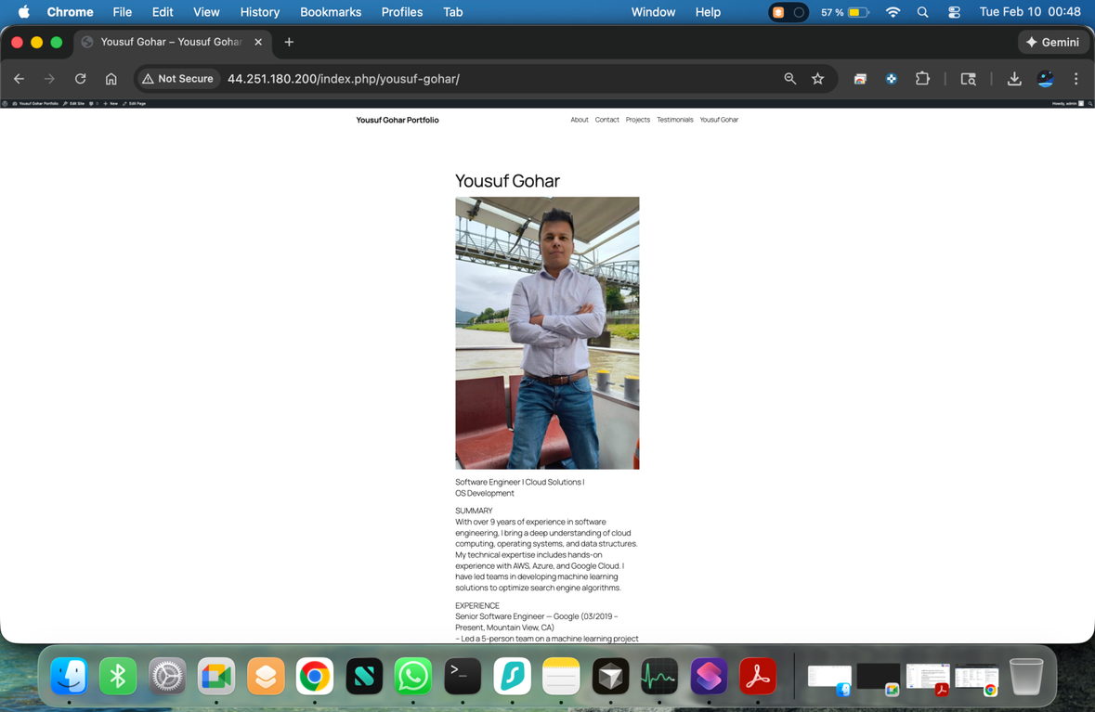
Author Profile Page (Live)
Showcases the personal portfolio page served from the live WordPress site.
Features a profile picture and a detailed bio summarizing experience and skills.
Demonstrates dynamic content rendering and user-focused pages in the deployment.

Slide 10
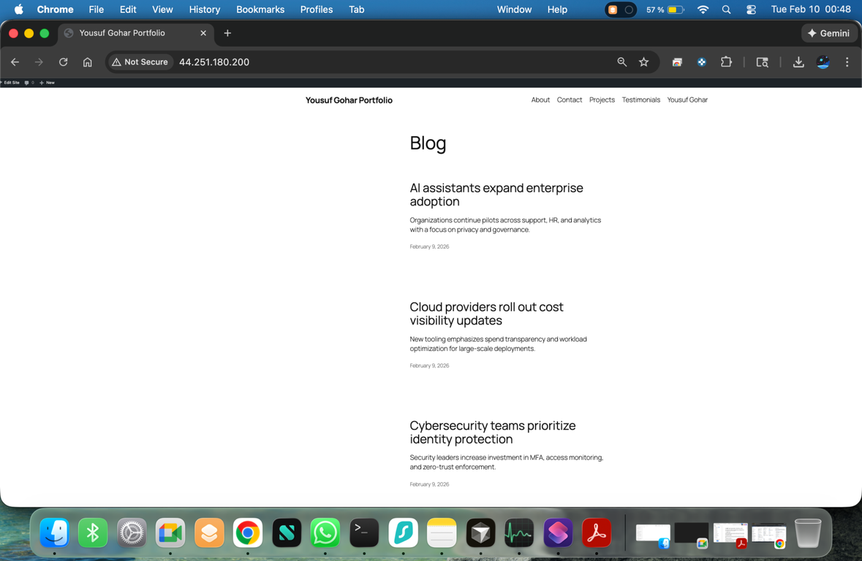
Live Blog Page
Demonstrates that the WordPress blog is functioning correctly on the deployed infrastructure.

Slide 11



Future Enhancements
Bastion Host & NAT
Load Balancing & ASG
Isolate administration and enable outbound internet for private subnets.
Deploy multiple EC2 instances behind an Application Load Balancer and Auto Scaling Group.
HTTPS & Secrets
Monitoring & Launch Templates
Use ACM certificates and store sensitive data in Secrets Manager.
Add CloudWatch alarms and convert compute resources to launch templates.
[18][19]
Notes:
1.7.2013
10
‹#›

Slide 12

Conclusion & Key Takeaways
Two‑tier architectures provide a balance of simplicity and security.
By isolating the database and using scoped security groups, we protect sensitive data and reduce attack surfaces.
Infrastructure as Code enables repeatable, auditable deployments that scale with project complexity.
Continuous improvement—adding load balancing, auto‑scaling, HTTPS and monitoring—prepares the system for production workloads.
[20][21]
Notes:
1.7.2013
11
‹#›

