Slide 1


MC D⁰ Single Track L1 Efficiency
1

Slide 2
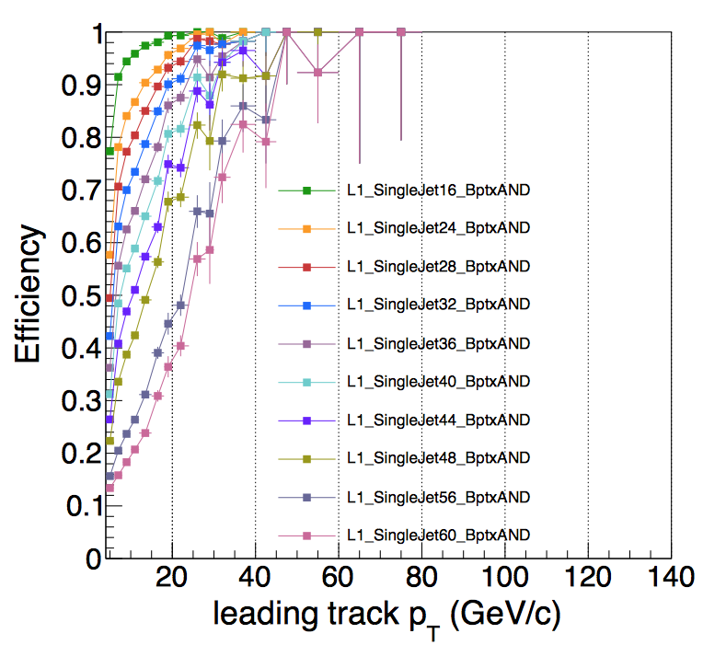
MC D⁰ Single Track L1 Efficiency Comparison
My Binning: const int nBin = 17; float bins[nBin+1]=
{10, 12, 15, 18, 20, 24, 28, 30, 34, 40, 45, 50, 60, 70, 80, 100,120,140};
2

