Slide 1
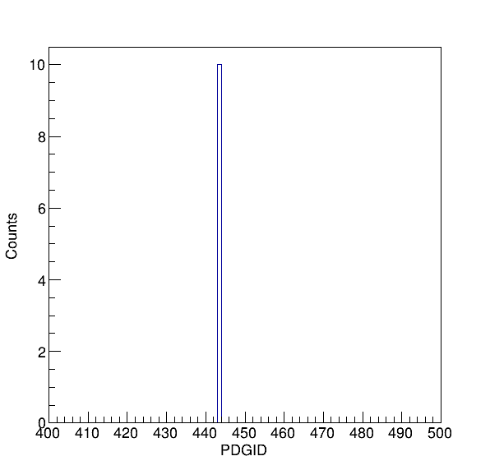
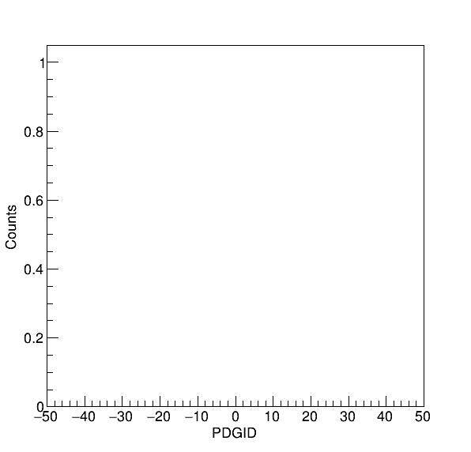


Origin PYTHIA 6 Decayer on GEANT 4 Particles
J/ψ Mother
Decay Daughters
Inject particle J/ψ in Fun4All macro
Set decay type: EDecayType decayType = EDecayType::kDiMuon in GlobalVariable.C
Without the line: particle->SetDecayTable(NULL), we are NOT able to force J/ψ -> μ⁺ μ⁻
PYTHIA 6 decayer is NOT working
1

Slide 2
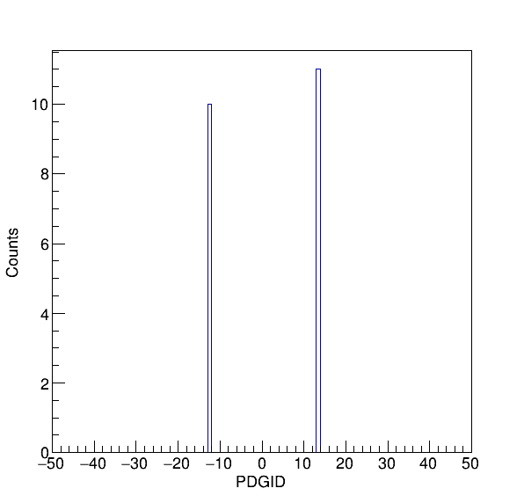
With the Function Nullify the Particle Decay Table
Decay Daughters
J/ψ Mother
Inject particle J/ψ in Fun4All macro
Set decay type: EDecayType decayType = EDecayType::kDiMuon in GlobalVariable.C
With the line: particle->SetDecayTable(NULL), we are able to force J/ψ -> μ⁺ μ⁻
PYTHIA 6 decayer is now working
2

