Slide 1
Readout Unit DCS CAN Bus
High Level Protocol (HLP)
Simon Voigt Nesbø
February 22, 2019

Slide 2
CAN High Level Protocol
Based on protocol used in STAR TOF:
J. Schambach et al, “CANbus protocol and applications for STAR TOF Control”, Journal of Physics: Conference Series, Volume 331, Part 2: Online Computing
Standard CAN frames (11-bit ID)
8 MSBs of ID used for Node ID (each RU is a node)
3 LSBs of ID used HLP commands
WRITE, WRITE_RESPONSE, READ, READ_RESPONSE
Acceptance filtering used in CAN Controller to filter messages based on Node ID only
DCS initiates WRITE and READ commands, RU responds with WRITE_RESPONSE, READ_RESPONSE
 | Command type
Data byte | WRITE (b″010″) | WRITE_RESPONSE (b″011″) | READ (b″100″) | READ_RESPONSE (b″101″)
0 | ADDR MSB | ADDR MSB | ADDR MSB | ADDR MSB
1 | ADDR LSB | ADDR LSB | ADDR LSB | ADDR LSB
2 | DATA MSB | DATA MSB | N/A | DATA MSB
3 | DATA LSB | DATA LSB | N/A | DATA LSB
RU responds with data that was written in WRITE_RESPONSE

Slide 3
Firmware

Slide 4
CAN High Level Protocol Module – Branch/Repo
Repository: RUv1_Test on gitlab
https://gitlab.cern.ch/alice-its-wp10-firmware/RUv1_Test
Branch: dcs_canbus (will be merged to master eventually)
Code is located in modules/dcs_canbus
The CAN HLP module is a master on the Xilinx UltraScale’s wishbone bus, and is able to read from and write to internal registers in the US firmware, using the custom CAN HLP protocol.
The CAN HLP module uses an instance of the OpenCores CAN Controller for the CAN bus communication, and includes the custom HLP protocol and FIFOs for communicating with the Wishbone bus in the Xilinx US firmware.

Slide 5
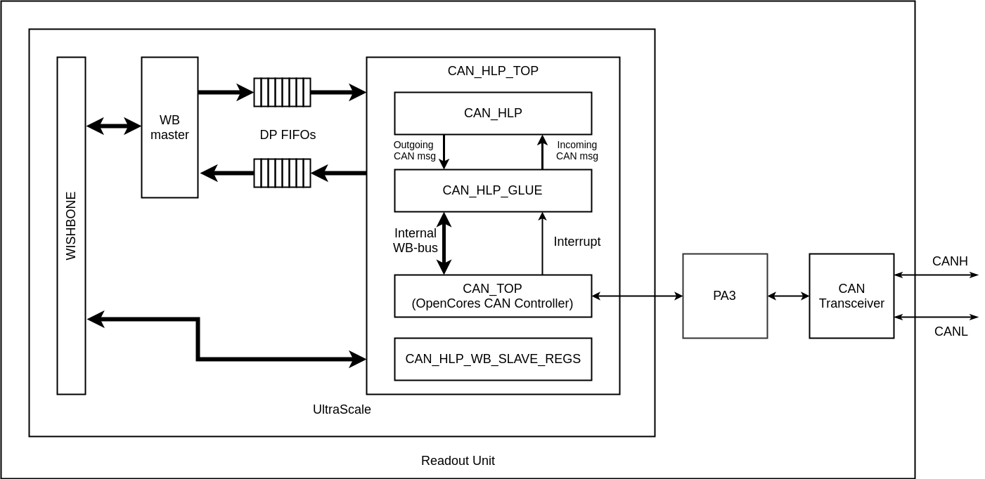
CAN High Level Protocol Firmware
Structure:
CAN_HLP_TOP
CAN_HLP
CAN_HLP_GLUE
CAN_TOP
CAN_HLP_WB_SLAVE_REGS
CAN_HLP:
WB master interface via DP FIFOs
Reuse modules used for USB/GBT
Interprets HLP format in CAN packages
CAN_HLP_GLUE:
Glue logic between OpenCores CAN controller and CAN_HLP module
Configures CAN controller on reset (bit rate etc.)
Talks to CAN controller via dedicated WB bus

Slide 6
CAN High Level Protocol – Integration with RUv1_Test firmware
In fabric_top.vhd:
The can_hlp_top module is created by the can_hlp_top_tmr_wrapper instance
can_hlp_top_tmr_wrapper wraps the can_hlp_top module to allow connection to triplicated WB signals/array
can_hlp_top_tmr_wrapper connects to an instance of wishbone_master_tripleout dedicated for CAN bus. The wishbone_master_tripleout module enables wishbone communication with can_hlp_top using FIFOs
can_hlp_top_tmr_wrapper does not actually triplicate the logic, just triplicates bus signals
DIPSWITCH(7:0) is used for CAN HLP node ID
PA3_IO_o(9) used for CAN_TX (was previously used for PA3 Wb2Fifo)
PA3_IO_i(10) used for CAN_RX

Slide 7
CAN High Level Protocol – PA3 firmware
The CAN controller on the RUv1 board is not connected directly to the Xilinx US FPGA, it is connected to Microsemi PA3 FPGA
CAN signals from/to US need to pass through PA3
Requires a firmware in PA3 where signals to/from US are connected to signals to/from CAN controller
This is implemented in CAN_PASSTHROUGH branch of PA3 firmware
https://gitlab.cern.ch/alice-its-wp10-firmware/RUv1_auxFPGA/tree/CAN_PASSTHROUGH
This will eventually be merged into master branch of PA3 firmware
Passthrough of CAN signals is included in latest release of PA3 firmware (v0206).

Slide 8
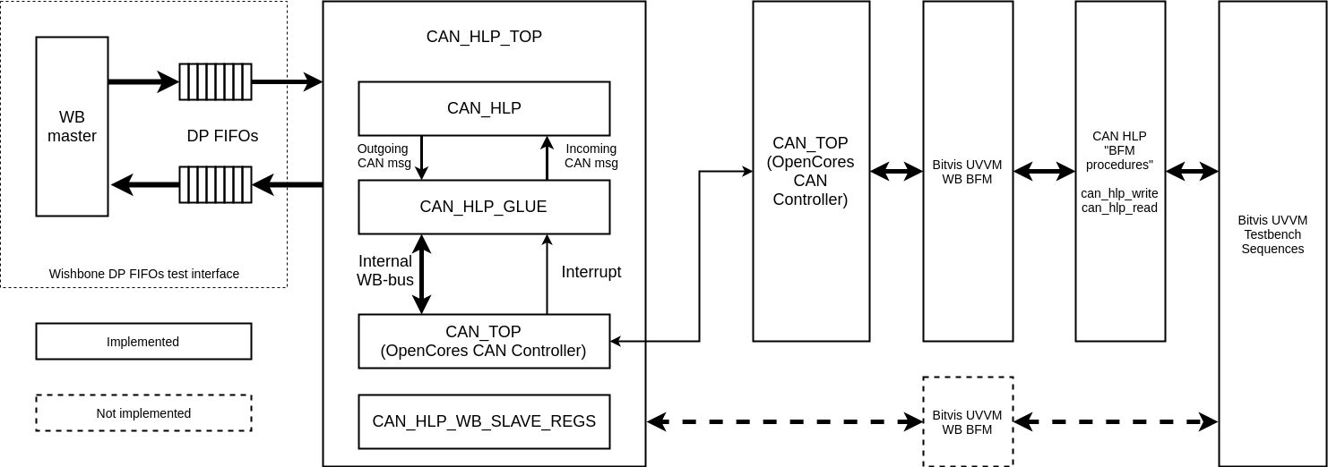
CAN High Level Protocol Test bench
Testbench using Bitvis UVVM library.
Uses an instance of OpenCores CAN controller as «CAN BFM».
can_hlp_write/read() procedures to read/write to CAN_HLP with HLP protocol.
Implemented using Bitvis WB BFM and OpenCores CAN controller
Test bench

Slide 9
CAN High Level Protocol Test bench
The CAN HLP module testbench has not been integrated into the main testbench for the Xilinx at the time this is written, but there is a standalone testbench for the module.
To run CAN HLP test bench:
“make environment” from RUv1_Test top level directory
“do 07-compile_and_run_can_hlp.do” from modules/dcs_canbus/sim directory in vsim
Testbench code is in can_hlp_uvvm_tb.vhd, found in modules/dcs_canbus/source/bench/can_hlp

Slide 10
OpenCores CAN Controller

Slide 11
OpenCores CAN Protocol Controller
https://opencores.org/project,can
Written in Verilog
Supports basic CAN and extended CAN
11-bit ID and 29-bit ID
ID mask and filtering
Up to 1Mbps operation
Transmit/receive/error interrupts
Wishbone interface (8-bit address and data)
Register map compatible with Philips SJA1000 CAN Controller IC
https://www.nxp.com/docs/en/data-sheet/SJA1000.pdf
Size: 12k gates (930 flip-flops)
Sources located in modules/dcs_canbus/source/rtl/can_controller

Slide 12
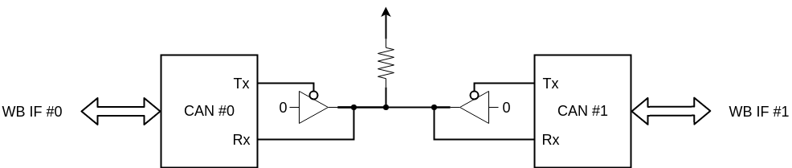
OpenCores CAN Protocol Controller Test bench
Simple Bitvis UVVM style test bench (in VHDL)
Testbench code located in modules/dcs_canbus/source/bench/can_controller
Testbench scripts located in modules/dcs_canbus/sim
Testbench consists of two instances of the CAN controller connected together
Two separate WB interfaces to write to each controller
40 MHz clock
To run simulation: run “07-compile_and_run_can_ctrl.do” from modules/dcs_canbus/sim directory in vsim

Slide 13
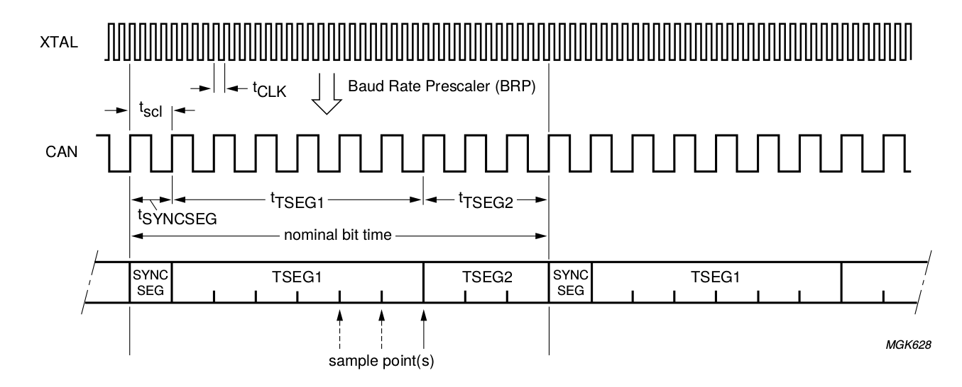
OpenCores CAN Protocol Controller Test bench
Bit Timing Register (BTR0) configured for 4x baud clock prescale
t_{SEG1} set to 7 baud clocks, t_{SEG2} set to 3 baud clocks, in BTR1
t_{SYNCSEG} is always 1 baud clock
Gives us a bit rate of 40 MHz / (4 * (1+7+3)) = 1Mbps

Slide 14
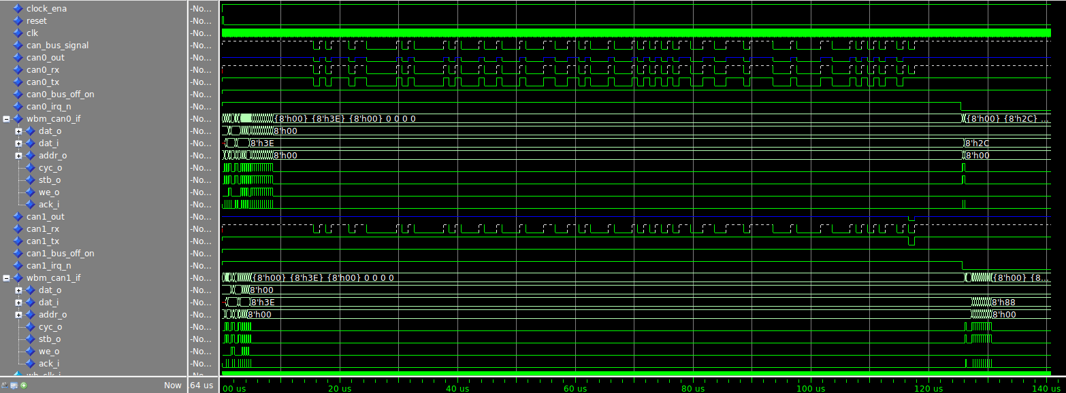
OpenCores CAN Protocol Controller Test bench

Slide 15
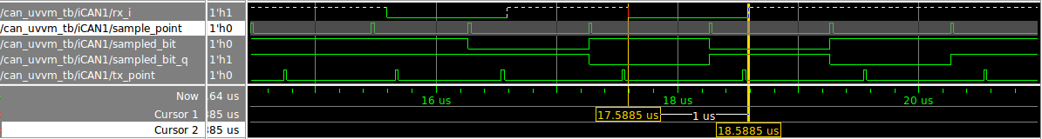
OpenCores CAN Protocol Controller Test bench

Slide 16
OpenCores CAN Protocol Controller Test bench
Testbench log
Set up TX buffer on CAN0 with message for CAN1 (ID 0xBB)
# UVVM: ID_LOG_HDR 4940.0 ns TB seq. Start a transaction from CAN0 to CAN1
# UVVM: -------------------------------------------------------------------------------------------------------------------------------------------------------------------------
# UVVM: ID_BFM 5115.0 ns TB seq. wb_write(A:x"0A", x"BB") completed. Set TXID1 to xBB
# UVVM: ID_BFM 5465.0 ns TB seq. wb_write(A:x"0B", x"08") completed. Set TXID2 to x08, 8 bytes data
# UVVM: ID_BFM 5815.0 ns TB seq. wb_write(A:x"0C", x"11") completed. Set data1 to x11
# UVVM: ID_BFM 6165.0 ns TB seq. wb_write(A:x"0D", x"22") completed. Set data2 to x22
# UVVM: ID_BFM 6515.0 ns TB seq. wb_write(A:x"0E", x"33") completed. Set data3 to x33
# UVVM: ID_BFM 6865.0 ns TB seq. wb_write(A:x"0F", x"44") completed. Set data4 to x44
# UVVM: ID_BFM 7215.0 ns TB seq. wb_write(A:x"10", x"55") completed. Set data5 to x55
# UVVM: ID_BFM 7565.0 ns TB seq. wb_write(A:x"11", x"66") completed. Set data6 to x66
# UVVM: ID_BFM 7915.0 ns TB seq. wb_write(A:x"12", x"77") completed. Set data7 to x77
# UVVM: ID_BFM 8265.0 ns TB seq. wb_write(A:x"13", x"88") completed. Set data8 to x88
# UVVM: ID_BFM 8615.0 ns TB seq. wb_write(A:x"01", x"01") completed. Request transmission on CAN0
# UVVM:
# UVVM:
# UVVM: ID_LOG_HDR 8615.0 ns TB seq. Wait for CAN1 to receive message
# UVVM: -------------------------------------------------------------------------------------------------------------------------------------------------------------------------
# UVVM:
# UVVM:
# UVVM: ID_LOG_HDR 125613.5 ns TB seq. Got interrupt from CAN1.
# UVVM: -------------------------------------------------------------------------------------------------------------------------------------------------------------------------
# UVVM: ID_BFM 125790.0 ns TB seq. wb_check(A:x"00", x"XX")=> OK, received data = x"3E". Check that CAN0 transmit interrupt was set
# UVVM: ID_BFM 126140.0 ns TB seq. wb_check(A:x"02", x"XX")=> OK, received data = x"2C". Check that CAN0 transmit complete status bit is set
# UVVM: ID_BFM 126315.0 ns TB seq. wb_check(A:x"00", x"XX")=> OK, received data = x"3E". Check that CAN1 receive interrupt was set
# UVVM:
# UVVM:
# UVVM: ID_LOG_HDR 127315.0 ns TB seq. Verify message received by CAN1
# UVVM: -------------------------------------------------------------------------------------------------------------------------------------------------------------------------
# UVVM: ID_BFM 127490.0 ns TB seq. wb_check(A:x"14", x"BB")=> OK, received data = x"BB". Verify received RXID1
# UVVM: ID_BFM 127840.0 ns TB seq. wb_check(A:x"15", x"08")=> OK, received data = x"8". Verify received RXID2, 8 bytes data
# UVVM: ID_BFM 128190.0 ns TB seq. wb_check(A:x"16", x"11")=> OK, received data = x"11". Verify received data byte 1
# UVVM: ID_BFM 128540.0 ns TB seq. wb_check(A:x"17", x"22")=> OK, received data = x"22". Verify received data byte 2
# UVVM: ID_BFM 128890.0 ns TB seq. wb_check(A:x"18", x"33")=> OK, received data = x"33". Verify received data byte 3
# UVVM: ID_BFM 129240.0 ns TB seq. wb_check(A:x"19", x"44")=> OK, received data = x"44". Verify received data byte 4
# UVVM: ID_BFM 129590.0 ns TB seq. wb_check(A:x"1A", x"55")=> OK, received data = x"55". Verify received data byte 5
# UVVM: ID_BFM 129940.0 ns TB seq. wb_check(A:x"1B", x"66")=> OK, received data = x"66". Verify received data byte 6
# UVVM: ID_BFM 130290.0 ns TB seq. wb_check(A:x"1C", x"77")=> OK, received data = x"77". Verify received data byte 7
# UVVM: ID_BFM 130640.0 ns TB seq. wb_check(A:x"1D", x"88")=> OK, received data = x"88". Verify received data byte 8
Wait for CAN1 to receive message
Verify message contents

Slide 17
CAN HLP Hardware Setup

Slide 18
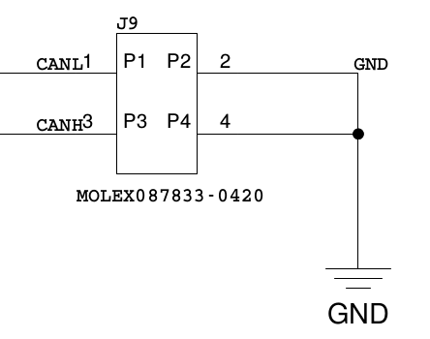
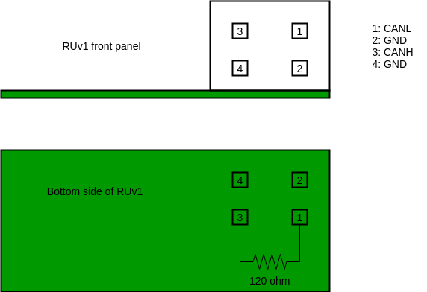
CAN High Level Protocol – Hardware Setup
Connector J9 on RUv1 is used for CAN bus
Located on bottom right side of front panel
CAN bus requires 120 ohm termination at the end of the bus
It should not be terminated at each node
Termination resistor can be soldered to the last RU on the bus
There is enough space to add a 1/4W through hole resistor to pins 1 and 3 on the backside of the RU, as indicated on the picture

Slide 19
CAN High Level Protocol – Hardware Setup
CAN bus connector on RUv1 board (MOLEX 087833-0420):
https://www.digikey.ch/product-detail/en/molex-connector-corporation/87833-0420/WM18858-ND/718131?cur=CHF&lang=en
Housing and precrimped leads to mate with RUv1 CAN bus connector:
https://www.digikey.ch/product-detail/en/molex-llc/0503948051-12-B6/0503948051-12-B6-ND/6047435
https://www.digikey.ch/product-detail/en/molex-llc/0511100450/WM18030-ND/267654
Actual crimp contacts:
https://www.digikey.ch/product-detail/en/molex-llc/0503948051/WM1128TR-ND/467800

Slide 20
CAN High Level Protocol – Hardware Setup
CAN HLP node ID:
The node ID is configured with DIPSWITCH[7:0] in the firmware
At the time of this writing, the DIPSWITCH assignments are mirrored in the firmware compared to the hardware
This means that currently switch 10 to 3 on the board is used for ID, where switch 10 is the LSB of the ID.
The DIPSWITCH is at the left side of the RUv1 board, when seen from the front panel
It is marked S8

Slide 21
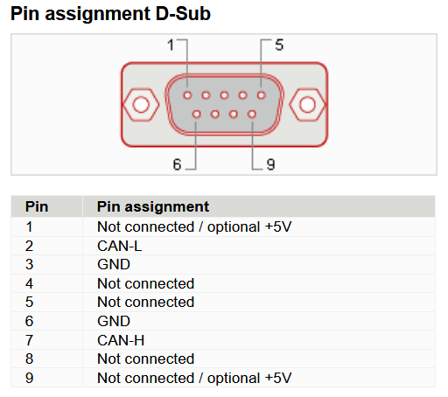
CAN High Level Protocol – PEAK CAN-USB Hardware Setup
CAN HLP has been tested with PEAK CAN to USB adapter
PEAK CAN to USB adapter needs internal solder links to enable termination
Refer to user manual for instructions

Slide 22
CAN HLP Software

Slide 23
Python scripts
Software located in modules/dcs_canbus/software/
can_hlp.py
Contains CanHlp class
Has a readHLP() and writeHLP() function for reading/writing registers using HLP protocol
Requires python-can package and python 3
can_hlp_test.py
Tests HLP by reading/writing some registers
can_hlp_test_loop.py
Reads/writes registers in a loop until interrupted with CTRL+C.

Slide 24
PEAK CAN bus Adapter Setup
Set up SocketCAN interface for CAN/USB adapter:
modules/dcs_canbus/software/can_hlp/setup_socketcan.sh
Must be run with sudo
Modprobes kernel modules for canbus
Sets up can0 SocketCAN interface for PEAK adapter

Slide 25
AnaGate CAN Controller Setup
Connect the AnaGate controller and set up ethernet on the computer so that they are on the same network. The AnaGate controller is configured with the IP address 192.168.1.254 by default, so the following settings for ethernet can be used on the computer:
IP: 192.168.1.2
Mask: 255.255.255.0
Gateway: 0.0.0.0
Scripts are located in modules/dcs_canbus/software/can_hlp/SocketCANGateway/
Run the script to set up the virtual CAN bus interface:
SocketCANGateway/InitVCAN.sh
Next run the bridge (located under x86_64_Release or x86_Release):
SocketCANGateway vcan0 --baudrate=250000 --termination=1 --highspeed=1 --canport=0
That will configure the AnaGate controller to use the vcan0 interface, run at 250kbit, use internal termination, highspeed CAN, and use the first CAN port on the AnaGate (CAN A port on AnaGate Quattro).

Slide 26
Running test script
After a CAN controller has been configured to use SocketCAN, the can_hlp_test.py and can_hlp_test_loop.py scripts can be run to test the interface.
Running can_hlp_test.py will:
Read out git hash (address 0x0100 and 0x0101 for git hash LSB/MSB)
Read out counter registers in CAN HLP module
Test writing to test register in CAN HLP module
Note:
The scripts needs to be edited to use the SocketCAN interface configured for the CAN controller (typically can0 for PEAK adapter, and vcan0 for AnaGate controller)
The scripts send commands to node id 1 by default. The RU needs to have the DIP switches configured for ID 1, or the scripts needs to be modified reflect the position of the DIP switches on the RU.

Slide 27
can_hlp_test.py output
candump log:
can_hlp.py log:
IF ID SIZE DATA
can0 035 [4] 12 05 00 00
can0 034 [2] 12 06
can0 035 [4] 12 06 00 08
can0 034 [2] 01 00
can0 035 [4] 01 00 E7 CF
can0 034 [2] 01 01
can0 035 [4] 01 01 0A 52
can0 032 [4] 12 06 00 08
can0 033 [4] 12 06 00 08
can0 034 [2] 12 00
can0 035 [4] 12 00 06 5E
can0 034 [2] 12 01
can0 035 [4] 12 01 05 B6
can0 034 [2] 12 02
can0 035 [4] 12 02 05 6A
can0 034 [2] 12 03
can0 035 [4] 12 03 00 4E
can0 034 [2] 12 04
can0 035 [4] 12 04 00 00
can0 034 [2] 12 05
can0 035 [4] 12 05 00 00
can0 034 [2] 12 06
can0 035 [4] 12 06 00 08
simon@simon-ThinkPad-T450s:~/Code/Python/CAN_HLP$ python3 can_hlp.py
Read response received.
Read response received.
githash: a52e7cf
Write response received.
Read response received.
Read response received.
Read response received.
Read response received.
Read response received.
Read response received.
Read response received.
can_reg_rx_msg_count: 1640
can_reg_tx_msg_count: 1472
can_reg_read_count: 1395
can_reg_write_count: 79
can_reg_status_alert_count: 0
can_reg_unknown_count: 0
can_reg_test_count: 8
exiting SAFELY
commit a52e7cf9801c9df01dd737a2faf599e0f3855790
Author: Simon Voigt Nesbo <svn@hib.no>
Date: Mon May 28 19:42:42 2018 +0200
[dcs_canbus] SVN bugfixes to CAN BFM, and random message generation in CAN BFM tb.

Slide 28
Testing with 118 meter cable

Slide 29
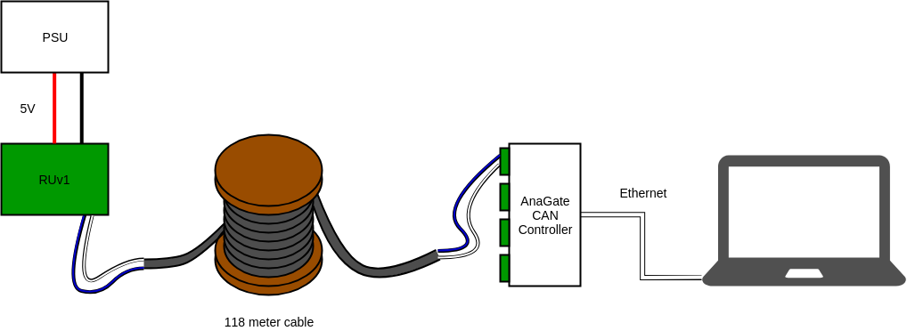
Test setup - hardware
The test setup looks roughly as shown in the figure. Test scripts running on the laptop communicate with the AnaGate controller via Ethernet, which is connected to the RUv1 with the cable.
The cable has two pair of wires, a white/blue and a white/orange pair. The blue/white pair (pair number 1) in the cable was used. This pair should have 120 ohm impedance, and is intended to be used for the CAN bus data transmission.

Slide 30
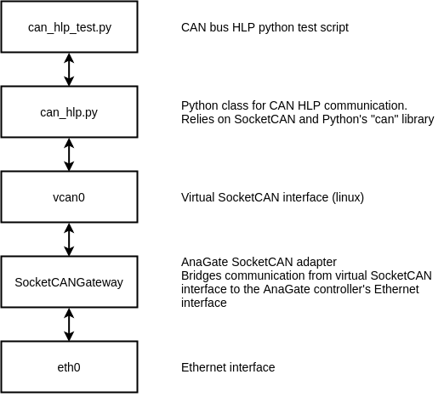
Test setup - software
From a software point of view, the test setup is roughly as indicated in the figure.
A test in the script was comprised of:
Read out the githash registers from the Xilinx, and verify that the values read were as expected (2 CAN HLP read transactions)
Write a random value to a test register (1 CAN HLP write transaction)
Read back the value from the test register and verify that it was correctly written and read back (1 CAN HLP read transaction)
Each CAN HLP transaction consists of 2 CAN bus frames, the command from the PC, and the response from the RUv1.

Slide 31
Test results
3 different bit rates were tested for CAN bus:
1 Mbit
500 kbit
250 kbit
1 Mbit and 500 kbit
The 1 Mbit and 500 kbit did not work reliably. The first transaction succeeded in some cases, but the data returned was not as expected.
250 kbit
The 250 kbit bit rate appeared to work reliably. A test loop script was run for around 18 hours without errors.

Slide 32
Test results 250 kbit
The test loop script ran for about 18 hours in total at 250 kbit, without any errors.
5775279 tests
17325835 CAN HLP read transactions
5775278 CAN HLP write transactions
82.89 tests per second on average
331.57 CAN HLP transactions per second on average (3.02 ms per CAN HLP transaction on average)

Slide 33
Test results – eye diagrams
Some eye diagrams were measured for the CAN bus using Agilent DSO9254A oscilloscope with Agilent InfiniiMax differential probe.
Initially this was performed at each of the 3 bit rates, with the AnaGate transmitting and the RUv1 powered off.
The CAN controller on the RUv1 does presumably have high-impedance inputs, and the CAN bus lines were terminated with 120 ohm resistance at each end (internal in the AnaGate controller, external resistor on RUv1). So from an electrical point of view it should not make a difference on the signal whether the RUv1 is powered or not.
Measurements were also performed at 250 kbit with the RUv1 responding, but this did not yield very good eye diagrams since the CAN voltage levels from the RUv1 were not exactly the same as from the AnaGate controller, and way to trigger on either the RUv1 or the AnaGate could not be found.

Slide 34
Test results – eye diagrams
See next couple of slides for eye diagrams etc.
Eye diagrams actually don’t look that bad at 500 kbit and 1 Mbit
Perhaps the firmware could run at those baud rates?
Changing bit timing settings in firmware may help?
Signal level from RUv1 lower than from AnaGate
Around 1.75 Vpp out from RUv1
Around 2.75 Vpp out from AnaGate

Slide 35
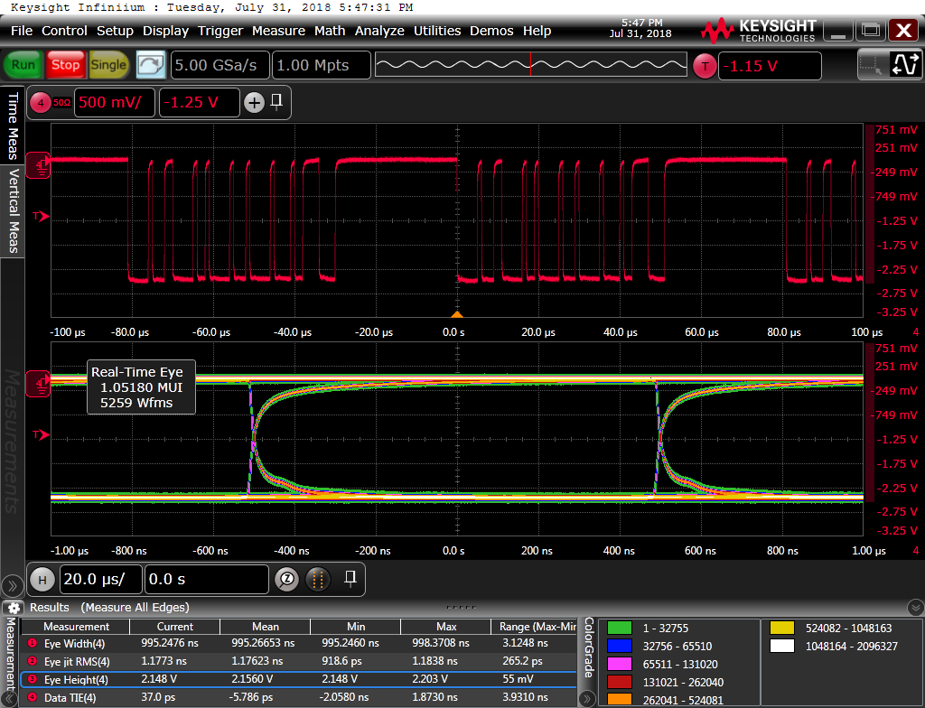
Test results – eye diagrams @ 1 Mbit – RUv1 not powered
Measured at RUv1 side

Slide 36
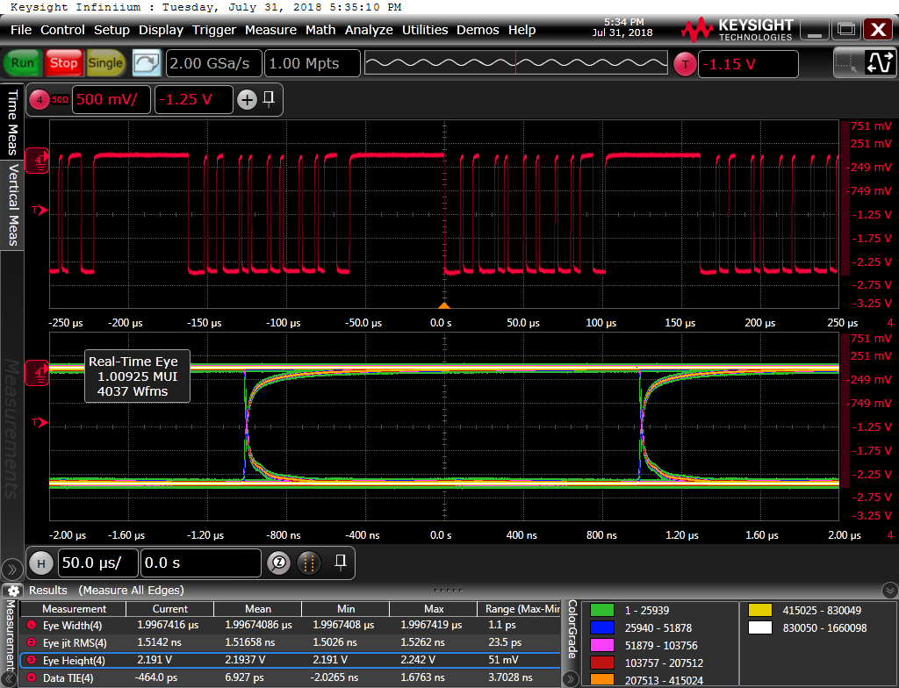
Test results – eye diagrams @ 500 kbit – RUv1 not powered
Measured at RUv1 side

Slide 37
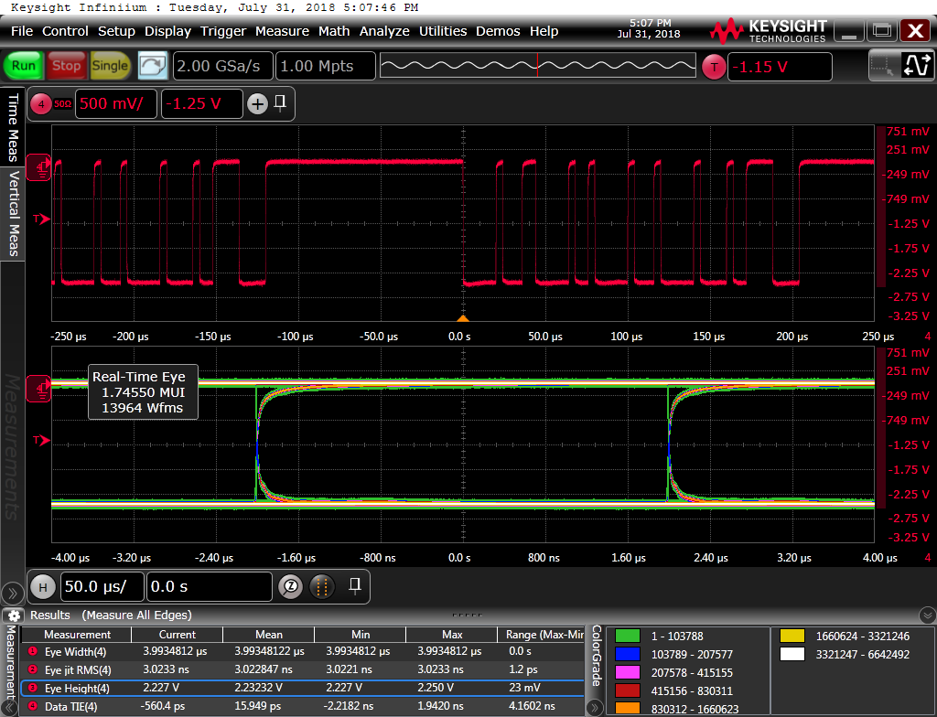
Test results – eye diagrams @ 250 kbit – RUv1 not powered
Measured at RUv1 side

Slide 38
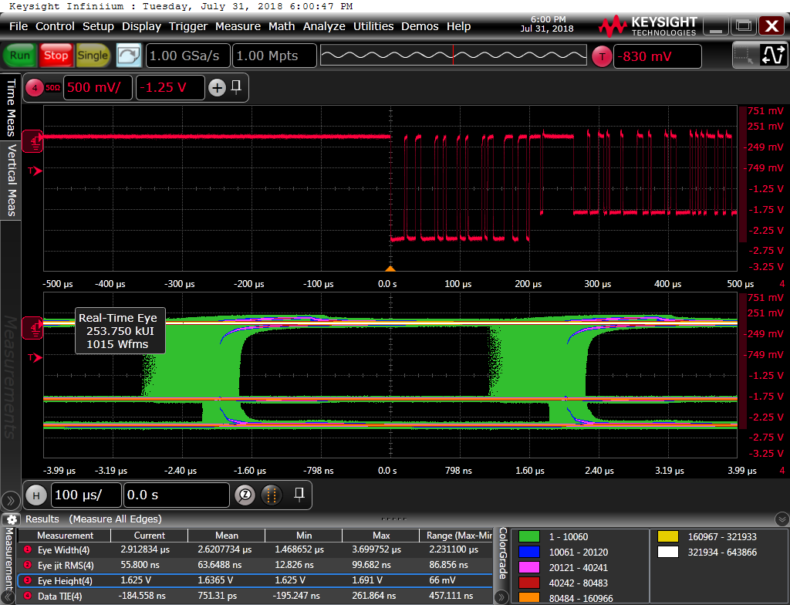
Test results – eye diagrams @ 250 kbit – RUv1 powered
Measured at RUv1 side
Could not find a way to trigger only on the signal from either of the RUv1 or AnaGate was, so eye diagram looks messy
Notice different signal levels. Output from RUv1 is a bit lower than from AnaGate

Slide 39
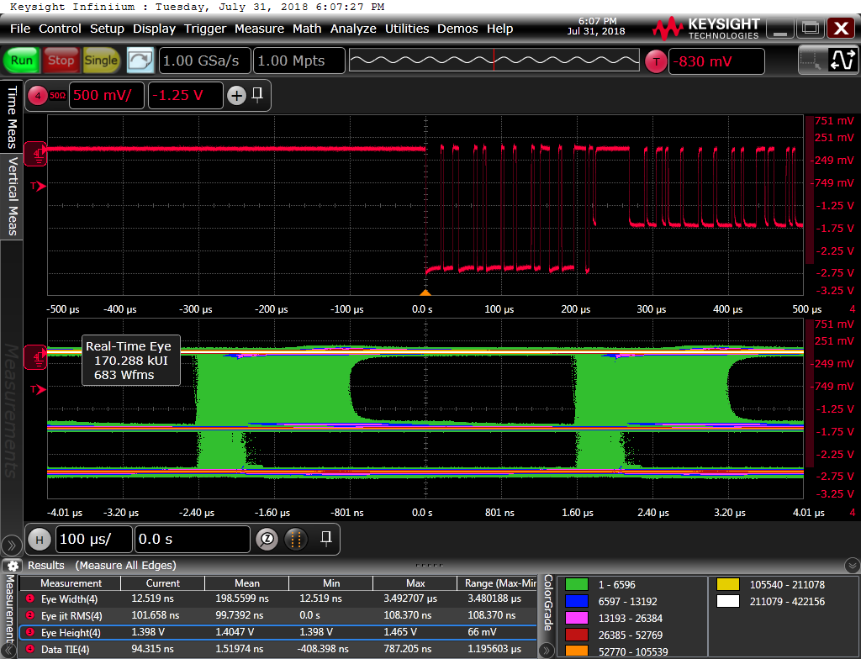
Test results – eye diagrams @ 250 kbit – RUv1 powered
Measured at AnaGate side
Could not find a way to trigger only on the signal from either of the RUv1 or AnaGate was, so eye diagram looks messy
Notice different signal levels. Output from RUv1 is a bit lower than from AnaGate
Signal from RUv1 attenuated quite a bit when it reaches AnaGate (compare to previous slide)

Slide 40
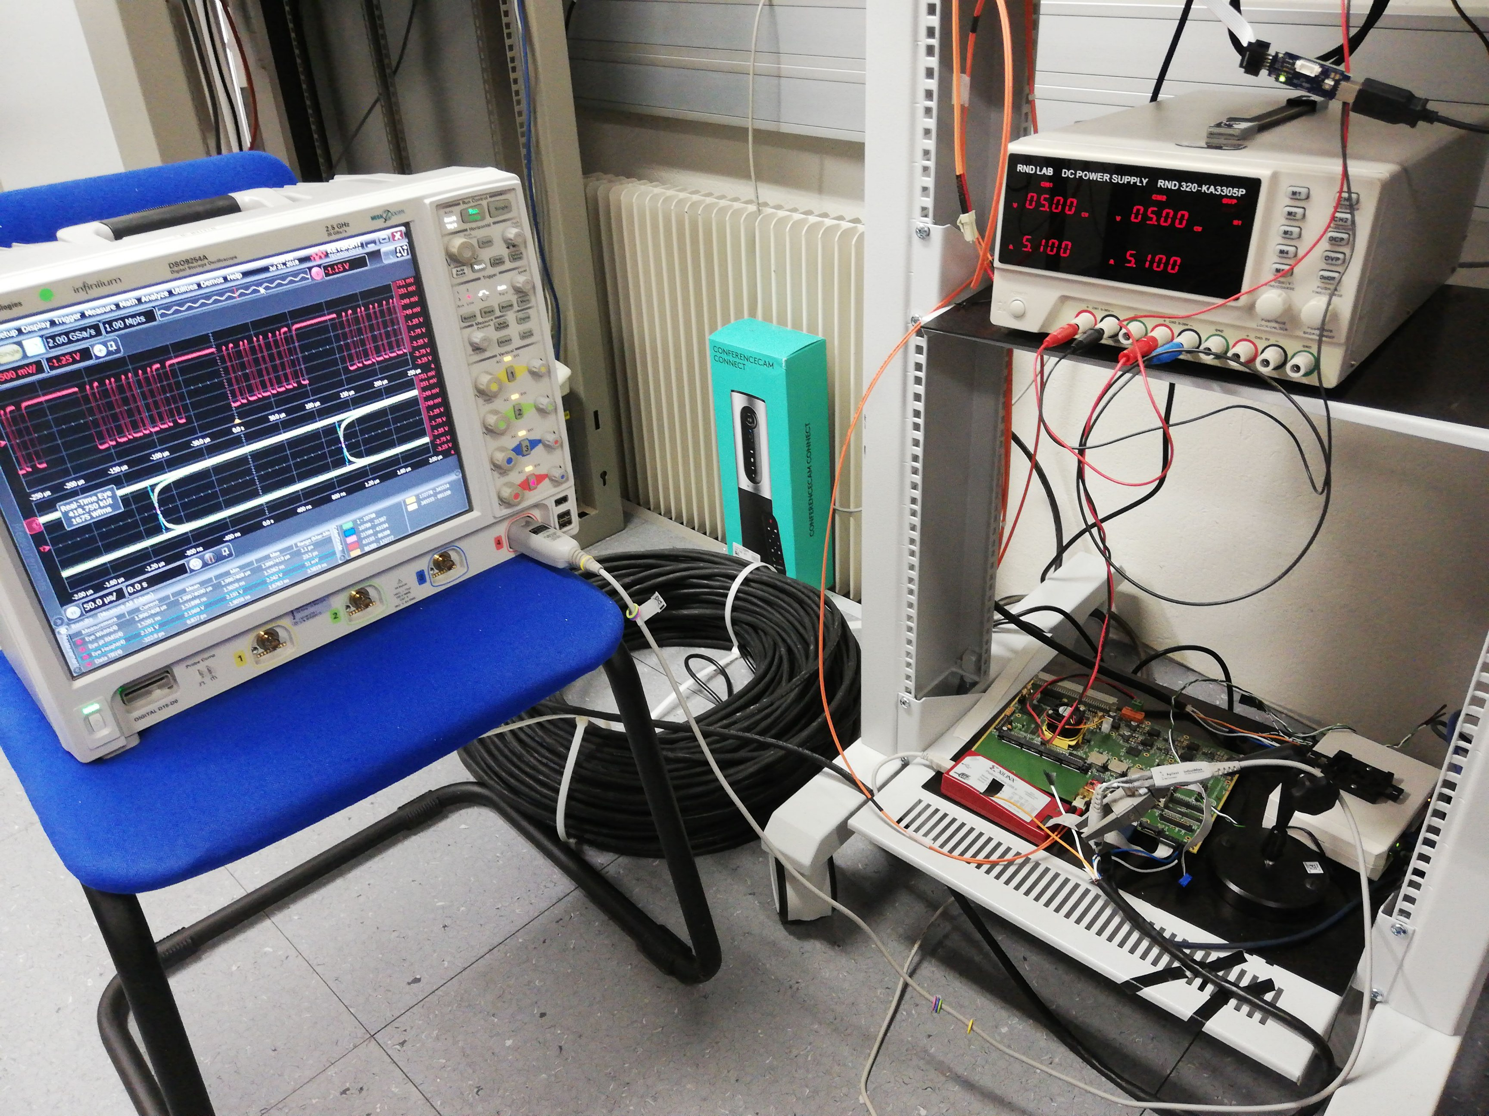
Test results – eye diagrams
Eye diagrams measured with Agilent DSO9254A oscilloscope with Agilent InfiniiMax differential probe.

Slide 41
Backup

