Slide 1
Unit 9 Neural Networks
EE-UY 4563/EL-GY 9143: Introduction to machine learning
Prof. Sundeep rangan

Slide 2
Learning Objectives
Mathematically describe a neural network with a single hidden layer
Describe mappings for the hidden and output units
Manually compute output regions for very simple networks
Select the loss function based on the problem type
Build and train a simple neural network in Keras
Write the formulas for gradients using backpropagation
Describe mini-batches in stochastic gradient descent

Slide 3
Outline
Motivating Idea: Nonlinear classifiers from linear features
Training Neural Networks and Stochastic Gradient Descent
Building and Training a Network in PyTorch
Synthetic data
MNIST
Tensorflow Version [Optional]
Synthetic data
MNIST
Backpropagation Training

Slide 4
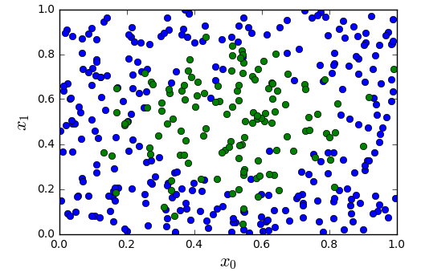
Most Datasets are not Linearly Separable
Consider simple synthetic data
See figure to the left
2D features
Binary class label
Not linearly separable
Need a better classifier!
All code in https://github.com/sdrangan/introml/blob/master/neural/synthetic.ipynb

Slide 5
From Linear to Nonlinear
Idea: Build nonlinear region from linear decisions
Possible form for a classifier:
Step 1: Classify into small number of linear regions
Step 2: Predict class label from step 1 decisions

Slide 6
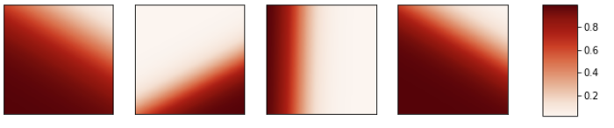
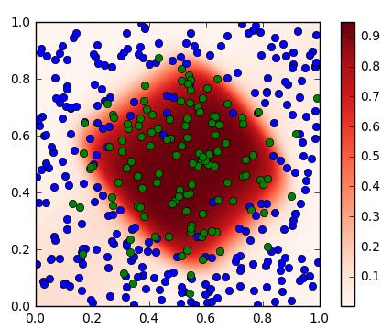

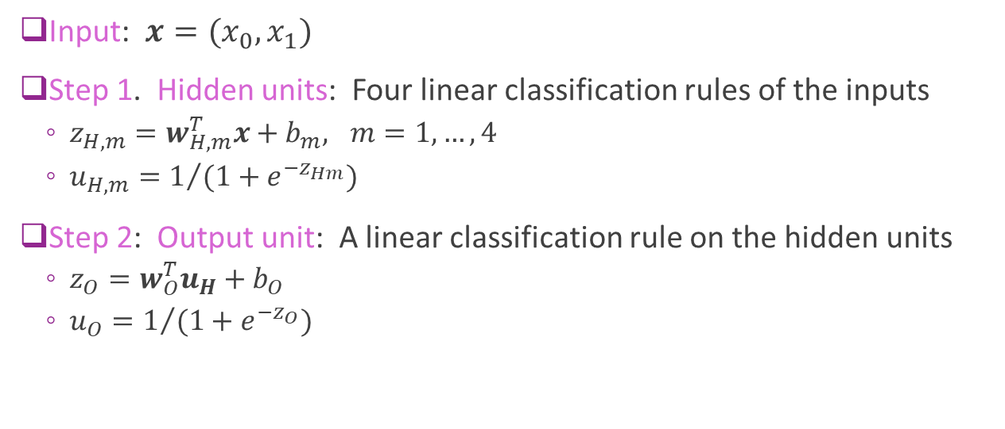






A First Neural Network
$$u_{H,1}$$
$$u_{H,2}$$
$$u_{H,3}$$
$$u_{H,4}$$
$$u_{o}$$
$$x_{1}$$
Input: $x=(x_{0},x_{1})$
Step 1. Hidden units: Four linear classification rules of the inputs
$z_{H,m}=w_{H,m}^{T}x+b_{m}, m=1,…,4$
$u_{H,m}=1/{(1+e^{−z_{Hm}})}$
Step 2: Output unit: A linear classification rule on the hidden units
$z_{O}=w_{O}^{T}u_{H}+b_{O}$
$u_{O}=1/{(1+e^{−z_{O}})}$
$$x_{0}$$

Slide 7

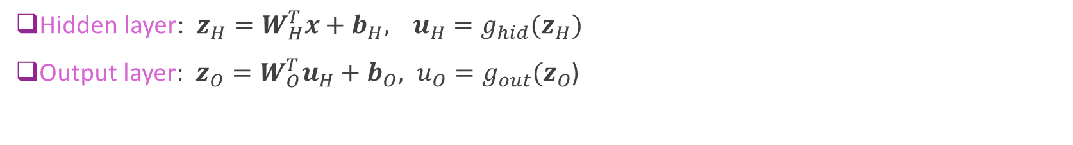


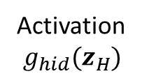

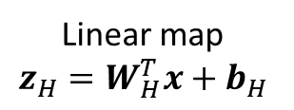


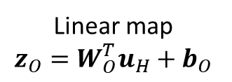
General Neural Net Block Diagram
Hidden layer: $z_{H}=W_{H}^{T}x+b_{H},$ $u_{H}=g_{hid}(z_{H})$
Output layer: $z_{O}=W_{O}^{T}u_{H}+b_{O}, {u_{O}=g}_{out}(z_{O}$)
Linear map $$z_{H}=W_{H}^{T}x+b_{H}$$
Activation $g_{hid}(z_{H})$
Linear map $$z_{O}=W_{O}^{T}u_{H}+b_{O}$$
Activation
$g_{out}(z_{O}$)
$$u_{O}$$
$$x$$
$$z_{O}$$
Input
$$z_{H}$$
$$u_{H}$$
Hidden layer
Output layer

Slide 8
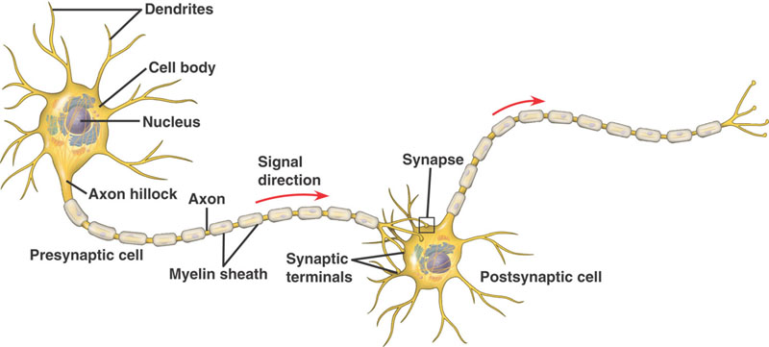
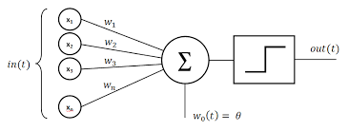
Inspiration from Biology
Simple model of neurons
Dendrites: Input currents from other neurons
Soma: Cell body, accumulation of charge
Axon: Outputs to other neurons
Synapse: Junction between neurons
Operation:
Take weighted sum of input current
Outputs when sum reaches a threshold
Each neuron is like one unit in neural network

Slide 9
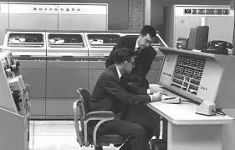
History
Interest in understanding the brain for thousands of years
1940s: Donald Hebb. Hebbian learning for neural plasticity
Hypothesized rule for updating synaptic weights in biological neurons
1950s: Frank Rosenblatt: Coined the term perceptron
Essentially single layer classifier, similar to logistic classification
Early computer implementations
But, Limitations of linear classifiers and computer power
1960s: Backpropagation: Efficient way to train multi-layer networks
More on this later
1980s: Resurgence with greater computational power
2005+: Deep networks
Many more layers. Increased computational power and data
Enabled first breakthroughs in various image and text processing.
Next lecture

Slide 10
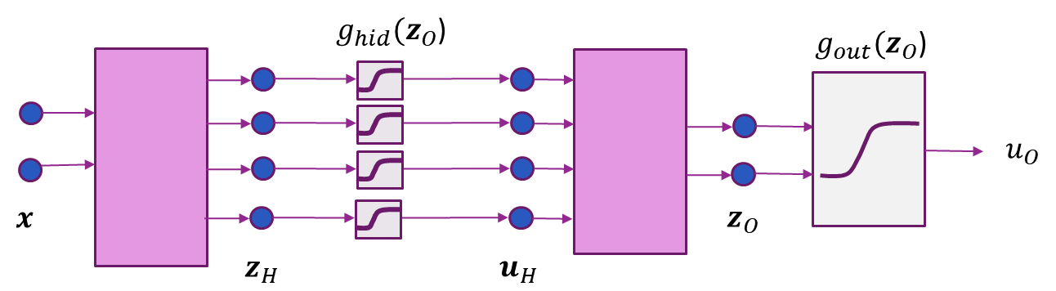

Terminology
Equations:
$z_{H}=W_{H}^{T}x+b_{H},$ $u_{H}=g_{hid}(z_{H})$
$z_{O}=W_{O}^{T}u_{H}+b_{O}, {u_{O}=g}_{out}(z_{O}$)
Units:
Hidden units: The components of $u_{H}$
Output units: The components of $u_{O}$
Activations:
“Activation functions”: $g_{hid}(z_{H})$ and $g_{out}(z_{O}$)
$z_{H}$ and $z_{O}$ are the “pre-activations”
$u_{H}$ and $u_{O}$ are the “post-activations”

Slide 11
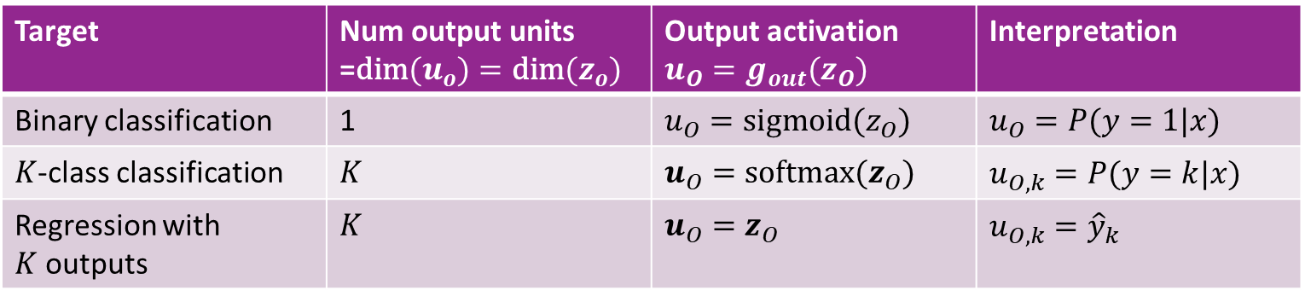
Selecting the Output Activation
Output layer
Target | Num output units =$\text{dim}(u_{o})=\text{dim}(z_{o})$ | Output activation $u_{O}=g_{out}(z_{O})$ | Interpretation
Binary classification | 1 | $u_{O}=\text{sigmoid}(z_{O})$ | $u_{O}=P(y=1|x)$
$K$-class classification | $K$ | $u_{O}=\text{s}\text{oftmax}(z_{O})$ | $u_{O,k}=P(y=k|x)$
Regression with $K$outputs | $K$ | $u_{O}=z_{O}$ | $u_{O,k}={\hat{y}}_{k}$

Slide 12
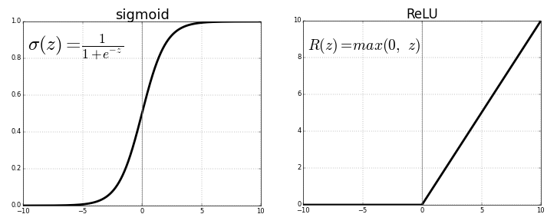
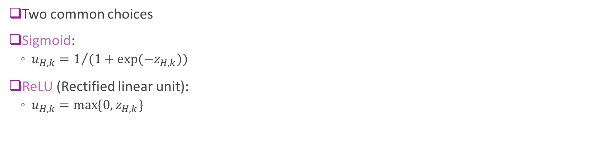
Selecting the Hidden Activation
Two common choices
Sigmoid:
$u_{H,k}=1/{(1+\exp{(−z_{H,k})})}$
ReLU (Rectified linear unit):
$u_{H,k}=\max{\{0, z_{H,k}\}}$
Sigmoid
ReLU

Slide 13
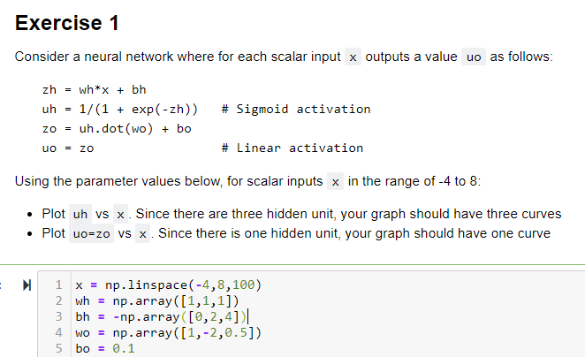
In-Class Exercise

Slide 14
Outline
Motivating Idea: Nonlinear classifiers from linear features
Training Neural Networks and Stochastic Gradient Descent
Building and Training a Network in PyTorch
Synthetic data
MNIST
Tensorflow Version [Optional]
Synthetic data
MNIST
Backpropagation Training

Slide 15
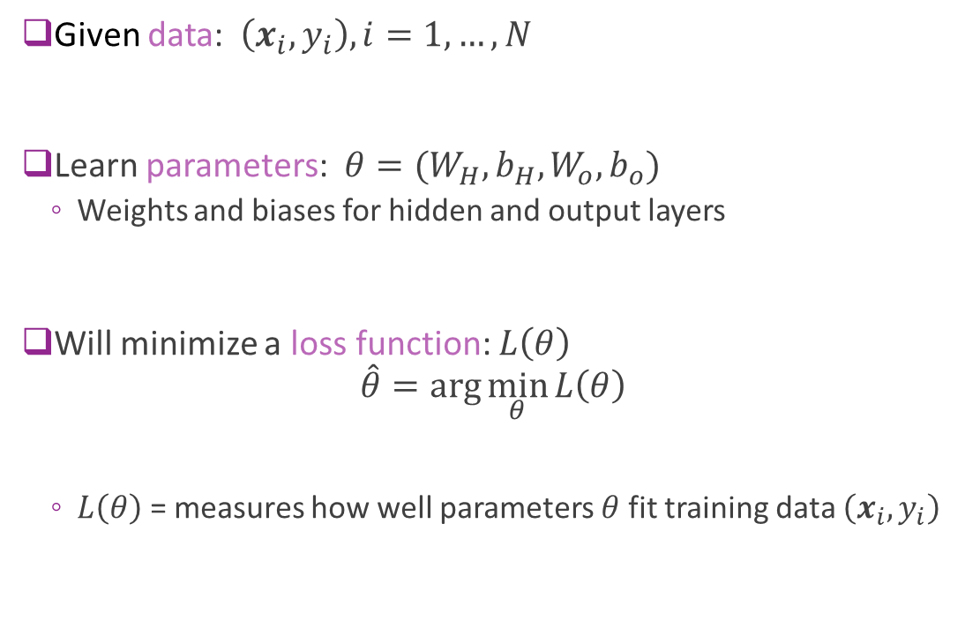


Training a Neural Network
Given data: $\left(x_{i},y_{i}\right), i=1,…,N$
Learn parameters: $θ=(W_{H},b_{H},W_{o},b_{o})$
Weights and biases for hidden and output layers
Will minimize a loss function: $L\left(θ\right)$ $\hat{θ}=\arg{\min_{θ}{L\left(θ\right)}}$
$L\left(θ\right)$ = measures how well parameters $θ$ fit training data $\left(x_{i},y_{i}\right)$
$$W_{H},b_{H}$$
$$W_{O},b_{O}$$

Slide 16
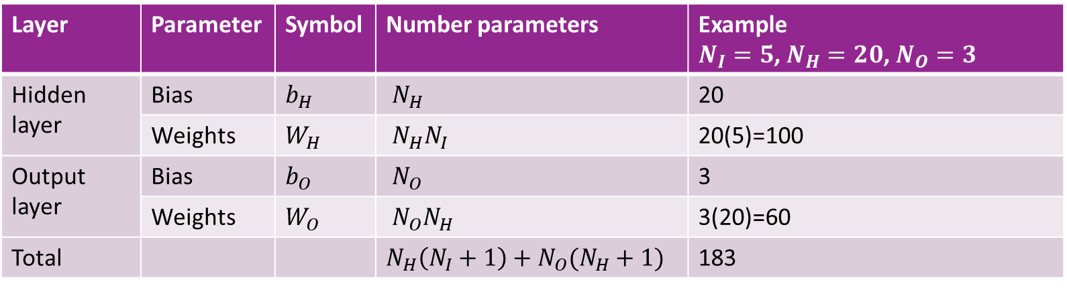
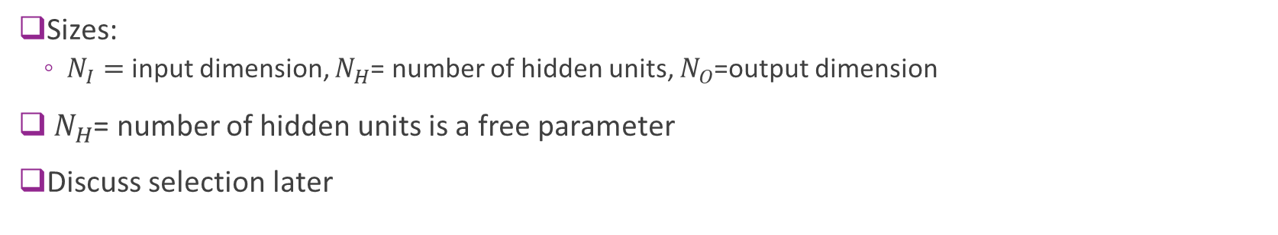
Number of Parameters
Layer | Parameter | Symbol | Number parameters | Example $N_{I}=5$, $N_{H}=20$, $N_{O}=3$
Hidden layer | Bias | $b_{H}$ | $N_{H}$ | 20
 | Weights | $W_{H}$ | $N_{H}N_{I}$ | 20(5)=100
Output layer | Bias | $b_{O}$ | $N_{O}$ | 3
 | Weights | $W_{O}$ | $N_{O}N_{H}$ | 3(20)=60
Total |  |  | $N_{H}\left(N_{I}+1\right)+N_{O}(N_{H}+1)$ | 183
Sizes:
$N_{I}=$ input dimension, $N_{H}$= number of hidden units, $N_{O}$=output dimension
$N_{H}$= number of hidden units is a free parameter
Discuss selection later

Slide 17
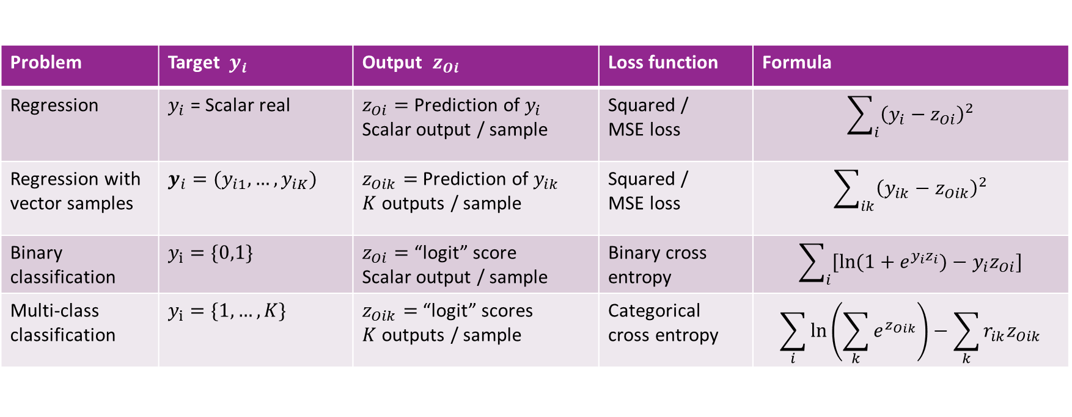
Selecting the Right Loss Function
Depends on the problem type
Always compare final output $z_{Oi}$ with target $y_{i}$
Problem | Target $y_{i}$ | Output $z_{Oi}$ | Loss function | Formula
Regression | $y_{i}$ = Scalar real | $z_{Oi}=$Prediction of $y_{i}$ Scalar output / sample | Squared / MSE loss | $$\sum_{i}{{\left(y_{i}−z_{Oi}\right)}^{2}}$$
Regression with vector samples | $y_{i}=(y_{i1},…,y_{iK})$ | $z_{Oik}=$Prediction of $y_{ik}$ $K$ outputs / sample | Squared / MSE loss | $$\sum_{ik}{{\left(y_{ik}−z_{Oik}\right)}^{2}}$$
Binary classification | $y_{i}=\{0,1\}$ | $z_{Oi}=$“logit” score Scalar output / sample | Binary cross entropy | $$\sum_{i}{[ln⁡(1+e^{y_{i}z_{i}})−y_{i}z_{Oi}]}$$
Multi-class classification | $y_{i}=\{1,…,K\}$ | $z_{Oik}=$“logit” scores $K$ outputs / sample | Categorical cross entropy | $$\sum_{i}{ln⁡\left(\sum_{k}{e^{z_{Oik}}}\right)−\sum_{k}{r_{ik}z_{Oik}}}$$

Slide 18
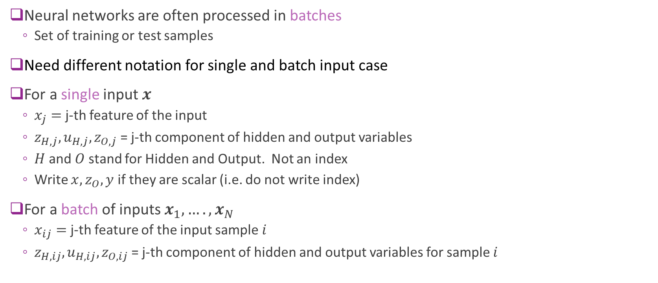
Note on Indexing
Neural networks are often processed in batches
Set of training or test samples
Need different notation for single and batch input case
For a single input $x$
$x_{j}=$ j-th feature of the input
$z_{H,j},u_{H,j},z_{O,j}$ = j-th component of hidden and output variables
$H$ and $O$ stand for Hidden and Output. Not an index
Write $x,z_{O},y$ if they are scalar (i.e. do not write index)
For a batch of inputs $x_{1},….,x_{N}$
$x_{ij}=$ j-th feature of the input sample $i$
$z_{H,ij},u_{H,ij},z_{O,ij}$ = j-th component of hidden and output variables for sample $i$

Slide 19
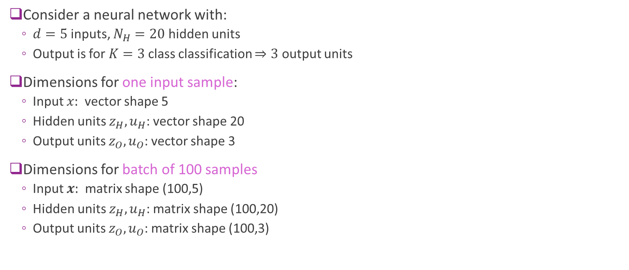
Dimension Example
Consider a neural network with:
$d=5$inputs, $N_{H}=20$ hidden units
Output is for $K=3$ class classification $⇒3$ output units
Dimensions for one input sample:
Input $x:$ vector shape 5
Hidden units $z_{H},u_{H}$: vector shape 20
Output units $z_{O},u_{O}$: vector shape 3
Dimensions for batch of 100 samples
Input $x:$ matrix shape (100,5)
Hidden units $z_{H},u_{H}$: matrix shape (100,20)
Output units $z_{O},u_{O}$: matrix shape (100,3)

Slide 20
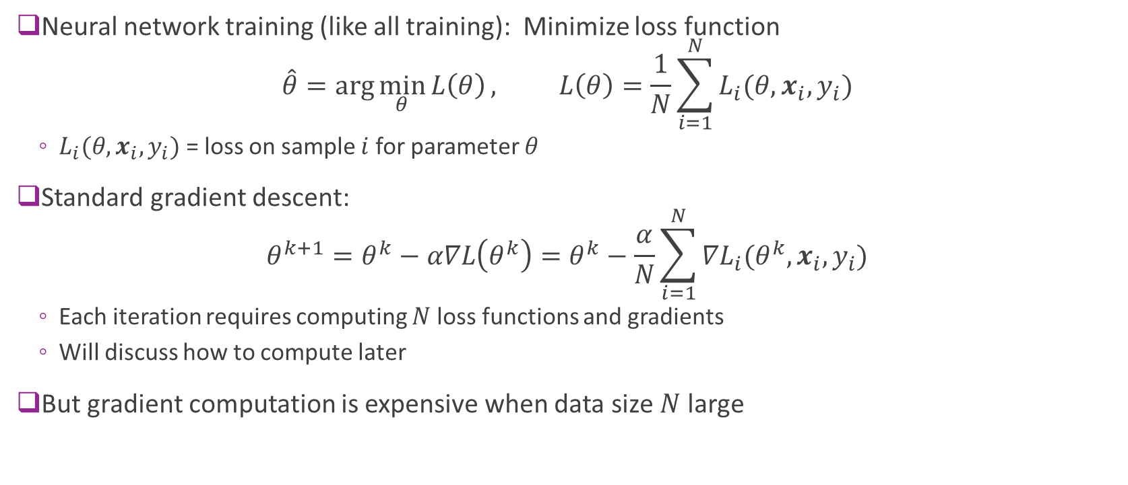
Problems with Standard Gradient Descent
Neural network training (like all training): Minimize loss function $\hat{θ}=\arg{\min_{θ}{L\left(θ\right)}}, L\left(θ\right)=\frac{1}{N}\sum_{i=1}^{N}{L_{i}(θ,x_{i},y_{i})}$
$L_{i}(θ,x_{i},y_{i})$ = loss on sample $i$ for parameter $θ$
Standard gradient descent: $θ^{k+1}=θ^{k}−α∇L\left(θ^{k}\right)=θ^{k}−\frac{α}{N}\sum_{i=1}^{N}{{∇L}_{i}(θ^{k},x_{i},y_{i})}$
Each iteration requires computing $N$loss functions and gradients
Will discuss how to compute later
But gradient computation is expensive when data size $N$ large

Slide 21
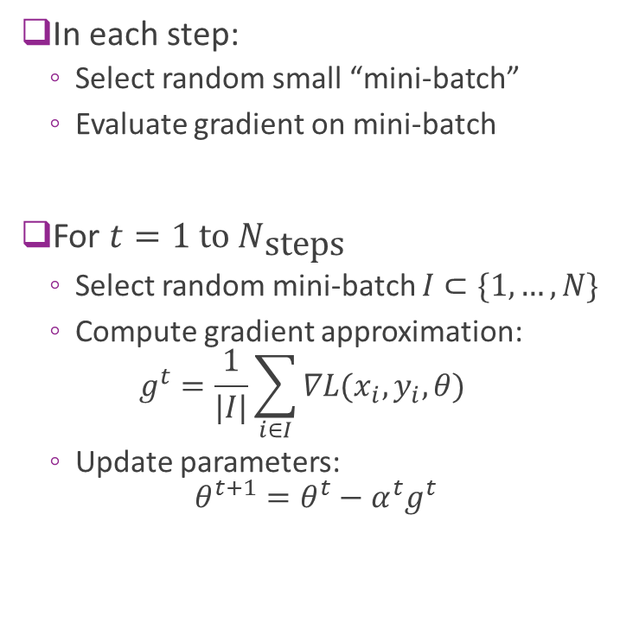
Stochastic Gradient Descent
In each step:
Select random small “mini-batch”
Evaluate gradient on mini-batch
For $t=1 \text{to} N_{\text{steps}}$
Select random mini-batch $I⊂\{1,…,N\}$
Compute gradient approximation: $g^{t}=\frac{1}{|I|}\sum_{i∈I}{∇L(x_{i},y_{i},θ)}$
Update parameters: $θ^{t+1}=θ^{t}−α^{t}g^{t}$
Full batch of training records
e.g. 50,000 in MNIST
Randomly selected mini-batch
e.g. 100 records

Slide 22
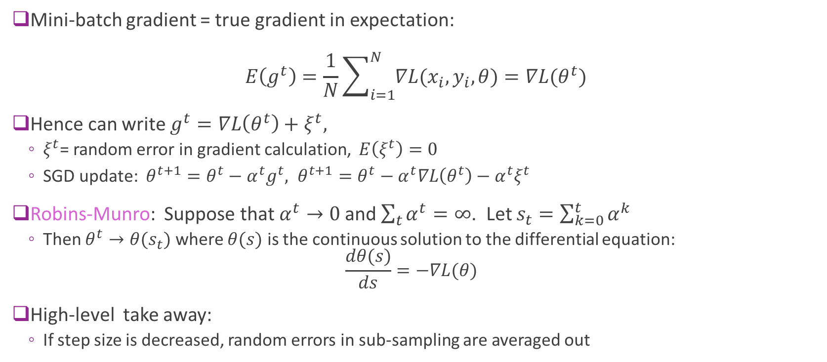
SGD Theory (Advanced)
Mini-batch gradient = true gradient in expectation: $E\left(g^{t}\right)=\frac{1}{N}\sum_{i=1}^{N}{∇L(x_{i},y_{i},θ)}=∇L(θ^{t})$
Hence can write $g^{t}=∇L\left(θ^{t}\right)+ξ^{t},$
$ξ^{t}$= random error in gradient calculation, $E\left(ξ^{t}\right)=0$
SGD update: $θ^{t+1}=θ^{t}−α^{t}g^{t}, θ^{t+1}=θ^{t}−α^{t}∇L\left(θ^{t}\right)−α^{t}ξ^{t}$
Robins-Munro: Suppose that $α^{t}→0$ and $\sum_{t}{α^{t}}=∞$. Let $s_{t}=\sum_{k=0}^{t}{α^{k}}$
Then $θ^{t}→θ(s_{t})$ where $θ(s)$ is the continuous solution to the differential equation: $\frac{dθ(s)}{ds}=−∇L(θ)$
High-level take away:
If step size is decreased, random errors in sub-sampling are averaged out

Slide 23
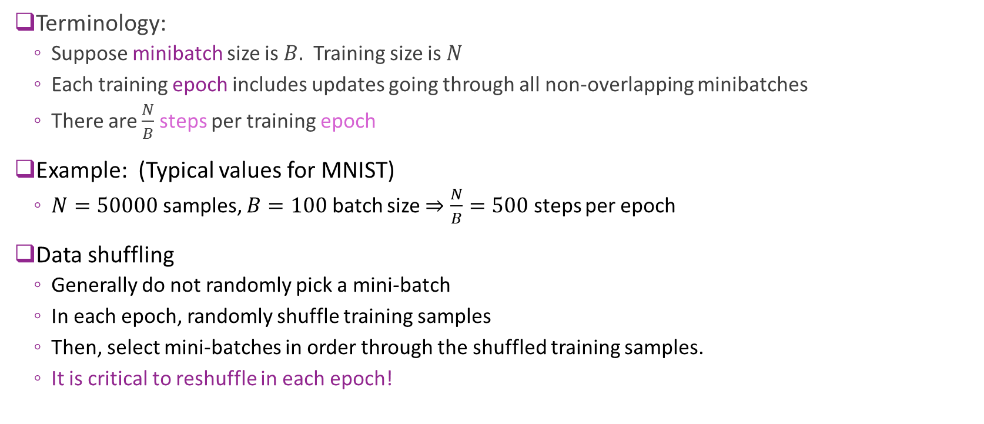
SGD Practical Issues
Terminology:
Suppose minibatch size is $B.$ Training size is $N$
Each training epoch includes updates going through all non-overlapping minibatches
There are $\frac{N}{B}$ steps per training epoch
Example: (Typical values for MNIST)
$N=50000$ samples, $B=100$ batch size $⇒\frac{N}{B}=500$ steps per epoch
Data shuffling
Generally do not randomly pick a mini-batch
In each epoch, randomly shuffle training samples
Then, select mini-batches in order through the shuffled training samples.
It is critical to reshuffle in each epoch!

Slide 24
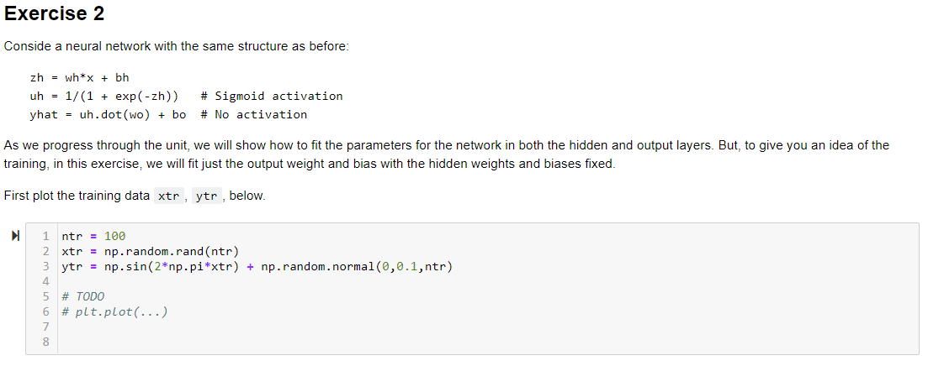
In-Class Exercise

Slide 25
Outline
Motivating Idea: Nonlinear classifiers from linear features
Training Neural Networks and Stochastic Gradient Descent
Building and Training a Network in PyTorch
Synthetic data
MNIST
Tensorflow Version [Optional]
Synthetic data
MNIST
Backpropagation Training

Slide 26

PyTorch vs. Tensorflow
Both are excellent open-source packages
In 2024, course is being updated to PyTorch
Syntax, APIs are a bit easier
Tensorflow version will remain in github
Labs will be in PyTorch
But, you can do your project in either

Slide 27
Pytorch Recipe
Step 1. Create a model as a class
Number of hidden units, output units, activations, …
Step 2. Select an optimizer
Step 3. Select a loss function
Step 4. Fit the model
Step 5. Test / use the model

Slide 28
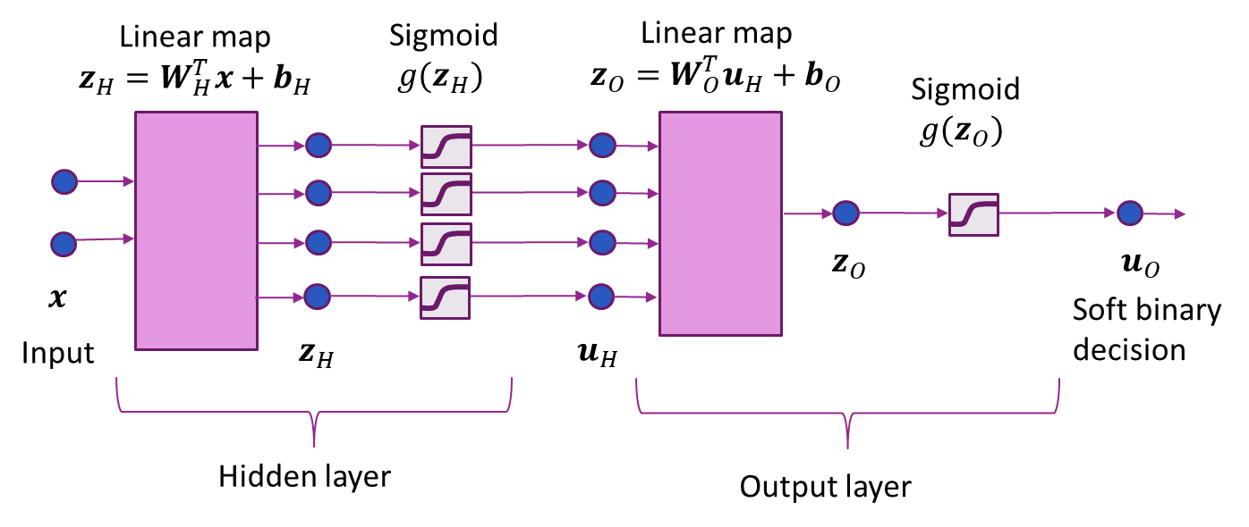
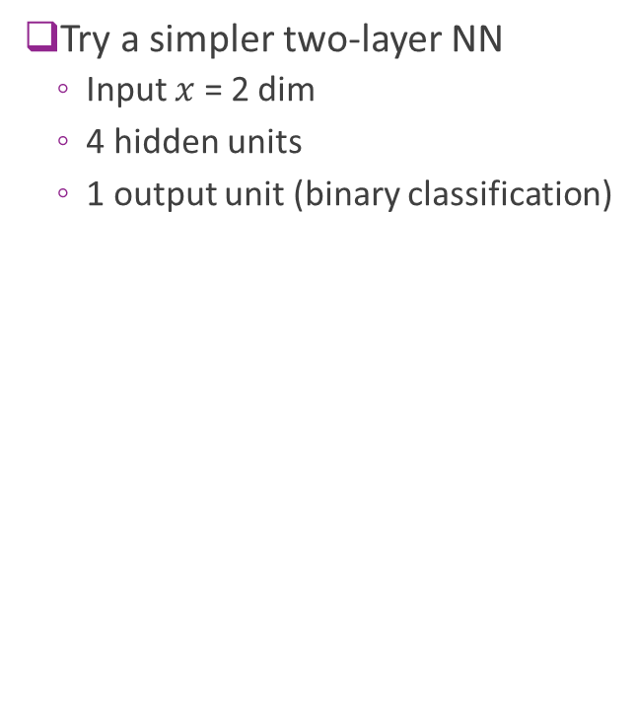
Synthetic Data Example
Try a simpler two-layer NN
Input $x$ = 2 dim
4 hidden units
1 output unit (binary classification)

Slide 29


Step 0: Import the Packages
https://pytorch.org/get-started/locally/
Install Pytorch
If you are using Google Collaboratory: Pytorch is pre-installed

Slide 30
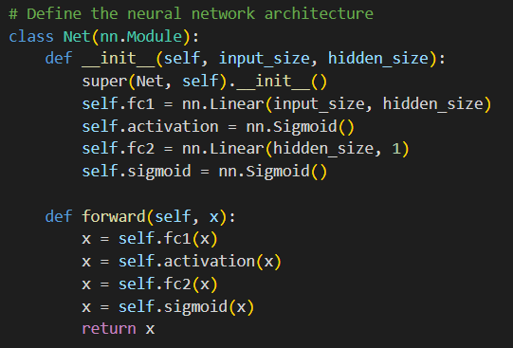
Step 1: Define Model
Each network is defined as a class
Derives from nn.Module
Constructor
Creates layers of the network
This network: Two fully connected layers & activations
Forward function
Describes set of operations from input to output

Slide 31
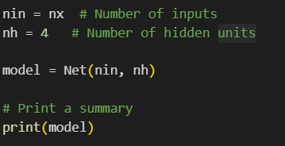
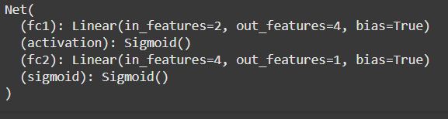
Step 1: Continued
Create an instance of the model
Print the model summary
For each layers
Show dimensions

Slide 32
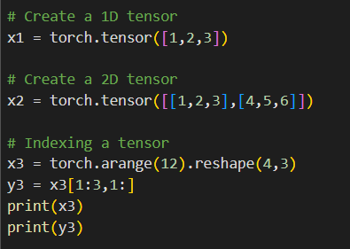
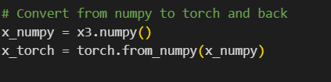
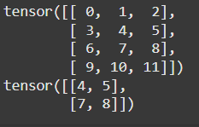
PyTorch Tensors
Data in pytorch is passed as tensors
Essentially, multi-dimensional arrays
Syntax is identical to numpy

Slide 33
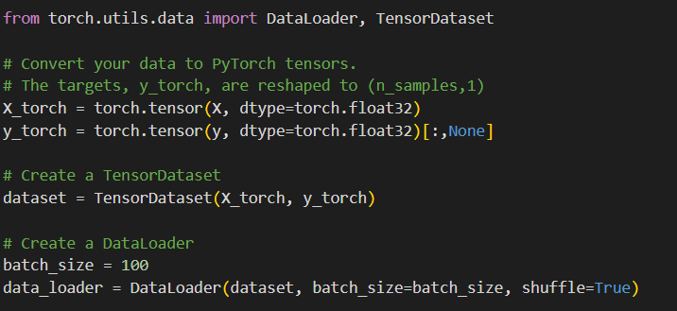
Step 2: Create a DataLoader
DataLoader:
An object that creates the mini-batches
Performs all the shuffling automatically
We will explore more complex dataloaders later

Slide 34

Step 2, 3: Select an Optimizer & Compile
Adam optimizer generally works well for most problems
In this case, had to manually set learning rate
You often need to play with this.
Use binary cross-entropy loss

Slide 35
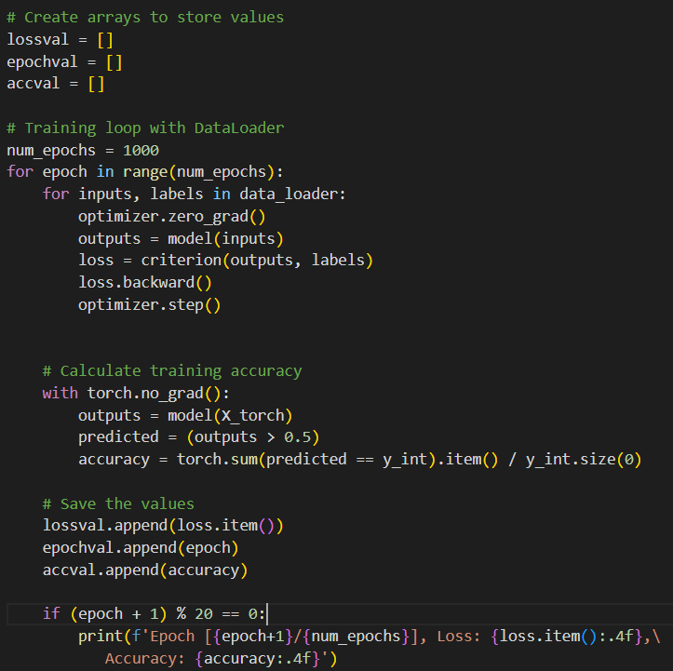
Step 4: Fit the Model
Manually implement the SGD loop
Loop over epochs
Loop over mini-batches
Compute outputs and loss
Compute gradient of loss
Take an optimizer step
Measure accuracy
Print results periodically

Slide 36
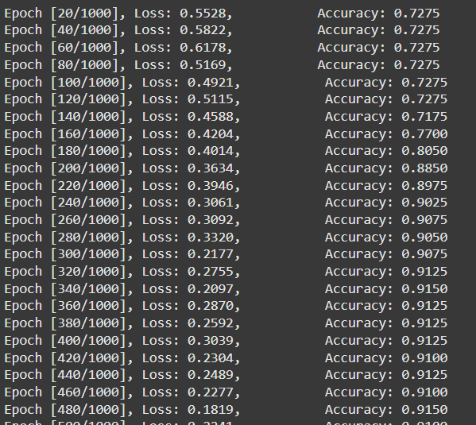
Step 4: Output
Prints progress after each 20 epochs
You can see the loss decreasing
And accuracy increasing

Slide 37
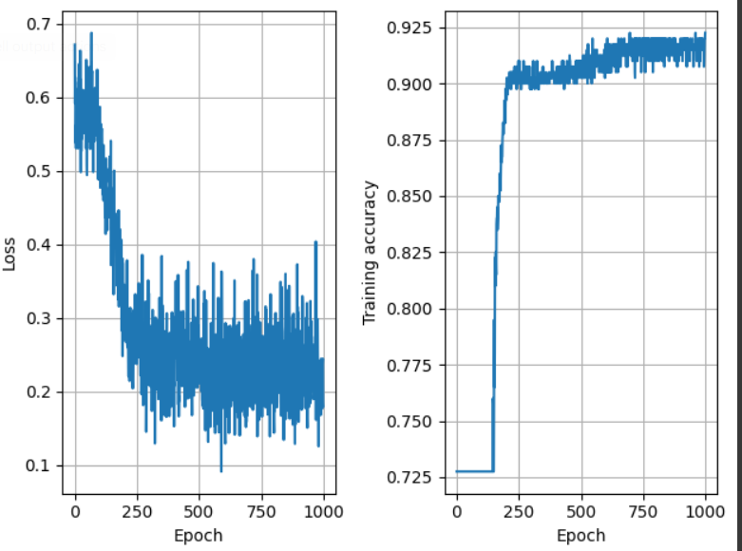
Performance vs Epoch
Can observe loss function slowly converging
But there is “noise”
Due to random selections in each mini-batch

Slide 38
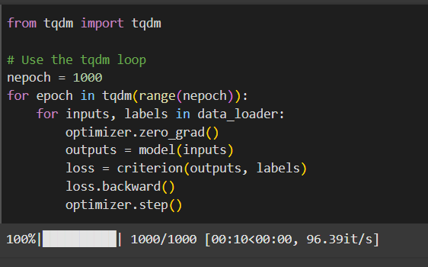
Using TQDM
Periodic printing can create long outputs
May be better to use a progress bar
Progress bar can be created with tqdm package
Progress bar

Slide 39
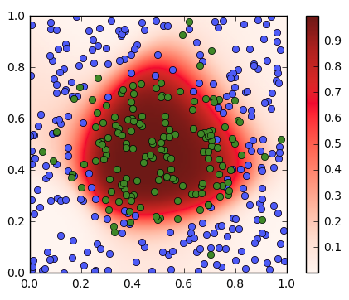

Step 5. Visualizing the Decision Regions
Feed in data $x=(x_{1},x_{2})$ over grid of points in $\left[0,1\right]×\left[0,1\right]$
Use predict to observe output for each input point
Plot outputs $u_{O}=sigmoid(z_{O})$

Slide 40
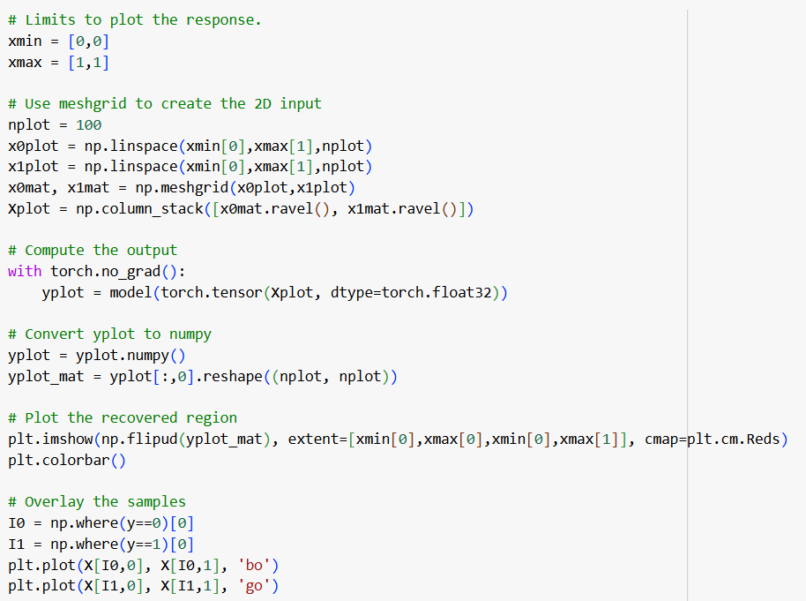
Step 5. Full Plotting Code
Meshgrid
Creates grid of points in square
torch.no_grad():
Turns off the gradient for the prediction
Computes prediction
Plots the outputs

Slide 41
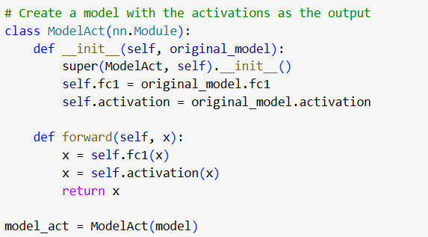
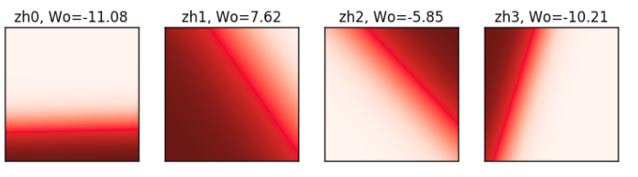

Visualizing the Hidden Layers
Create a new model with hidden layer output
Feed in data $x=(x_{1},x_{2})$ over $\left[0,1\right]×\left[0,1\right]$
Predict outputs from hidden outputs
Each hidden layer is a logistic regression layer with a different separating line!

Slide 42
Outline
Motivating Idea: Nonlinear classifiers from linear features
Training Neural Networks and Stochastic Gradient Descent
Building and Training a Network in PyTorch
Synthetic data
MNIST
Tensorflow Version [Optional]
Synthetic data
MNIST
Backpropagation Training

Slide 43
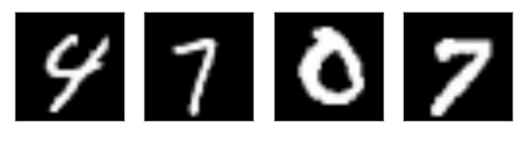
Recap: MNIST data
Classic MNIST problem:
Detect hand-written digits
Each image is 28 x 28 = 784 pixels
Dataset size:
50,000 training digits
10,000 test
10,000 validation (not used here)
Can be loaded with sklearn and many other packages

Slide 44
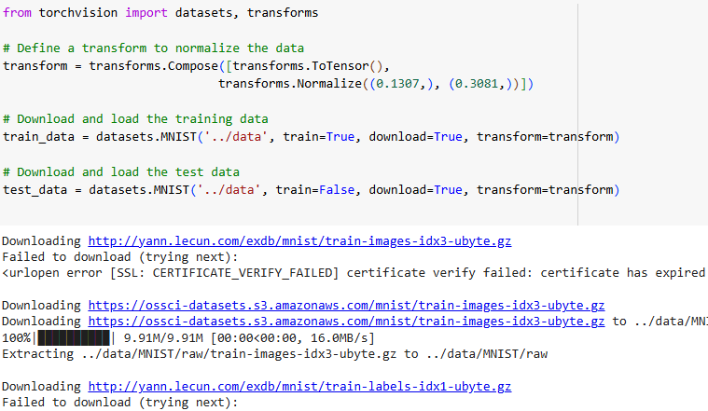
Downloading the MNIST data
We can download the MNIST data from PyTorch directly
Transforms:
Used to convert images to arrays
Each sample is (1,28,28)
The first 1 is since the image in black/white
Single channel, no color
Scaling used to make data:
zero mean and unit variance

Slide 45
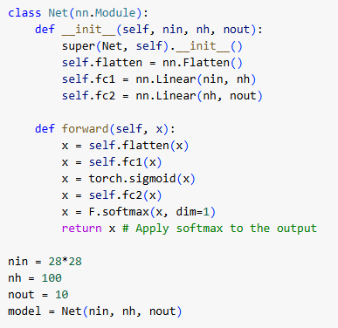

Simple MNIST Neural Network
Flatten layer:
Converts (1,28,28) sample to 784 vector
FC1, FC2: Fully connected layers
100 hidden units
Sigmoid activation
Output is softmax
10 outputs since we have 10 classes

Slide 46

Fitting the Model
Train with 30 epochs
Mini-batch size = 100
After each epoch
Evaluate accuracy on test data set

Slide 47

Fitting the Model
Run for 30 epochs, ADAM optimizer
batch size = 100
Final accuracy = 0.97
Not great, but much faster than SVM.
Also, CNNs we study later do even better.
We will discuss later

Slide 48


Training and Validation Accuracy
Training accuracy continues to increase
Validation accuracy eventually flattens and sometimes starts to decrease.
Should stop when the validation accuracy starts to decrease.
This indicates overfitting.

Slide 49

In-Class Exercise

Slide 50
Outline
Motivating Idea: Nonlinear classifiers from linear features
Training Neural Networks and Stochastic Gradient Descent
Building and Training a Network in PyTorch
Synthetic data
MNIST
Tensorflow Version [Optional]
Synthetic data
MNIST
Backpropagation Training

Slide 51
Keras Recipe
Step 1. Describe model architecture
Number of hidden units, output units, activations, …
Step 2. Select an optimizer
Step 3. Select a loss function and compile the model
Step 4. Fit the model
Step 5. Test / use the model

Slide 52
Synthetic Data Example
Try a simpler two-layer NN
Input $x$ = 2 dim
4 hidden units
1 output unit (binary classification)

Slide 53

Step 0: Import the Packages
Install Tensorflow
For this lab, you can use the CPU version
If you are using Google Collaboratory, TF is pre-installed
https://www.tensorflow.org/install

Slide 54



Step 1: Define Model
Load modules for layers
Clear graph (extremely important!)
Build model
This example: dense layers
Give each layer a dimension, name & activation

Slide 55

Step 1: Continued
Print the model summary
For each layers
Shows dimensions and shape
Note shapes:
(None, 4)
Batch size
This is not fixed
Dim per sample in batch

Slide 56

Step 2, 3: Select an Optimizer & Compile
Adam optimizer generally works well for most problems
In this case, had to manually set learning rate
You often need to play with this.
Use binary cross-entropy loss
Metrics indicate what will be printed in each epoch

Slide 57

Step 4: Fit the Model
Use keras fit function
Specify number of epoch & batch size
Prints progress after each epoch
Loss = loss on training data
Acc = accuracy on training data

Slide 58


Fitting the Model with Many Epochs
This example requires large number of epochs (~1000)
Do not want to print progress on each epoch
Rewrite code to manually print progress
Can also use a callback function

Slide 59

Performance vs Epoch
Can observe loss function slowly converging

Slide 60

Step 5. Visualizing the Decision Regions
Feed in data $x=(x_{1},x_{2})$ over grid of points in $\left[0,1\right]×\left[0,1\right]$
Use predict to observe output for each input point
Plot outputs $u_{O}=sigmoid(z_{O})$

Slide 61

Visualizing the Hidden Layers
Create a new model with hidden layer output
Feed in data $x=(x_{1},x_{2})$ over $\left[0,1\right]×\left[0,1\right]$
Predict outputs from hidden outputs
Each hidden layer is a logistic regression layer with a different separating line!

Slide 62
Outline
Motivating Idea: Nonlinear classifiers from linear features
Training Neural Networks and Stochastic Gradient Descent
Building and Training a Network in PyTorch
Synthetic data
MNIST
Tensorflow Version [Optional]
Synthetic data
MNIST
Backpropagation Training

Slide 63

Stochastic Gradient Descent
Training uses SGD
In each step:
Select a subset of sample for minibatch $I⊂\{1,…,N\}$
Evaluate mini-batch loss $L\left(θ^{t}\right)= \sum_{i∈I}{L_{i}(θ^{t},x_{i},y_{i})}$
Evaluate mini-batch gradient $g^{t}= \sum_{i∈I}{{∇L}_{i}(θ^{t},x_{i},y_{i})}$
Take SGD step: $θ^{t+1}=θ^{t}−αg^{t}$
Question: How do we compute gradient?

Slide 64

Gradients with Multiple Parameters
For neural net problem: $θ=(W_{H},b_{H},W_{o},b_{o})$
Gradient is computed with respect to each parameter:
$$∇L\left(θ\right)=[∇_{W_{H}}L\left(θ\right),∇_{b_{H}}L\left(θ\right),∇_{W_{O}}L\left(θ\right),∇_{b_{O}}L\left(θ\right)]$$
Gradient descent is performed on each parameter: $W_{H}←W_{H}−α∇_{W_{H}}L\left(θ\right),$ $b_{H}←b_{H}−α∇_{b_{H}}L\left(θ\right),$ $….$

Slide 65









Computation Graph & Forward Pass
Neural network loss function can be computed via a computation graph
Sequence of operations starting from measured data and parameters
Loss function computed via a forward pass in the computation graph
$z_{H,i}=W_{H}x_{i}+b_{H}$
$u_{H,i}=g_{act}(z_{H,i})$
$z_{O,i}=W_{O}u_{H,i}+b_{O}$
$L=\sum_{i}{L_{i}(z_{O,i},y_{i}) }$
$$L(θ)$$
Observed variable
Trainable variable
Computed variables
$$x$$
$$z_{H}$$
$$u_{H}$$
$$z_{O}$$
$$W_{H},b_{H}$$
$$W_{O},b_{O}$$
$$y$$

Slide 66



Forward Pass Example in Numpy
Example network:
Single hidden layer with $N_{H}$ hidden units, single output unit
Sigmoid activation, binary cross entropy loss

Slide 67








Back-Propagation on A Two Node Graph
Back Propagation:
A way to compute gradients
Iterative procedure that works in reverse
Consider a simple 2 node computation graph
Input $x=\left(x_{1},…,x_{N}\right),$Hidden $z=\left(z_{1},…,z_{M}\right)$
Scalar output $J$
First, we compute $\frac{∂J}{∂z_{i}}$
Then compute $\frac{∂J}{∂x_{j}}$ from multi-variable chain rule: $\frac{∂J}{∂x_{j}}=\sum_{i=1}^{n}{\frac{∂J}{∂z_{i}}\frac{∂z_{i}}{∂x_{j}}}$
Variables computed in forward pass
$$z=f(x)$$
$$J=g(z)$$
$$x$$
$$z$$
$$J$$
$$\frac{∂J}{∂x_{j}}$$
$$\frac{∂J}{∂z_{i}}$$
Gradients computed in reverse pass

Slide 68


Back-Prop on a General Computation Graph
Backpropagation:
Compute gradients backwards
Work one node at a time
First compute all derivatives of all the variables
${∂L}/{∂z_{O}}$
${∂L}/{∂u_{H}}$ from ${∂L}/{∂z_{O}},{∂z_{O}}/{∂u_{H}}$
${∂L}/{∂z_{H}}$ from ${∂L}/{∂u_{H}},{∂u_{H}}/{∂z_{H}}$
Then compute gradient of parameters:
${∂L}/{∂W_{O}}$ from ${∂L}/{∂z_{O}},{∂z_{O}}/{∂W_{O}}$
${∂L}/{∂b_{O}}$ from ${∂L}/{∂z_{O}},{∂z_{O}}/{∂b_{O}}$
${∂L}/{∂W_{H}}$ from ${∂L}/{∂z_{H}},{∂z_{H}}/{∂W_{H}}$
${∂L}/{∂b_{H}}$ from ${∂L}/{∂z_{H}},{∂z_{H}}/{∂b_{H}}$

Slide 69

Back-Propagation Example (Part 1)
Continue our example:
Single hidden layer with $M$hidden units, single output unit
Sigmoid activation, binary cross entropy loss
$N$ samples, $D$ input dimension
Loss node forward pass:
$L=\ln\left[1+e^{z_{oi}}\right]−y_{i}z_{oi}$
Gradient reverse step:
$\frac{∂L}{∂z_{O,i}}=$ $\frac{1}{1+e^{−z_{oi}}}−y_{i}$

Slide 70

Back-Propagation Example (Part 2)
Node $z_{O}$
$z_{O}=u_{H}W_{O}+b_{O}$
$z_{Oi}=\sum_{m}{{u_{H,im}W}_{Om}+b_{O}}$
Gradient:
$\frac{∂z_{O,i}}{∂W_{O,m} }=u_{H,i,m}$
$\frac{∂z_{O,i}}{∂b_{O} }=1$
Other partial derivatives are zero
Apply chain rule:
$\frac{∂L}{∂W_{O,m}}=\sum_{i}{\frac{∂L}{∂z_{O,i}}\frac{∂z_{O,i}}{∂W_{O,m}}}=\sum_{i}{\frac{∂L}{∂z_{O,i}}u_{H,im}}$
$\frac{∂L}{∂b_{O}}=\sum_{i}{\frac{∂L}{∂z_{O,i}}\frac{∂z_{O,i}}{∂b_{O}}}=\sum_{i}{\frac{∂L}{∂z_{O,i}}}$

Slide 71

Back-Propagation Example (Part 3)
Node $z_{O}$
$z_{O}=u_{H}W_{O}+b_{O}$
$z_{Oi}=\sum_{m}{{u_{H,im}W}_{Om}+b_{O}}$
Gradient:
$\frac{∂z_{O,i}}{∂u_{H,ij}}=W_{O,j}$, m=1,…,M
Other partial derivatives are zero
Apply chain rule:
$\frac{∂L}{∂u_{H,ij}}=\frac{∂L}{∂z_{O,i}}\frac{∂z_{O,i}}{∂u_{H,ij}}=\frac{∂L}{∂z_{O,i}}W_{O,j}$

Slide 72

Back-Propagation Example (Part 4)
Node $u_{H}$
$u_{H} =g_{act}(z_{H})$
$u_{H,ij}=\frac{1}{1+\exp{(−z_{H,ij})}}$
Gradient:
$\frac{∂u_{H,ij}}{∂z_{H,ij}}=\frac{\exp\left(−z_{H,ij}\right)}{{\left(1+\exp\left(−z_{H,ij}\right)\right)}^{2} }=u_{H,ij}(1−u_{H,ij})$
Other partial derivatives are zero
Apply chain rule:
$\frac{∂L}{∂z_{H,ij}}=\frac{∂L}{∂u_{H,ij}}\frac{∂u_{H,ij}}{∂z_{H,ij}}=\frac{∂L}{∂u_{H,ij}}u_{H,ij}(1−u_{H,ij})$

Slide 73

Back-Propagation Example (Part 5)
Node $z_{O}$
$z_{H}=XW_{H}+b_{H}$
$z_{Hij}=\sum_{k}{{x_{ik}W}_{H,kj}+b_{H,j}}$
Gradient:
$\frac{∂z_{H,ij}}{∂W_{H,kj} }=x_{ik}$
$\frac{∂z_{H,ij}}{∂b_{H,j} }=1$
Other partial derivatives are zero
Apply chain rule:
$\frac{∂L}{∂W_{O,kj}}=\sum_{i}{\frac{∂L}{∂z_{H,ij}}\frac{∂z_{H,ij}}{∂W_{H,kj}}}=\sum_{i}{\frac{∂L}{∂z_{H,ij}}x_{ik}}$
$\frac{∂L}{∂b_{H,j}}=\sum_{i}{\frac{∂L}{∂z_{O,ij}}\frac{∂z_{O,i}}{∂b_{O,j}}}=\sum_{i}{\frac{∂L}{∂z_{O,ij}}}$

Slide 74

In-Class Exercise
Implement backpropgation in numpy
Demo already performs output layer
You need to finish the hidden layer
Test the gradient
Note the python broadcasting

Slide 75

Lab for this unit
Music instrument classification based on music signals
Use hand-crafted features for audio (MFCC)
Train a neural net
Optimize the learning rate

Slide 76
Initialization and Data Normalization
Solution by gradient descent algorithm depends on the initial solution
Typically weights are set to random values near zero.
Small weights make the network behave like linear classifier.
Hence model starts out nearly linearly
Becomes nonlinear as weights increase during the training process.
Starting with large weights often lead to poor results.
Normalizing data to zero mean and unit variance
Allows all input dimensions be treated equally and facilitate better convergence.
With normalized data, it is typical to initialize the weights to be uniform in [-0.7, 0.7] [ESL]

Slide 77

Regularization
To avoid the weights get too large, can add a penalty term explicitly, with regularization level $λ$
Ridge penalty
$$R\left(θ\right)=\sum_{d,m}{w_{H,d,m}^{2}+\sum_{m,k}{w_{O,m,k}^{2}={\left\|w_{H}\right\|}^{2}+{\left\|w_{O}\right\|}^{2}}}$$
Total loss
$$L_{reg}\left(θ\right)=L\left(θ\right)+λR\left(θ\right)$$
Change in gradient calculation
Typically used regularization
L2 = Ridge: Shrink the sizes of weights
L1: Prefer sparse set of weights
L1-L2: use a combination of both

Slide 78

Regularization in Keras
Activity regularization tries to make the output at each layer small or sparse.

Slide 79
Choice of network parameters
Number of layers (typically not more than 2)
Number of hidden units in the hidden layer
Regularization level
Learning rate
Determined by maximizing the cross validation error through typically exhaustive search

Slide 80
Learning Objectives
Mathematically describe a neural network with a single hidden layer
Describe mappings for the hidden and output units
Manually compute output regions for very simple networks
Select the loss function based on the problem type
Build and train a simple neural network in Keras
Write the formulas for gradients using backpropagation
Describe mini-batches in stochastic gradient descent
Importance of regularization
Hyperparameter optimization

