Slide 1
Unit 8 K-NN and Kernel Methods
EE-uy 4563/EL-GY 9143: Introduction to machine learning

Slide 2
Learning Objectives
Mathematically describe K-NN and kernel methods
For regression and classification
Visualize the regression and classification output
Select kernel hyper-parameters from cross validation
Compute the bias and variance error for estimators

Slide 3
Relation to SVM Lecture
Unit 8 also has a lecture on SVM
Beginning 2025, we are not teaching SVM
Spending more time on Kernel methods and decision trees
SVMs are not widely-used
But look at SVM if you are interested

Slide 4

Outline
$K$-Nearest Neighbors
Kernel Smoothing
Kernel Regression
Example with Climate Data

Slide 5
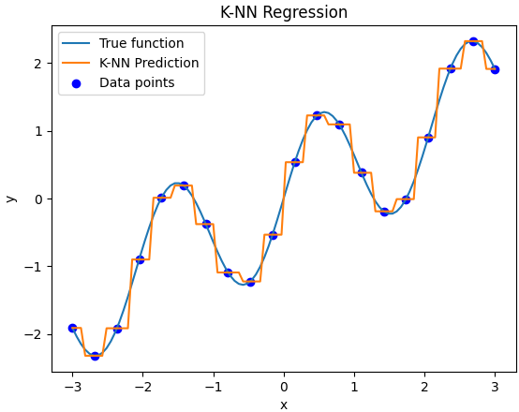
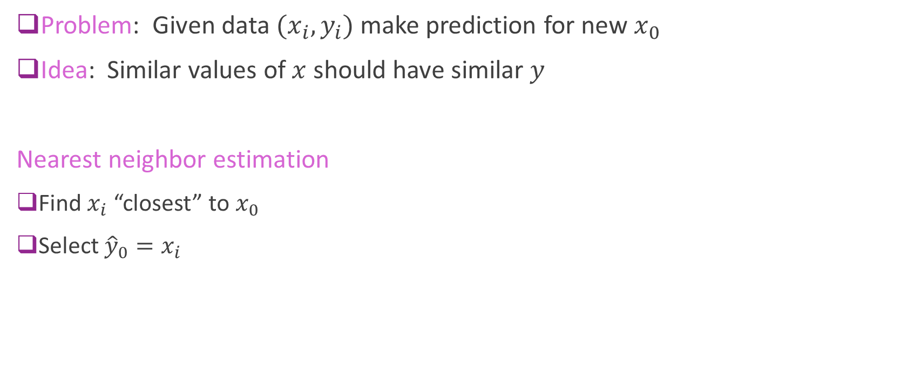
Nearest Neighbor Regression
Problem: Given data $(x_{i},y_{i})$ make prediction for new $x_{0}$
Idea: Similar values of $x$ should have similar $y$
Nearest neighbor estimation
Find $x_{i}$ “closest” to $x_{0}$
Select ${\hat{y}}_{0}=x_{i}$

Slide 6
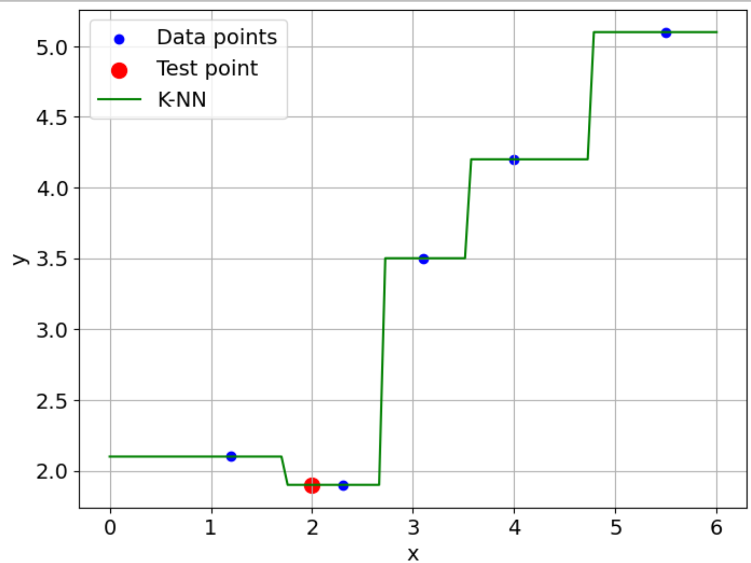
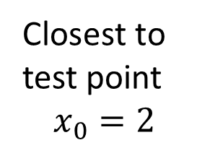
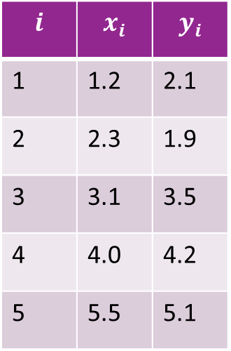
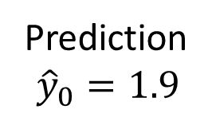
Example
Data
Closest to
test point $$x_{0}=2$$
$$i$$ | $$x_{i}$$ | $$y_{i}$$
1 | 1.2 | 2.1
2 | 2.3 | 1.9
3 | 3.1 | 3.5
4 | 4.0 | 4.2
5 | 5.5 | 5.1
Prediction $${\hat{y}}_{0}=1.9$$

Slide 7
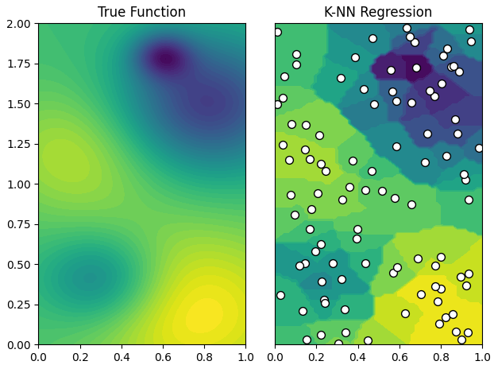
Nearest Neighbor in 2D
Gives a “tessellation” of space
Vornoi regions
Each region mapped to a point

Slide 8
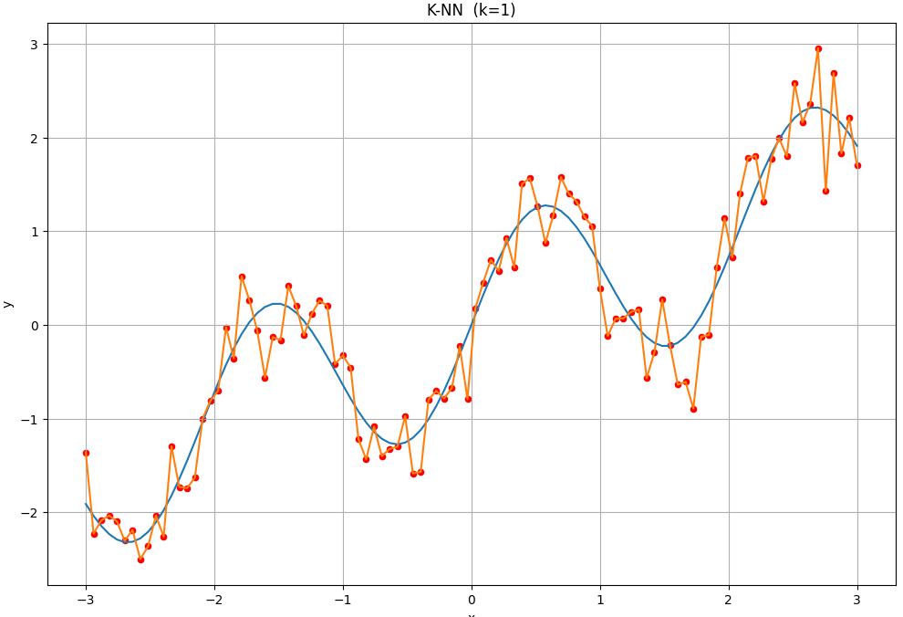

K-Nearest Neighbor
Problem with nearest neighbor:
Prediction sensitive to noise
Overfits data
K-Nearest neighbor:
Take average of $K$ closest points
Increasing $K$
Reduces noise effect (lower variance error)
Smooths (increase bias error)
Example of overfitting data

Slide 9
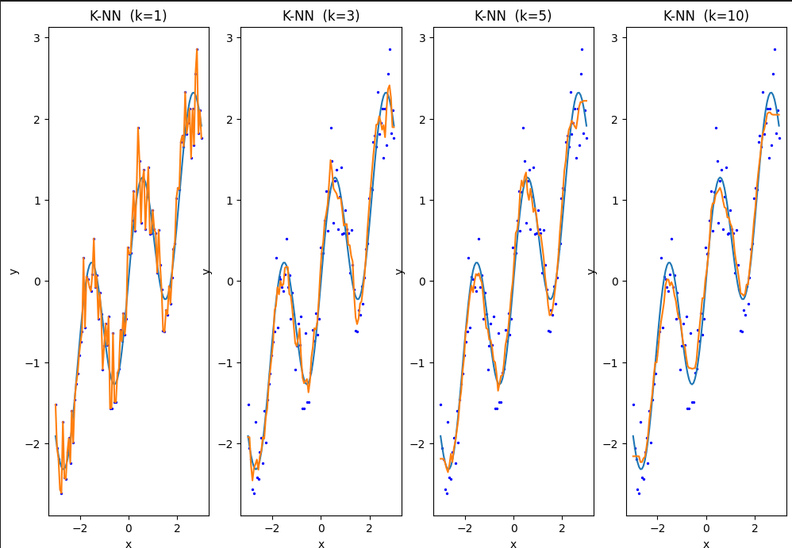
1D Example
High variance error
Low bias error
Low variance error
High bias error

Slide 10
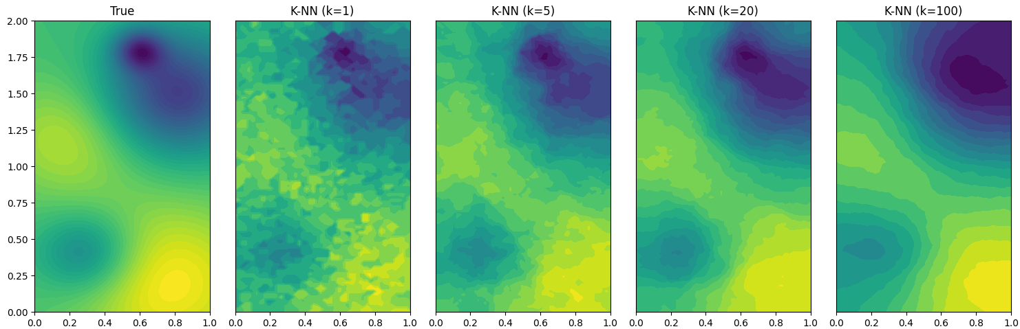
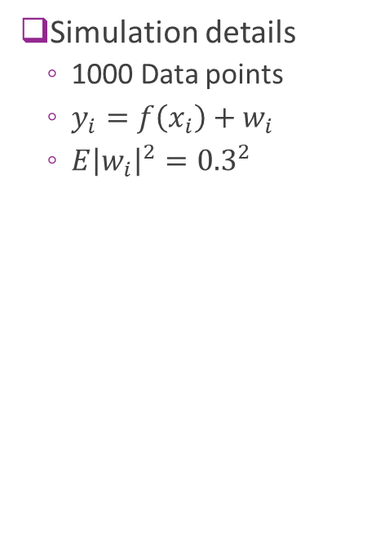
2D Example
Simulation details
1000 Data points
$y_{i}=f\left(x_{i}\right)+w_{i}$
$E{\left|w_{i}\right|}^{2}={0.3}^{2}$
High variance error
Low bias error
Low variance error
High bias error

Slide 11
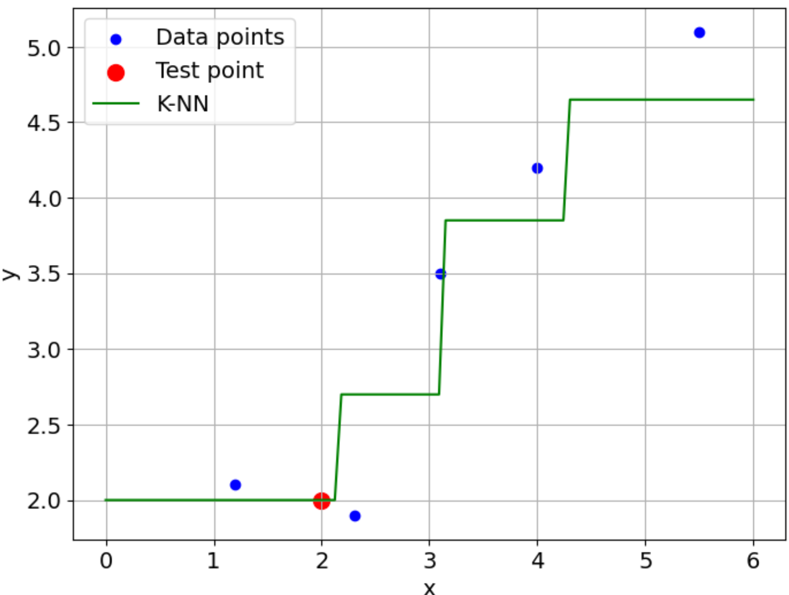



Error Analysis for K-NN
Suppose that $y_{i}=f\left(x_{i}\right)+w_{i},$
$w_{i}$ = measurement noise
$E\left(w_{i}\right)=0, E\left(w_{i}^{2}\right)=σ^{2}$
Given new test point $x_{0}$
Prediction is:
${\hat{y}}_{0}=\frac{1}{K}\sum_{i∈I_{K}(x_{0})}{y_{i}},$
$I_{K}\left(x_{0}\right)=$ $K$ indices closest to $x_{0}$
What is the bias and variance error?
$I_{K}\left(x_{0}\right)=\{1,2\}$ for $K=2$
$$x_{0}=2.0$$

Slide 12
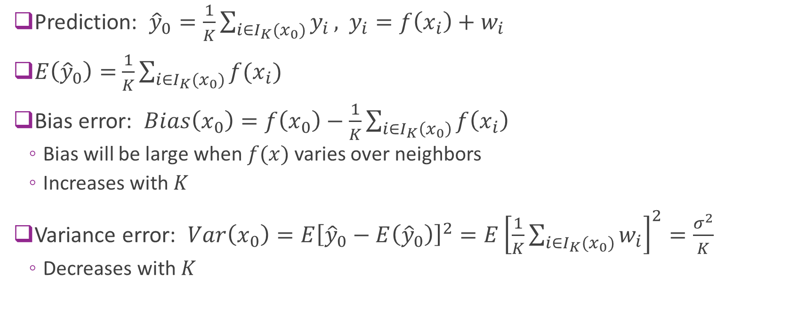
Bias and Variance
Prediction: ${\hat{y}}_{0}=\frac{1}{K}\sum_{i∈I_{K}(x_{0})}{y_{i}},$ $y_{i}=f\left(x_{i}\right)+w_{i}$
$E\left({\hat{y}}_{0}\right)=$ $\frac{1}{K}\sum_{i∈I_{K}(x_{0})}{f(x_{i})}$
Bias error: $Bias\left(x_{0}\right)=f\left(x_{0}\right)−\frac{1}{K}\sum_{i∈I_{K}\left(x_{0}\right)}{f\left(x_{i}\right)}$
Bias will be large when $f(x)$ varies over neighbors
Increases with $K$
Variance error: $Var\left(x_{0}\right)=E{\left[{\hat{y}}_{0}−E\left({\hat{y}}_{0}\right)\right]}^{2}=E{\left[\frac{1}{K}\sum_{i∈I_{K}(x_{0})}{w_{i}}\right]}^{2}=\frac{σ^{2}}{K}$
Decreases with $K$

Slide 13
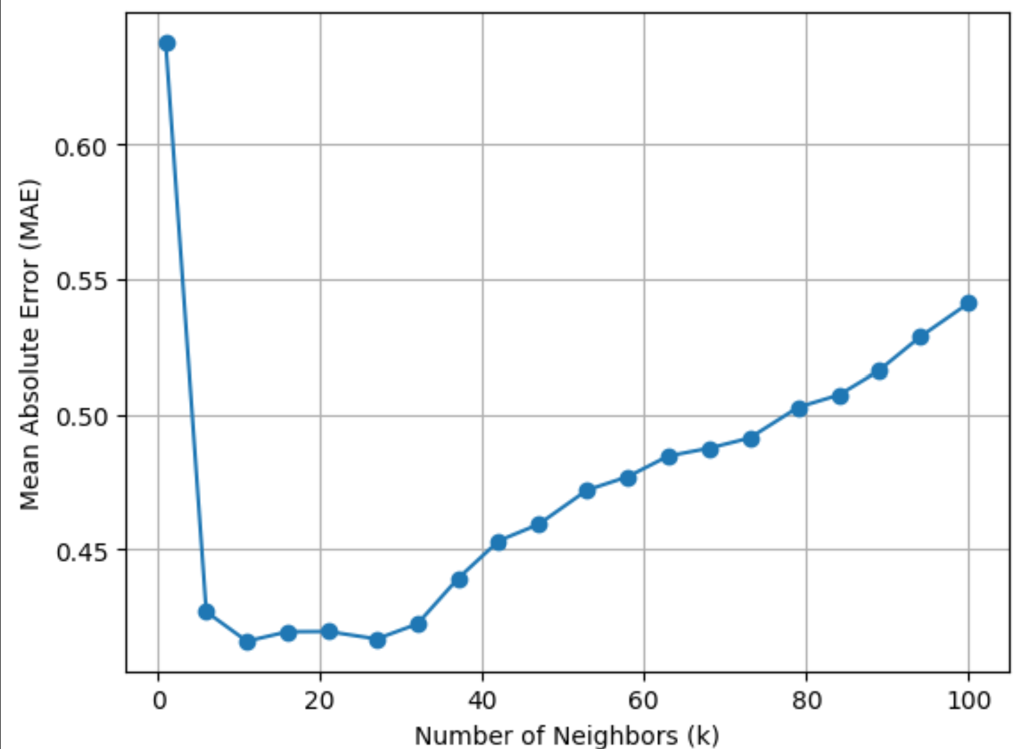
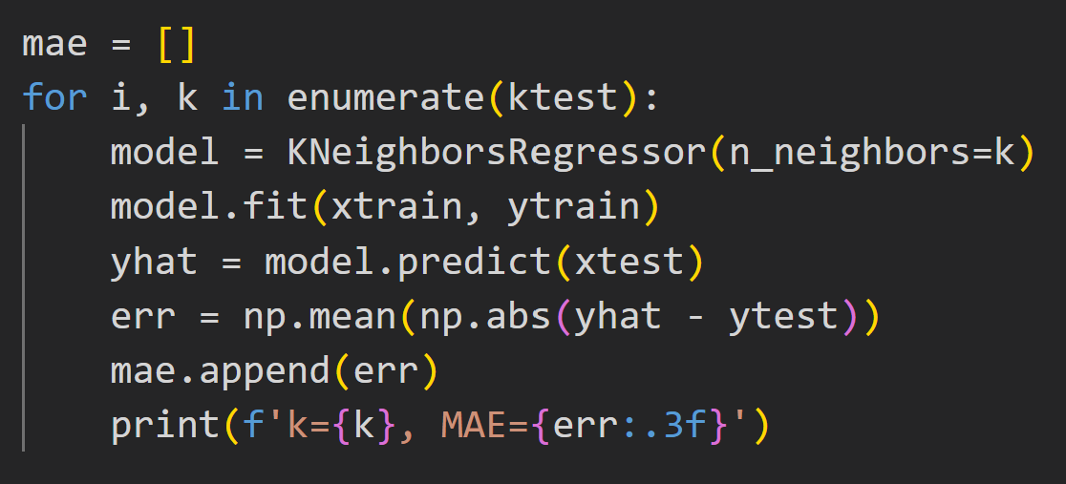

Using Cross-Validation
As usual find optimal $K$ with cross-validation

Slide 14
Parametric vs. Non-Parametric
Parametric methods
Ex: Linear regression
Assume function form
Model has parameters
Fit parameters
Use model directly
Non-Parametric methods
Ex: K-NN
No functional assumption
No parameters
But assumes smoothness
No fitting
Use data directly

Slide 15
Computational Cost Comparison
Task | Parametric Method (e.g. linear regression) | Non-Parametric (e.g. K-NN)
Model Fitting | Can be hard (e.g. gradient descent) | None, except hyper-parameters
Inference (after fitting) | Generally easier | Hard Must search through all data

Slide 16
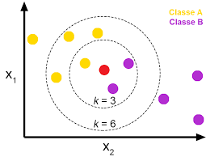

K-NN Classification
K-NN can also be used for classification
Data $(x_{i},y_{i})$ binary labels $y_{i}∈\{0,1\}$
Test point $x_{0}$
Find indices of $K$ closest neighbors $I_{K}\left(x_{0}\right)$
Predict probability: $p\left(x_{0}\right)=\frac{1}{K}\sum_{i∈I_{K}(x_{0})}{y_{i}}$
Fraction of neighbors that are class 1
Class estimate ${\hat{y}}_{0}=\left\{\begin{matrix}1 & p\left(x_{0}\right)≥t \\ 0 & p\left(x_{0}\right)<t\end{matrix}\right.$
$t$ = threshold. Typically, $t=\frac{1}{2}$

Slide 17
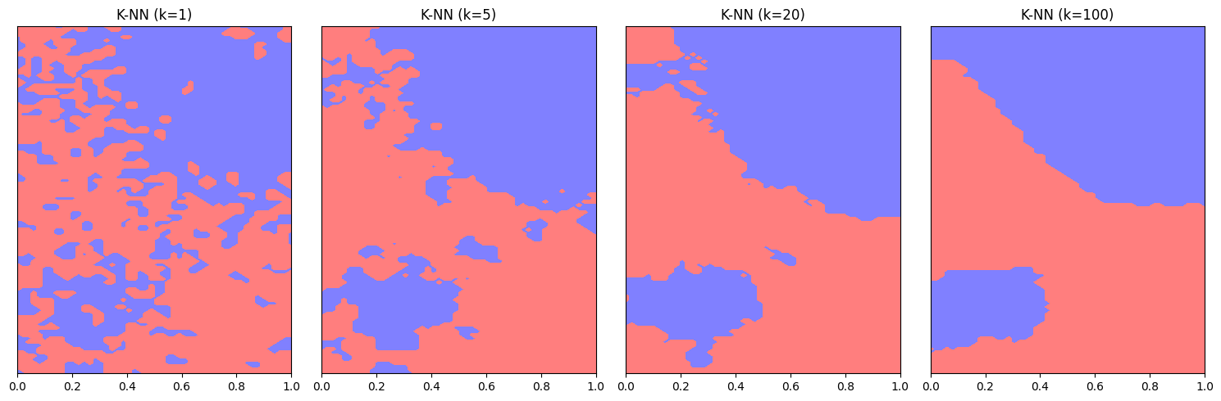

K-NN 2D Classification
1000 data points
Larger $K$:
Smoother decision regions

Slide 18
Outline
$K$-Nearest Neighbors
Kernel Smoothing
Kernel Regression
Example with Climate Data

Slide 19
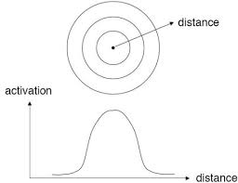
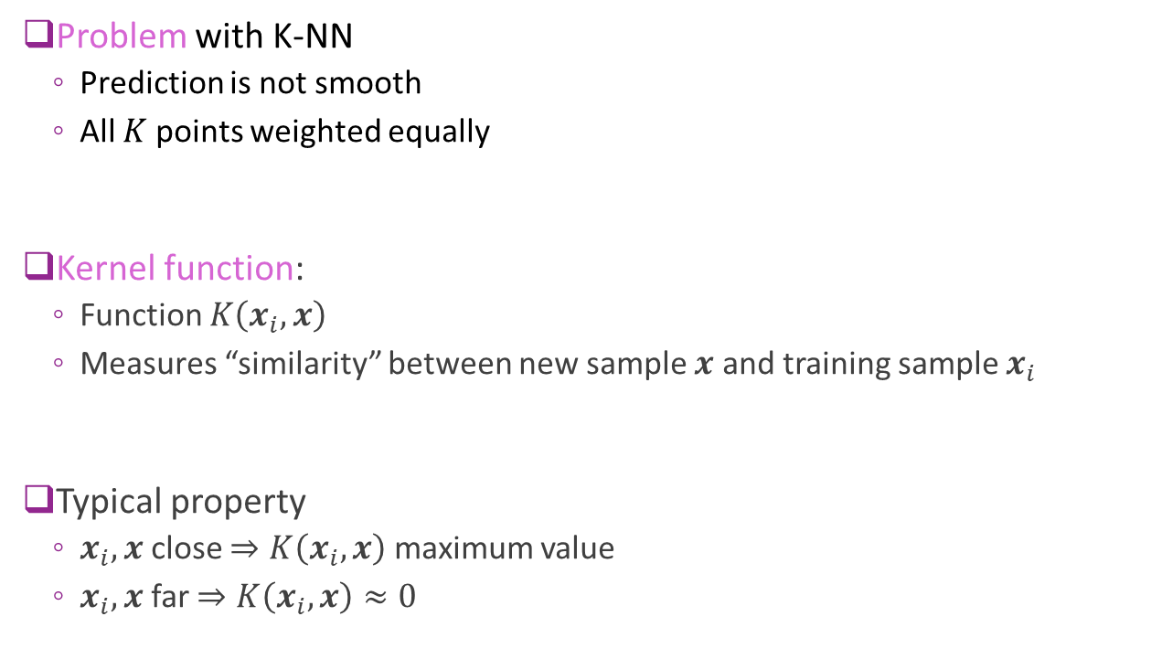
The Kernel Function
Problem with K-NN
Prediction is not smooth
All $K$ points weighted equally
Kernel function:
Function $K\left(x_{i},x\right)$
Measures “similarity” between new sample $x$ and training sample $x_{i}$
Typical property
$x_{i},x$ close $⇒K\left(x_{i},x\right)$ maximum value
$x_{i},x$ far $⇒K\left(x_{i},x\right)≈0$

Slide 20
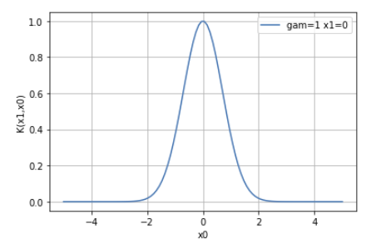

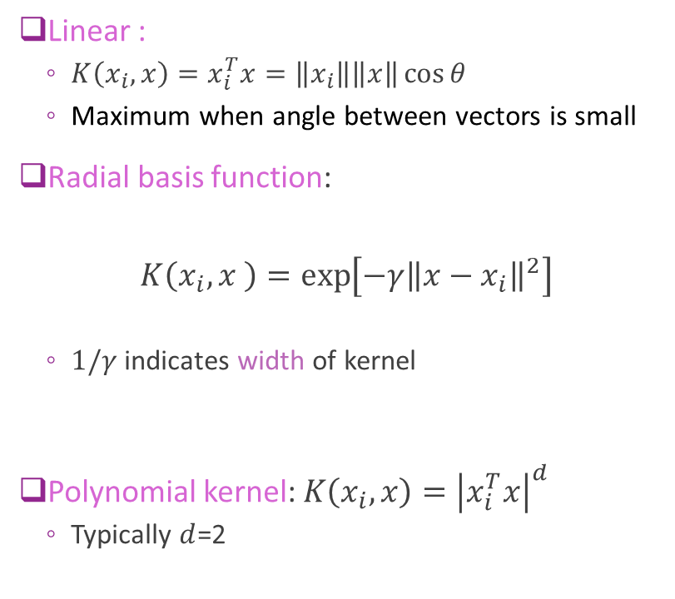


Common Kernels
Linear :
$K\left(x_{i},x\right)=x_{i}^{T}x=\left\|x_{i}\right\|\left\|x\right\|\cos{θ}$
Maximum when angle between vectors is small
Radial basis function:
$$K\left(x_{i},x \right)=\exp\left[−γ{\left\|x−x_{i}\right\|}^{2}\right]$$
$1/γ$ indicates width of kernel
Polynomial kernel: $K\left(x_{i},x\right)={\left|x_{i}^{T}x\right|}^{d}$
Typically $d$=2
$$x_{i}$$
$$θ$$
$$x$$

Slide 21
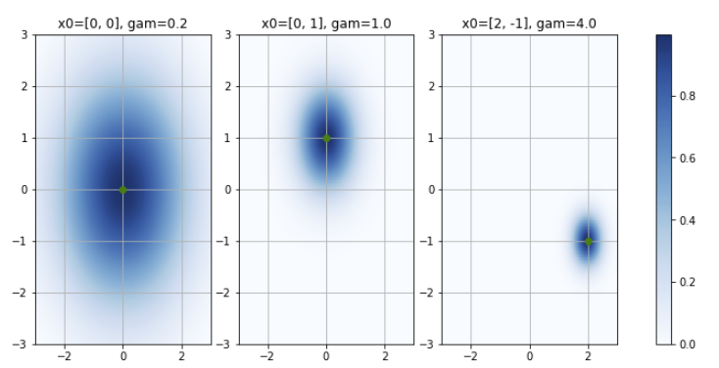
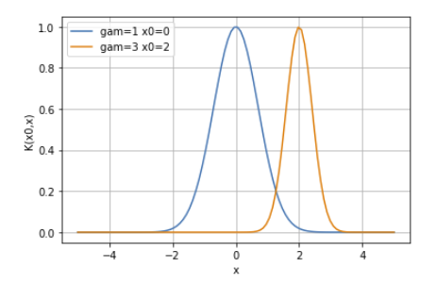
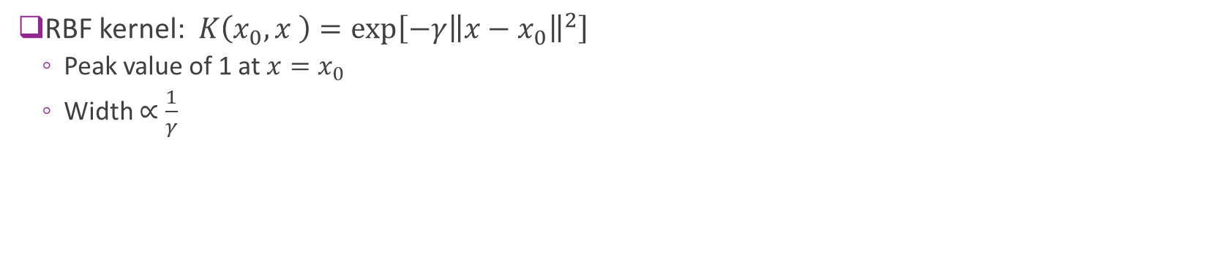
RBF Kernel Examples
RBF kernel: $K\left(x_{0},x \right)=\exp\left[−γ{\left\|x−x_{0}\right\|}^{2}\right]$
Peak value of 1 at $x=x_{0}$
Width $∝\frac{1}{γ}$
RBFs in 1D
RBFs in 2D

Slide 22
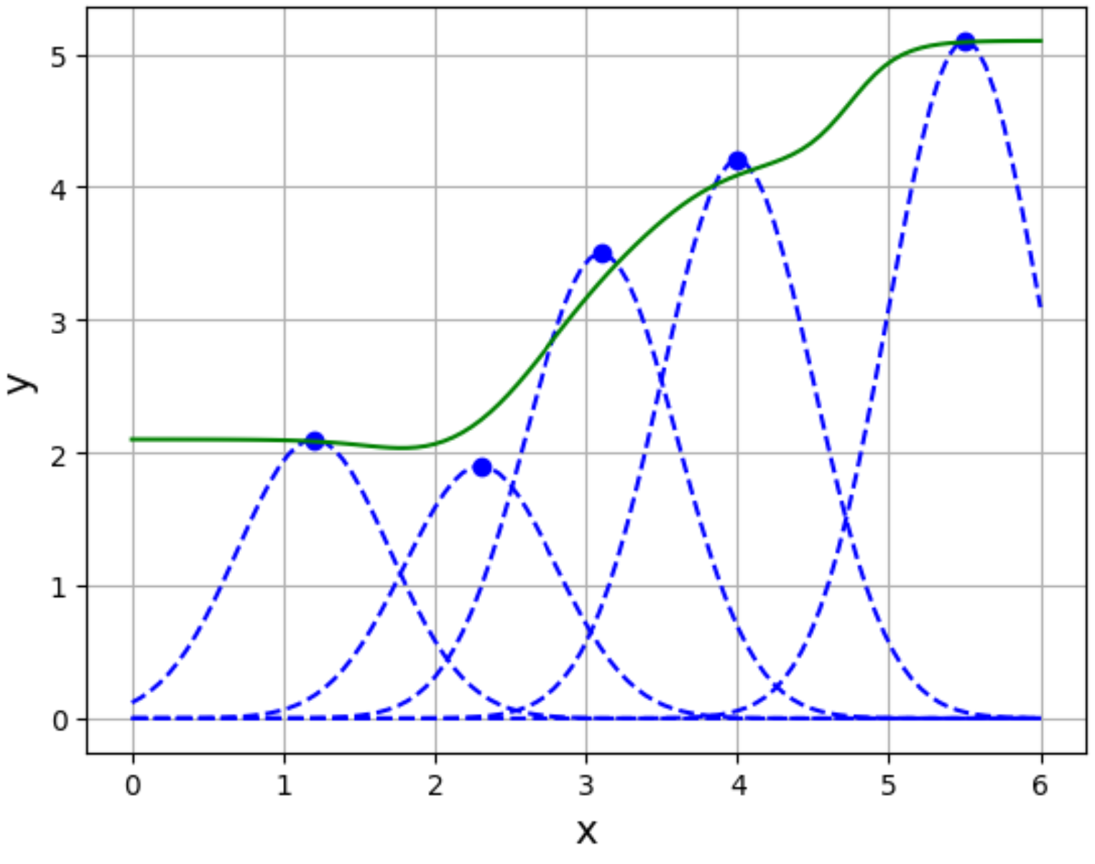
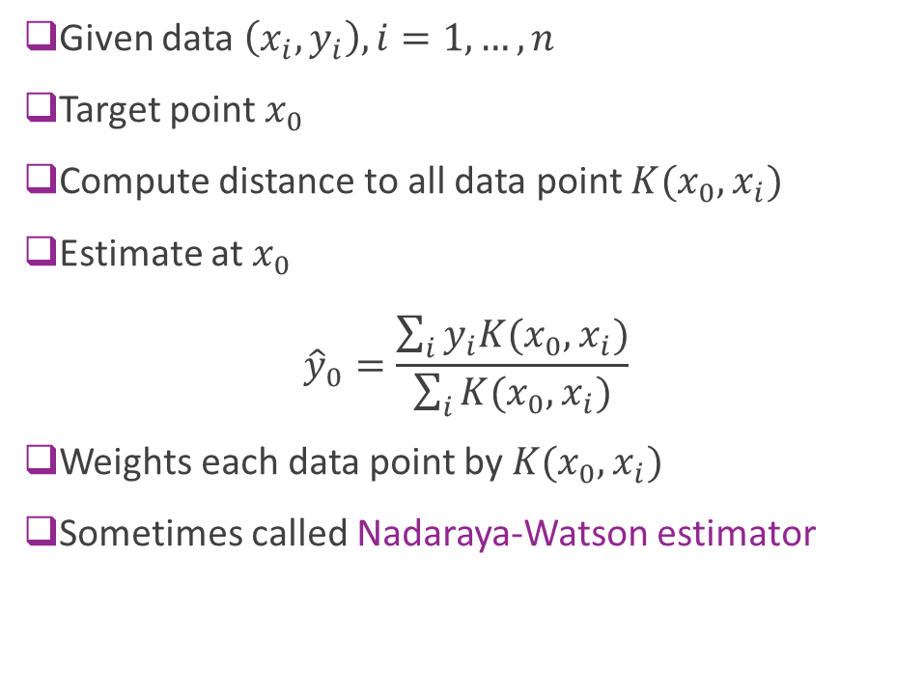
Kernel Smoothing
Given data $\left(x_{i},y_{i}\right), i=1,…,n$
Target point $x_{0}$
Compute distance to all data point $K(x_{0},x_{i})$
Estimate at $x_{0}$ ${\hat{y}}_{0}=\frac{\sum_{i}{y_{i}K(x_{0},x_{i})}}{\sum_{i}{K(x_{0},x_{i})}}$
Weights each data point by $K(x_{0},x_{i})$
Sometimes called Nadaraya-Watson estimator

Slide 23
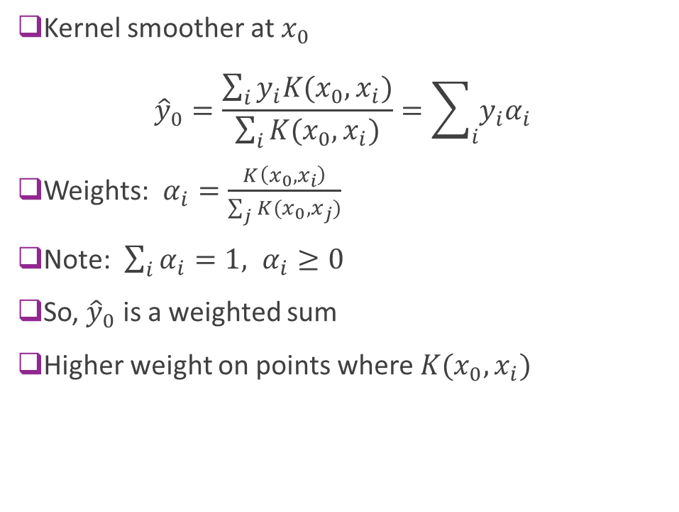
Kernel Smoothing as Weighted Sum
Kernel smoother at $x_{0}$ ${\hat{y}}_{0}=\frac{\sum_{i}{y_{i}K(x_{0},x_{i})}}{\sum_{i}{K(x_{0},x_{i})}}=\sum_{i}{y_{i}α_{i}}$
Weights: $α_{i}=\frac{K\left(x_{0},x_{i}\right)}{\sum_{j}{K(x_{0},x_{j})}}$
Note: $\sum_{i}{α_{i}}=1, α_{i}≥0$
So, ${\hat{y}}_{0}$ is a weighted sum
Higher weight on points where $K(x_{0},x_{i})$

Slide 24
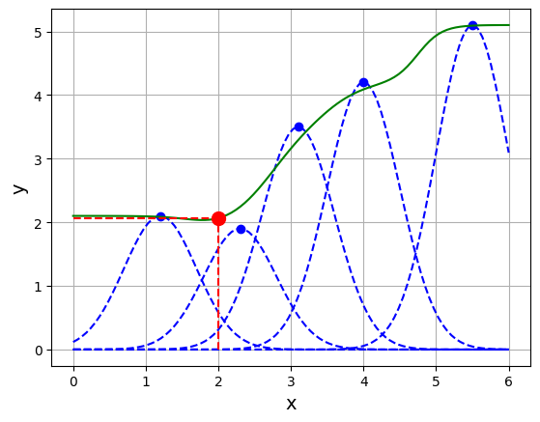
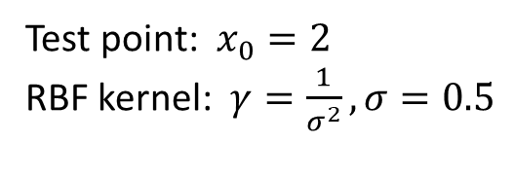

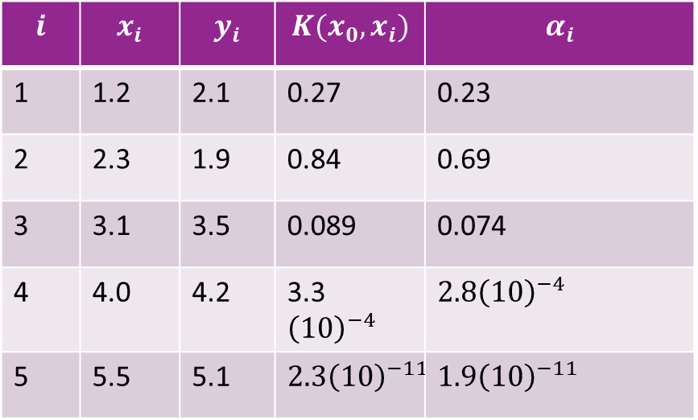

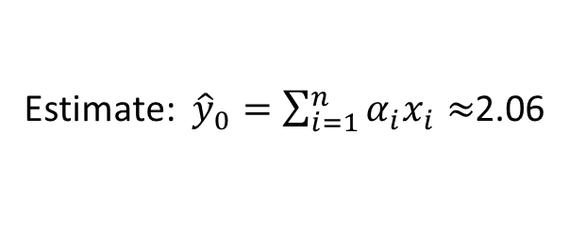
Example with RBF
Test point: $x_{0}=2$
RBF kernel: $γ=\frac{1}{σ^{2}}, σ=0.5$
Estimate: ${\hat{y}}_{0}=\sum_{i=1}^{n}{α_{i}x_{i}}≈$2.06
$$i$$ | $$x_{i}$$ | $$y_{i}$$ | $$K(x_{0},x_{i})$$ | $$α_{i}$$
1 | 1.2 | 2.1 | 0.27 | 0.23
2 | 2.3 | 1.9 | 0.84 | 0.69
3 | 3.1 | 3.5 | 0.089 | 0.074
4 | 4.0 | 4.2 | 3.3${\left(10\right)}^{−4}$ | $2.8{\left(10\right)}^{−4}$
5 | 5.5 | 5.1 | $$2.3{\left(10\right)}^{−11}$$ | $1.9{\left(10\right)}^{−11}$
$${\hat{y}}_{0}$$
$$x_{0}$$

Slide 25
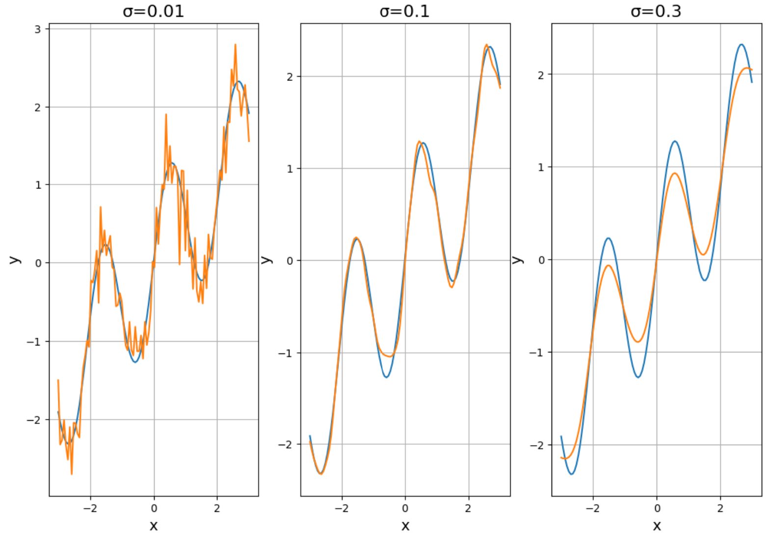
1D Example
s
High variance error
Low bias error
Low variance error
High bias error

Slide 26
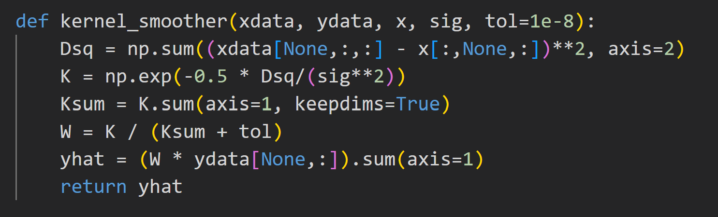
Kernel Smoother in Python
No built-in function in sklearn
But you can write it manually

Slide 27

Error Analysis for Kernel
Suppose that $y_{i}=f\left(x_{i}\right)+w_{i},$
$w_{i}$ = measurement noise
$E\left(w_{i}\right)=0, E\left(w_{i}^{2}\right)=σ^{2}$
Given new test point $x_{0}$
Prediction is:
${\hat{y}}_{0}=\sum_{i}{α_{i}y_{i}},$
What is the bias and variance error?
$$x_{0}=2.0$$

Slide 28
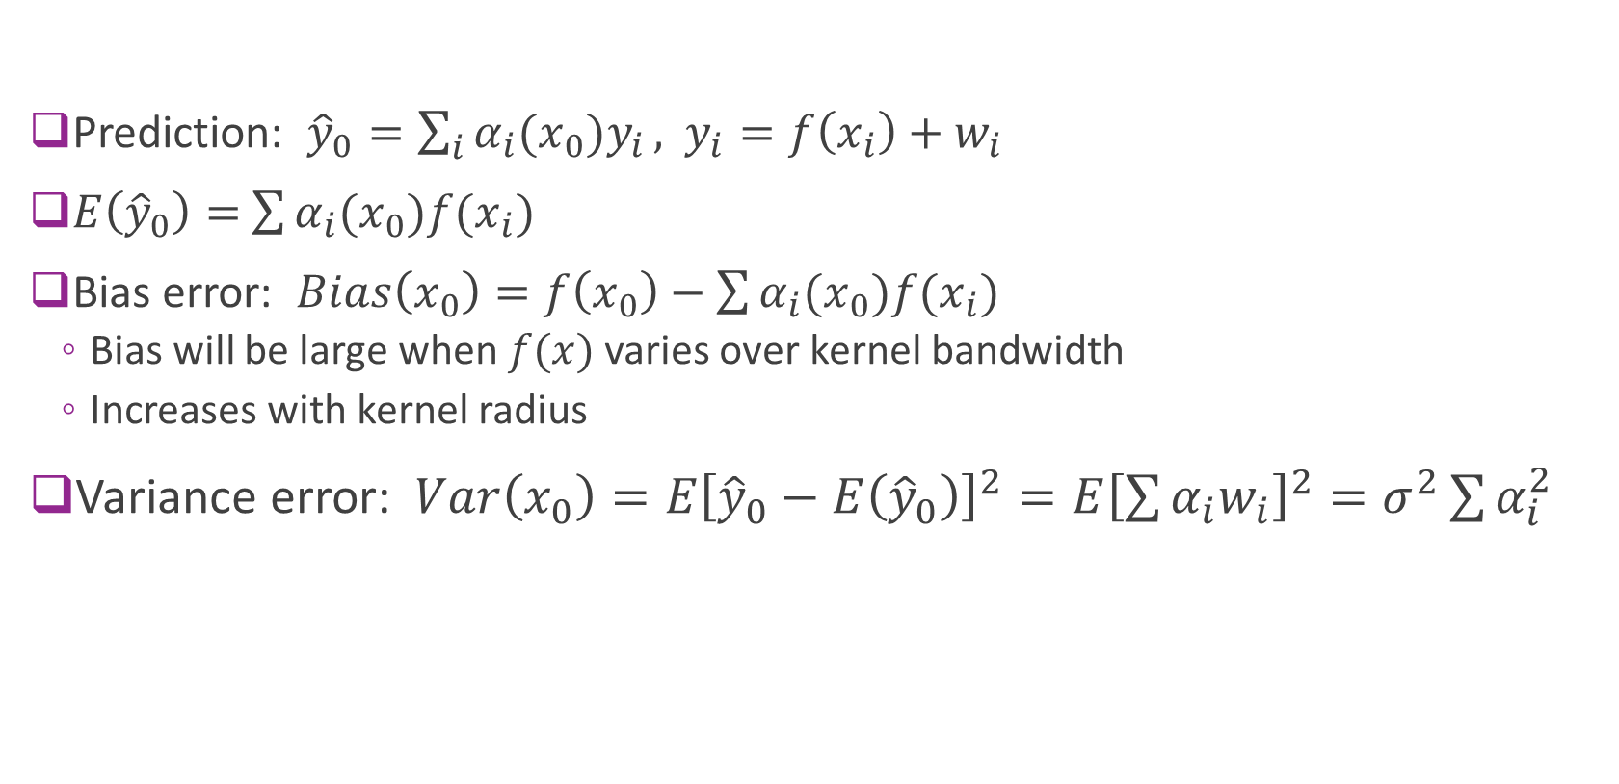
Bias and Variance
Prediction: ${\hat{y}}_{0}=\sum_{i}{α_{i}(x_{0})y_{i}},$ $y_{i}=f\left(x_{i}\right)+w_{i}$
$E\left({\hat{y}}_{0}\right)=$ $\sum{α_{i}(x_{0})f(x_{i})}$
Bias error: $Bias\left(x_{0}\right)=f\left(x_{0}\right)−\sum{α_{i}(x_{0})f(x_{i})}$
Bias will be large when $f(x)$ varies over kernel bandwidth
Increases with kernel radius
Variance error: $Var\left(x_{0}\right)=E{\left[{\hat{y}}_{0}−E\left({\hat{y}}_{0}\right)\right]}^{2}=E{\left[\sum{α_{i}w_{i}}\right]}^{2}=σ^{2}\sum{α_{i}^{2}}$

Slide 29

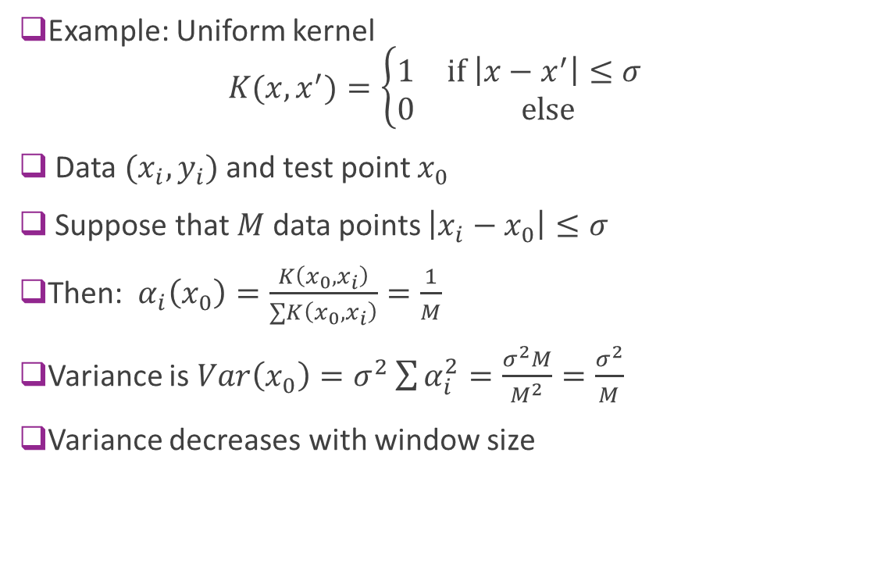
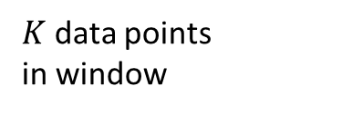

Variance Error for a Uniform Kernel
Example: Uniform kernel $K(x,x^{′})=\left\{\begin{matrix}1 & \text{if} \left|x−x^{′}\right|≤σ \\ 0 & \text{else}\end{matrix}\right.$
Data $(x_{i},y_{i})$ and test point $x_{0}$
Suppose that $M$ data points $\left|x_{i}−x_{0}\right|≤σ$
Then: $α_{i}\left(x_{0}\right)=\frac{K\left(x_{0},x_{i}\right)}{∑K\left(x_{0},x_{i}\right)}=\frac{1}{M}$
Variance is $Var\left(x_{0}\right)=σ^{2}\sum{α_{i}^{2}}=\frac{σ^{2}M}{M^{2}}=\frac{σ^{2}}{M}$
Variance decreases with window size
$$−\frac{σ}{2}$$
$$\frac{σ}{2}$$
$K$ data points in window

Slide 30
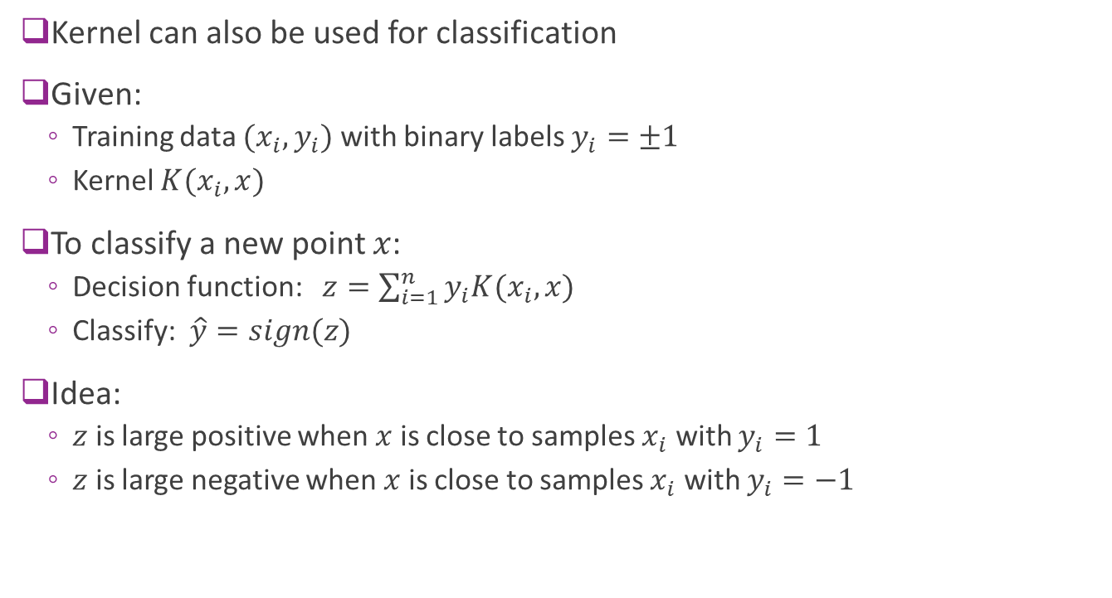
Kernel Classifier
Kernel can also be used for classification
Given:
Training data $(x_{i},y_{i})$ with binary labels $y_{i}=±1$
Kernel $K(x_{i},x)$
To classify a new point $x$:
Decision function: $z=\sum_{i=1}^{n}{y_{i}K(x_{i},x)}$
Classify: $\hat{y}=sign(z)$
Idea:
$z$ is large positive when $x$ is close to samples $x_{i}$ with $y_{i}=1$
$z$ is large negative when $x$ is close to samples $x_{i}$ with $y_{i}=−1$

Slide 31
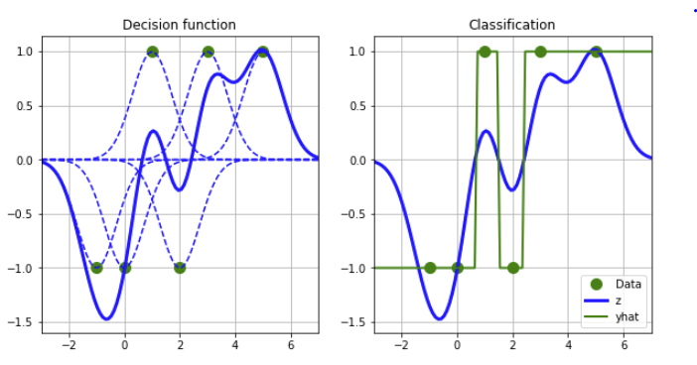
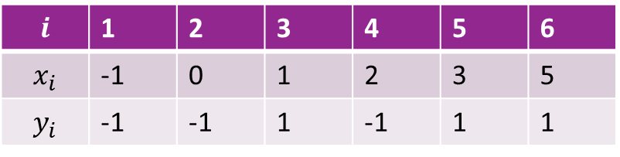

Example in 1D
Example data with 6 points $(x_{i},y_{i})$
RBF kernel: $K\left(x_{i},x\right)=e^{−γ{\left(x_{i}−x\right)}^{2}}, γ=1$
Decision function:
$z=\sum_{i=1}^{n}{y_{i}K(x_{i},x)}$
Sum of bell curves
Positive when near positive samples
Negative when near negative samples
Classification:
$\hat{y}=sign(z)$
$$i$$ | 1 | 2 | 3 | 4 | 5 | 6
$$x_{i}$$ | -1 | 0 | 1 | 2 | 3 | 5
$$y_{i}$$ | -1 | -1 | 1 | -1 | 1 | 1

Slide 32
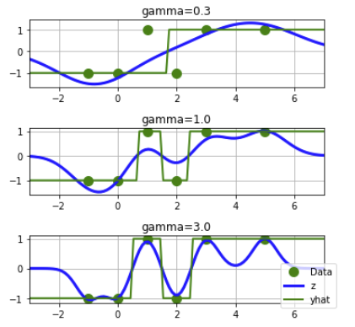

Effect of Gamma
Same data as before
RBF kernel: $K\left(x_{i},x\right)=e^{−γ{\left(x_{i}−x\right)}^{2}}$
As $γ$ increases:
Decision function $z≈y_{i}$ when $x=x_{i}$
Classifier fits training data better
Classification region more complex
As a classifier, higher $γ$results in:
Lower bias error
But, higher variance error

Slide 33
Outline
$K$-Nearest Neighbors
Kernel Smoothing
Kernel Regression
Example with Climate Data

Slide 34
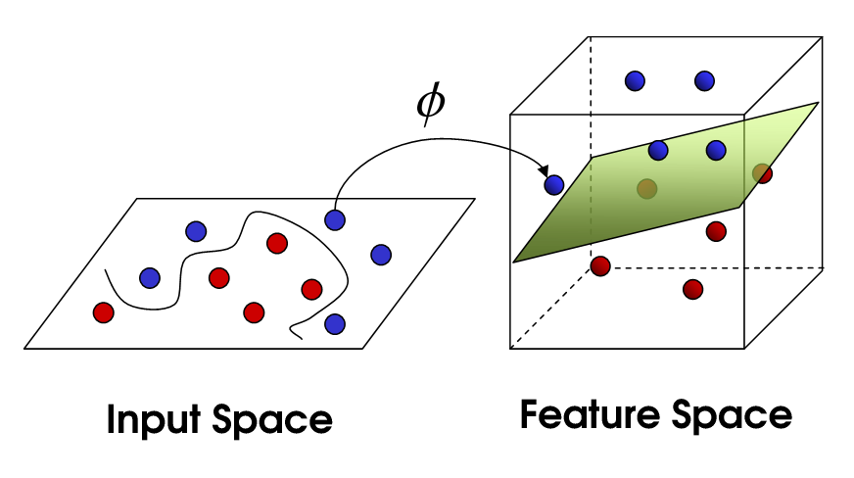

Transform Linear Models
Recall transforms
Data $(x_{i},y_{i})$
Transform data $z_{ij}=φ_{j}\left(x_{i}\right), j=1,…,p$
Each $φ_{j}\left(x\right)$ is a “basis” function
Linear model: $\hat{y}=\sum_{j=1}^{p}{w_{j}φ_{j}(x)}$
Weights $w_{j}$ found by linear regression
Maps original data $x$ to a higher dimensional space $z$

Slide 35

Inner Product Kernel
Consider a transform $z=φ(x)$
Define kernel $K\left(x,x^{′}\right)=φ{\left(x\right)}^{T}φ\left(x^{′}\right)$
Inner product in the transformed space
$K\left(x,x^{′}\right)$ has three key properties:
Positive: $K\left(x,x\right)≥0$ since $K\left(x,x\right)={\left\|φ\left(x\right)\right\|}^{2}$
Symmetry: $K\left(x,x′\right)=φ{\left(x\right)}^{T}φ\left(x^{′}\right)=φ{\left(x′\right)}^{T}φ\left(x\right)=K\left(x^{′},x\right)$
Positive semi-definite property: Given any $α_{i}$ and $x_{i}$ $\sum_{i,j}{α_{i}α_{j}K(x_{i},x_{j})}≥0$
Why? $\sum_{i,j}{α_{i}α_{j}K(x_{i},x_{j})}=\sum_{i,j}{α_{i}α_{j}φ{\left(x_{i}\right)}^{T}φ\left(x_{j}\right)}={\left\|\sum_{j}{α_{j}φ\left(x_{j}\right)}\right\|}^{2}$

Slide 36

“Kernel Trick”
Consider transformed linear model: $\hat{y}=\hat{f}\left(x\right)=\sum_{j=1}^{p}{w_{j}φ_{j}(x)}$
Suppose $w$ solved with Ridge regression: $w={\arg{\min_{w}{\sum_{i}{{\left(y_{i}−\hat{f}\left(x_{i}\right)\right)}^{2}}+λ\left\|w\right\|}}}^{2}$
Theorem: For any transformed linear model: $\hat{y}=\hat{f}\left(x\right)=\sum_{i=1}^{n}{β_{i}K(x_{i},x)}$
Coefficients are solutions to $\left(K+λI\right)β=y$
$K$ is the matrix with coefficients $K_{ij}=K(x_{i},x_{j})$

Slide 37

Implications of the Kernel Trick
In any transformed model: $\hat{y}=\hat{f}\left(x\right)=\sum_{i=1}^{n}{β_{i}K(x_{i},x)}$
Similar to Kernel smoothing
But parameters $β$ are fit from the data
No need to transform data $x↦φ(x)$
Can solve for coefficients directly with Kernel $K(x_{i},x)$

Slide 38

Proof of Kernel Trick
Weights are given by: $w={\left(A^{T}A+λI\right)}^{−1}A^{T}y$ with $A=\left[\begin{matrix}φ{\left(x_{1}\right)}^{T} \\ ⋮ \\ φ{\left(x_{n}\right)}^{T}\end{matrix}\right]$
From linear algebra $w=A^{T}{\left(AA^{T}+λI\right)}^{−1}y$
Let $β={\left(AA^{T}+λI\right)}^{−1}y$ so $w=A^{T}β$
For any other data point $x,$ $\hat{y}=\hat{f}\left(x\right)=w^{T}φ\left(x\right)=β^{T}A^{T}φ(x)$
By definition of the kernel:
${\left[AA^{T}\right]}_{ij}=φ{\left(x_{i}\right)}^{T}φ\left(x_{j}\right)=K(x_{i},x_{j})$ and ${\left[A^{T}φ\left(x\right)\right]}_{i}=K(x_{i},x)$
Hence: $\hat{y}=\hat{f}\left(x\right)=w^{T}φ\left(x\right)=β^{T}A^{T}φ\left(x\right)=\sum{β_{i}}K(x_{i},x)$
Also: $\left(K+λI\right)β=y$

Slide 39

Kernel Representation (Advanced)
Say a kernel $K\left(x,x′\right)$ is symmetric and positive semidefinite if:
Symmetry: $K\left(x,x′\right)=K\left(x^{′},x\right)$
Given any $α_{i}$ and $x_{i}$ $\sum_{i,j}{α_{i}α_{j}K(x_{i},x_{j})}≥0$
Sometimes people say positive semidefinite to include symmetric
Theorem: If kernel $K\left(x,x′\right)$ is symmetric and positive semidefinite then there exists a mapping $x↦φ(x)$ to a Hilbert space such that $K\left(x,x′\right)=\left\langle φ\left(x\right),φ(x′)\right\rangle$
All kernels are inner products in some transformed space
The space may be infinite dimensional

Slide 40
Outline
$K$-Nearest Neighbors
Kernel Smoothing
Kernel Regression
Example with Climate Data

Slide 41


Temperature Modeling
Problem: Interpolate temperature from limited measurements
Data has natural spatial structure
Kernel methods apply well
Data from excellent Berkeley Earth page
Several other sources as well

Slide 42


Loading the Data
Get data from data webpage
Can manually download file
Or use downloader in jupyter notebook
File is NetCDF (.nc) file
Used for multi-dimensional data

Slide 43

Visualize the Temperature
Berkeley data has climate
Over time and space
We look at one “time slice”
Temperature anomaly:
Difference from average monthly temp
Temperature anomaly used for fitting
Removes known variation

Slide 44


Projections
You can also view via azimuthal map projection
Example: Aitoff

Slide 45


Interpolation with K-NN
Take 3% of the data for training
Interpolate to remaining 90%
Use $(x,y,z)$ instead of lat-long for distance
Ensures distance is measured on sphere

Slide 46


Interpolation with K-NN
Error with $K=1$
MAE = ${1.6}^{∘}$
Error map to the right
Errors largest at mountains and coastlines
Locations of rapid variation

Slide 47



Selecting $K$
$K=3$ is optimal

Slide 48

Kernel Smoother
Compute MAE vs. bandwidth
Performs slightly better than K-NN

