Slide 1
Unit 12 Text Embeddings
EE-uy 4563/El-GY 9143: Introduction to machine learning
Prof. Sundeep rangan

Slide 2
Learning Objectives
Describe the function of a text embedding
Describe the role of tokenization in a text embedding
Perform Byte-Pair Encoding on simple corpusS
Describe attention architecture in modern LLMs
Encode text with a pre-trained text embedding
Use the text embedding for simple downstream tasks such as classification

Slide 3
Outline
Text Embeddings and Tokenization
Modern LLMs at a Glance
Using a pre-trained LLM

Slide 4
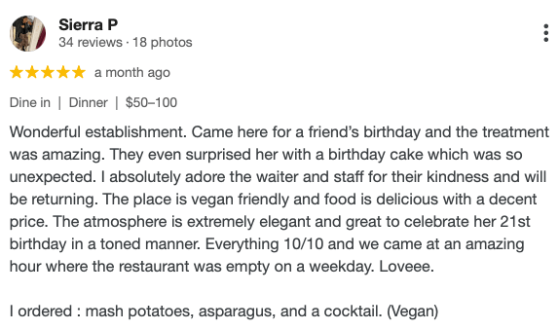
What is a Text Embedding?
ML models work on numeric data
Input is typically a vector
Embedding: Maps text to a vector
Used by downstream tasks
E.g., classification
Embedding
“Positive review”
Classifier
Vector of numbers

Slide 5
Three Key Goals
Compactness
Low dimensionality relative to the input space
Enables efficient storage and faster downstream computation
Expressiveness
Capture the salient features of the input
Preserve semantic, syntactic, and contextual information
Semantic Similarity
Texts with similar meaning should have nearby vectors
Enables clustering, retrieval, and generalization
Embedding
Vector

Slide 6
Typical Embedding Flow
Token-level embedding
Document embedding
Original text
‘Wonderful’, ‘establishment’.
‘Came’
‘here’,
…
Tokenization

Slide 7
Character and Word Tokenization
Early systems used one of two simple possibilities for tokens: Character or Word
Character level: Each character is a token
Word level: Each work is a token
Consider example: “The food was delicious”
Encoding type | Token | Robustness | Keeps semantic meaning
Character-level | ‘T’, ‘h’, ‘e’, ‘ ‘, ‘f’, … | Simple, works on all text | No semantic meaning
Word-level | ‘The’, ‘food’, ‘was’, ‘delicious’ | Only if all words are in “vocabulary” | Yes, with proper training

Slide 8
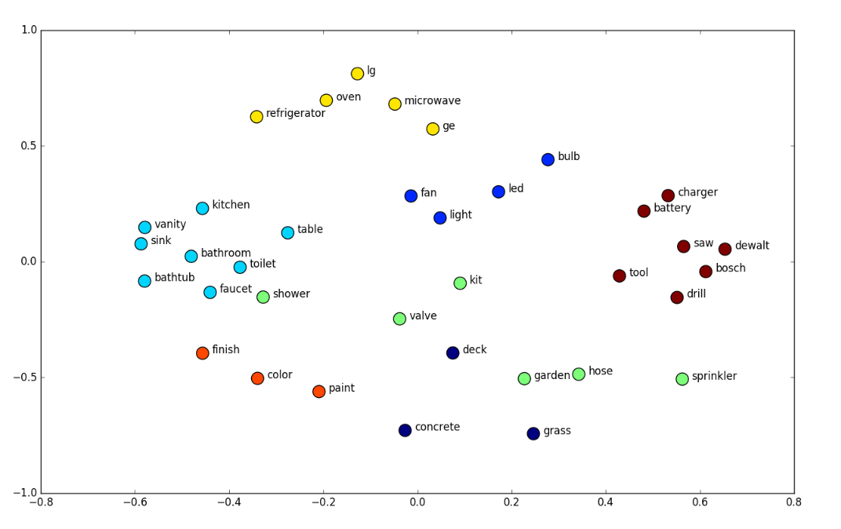
Word Embeddings
Used with word-level tokenization
Assign each word token to a vector
Training goal:
Assign similar words similar embeddings
Trained by looking a “context word”
Context word = word close to target
Example: GloVe
Global Vectors for Word Representation
Stanford 2014

Slide 9
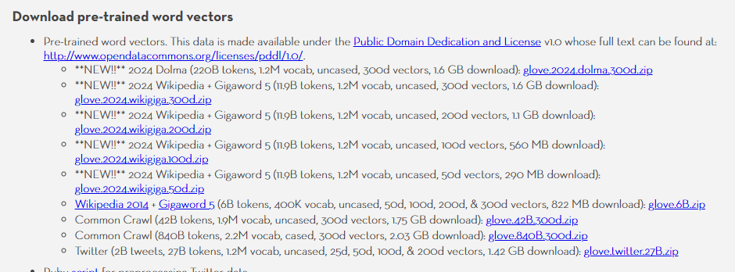
Limitations of Word Embeddings
Word embeddings were widely-used for many years (up to about 2016)
But hit many limitations
Vocabulary size must grow
Even with large vocabularies may out-of-vocabulary words
Also, words lose context in sentence
https://nlp.stanford.edu/projects/glove/

Slide 10
Sub-Word Tokenization
Sub-word tokenization: Overcomes limitations of character and word-level tokenization
Became widely-used around 2016-2018, especially with BERT
Consider example: "The food was unicornishly delicious :)"
Encoding type | Token | Procs and cons
Character-level | ‘T’, ‘h’, ‘e’, ‘ ‘, ‘f’, … | Simple, works on all text, but no semantic meaning
Word-level | ‘The’, ‘food’, ‘was’, OOV, ‘delicious’, OOV | Keeps semantic meaning of words, but may be out of vocabulary items
Sub-word | 'The', 'food', 'was', 'unicorn', 'ish', 'ly', 'delicious' | Applies to all words and keeps semantic meaning

Slide 11
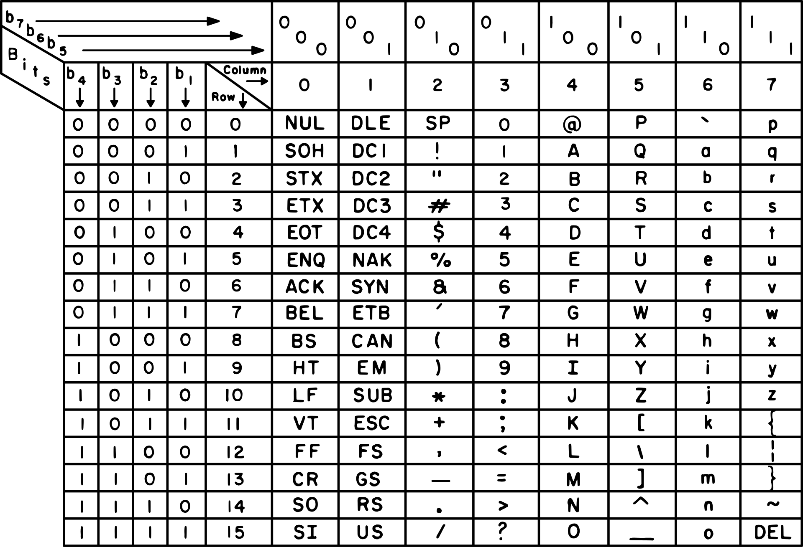
ASCII Characters
American Standard Code for Information Interchange
1 byte (8 bits) for each character
Encodes 128 characters
95 English characters (upper and lower case)
10 digits (0 to 9)
Punctuation characters
33 control characters (CR, LF, Tab, …)
Limitations
Non-English characters
Accented letters (e.g., é, ñ, ü)
Non-Latin scripts (e.g., Cyrillic, Arabic, Chinese)
Wastes the 8th bit in modern systems
Inflexible for globalization, multilingual content, or emoji

Slide 12
UTF-8 Encoding
UTF-8: Unicode Transformation Format (8-bit)
Encodes all Unicode characters using 1 to 4 bytes
Compatible with ASCII — first 128 characters are identical
Efficient for English, flexible for global languages
Variable-length encoding:
1 byte for basic Latin (e.g., A–Z)
2–4 bytes for accented letters, symbols, and non-Latin scripts
Self-synchronizing — easy to detect character boundaries
Most common encoding on the web and in modern software

Slide 13
UTF-8 Examples
Character | Description | Unicode Code Point | UTF-8 Byte | UTF-8 Encoding (Hex)
A | Latin capital letter | U+0041 | 1 byte | 41
é | Latin small letter e acute | U+00E9 | 2 bytes | C3 A9
你 | Chinese character “you” | U+4F60 | 3 bytes | E4 BD A0
😊 | Smiling face with smiling eyes | U+1F60A | 4 bytes | F0 9F 98 8A

Slide 14
Byte Pair Encoding
Most common method used today for sub-word encoding
Encoder is trained on a large (often multi-lingual) corpus
Start with a token vocabulary of single bytes [0-255] or 256 tokens
Look for most common pair and add to the vocabulary
Keep repeating until a desired maximum vocabulary
Frequent sequences are encoded together
GPT-2: ~50000 tokens developed in Feb 2019 by Open AI

Slide 15
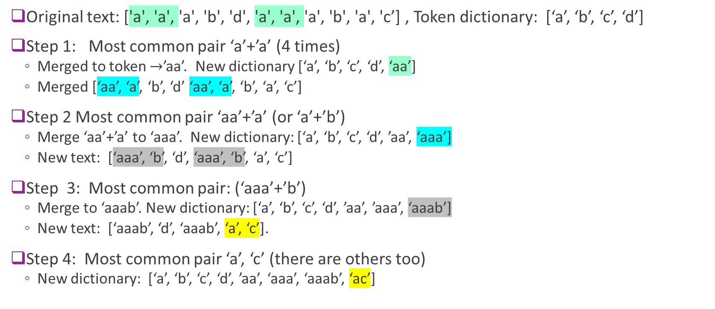
BPE Encoding 1: Create the Dictionary
Original text: ['a', 'a', 'a', 'b', 'd', 'a', 'a', 'a', 'b', 'a', 'c’] , Token dictionary: [‘a’, ‘b’, ‘c’, ‘d’]
Step 1: Most common pair ‘a’+’a’ (4 times)
Merged to token $→$’aa’. New dictionary [‘a’, ‘b’, ‘c’, ‘d’, ‘aa’]
Merged [‘aa’, ‘a’, ‘b’, ‘d’ ‘aa’, ‘a’, ‘b’, ‘a’, ‘c’]
Step 2 Most common pair ‘aa’+’a’ (or ‘a’+’b’)
Merge ‘aa’+’a’ to ‘aaa’. New dictionary: [‘a’, ‘b’, ‘c’, ‘d’, ’aa’, ‘aaa’]
New text: [‘aaa’, ‘b’, ‘d’, ‘aaa’, ‘b’, ‘a’, ‘c’]
Step 3: Most common pair: (‘aaa’+’b’)
Merge to ‘aaab’. New dictionary: [‘a’, ‘b’, ‘c’, ‘d’, ’aa’, ’aaa’, ‘aaab’]
New text: [‘aaab’, ‘d’, ‘aaab’, ‘a’, ‘c’].
Step 4: Most common pair ‘a’, ‘c’ (there are others too)
New dictionary: [‘a’, ‘b’, ‘c’, ‘d’, ’aa’, ‘aaa’, ‘aaab’, ‘ac’]

Slide 16
BPE Encoding 2: Index the tokens
Token dictionary from previous example:
[‘a’, ‘b’, ‘c’, ‘d’, ’aa’, ‘aaa’, ‘aaab’, ‘ac’]
Assign each token an ID
Token | Token ID
a | 0
b | 1
c | 2
d | 3
aa | 4
aaa | 5
aaab | 6
ac | 7

Slide 17
BPE Encoding 3: Encode a New Sentence
New example sentence: ‘aabacaadaaabac’
Find longest tokens possible
[‘aa’, ‘b’ ‘ac’, ‘aa’, ‘d’, ‘aaab’, ‘ac’]
Set IDs
[4, 1, 7, 4,3,6,7]
Token | Token ID
a | 0
b | 1
c | 2
d | 3
aa | 4
aaa | 5
aaab | 6
ac | 7

Slide 18
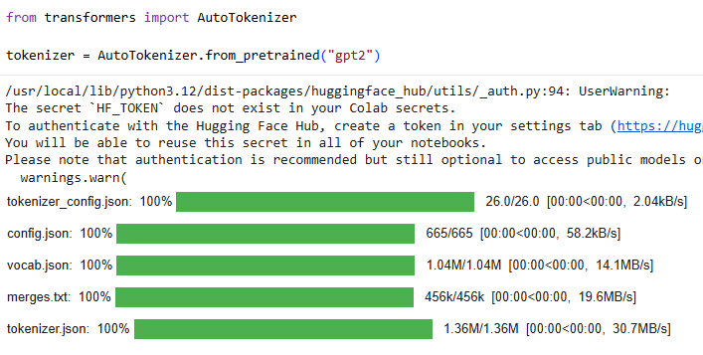
Using a Pre-Trained Tokenizer
Can download many tokenizers from Hugging Face

Slide 19


Using the Tokenizer is Easy

Slide 20
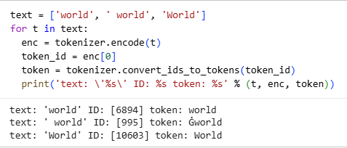
Spaces are Part of the Token
They are not removed
They are kept along with all other punction
Special character to represent ‘Space’ + ‘world’ is one token

Slide 21
Outline
Tokenization
Modern LLMs at a Glance
Using a pre-trained LLM

Slide 22
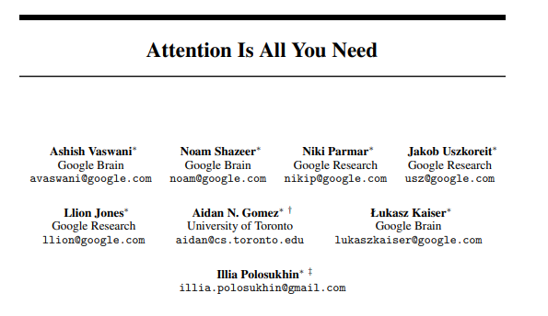
Transformers
Landmark paper, 2017
Introduced the transformer architecture
Originally for problems in NLP
Now used in many fields:
ViT: An Image is Worth 16x16 Words, Dosovitskiy et al, 2020
DETRL End-to-End Object Detection with Transformers Carion et al, 2020

Slide 23
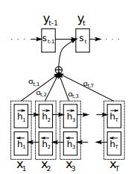
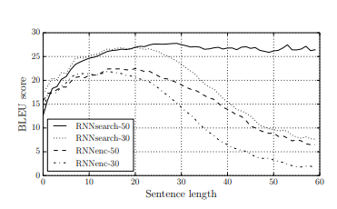
Prior Work
Pre-2014 - RNN, LSTM, GRU
RNNs struggled with long sequence data
Could not handle long sequence lengths (forgetful)
Example on next slide
Neural Machine Translation by Jointly Learning to Align and Translate
Bahdanau, 2014
Landmark Paper
Proposed New Architecture:
Added attention mechanism to RNN
Proposed initial idea of attention
Model gave attention to particular hidden states when decoding

Slide 24
Challenges with Long-Term Dependencies
NLP Challenge: Long-term dependencies
Language refers to items far in past
Conventional architectures: RNN, LSTM, …
Iteratively update state on each word / token
“Forget” about items in past
Struggled with language
Need to consider a long-term context
Example Problem
When the scientists submitted their paper to the journal, they were hopeful. The reviewers, however, found several flaws in the methodology. After weeks of revisions and back-and-forth communication, the paper was finally accepted. But when the journal published it, they noticed that the acknowledgments section was missing, which caused quite a stir among the authors.
Question:
Who does “they” refer to?

Slide 25

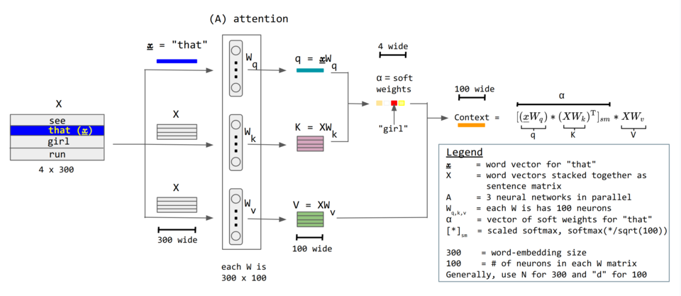

Attention
Takes two contexts of tokens
Query and key
Each $L≈$1024 length
Finds similarities $L×L$ matrix
Similarities look up $L$ values

Slide 26
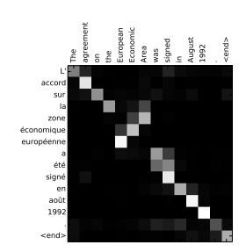
Attention Illustrated
Find similarity matrix between tokens
Example to the right:
Translation from French to English
Can find long-term relations easily

Slide 27
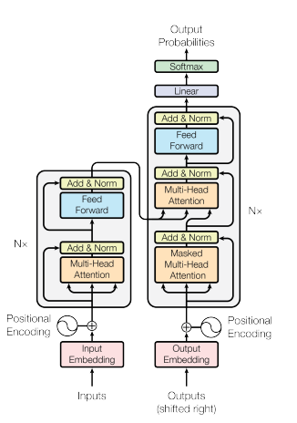
Full Architecture
Each layer consists of:
Multi-headed attention
Add and normalization
Feedforward neural network
Repeated multiple attention layers
Skip connections between layers

Slide 28
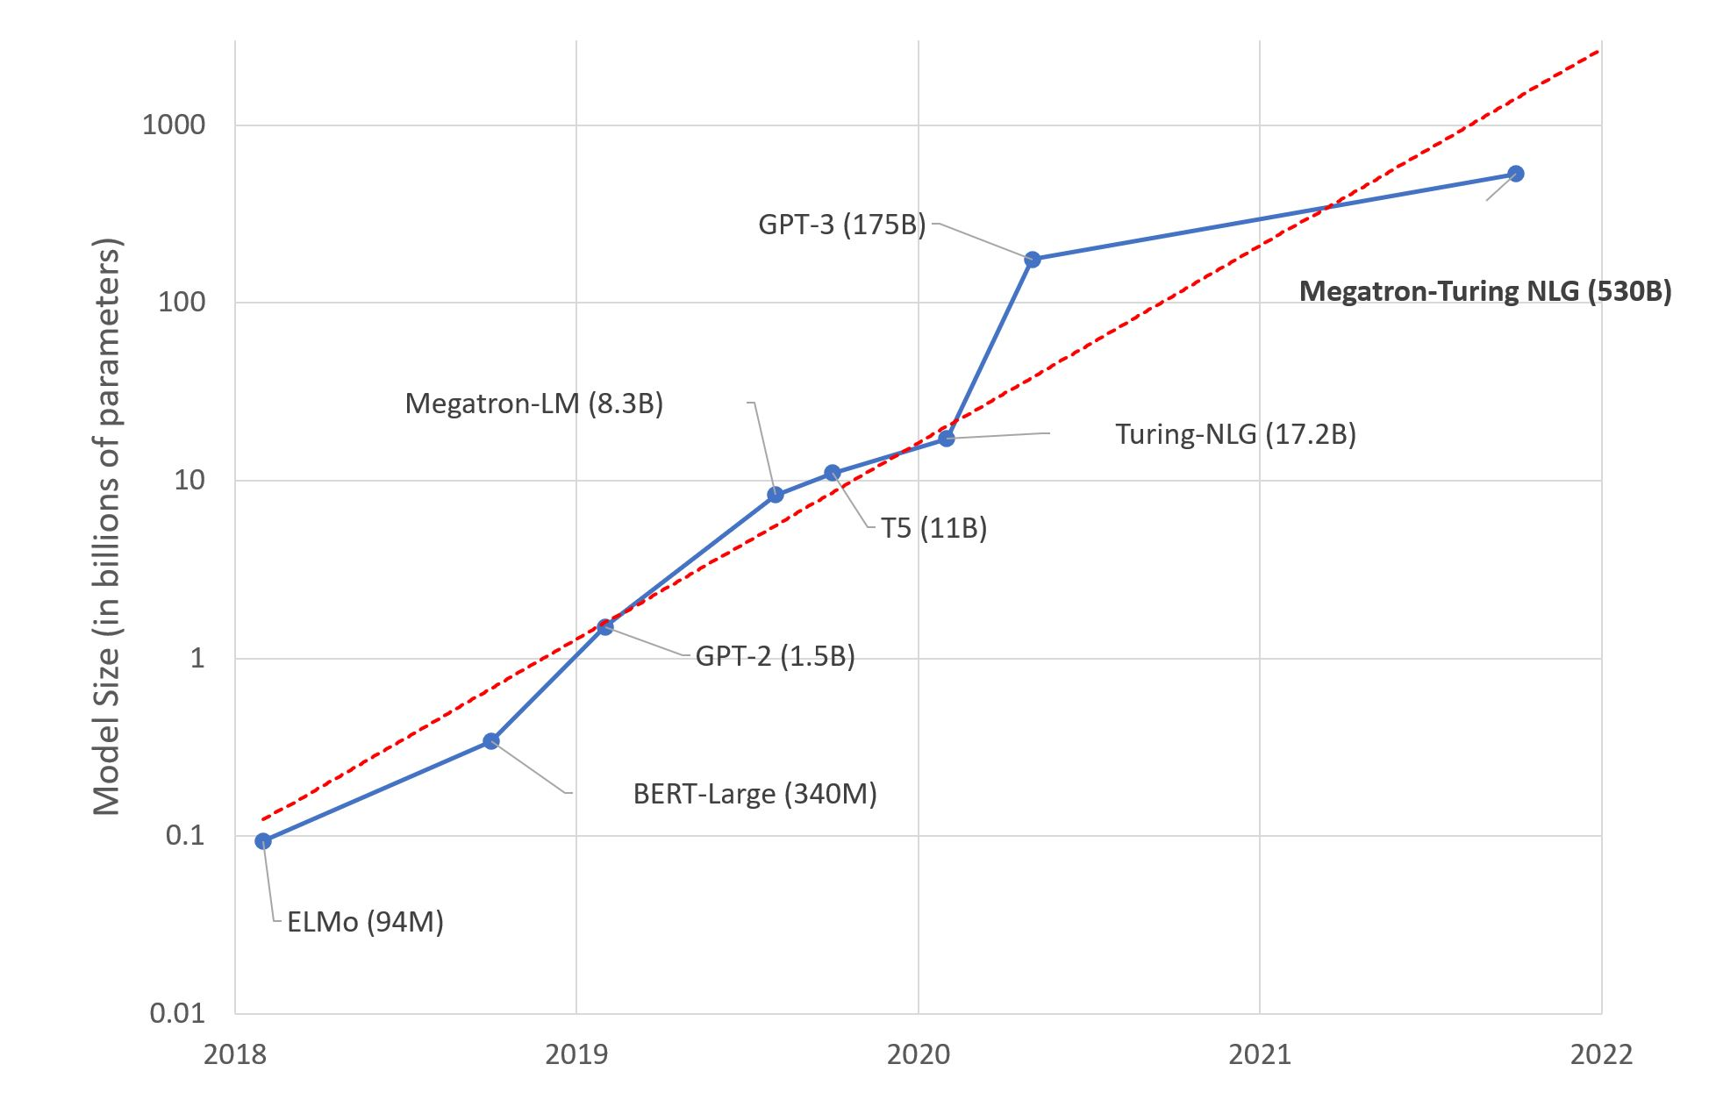
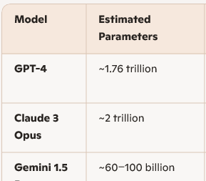
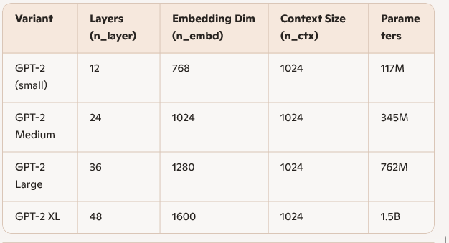
Model Sizes
Model are massive
But more efficient architectures:
Retrieval-augmented-Generation (RAG)
Multi-Agent systems
Tool use and external APIs

Slide 29
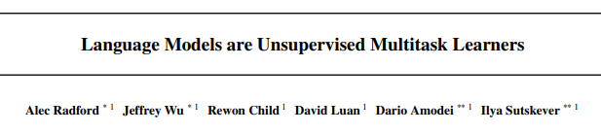
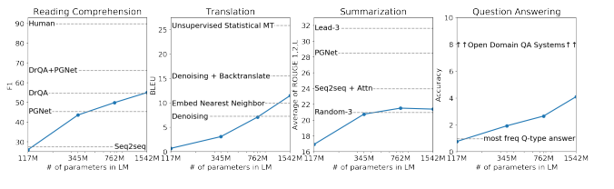


Unsupervised Multitask Training
Landmark OpenAI Paper
Train on diverse tasks
Change final layers for each task
Training requires:
10000+ GPUs
Weeks + $$$

Slide 30
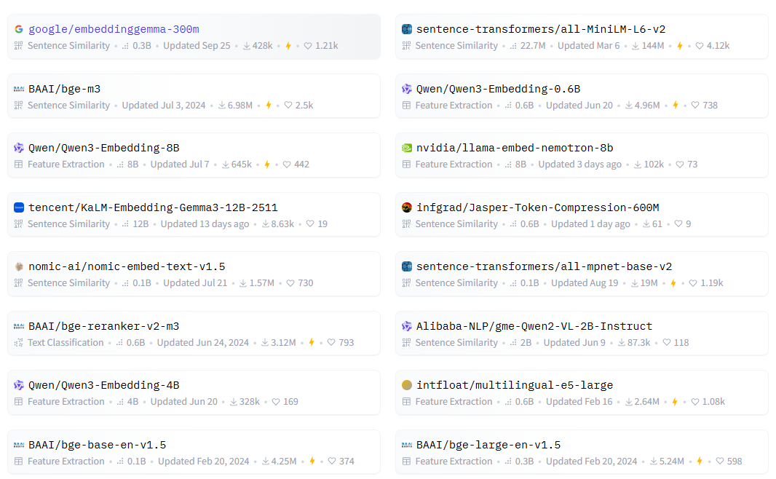

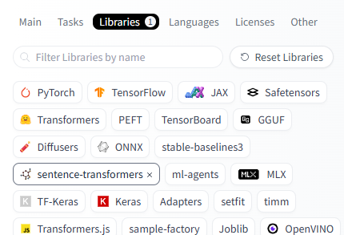
Pre-Trained Models in Hugging Face
Hugging Face
Has 1000s of pre-trained models
Sentence Transformers
Easy-to-use
No training
Varying complexity

Slide 31
Outline
Tokenization
Modern LLMs at a Glance
Using a pre-trained LLM

Slide 32


Movie Sentiment Analysis
Problem: Given text for a movie detect sentiment?
Not given the numeric score
Requires deep understanding of text
“Negative review”

Slide 33
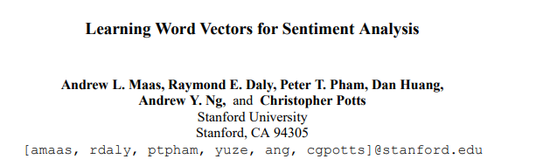

IMDB Review Data
Dataset from 2011 classic paper
50,000 reviews taken from IMBD database
Available from Kaggle

Slide 34
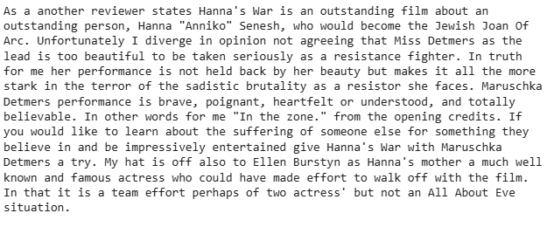
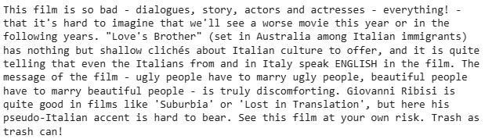
Example Reviews
Example Positive Review
Example Negative Review

Slide 35
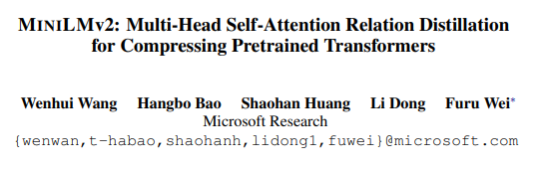

Downloading a Pre-Trained LLM
Use MiniLMV2:
From Microsoft 2021
Very compact, easy to use
Download from Hugging Face

Slide 36


Encoding the Reviews
Encode the reviews with the model
On Google Colab free T4 GPU
About 2 mins for 50,000 reviews
With CPU it is too long
Each embedding is dimension 384
Output a 50000 $×$ 384 matrix
384 embed dimension
50000 reviews
50000 reviews

Slide 37
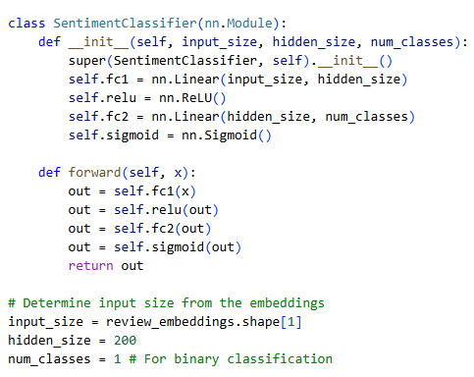
Training a Classifier
Used a simple neural network
Input = 384 (embedding dimension)
50 hidden units
Binary output (positive or negative)

Slide 38
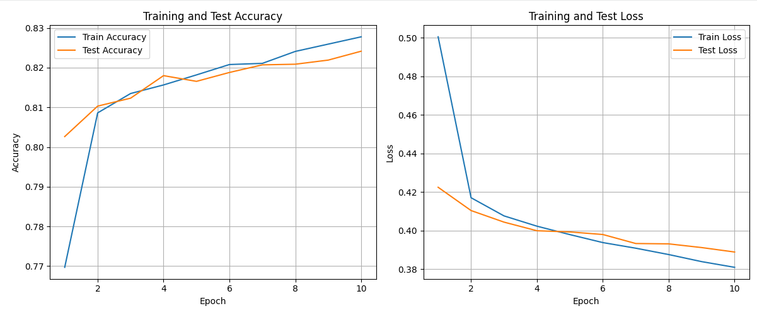
Classification Results
Not the best, but it works

