Slide 1
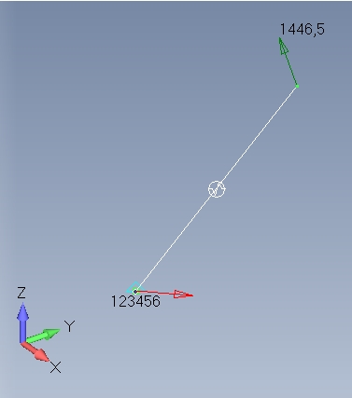
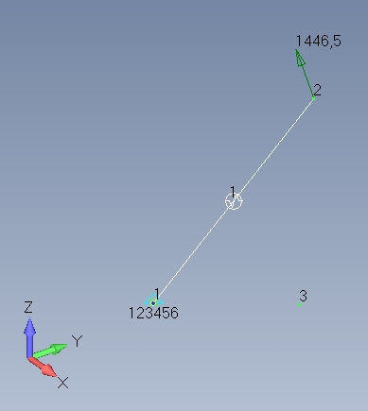
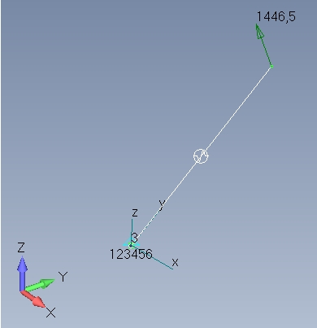
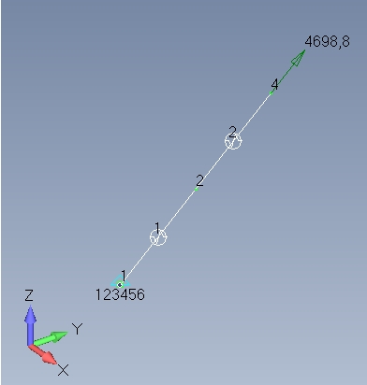
All forces correct
All forces correct
test_bush_01
test_bush_02
All forces (only Fx nonzero) correct
All forces correct
test_bush_03
test_bush_04

Slide 2
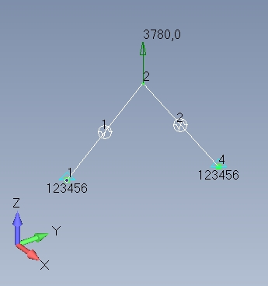
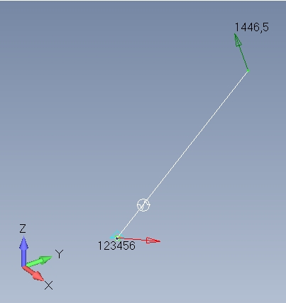
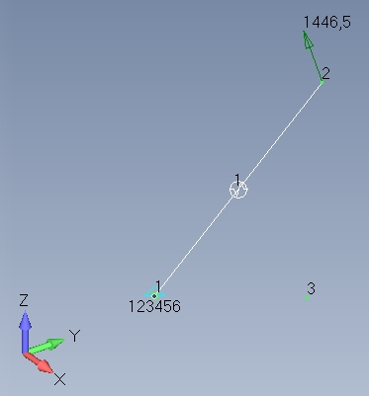
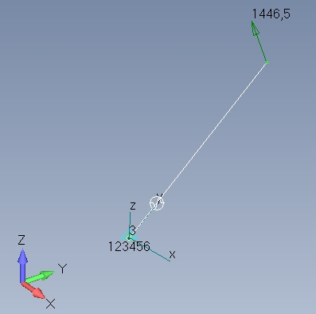
All forces correct
All forces correct
test_bush_05
test_bush_06
All forces correct
All forces correct
test_bush_07
test_bush_08

Slide 3
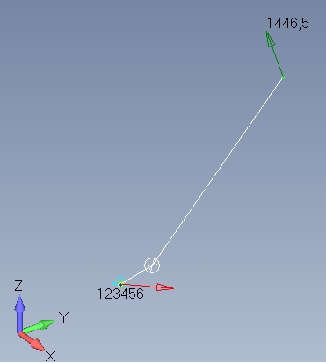
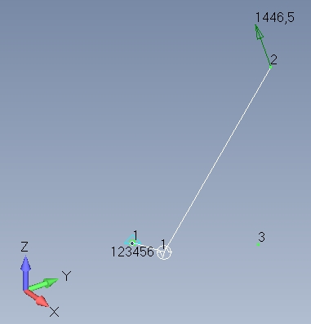
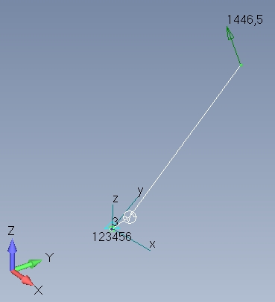
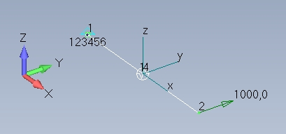
My,Mz wrong mag
Mx wrong sign and mag
Mx,My,Mz wrong mag
test_bush_09
test_bush_10
My,Mz wrong mag
Mx wrong sign
6 S/C’s: All forces correct
test_bush_12
test_bush_11

Slide 4
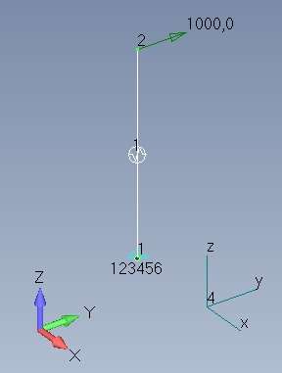
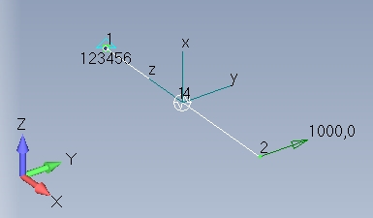
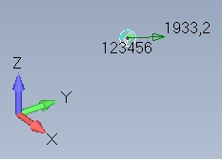
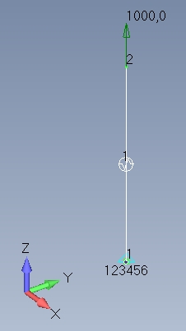
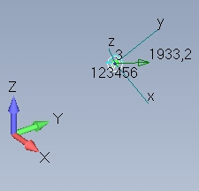
6 S/C’s: All forces correct
6 S/C’s: All forces correct
test_bush_14
test_bush_13
All forces correct
test_bush_51
6 S/C’s: All forces correct
All forces correct
test_bush_15
test_bush_52

