Slide 1
🏏 Cricket Match Analysis Dashboard
Data Visualization & Insights using Streamlit, Pandas, and Plotly

Slide 2
Project Overview
This dashboard presents an Exploratory Data Analysis (EDA) of cricket match data across various formats such as IPL, ODI, T20, and Test matches. The goal is to extract performance insights using Python and Streamlit.

Slide 3
Data Sources
CSV files generated from structured Cricsheet JSON data
Separate datasets for IPL, ODI, T20, and Test matches
Parsed fields include batting, bowling, match info, and deliveries

Slide 4
Technologies Used
Python (pandas, seaborn, matplotlib, plotly)
Streamlit for interactive dashboards
cricsheet.org for match data
Visual Studio code for development
Power BI for BI dashboarding

Slide 5
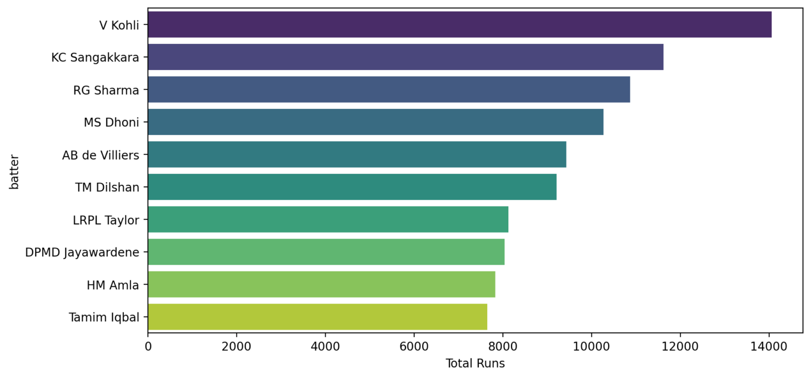
Top 10 Batters across Formats

Slide 6
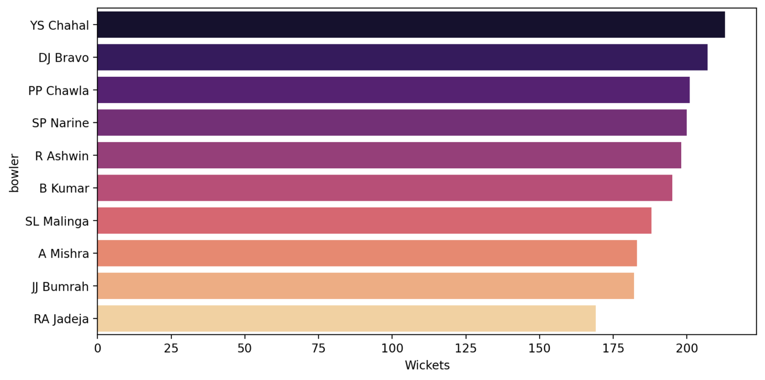
Top 10 Bowlers (Most Wickets)

Slide 7
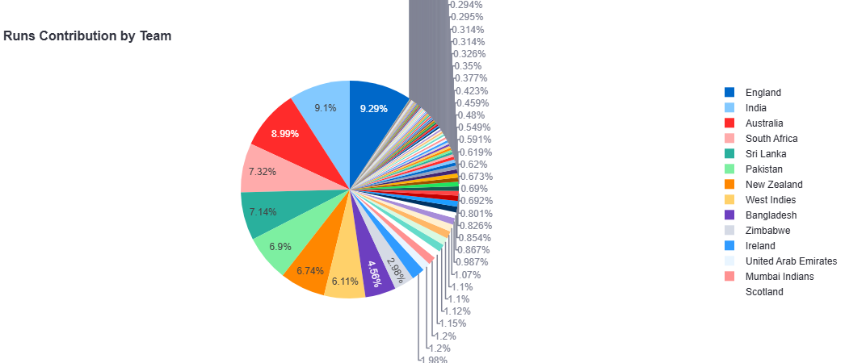
Runs Contribution by Batting Team

Slide 8
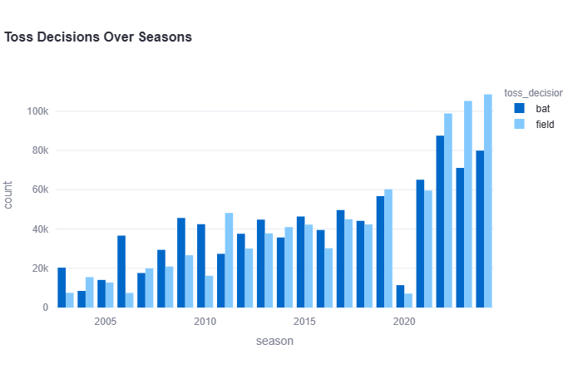
Toss Decision Trends by Season

Slide 9
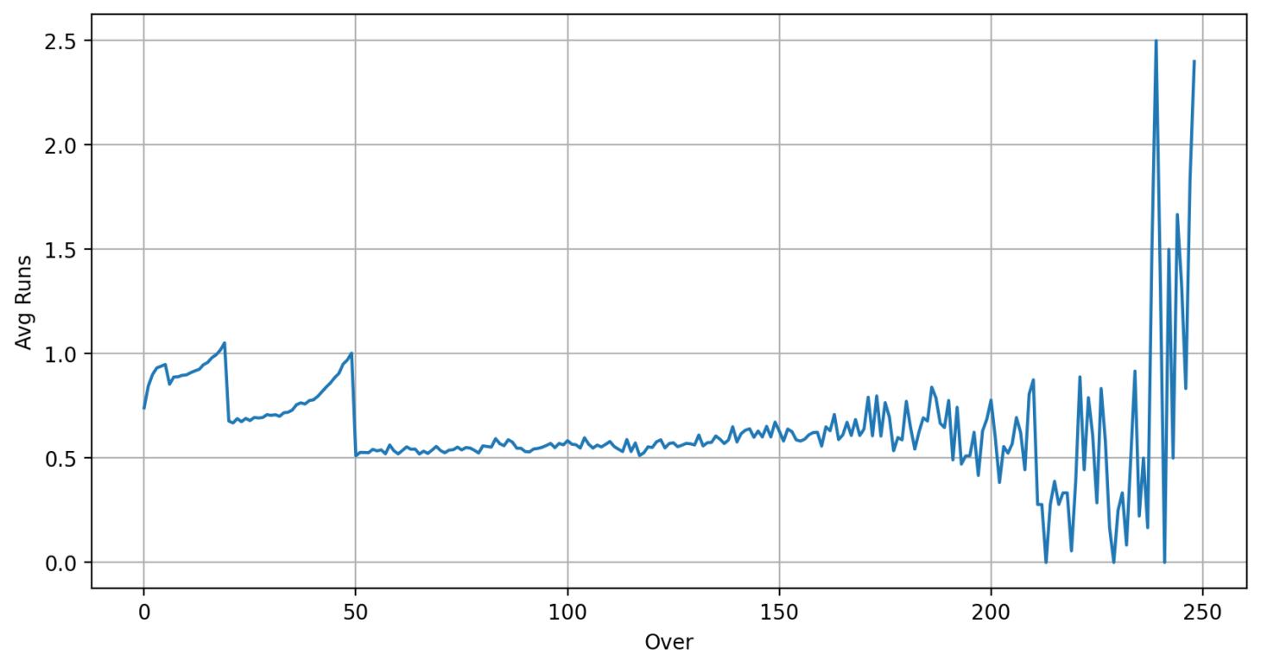
Runs per over trend (Run Rate)

Slide 10
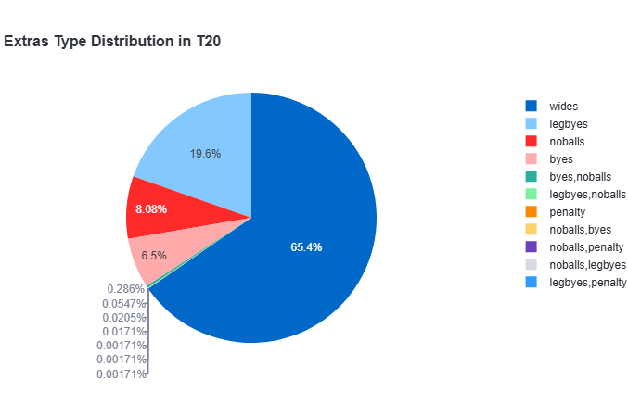
Extras Type Distribution

Slide 11
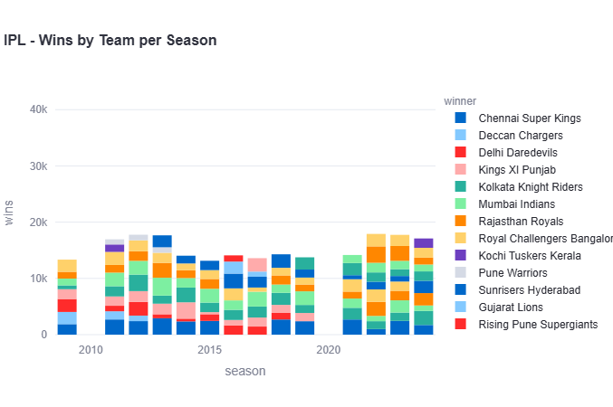
Team Performance by Season (Wins)

Slide 12
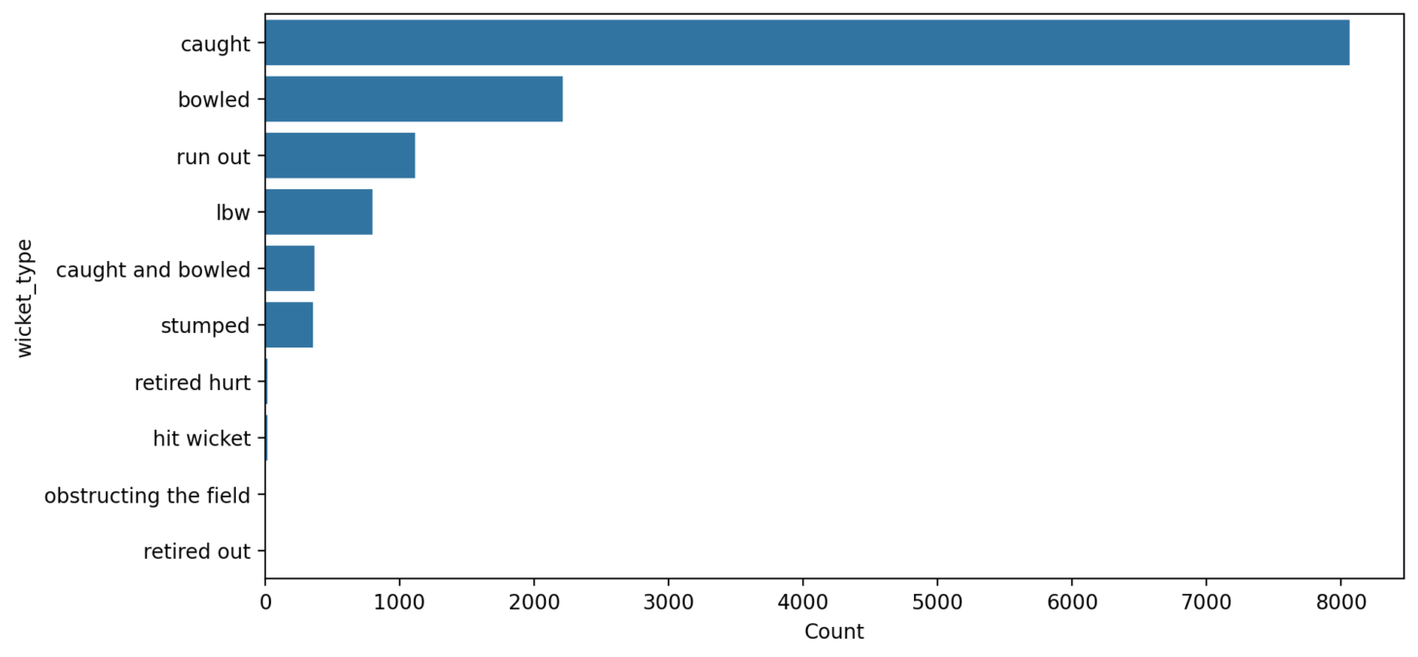
Player Dismissal Types

Slide 13
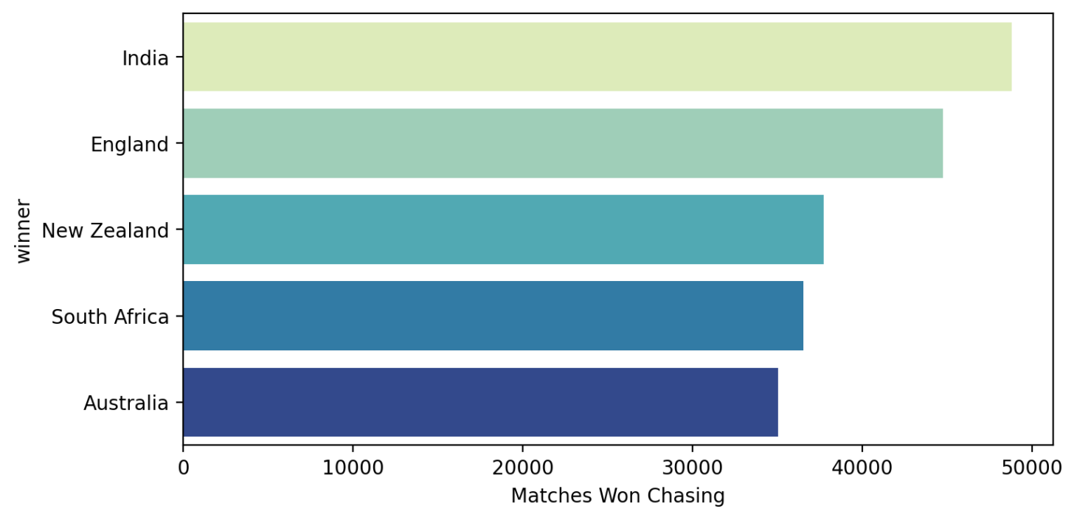
Most Successful Chasing Teams

Slide 14
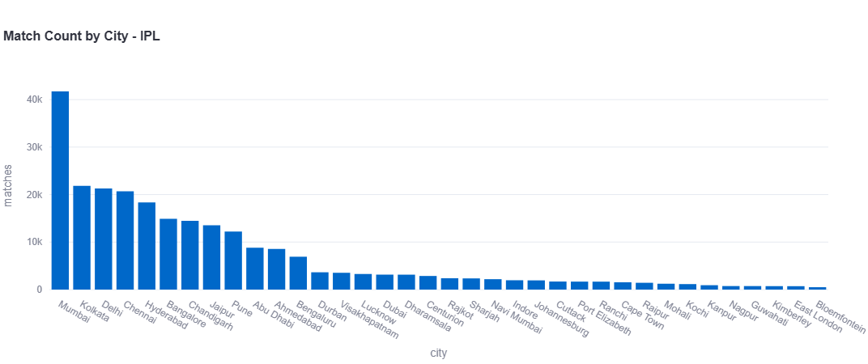
Match Frequency by City (Heatmap)

Slide 15
Conclusion & Key Insights
Identified top performing players and teams across formats
Patterns in run rate, toss decisions, dismissals.
Streamlit enables interactive analysis.

